Slide 1
Sovereign risk and investment
Yilin DONG

Slide 2
The role of investment under direct sanctions
A representative agent with utility function:
U₁=u(C₁)+βu(C₂)
Fist period finance constraint is:
K₂=Y₁+D₂-C₁
Y₁: on date 1 the country receives endowment
D_{2:}country’s borrowing from foreign lenders on date 1
(clearly, D+B=0 , B: country’s foreign assets)
K₂: I₁=K₂-K₁=K₂ (K₁=0)

Slide 3
The role of investment under direct sanctions
Second period finance constraint:
C₂=F(K₂)+K₂-R ; Y₂=F(K₂)
R=min{ (1+r) D₂, η[F(K₂)+K₂]}
interpret R broadly, as the lesser of face value owed to creditors and the cost of sanctions they impose in event of default.
specially, we assume creditor sanctions reduce the country’s date 2 resources by η fraction in case of default

Slide 4
The role of investment under direct sanctions
Repay in full: consumption obeys Euler equation
u’(C₁)=(1+r)βu’(C₂)
Creditor should consider the case that lenders won’t be repaid in full:
η[F(K₂)+K₂]<(1+r) D₂

Slide 5
Discretion over investment: Calculation the Debt Ceiling
Goal to the creditor: figure out how much they can safely lend. Denote by D the most they can lend without triggering default.
K₂=Y₁+D₂-C₁ C₂=F(K₂)+K₂-R
⬇ ⬇

Slide 6
Discretion over investment: Calculation the Debt Ceiling

Slide 7
Discretion over investment: Calculation the Debt Ceiling
A simple example convey intuition behind general case
Utility function :
U₁=log C₁+βlogC₂
production function:
Y₂=αK₂
A critical inequality assumption is
1+r > η(1+α)
This inequality ensure that a higher debt makes default more
attractive even when all additional borrowing is invested.

Slide 8
Discretion over investment: Calculation the Debt Ceiling
How the sovereign’s investment and repayment decisions depend on D₂ by solving the utility maximization U^{D} and U^{N} (U^{D}-U^{N}=0)
Find U^{N}
K₂=Y₁+D₂-C₁
C₂=F(K₂)+K₂-R =αK₂+K₂-R=(1+α)K₂-(1+r)D₂
Budget constraint:

Slide 9
Discretion over investment: Calculation the Debt Ceiling
Optimal consumption levels:
Plug into utility function: U₁=log C₁+βlogC₂

Slide 10
Discretion over investment: Calculation the Debt Ceiling
For U^{D}
fist period finance:
K₂=Y₁+D₂-C₁
second period finance:
C₂=F(K₂)+K₂-R R=η[F(K₂)+K₂]
=αK₂+K₂-η(αK₂+K₂)=(1-η)(1+α)K₂
Budget constraint:

Slide 11
Discretion over investment: Calculation the Debt Ceiling

Slide 12
Discretion over investment: Calculation the Debt Ceiling
Now, consider the ratio D₂/Y₁
D₂=0 (no borrowing) , the difference close to β log(1-η)
But it rise as D₂/Y₁ rise, which implies,
high debt on date 1 make default more attractive strategy

Slide 13
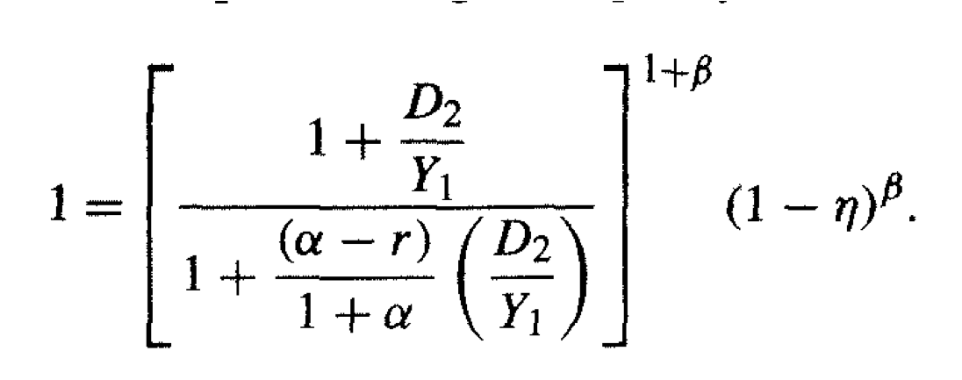
Discretion over investment: Calculation the Debt Ceiling
The point at which the sovereign is indifferent between default and full repayment when U^{D}-U^{N}=0

Slide 14
Discretion over investment: Calculation the Debt Ceiling
A higher world interest rate r, making default more attractive ,lower D
High α, more productive domestic capital (Y₂=αK₂), increase borrow limiting
Making the force of sanctions greater (raising η) increase borrowing limiting

