Slide 1
Optimal Unemployment Insurance
Ljungqvist-Sargent
Presented by: Carolina Clerigo

Slide 2
A one Spell model
This model focus on a single spell of unemployment follow by a single spell of employment
Settings by Shavell-Weiss and Hopenhayn and Nicolini
Employment is an absorbing state, no incentive problems once job is found
Unemployed worker chooses C_{t} and a_{t} according to

Slide 3
A one Spell model
C_{t} ≥0 and a_{t} ≥0
u(c) : strictly increasing, twice differentiable and strictly concave
All jobs have a wage of w >0, this remains forever
a: search effort. Is zero when worker found a job
P(a): probability of finding a job.
P(a): increasing, twice differentiable and strictly concave
P(0)=0
Notes:
Once worker finds jobs he is out of unemployment agency

Slide 4
A one Spell model
Worker can’t borrow and has no savings, the good is non storable
Unemployment insurance is only option to smooth consumption over time and across states

Slide 5
A one Spell model
Autarky problem-No access to insurance
U(w) is the utility for worker once he find a job (a=0)
Expected sum of discounted utility if employed:
Expected present utility for unemployed worker
FOC for a ≥0
Notes:
Because employment absorbing state
Vu, bellman equation
No state variables
Time invariant optimal A

Slide 6
A one Spell model
Unemployment with full Information
Agency con observe and control consumption and search effort
Want to provide unemployed worker with V> V_{aut}, minimizing expected discounted costs
C(V): expected discounted cost
Strictly convex
Given V, agency assigns first period consumption and search effort(a), and promise V^{u} on future periods of unemployment
Notes:
(optimal V^{u} with a* ) is vaut
Cost fucntion is convex, because higher V, impliyes lower marginally utility for worker, and theeefore greater cost

Slide 7
A one Spell model
Unemployment with full Information
Agency minimization problem
s.t promise keeping constraint
Policy functions are c=c(v), a=a(v) and V^{u}=V^{u}(V)
FOC for interior solution
Notes:
Ve, oince worker is employed out of unemployment agency reach
Promise keeping constarint, c a vu attains at least V

Slide 8
A one Spell model
Unemployment with full Information
C’(v)= θ (envelope theorem)
C’(V^{u})= C’(V) so we get V^{u} =V, so the continuation value is constant when unemployed, and therefore consumption is fully smoothed throughout the unemployment spell because c and a are constant during unemployment time.

Slide 9
A one Spell model
Asymmetric information
Agency can’t observe search effort (a)
Agency can observe and control consumption
The worker is free to choose search effort(a)
s.t
Incentive constraint

Slide 10
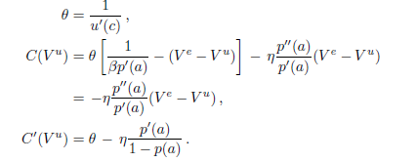
A one Spell model
Asymmetric Information
FOC for Interior Solution
if a>0 then βp’(a)(Ve-V^{u})=1
Notes:
Hopenhayn and nicolini let agency chose ve as well. Agency can tax previousoly unemployed worker regarding length of unemployment, this reduces the rate at which replacement ratio falls

Slide 11
A one Spell model
Asymmetric information
η is positive since C(V^{u})>0
C’(V)= θ (envelope theorem), so then we have
C’(V^{u})=C’(V)- η p’(a)/(1-p(a)) so C’(V^{u})< C’(V) and soV^{u} <V
Consumption of unemployed worker falls as duration of unemployment lengthens, and search effort rises as V^{u} falls. This is so to provide incentive to search.
This model assumes p’(a)>0, if p’(a)=0 then V^{u}=V and consumption doesn’t fall with duration of unemployment (as in perfect information case
)

Slide 12
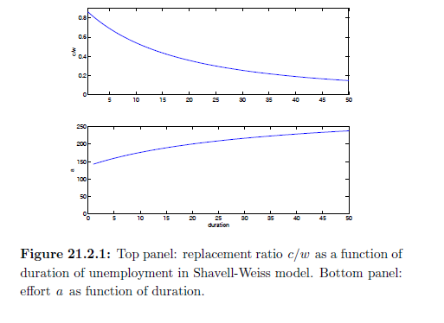
A one Spell model
Asymmetric information

Slide 13
A one Spell model
Computational details
Rewrite FOC from autarky problem as if a≥0
If a=0 then and to rule out a=0 we need
Re-express promise keeping constraint as
and get
Notes:
When the RHS of the keepng constarint is negative, C is 0 so that is the lower bound

Slide 14
A one Spell model
Computational details
Assume functional form is P(a)=1-exp(ra)
Then from autarky FOC βp’(a)(Ve-V^{u})≤1 we get
Using this values for c and a, we can write the bellman equation as a function of V^{u}

Slide 15
Multiple Spell model
A lifetime contract
Multiple unemployment spells
Incentive problem once job is found. The search effort affects the probability of finding a job. Effort on the job affects the probability of ending a job and affects output as well.
Each job pays same wage:w
Jobs randomly end
A planner’s observes output and employment status. He doesn’t observe effort

Slide 16
Multiple Spell model
A lifetime contract
The planner uses history dependence to tie compensation while unemployed(employed) to previous outcomes, this way the planner partially knows the effort of worker while employed(unemployed)
Replacement rate

Slide 17
Multiple Spell model
A lifetime contract
Effort levels a ϵ {a_{L}, a_{H}}
y^{i}> y^{i-1}
Employed worker produces y_{t} ϵ{y^{1…} y^{n} }
Prob(y_{t} =y^{i} )=p(y^{i},a)
p(y^{i,} a) increases with y^{i}
Probability job will end π_{eu,} can depend on y or on a
π_{eu} (y) decreases with y or π_{eu} (a) decreases with a

Slide 18
Multiple Spell model
A lifetime contract
Unemployed workers have no production, only search effort
Probability unemployed finds a job π_{ue} (a) , increases with a
U(c,a)=u(c) – φ(a)
Workers order (c_{t}, a_{t}) according to
Notes:
U© conbcave
Phi (a) strictly convex

Slide 19
Multiple Spell model
A lifetime contract
The planner can borrow/lend at risk free rate R=β⁻¹
Employment states (e, u)
Production of worker
Observed information is x_{t}=(z_{t-1}, s_{t})

Slide 20
Multiple Spell model
A lifetime contract
At time t planner observes x_{t} , workers observe (x_{t} ,a_{t} )
X₀ =s₀
X_{t+1}Ξ(z_{t}, s_{t+1}) π (x_{t+1}| s_{t} ,a_{t}) = π_{z} (z_{t}; s_{t} ,a_{t}) * π_{s} (s_{t+1}; z_{t} ,s_{t} ,a_{t})
π_{s} (u;u,a)=1- π_{ue}(a)
π_{s} (e;u,a)=π_{ue}(a)
π_{s} (u;y,e,a)=π_{eu}(z,a)
π_{s} (e;y,e,a)=1-π_{eu}(z,a)

Slide 21
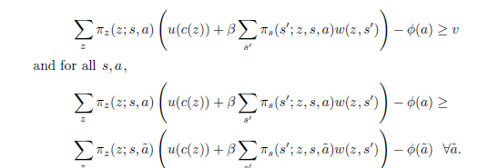
Multiple Spell model
A recursive lifetime contract
υ :promised value of expected utility
W(z, s’):continuation value
Constraints
Promise keeping constraint
Effort inducing constraint

Slide 22
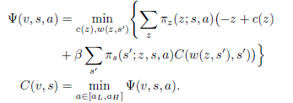
Multiple Spell model
A lifetime contract
Agent wants to minimize cost of delivering υ to worker in state s
Bellman equation for C(υ,s)

Slide 23
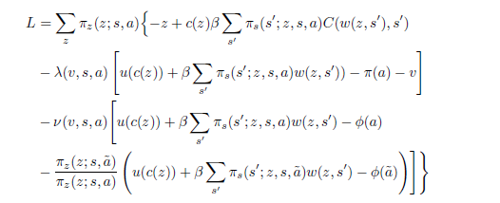
Multiple Spell model
A lifetime contract
The problem resumes to

Slide 24
Multiple Spell model
A lifetime contract
FOC for c(z) and w(s’,z)
Envelope theorem

Slide 25
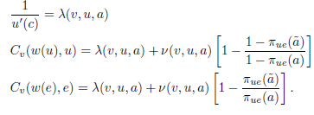
Multiple Spell model
Compensation dynamics when unemployed
If s=u, then FOC
Effort-inducing constraint

Slide 26
Multiple Spell model
Compensation dynamics when unemployed
If s=u, then FOC
Effort-inducing constraint

Slide 27
Multiple Spell model
Compensation dynamics when unemployed
In order to induce high effort, compensation must fall over unemployment spell
C_{u}(t) and υ_{u}(t) be consumption and continuation value for unemployed worker

Slide 28
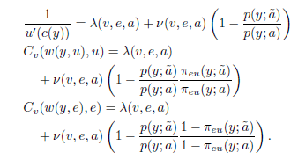
Multiple Spell model
Compensation dynamics when employed
FOC become
To induce high effort, wages and continuation values increase with current output

Slide 29
Multiple Spell model
Compensation dynamics when employed

Slide 30
Multiple Spell model
Compensation dynamics when employed
If job separation depends on output, the replacement ratio is 100%
π_{eu}(y,~a)=π_{eu} (y,a)
C_{u}(t), C_{e}(t)and υ_{u}(t) υ_{e}(t) be consumption and promised value for unemployed and employed worker

Slide 31
Multiple Spell model
Compensation dynamics when employed
If job separation depends on effort, the replacement ratio is less than100%
π_{eu}(y,~a)>π_{eu} (y,a) with a~=a_{L} a=a_{H}
Since >0 then,
C_{u}(t+1)<C_{e}(t)

