Slide 1
Fiscal policies in the nonstohastic growth models
Ljungqvist-Sargent, Chapter 11
Presented by Pavlo Iavorskyi

Slide 2
Government.
$\left\{g_{t}, τ_{ct},τ_{it},τ_{kt},τ_{nt},τ_{ht}\right\}$ , $t≥0$
$g_{t}$ - a government spending;
$τ_{ct}$- a consumption tax rate;
$τ_{it}$ - an investment tax rate;
$τ_{kt}$ - an “ earning from capital” tax rate;
$τ_{nt}$ - an “ earning from labor” tax rate;
$τ_{ht}$ - a lump sum tax;

Slide 3
Preferences, technology, information.
$$\sum_{t=0}^{∞}{β^{t}U\left(c_{t},1−n_{t}\right)} (11.2.1)$$
$U()$ is strictly increasing, strictly concave and twice continuously differentiable;
Technology: $g_{t}+c_{t}+x_{t}≤F(k_{t},n_{t}$), $k_{t+1}=x_{t}+(1−δ)k_{t}$
$g_{t}+c_{t}+k_{t+1}≤F(k_{t},n_{t}$) $+\left(1−δ\right)k_{t} (11.2.3)$
$F(k_{t},n_{t}$) is homogeneous function with positive and decreasing marginal products.

Slide 4
Household, Government and Firm.
$$\sum_{t=0}^{∞}{\left\{q_{t}\left(1+t_{ct}\right)c_{t}+q_{t}(1−t_{it})\left[k_{t+1}+(1−δ)k_{t}\right] \right\}}$$
$$≤\sum_{t=0}^{∞}{\left\{r_{t}\left(1−t_{kt}\right)k_{t}+w_{t}\left(1−t_{nt}\right)n_{t}−q_{t}τ_{ht}\right\}} (11.2.4)$$
$$\sum_{t=0}^{∞}{\left\{q_{t}g_{t}\right\}}≤\sum_{t=0}^{∞}{\left\{τ_{ct}{q_{t}c}_{t}−τ_{it}q_{t}\left[k_{t+1}+\left(1−δ\right)k_{t}\right]+r_{t}τ_{kt}q_{t}+w_{t}τ_{nt}q_{t}+q_{t}τ_{ht}\right\}}$$
(11.2.5a)
$$\sum_{t=0}^{∞}{\left[q_{t}F\left(k_{t},n_{t}\right)−r_{t}k_{t}−w_{t}n_{t}\right] } (11.2.5b)$$
$\left\{q_{t},r_{t,}w_{t}\right\}$ is a price system.

Slide 5
Competitive equilibrium with distorting taxes
Definition. A competitive equilibrium with distorting taxes is a budget feasible government policy $\left\{g_{t}, τ_{ct},τ_{it},τ_{kt},τ_{nt},τ_{ht}\right\}$ that satisfy (11.2.5a); a feasible allocation $\left\{c_{t}, x_{t},n_{t},k_{t}\right\}$ that given the price system $\left\{q_{t},r_{t,}w_{t}\right\}$ and the government policy solves the household’s(11.2.1, 11.2.4) and the firm’s (11.2.3, 11.2.5b) problems.

Slide 6
No arbitrage condition.
$$\sum_{t=0}^{∞}{q_{t}\left(1+t_{ct}\right)c_{t}≤ }\sum_{t=0}^{∞}{w_{t}\left(1−t_{nt}\right)n_{t}−\sum_{t=0}^{∞}{q_{t}{τh}_{t}} \text{(11.2.6) }}+\sum_{t=1}^{∞}{\left[r_{t}\left(1−t_{kt}\right)+q_{t}\left(1−t_{it}\right)\left(1−δ\right)−q_{t−1}\left(1−t_{it−1}\right)\right]}k_{t}$$
$$+ \left[r_{0}\left(1−t_{k0}\right)+q_{0}\left(1−t_{i0}\right)\left(1−δ\right)\right]k_{0}+ \lim_{T→∞}{q_{T}\left(1−t_{iT}\right)k_{T+1}}$$
$${q_{t}\left(1−t_{it}\right)=q_{t+1}\left(1−t_{it+1}\right)\left(1−δ\right)+r}_{t+1}\left(1−t_{kt+1}\right) (11.2.8)$$

Slide 7
Household’s and Firm’s Problem.
Household’s Euler equations:
$β^{t}U_{1t}= μq_{t}\left(1+τ_{ct}\right)$ (11.2.10a)
$β^{t}U_{2t}≤ μw_{t}\left(1−τ_{nt}\right)$ (11.2.10b)
Firm’s zero-profit conditions:
$r_{t}=q_{t}F_{kt}$
$w_{t}=q_{t}F_{nt}$ (11.2.11)

Slide 8
Computing equilibrium. 1.
Assumptions: $U\left(c,1−n\right)=u\left(c\right)$, inelastic labor supply, full employment.
$k_{t+1}=f\left(k_{t}\right)+\left(1−δ\right)k_{t}−g_{t}−c_{t}$ (11.3.1)
$u^{′}\left(c_{t}\right)=βu^{′}\left(c_{t+1}\right)\frac{\left(1+τ_{ct}\right)}{\left(1+τ_{ct+1}\right)}\left[\frac{\left(1−τ_{it+1}\right)}{\left(1−τ_{it}\right)}\left(1−δ\right)+\frac{\left(1−τ_{kt+1}\right)}{\left(1−τ_{it}\right)}f^{′}(k_{t+1})\right]$ (11.3.3)
At steady state capital level and tax rates are constant:
$f^{′}(\overline{k})=(ρ+δ)\frac{\left(1−τ_{i}\right)}{\left(1−τ_{k}\right)}$ (11.3.7)

Slide 9
Computing equilibrium. 2.
$c_{t}=f\left(k_{t}\right)+\left(1−δ\right)k_{t}−g_{t}−k_{t+1}$ (11.3.8a)
$q_{t}=\frac{β^{t}U_{1t}}{\left(1+τ_{ct}\right)}$ (11.3.8b)
$\frac{r_{t}}{q_{t}}=f^{′}(k_{t})$ (11.3.8c)
$\frac{w_{t}}{q_{t}}=\left[f\left(k_{t}\right)−k_{t}f^{′}(k_{t}) \right]$ (11.3.8d)
$R_{t+1}=\frac{\left(1+τ_{ct}\right)}{\left(1+τ_{ct+1}\right)}\left[\frac{\left(1−τ_{it+1}\right)}{\left(1−τ_{it}\right)}\left(1−δ\right)+\frac{\left(1−τ_{kt+1}\right)}{\left(1−τ_{it}\right)}f^{′}(k_{t+1})\right]$ (11.3.8e)
$\frac{s_{t}}{q_{t}}=\left[(1−δ)−(1−τ_{k})f^{′}(k_{t}) \right]$ (11.3.8f)
$s_{t}$ is the per unit value of the capital stock at time t measured in units of time t consumption.

Slide 10
Computing equilibrium. 3.
$R=(1+ρ)$ (11.3.10)
$\frac{s}{q}=\left[\left(1+ρ\right)+(ρ+δ)τ_{i} \right]$ (11.3.11)

Slide 11
Remarks.
The equilibrium allocation in the “only lump sum tax” case is identical to the one that solves planning problem in which government spending is taken as an exogenous stream that is deducted from output;
When labor is inelastic, constant $τ_{c}$ and $τ_{n}$ are not distorting;
Variations in $τ_{c}$ over time are distorting;
Capital taxation is distorting.

Slide 12
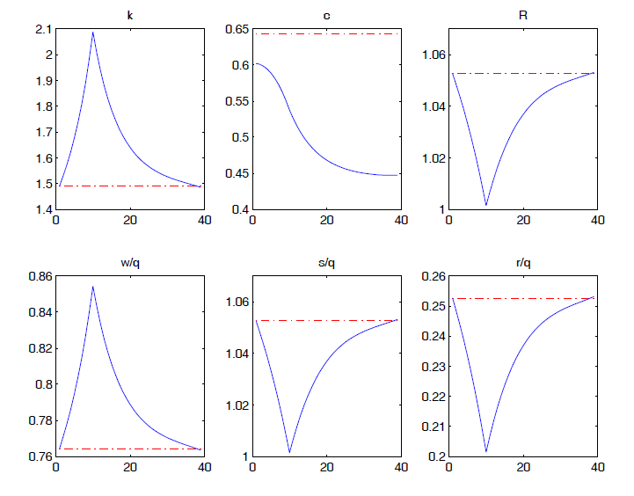
Experiments. 1.
Assumptions: $u\left(c\right)=\frac{c^{1−γ}}{1−γ}$, $f\left(k\right)=k^{α}$, $δ=0.2, γ=2, β=0.95$
Responses to foreseen permanent increase in g at t = 10.

Slide 13
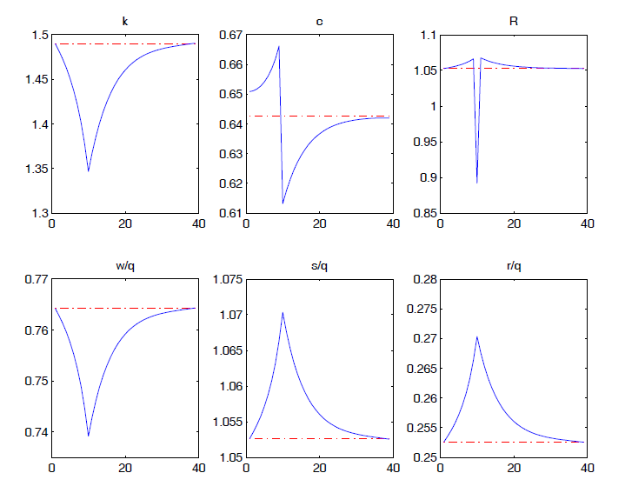
Experiments. 2.
Responses to foreseen permanent increase in $τ_{c}$ at t = 10.

Slide 14
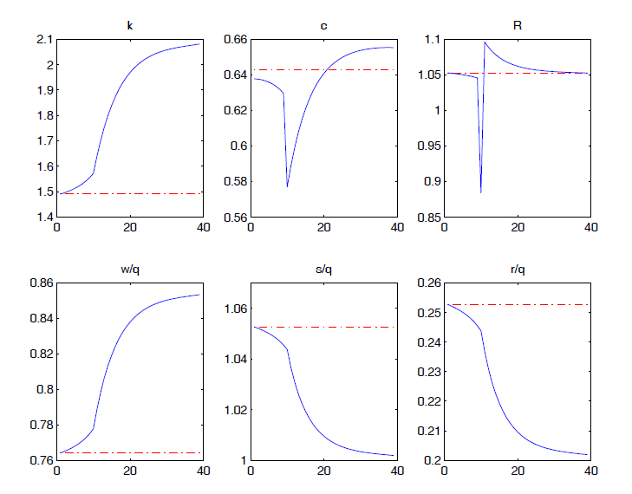
Experiments. 3.
Responses to foreseen permanent increase in $τ_{i}$ at t = 10.

Slide 15
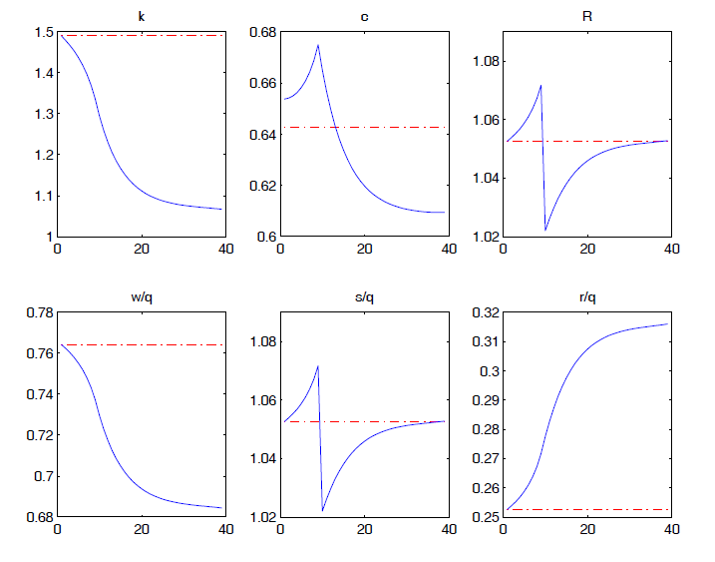
Experiments. 4.
Responses to foreseen permanent increase in $τ_{k}$ at t = 10.

Slide 16
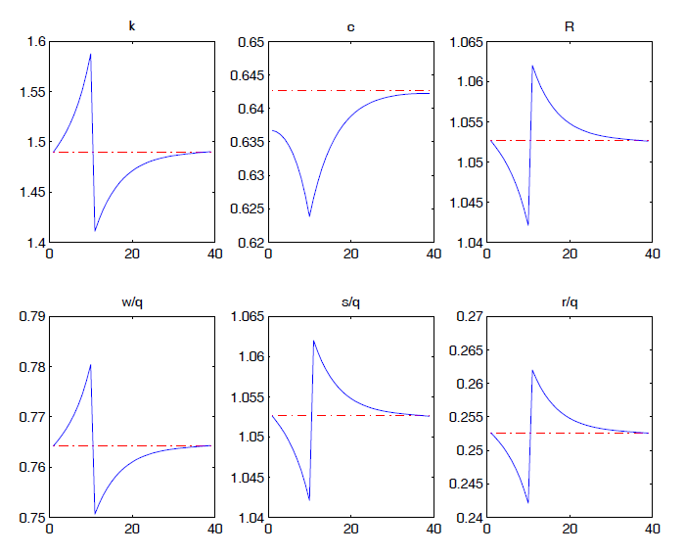
Experiments. 5.
Responses to foreseen one-time increase in g at t = 10.

Slide 17
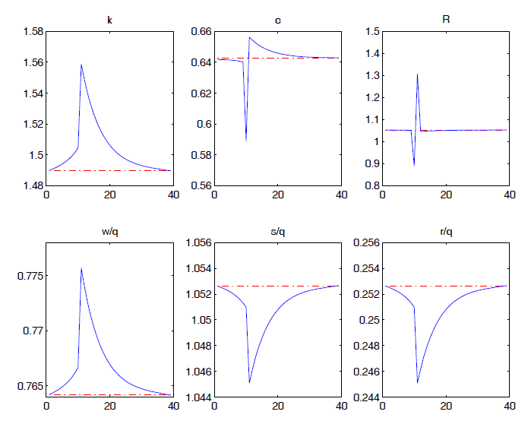
Experiments. 6.
Responses to foreseen one-time increase in $τ_{i}$ at t = 10.

Slide 18
Technology Growth. 1.
$Y_{t}=F(k_{t},A_{t}n_{t}$) (11.9.1)
$A_{t+1}= μ_{t+1}A_{t}$ (11.9.2)
$k_{t+1}={μ_{t+1}^{}}_{}^{−1}\left[f\left(k_{t}\right)+\left(1−δ\right)k_{t}−g_{t}−c_{t}\right]$ (11.9.4)
$u^{′}\left(c_{t}A_{t}\right)=$ $βu^{′}\left(c_{t+1}A_{t+1}\right)\frac{\left(1+τ_{ct}\right)}{\left(1+τ_{ct+1}\right)}\left[\frac{\left(1−τ_{it+1}\right)}{\left(1−τ_{it}\right)}\left(1−δ\right)+\frac{\left(1−τ_{kt+1}\right)}{\left(1−τ_{it}\right)}f^{′}(k_{t+1})\right]$
(11.9.5)
$f^{′}(\overline{k})=\left[\left(1+ρ\right)μ^{γ}−(1−δ)\right]\frac{\left(1−τ_{i}\right)}{\left(1−τ_{k}\right)}$ (11.9.8)

Slide 19
Technology Growth. 2.
$R=(1+ρ)μ^{γ}$ (11.3.9)
$\frac{S}{q}=\left[\left(1−τ_{i}\right)(1+ρ)μ^{γ}+(1−δ)τ_{i} \right]$ (11.3.10)

Slide 20
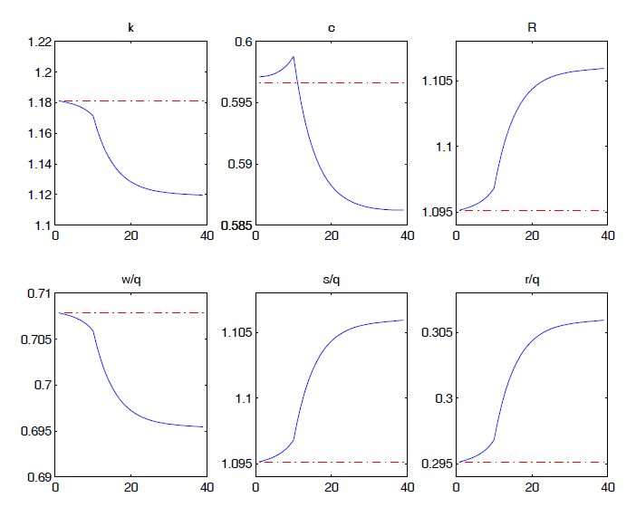
Experiments. 7.
Responses to foreseen permanent increase in productivity growth at t = 10.

Slide 21
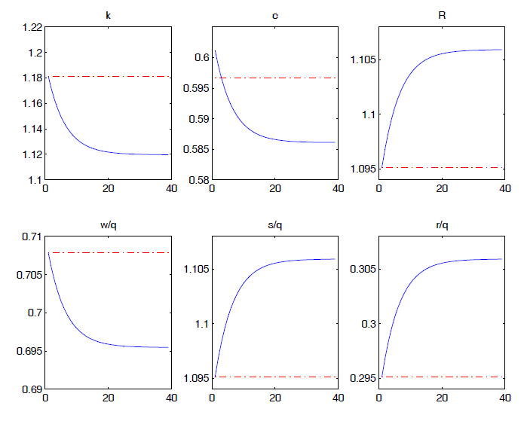
Experiments. 8.
Responses to unforeseen permanent increase in productivity growth at t = 1.

Slide 22
Questions?

