Slide 1
The Equity Premium Puzzle
Bocong Du
November 18, 2013 Chapter 13 LS
1/25

Slide 2
Framework Interpretation of Risk-Aversion Parameter The Equity Premium Puzzle
Two Statements
The Mehra-Prescott data
Framework:
Prepare: Interpretation of risk-aversion parameter
The equity premium puzzle ---- Issue raised
Two statements of the equity premium puzzle
A parametric statement
A non-parametric statement
The Mehra-Prescott data
November 18, 2013 Chapter 13 LS
2/25

Slide 3
Interpretation of risk-aversion parameter
Framework Interpretation of Risk-Aversion Parameter The Equity Premium Puzzle
Two Statements
The Mehra-Prescott data
CRRA Utility function:
The individual’s coefficient of relative risk aversion:
November 18, 2013 Chapter 13 LS
3/25

Slide 4
Framework Interpretation of Risk-Aversion Parameter The Equity Premium Puzzle
Two Statements
The Mehra-Prescott data
Consider offering two alternative to a consumer who starts off with risk-free consumption level c:
Receive :
c-π with certainty
Receive:
c-y with probability 0.5
c+y with probability 0.5
Aim: given y and c, we want to find the function π(y, c) that solves:
November 18, 2013 Chapter 13 LS
4/25

Slide 5
Framework Interpretation of Risk-Aversion Parameter The Equity Premium Puzzle
Two Statements
The Mehra-Prescott data
Taking the Taylor series expansion of LHS:
Taking the Taylor series expansion of RHS:
LHS=RHS:
November 18, 2013 Chapter 13 LS
5/25

Slide 6
Framework Interpretation of Risk-Aversion Parameter The Equity Premium Puzzle
Two Statements
The Mehra-Prescott data
In CRRA case, we get:
Another form:
Discussion of macroeconomists' prejudices about
November 18, 2013 Chapter 13 LS
6/25

Slide 7
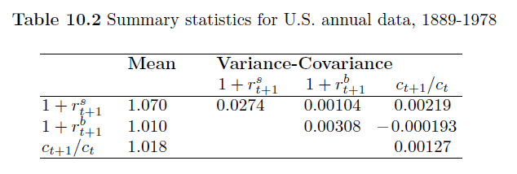
The Equity Premium Puzzle
Framework Interpretation of Risk-Aversion Parameter The Equity Premium Puzzle
Two Statements
The Mehra-Prescott data
: The real return to stock
: The real return to relatively riskless bonds
: The growth rate of per capita real consumption of nondurables and services
November 18, 2013 Chapter 13 LS
7/25

Slide 8
A Parametric Statement of the Equity Premium Puzzle
Framework Interpretation of Risk-Aversion Parameter The Equity Premium Puzzle
Two Statements
The Mehra-Prescott data
A Parametric Statement
A Non-Parametric Statement
Market Price of Risk
Hansen-Jagannathan Bounds
Starting from Euler Equations:
Assumption:
November 18, 2013 Chapter 13 LS
8/25

Slide 9
Framework Interpretation of Risk-Aversion Parameter The Equity Premium Puzzle
Two Statements
The Mehra-Prescott data
A Parametric Statement
A Non-Parametric Statement
Market Price of Risk
Hansen-Jagannathan Bounds
Substituting CRRA and the stochastic processes into Euler Equation:
Taking logarithms:
November 18, 2013 Chapter 13 LS
9/25

Slide 10
Framework Interpretation of Risk-Aversion Parameter The Equity Premium Puzzle
Two Statements
The Mehra-Prescott data
A Parametric Statement
A Non-Parametric Statement
Market Price of Risk
Hansen-Jagannathan Bounds
Taking the difference between the expressions for r^{s} and r^{b}:
Approximation:
= 0
From Table 10.2 (-0.000193)
Then we get:
0.06
0.00219
27.40
The Equity Premium Puzzle
November 18, 2013 Chapter 13 LS
10/25

Slide 11
A Non-Parametric Statement of the Equity Premium Puzzle
Framework Interpretation of Risk-Aversion Parameter The Equity Premium Puzzle
Two Statements
The Mehra-Prescott data
A Parametric Statement
A Non-Parametric Statement
Market Price of Risk
Hansen-Jagannathan Bounds
Market Price of Risk:
: Time-t price of the asset
: one-period payoff of the asset
: stochastic discount factor for discounting the stochastic payoff
(price kernel)
November 18, 2013 Chapter 13 LS
11/25

Slide 12
Framework Interpretation of Risk-Aversion Parameter The Equity Premium Puzzle
Two Statements
The Mehra-Prescott data
A Parametric Statement
A Non-Parametric Statement
Market Price of Risk
Hansen-Jagannathan Bounds
Apply Cauchy-Schwarz inequality:
Market Price of Risk
: the reciprocal of the gross one-period risk-free return by setting
: a conditional standard deviation
November 18, 2013 Chapter 13 LS
12/25

Slide 13
Framework Interpretation of Risk-Aversion Parameter The Equity Premium Puzzle
Two Statements
The Mehra-Prescott data
A Parametric Statement
A Non-Parametric Statement
Market Price of Risk
Hansen-Jagannathan Bounds
Hansen-Jagannathan bounds:
Construct structural models of the stochastic discount factor
Construct x, c, p, q, and π
Inner product representation of the pricing kernel
Classes of stochastic discount factors
A Hansen-Jagannathan bound: One example
The Mehra-Prescott data ---- HJ statement of the equity premium puzzle
November 18, 2013 Chapter 13 LS
13/25

Slide 14
Framework Interpretation of Risk-Aversion Parameter The Equity Premium Puzzle
Two Statements
The Mehra-Prescott data
A Parametric Statement
A Non-Parametric Statement
Market Price of Risk
Hansen-Jagannathan Bounds
Construct structural models of the stochastic discount factor
Construct x, c, p, q, and π
X₁
X₂
X₁
.
.
.
X_{J}
p = c · x
p: portfolio
C=
C₁ C₂ C₃ … C_{J}
1×J
x=
c: a vector of portfolio weights
J×1
We seek a price functional q = π(x)
q_{j} = π(x_{j})
J basic securities
x: random vector of payoffs on the basic securities
q: price of the basic securities
November 18, 2013 Chapter 13 LS
14/25

Slide 15
Framework Interpretation of Risk-Aversion Parameter The Equity Premium Puzzle
Two Statements
The Mehra-Prescott data
A Parametric Statement
A Non-Parametric Statement
Market Price of Risk
Hansen-Jagannathan Bounds
The law of one price:
Which means the pricing functional π is linear on P
Tow portfolios with the same payoff have the same price:
π(c, x) depends on c · x, not on c
If x is return, then q=1, the unit vector, and:
November 18, 2013 Chapter 13 LS
15/25

Slide 16
Framework Interpretation of Risk-Aversion Parameter The Equity Premium Puzzle
Two Statements
The Mehra-Prescott data
A Parametric Statement
A Non-Parametric Statement
Market Price of Risk
Hansen-Jagannathan Bounds
Construct structural models of the stochastic discount factor
Inner product representation of the pricing kernel
E(y·x) : the inner product of x and y
x is the vector
y is a scalar random variable
Riesz Representation Theorem proves the existence of y in the linear functional
Definition:
A stochastic discount factor is a scalar random variable y that satisfied the following equation:
November 18, 2013 Chapter 13 LS
16/25

Slide 17
Framework Interpretation of Risk-Aversion Parameter The Equity Premium Puzzle
Two Statements
The Mehra-Prescott data
A Parametric Statement
A Non-Parametric Statement
Market Price of Risk
Hansen-Jagannathan Bounds
The vector of prices of the primitive securities, q, satisfies:
Where C=
1, 1, 1 … 1
1×J
There exist many stochastic discount factors
Classes of stochastic discount factors
Note:
The expected discount factor is the price of a sure scalar payoff of unity
November 18, 2013 Chapter 13 LS
17/25

Slide 18
Framework Interpretation of Risk-Aversion Parameter The Equity Premium Puzzle
Two Statements
The Mehra-Prescott data
A Parametric Statement
A Non-Parametric Statement
Market Price of Risk
Hansen-Jagannathan Bounds
Classes of stochastic discount factors
Example 1:
Example 2:
Example 3:
Example 4:
A special case: Excess Returns
A special case: q=1
November 18, 2013 Chapter 13 LS
18/25

Slide 19
Framework Interpretation of Risk-Aversion Parameter The Equity Premium Puzzle
Two Statements
The Mehra-Prescott data
A Parametric Statement
A Non-Parametric Statement
Market Price of Risk
Hansen-Jagannathan Bounds
A Hansen-Jagannathan bound: Example 4
Given data on q and the distribution of returns x
A linear functional so y exits
e is orthogonal to x
We know:
*
November 18, 2013 Chapter 13 LS
19/25

Slide 20
Framework Interpretation of Risk-Aversion Parameter The Equity Premium Puzzle
Two Statements
The Mehra-Prescott data
A Parametric Statement
A Non-Parametric Statement
Market Price of Risk
Hansen-Jagannathan Bounds
From:
Hansen-Jagannathan bound
Two specifications:
For an excess return q = 0
For a set of return q = 1
November 18, 2013 Chapter 13 LS
20/25

Slide 21
Framework Interpretation of Risk-Aversion Parameter The Equity Premium Puzzle
Two Statements
The Mehra-Prescott data
A Parametric Statement
A Non-Parametric Statement
Market Price of Risk
Hansen-Jagannathan Bounds
Excess Return
: a return on a stock portfolio
: a return on a risk-free bond
So for an excess return, q = 0
*
November 18, 2013 Chapter 13 LS
21/25

Slide 22
Framework Interpretation of Risk-Aversion Parameter The Equity Premium Puzzle
Two Statements
The Mehra-Prescott data
A Parametric Statement
A Non-Parametric Statement
Market Price of Risk
Hansen-Jagannathan Bounds
Hansen-Jagannathan bound
(This bound is a straight line)
When z is a scalar:
Market Price of Risk
determines a straight-line frontier above which the stochastic discount factor must reside.
November 18, 2013 Chapter 13 LS
22/25

Slide 23
Framework Interpretation of Risk-Aversion Parameter The Equity Premium Puzzle
Two Statements
The Mehra-Prescott data
A Parametric Statement
A Non-Parametric Statement
Market Price of Risk
Hansen-Jagannathan Bounds
For a set of return, q = 1
*
The Hansen-Jagannathan Bound
(This bound is a parabola)
November 18, 2013 Chapter 13 LS
23/25

Slide 24
Framework Interpretation of Risk-Aversion Parameter The Equity Premium Puzzle
Two Statements
The Mehra-Prescott data
The Mehra-Prescott data
The stochastic discount factor
CRRA utility
Data: annual gross real returns on stocks and bills in the United States for 1889 to 1979
November 18, 2013 Chapter 13 LS
24/25

Slide 25
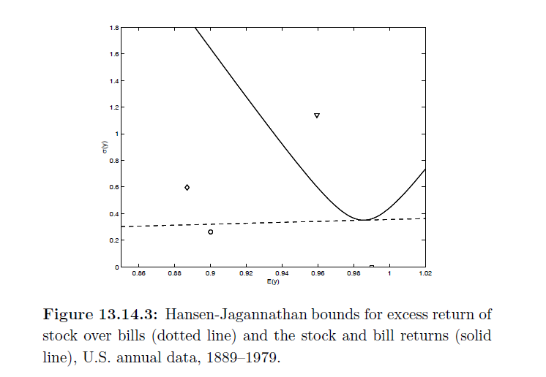
Framework Interpretation of Risk-Aversion Parameter The Equity Premium Puzzle
Two Statements
The Mehra-Prescott data
November 18, 2013 Chapter 13 LS
25/25

Slide 26
Questions
Comments

