Slide 1

ACTIVITIES FUNDING BOARD
SFAC PRESENTATION FISCAL YEAR 2026
- Presented by Brandon Hilliard, AFB Chair
& Bradyn Lansiquot, Vice Chair

Slide 2

  About AFB
  Our Team
  AFB Funding Process
  UH Goals & DSA values
  Previous Year Facts
  Impact & Challenges
  Future Plans
AGENDA

Slide 3

OUR MISSION
The AFB mission is to allocate the 1% of Student Service Fees to Registered Student Organizations to increase campus vibrancy and inclusion by funding more events on campus and have members of registered student organizations attend conferences.
OUR VISION
AFB works to engage all RSO's through Inclusive outreach, to increase the utilization of allocated funds

Slide 4
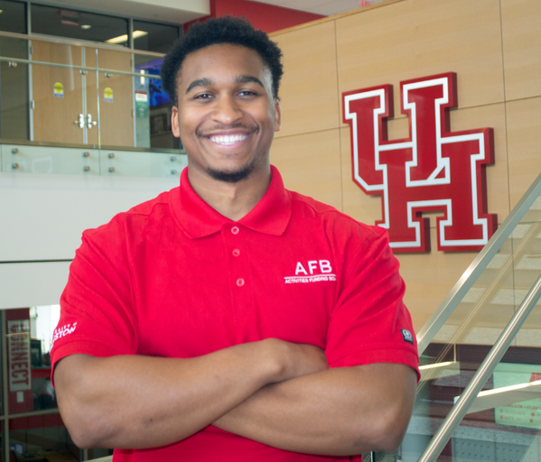
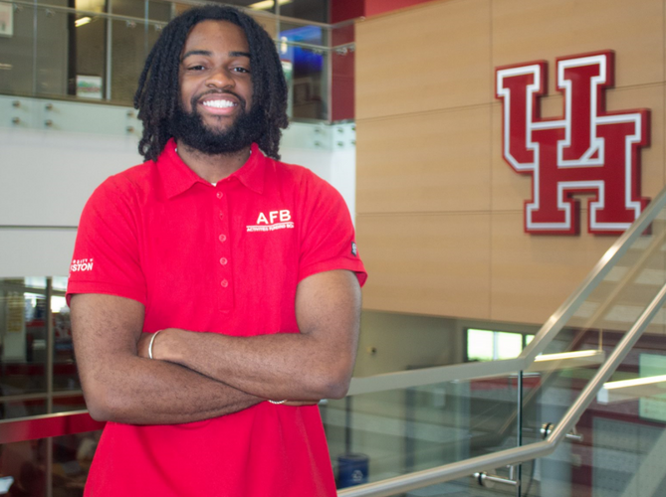
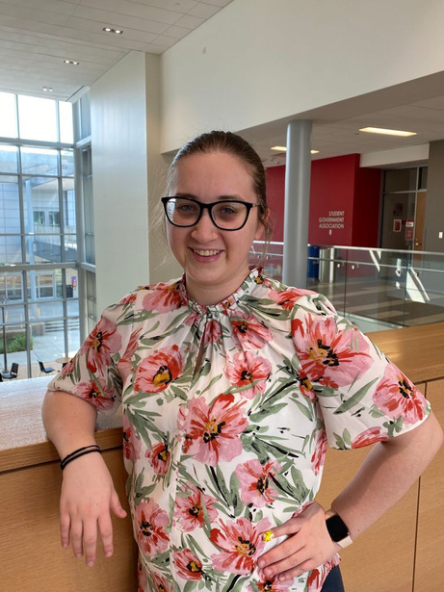
MEET OUR TEAM
Brandon Hilliard
Bradyn Lansiquot
Chair
Senior
Technology Leadership Innovation Management Major
Allyson Yolland
Vice Chair
Senior
Economics Major
AFB Advisor
Assistant Director, Center for Student Involvement

Slide 5
ORGANIZATIONAL CHART
CHAIR
AFB ADVISOR
COMMUNICATIONS CHAIR
AFB HEARING COMMITTEE
VICE CHAIR

Slide 6
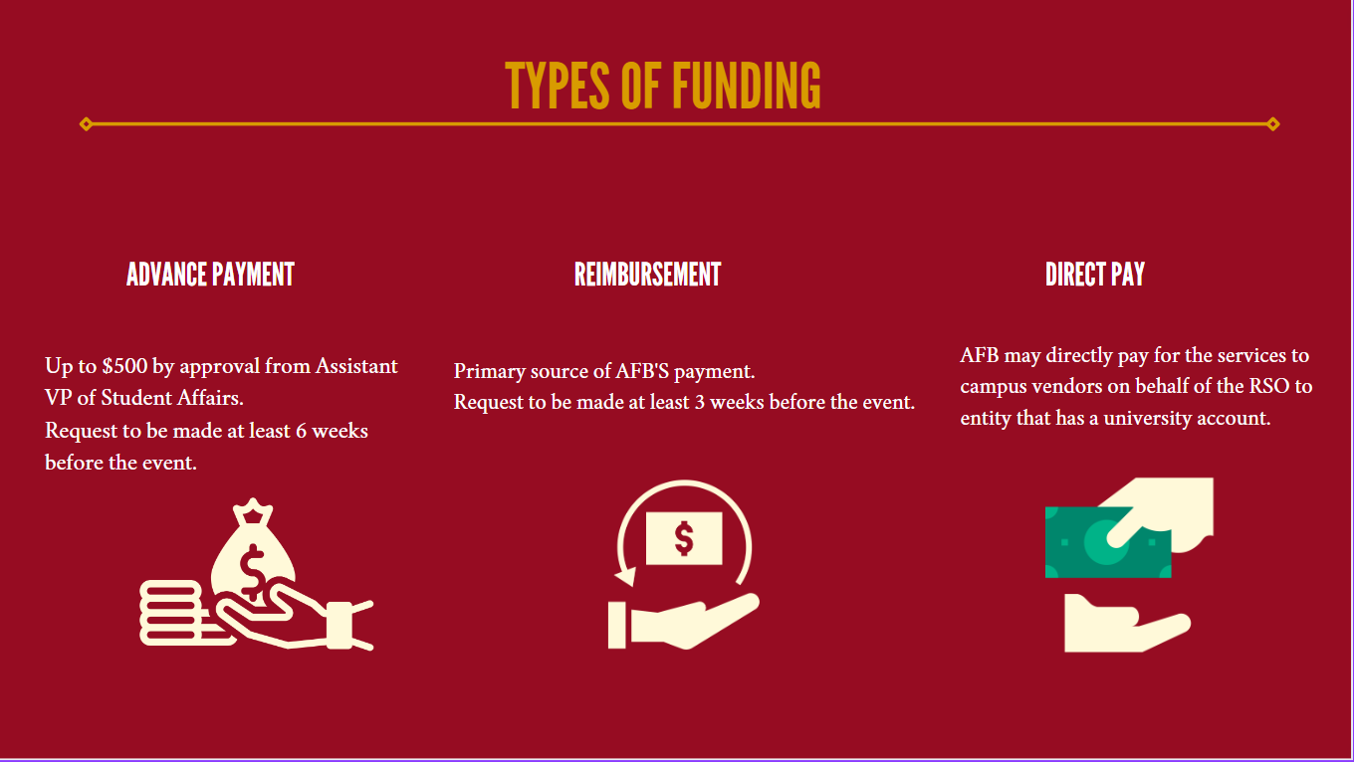

Slide 7
AFB FUNDING PROCESS
Stage 1
Student organization(s) applies for funding through Finance tool on Get Involved
AFB reviews the application and determines if applicable for hearing.
If no hearing necessary, organization will be moved to stage 5.
Stage 2
Stage 3
Hearing date is scheduled from the pre-set hearing dates

Slide 8
AFB FUNDING PROCESS
Stage 4
Hearing committee makes decision based on Bylaws and Guidelines
Stage 5
AFB send Notice of Award, if approved for funding
Stage 6
After event is held, organization submits reciepts

Slide 9
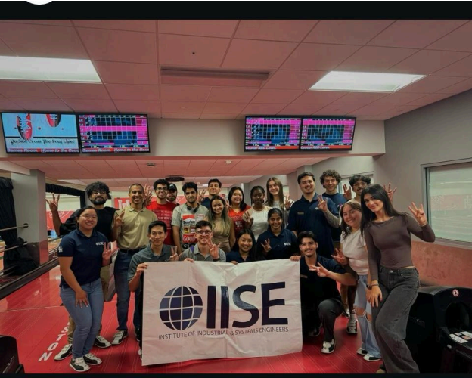
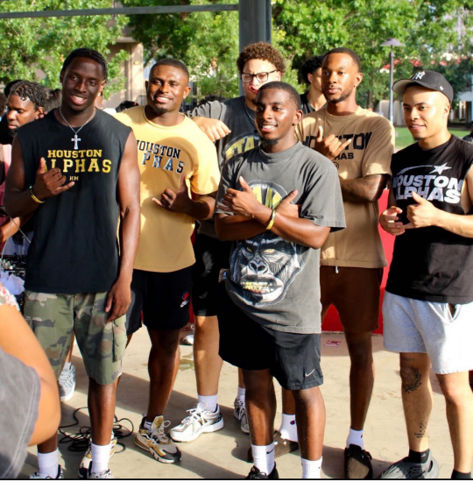
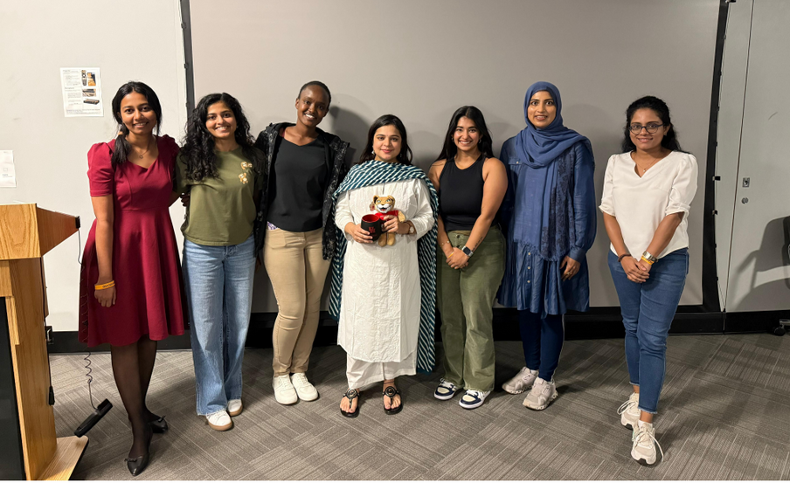
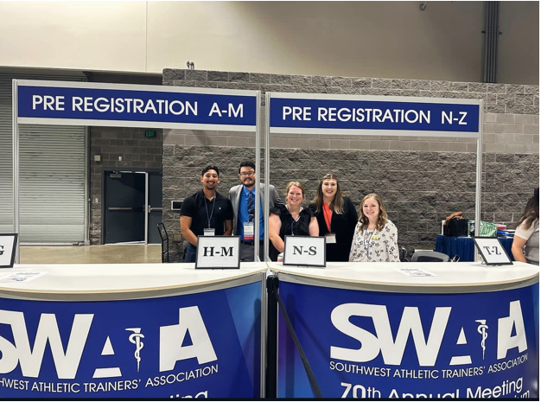
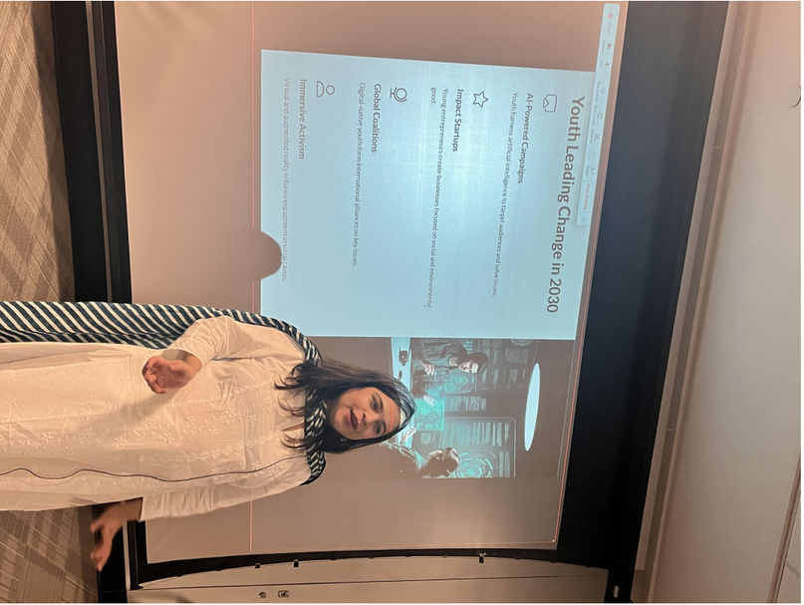
Institute of Industrial & System Engineers- Networking Event
Alpha Phi Alpha Fraternity-
The Intro
Women in Physics - Impact of Social Media on Children
Masters of Athletic Training Society - Southwest Athletic Trainers Association Conference

Slide 10

HOW ARE WE DIFFERENT FROM CCA?
  CCA provides funding for cultural events
  CCA Co-sponsors and provides liaison assistance (marketing, equipment)
  AFB allocates funds for conferences and Fiesta
  CCA does not fund the first general body meeting, or conferences
  AFB is able to fund up to $3000 a year, while CCA is able to fund up to $5000 a year for member organizations

Slide 11
RELATIONSHIP TO DSA STRATEGIC VALUES & INITIATIVES
DSA Value: Community
"We celebrate and draw on our diversity, collaborating with partners amongst the university, and community to foster a sense of belonging and shared responsibility for the well-being of all."
DSA Initiatives: Increased student engagement students at UH Sugar Land and UH Katy campuses
One of our primary focuses is on raising awareness of the resources available through the Activities Funding Board. We want to empower student organizations by ensuring they know they can access funding to host conferences and events that foster inclusive environments on both campuses.
Notes:
DSA Values

Slide 12

RELATIONSHIP TO UNIVERSITY OF HOUSTON GOALS
UH Goal:
Student Success - Provide a Top Tier, Inclusive Educational Experience to All - Make educational programs more financially accessible for all students.
Notes:
https://uh.edu/strategic-plan/

Slide 13
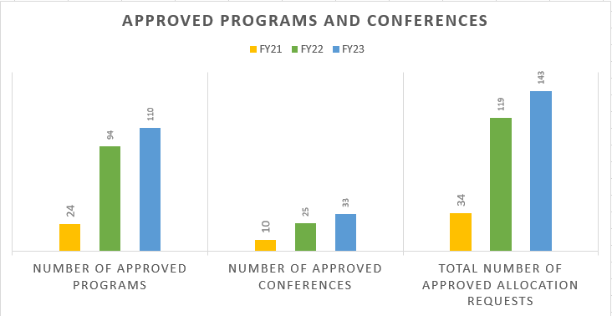
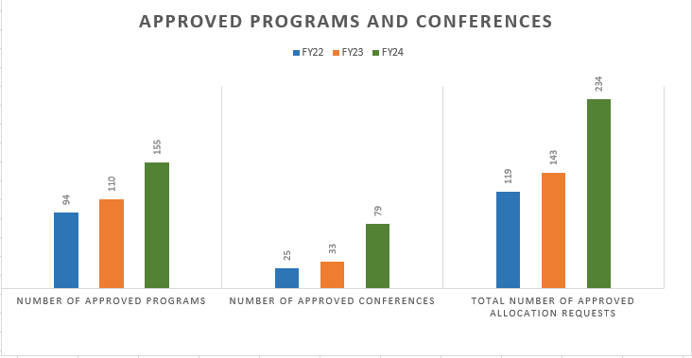
APPROVED PROGRAMS & CONFERENCES

Slide 14
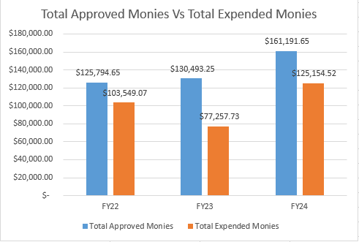
APPROVED FUNDS VS. EXPENDED FUNDS

Slide 15

Impacted over 150 Organizations
  Ahlul Bayt Student Organization
  Alpha Phi Alpha
  American Institute of Chemical Engineers
  American Marketing Association
  American Medical Womens Association
  Black Students Health Association
  Biomedical Engineering Society
  Caribbean Collective
  Cougar AI
  Graduate English Society
  Industry Pharmascist Organization
  Institute of Industrial Engineers
  Interfraternity Council
  Kappa Epsilon
  Mindful Coogs Student Organization
  National Society of Black Engineers
  Pakistan Student Association
  Precious Plastic UH
  Roarin Raas
  Society for Advancement of Chicanos/Hispanic and Native Americans in Science at UH
  Space City Raas
  The Collegiate 100
  Young Life
  Zeta Tau Alpha

Slide 16


OUR IMPACT
  Assisted over 60 newly created organizations
  276% increase in social media interactions
  67% increase in followers after starting merchandise giveaways.
  This led to a 332% increase in profile activity

Slide 17
YEARLY CHALLENGES
Organizations may need assistance understanding which funding type would work best for each individual request
Organizations’ events may not meet AFB guidelines
Organizational outreach as an ongoing process needs improvement
Organizations may need help with initial steps to set up reimbursement process

Slide 18



Outreach Plans
1
2
3
Information Sessions
Weekly Newsletter, Social media Q&A’s
Attending Tabling EVents

Slide 19
AFB would like to continue its 1% base with no additional funding requests at this time
FY 2026 REQUEST

Slide 20

Thank you!
We appreciate your continued support in our mission
Questions?

