Slide 1
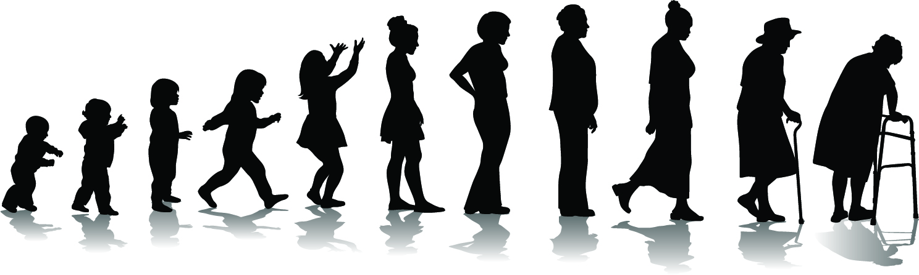

The Cougar Health And Related Medical Services (CHARMS) Initiative
Luis D. Medina, PhD
Assistant Professor
University of Houston | Department of Psychology
Director, Collaborative on Aging Research and Multicultural Assessment (CARMA)

Slide 2
Acknowledgments
UH Quality Enhancement Plan: Cougar Initiative to Engage (CITE) Office
Departments of Psychology, Health & Human Performance; Graduate College of Social Work; College of Nursing
Community Partners
  BakerRipley
  Boynton Chapel United Methodist Church
  Community Family Centers
  Houston Area Community Services (HACS)
  Houston Health Department
  YMCA of Greater Houston

Slide 3
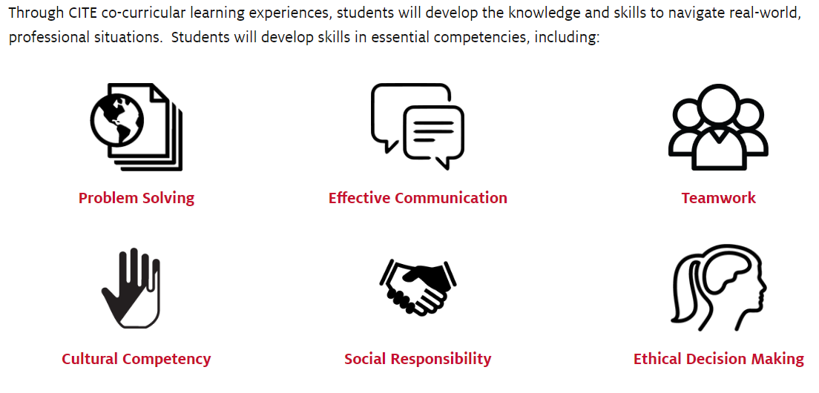
CITE Learning Objectives

Slide 4
CHARMS Learning Process
Didactic Training
  Responsible Conduct of Research (RCR)
    CITI Program (citiprogram.org)
  Cultural Competency
    USD HHS “Think Cultural Health” (ccnm.thinkculturalhealth.hhs.gov)
Track-Specific Training
  Relevant screening measures
Health Fair

Slide 5
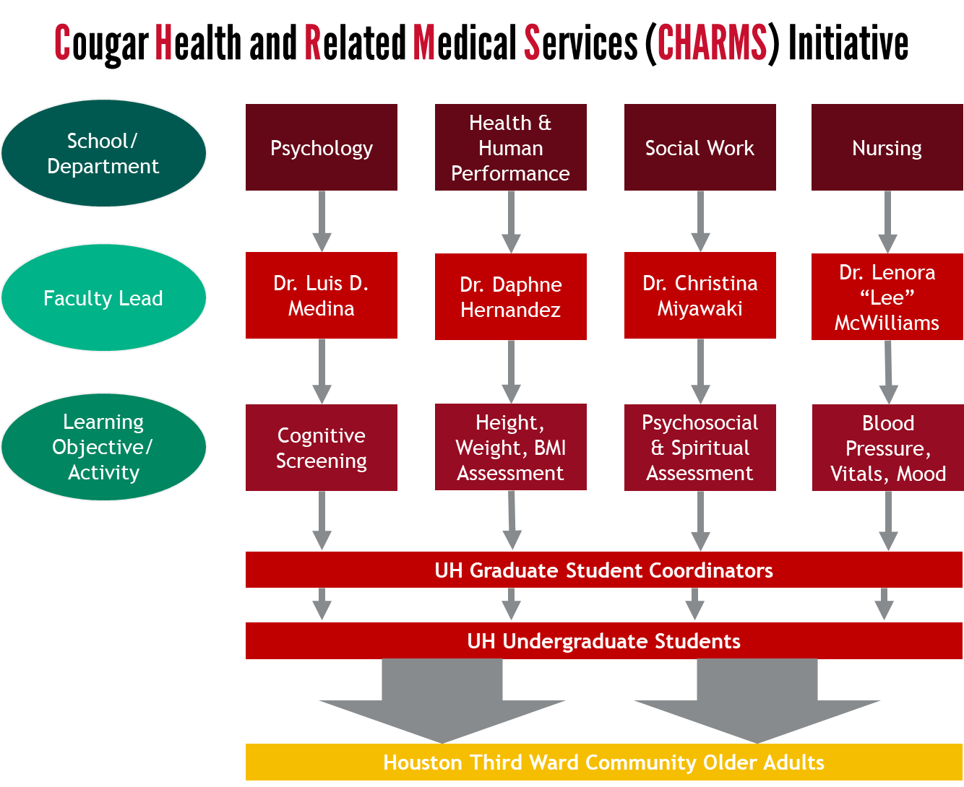

Slide 6
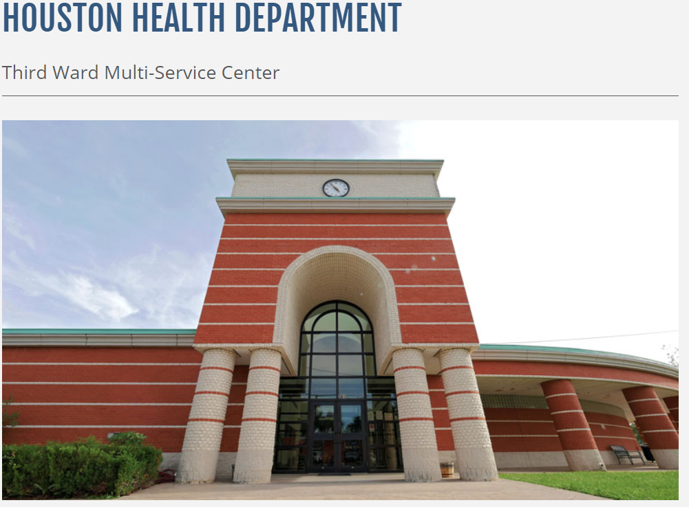

Health Fair
Saturday, March 21
AM Shift: 9am-12pm
PM Shift: 12pm-3pm
Student Responsibilities:
Advertising of health fair
Prepare materials
Set up (AM shift) and tear down (PM shift)
Screenings and feedback
Follow-up

Slide 7
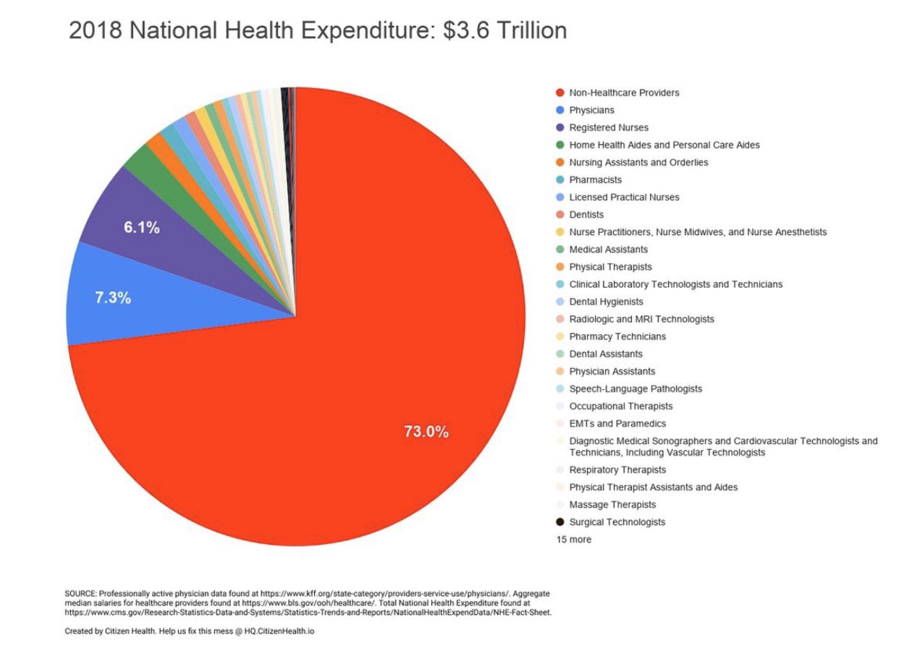
Notes:
The insured share of the population was 90.6 percent in 2018 and 90.8 percent in 2017, as the number of uninsured increased by 1 million to 30.7 million in 2018.

Slide 8
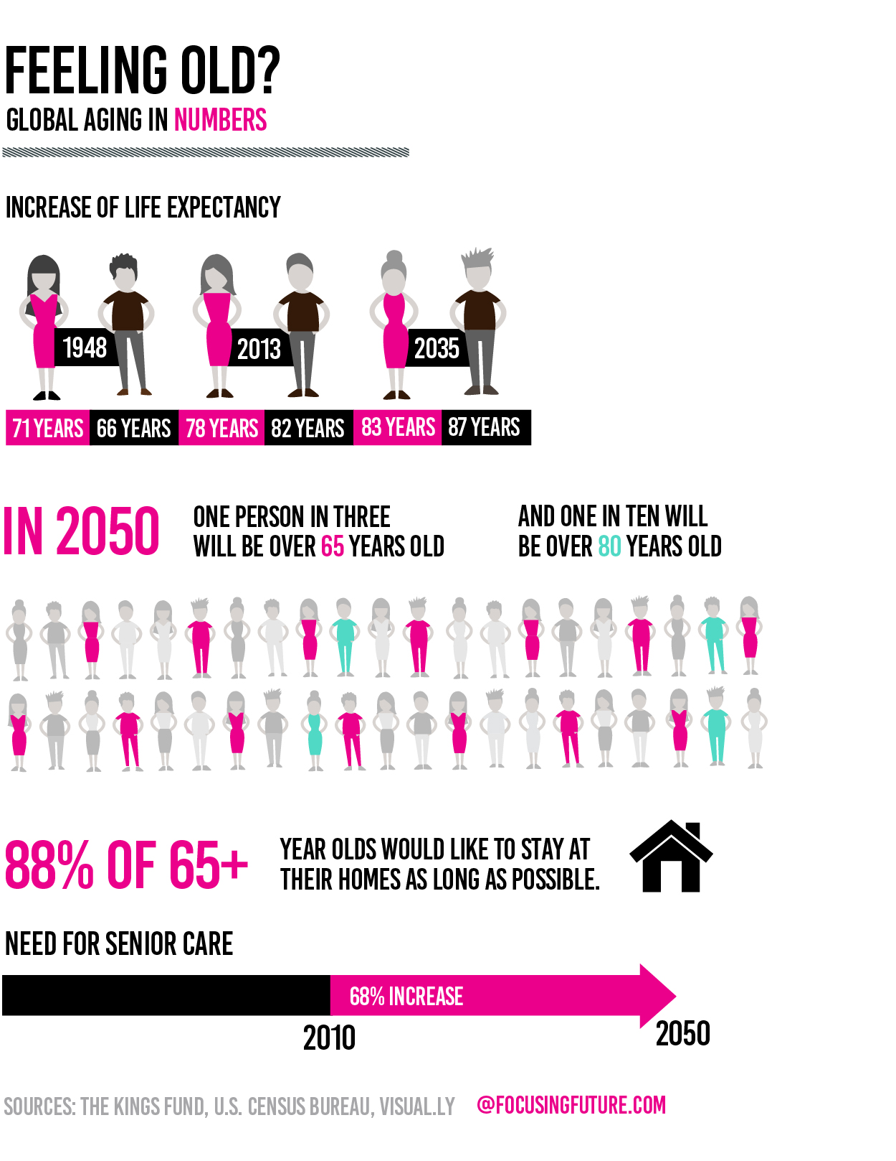
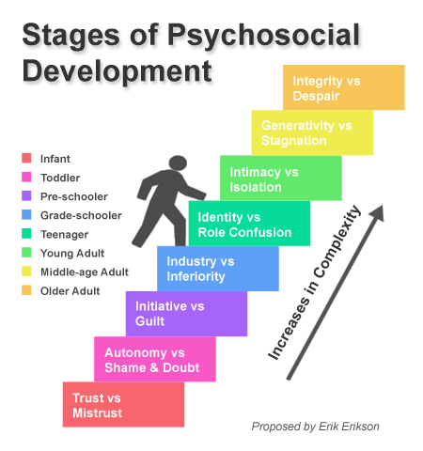
Notes:
People are living longer and we’re not equipped to handle the needs of older adults, which are different from those of younger individuals.

Slide 9
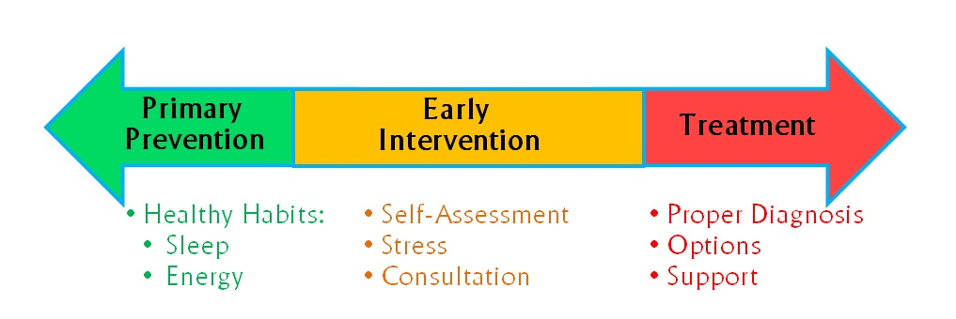
Prevention
aimed at preventing a problem from occurring in the first place or from getting worse
Intervention
treatment that occurs after the problem has arisen
VS
In the US…
“…we tend to be reactive vs proactive…[W]e often wait for a disaster or problem to occur, rather than spending effort and money on preventing it from happening in the first place.”
Courtesy of Dolan Clune
Notes:
People are living longer and we’re not equipped to handle the needs of older adults, which are different from those of younger individuals.

Slide 10
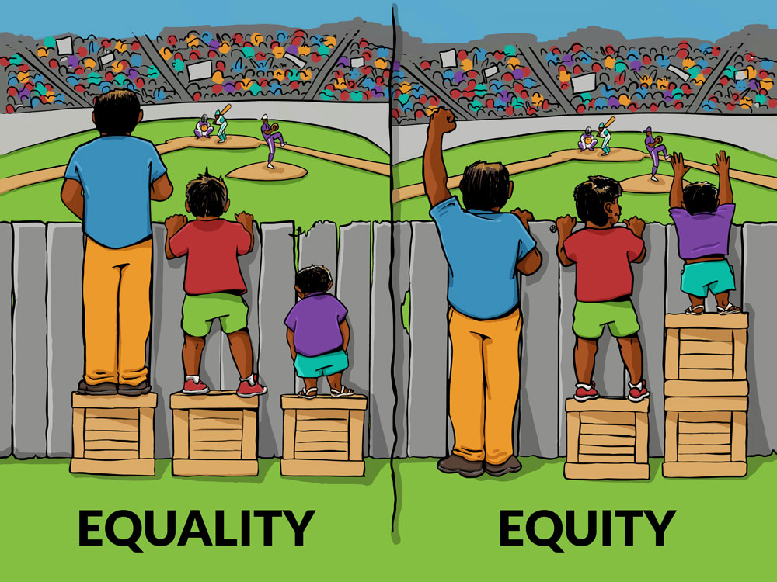
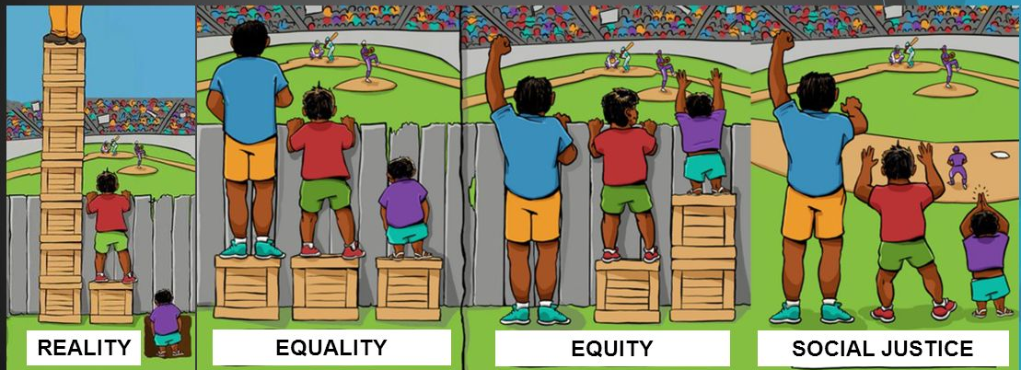
Towards Health Equity
Images adapted from Craig Froehle, Center for Story-based Strategy, and Interaction Institute for Social Change

Slide 11
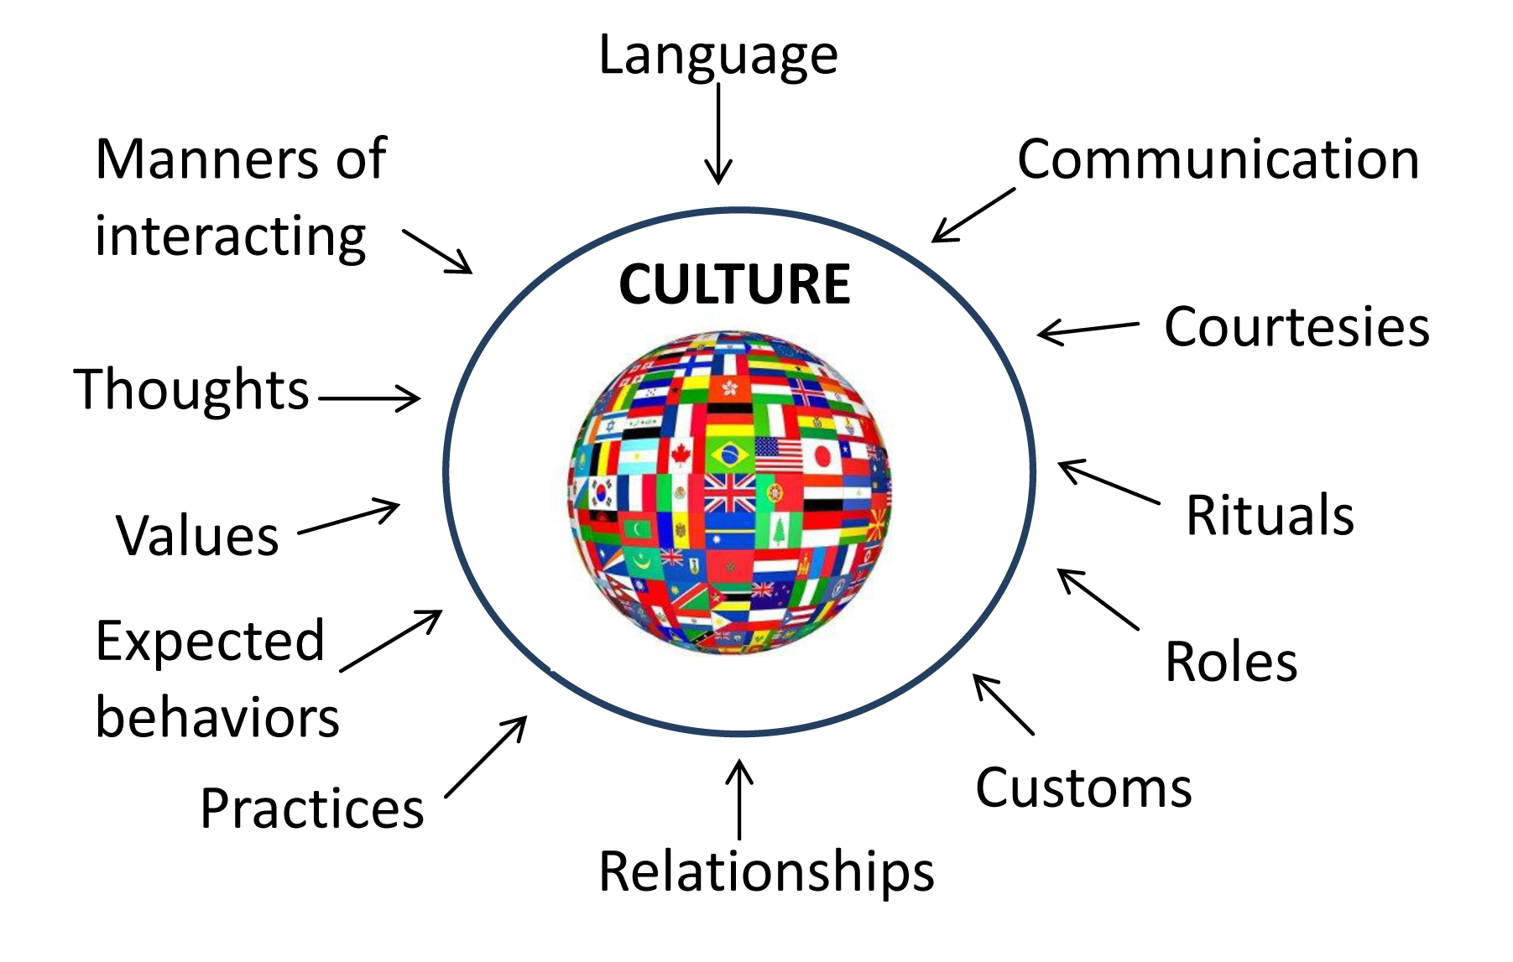
Cultural impacts and care
Language
Demographics and incidence of disease
Worldwide incidences
Belief and its impact on care

Slide 12
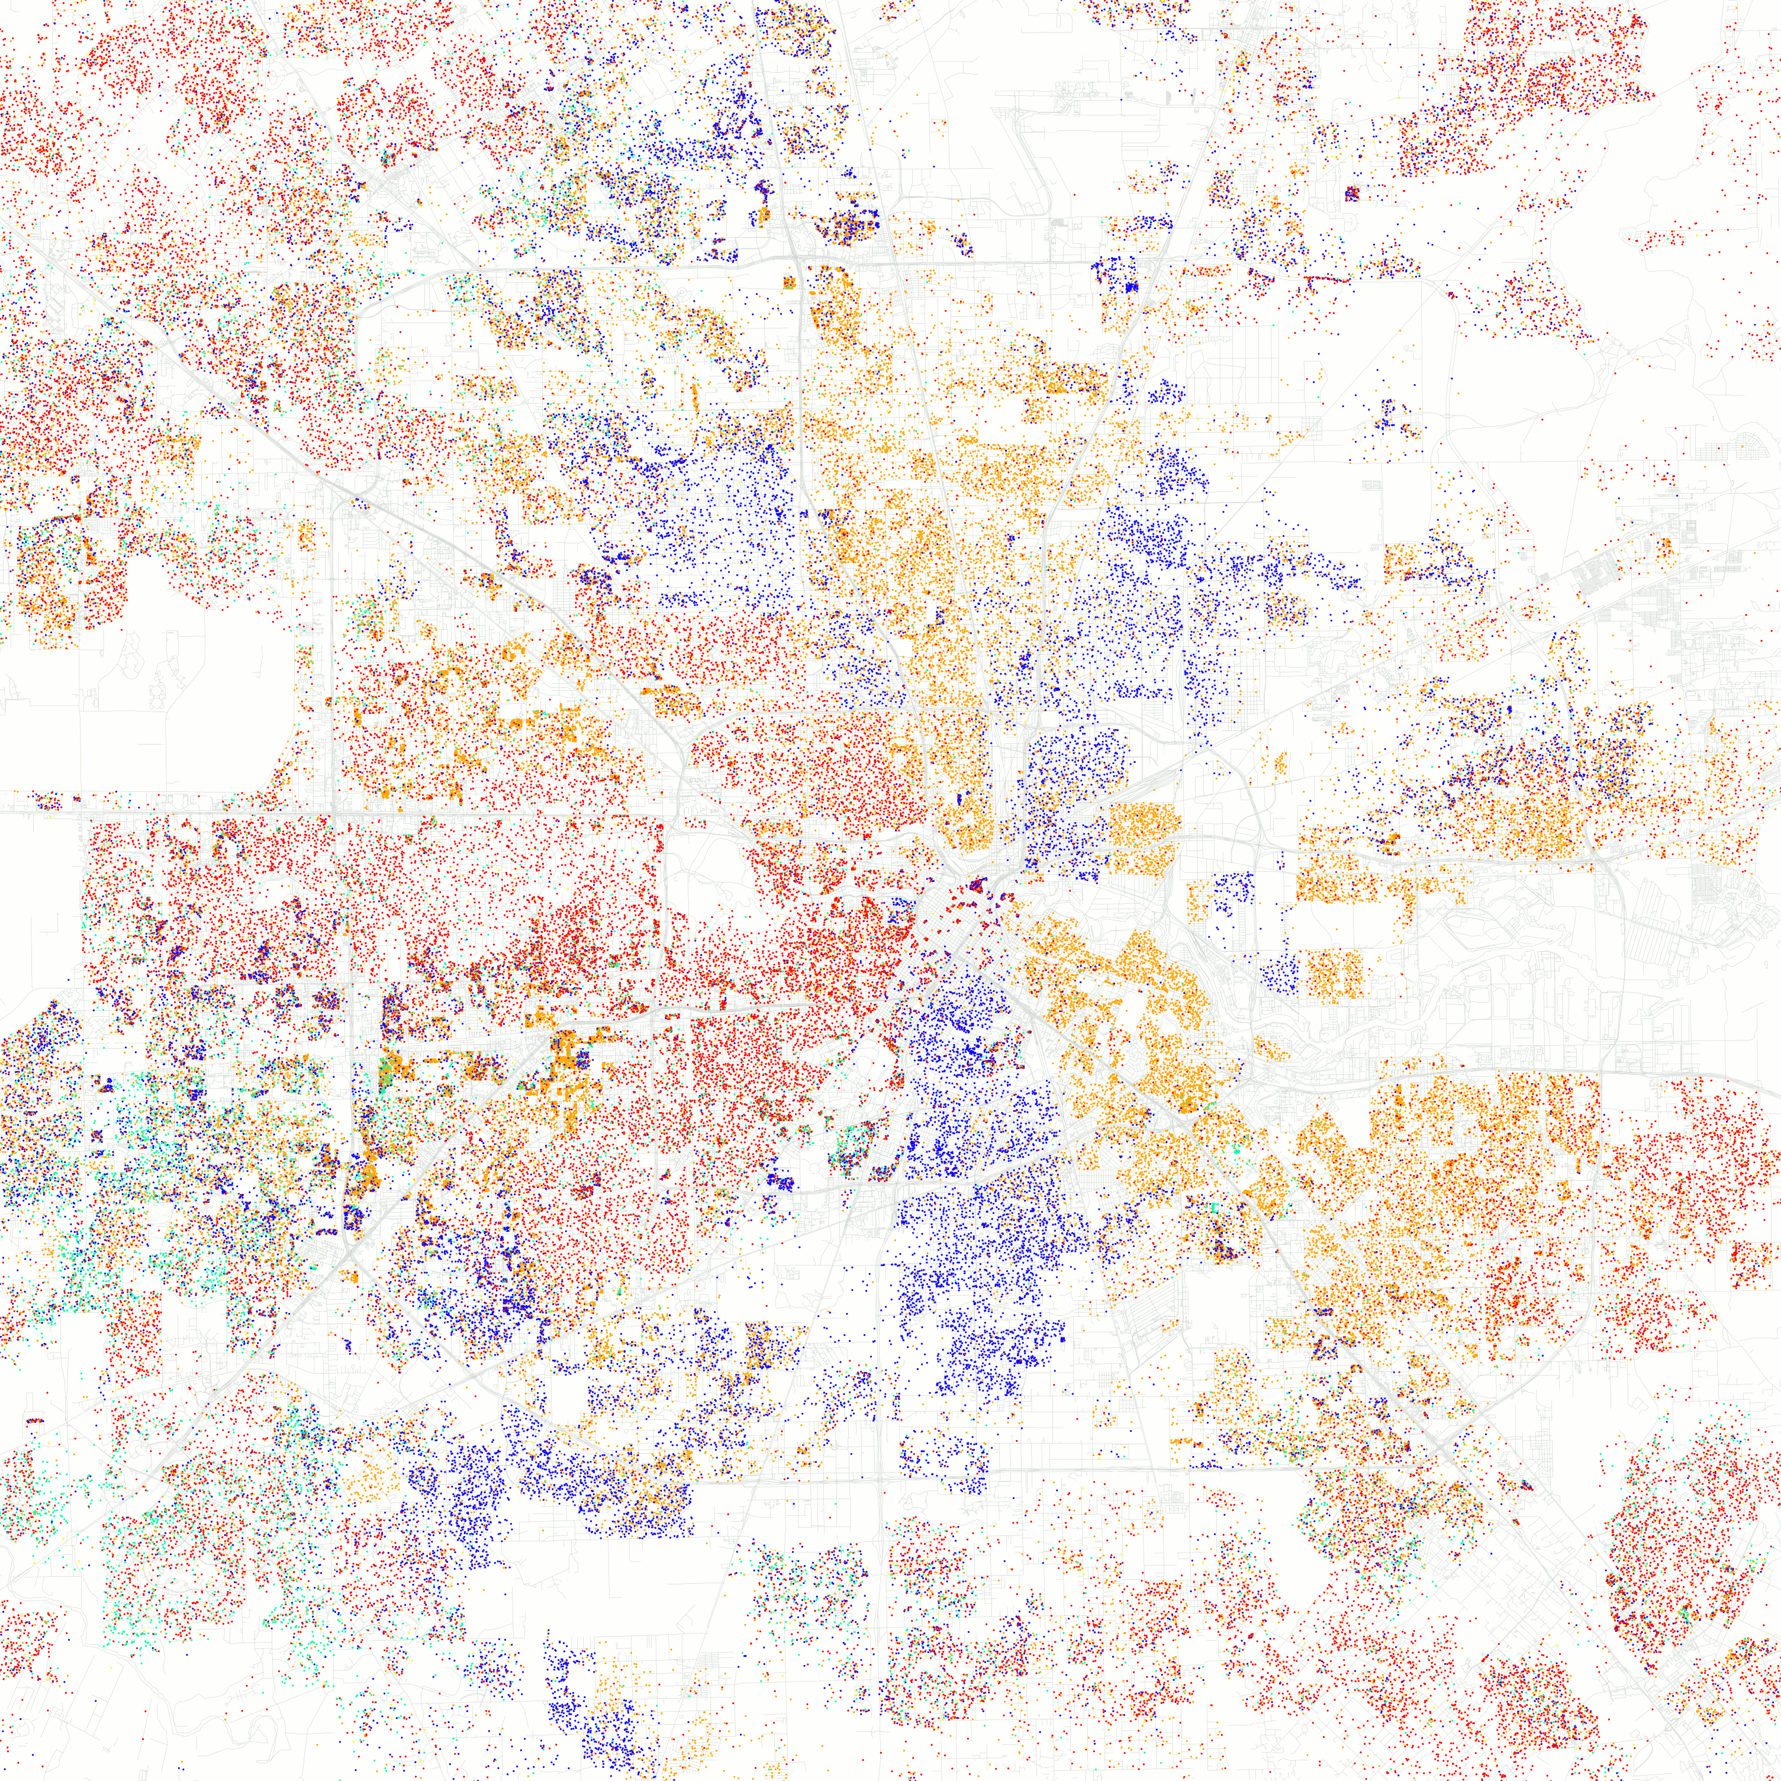
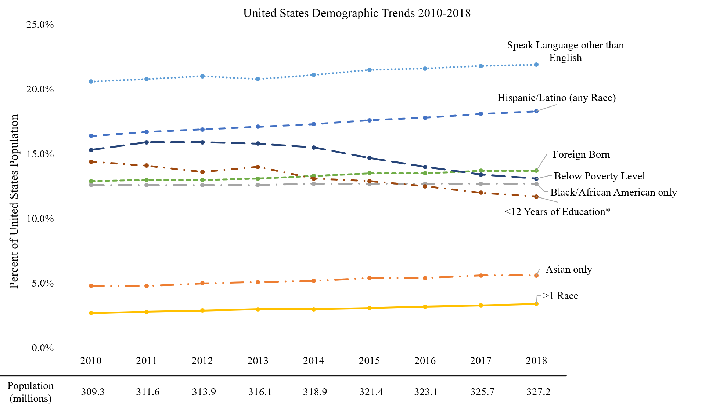
Changing Demographics
Data from U.S. Census
Medina et al. (in prep)
Notes:
This is a map of Houston from the 2010 Census showing ethnoracial diversity in the city. Red= White; Orange = H/Ls; Blue=Black; Green=Asian; Yellow=Other. At the time, 37% of the population was Hispanic/Latino. Houston has been a “majority-minority” city since the 1990 Census.

Slide 13
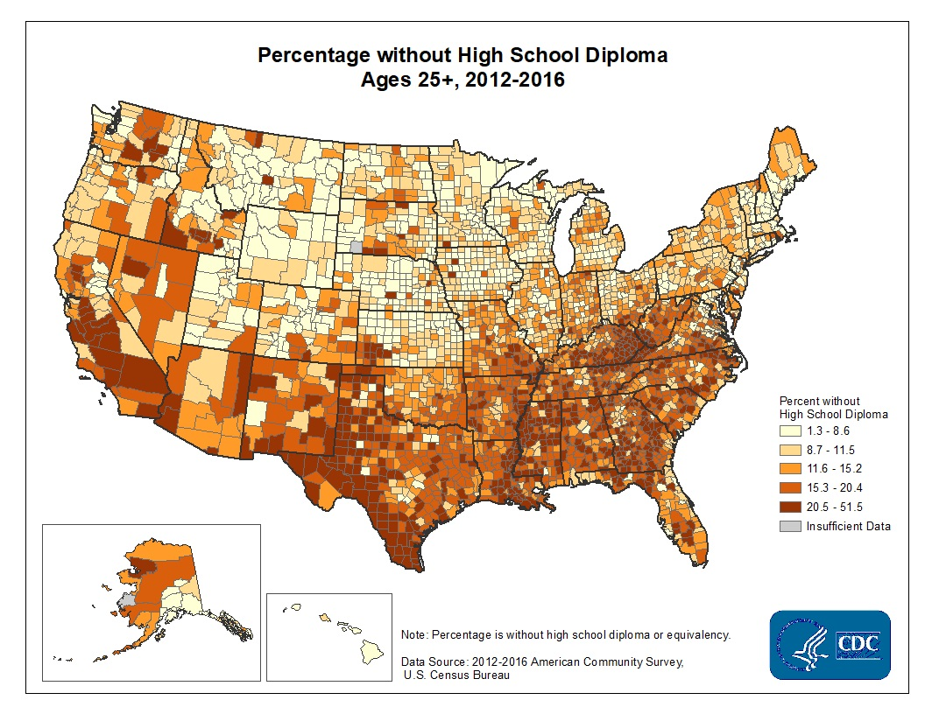
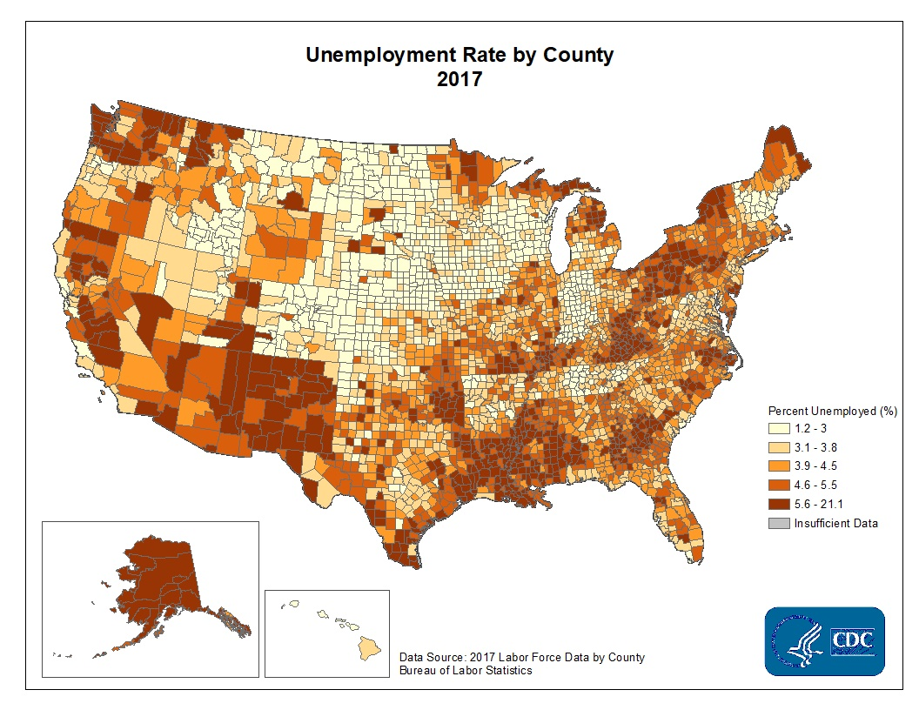
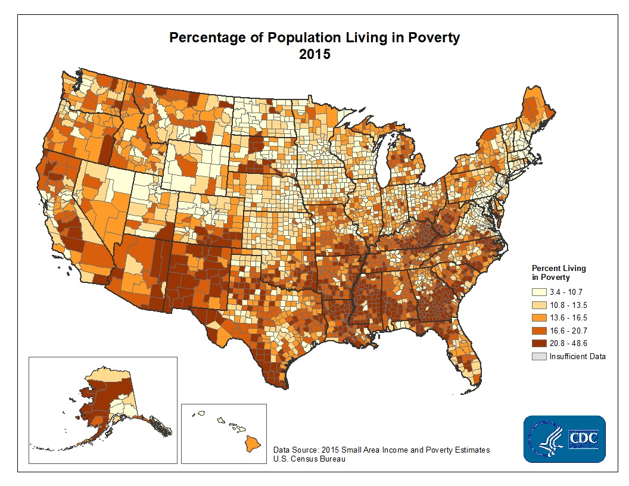
Social Determinants of Health (SDOH)

Slide 14
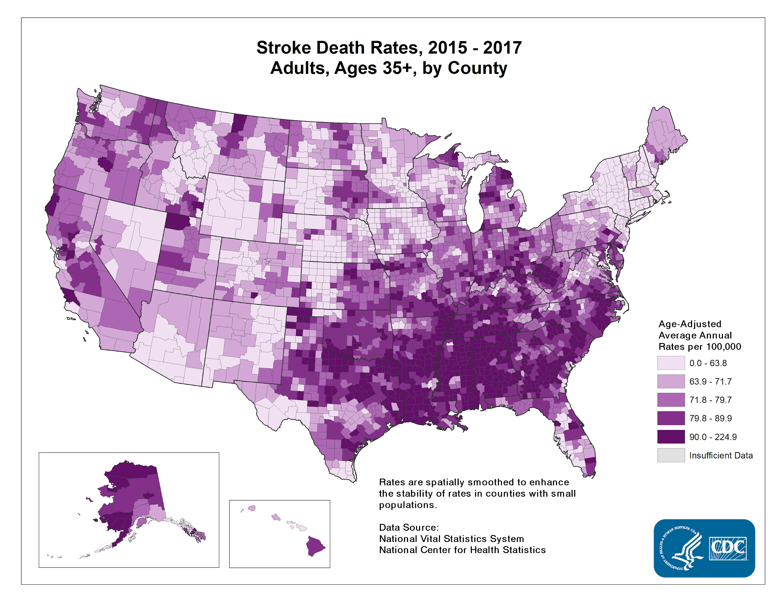
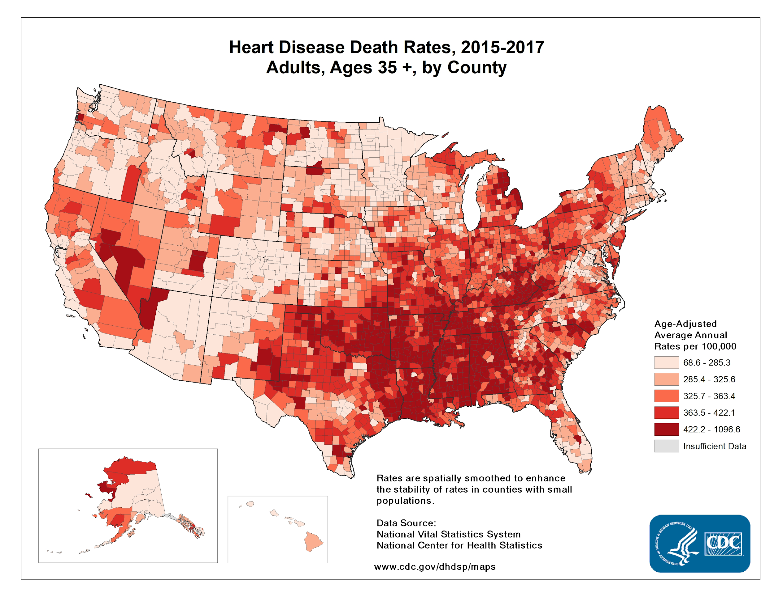
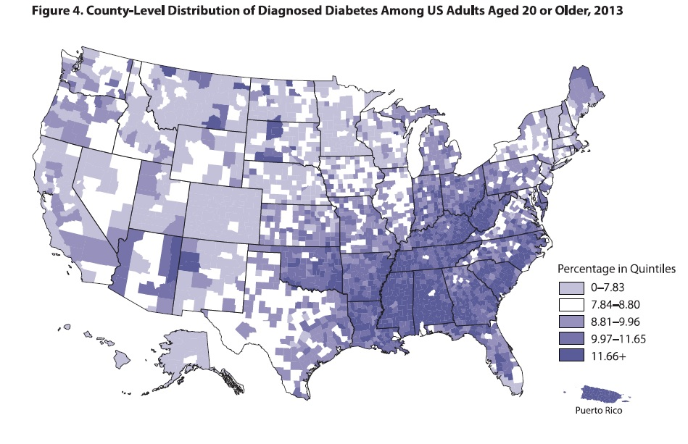
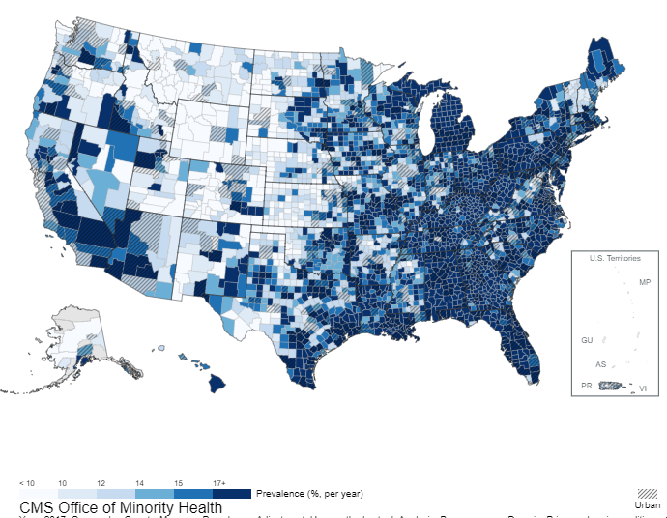
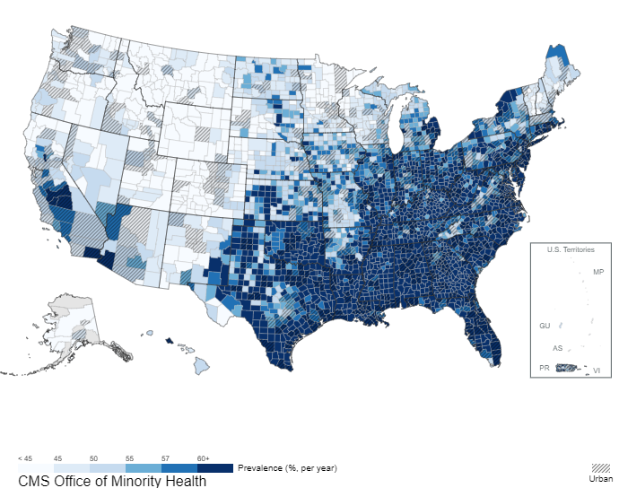
2017 Prevalence of Obesity (All Races)
2017 Prevalence of Hypertension (All Races)

Slide 15
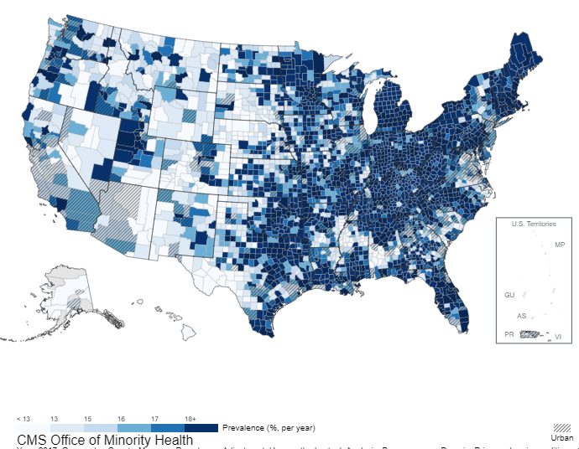
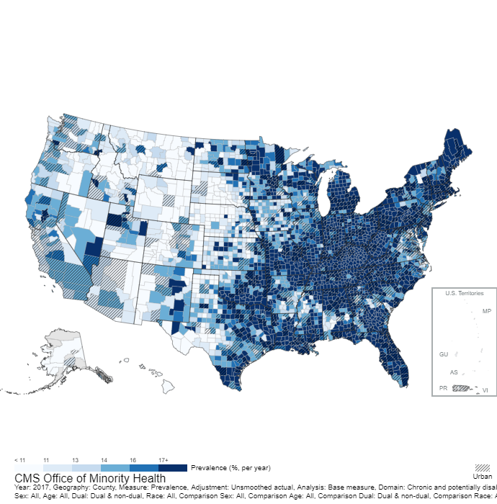
2017 Prevalence of Anxiety Disorders (All Races)
2017 Prevalence of Depression (All Races)

Slide 17
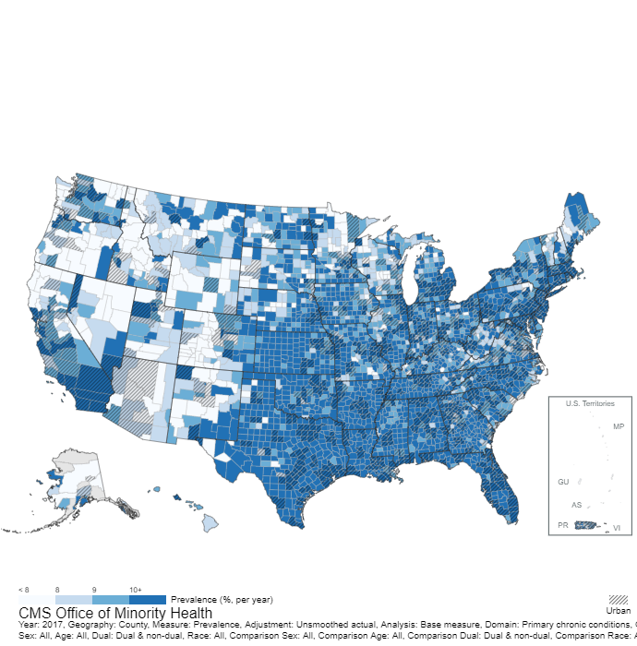
2017 Prevalence of Alzheimer’s, Related Disorders, & Senile Dementia (All Races)

Slide 18
Prevalence Rates of Dementia
Adapted from Gurland et al., 1999

Slide 19
Age-Related Disparities
Alzheimer’s disease & related dementias
Mental distress & mood disorders
Polypharmacy & medication misuse
Vision problems
Hypertension
Diabetes
Obesity & mobility issues → disability

Slide 20
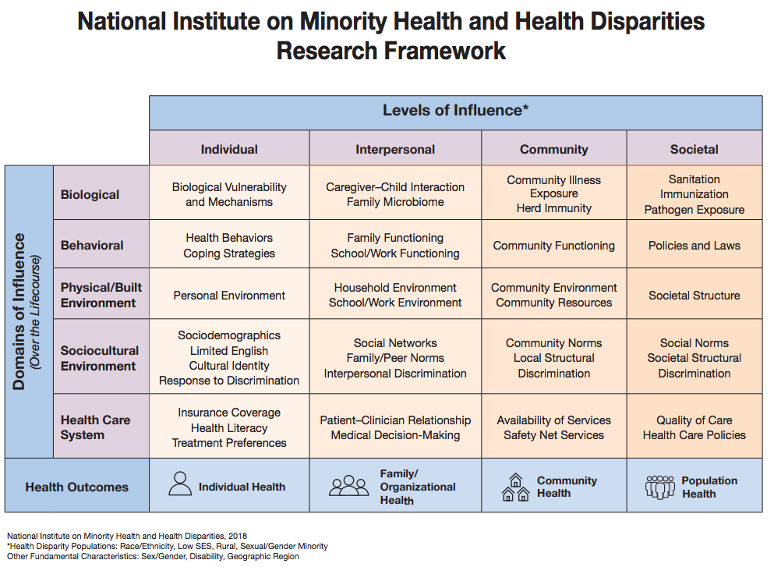

Slide 21
Summary
Aging population with specific needs
Some groups (e.g., Hispanics/Latin*, Black/African Americans) are at increased risk for age-related conditions
With our current population growth, these conditions will be an even larger problem over the next few decades
Prevention vs Intervention
  Early detection and education are key!

Slide 22


