Slide 1
FY2020 Annual Budget
Presentation to the
Administration and Finance Committee
August 22, 2019

Slide 3
UH System Sources of Funding for the Operating Budget over Time
*includes sponsored research grants and financial aid
**includes other operating income (e.g. auxiliaries)

Slide 4
UH System Accomplishments
Record enrollment of 73,931
Record degrees awarded of 17,057
  44% to minority students
  24% in STEM fields
Record research expenditures of $183 million
The “Here, We Go” campaign reached its goal of $1 billion dollars 18 months ahead of schedule.
Philanthropy of $144 million this past year

Slide 5
UH System FY19 Budget Summary
$1.78 billion operating budget – an increase of $106.2 million compared to FY19
FY20 sources of operating revenue, on a percentage basis, consistent with FY19
2/3^{rd’s} of the total operating budget supports student success
$4.5 million in reductions/reallocation of resources to fund higher strategic priorities
$266.8 million capital budget – representing 29 projects

Slide 7
University of Houston System
FY2020 Proposed Operating Budget
($ in Millions)

Slide 8
University of Houston System
FY2020 Proposed Capital Budget
($ in Millions)

Slide 9
University of Houston System
FY2020 Proposed Operating and Capital Budget
($ in Millions)

Slide 10
University of Houston System
FY2020 Proposed Allocation of
New Operating Funds by Priority
($ in Millions)

Slide 11
University of Houston System
FY2020 Proposed Allocation of New HEAF by Priority
($ in Millions)

Slide 12
University of Houston System
FY2020 Proposed Allocation of Incremental Operating Funds and HEAF by Priority
($ in Millions)

Slide 13
University of Houston System
Highlighted Use of New and Reallocated Funds
University of Houston
  Additional set aside for need-based scholarships
  New faculty positions
  Additional investment in Graduate Tuition Fellowships
  Start-up funding for the College of Medicine
  Continuing to address existing graduate tuition fellowship budget needs
  Provide funds to support Academic performance funding
  Invest in faculty and staff retention via a merit pool
  Invest in technology and campus safety and security which supports students, faculty, and staff
  Invest in classroom renovations & faculty start-ups
  Invest in campus infrastructure to support students, faculty, and staff (including the Core Renovation Projects and Life Sciences Projects and capital renewal/deferred maintenance/life safety )

Slide 14
University of Houston System
Highlighted Use of New and Reallocated Funds
University of Houston – Clear Lake
  Expand tenured track faculty positions to support both new academic programs and overall undergraduate enrollment growth in support of student success
  Fund the transition of Student Affairs, as a department under Academic Affairs, to a separate division now lead by the Vice President for Student Affairs to better support the unique and diverse student population at UHCL
  Increase the number of new student internships and other experiential learning opportunities for our students enabling them to apply their classroom learning to real world experiences and to solve real challenges that will better prepare them for success after they graduate from UHCL
  Hire key university leaders in innovation and technology that will support and promote UHCL and its students, thereby enhancing research excellence and national competitiveness
  Invest in faculty and staff (new positions and compensation) to support the success of both System and University initiatives following a period of three years of austerity and budget reductions
  Invest in the University’s Strategic Planning process utilizing the Balanced Scorecard Institute as the basis for development and university wide implementation, with the final plan completion due by the end of fiscal year 2020
  Invest in campus infrastructure to support students, faculty, and staff

Slide 15
University of Houston System
Highlighted Use of New and Reallocated Funds
University of Houston-Downtown
  Continue investment in instructional and scholarly capacity by adding six full-time faculty positions through both new and reallocated funds
  Enhance opportunities for student academic success as well as student life on campus through investments in scholarships, advising, orientation, and club sports – including eSports
  Provide operating funds to bring the new Science and Technology building online, including investment in support staff
  Continue strengthening UHD’s operating budget by reducing reliance on one-time funds
  Isolate funds for a mid-year merit pool for faculty and staff, conditional on the achievement of enrollment goals, thus enabling the institution to maintain regional competitiveness in recruiting and retaining a well-qualified professoriate and skilled support staff
  Invest in campus infrastructure to support students, faculty, and staff

Slide 16
University of Houston System
Highlighted Use of New and Reallocated Funds
  University of Houston-Victoria
    Hire new faculty to support fast-growing programs
    Increase in compensation for faculty and staff due to promotions, equity adjustments, and merit compensation
    Increase the proportion of face-to-face classes and course offerings
    Expand student recruitment and retention efforts
    Continued focus on being a destination university by developing new residential campus infrastructure, expanding academic programs, and building new academic facilities
    Relocating UHV Katy operations to the UH System in Katy campus
    Invest in campus infrastructure to support students, faculty, and staff

Slide 17
University of Houston
FY2020 Annual Budget

Slide 18
University of Houston
Recent Accomplishments
Record student enrollment of 46,324
10,283 total degrees awarded during the 2018-19 academic year
381 Doctorates awarded during the 2018-19 academic year
4-year graduation rate of 36% (up from 33%)
6-year graduation rate of 59% (up from 54%)
72% of freshmen participating in UHin4
The Petroleum Engineering graduate program was ranked 14th nationally by U.S. News and World Report;
The Graduate School of Social Work moved up from #38 in 2017 to #22 in 2019 in U.S. News and World Report;
The Law Center had three programs ranked in the top 10 by U.S. News and World Report including Health Care Law (#6), Intellectual Property Law (#7), and Part-Time Law (#9);
The Cyvia and Melvyn Wolff Center for Entrepreneurship at the C.T. Bauer College of Business is ranked #2 in the U.S. and on the list of the top 25 Best Undergraduate Programs for Entrepreneurs in 2019 by the Princeton Review and Entrepreneur Magazine; and
UH Library’s ranking among its Association of Research Libraries (ARL) peers rose from 76th in 2013 to 62nd in 2018.

Slide 20


Slide 24
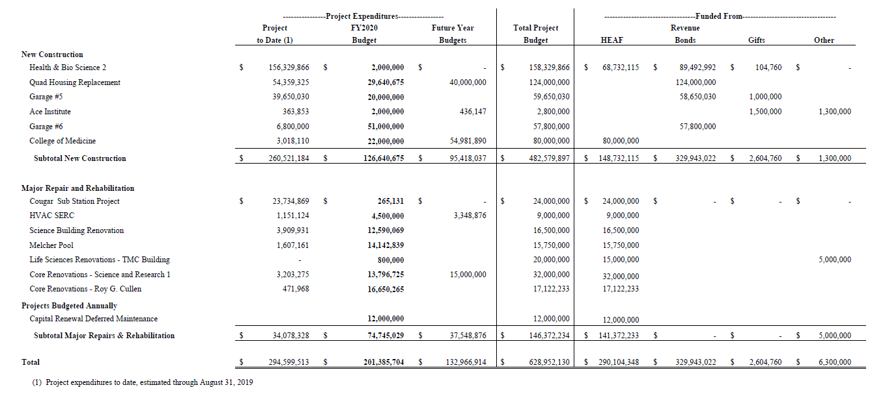
University of Houston
Capital Projects Budget Summary

Slide 25
University of Houston-Clear Lake
FY2020 Annual Budget

Slide 26
University of Houston-Clear Lake
Recent Accomplishments
Ranked 17th place in U.S. News & World Report’s 2019 rankings for Top Public Schools Regional Universities West. Advanced 2 places following an advancement of 11 places the previous year in the overall rankings for Best Regional Universities West to 61st of 659 western colleges and universities. Ranked 15th Safest campus in the United States, the only Texas campus in the top 25.
Assembled the final pieces of President Blake’s leadership team with the additions of: Dr. Aaron Hart, Vice President of Student Affairs; Mr. Joseph Staley, Vice President of University Advancement; Dr. Miguel Gonzalez, Dean, College of Sciences and Engineering; Ms. Evelyn Miralles, Associate VP for Strategic Information Initiatives and Technology; Dr. Gigi Do, Assistant VP for Global Learning and Strategy & Strategic International Programs; and Dr. Vivienne McClendon, Executive Director for the Neumann Library.
Broke historical enrollment records by exceeding 9,000 undergraduate and graduate students at 9,040 in Fall 2018, and the University is set to exceed that high mark for Fall 2019.
Welcomed first academic cohorts to newly approved Bachelor of Science in Mechanical Engineering and a Master of Arts in Teaching. Achieving almost double projected enrollment for Mechanical Engineering at 168 students for Fall 2019.
Opened the new Health Sciences and Classroom Building at UHCL Pearland enabling the University to meet the growing demand for nurses and other critical health care professionals. The Master’s of Arts in I/O Psychology is relocating to Pearland in Fall 2019.
Opening Fall 2019, Hunter Hall will serve UHCL students as the first on-campus residence hall. Hunter Hall will provide UHCL students with a quick commute to class, on-campus dining, multiple nearby study spots, and an enriched on-campus residential experience.
Continued to expand the university’s outreach to the community though addition of a satellite office of the Center for Autism and Developmental Disabilities (CADD) to Pearland; the launch of the Center for Workplace Consulting, providing students with the opportunity to engage in real-world consulting projects; and the continuation of the highly successful Low Carb Houston Conference, with the second annual conference scheduled for October 2019 .

Slide 27
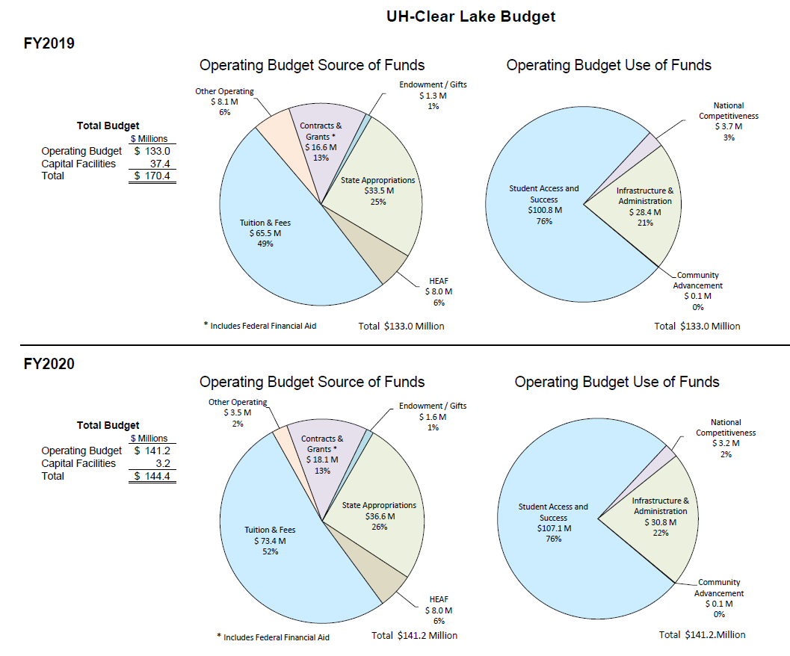

Slide 30
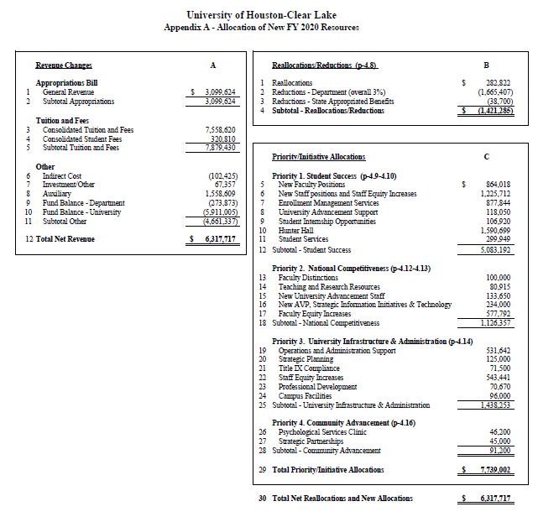

Slide 32
University of Houston-Clear Lake
Capital Projects Budget Summary

Slide 33
University of Houston-Downtown
FY2020 Annual Budget

Slide 34
University of Houston-Downtown
Recent Accomplishments
Grew enrollment by 2.5% over the prior year
Attained in 2019 a record 6-year graduation rate of 27.71%, essentially achieving the institutional goal of 28%-by-2020 one year ahead of schedule
Opened UHD’s $73 million Science and Technology building
Exceeded 2019 fundraising goal by 9%, while exceeding UHD’s ‘Here We Go’ campaign target by 20%
Successfully transitioned student record system to align with other UHS components
Awarded $1 million from Howard Hughes Medical Institute for Inclusive Excellence SynergIE program (one of 57 programs in the country, and 1 of 2 in TX)
Received a $2.75 million Title V grant for developing accelerated transfer pathways for career and academic success
Awarded a second Texas Higher Education Coordinating Board grant to develop a competency based concentration in Restaurant and Food Service Administration to meet 60x 30 TX goals

Slide 38
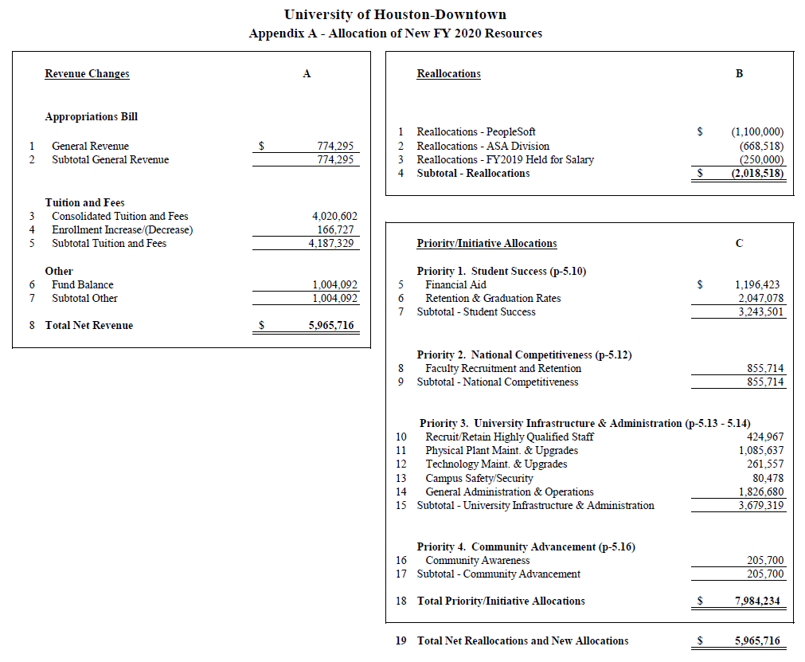

Slide 40
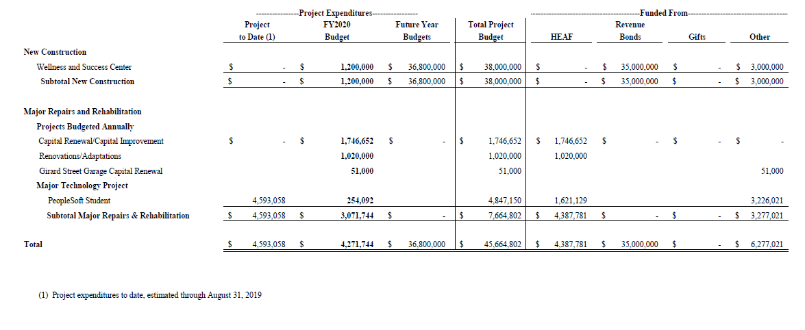
University of Houston-Downtown
Capital Projects Budget Summary

Slide 41
University of Houston-Victoria
FY2020 Annual Budget

Slide 42
University of Houston-Victoria
Recent Accomplishments
  Collaborated with Academic Partnership to improve marketing methods to recruit additional transfers from community colleges and graduate students in selected degrees.
  Submitted the following new programs to UHS for approval: Bachelor of Arts and Bachelor’s of Science in University Studies, Master of Science Degree in Kinesiology with a concentration in Sport Management, Master of Accountancy and Master of Science in Criminal Justice in FY2020.
  The University ranked 34th in a Washington Monthly regional list of “Best Bang for the Buck” Colleges. Two School of Business degree programs, Human Resources Management and International Business, received national recognition based on affordability, academic quality and student success.
  Received $1.5M from the M.G. & Lillie A. Johnson Foundation to enhance health career education offerings for students.
  Sixty-two UHV athletes earned academic honor in the Red River Athletic Conference

Slide 48
University of Houston-Victoria
Capital Projects Budget Summary

Slide 49
University of Houston
System Administration
FY2020 Annual Budget

