Slide 1
FY2019 Annual Budget
May 24, 2018

Slide 2
UH System Accomplishments
Record enrollment of 72,178
Record degrees awarded of 16,197
  43% to minority students
  25% in STEM fields
Record research expenditures of $166 million
Public launch of the $1 billion “Here, We Go” fundraising campaign
Philanthropy of $155 million this past year – more than double what it was in 2009

Slide 3
UH System FY19 Budget Summary
$1.7 billion operating budget – an increase of $47.8 million compared to FY18
FY19 sources of operating revenue, on a percentage basis, relatively constant to FY18
2/3^{rd’s} of the total operating budget supports student success
$7.7 million in reductions/reallocation of resources to fund higher strategic priorities
$365 million capital budget – representing 33 projects

Slide 5
UH System Sources of Funding for the Operating Budget over Time
*includes sponsored research grants and financial aid
**includes other operating income (e.g. auxiliaries)

Slide 7
University of Houston System
FY2019 Proposed Operating Budget
($ in Millions)

Slide 8
University of Houston System
FY2019 Proposed Capital Budget
($ in Millions)

Slide 9
University of Houston System
FY2019 Proposed Operating and Capital Budget
($ in Millions)

Slide 10
University of Houston
FY2019 Annual Budget

Slide 11
University of Houston
Recent Accomplishments
Record student enrollment of 45,364
9,448 total degrees awarded
369 Doctorates awarded
4-year graduation rate of 33% (up from 30%)
6-year graduation rate of 54% (up from 51%)
71% of freshmen participating in UHin4
Several of UH’s programs received national recognition this year(e.g. Graduate School of Social Work, Cyvia & Melvyn Wolff Center for Entrepreneurship, Petroleum Engineering, and UH Libraries).

Slide 13

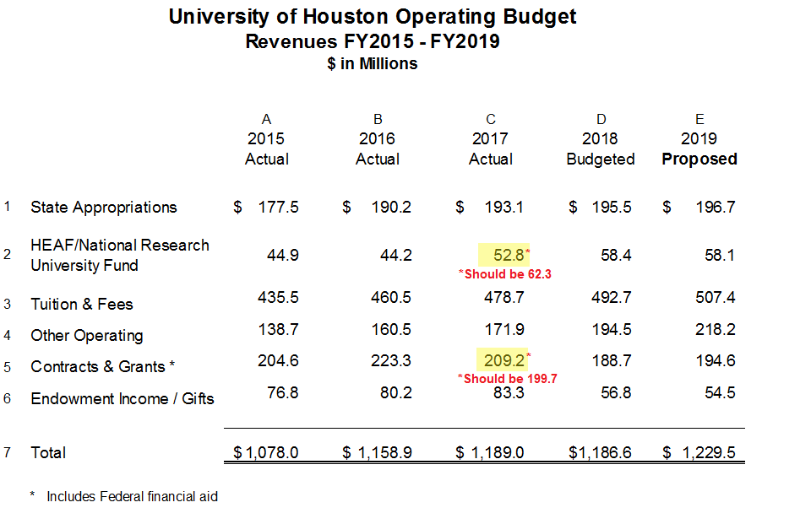

Slide 14
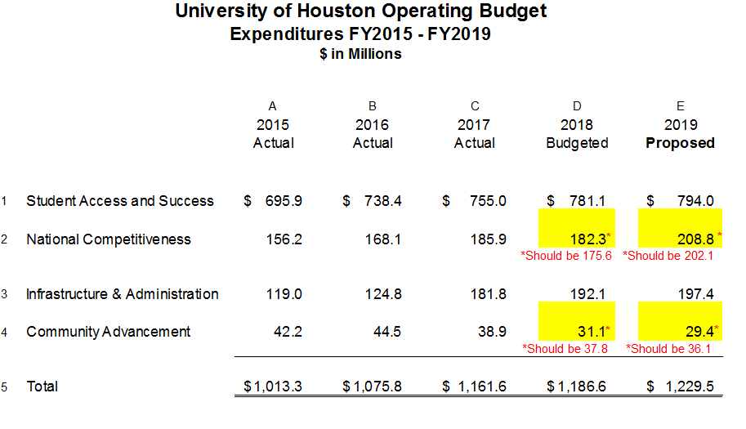

Slide 15
University of Houston
Highlighted Use of New Funds
Additional set aside for need-based scholarships
New faculty positions
Invest in student support services (e.g. counseling and psychological services, veteran’s services, and career counseling) and campus services (e.g. parking)
Continuing to address existing graduate tuition fellowship budget needs
Invest in technology and campus safety and security which supports students, faculty, and staff
Invest in academic renovations & faculty start-ups
Invest in campus infrastructure to support students, faculty, and staff (including the Core Renovation Projects and Life Sciences Projects)

Slide 18
University of Houston
Capital Projects Budget Summary

Slide 19
University of Houston-Clear Lake
FY2019 Annual Budget

Slide 20
University of Houston-Clear Lake
Recent Accomplishments
Tied for 16th place in U.S. News & World Report’s 2018 rankings for Top Public Schools Regional Universities West. Advanced 11 places in the overall rankings Best Regional Universities West, tying for 63rd of 659 western colleges and universities.
Welcomed Her Excellency Hunaina Sultan Ahmed Al Mughairy, the Ambassador from the Sultanate of Oman to the United States at UHCL in April. While at UHCL, she led a discussion titled “Women in International Diplomacy and Global Leadership.” The trip solidified UHCL as the host for “Future Technologies in Science Diplomacy,” an October 2019 conference that will include Her Excellency as well as a number of Omani government ministers.
Received approval to offer a Bachelor of Science in Mechanical Engineering and a Master of Arts in Teaching beginning this fall to answer community needs. As of late April, 58 students had applied to the BS in Mechanical Engineering and 28 had been admitted.
Acquired new healthcare simulation equipment and expanded community healthcare facility partnerships to enhance student learning and success. Decreased required credit hours for BSN from 45 to 30 to support the national initiative of 80 percent of nurses holding a BSN degree.
Continued the successful Clear Lake Association of Senior Programs (CLASP), a project led by UHCL Distinguished Alumna and the first elected female judge of mainland Galveston County Marilyn Lunney. Since 2003, UHCL has hosted the program CLASP and it has welcomed speakers which have included astronauts, authors, artists and a variety of experts in their fields.

Slide 24
University of Houston-Clear Lake
Highlighted Use of New and Reallocated Funds
Acquire new technology through Education Advisory Board (EAB) to support our partnership with the Houston Guided Pathways to Success (GPS) consortium
Expand student support and access to wellness programs, career development, student life activities, and psychiatric services.
Increase new student scholarship funding through the New Hawk and Automatic Transfer Scholarships.
Fund new faculty for the new Mechanical Engineering program and doctorate in Psychology.
Investment in library resources to enhance the quality of academic program offerings and faculty research.
Investment in the Exercise and Rehabilitation Institute, housed in the new Recreation and Wellness Center, to support collaboration and partnerships with healthcare institutions in order to enhance the health and functional performance of the community.
Investment in the Pearland Campus satellite operation for the Center for Autism and Developmental Disabilities that will open Spring 2019 in the new Health Sciences and Classroom building.

Slide 27
University of Houston-Clear Lake
Capital Projects Budget Summary

Slide 28
University of Houston-Downtown
FY2019 Annual Budget

Slide 29
University of Houston-Downtown
Recent Accomplishments
Attained an all-time high graduation rate of 20.76%
Increased FTIC retention rate to a record high 72.26%
Awarded 3,177 degrees (increase 19.25% over previous year)
Approximately $600,000 was raised through the UHD Harvey Relief Fund.
UHD received the Texas Higher Education Coordinating Board’s STAR award for its course redesign program and its impact on improving student success.
The Texas Higher Education Coordinating Board awarded UHD and HCC a $250,000 grant for the Texas Affordable Baccalaureate degree.

Slide 33
University of Houston-Downtown
Highlighted Use of New and Reallocated Funds
Invest in increasing transfer enrollment by developing degree maps, hiring new embedded advisors and increasing transfer scholarships.
Improve FTIC retention and graduation rate by supporting peer mentors, increasing FTIC Scholarships and investing in predictive analytics.
Provide new financial incentives to the colleges to increase undergraduate enrollment.
Pioneering a 2² model with the HCC’s Coleman College of Health Sciences to offer Bachelor of Science in Nursing (BSN).
Hire five tenure track faculty in high demand programs.
Continued investment in a new Student Information System.
Hire full time Title IX Coordinator.
Invest in the campus infrastructure including the physical plant and technology.

Slide 36
University of Houston-Downtown
Capital Projects Budget Summary

Slide 37
University of Houston-Victoria
FY2019 Annual Budget

Slide 38
University of Houston-Victoria
Recent Accomplishments
  Joined the Houston GPS (Guided Pathway to Success), a regional collaboration of two- and four-year educational institutions, to provide seamless pathways for students transferring from area community colleges to universities
  Awarded the first specialist degree in School of Psychology
  Accreditation visits in Nursing and Counseling
  First UHV Team Men’s Soccer to advance to National playoffs
  Awarded “Conference Champions of Character” in Men’s Soccer
  Implemented business plan for UHV Katy
  Received a $645,677 National Science Foundation five-year grant to increase enrollment, retention and graduation of low-income mathematics and computer science majors through annual scholarships and other programs
  Launched the UHV “Here, We Go” campaign with a $839,775 lead gift from the M.G. and Lillie A. Johnson Foundation

Slide 42
University of Houston-Victoria
Highlighted Use of New and Reallocated Funds
  Additional financial aid for students
  Hire new faculty to support fast-growing programs
  Continued focus on being a destination university by investing in new residential campus infrastructure, expanding academic programs, and building new academic facilities
  Expand student recruitment and retention efforts
  Additional support for UHV Katy operations
Equitable and competitive compensation for faculty for promoted full-time, tenure-track faculty and staff compensation

Slide 45
University of Houston-Victoria
Capital Projects Budget Summary

Slide 46
University of Houston
System Administration
FY2019 Annual Budget

