Slide 1
Amazon Business Buyer Training for University of Houston
System
Erica Heffernan
3/17/2021

Slide 2
Table of Contents
Organization’s Goals
Joining the Amazon Business Account
Shopping on Amazon Business
Business Account Navigation
Account Configuration
  Checkout
Amazon Business Analytics
Your Orders
Business Customer Support

Slide 3
Join the Amazon Business Account

Slide 4
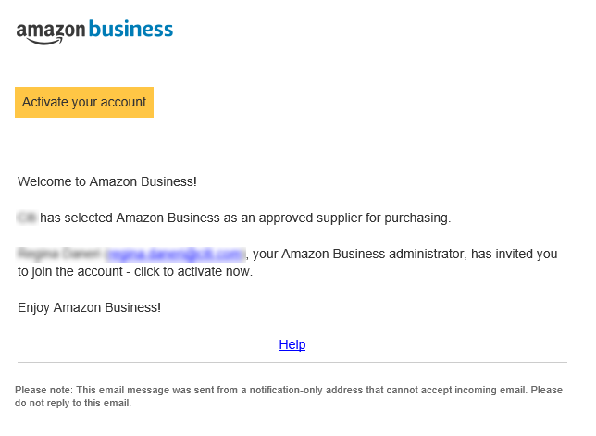
Inviting Users to Amazon Business
How do Invitations Work?
When your Administrator adds you to the business account, an invitation to join is immediately emailed.
Invitations are tied to your business email address. You cannot change the email address used to invite you to the account.
You must take action after being invited to an account in order to become an active user.
Account invitations are valid for 90 days from send date. After 90 days, they will expire and need to be resent

Slide 5
Accessing the Account through Single Sign On and Direct access
How do you sign in?
To access the centralized account, use the link provided to access Amazon Business. This will automatically log you into the appropriate account.
Depending on how you have used your work email on Amazon in the past, you may need to take action to separate or migrate an existing account.
  For those who have not used their work email in the past, they will be immediately authenticated into the central account.
  For those who do need to take action to separate out their existing account, this is a one time process. They will be authenticated automatically each subsequent time.
UH: Single Sign On Link
UHV: Direct Access at Amazon.com
UHCL: Direct Access at Amazon.com

Slide 6
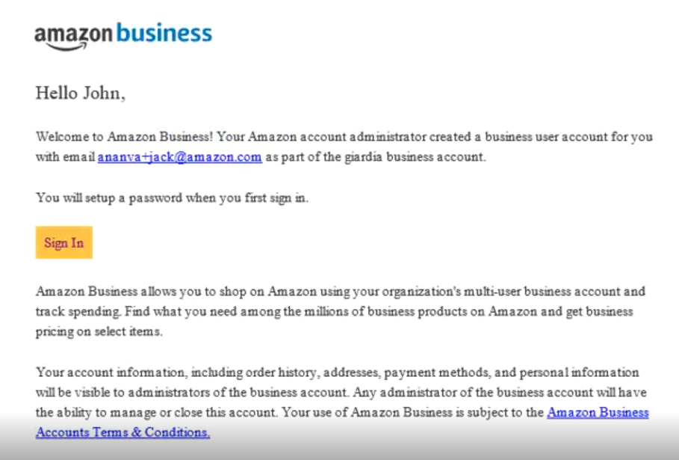
New to Amazon with AAC
Your Amazon business Account has already been created on your behalf.
Use the “Welcome to Amazon” email in your inbox to set up your password the first time you sign in.
The ability to reset your password will not expire. If you cannot find the welcome email, try signing in with your work email and use the “forgot password” link
work@email.com

Slide 7
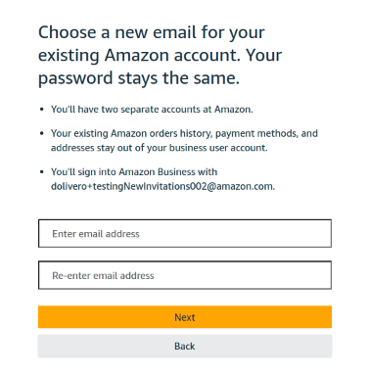
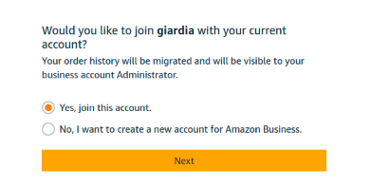
Existing Account with Work Email

Slide 8
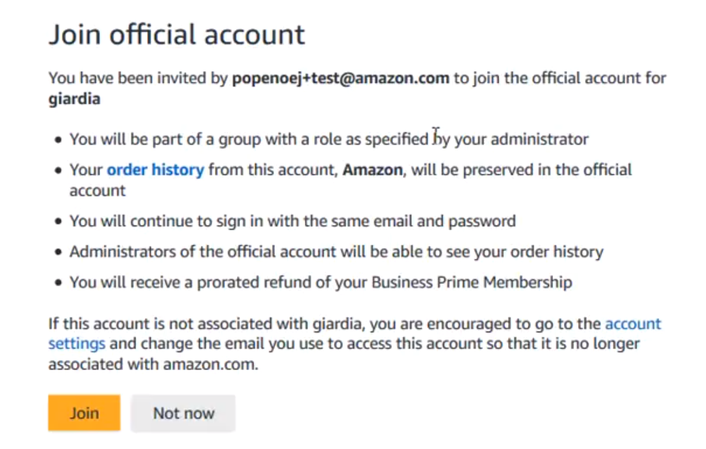
Existing Business Account with Work Email
When user clicks on "Get Started", he/she is taken to a page to download order history and start the process of moving.
With one-click, the account is automatically de-registered and user is automatically added to the official account
Same user credentials work, no password reset needed!
admin@workemail.com

Slide 9
Shopping on Amazon Business

Slide 10
The Power of the Amazon Marketplace
1
2
3
Choice
Competition
Transparency
Breadth and depth of selection
Multiple offers from Sellers
Visibility to Buy-side and Sell-side
Access to hundreds of millions of products and services
Including Amazon Retail
Product and seller reviews, ratings and pricing

Slide 11
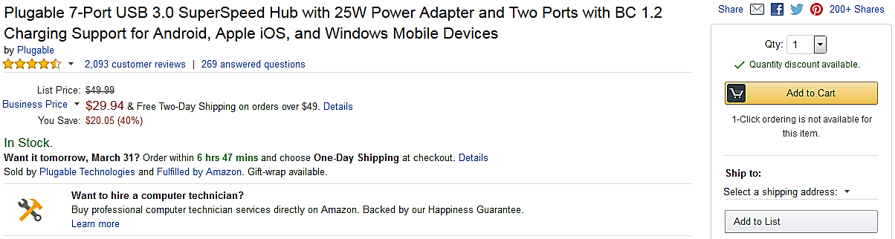



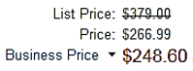
Amazon Business Benefits
Business Pricing & Quantity Discounts
Business pricing and quantity discounts are only available to registered business account customers on Amazon. Click to learn more.
Business Prime Shipping
Once Business Prime Shipping has been purchased, it provides Free Two-Day Shipping on eligible items for all users in the business account. There are multiple pricing tiers to meet the needs of businesses of all sizes. Click to learn more.
Buying Policies
Customize Amazon Business to your organization’s buying standards and procedures. Features include approval workflows, negotiated pricing, and preferred suppliers and preferred products.
Business-Only Selection
Business-only selection refers to items and offers that are only available for purchase by Amazon Business customers.
Amazon Business Analytics
Use Amazon Business Analytics to view data about your orders, create and filter reports based on your business needs, and view both charts and tables. Click to learn more.

Slide 12
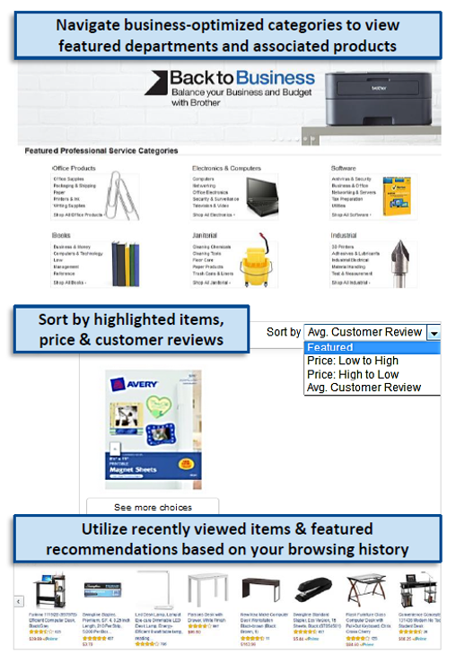
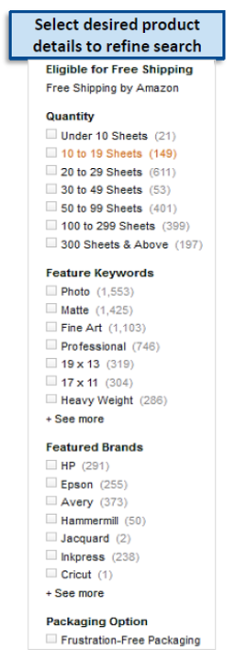
Search & Browse Optimization
Optimizing search functions in Amazon Business allows you to find the best products to meet your needs and compare prices to find the best value
Amazon is the “everything store.” With such a large selection, we do our best to make it easy for you and your end users to find what you’re looking for.
Recommended filters:
  Business Sellers
  Prime Eligible
  Brand
  Average Customer Review/Rating
  Diversity Credentials

Slide 13
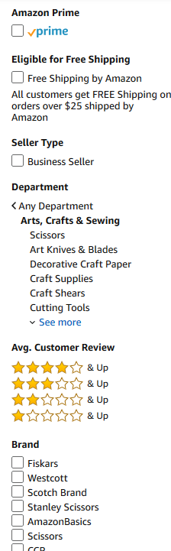
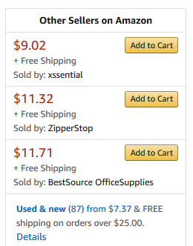

Search Optimization
Optimizing search functions in Amazon Business allows you to find the best products to meet your needs and compare prices to find the best value
Maximize Savings! Search All Departments & try using generic descriptors instead of brand names
Consider refining search results with filters available of left side of your screen, such as Prime or Business Seller
Sort results by options listed on the top left of your screen, such as Price: Low to High
In many cases, you can also Select Quantity Discounts to review quantity discounts and purchasing options
To compare offers, scroll down & select Used & new to pull up the Offer Listing page

Slide 14

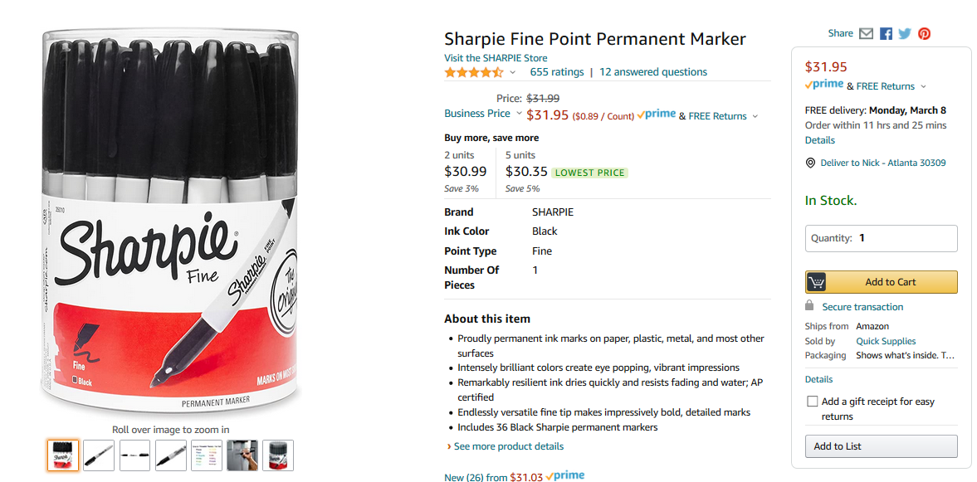

Take Advantage of Amazon Prime Shipping Benefits
An easy way to ensure that your products arrive on time and as expected, is to order products fulfilled directly from Amazon. All products clearly mark who the seller is on the product detail page.
Prime Eligibility – Fulfilled by Amazon
Prime eligible items are fulfilled by Amazon. We recommend searching for prime eligible items.
What’s not Included?
Business Prime Shipping does not include additional Prime benefits such as Amazon Fresh, Pantry, Video, or Music.

Slide 15
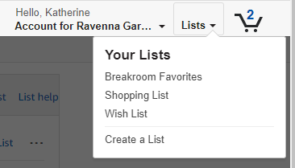
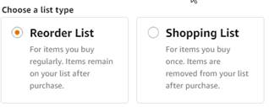
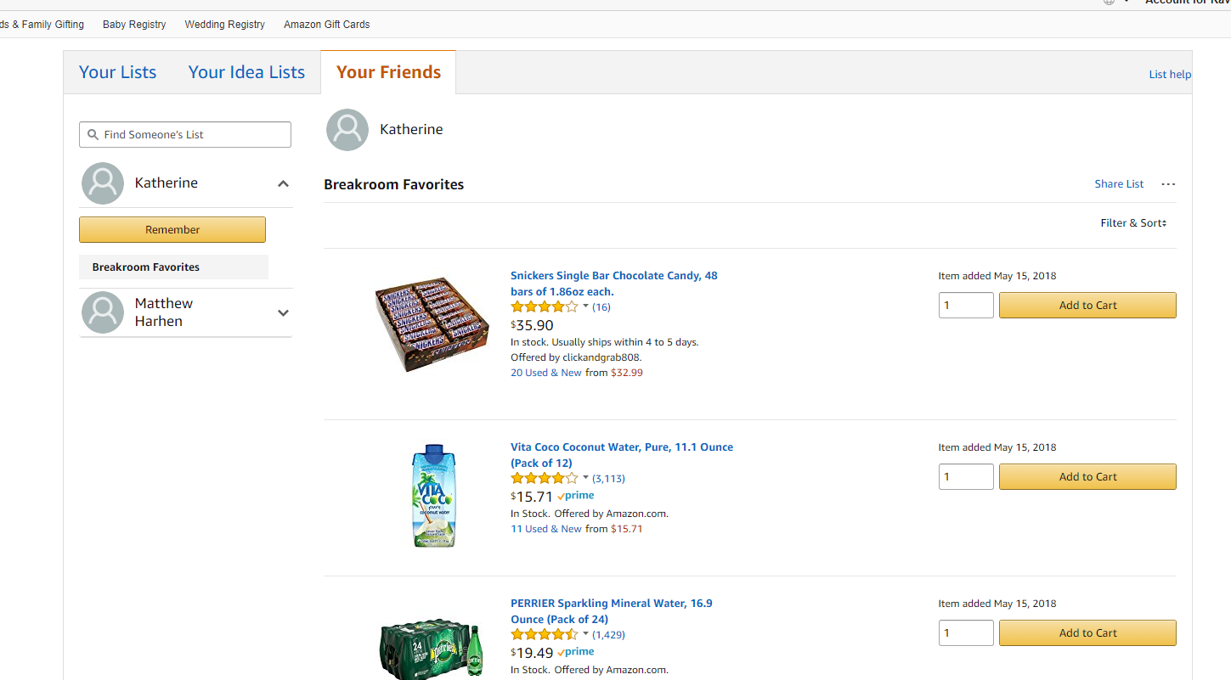
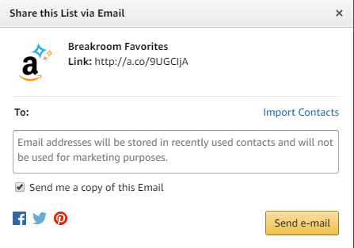
Reorder & Shopping Lists
How do lists work on Amazon Business?
Lists make it easy to keep track of the things you need and are easy to share with others. Any User on Amazon Business can create a shopping list
Choose between multiple list types depending on if you want the items to remain on a list after they are ordered
To share your list, create a public list and use the URL to email it directly to your desired audience
When a list is shared with you, you can save it to your own account or make a copy to edit yourself

Slide 16
Business Account Navigation

Slide 17
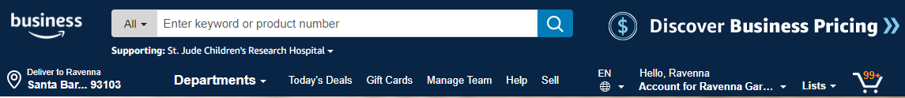
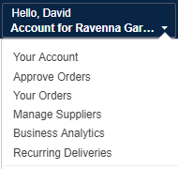
Business Account Navigation
Page | Functionality
Your Account | Standard Amazon account information
Approve Orders | If workflow approvals are enabled, approvers can view and take action on pending orders
Your Orders | View and track your orders. Administrations can view orders others have placed on behalf of the organization
Manage Suppliers | Easily find suppliers on Amazon Business and add them to your list of Saved Suppliers. Learn more.
Business Analytics | Create and filter custom reports based on your business needs to view your organization’s orders
Recurring Deliveries | Have essential items delivered automatically, based on a schedule you choose. Learn More.

Slide 18
Account Configuration

Slide 19
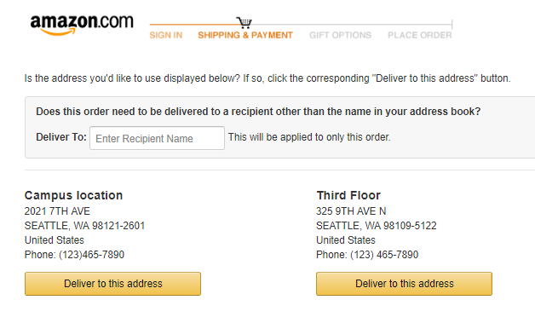
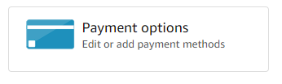
Checkout – addresses and payment method
When checking out on Amazon Business, be sure to enter the appropriate payment and select the shipping address. Payment method can be entered in Your Account or during the checkout process
Purchase cards are the recommended form of payment for the Amazon Business account.
The Amazon Business account is intended for business purchases only. No purchases should be made on a personal credit card.
If you have access and permission to use multiple different cards, multiple cards can be stored in your account information.
Payment instruments are visible to your account administrator and can be audited.
Shipping Address
When selecting shipping address, you can either use the default address name provided or choose to add the name of a specific recipient. This will replace the first line of the address.
If you don’t see the shipping address you are looking for, contact your account or group administrator.

Slide 20



Amazon Business Discounts
There are a variety of discounts available on Amazon Business that your organization can take advantage of to unlock savings.
Business Pricing
Business pricing is cheaper pricing available only for registered Amazon Business customers. No action is needed to turn on business pricing and is available on select items.
Quantity Discounts
Quantity Discounts are volume-tiered discounts, only available for registered Amazon Business customers. Quantity discounts appear on the product detail page and users can review the tiered discounts available.
Subscribe & Save
Subscribe & Save is part of the Amazon Recurring Delivery program. Customers can subscribe to eligible Subscribe & Save items and get a 5% discount for their new subscriptions.

Slide 21
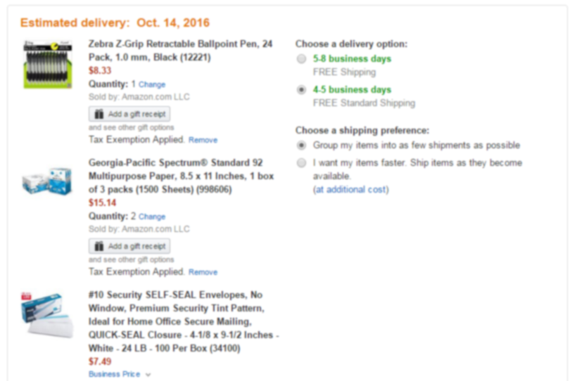
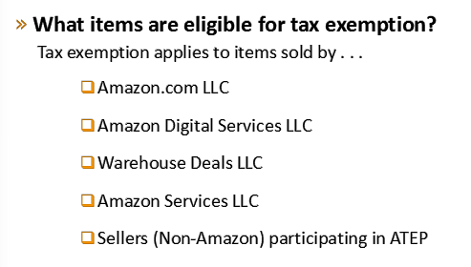
Checking out with Tax Exemptions
All products purchased from Amazon or any of the 95% of third party sellers who participate in ATEP will automatically reflect that tax exemptions have been applied during the checkout process
Confirm tax exemptions are applied:
On the Review Your Order page (checkout), verify and/or modify which items should be charged sales tax.
If needed, you can manually add tax by clicking Remove next to the specific item

Slide 22
Business Analytics

Slide 23
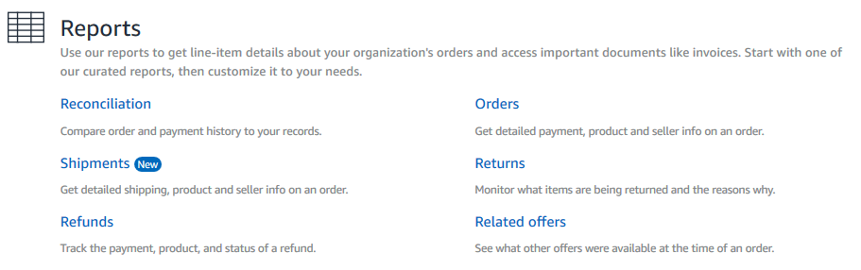
Amazon Business Analytics
Amazon Business Analytics provides the ability to:
Aggregate purchases to compare and track spend over time
Monitor and track 60+ data fields including customer info, shipment info, payment info, and seller info
Customize and save report templates to meet business needs
Download CSV files to analyze your data in excel

Slide 24
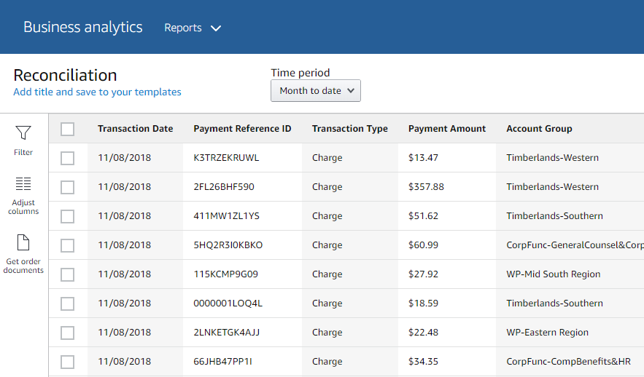
Reporting & Reconciliation
Use the Reconciliation Report to view data including transaction info, customer info, and order info.
Simplify the reconciliation process by matching corporate credit card charges to each item in a shipment.
Match the Payment Reference ID in the Reconciliation Report against your credit card statement
Customize report columns and filters at the left to find required information

Slide 25
Your Orders

Slide 26
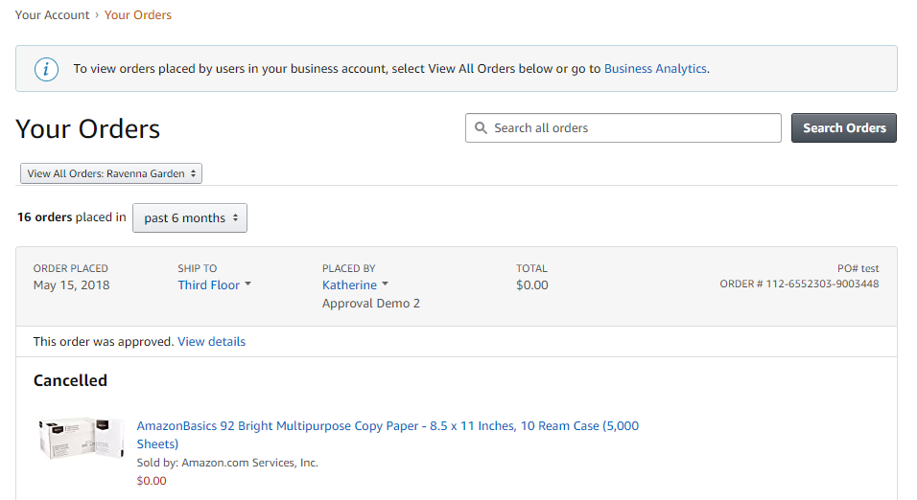
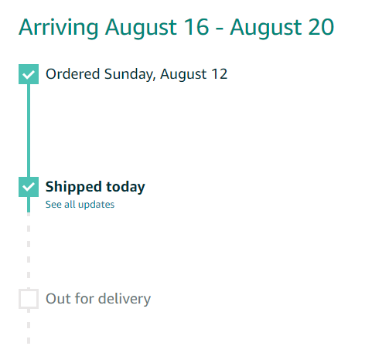
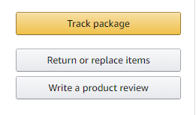
Your Orders
This section of the account provides additional detail regarding the status of all orders you have placed within the Business Account.
Take a variety of actions on your orders such as initiating returns or tracking the delivery of a package.

Slide 27


Return an Item
Navigate to Your Orders from the dropdown
Use Contact Us or our Chat feature for assistance with Returns

Slide 28
Business Customer Support

Slide 29
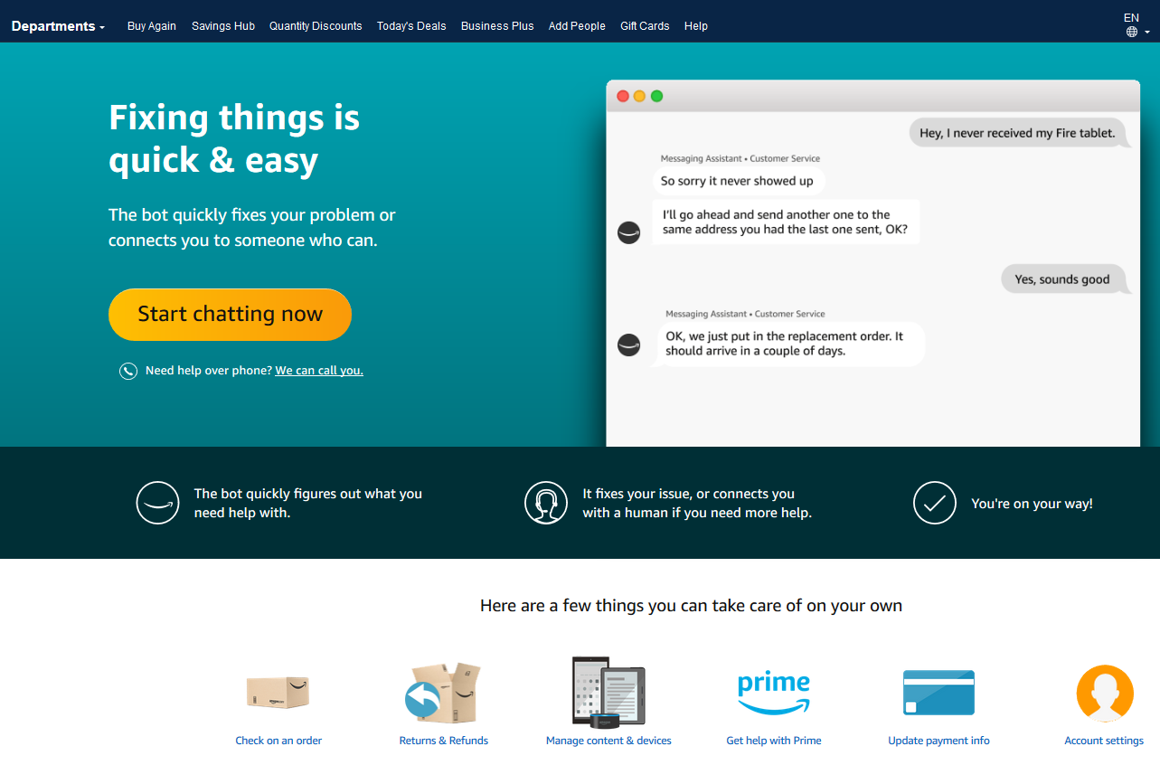
Business Customer Support
Dedicated U.S. based Business Customer Support can be reached a number of ways including email, chat and phone. Not sure what you’re looking for? Learn more about the features and benefits on Amazon Business HERE.

Slide 30
Common Customer Support Questions
See below for quick resolutions to frequently asked questions from your end users as well as contact information for a variety of support resources
Contact Business Customer Support: CLICK HERE
  Provides end users the option to call, email, or live chat. Please use this method of contact for anything relating to an order, transaction, charge, or shipment
Cancel an Individual Prime Membership:
  Your Account > Manage My Prime Membership > End Membership
  The end user must follow the steps to receive a pro-rated refund
Request a Tax Exemption Refund:
  Your Orders > Locate Order > Contact Seller > Request refund through email
  Additional tax queries can be emailed to tax-exempt@amazon.com
Your Customer Advisor – Johnny Przybyszewski– johnnypz@amazon.com
This person is your point of contact for anything related to the Amazon Business account structure, new features and functionality, and questions that do not fall into the above categories

Slide 31


