Slide 1
Classroom Dynamics
Peer Facilitator Workshop
Donna L. Pattison, PhD
Instructional Professor
Department of Biology & Biochemistry

Slide 2
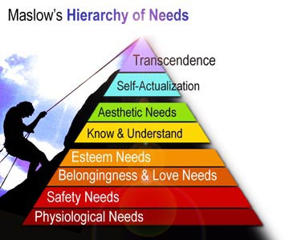
http://miraclemind.com/investors/newsletter/?a=2008_5_5; retrieved 10/15/2012

Slide 3
What impact does unmet physiological needs have on learning?
What impact does abusive home or relationship situations have on learning?
As a peer facilitator, will you know if these are issues for your student? What campus resources are available for you to direct your students to if you become aware of a student’s needs?
http://miraclemind.com/investors/newsletter/?a=2008_5_5; retrieved 10/15/2012

Slide 4
What are the characteristics of a “self-actualized” individual?
What is the role of the university in helping students become “self-actualized” individuals?

Slide 5
The Cycle of Growth
Create a cycle depicting the impact on a positive school experience on an individual’s perception of self and subsequent goal setting and achievement.
Create a cycle depicting the impact of a negative school experience on an individual’s perception of self and subsequent goal setting and achievement.
Use sticky notes for the blocks. You may use as many blocks in the cycle as you need.
Compare the cycles from different blocks to create one graphic for the class of both positive and negative feedback cycles.
Hamachek, Don. (1990) Psychology in Teaching, Learning, and Growth. (4th edition) Allyn and Bacon: Boston, p. 65

Slide 6
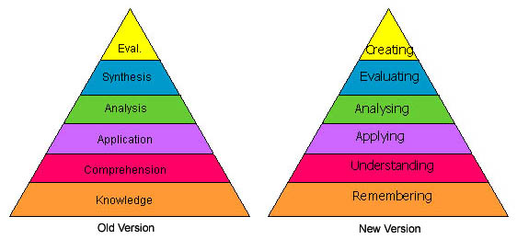
Bloom’s Taxonomy of Cognitive Development
http://projects.coe.uga.edu/epltt/images/1/1e/Bloom_1.jpg; retrieved 10/16/2012

Slide 7
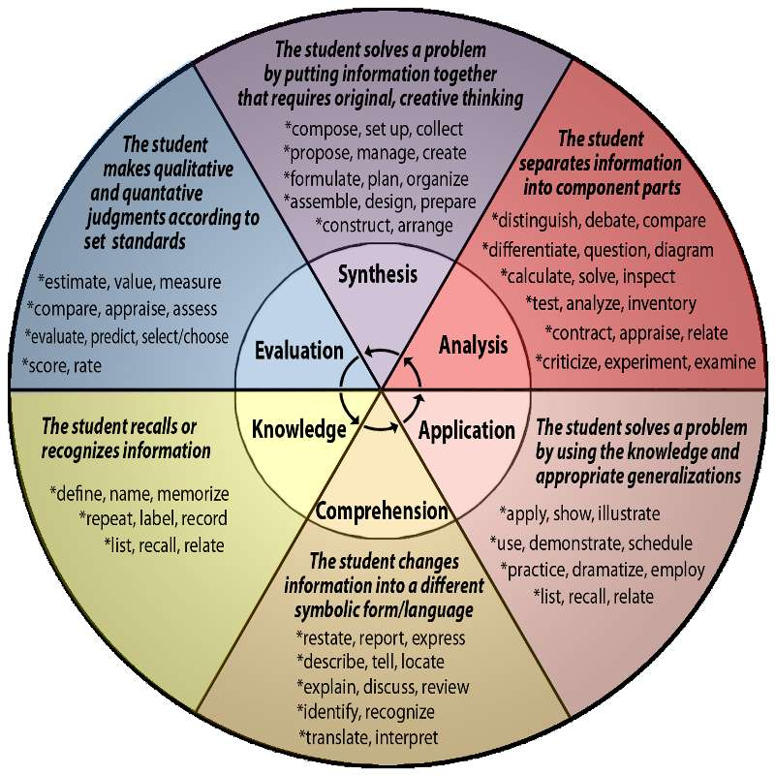
http://www.redwoods.edu/Departments/Distance/Tutorials/BloomsTaxonomy/Blooms-Taxonomy.jpg; retrieved 10/16/2012

Slide 8
Activity
1) Classify each question on the worksheet (in the folder on the website) by what level of Bloom’s Taxonomy they represent.
Which types of questions are easiest to write as the instructor?
Which questions are easiest for students to answer and study for?
Which questions are students likely to struggle with and why?
How will you help your students recognize what types of questions they are struggling with and adapt their strategies accordingly?

