Slide 1
Ice Breaker Activities

Slide 2
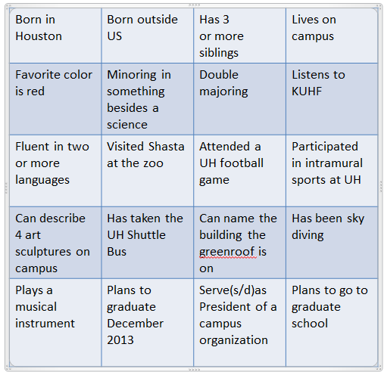
Get to Know Your Fellow Facilitators!
Whoever gets the most squares signed off, wins.
No one can sign more than two boxes for you.

