Slide 1
How Do We Learn and Remember?
Peer Facilitator Workshop
Donna L. Pattison

Slide 2
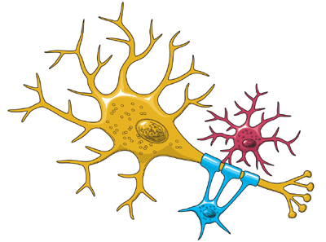
Learning causes brain cells….
Dentrites grow as neurons are repeatedly activated.
High levels of neurotrophins in actived brain areas. Levels highest in childhood.
https://www.ninds.nih.gov/Disorders/Patient-Caregiver-Education/Life-and-Death-Neuron, retrieved 10/26/2017

Slide 3
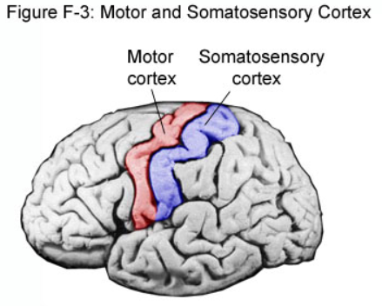
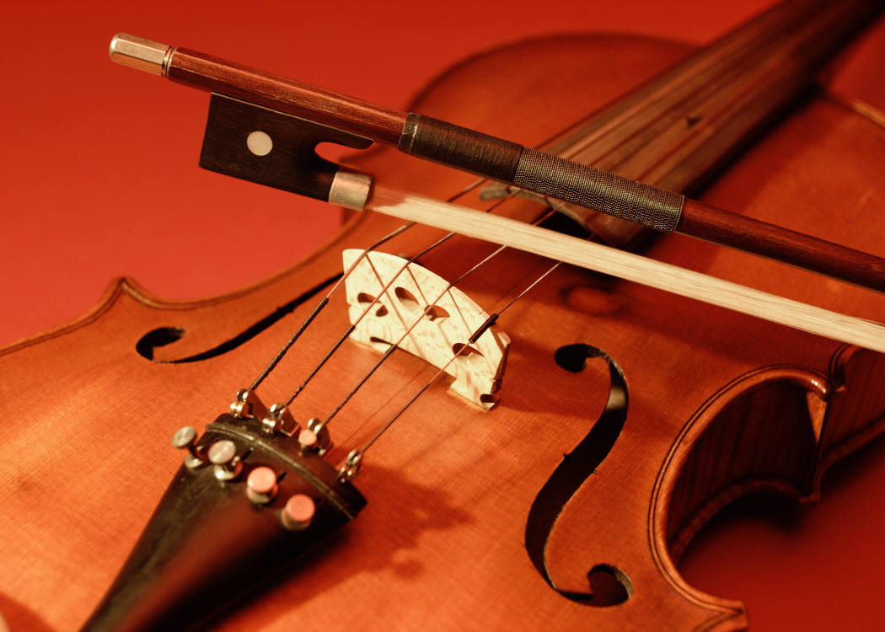
The Brain is Plastic!
http://www.google.com/imgres?imgurl=&imgrefurl=http%3A%2F%2Fmva.me%2Feducational%2Fbrain_areas.html&h=0&w=0&sz=1&tbnid=8ycD_26Kxm9ZPM&tbnh=196&tbnw=257&zoom=1&docid=BLB1yIjmhM58UM&ei=axMNUtrkFaG4yQHwj4DQCQ&ved=0CAIQsCU
Notes:
Violinists have expanded somatosensory cortex regions compared to non-musicians due to the left hand string repetition. Practice and repetition yield physical changes in the brain.

Slide 4
Use it or lose it…..
Bonjour! Je m’apelle….
Visual Cortical growth….and then…..
Nature, 2004
Pruning
Notes:
If you don’t continuously practice juggling, your juggling skills decline. If you don’t use a second language you’ve learned, you forget parts of it over time.

Slide 5
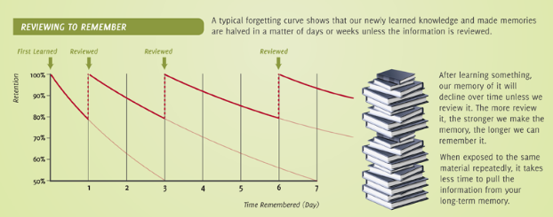

Without repetition and rehearsal, we forget!
http://thinkedu.net/blog/wp-content/uploads/2015/12/Memory-Retention-and-the-Forgetting-Curve-Infographic.png; retrieved 10/26/2017)

Slide 6
Enhancing Long-Term Recall
Space out practice time. Cramming doesn’t work.
Cumulative tests or exams (repetition and improved connections between early material in a course and later material).
Reflection (Increases the number of connections students make between new learning and prior knowledge. Creates an additional memory path). Ask how they can use the knowledge to solve other problems or apply the knowledge. Strengthens memory and deepens understanding.
Explain in your own words. Personal language is the most familiar pattern to students.
Visual information.

Slide 7
What are ways to generate repetition and elaboration?
https://www.ninds.nih.gov/Disorders/Patient-Caregiver-Education/Life-and-Death-Neuron, retrieved 10/26/2017

Slide 8
What are ways to generate repetition and elaboration?
Flashcards
Outlining
Concept Maps
Answering questions at the back of chapters or within chapters.
Explaining a concept to someone else.
Reviewing notes and study tools.
Practice tests.
Videos on the topic.
Can you think of any other methods to recommend to your students?

Slide 9

You have 1 minute to memorize the next slide…..

Slide 10
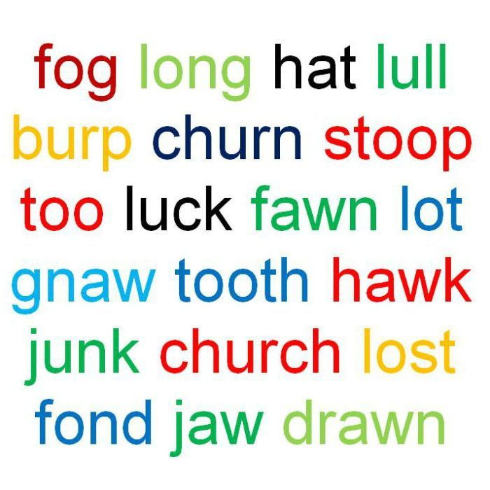
http://www.abc.net.au/radionational/programs/scienceshow/testing-the-effect-of-colour-on-the-ability-to-memorise/4545604

Slide 11

Now write down all the words you can remember.

Slide 12
Use some metacognition here. How did you think about this task?
How many words did you remember?
2. What “tricks” or mneumonic devices did you use to help
remember the words?
Color
Make sentences out of the words
Make sentences out of the first letter of words
Turn the words into a story
Others?
What can you take from this exercise to teach your students how to master course material?

Slide 13
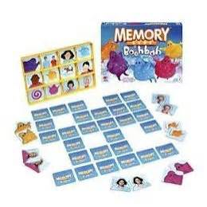
Remember this childhood game? Think about how you think to win. What do you do?
http://di1-2.shoppingshadow.com/images/pi/52/05/9a/96728429-260x260-0-0_Hasbro+Boohbah+Memory+Game.jpg
Notes:
Spatial relations and patterns.

Slide 14
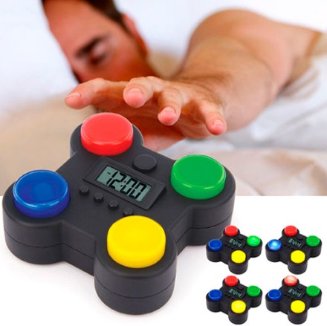
How about this game? Think about how you think to win. What must you do?
http://www.infmetry.com/wp-content/uploads/2010/07/Memory-Game-Alarm-Clock-cool-gifts.jpg
Notes:
Sound, light, and patterns

Slide 15
You have 30 seconds to memorize this……
DOENSFTHECBNIHNASANSFNOAA

Slide 16
Write down what you remember……

Slide 17
DOE NSF THECB NIH NASA NSF NOAA
How many letters did you remember?
2. What “tricks” or mneumonic devices did you use to help
remember the words?
Recognized a few of the acronyms
Make sentences out of the first letter of words
Turn the letters into a story
Chunking into 3 or 4 letter clusters
Other methods?
What can you take from this exercise to teach your students how to master course material?

Slide 18
You have 30 seconds to memorize this……
MDFLOHHIMNNHVAPALATXCOCANCDENJTN

Slide 19
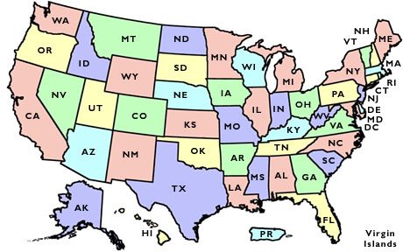
MD FL OH HI MN NH VA PA LA TX CO CA NC DE NJ TN
We recognize the patterns easily when we understand the meaning.

Slide 20
You have 10 seconds to memorize this……
417625278

Slide 21

417-62-5278
Three pieces of information instead of 9

Slide 22
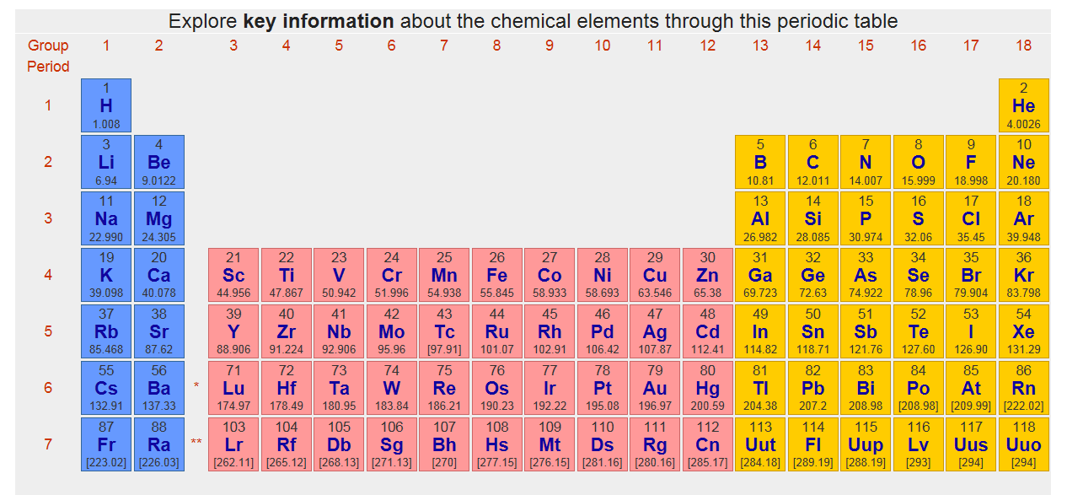
Patterns: If you understand the organization, it makes sense! A few things to remember rather than 118….

Slide 23
Other Useful Patterns in Mastering Material
Similarity and Difference
Compare and Contrast
Cause and Effect
Hierarchy
Alphabetical Order
Chronological

