Slide 1
Classroom Dynamics
Peer Facilitator Workshop
Donna L. Pattison, PhD
Instructional Professor
Department of Biology & Biochemistry

Slide 2
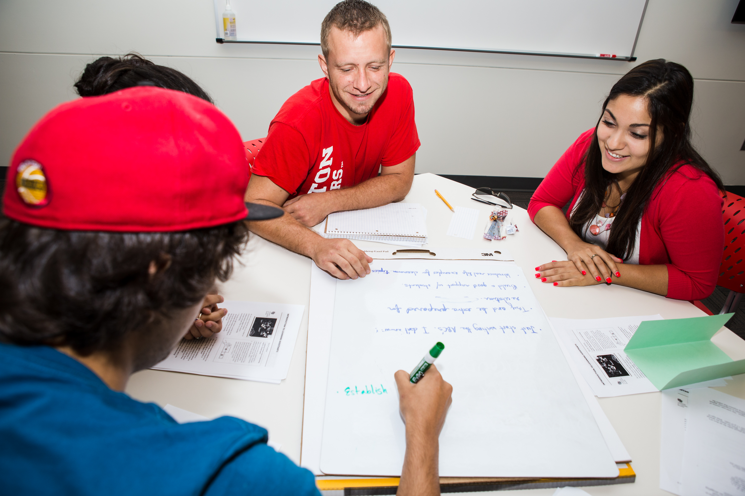
In groups of 4 on the dry erase board:
Create two lists (draw from experience…examples are great):
What are the characteristics of a poor classroom environment?
What are the characteristics of a healthy classroom environment? What are the behaviors of the instructor?

Slide 3

Creating a Positive Classroom Environment
Expectations
Leadership
Respect and friendship patterns
Norms: shared expectations for behavior
Communication
Cohesiveness
Arends, R. (1991) Learning to Teach. McGraw-Hill: Chapter 4, p. 100.

Slide 4
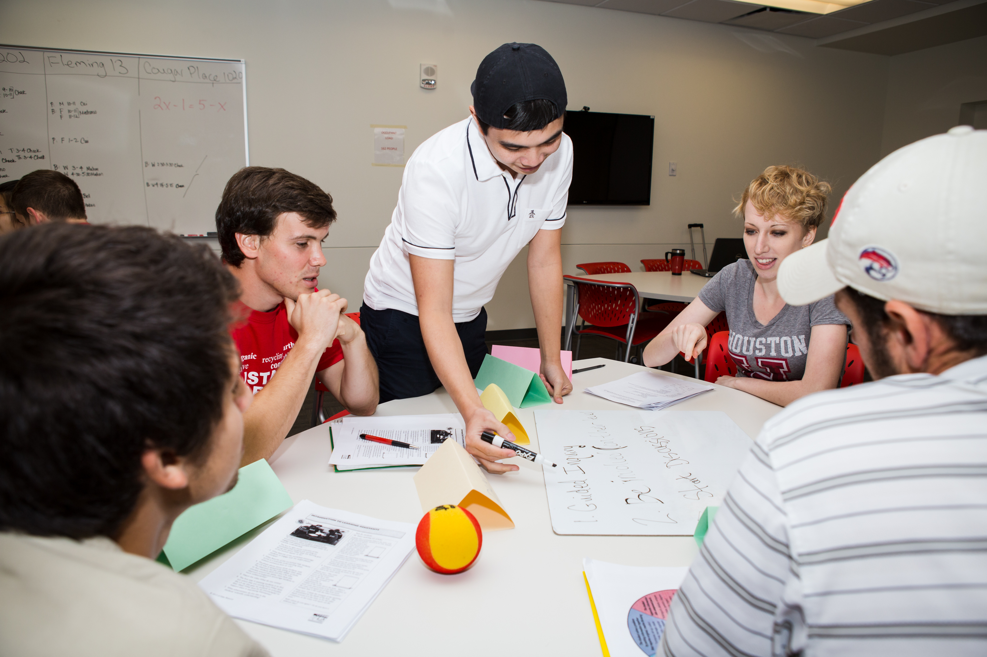
You and Me Against the Material
Form a rapport with the students that clearly communicates that we’re on the same side.
Coach not judgmental rater or just another source of knowledge.
  Show how
  Perk interest
  Involve students
  Connect subjects to student backgrounds and experiences.
Haberman, M. (1995) Star Teachers of Children in Poverty. Kappa Delta Pi;
Chapter 3, p. 85-86.

Slide 5

Practices of Star Teachers
Use students’ interests. Generate interest.
Listen, hear, remember, and use students’ ideas.
Model cooperation with all other instructors.
Respect students’ expression of ideas.
Demonstrate empathy for students’ expressions of feelings.
Identify students in distress and refer them to the appropriate resources.
Be a source of constant encouragement by finding good parts of all students’ work.
Defuse, sidestep, redirect all challenges to your authority.
Use cooperative learning frequently.
Haberman, M. (1995) Star Teachers of Children in Poverty.
Kappa Delta Pi; Chapter 3, p. 90.

Slide 6
Conflict Resolution in the Classroom
Give examples of conflict that might occur in discussion sections.

Slide 7
Encouraging Constructive
Conflict Resolution
Define the conflict as small.
Resolve the problem as soon as possible.
Focus on the problem, not the person.
Reduce the conflict to several smaller problems and resolve them.
Emphasize similarities and common goals.
Acknowledge that a conflict exists.
Use a neutral third party to help resolve the conflict.
Trowbridge, L. and Bybee, R. (1990) Becoming a Secondary School Science Teacher. Merrill Publishing Co.: Chapter 21, p. 374.

Slide 8
Techniques to Influence Behavior
Nonverbal signals: staring, clearing your throat, shaking your head, stopping discussion and waiting.
Proximity control.
Use humor to let the student know enough is enough. Avoid sarcasm and personal remarks.
Ask the student a simple, direct question to bring them into the discussion.
Be prepared for class.
Use a variety of instructional methods.
Show a personal interest in students.
Trowbridge, L. and Bybee, R. (1990) Becoming a Secondary School Science Teacher. Merrill Publishing Co.: Chapter 21, p. 375.

Slide 9
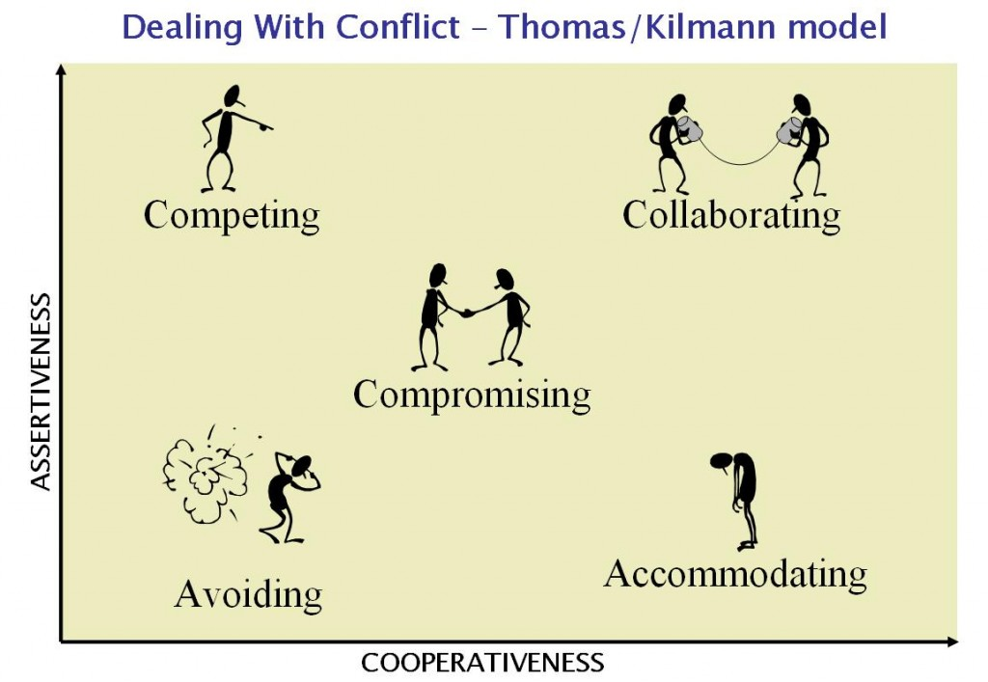
Conflict Resolution: What’s Your Natural Approach
http://www.earthpm.com/2010/03/conflict-management-climate-change-style/; retrieved 7/20/2015
Video link: http://www.kilmanndiagnostics.com/videos-thomas-kilmann-conflict-mode-instrument-tki

Slide 10
Conflict Resolution:
Some Examples
https://www.youtube.com/watch?v=ZaF5478dczs&index=2&list=PLAA05033D768032E6

