Slide 1

Understanding Our Students: Considerations and Best Practices for Developing an Inclusive Teaching Environment
Dr. Donna Pattison
Department of Biology & Biochemistry
dpattison@uh.edu
Dr. Martha Dunkelberger
Department of Communication Sciences and Disorders
mdunkelb@Central.uh.edu

Slide 2
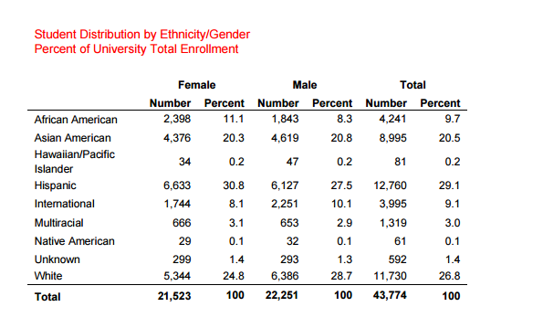
Who we are:
Second most ethnically diverse major research university in the US (US News & World Report)
Students represent 137 countries
Designated as a Hispanic Serving and an Asian-American Serving Institution (U.S. Department of Education)

Slide 3
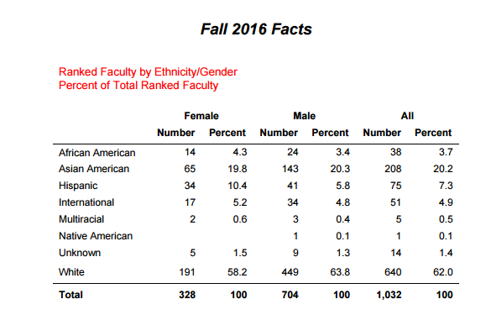

Slide 4
What does “diversity” mean to you? Give examples.
What challenges do you feel our students face relative to our discussion on diversity?
Notes:
Use whiteboards. Paired (or groups of 3) discussions and then share out.

Slide 5
Characteristics to Consider
Gender
Ethnicity
Religion
Country of origin
Sexual orientation
Socioeconomic status
First generation college
Allen, D. and Tanner, K. (2007) Transformations: Approaches to College Science Teaching. Chapter 14 Cultural Competence in the College Biology Classroom.

Slide 6
Understanding Poverty and Helping Students Navigate
Situational versus Generational Poverty
Resources:
Financial
Emotional
Academic (Reading, writing, computational, resource access)
Health
Support Systems
Knowledge of Middle Class and Academic “Rules”
Role Models
What can we do to help students “survive” in the college environment?
Notes:
Financial: Poverty: People are all you have. They always come first. Any temporary wealth is expected to be spent immediately or shared.
Support Systems: Kid is sick and you have to work; who helps you navigate the system; what happens when the car breaks down?

Slide 7
Explicit vs Implicit Bias
What’s the difference between the two?
Give an example of implicit bias.
Notes:
Explicit bias is obvious. Implicit is unconscious. Examples: Asian students are always smart.

Slide 8

The unintentional messages we send:
https://www.youtube.com/watch?v=XP3cyRRAfX0&feature=kp; retrieved 7/6/2014
Jot down the instances of unintentional messages.

Slide 9
Microaggressions
What is a microaggression? Give an example.
Comments or actions that are subtly and often unintentionally hostile or demeaning to a member of a minority or marginalized group.
How do you handle microaggressions?
Notes:
Use notecards.

Slide 10
Analyze the excerpt below:
When I asked my last professor what he was looking for in an applicant for a researcher position, he said, “Somebody like myself.”
I was very quiet and I thought, “ I guess I’m in trouble ‘cause I don’t look very much like you”. I didn’t say that to him. I just thought it.
-Male black science nonswitcher (Seymour and Hewitt, 1997)
Allen, D. and Tanner, K. (2007) Transformations: Approaches to College Science Teaching. Chapter 14 Cultural Competence in the College Biology Classroom.

Slide 11
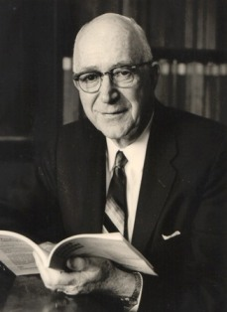
Brown v Board of Education of Topeka (1954)
The verdict:
Gordon Allport: Sociologist
Argued that laws alone would not reduce intergroup prejudice and promote better acceptance and understanding
Solution? Cooperative Learning.
http://www.mindingthecampus.com/originals/Gordon%20Allport.jpg; retrieved 10/03/2012

Slide 12
Common Characteristics of Culturally Competent Educators
Use active learning
Develop a learning community in the classroom
Modify curriculum and instruction to match student learning styles
Maintain high expectations for all students
View culture as an asset to the learning environment
Generate cultural connections within the framework of teaching
Allen, D. and Tanner, K. (2007) Transformations: Approaches to College Science Teaching. Chapter 14 Cultural Competence in the College Biology Classroom.

Slide 13
Maintaining High Expectations for All Students
Pitfall:
The microscope:
Explaining to one student how to focus the microscope vs focusing it for another student.
Topic assignment:
Challenging assignment to the “best” students and lesser topics for “other” students
Open discussion:
Inadvertently calling on men more often than women in the classroom or vice versa.
Addressing answers to men rather than the woman who asked or vice versa.
Is there a hint of cultural bias in the examples above?
Allen, D. and Tanner, K. (2007) Transformations: Approaches to College Science Teaching. Chapter 14 Cultural Competence in the College Biology Classroom.

Slide 14
What are different ways you can assign groups and rearrange seating patterns?

Slide 15
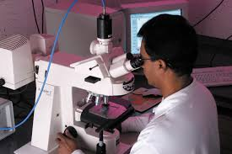
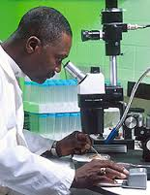
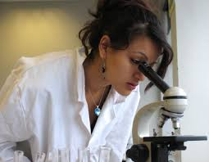
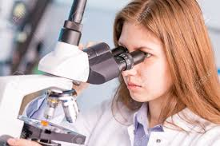
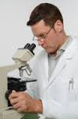
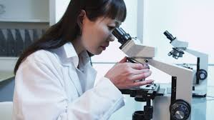
Developing Your Own Cultural Competence
Take time to reflect on your habits and thoughts of mind. Be honest with yourself. What do you believe? What experiences have you had to make you feel that way? Are some of your beliefs actually driven by stereotypes or television/radio models rather than real life experience?
Using diverse role models as examples in curriculum.
Monitoring your language use.

Slide 16
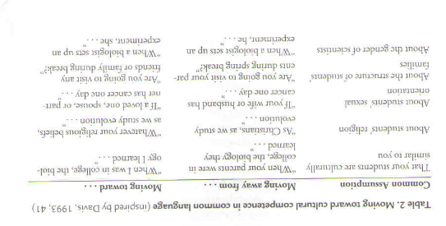
Language provides cultural cues…even if we don’t mean to be providing those cues!
Allen, D. and Tanner, K. (2007) Transformations: Approaches to College Science Teaching. Chapter 14 Cultural Competence in the College Biology Classroom.

Slide 17
Be aware of your patterns of interaction with students
Who do you call on?
Who do you praise?
Who do you correct?
Whose name do you use when referring to a group project?
Who do you interact with?
To whom do you tend to gravitate?
Whose names do you remember?
The clipboard method: If the class is small enough, track your interactions as they unfold during class.

Slide 18
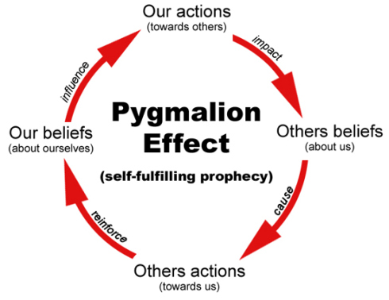
The Pygmalion Effect
http://awesomeculture.com/wp-content/uploads/2011/10/pygmalion_effect1.jpg; retrieved 11/13/2012

Slide 19
Campus Resources
A Handy List of Everything is Located on the Center for Diversity and Inclusion website!
http://www.uh.edu/cdi/resources/campus_resources.html

