Slide 1
Creating intellectually stimulating environments in large classrooms
4/26/19
Diane O’Dowd
UCI, dkodowd@uci.edu http://www.researchandteaching.bio.uci.edu

Slide 2
Describe a class that is
“intellectually” interesting or stimulating
A place where students have the opportunity to discuss new ideas, ask questions, challenge assumptions, think deeply about topic: have unexpected realizations
A place where instructors have the opportunity to readily evaluate student understanding and logic during learning: have unexpected realizations

Slide 3
Move away from:
Lecture: an educational talk to an audience
Move toward:
Dialogue: a discussion between two or more people or groups, esp. one directed toward exploration of a particular subject or resolution of a problem

Slide 4
Strategies that promote dialogue in large classes
Multiple choice clicker questions
  PollEverywhere.com
Free response problems
Physical demonstrations
Notes:
.

Slide 5
“Structural complexity: Thinking outside the box”
Basic Concept Addressed:
  Relationship between biological structures that make up all organisms
Illustrate how a short exercise can contribute to creation of intellectually stimulating environment

Slide 6
Lecture 1: Unifying themes in Biology
A. Biological systems can be organized in terms of structural complexity
CQ 1-2
Which list is correctly ranked from highest to lowest
  A. Organ>Cell>Atom>Tissue>Molecule
  B. Tissue>Organ>Cell>Molecule>Atom
  C. Organ>Tissue>Cell>Molecule>Atom
  D. Cell>Tissue>Molecule>Organ>Atom

Slide 7
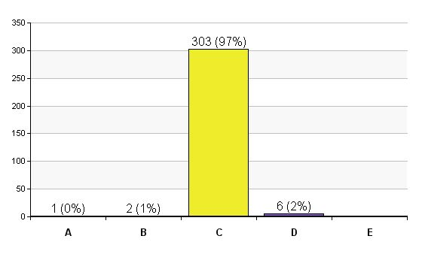
  C. Organ>Tissue>Cell >Molecule>Atom

Slide 8
Names:
Class Card #1
Put the following in order, highest to lowest level in terms of structural complexity.
  Muscle
  Hydrogen ion
  Neuron
  Phospholipid
  Nucleus
  Human sperm
  Mitochondrion
  Heart

Slide 9
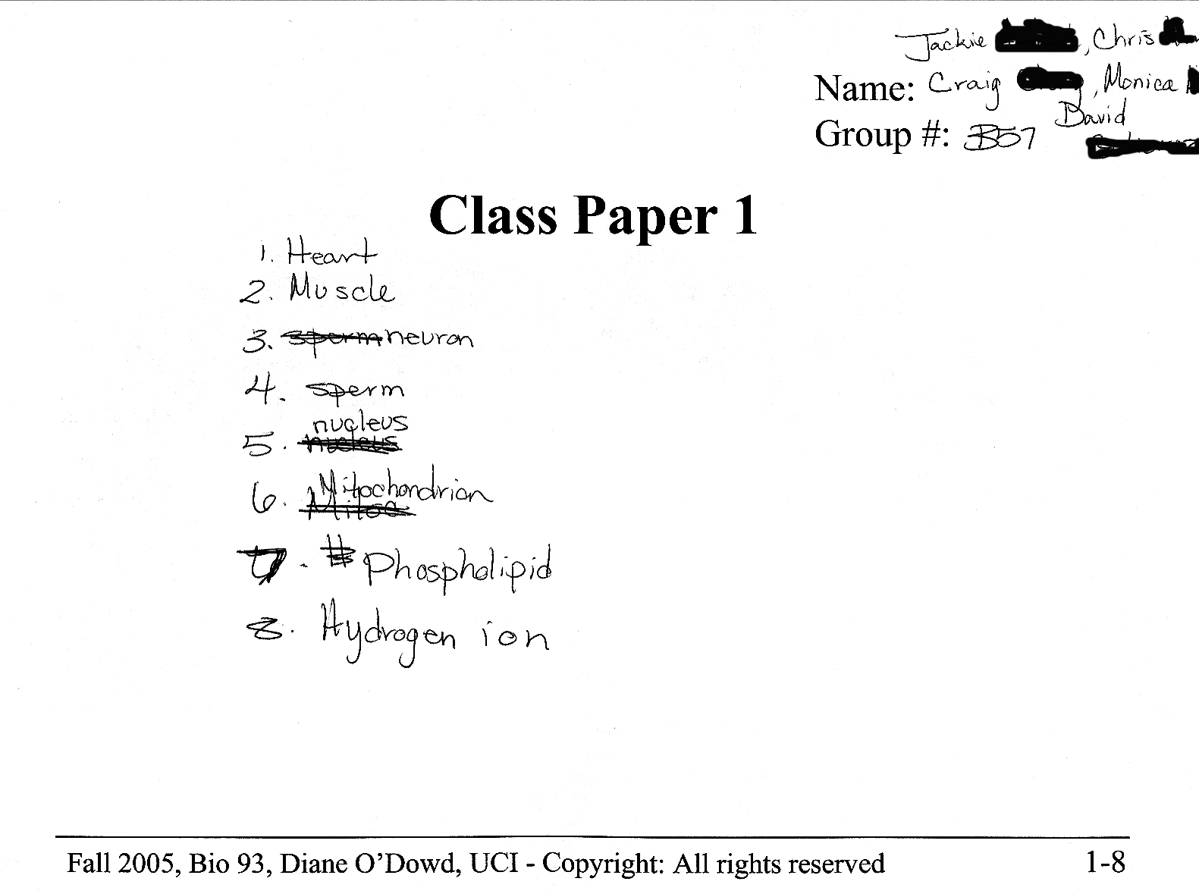
Close=11%
Groups rarely ever put 2 items on the same line
This realization happens during the class discussion

Slide 10
Modification #1
Add Ostrich Egg to list
  highlight the difference between size and complexity
  Unexpected outcome: many group put ostrich egg above heart!
  Increased opportunity for exploring how assumptions affect logic

Slide 11
Modification #2
Switched from fixed to fluid groups
  Easier to implement
  Unexpected outcome: increased student satisfaction with group work
  Reason: opportunity to learn names of more classmates

Slide 12
Implementation suggestions
Wrap up includes overt discussion of learning goals that go beyond content
    how assumptions affect construction of arguments
    importance of asking questions during learning
    value of dialogue during problem solving
Do early in class to increase student buy-in
Keep it fresh
Notes:
.

Slide 13
What is your biggest concern about using active learning strategies?
Time required to develop new materials
Content will have to be sacrificed
Time required for admin/technology issues
Student resistance
E. Other

Slide 14
Learn before lecture (LBL) strategy
Pre-class exposure to new material
  Worksht/video: guides learning of new info
  Accountability: preclass online quiz
Lecture
  Active learning/problem solving
LBLs added to 3 lectures in 2009
  Assess learning outcomes

Slide 15
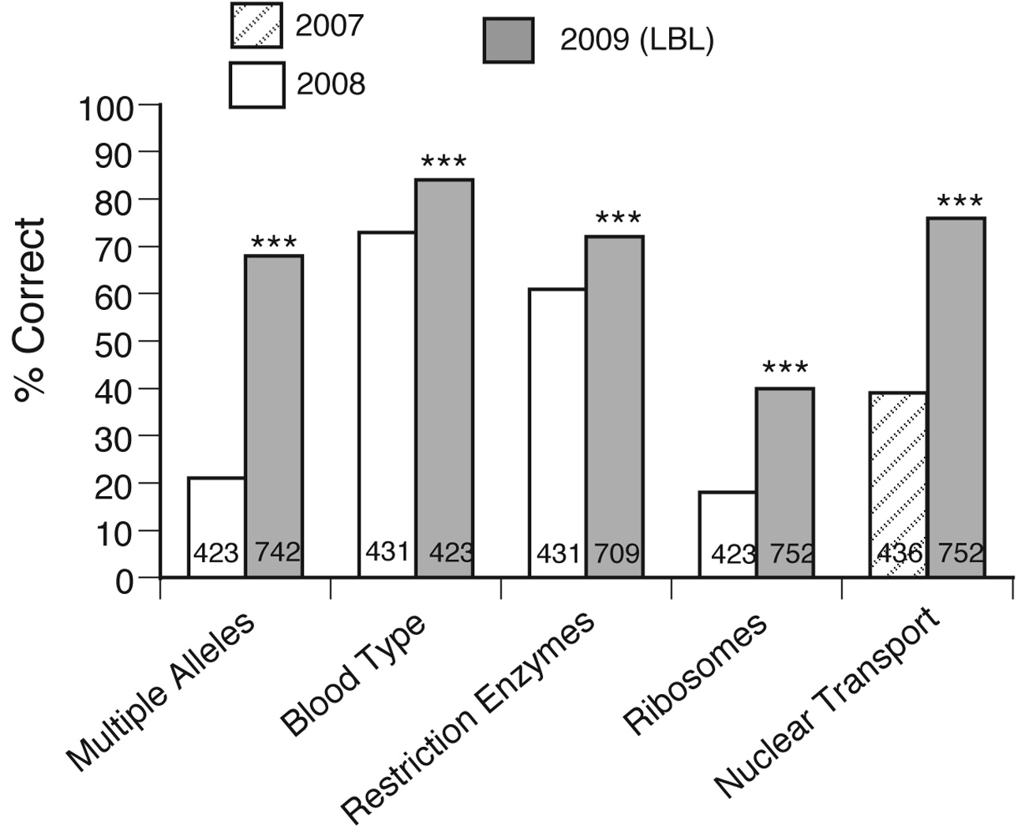
Increase in performance on exam questions on topics presented in LBL vs lecture format
Moravec et al, CBE, 2010

Slide 16
Implementation: Incremental
  LBLs added to 3 lectures in 2009
    Assess learning outcomes
  LBLs in 4 lectures in 2010, 2011
  LBLs in 5 lectures in 2012, 13
Fully flipped vs course with LBLs

Slide 17
Gateway Drug Hypothesis
Faculty who begin by trying small, easy to implement active learning exercises are more likely progress to higher stakes, riskier behavior
Developing/testing new strategies in their own class

Slide 18
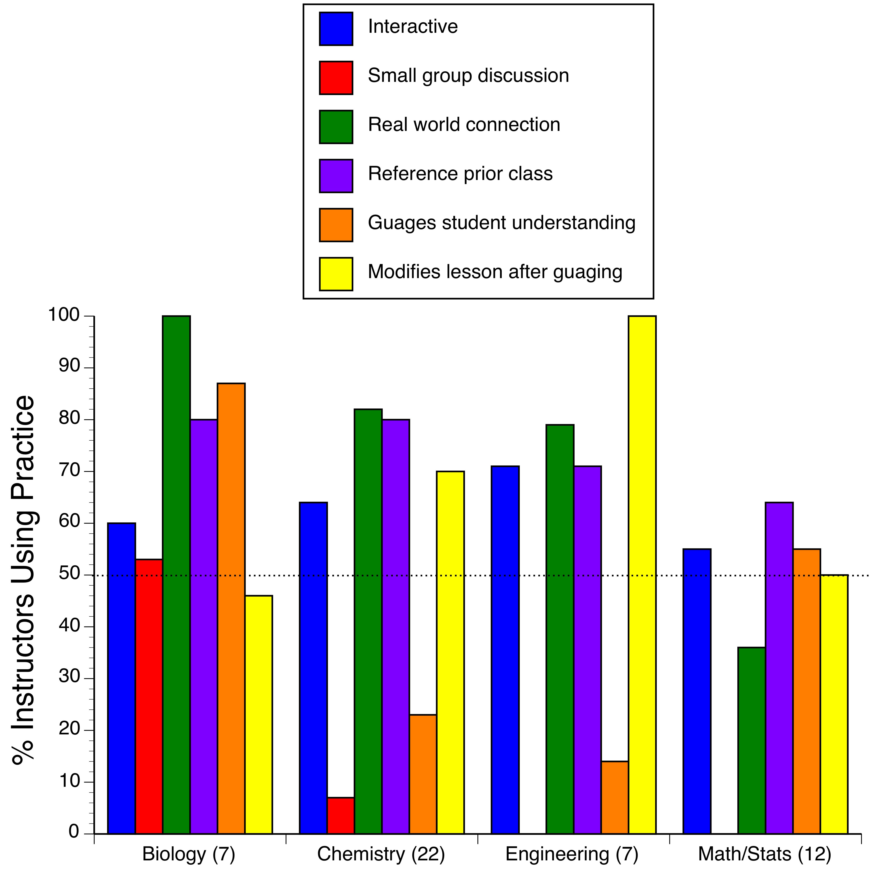
NSF Wider/Eager Study
Reimer et al., RSF Journal, 2016

Slide 19
Valuing teaching in the merit/promotion process at UCI: A story of incremental change

Slide 20
Promotion Process: One bucket system
Service
Teaching
Research

Slide 21
Promotion Process: Three bucket system
Research
Teaching
Service
Notes:
.

Slide 22
Department Chair
Junior faculty
  Require citation of a least one! pedagogy reference in new course action forms
  Institute program of peer observation conducted by mentor faculty
    Guide implementation of evidence based teaching practices
    Second form of evaluation in promotion process
Senior faculty
  Participate in providing peer observations
    Expose senior faculty to evidence based teaching practices

Slide 23
Vice Provost, Academic Personnel
WIG: Excellence in Teaching Required for Merit/Promotion
  In UC system VPAP oversees academic reviews
  Every 2-4 years depending on rank (Assist, Assoc, Full)
  Files evaluated by Dept, Chair, Dean,
  CAP,
  VPAP, Provost, and Chancellor

Slide 24
Vice Provost, Academic Personnel
Fall 2014
  CAP/AP agrees that we require excellence not only in research but at least 1 of the other 2 areas
  Announced to all Deans and Faculty University wide
Problem
  Evaluation of teaching relied only on student evals.
Spring 2016
  Evidence of Teaching Effectiveness MUST INCLUDE
    Student Evaluations of Teaching
    One additional form (self statement, peer observ., other)

Slide 25
What was submitted?
  2016-17
    80% teaching statements
      List
      Descriptive
      Reflective – most useful based on comments at all levels of review
    20% - syllabi, peer observations, awards, syllabi
  2017-18
    Encourage submission of reflective statement
    Two goals
      Better able to evaluate contribution with second form of evidence that allows for triangulation
      Stimulates broad discussion of innovative practices in teaching

Slide 26
Teaching Statements
  Support for writing “concise, reflective” teaching statements
    Created guidelines, accessible from this link http://dtei.uci.edu/the-reflective-teaching-statement/
    Provide support in writing, edit statements
  2017-18 submissions
    90% teaching statements with ~50% reflective
    Large increase in evaluative comments regarding teaching from Dept level review and up.

Slide 27
Promotion Process: Three bucket system
Research
Teaching
Service

Slide 28
What works for me might not work for you
What works at UCI might not work at UH
What works this year might not work next year
To be effective the science education (and administrative) environment must be as dynamic, intellectually stimulating, and evaluative as the science research environment

Slide 29

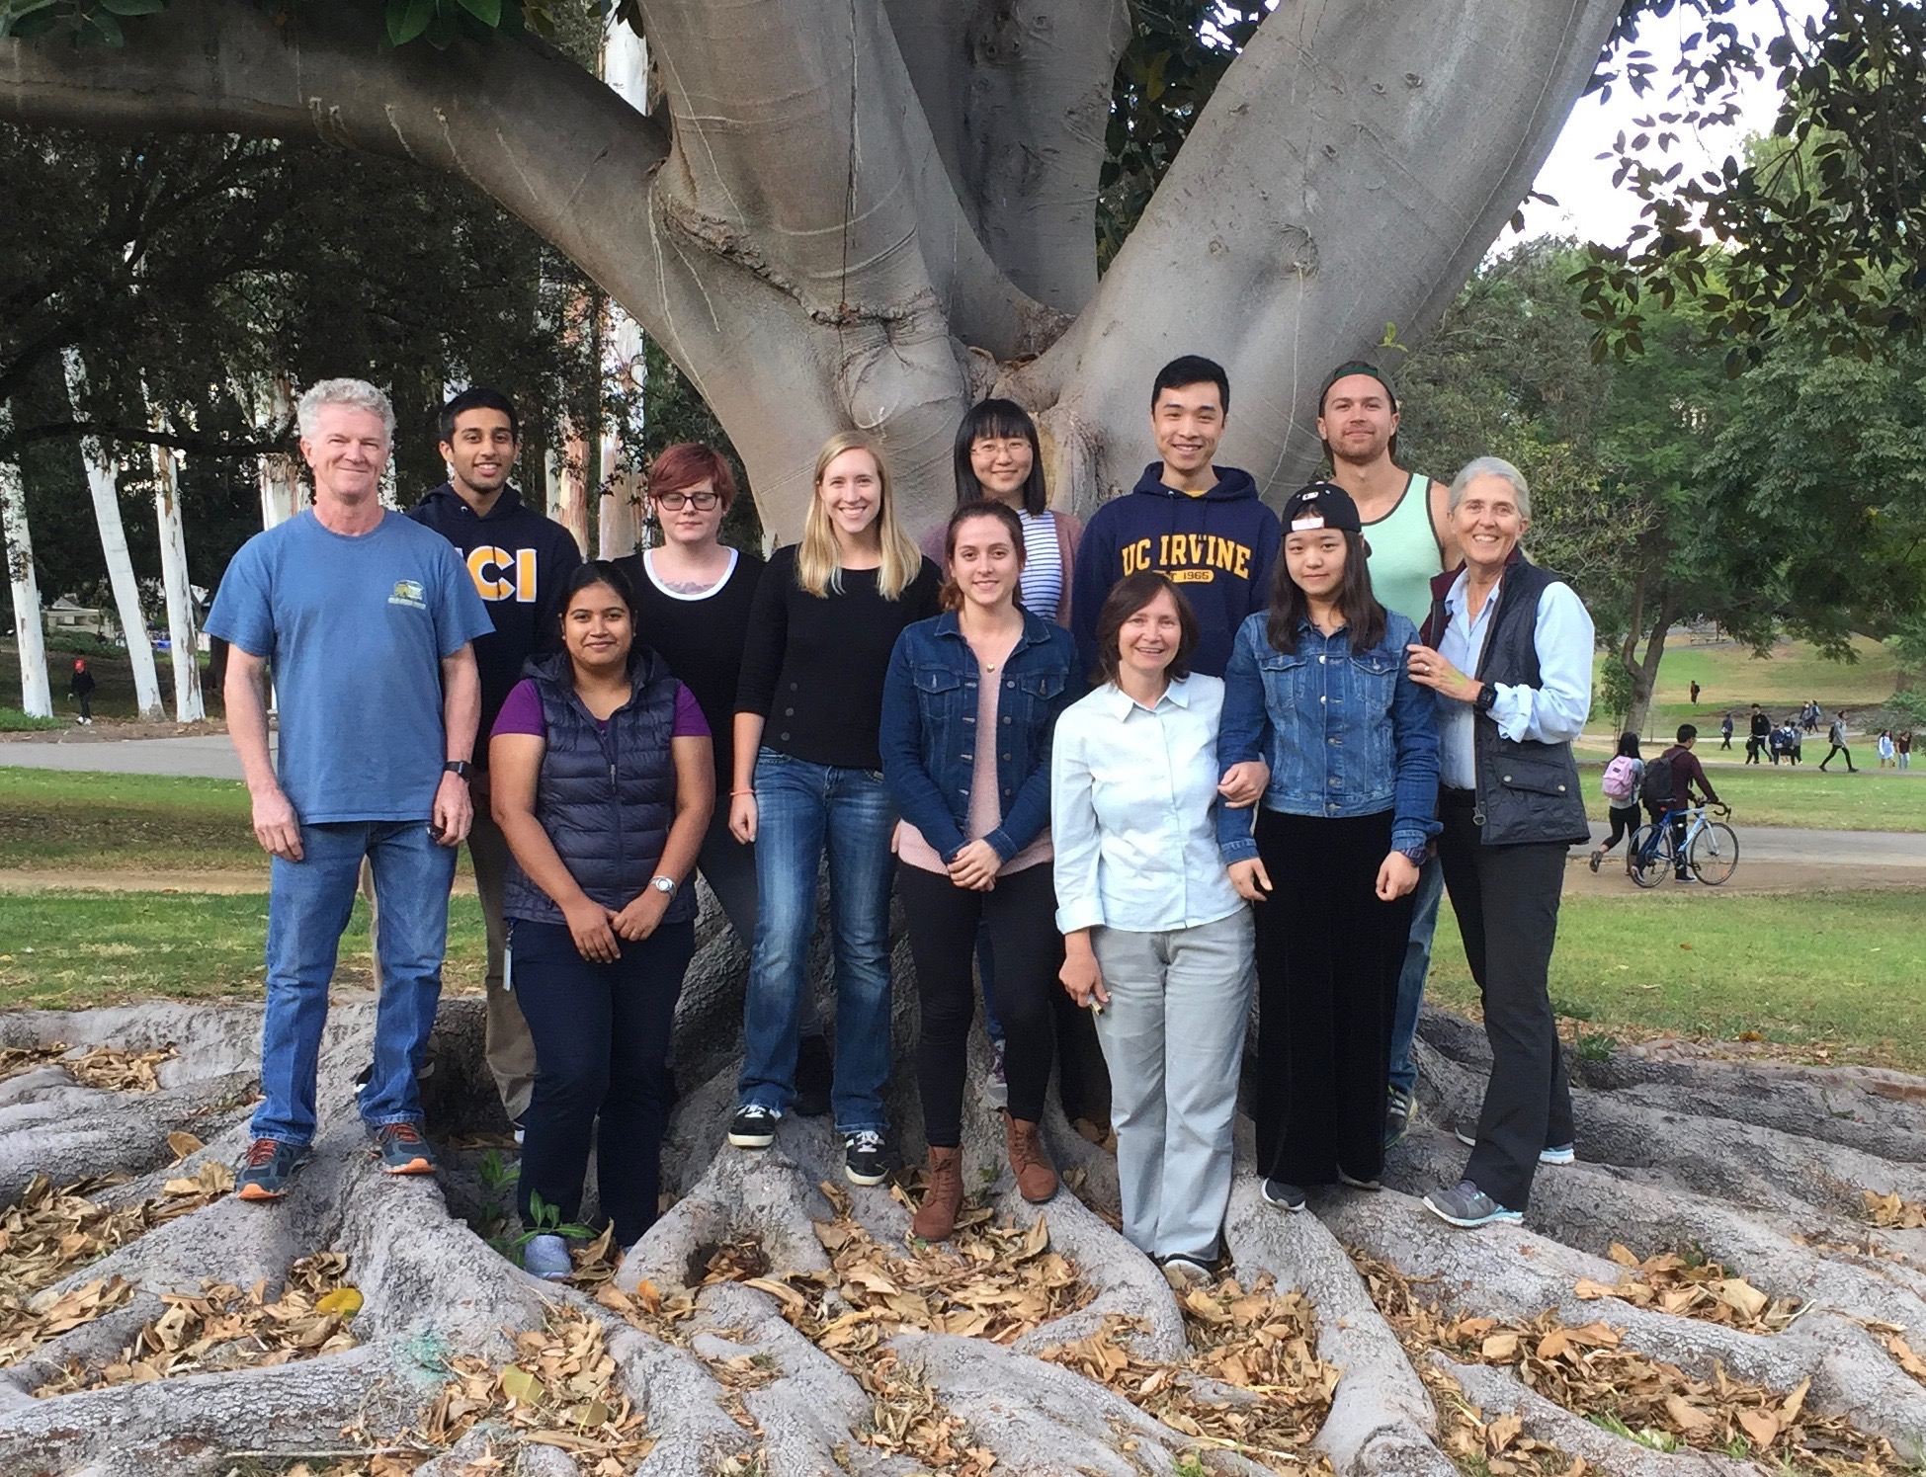
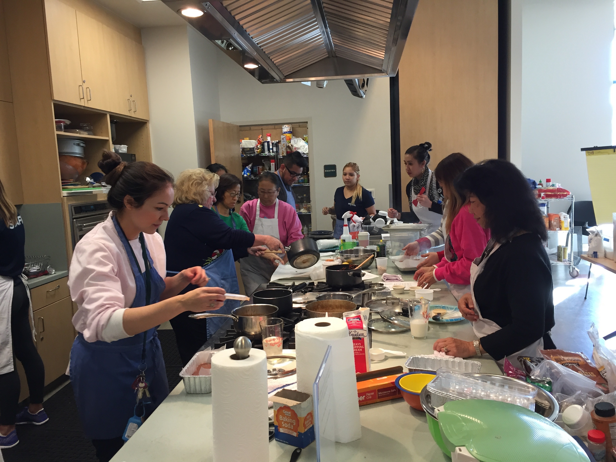
Intro Bio Team
Lab Team
Vice Provost Team
Funding from HHMI Professor Program, NIH, and Provost Office

