Slide 1
Teaching Students How to Take Exams and Evaluate Their Own Performance
Faculty Development Workshop
December 13, 2013
Donna L. Pattison, PhD
Instructional Professor
Department of Biology & Biochemistry

Slide 2
How do YOU Approach a Multiple Choice Test?
Notes:
Sharing how you approach a test is useful for students to know. It is also helpful to think about in terms of writing good questions and avoiding making the answer obvious (see the do’s and don’ts slides to follow).

Slide 3
Tips for Taking Multiple Choice Tests:
Read carefully. Read twice.
Try to think of the answer BEFORE looking at the choices.
Mark questions you are not sure about and move on.
Cross out answers you know are incorrect. Put a ? next to ones that might be possible.
Try to figure out why an answer choice might NOT be correct or why a statement might be FALSE rather than true to help eliminate answer choices.
Go with the “correct most often or mostly true” statement. Don’t get caught in the minute exceptions.
Think about the meanings of prefixes, suffixes, and word roots if you are unfamiliar with the terminology.
If the answer choice contains vocabulary you have never seen before (and you studied) it is probably a distractor, not the answer.
Watch out for the wording. Is the question asking for the which is true or not true?
Use words such as all, more, always, and only as clues to the context of the answer.
Use the grammar in the question stem to help you (a vs an, plural vs singular).
Read the question stem and the answer choice as a sentence. Does it make sense?

Slide 4
What are the benefits of reviewing exams with students?
Disadvantages?
Notes:
Benefits: Students get another opportunity to learn what they did not understand. You can provide tips on how to approach the question and how to study for the types of problems involved. You learn from the students if you did not clearly word the question or if the question could be interpreted in more than one way or if you have unintentionally included multiple, potentially or partially correct answer choices. You gain better insight on where the misconceptions are and where and why students get things confused which allows you to improve your teaching for the next class.
Disadvantages: It takes up class time to review the exams and your exam questions are now “public”. You will spend more time writing new exam questions.

Slide 5
What types of errors do students typically make on multiple choice questions?
Type I Error: “Headbangers” or
“Doh, I knew that”; Carelessness
  Read too fast or just spotted
  key words
  Circled right answer on exam but bubbled incorrectly on scantron or not at all
  Second guessing oneself
Type II Error: “Something about the question”
  Student gets confused by wording. Superficial understanding of topic or problem with the question.
Type III Error: “I just didn’t know the answer”
  Student needs to attend class and STUDY
Tichenor, L. (2009). Tips on Classrom Assessment: How to Teach Our Students to Take Multiple-Choice Exams. In College Science Teachers Guide to Assessment (pp. 43-44). Arlington: NSTApress.

Slide 6
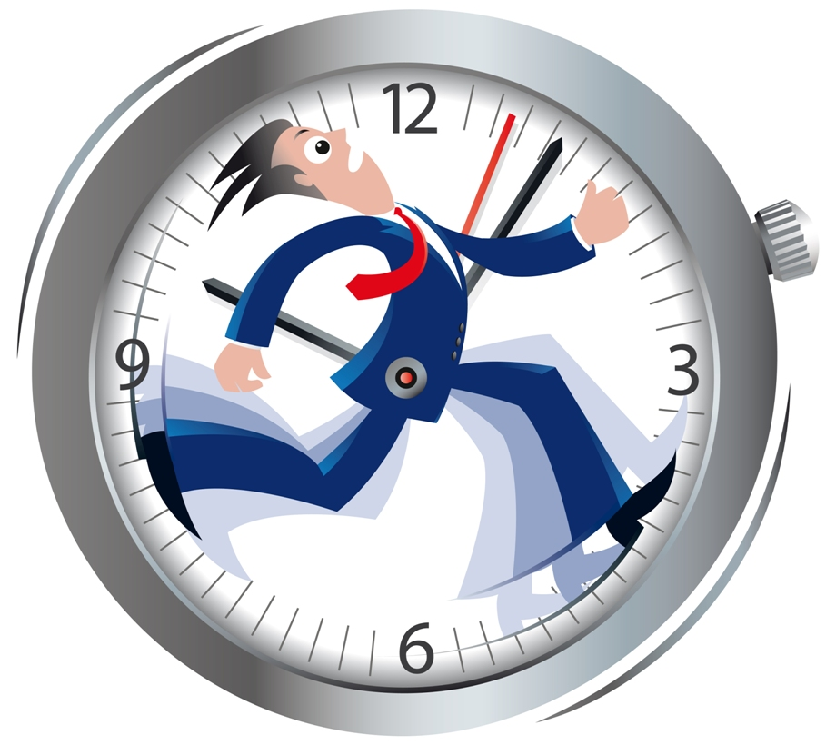
How do we provide opportunities for reflection on exams when the classes have enrollments
from 60-550?
100 students x 5 minutes to hand them their exam and set them at a table or desk to review it= over 8 hours of time
535 students x 5 minutes = over 44 hours

Slide 7
ANALYZING YOUR RETURNED TESTS
Test Item Missed
Study Methods
I did not read the text thoroughly.
The information was not in my notes.
I studied the information but could not remember it.
I knew the gist of the information but needed verbatim information.
I knew the information but could not apply it.
I studied the wrong information.
Test Anxiety
I experienced mental block.
I spent too much time daydreaming.
I was so tired I could not concentrate.
I was so hungry I could not concentrate.
I panicked.
Test Taking Skills
I carelessly marked a wrong choice.
I did not eliminate grammatically incorrect choices.
I did not choose the correct choice.
I did not notice limiting words.
I did not notice a double negative.
I changed a correct answer to a wrong one.
I missed the directions.
I misread the questions.
I made poor use of the time provided.
I wrote poorly organized responses.
I wrote incomplete responses.
Other:
Strategies for Improvement:
http://www.las.uh.edu/LSS/study-strategies-handouts.aspx

Slide 8
Self-evaluation strategies to help students assess preparedness and foster good study skills:
Through clicker questions or short class surveys, ask basic questions:
Have you reviewed your class notes since the last lecture?
Are you taking notes?
Have you read chapter X yet?
Did you do the Concept Checks at the end of each chapter section?
Can you sketch the process without using your notes or the book?
The number of hours I spend studying for this class a week is..
When reading the textbook, do you turn headings into questions to help stay focused?
Do you take notes on paper or add them to the powerpoints during lecture?
Do you have a study group?

Slide 9
How do you advise students to prepare for your exams?
Attend class. Participate. Mentally engage.
Take notes. Not just key words written on board.
Review class notes within 48 hours of lecture.
Read the text.
Do end of chapter questions.
Study with others.
Practice recall (avoiding the “illusion of knowing” trap):
  Write out a process or section of material as an outline or paragraph.
  Explain a concept to someone else.
  Diagram a process or draw a structure.
  Make a concept map.
  Do practice tests provided. Make your own.
  Don’t just try to memorize answers. Try to understand why other answer choices are not correct.
Set up a study schedule and stick to it. Assign an “accountability coach” to ensure you stick to it.
Get some sleep before the exam. All-nighters just make the brain foggy.
Take a break. A saturated sponge will not take up anymore water. A saturated brain needs time to process information too or it won’t soak it up either.
Notes:
An “accountability coach” can be a friend, roommate, sibling, parent, grandparent, coach or anybody else that cares about you and whether or not you are successful. It is easier to stick to a diet or exercise program if you have a buddy. It’s also easier to commit to a study plan if you have a buddy. Someone else in the class can serve as an accountability coach and a study partner. Why go it alone? Nothing on your transcript says you had a study partner or you forged the path alone. Students sometimes feel like they should be able to master the material all by themselves without any help. What would be the point of teachers then? As a teacher, sometimes you have to help them change their expectations about their own learning and how it can best be accomplished.

Slide 10
How to read the textbook:
SQ4R
Survey
Question
Read
Recite
wRight
Review
http://www.las.uh.edu/LSS/handouts/Reading/Summary%20Of%20SQ4R.pdf
Notes:
As instructors, we tend to assume a student knows HOW to read a textbook. This, however, is often not true. Students attempt to read science textbooks as though they were English literature novels. It is an ineffective, time-consuming, and frustratingly overwhelming way to approach a science textbook. Using the SQ4R method can help make the reading manageable for students and help them get more out of it. Remember that many of today’s entering college freshmen have had few physical books to work with. Many school districts have little to no budget for books so teachers are expected to provide the content on worksheets. The classroom may have a class set of books but students are expected to use “Google” to complete their homework assignments because there are not enough books to provide one to each student. Many districts are now moving to electronic books. This sounds wonderful until you consider the fact that millions of students live below the poverty line and have no means to access the electronic books or homework assignments online. Increasingly, a growing number of our students have little to no experience with textbooks. They don’t know there is an index or a glossary because they’ve never held actual books. A brief lesson on how to read a textbook if you expect them too would not be amiss.

