Slide 1
Scientific Literacy: K-12 Benchmarks and Standards and You
Faculty Development Workshop
April 19, 2013
Donna L. Pattison, PhD
Instructional Professor
Department of Biology & Biochemistry

Slide 2
Today’s Discussion:
K-12 Benchmarks and Standards:
1. What are they?
2. How are they created?
3. How are they applied at the K-12 level?
4. Why should college educators care and how do we use them?

Slide 3
Major Literacy Projects
Project 2061
Project of American Association for the Advancement of Science (AAAS), The National Research Council (NRC), and NSTA
Science for All Americans (1989)
Benchmarks for Science Literacy (1993)
Atlas of Scientific Literacy: Mapping K- 12 Science Learning
National Science Education Standards (1996)
NRC: The National Academies of Science
Next Generation Standards (2013)
Based on the 2011 NRC report A Framework for K-12 Science Education: Practices, Crosscutting Concepts, and Core Ideas
Project of American Association for the Advancement of Science (AAAS), The National Research Council (NRC), and NSTA
Teams from 26 states

Slide 4
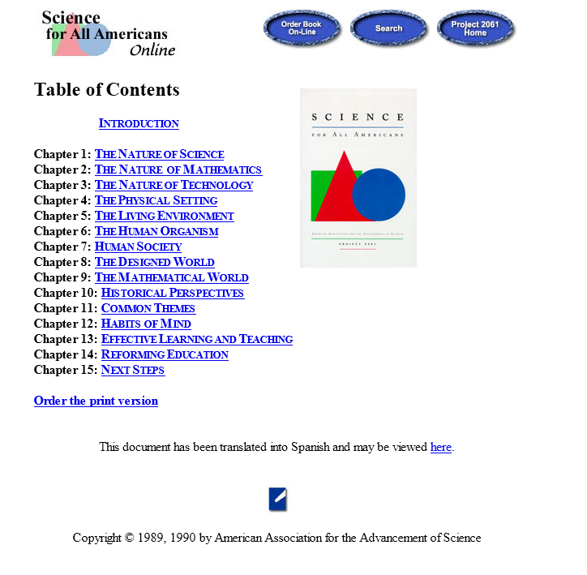
Retrieved: http://www.project2061.org/publications/sfaa/online/sfaatoc.htm

Slide 5
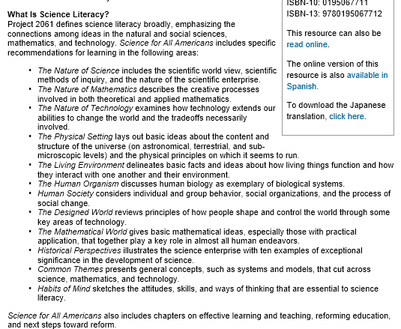
Science for All Americans
Retrieved http://www.project2061.org/publications/sfaa/default.htm

Slide 6
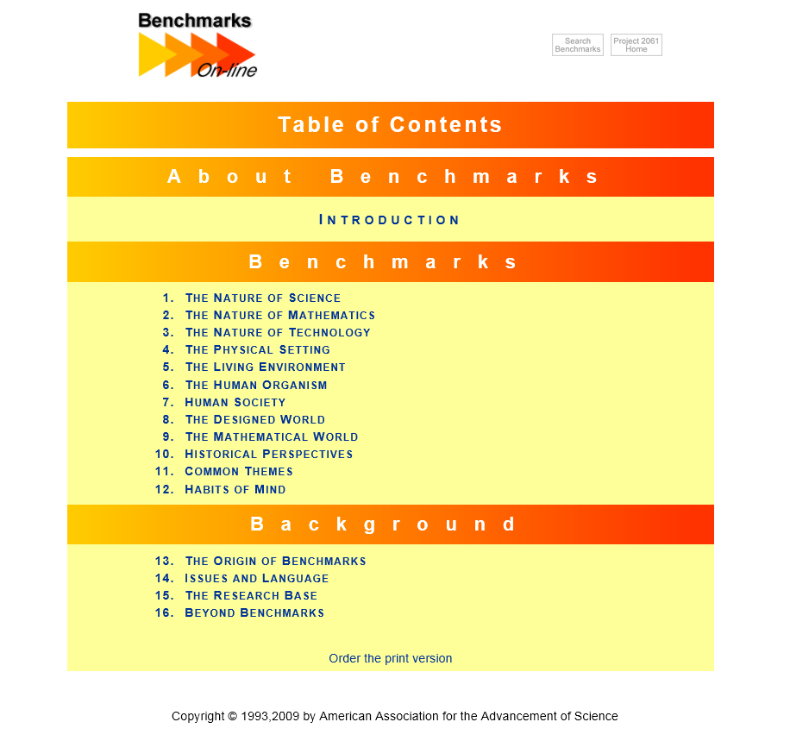

Slide 7
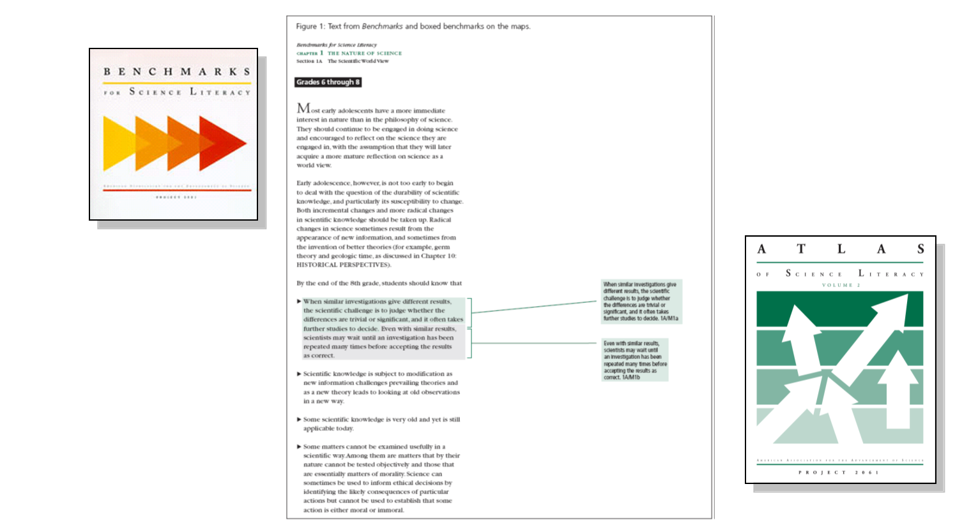
From Benchmarks to the Atlas Maps
Retrieved: http://www.project2061.org/publications/atlas/default.htm

Slide 8
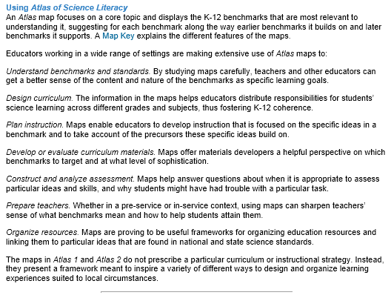
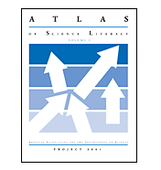

Atlas of Scientific Literacy: Mapping K- 12 Science Learning
Retrieved from http://www.project2061.org/publications/atlas/default.htm; 4/19/2013

Slide 9
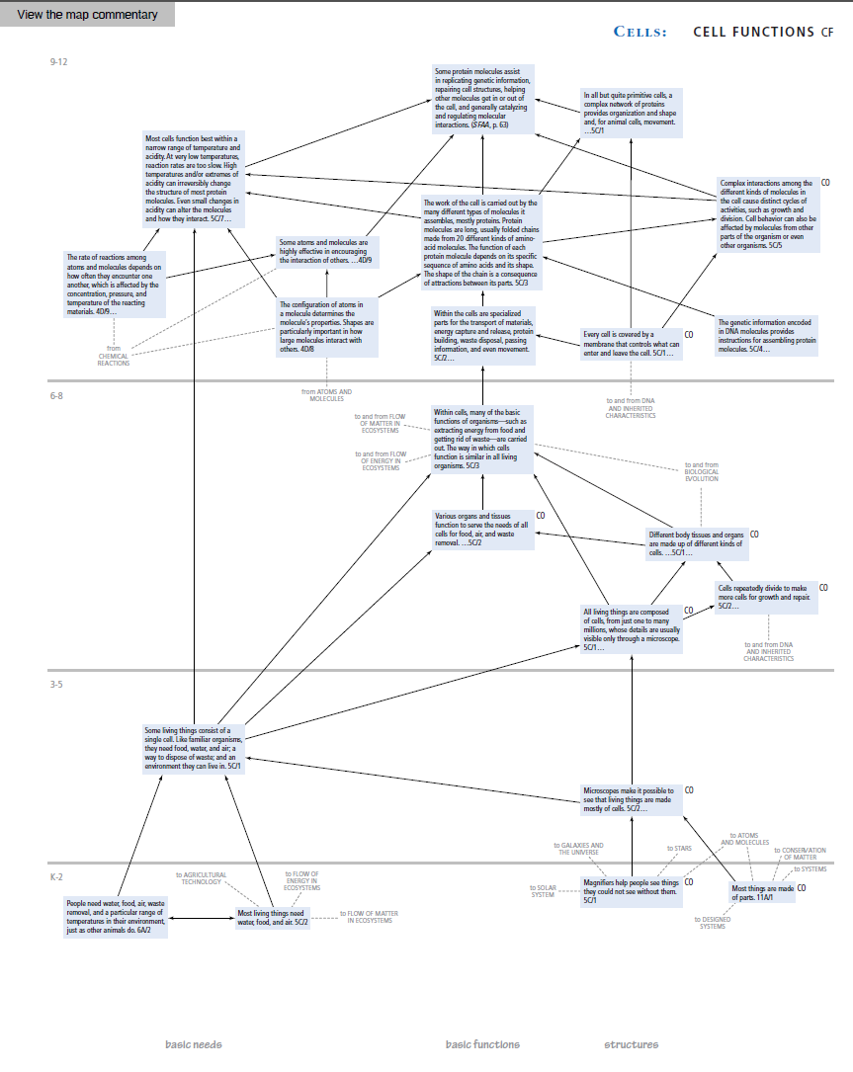
Atlas of Scientific Literacy: Mapping K- 12 Science Learning

Slide 10
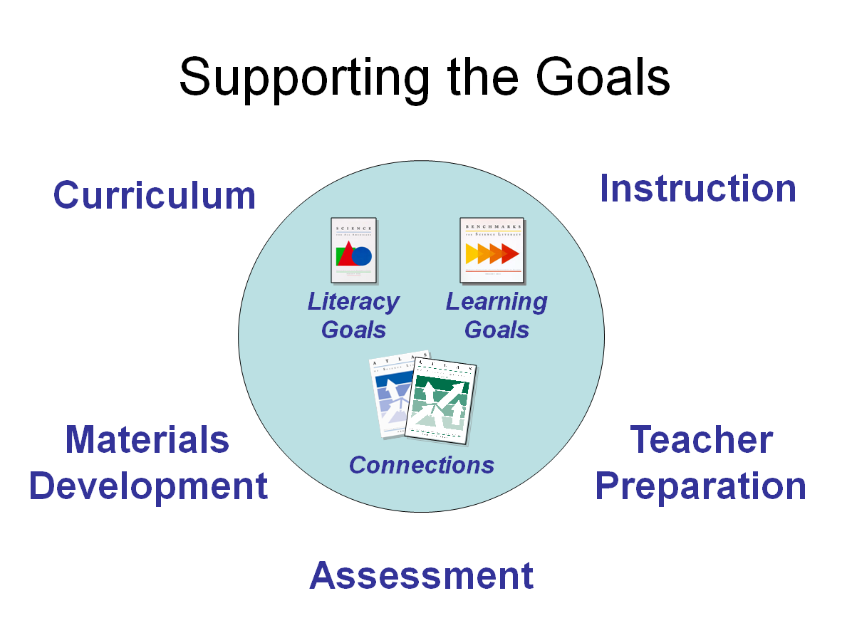
Retrieved: http://www.project2061.org/publications/atlas/default.htm

Slide 11
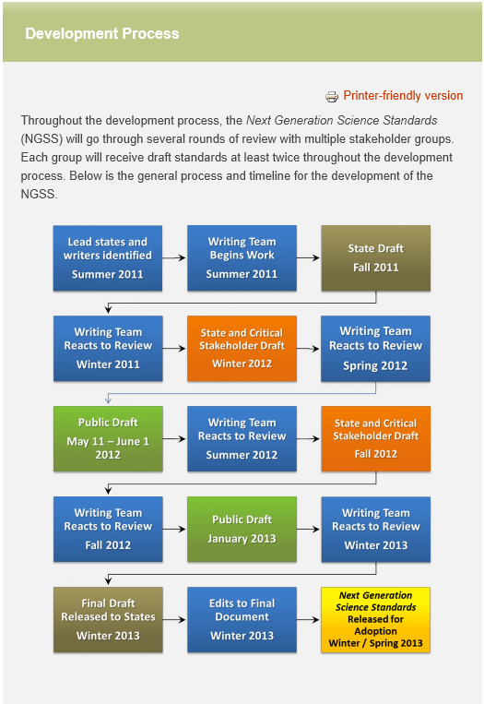


Slide 12

79th Texas Legislature, 3rd Session, House Bill 1: Required Texas Education Agency (K-12) and the Texas Higher Education Coordinating Board (College/University) to establish vertical teams to develop College and Career Readiness Standards. Standards approved in 2008.

Slide 13
BIOL1361
Lecture 1 and 2: Introduction and Themes (Chapter 1)
Objectives:
Students will be able to identify overarching themes in biology and will be able to organize information into a hierarchy.
Students will recognize the following concepts:
1. Organisms interact with the environment and each other.
2. Energy is required for life.
3. Structure and function are related.
4. Biological systems can be regulated by positive or negative feedback.
5. Many concepts in biology can be explained by looking at life through the lens of
evolutionary biology.
6. Science is hypothesis driven.
Alignment with College and Career Readiness Standards:
V. Cross-Disciplinary Themes
D. Classification
1. Understand that scientists categorize things according to similarities and
differences.
VI. Biology
E. Classification and taxonomy
1. Know ways in which living things can be classified based on each organism’s
internal and external structure, development, and relatedness of DNA
sequences.
F. Systems and homeostasis
1. Know that organisms possess various structures and processes (feedback
loops) that maintain steady internal conditions.

Slide 14
Developing Coherent Goals for College Programs
National Science Foundation’s Course, Curriculum, and Laboratory Improvement (CCLI) Program
Department of Education’s Fund for Improvement of Postsecondary Education (FIPSE)
Department of Education’s Mathematics-Science Partnerships program
UH QEP: Support for departmental teams engaged in curriculum reform

