Slide 1
Research in Education
Faculty Development Workshop
March 8, 2013
Donna L. Pattison, PhD
Instructional Professor
Department of Biology & Biochemistry

Slide 2

Discussion:
1) How do we know if we are effective instructors?
2) How do we know if a specific teaching method or activity is effective?

Slide 3
How do we know in general if we are effective instructors?
Evaluations
DFW rates
General student comments and feedback
How do we know if a specific teaching method or activity is effective?
Clickers?
Streaming?
Recitations?
Peer tutors?
Open inquiry lab?

Slide 4
Experimental and Quasi Experimental Studies
What are the characteristics of a true experimental
study?
Why are many educational research studies “quasi”
experimental rather than “purely” experimental?

Slide 5
Field Trip Survey
Which field trip did you attend?
Was the field trip worth your time? Please explain.
Would you recommend a field trip continue to be included as part of the BIOL1320 or BIOL1362 course in the future?
List at least one thing you learned on the field trip.
What other kinds of field trips would you like to see offered in the future?
6. Help future students and express your suggestions for improving this field trip in the future:

Slide 6
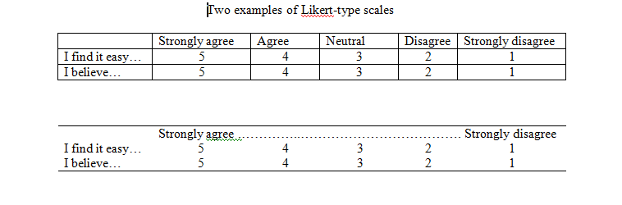
Likert Scales
A five point or a four point scale? Which should you chose?
Source: Mary Ochoa, UH

Slide 7
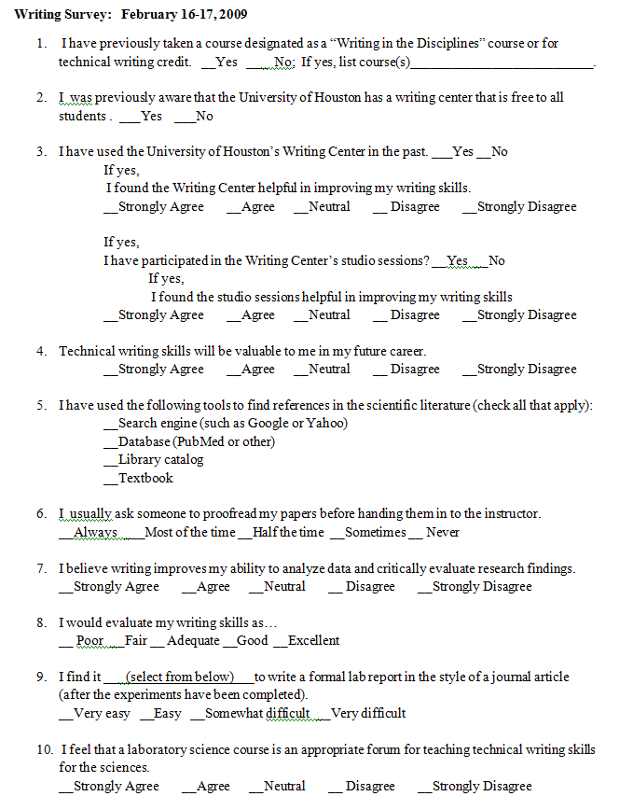

Slide 8
Literature Search / Places to Publish Your Own Research
Practice-Based Science Education Journals
Journal of College Science Teaching
American Biology Teacher
Journal of Chemical Education
Advances in Physiology Education
Biochemistry and Molecular Biology Education Journal
BioScene (history and philosophy of science)
Cell Biology Education
Journal of Undergraduate Neuroscience Education
Journal of Microbiology and Biology Education
Theory- and Educational-Research Journals
Journal of Research in Science Teaching
Science Education
Databases:
ERIC: Education Resources Information Center
BIOSIS
SciFinder

Slide 9
Professional Organizations and Conferences on Teaching in the Sciences
National Science Teachers Association/Society of College Science Teachers: National and Regional
American Society of Microbiology Educator’s Conference (right before the main ASM Conference)
Association of Biology Laboratory Educators Conference
National Association of Biology Teachers
National Association of Researchers in Science Teaching
Society for the Advancement of Biology Education Research
(has a Biochemistry Division)

