Slide 1
Peer Instruction: Making Science Engaging
Faculty Development Workshop
September 4, 2012
Donna L. Pattison, PhD
Instructional Professor
Department of Biology & Biochemistry

Slide 2
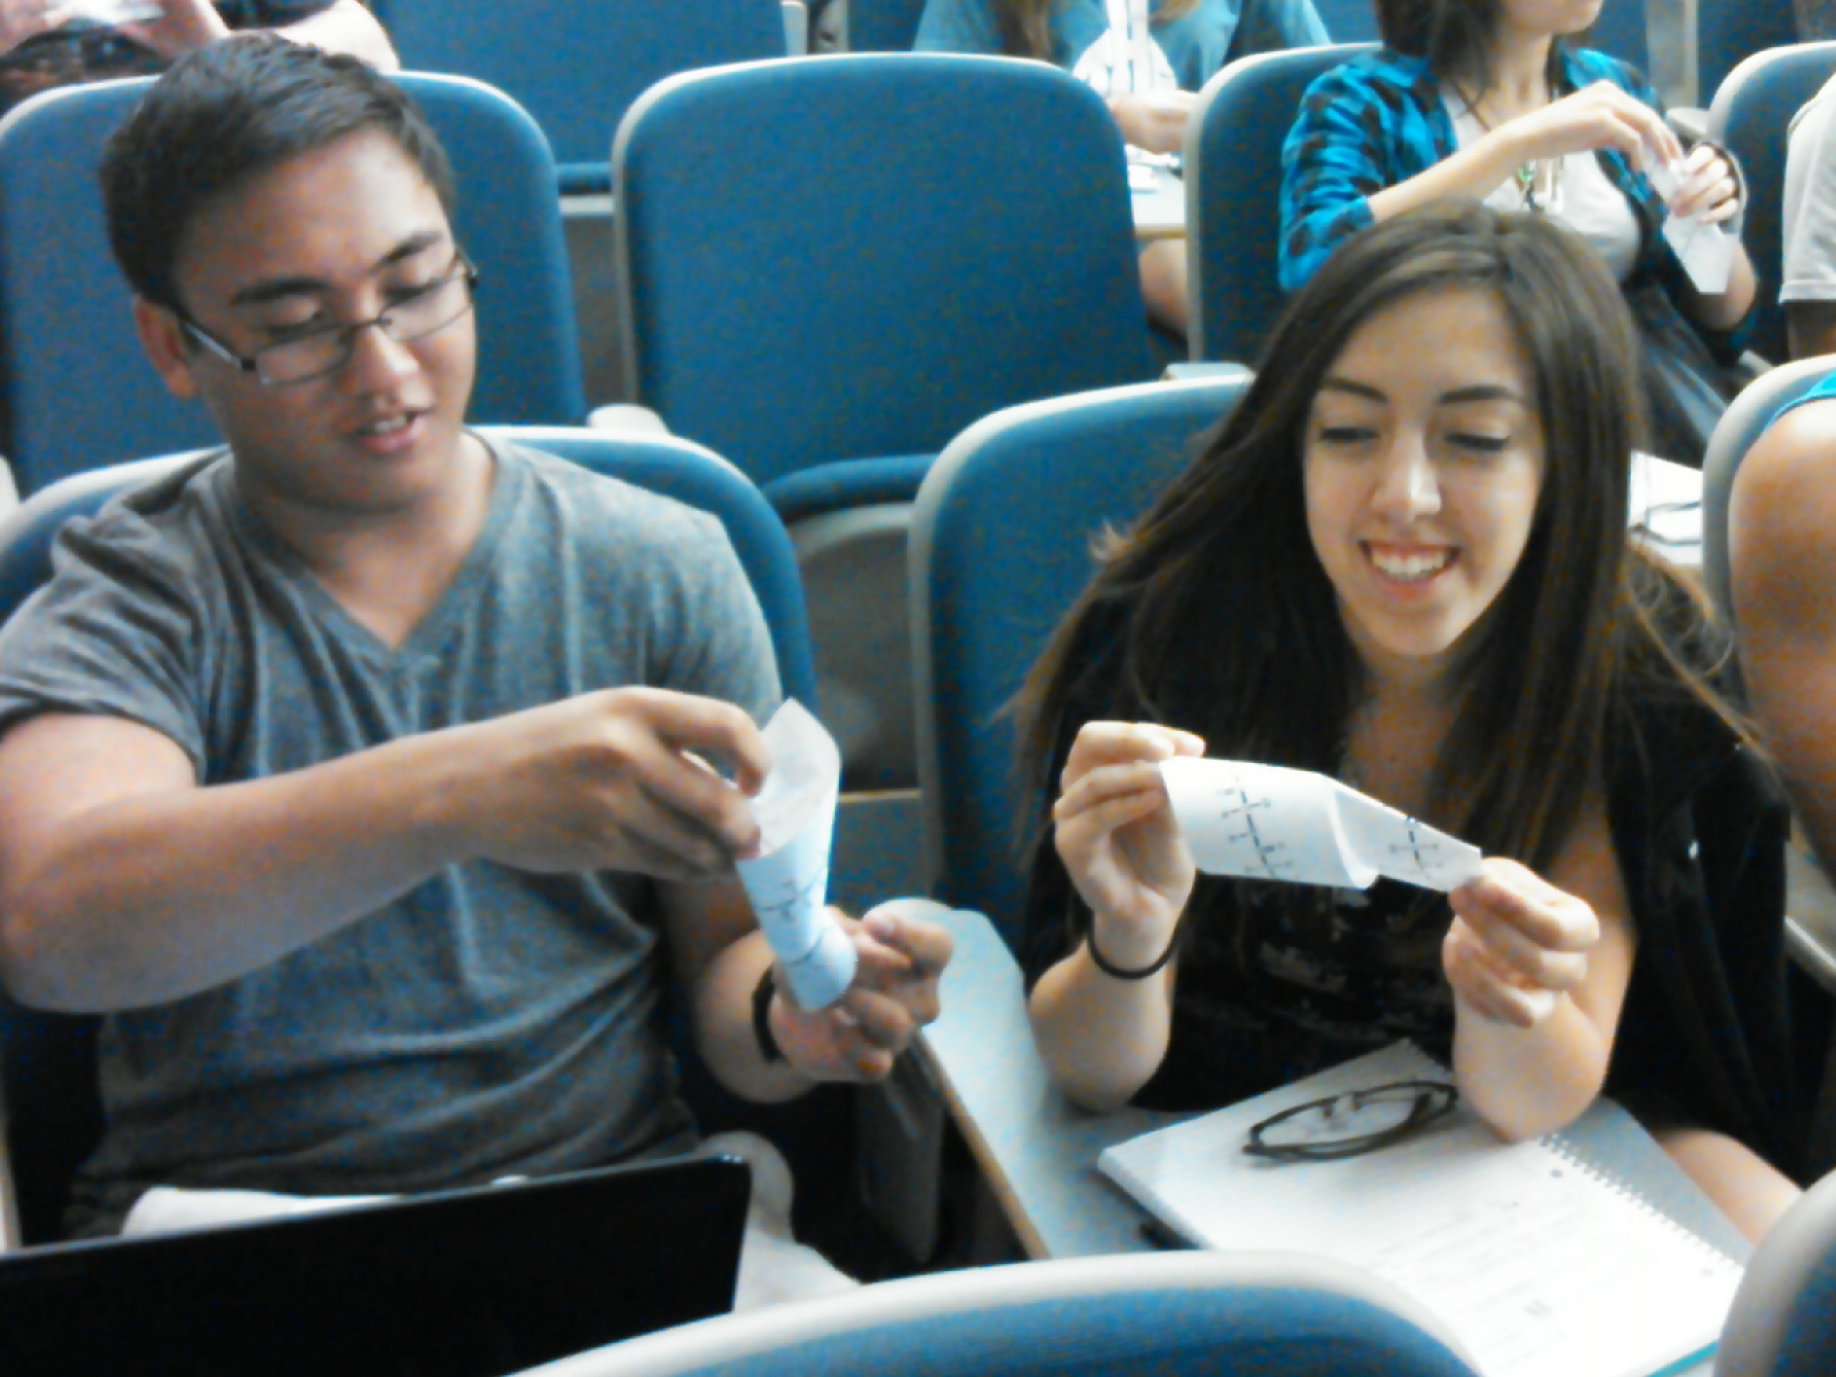
Peer Instruction
Key Points:
Provides students with an opportunity to synthesize the concepts
Provides instructors feedback on student understanding

Slide 3

Does it Work?
Measuring your success:
What do you need to do to determine if this method is working in YOUR classes?
Design the experiment.
Set up the timeline.

Slide 4
The Peer Instruction Method
Pre-class reading assignment
Mini lecture
ConcepTests
Discussion
Mazur Group

Slide 5

Pre-class Reading Assignment
How do you get students to read and think about the material?
How do you hold students accountable for the reading?
Do you grade it and how?
When do they hand it in?
Think about the above for a large class vs a small (<40 class).

Slide 6

Mini-Lecture
~10-20 minutes
Deal with difficulties or misconceptions
Concise and focused
  Ask yourself “What is the objective of my lecture?
  Can students get what I have to offer out of the textbook?
  What is the value added?”
  Can I move lecture material elsewhere?

Slide 7
Problem-solving
Conceptual problems vs “plug and chug” or fact finding.
Exams should reflect skills PRACTICED in class.
How do you TEACH critical thinking in biology courses?

Slide 8
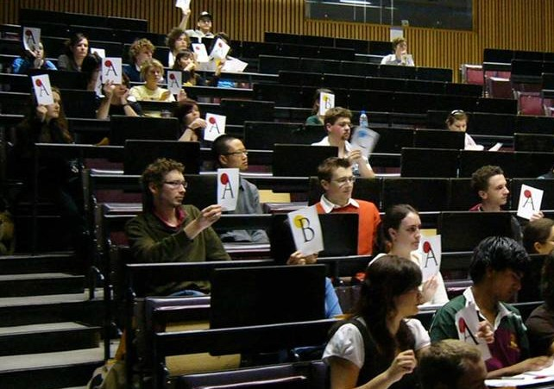

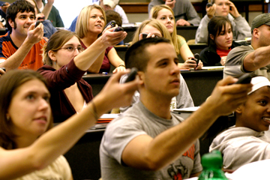
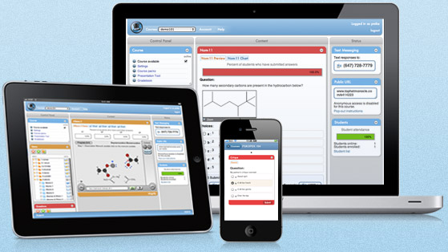
ConcepTests
http://arts.monash.edu.au/philosophy/peer-instruction/using/index.php; retrieved 9/3/2012
http://s3.amazonaws.com/thm-media/media/production_5-00-21/images/corporate/banner_pill1.jpg; retrieved 9/3/2012
http://www.reed.edu/cis/mlab/assets/images/clickers1.jpg; retrieved 9/3/2012

Slide 9
ConcepTests
Explain WHY we are using Peer Instruction and Clickers (or your preferred polling method).
1) Makes lectures more interactive.
2) Gets students to think and process the info.
3) Provides immediate feedback to both student
and instructor.

Slide 10
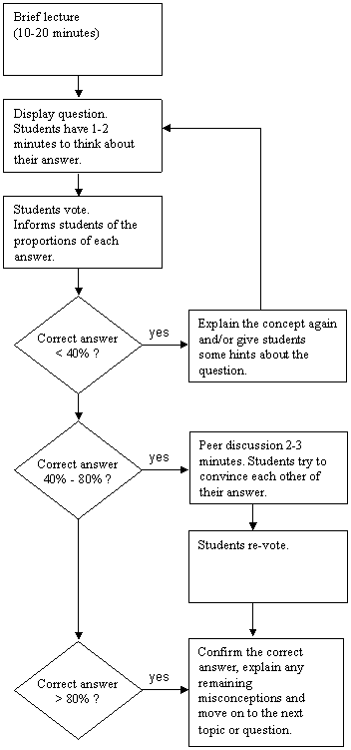
Know when to pair, re-teach, or move on….
http://arts.monash.edu.au/philosophy/peer-instruction/using/format.php; retrieved 9/3/2012

Slide 11
Confessions of a Converted Lecturer: Eric Mazur
http://www.youtube.com/watch?v=WwslBPj8GgI

