Slide 1
Just-in-Time Teaching in Biology
Faculty Development Workshop
September 18, 2012
Donna L. Pattison, PhD
Instructional Professor
Department of Biology & Biochemistry

Slide 2
Quick Links
Indiana University-Purdue University Indianapolis
http://webphysics.iupui.edu/webscience/webscience.html
http://www.biology.iupui.edu/biocourses/N100/2k4Warmup14.html

Slide 3

JITT: What is it?
Warm-up questions prior to class
Readings: text, journal or news articles, web materials
Marrs, K and Novak, G. (2004) Just-in-Time Teaching in Biology: Creating an Active Learner Classroom Using the Internet. Cell Biology Education (3) 49-61.

Slide 4
JITT: Why bother?
Promotes critical thinking
Promotes active learning
Provides feedback to the students as formative assessment rather than just summative)
Allows instructor to uncover misconceptions and judge prior learning on a topic
Connects course content to real world
Encourages frequent, short study sessions

Slide 5
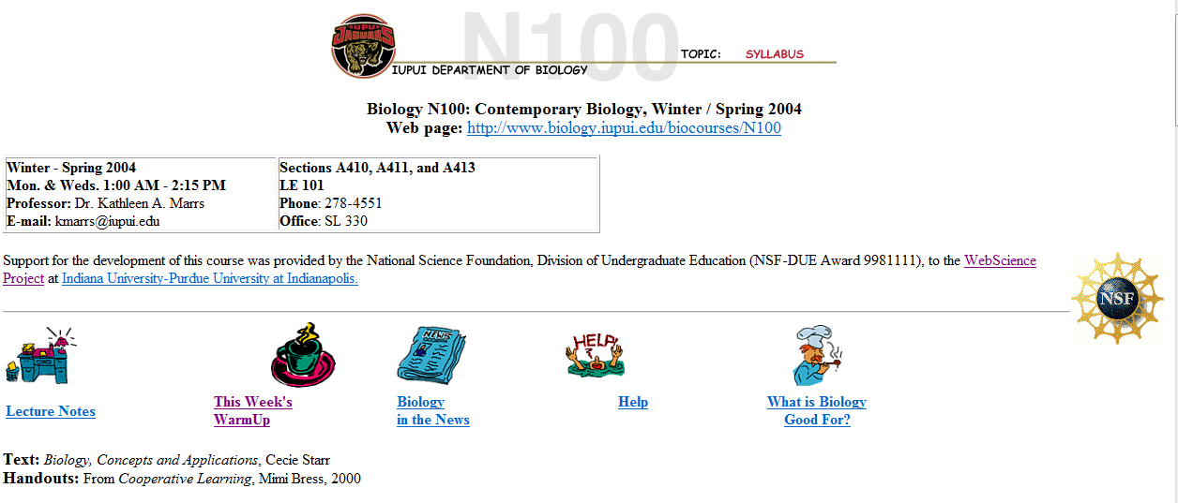
Indiana University-Purdue University Indianapolis
N100=General Science for nonmajors; >200 students; lecture hall
http://www.biology.iupui.edu/biocourses/N100/index.html; retrieved 9/17/2012

Slide 6
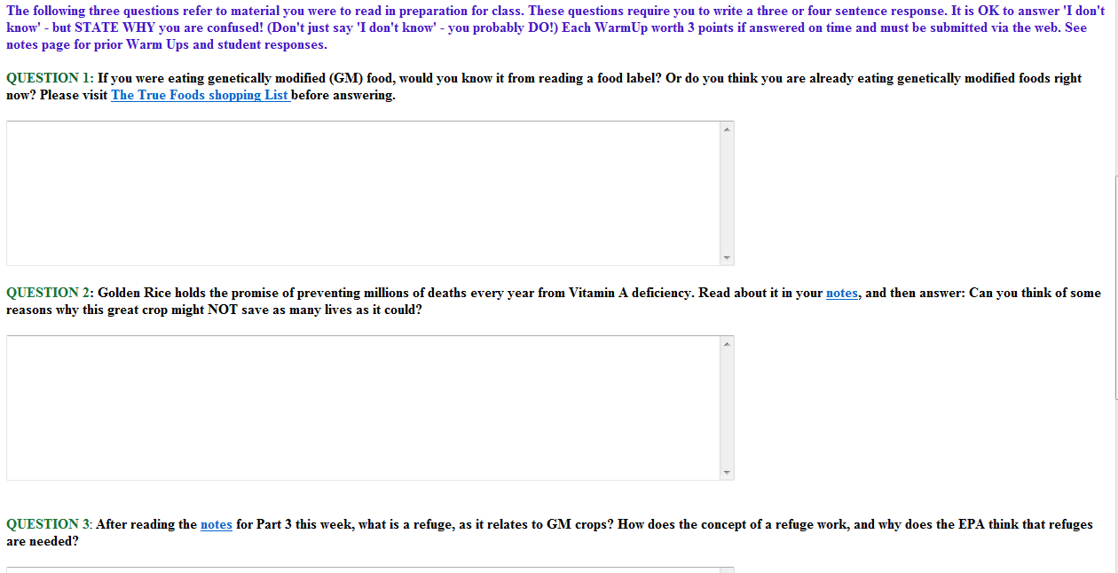
Warm-ups
One weekly warm-up posted on Fridays; due 3 hours before class
CGI-bin: Common Gateway Interface program (Web page tool): Collects responses and stores the info in an HTML file or bin
http://www.biology.iupui.edu/biocourses/N100/index.html; retrieved 9/17/2012

Slide 7
Warm-ups
Open-ended questions:
What is the difference between….
Why do you think…..
Estimate how many….
What happens if ….
What determines…
Explain in your own words….
Marrs, K and Novak, G. (2004) Just-in-Time Teaching in Biology: Creating an Active Learner Classroom Using the Internet. Cell Biology Education (3) 49-61.

Slide 8
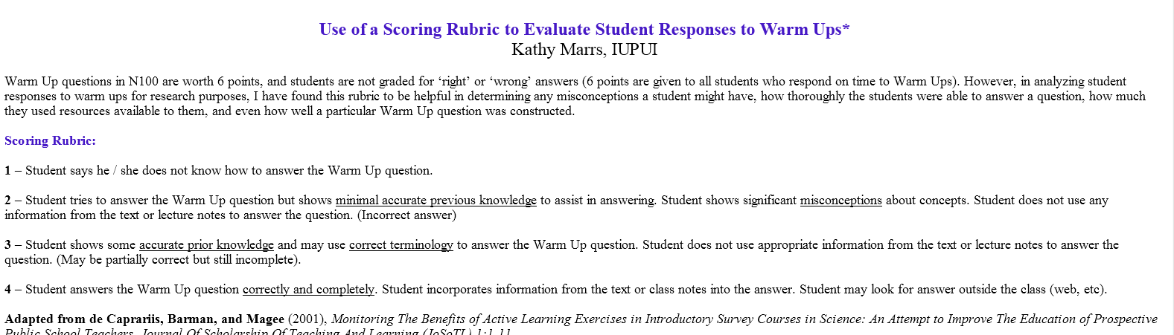
Warm-ups
http://www.biology.iupui.edu/biocourses/N100/warmupscoringrubric.html; 9/18/2012

Slide 9
Warm-ups
Use the actual student responses as a spring board for class discussion:
Extend
Expand
Compare

Slide 10
Does it Work?
Physics: DFW 33% pre-JITT; 19% with JITT
Biology: DFW 27% pre-JITT; 20% with JITT
Marrs, K and Novak, G. (2004) Just-in-Time Teaching in Biology: Creating an Active Learner Classroom Using the Internet. Cell Biology Education (3) 49-61.

Slide 11
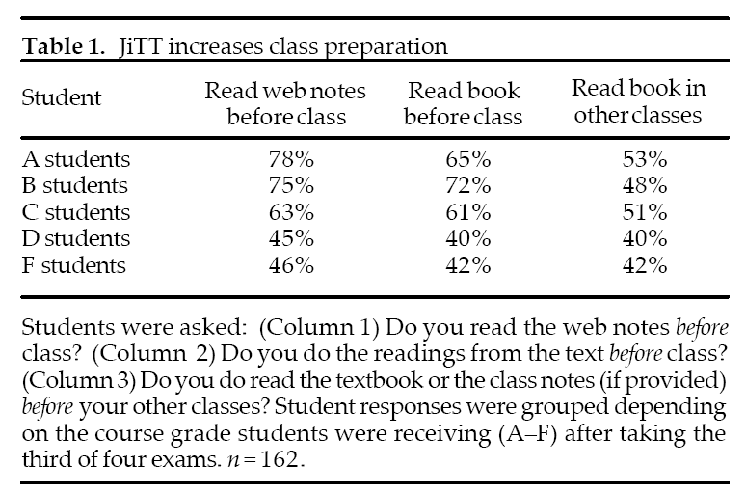
Does it Work?
Marrs, K and Novak, G. (2004) Just-in-Time Teaching in Biology: Creating an Active Learner Classroom Using the Internet. Cell Biology Education (3) 49-61.

Slide 12
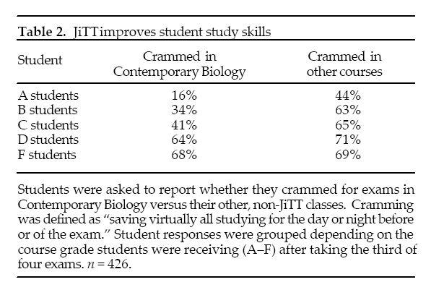
Does it Work?
Marrs, K and Novak, G. (2004) Just-in-Time Teaching in Biology: Creating an Active Learner Classroom Using the Internet. Cell Biology Education (3) 49-61.

