Slide 1
Converting Your Lab from Verification to Inquiry
Faculty Development Workshop
November 6, 2012
Donna L. Pattison, PhD
Instructional Professor
Department of Biology & Biochemistry

Slide 2
Cookbook Lab Guided Inquiry Open Inquiry
Purpose:
Advantages:
Disadvantages:

Slide 3
Does it Work?
Luckie et al (2004): 78% of comments from students in inquiry-based labs were positive vs 20% in traditional labs
Myers and Burgess (2003): Students completing inquiry-based labs critiques and designed experiments better then those who did not
Suits (2004) found SEM majors taught chemistry via inquiry scored higher in tests evaluating their ability to design, conduct, interpret, and report results for experiments
Handbook of College Science Teaching (2006) NSTA Press.
Chapter 21: Converting Your Lab from Verification to Inquiry by French and Russell

Slide 4
Things to Consider:
Building student lab skills and enthusiasm prior to implementation
Guiding students through the process
Resources and space
Time management
Evaluation
TA Training

Slide 5
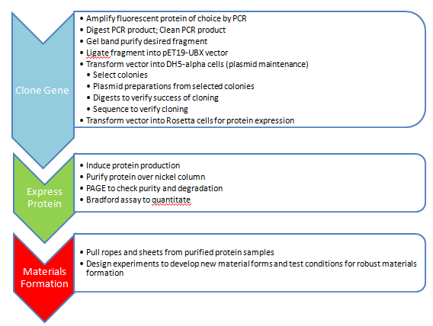
The Project Flow
Guided Exercises
Independent Inquiry

Slide 6
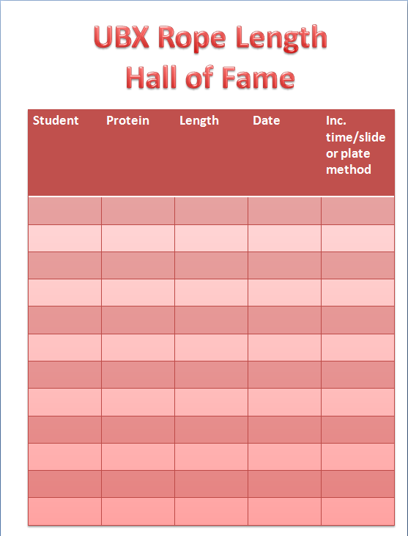
Generating Enthusiasm for the Project
Make it a competition

Slide 7
Guiding Students Through the Research Process
I. Generate an idea to pursue
a. Provide a few examples
b. Homework: Generate ideas (3 possible research ideas per student)
c. Small group discussion (professor, TA, lab group); chose 1 or 2 ideas to pursue
Write a research protocol
Team homework
Protocol reviewed by professor and TA; returned with comments
III. Open lab time: Supervision is the key!
Regularly scheduled lab time cancelled
Lab staffed by the teaching TAs during their regular class times
Lab staffed by prep TAs during their regular hours
Professor in lab as much as possible
Previous undergraduates when possible

Slide 8
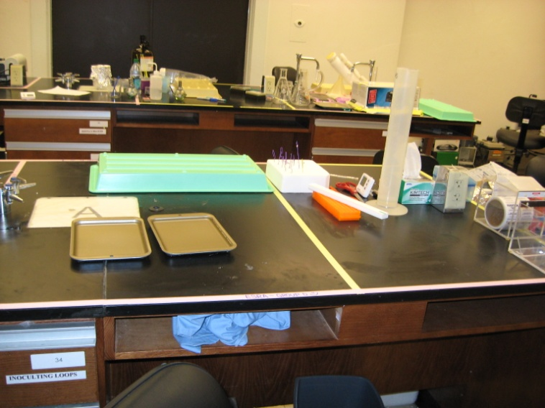
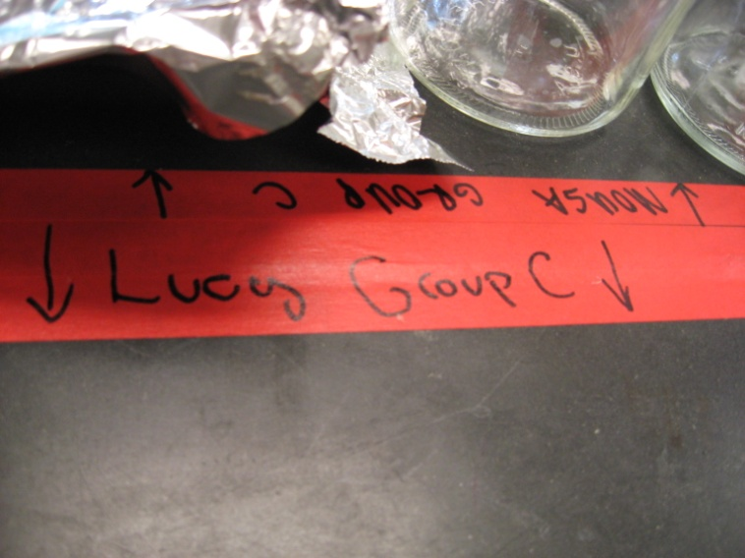
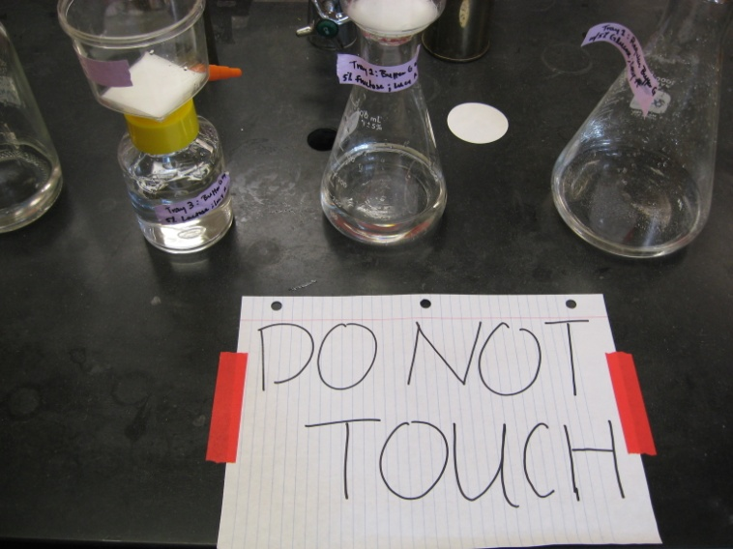
Resources and Space
Space:
Stake out territories (tape); pre-marking spaces eliminates territorial arguments
Resources:
Clearly define limits on product use (example: each group gets 6 mls of protein ONLY).
Supervise any reagent mixing. Check calculations.
Limit projects to those that can be done with items students supply or common supplies stocked routinely in the lab.
4) Be sure supplies are well-stocked ahead of time.

Slide 9
Time Management
Limit the duration of the project. Help students chose projects that can reasonably be completed in the given block of time.
Remind students there are many of them and not so many instructors.
Help the students with time management
a) Keep your expectations and theirs reasonable
b) Remind them (and remember) they have other classes
c) Review the time schedule for their project with them when reviewing their protocols

Slide 10

Evaluation
Student evaluation is rubric based
Includes points for creativity and effort
a) Team feedback on the productivity of group
members (filled out outside of class)
b) If you’ve spent much time in the lab, you often
know which groups put a lot of effort in and
which did the minimum before they present

