Slide 1
Improving Undergraduate Information Literacy Skills:
Integrating research tools and library resources into your course and assignment design
Porcia Vaughn, MSIS
Biology, Biochemistry, & Nursing Librarian
University of Houston, MD Anderson Library
All attributions are listed in the notes field for each slide and are allowed reuse under Creative Commons License
Notes:
Title: Improving Undergraduate Information Literacy Skills: Integrating research tools and library resources into your course and assignment design
Abstract: The science librarians at the University of Houston work with faculty to provide instruction, assignment creation, and student assessment related to information literacy competencies. For a student to be information literate in science, engineering, and technology they need to be able to identify their information need , obtain and evaluate said information, and use the information in an ethical and legal manner. This session will include examples of library resources and assignment design that will improve and assess your student literature research.
Links to Subject Resources and Librarian Contact
Biology & Biochemistry: http://guides.lib.uh.edu/biology
Chemistry: http://guides.lib.uh.edu/chemistry
Computer Science: http://guides.lib.uh.edu/computerscience
Earth & Atmospheric Sciences: http://guides.lib.uh.edu/geo
Engineering
-Biomedical Engineering: http://guides.lib.uh.edu/biomedical
-Chemical Engineering: http://guides.lib.uh.edu/chemeng
-Civil Engineering: http://guides.lib.uh.edu/civil
-Electrical & Computer Engineering: http://guides.lib.uh.edu/ece
-Environmental Engineering: http://guides.lib.uh.edu/environmental
-Industrial Engineering: http://guides.lib.uh.edu/industrial
-Mechanical Engineering: http://guides.lib.uh.edu/mechanical
-Petroleum Engineering: http://guides.lib.uh.edu/petroleum
Mathematics: http://guides.lib.uh.edu/math
Physics: http://guides.lib.uh.edu/physics
Technology
-Biotechnology: http://guides.lib.uh.edu/biotech
-Computer Information Systems: http://guides.lib.uh.edu/CIS
-Construction Management: http://guides.lib.uh.edu/cm
-Digital Media: http://guides.lib.uh.edu/DIGM
-Electrical Power Engineering Technology: http://guides.lib.uh.edu/elet
-Human Development & Consumer Sciences: http://guides.lib.uh.edu/hdcs
-Mechanical Engineering Technology: http://guides.lib.uh.edu/mect
-Organizational Leadership & Supervision: http://guides.lib.uh.edu/OLS
-Supply Chain & Logistics Technology: http://guides.lib.uh.edu/sclt

Slide 2
The Challenge
Poor Quality Research Papers
Novice
Time
Focus
Experience
Notes:
Novice: the students research skills are shallow and unable to handle the complex
Time: Time of the faculty and student lack of behaviors in time management
Focus: students are usually interested in current event from media outlets, not traditional scientific literature
Experience: No other courses expose students to STEM/technical writing before college or major.

Slide 3
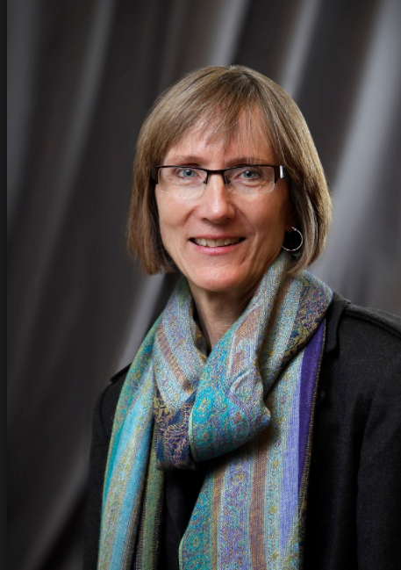
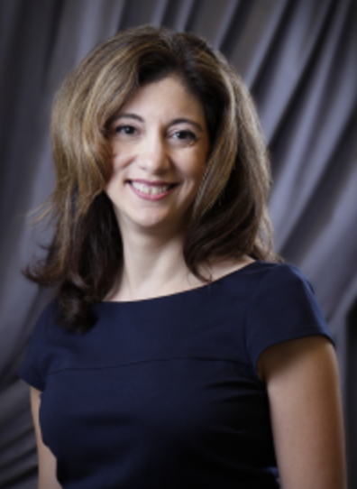
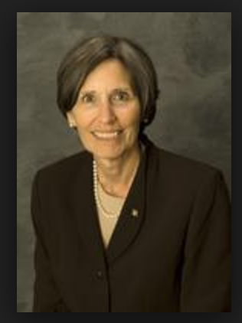
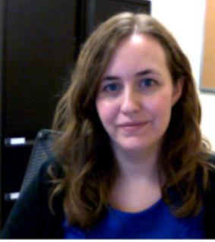
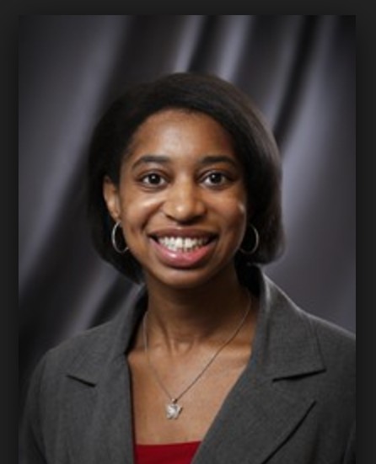
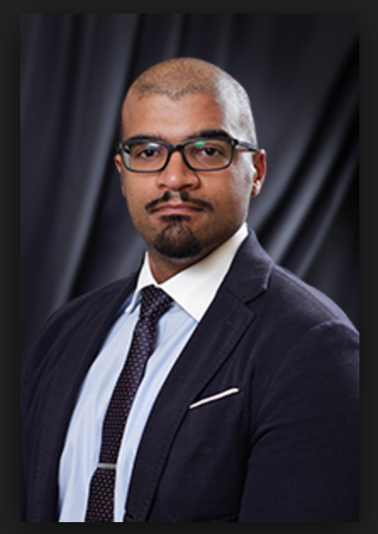
Your Librarians
ENGI
Medicine
Research Support
NSM
M.D. Anderson Library
Notes:
UH Library structure: Librarian/liaison model who are subject specialist that work closely with their academic departments.
Links to Subject Resources and Librarian Contact
Biology & Biochemistry: http://guides.lib.uh.edu/biology
Chemistry: http://guides.lib.uh.edu/chemistry
Computer Science: http://guides.lib.uh.edu/computerscience
Earth & Atmospheric Sciences: http://guides.lib.uh.edu/geo
Engineering
-Biomedical Engineering: http://guides.lib.uh.edu/biomedical
-Chemical Engineering: http://guides.lib.uh.edu/chemeng
-Civil Engineering: http://guides.lib.uh.edu/civil
-Electrical & Computer Engineering: http://guides.lib.uh.edu/ece
-Environmental Engineering: http://guides.lib.uh.edu/environmental
-Industrial Engineering: http://guides.lib.uh.edu/industrial
-Mechanical Engineering: http://guides.lib.uh.edu/mechanical
-Petroleum Engineering: http://guides.lib.uh.edu/petroleum
Mathematics: http://guides.lib.uh.edu/math
Physics: http://guides.lib.uh.edu/physics
Technology
-Biotechnology: http://guides.lib.uh.edu/biotech
-Computer Information Systems: http://guides.lib.uh.edu/CIS
-Construction Management: http://guides.lib.uh.edu/cm
-Digital Media: http://guides.lib.uh.edu/DIGM
-Electrical Power Engineering Technology: http://guides.lib.uh.edu/elet
-Human Development & Consumer Sciences: http://guides.lib.uh.edu/hdcs
-Mechanical Engineering Technology: http://guides.lib.uh.edu/mect
-Organizational Leadership & Supervision: http://guides.lib.uh.edu/OLS
-Supply Chain & Logistics Technology: http://guides.lib.uh.edu/sclt

Slide 4
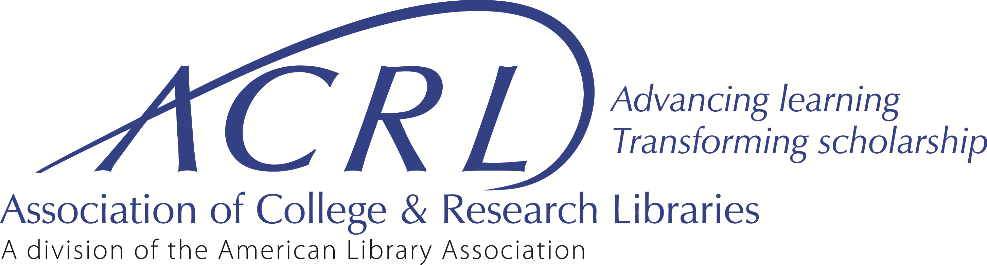
What is Information Literacy?
“Information literacy is a set of abilities requiring individuals to recognize when information is needed and have the ability to locate, evaluate, and use effectively and appropriately the needed information."
http://www.ala.org/acrl/standards/informationliteracycompetency
Notes:
Academic librarians and their partners in higher education associations have developed learning outcomes, tools, and resources that some institutions have deployed to infuse information literacy concepts and skills into their curricula.
Librarians have a greater responsibility in identifying core ideas within their own knowledge domain that can extend learning for students, in creating a new cohesive curriculum for information literacy, and in collaborating more extensively with faculty.
Information Literacy Defined
Information literacy is a set of abilities requiring individuals to "recognize when information is needed and have the ability to locate, evaluate, and use effectively the needed information." ¹ Information literacy also is increasingly important in the contemporary environment of rapid technological change and proliferating information resources. Because of the escalating complexity of this environment, individuals are faced with diverse, abundant information choices--in their academic studies, in the workplace, and in their personal lives. Information is available through libraries, community resources, special interest organizations, media, and the Internet--and increasingly, information comes to individuals in unfiltered formats, raising questions about its authenticity, validity, and reliability. In addition, information is available through multiple media, including graphical, aural, and textual, and these pose new challenges for individuals in evaluating and understanding it. The uncertain quality and expanding quantity of information pose large challenges for society. The sheer abundance of information will not in itself create a more informed citizenry without a complementary cluster of abilities necessary to use information effectively.
Information literacy forms the basis for lifelong learning. It is common to all disciplines, to all learning environments, and to all levels of education. It enables learners to master content and extend their investigations, become more self-directed, and assume greater control over their own learning. An information literate individual is able to:
Determine the extent of information needed
Access the needed information effectively and efficiently
Evaluate information and its sources critically
Incorporate selected information into one’s knowledge base
Use information effectively to accomplish a specific purpose
Understand the economic, legal, and social issues surrounding the use of information, and access and use information ethically and legally

Slide 5
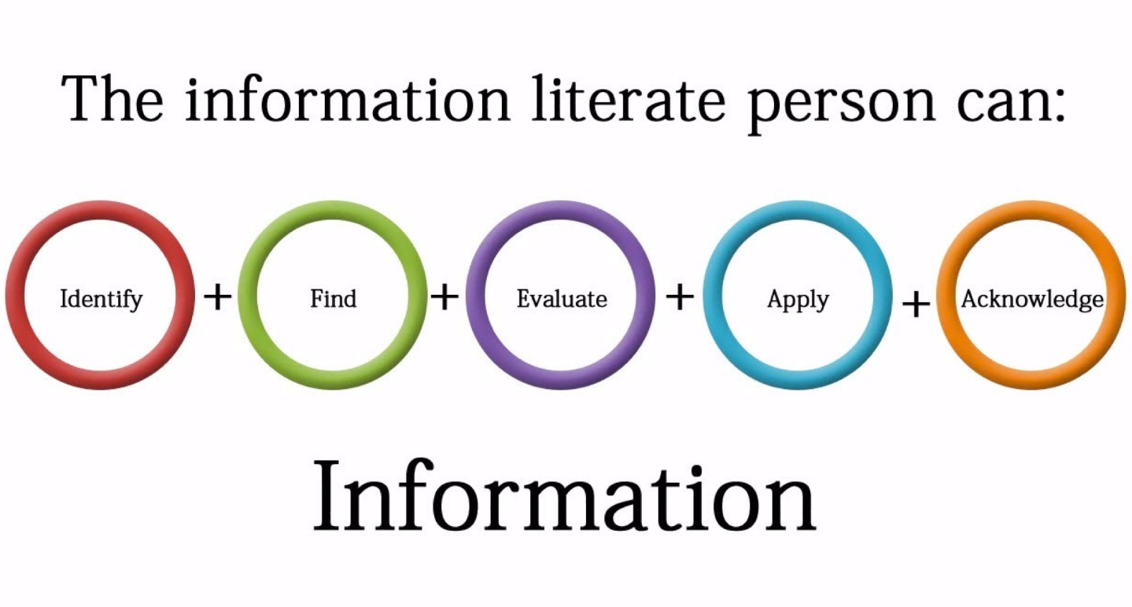
Notes:
IMAGE attribution: Martin, N.(2014). 5 Components of Information Literacy {Video file]. Retrieved from: https://youtu.be/1ronp6Iue9w
Determine the extent of information needed
Access the needed information effectively and efficiently
Evaluate information and its sources critically and incorporate selected information into one’s knowledge base
Use information effectively to accomplish a specific purpose
Understand the economic, legal, and social issues surrounding the use of information, and access and use information ethically and legally
Gaining skills in information literacy multiplies the opportunities for students’ self-directed learning, as they become engaged in using a wide variety of information sources to expand their knowledge, ask informed questions, and sharpen their critical thinking for still further self-directed learning. Achieving competency in information literacy requires an understanding that this cluster of abilities is not extraneous to the curriculum but is woven into the curriculum’s content, structure, and sequence. This curricular integration also affords many possibilities for furthering the influence and impact of such student-centered teaching methods as problem-based learning, evidence-based learning, and inquiry learning. Guided by faculty and others in problem-based approaches, students reason about course content at a deeper level than is possible through the exclusive use of lectures and textbooks. To take fullest advantage of problem-based learning, students must often use thinking skills requiring them to become skilled users of information sources in many locations and formats, thereby increasing their responsibility for their own learning.
To obtain the information they seek for their investigations, individuals have many options. One is to utilize an information retrieval system, such as may be found in a library or in databases accessible by computer from any location. Another option is to select an appropriate investigative method for observing phenomena directly. For example, physicians, archaeologists, and astronomers frequently depend upon physical examination to detect the presence of particular phenomena. In addition, mathematicians, chemists, and physicists often utilize technologies such as statistical software or simulators to create artificial conditions in which to observe and analyze the interaction of phenomena. As students progress through their undergraduate years and graduate programs, they need to have repeated opportunities for seeking, evaluating, and managing information gathered from multiple sources and discipline-specific research methods.

Slide 6
Competencies of Information Literacy
  Searching as Strategic Exploration
  Research as Inquiry
  Information Has Value
  Authority Is Constructed and Contextual
  Scholarship as Conversation
  Information Creation as a Process
Notes:
LINK to ACRL Information Literacy Concepts & Competencies: http://www.ala.org/acrl/standards/informationliteracycompetency

Slide 7
Searching as Strategic Exploration
Searching for information is often nonlinear and iterative, requiring mental flexibility to pursue alternate avenues as new understanding develops.
Notes:
LINK to ACRL Information Literacy Concepts & Competencies: http://www.ala.org/acrl/standards/informationliteracycompetency

Slide 8
Research as Inquiry
Research is iterative and depends on complex questions.
Notes:
LINK to ACRL Information Literacy Concepts & Competencies: http://www.ala.org/acrl/standards/informationliteracycompetency

Slide 9
Information has Value
As a commodity, as a means of education, and as a means to influence.
Notes:
LINK to ACRL Information Literacy Concepts & Competencies: http://www.ala.org/acrl/standards/informationliteracycompetency

Slide 10
Authority is Constructed & Contextual
Information resources reflect their creators’ expertise and credibility.
Notes:
LINK to ACRL Information Literacy Concepts & Competencies: http://www.ala.org/acrl/standards/informationliteracycompetency

Slide 11
Scholarship as Conversation
Communities of scholars, researchers, or professionals engage in sustained discourse.
Notes:
http://www.ala.org/acrl/standards/informationliteracycompetency

Slide 12
Information Creation as Process
Information conveys a message and is shared through various delivery methods.
Notes:
LINK to ACRL Information Literacy Concepts & Competencies: http://www.ala.org/acrl/standards/informationliteracycompetency

Slide 13
Competencies
Category | Tangible Abilities/Skills
Understanding Data | Ability to identify the context in which data is produced and reused (data life cycle)
 | Ability to recognize data types and formats
Finding/Obtaining Data Sources | Ability to find, select, and access data sources appropriate to the information needed
Reading/Interpreting Data | Ability to critically assess data after finding and obtaining.
 | Ability to use (identify) suitable data analysis and visualization tools and techniques.
 | Ability to synthesize multiple datasets
Managing Data | Ability to plan and organize a data strategy through the project life cycle.
 | Ability to handle, clean, and process data.
Using Data | Ability to apply results to learning, decision making, or problem solving.
 | Ability to make ethical use of data (transparency and honesty)
Share and Communicate Data | Ability to identify appropriate repository and prepare data for deposit (ingest)
 | Ability to communicate data through visualizations
Data Literacy
Notes:
Data literacy= the ability to collect, manage, evaluate, and apply data in a critical manner
Been, J. (2016).UH Libraries Data LiteracyCompetencies.

Slide 14
What Librarians Can Do
Identify ”Just In Time” Instruction
Create Learning Objects
  Research Guides
  Tutorials
Embed into Courses
  Blackboard presence
  Co-Instructors
  Rubrics
  Course Materials (Books, Journals, Databases)

Slide 15
Assisting Faculty with…
Curriculum competences for Information Literacy
Course Learning Objectives
Assignment Creation
Overall enhancing students confidence & skills in information seeking
Notes:
Thinking about how to approach teaching these class,
Active learing
Problem-based learning
Method is use of evidence and asking questions to answer a research question
seeing the value within the discipline and institution with the literature output

Slide 16
From Theory to Practice
Example Assignments & Assessments for Information Literacy

Slide 17
From theory to practice
Pre and post tests of student competencies
  Example Questions
    What is a primary article? Secondary?
    What is a review article’s main objective?
    Would this be an appropriate source to use? Why or why not?
    Name high impact journal title in this subject/discipline?

Slide 18
From theory to practice
Annotated Bibliography Assignment
  Example Questions
    Complete a citation that would allow some one to find the document.
    Which database or resource did you use and why?
    How did you determine your keywords to use in your search strategy?
    How reliable do you find this information? Why?
    Write and annotation for this article, evaluating the authors major claims, the reliability of the source, and any other reasons for choosing this article.
    How do you plan to use this article in your final paper?

Slide 19
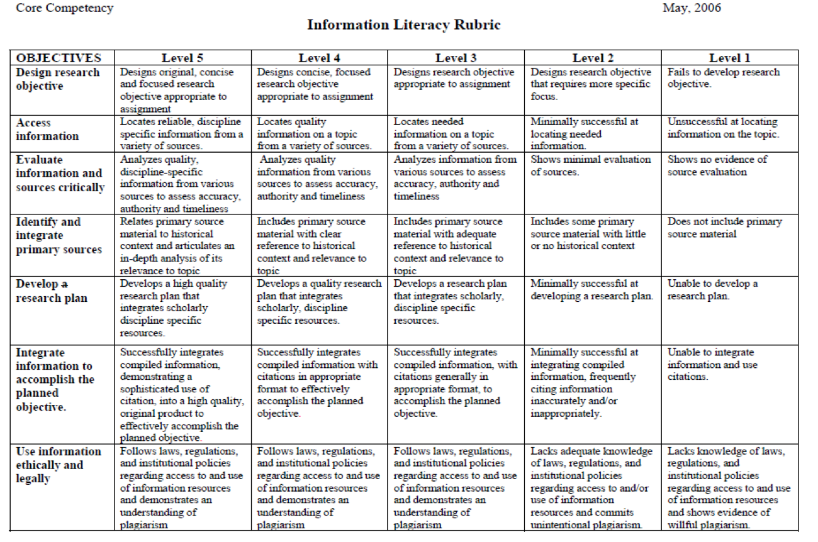
From theory to practice
Information Literacy Scoring Rubric
Notes:
Student is.. Developing, competent, proficient
IMAGE attribution: RAILS Rubric Assessment of Information Literacy Skills (2011). General Rubric. Retrieved from: http://railsontrack.info/

Slide 20
From theory to practice
Author/ Date (Citation) | Research Question(s)/ Hypotheses | Methodology | Analysis & Results | Conclusions | Implications for Future research
Literature Review Matrix
Notes:
Have student summarize and compare and contrast research articles as a step to critically evaluate literature.

Slide 21
From theory to practice
Keywords, Title, Abstract
  Examples
    Have student recreate 5 keywords or phrases.
    Have student recreate a 12 word title.
    Have student recreate a 250 word abstract.
Notes:
When we search databases our keywords are searched in the author keywords, title, abstract. Strip the keywords, title, abstract from course readings and have student recreate as a means to assess if they understand the content.

Slide 22
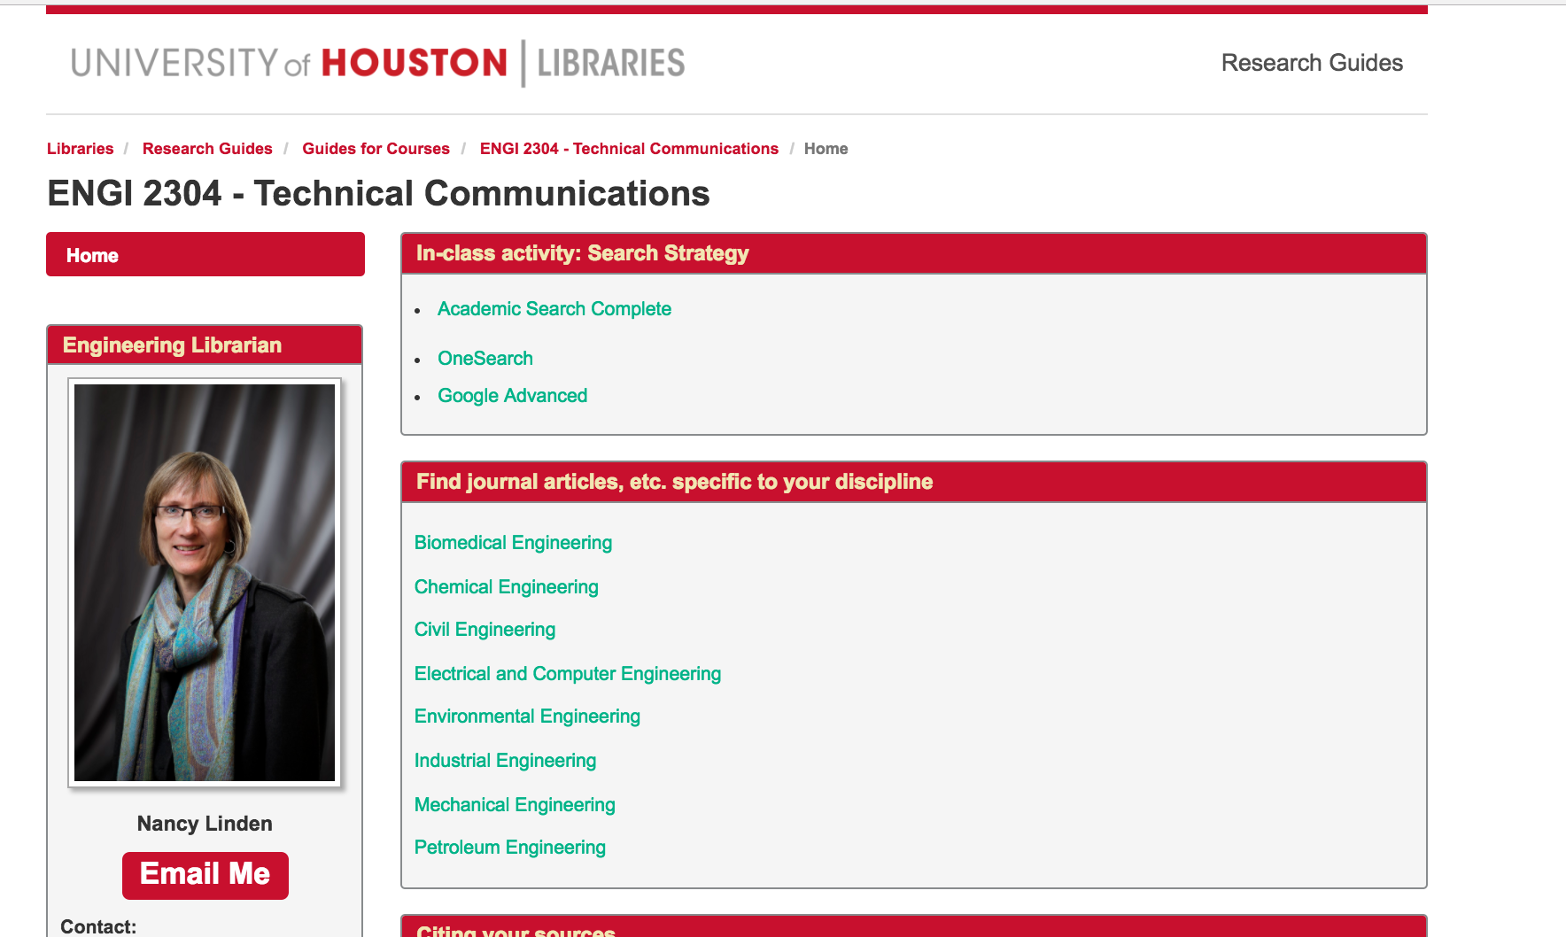
From Theory to Practice
Research Guides

Slide 23
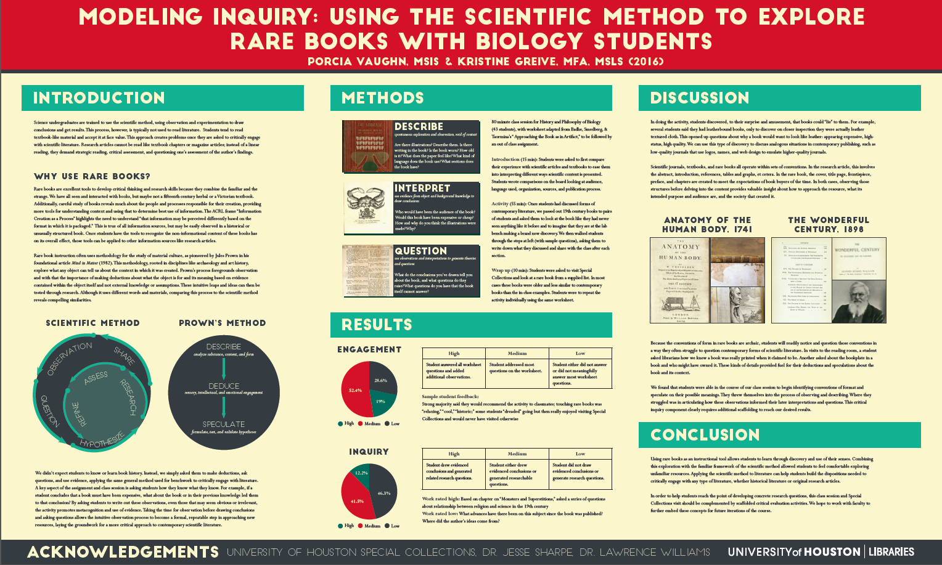
From theory to practice
Exploring Historical Literature

Slide 24
Successes & Lessons
Collaboration between liaison and faculty
Faculty excitement = student excitement

Slide 25
Next Step Questions
Do you know your librarian?
What are some ideas you have for collaborating with your librarian?

Slide 26
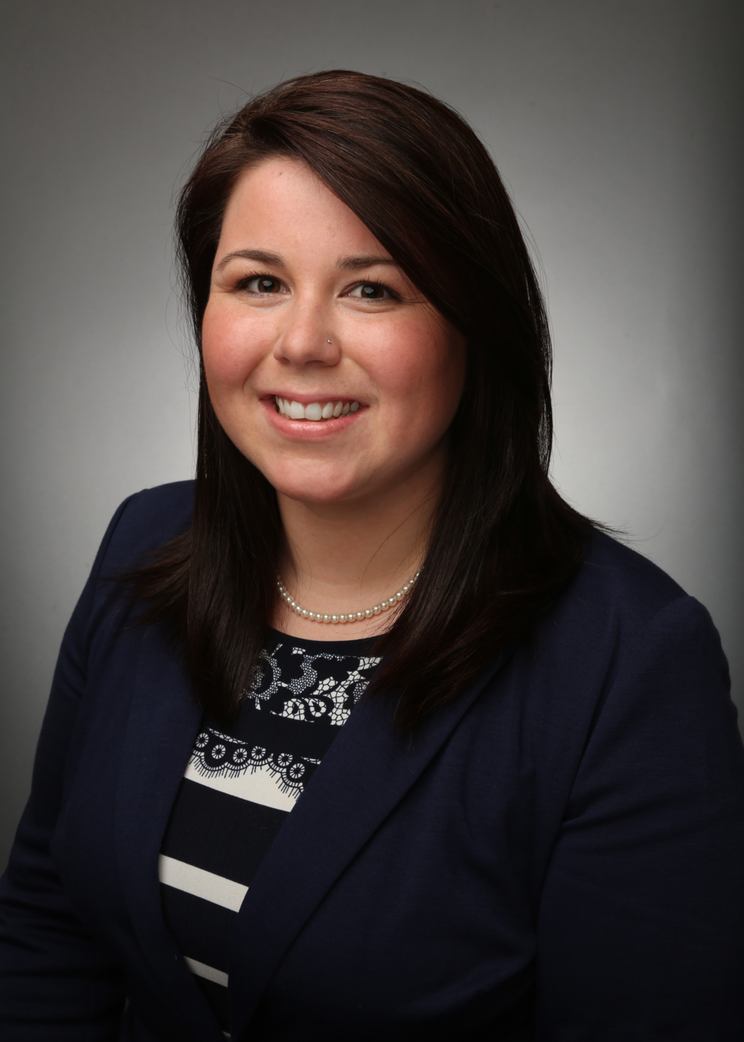
Contact Me!
Porcia Vaughn, porcianvaughn@gmail.com
Notes:
* I’m leaving UH on November 11th to work at the University of Texas Austin as the Biological Sciences Librarian who will continue to work on information literacy instruction in STEM and faculty publication and research support. Please feel free to contact me!

