Slide 1

How to teach novice students how to study
Chad Wayne, Ph.D.

Slide 2
What is the most important thing taught in your course?
The learning objectives outlined in the syllabus
The skills that help your student become proficient with the material and become a life-long learner

Slide 3
Not challenged academically in secondary education
Reading
  Limited, if any
Note-taking
  Rely mostly on handouts
Practice
  Given multiple attempts to complete assignments to satisfactory level
  Material reviews and practice exams
Assessment
  More frequent
Time management
  While important, is not quite so impactful

Slide 4
The challenge of higher education
Reading
  Voluminous
Note-taking
  May rely on handouts
Practice
  Limited
  Maybe material reviews and practice exams
Assessment
  Less frequent
Time management
  Impactful

Slide 5
Why teach students how to study?
Improve student success
  Better performance in your course
  Skills transfer to other courses
  Better learner for life
Give them life skills
  Organization skills
  Reading skills
  Time management skills
  Self-assessment skills

Slide 6
What to teach students?
Time management
Note-taking
When to study
How to use the textbook
Ask questions
How to uses assessments
The example of a perfect student
How to take multiple-guess exams

Slide 7
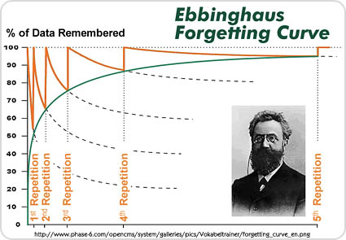
Time management
The Ebbinghaus forgetting curve
The flaws of procrastination (examples)
  Exercise v. Studying
  Focused v. Unfocused effort

Slide 8
Note-taking skills
Why go to class
  Asking the question: “What am I learning?”
  Experiential and associative learning
Writing v. reading as a study tool
Organizing ideas from slides & textbooks
Understand what the students are learning
  A&P answer two basic questions
Dos vs. Don’ts of study note taking

Slide 9
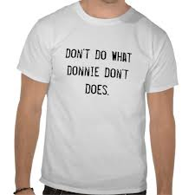
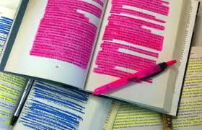
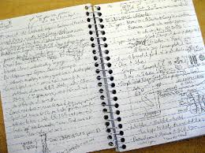
The Do’s & Don’ts of study-note taking
Don’t rewrite everything on the slide
Do write the important information that explains the topic being studied
  Condense the topics to the important facts
  Focus from top to bottom: concepts to facts

Slide 10
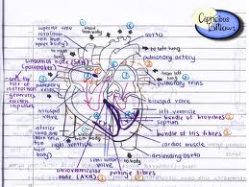
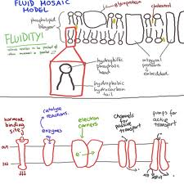
The Do’s & Don’ts of study-note taking
Don’t rewrite everything verbatim
Do use your own words and language
  Explain the information to yourself.
  Think of examples that you understand
  Abbreviations and pictures are your friends

Slide 11
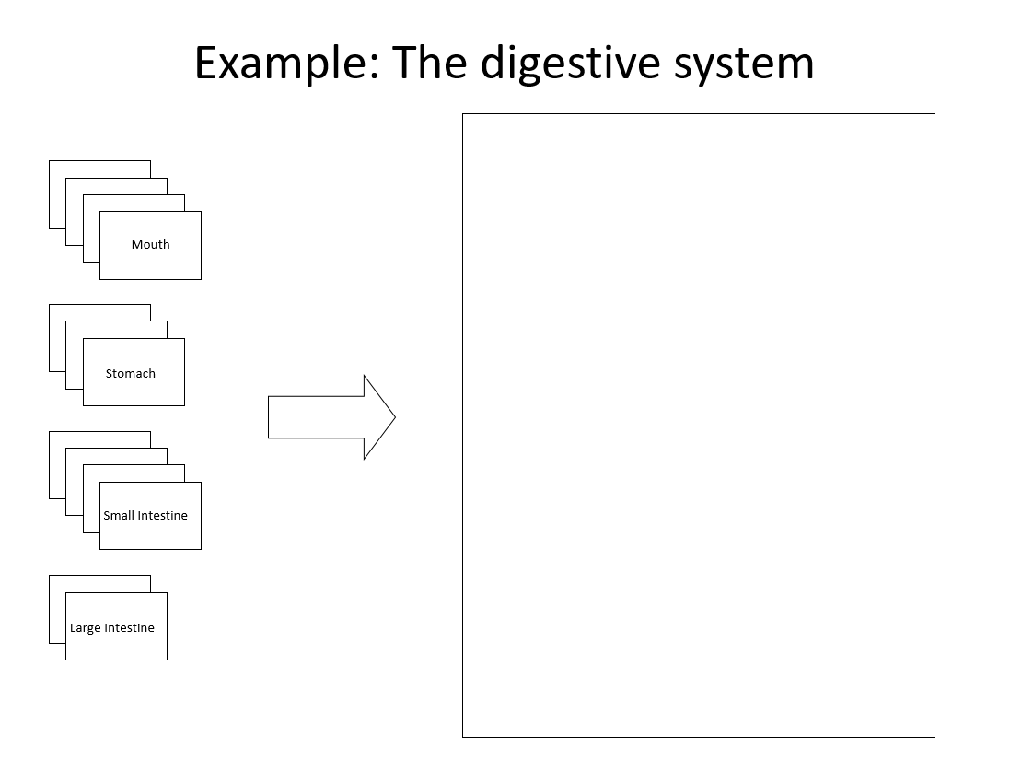
Show them an example

Slide 12
When should a student study
Weekly (about 30 minutes a day)
  Before class
  Immediately after class
  Day after class
In preparation for an exam
  Use the 4 to 5 days prior

Slide 13
Weekly material engagement
Example for freshmen A&P students
Weekly (5 days a week)
About 30-60 minutes a day
  Before class
  Immediately after class
  Day after class
Su
M
Tu
W
Th
F
Sa
Class
90 m
Class
90 m
HW
10-15 m
Notes
30 m
XC
10-15 m
Notes
30 m
HW
10-15 m
HW
10-15 m
HW
10-15 m
HW
10-15 m
HW
10-15 m
XC
10-15 m
XC
10-15 m
XC
10-15 m
XC
10-15 m
XC
10-15 m

Slide 14
Weekly material engagement
Example for junior Physiology students
Weekly (5 days a week)
About 30-60 minutes a day
  Before class
  Immediately after class
  Day after class
Su
M
Tu
W
Th
F
Sa
Class
90 m
Class
90 m
Notes
30 m
Notes
30 m
Reading 30-45 m
Reading 30-45 m

Slide 15
How to study notes
Reading notes is a surefire method of earning a C or worse
Rewrite notes from scratch without looking
  Forces students to self-explain topics
  Identifies what a student knows vs not knowing
  Prevents self-deception
  Forces engagement
Correct errors from scratch notes
Rest between attempts (10-20 min)
Repeat until 100% comfortable with the information
  Provides an end-point
Provides nervous test-takers a proof of readiness

Slide 16
Exam prep
Example for exams
Weekly (5 days a week)
Between 30-90 minutes a day
  Use lead up to exam to review
  Emphasize Ebbinghaus curve
  Self assess to determine how much time to spend
Su
M
Tu
W
Th
F
Sa
Class
90 m
Exam
90 m
Notes
30 m
Reading 30-45 m
Self-test
30 m
Self-test
60 m
Self-test
60 m
Self-test
60-90 m

Slide 17
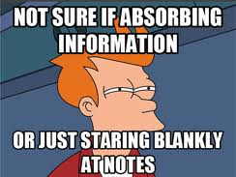



How to study (remaining focused)
Don’t be unfocused – if you are unfocused you spend useless time doing something you don’t want to be doing
Do use your time wisely – if you remain focused, then the time saved can be used for more important things

Slide 18

Using the textbook
For Preview
  Provides a roadmap for what will be discussed in class
    Familiarize yourself with its organization
    Helps identify the course learning objectives
  Read it like a story
For Review
  The textbook is a valuable resource when something just doesn’t make sense
  Find the section for the topic that is causing problems
    Read the section (and only that section) and take notes (in own words)

Slide 19

Asking questions
Don’t let complex subjects trip you up
Ask questions in class
  Remember you are not the only one who doesn’t get it. Ask your question, be a hero.
Out of class
  Make lists of things you don’t understand and when all else fails, contact the instructor
    E-mail the instructor simple questions
    Visit the instructor’s office for more complex subjects

Slide 20
Practice exams
Allow the student to see how an exam is structured
Not used to show student what to study
  No guarantees that the subjects on the practice exams are materials covered in class
  Often questions dropped from previous exams
Use it as the tool for which it is designed

Slide 21
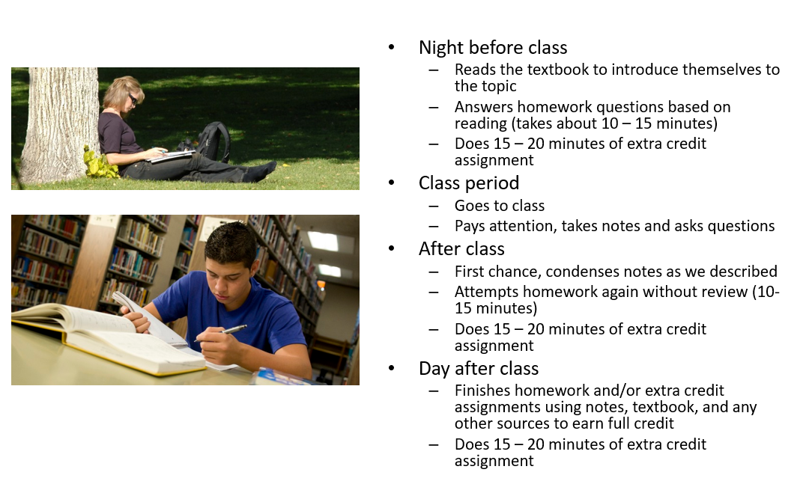
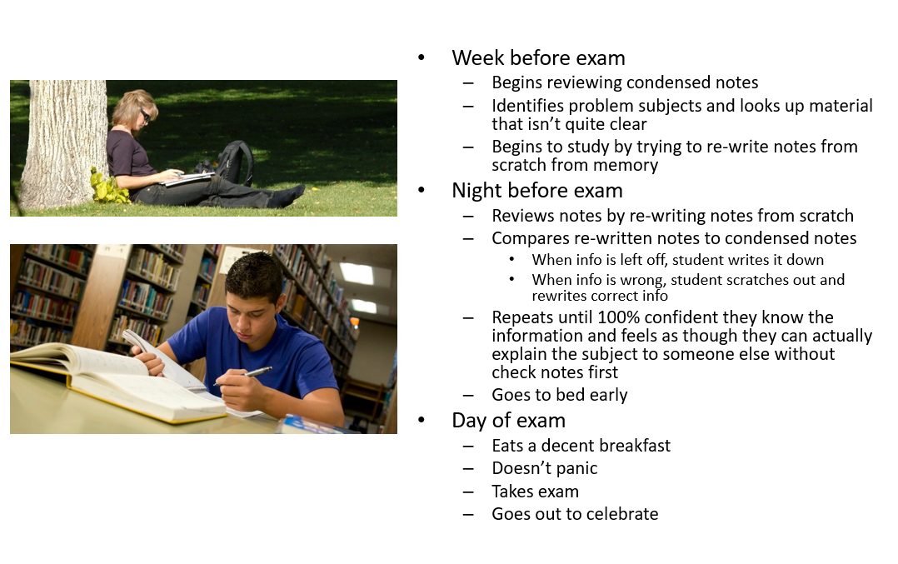
The perfect student example

Slide 22
Rules for taking exams
How to take multiple guess exams
  I suggest multiple rounds approach
How to check an exam
  Purpose is not to change answers but to find mistakes
  Read the question with the selected answer to determine whether the answer is a true statement

Slide 23
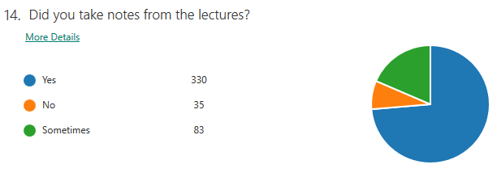
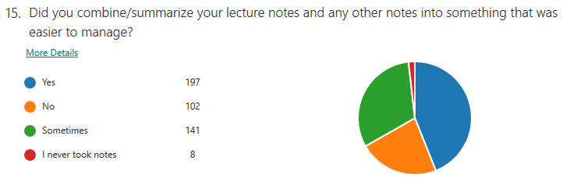
Will they listen? Results from Pre-test assessment

Slide 24
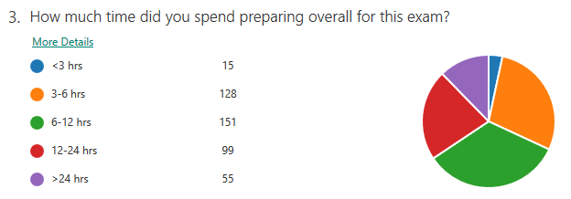
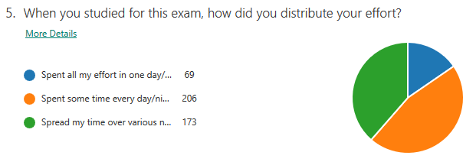
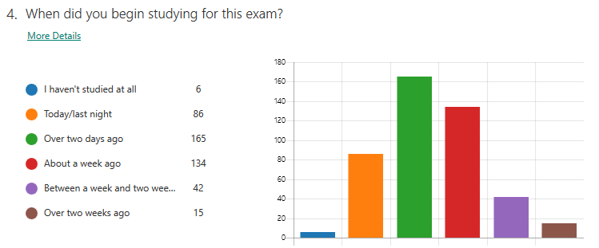
Will they listen? Results from Pre-test assessment

Slide 25
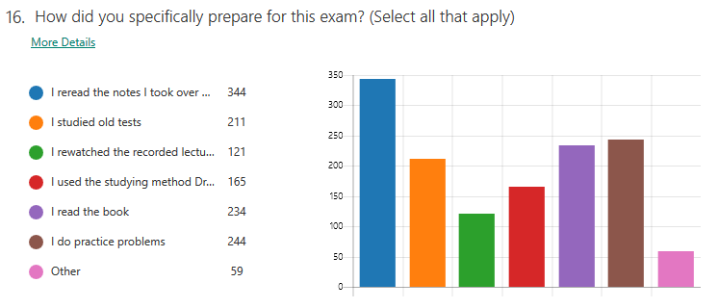
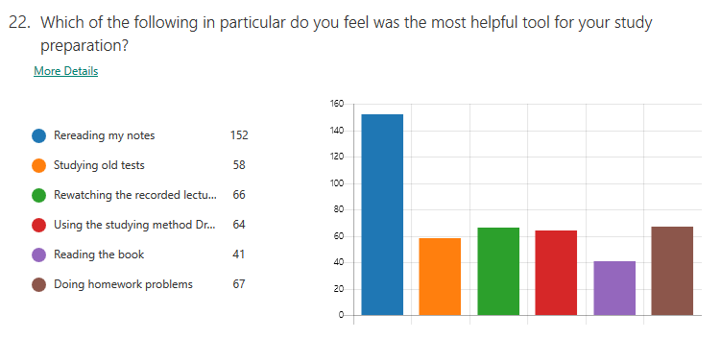
Will they listen? Results from Pre-test assessment

Slide 26
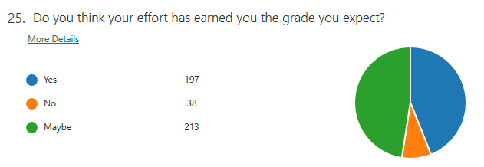
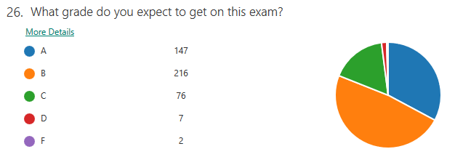
Will they listen? Results from Pre-test assessment

Slide 27


Questions?
cwayne@uh.edu

