Slide 1
Improving Course Accessibility
Brian Gharala – Instructional Designer FDIS
Andrea Arias Rodriguez and Ngozi Onwuama – NSM-IT Educational Technology and Multimedia Team

Slide 2
Agenda
What is Accessibility?
What are the Web Accessibility Guidelines?
Common Document Accessibility Issues and How to Fix Them.

Slide 3
Goals of This Meeting
By the end of this meeting, you should be able to:
  Identify ways you can improve the accessibility of your course documents using the inbuilt tools in Microsoft Word, Adobe Acrobat, and LMS Systems.
  Apply Accessibility Checkers to Course Documents.
  Identify and Apply Accessibility Best Practices to your Course Design.
Notes:
Promote Best Practices – Keep a word/Powerpoint file

Slide 4
Sections Outline
What is Accessibility?​
What are The Federal Web Accessibility Guidelines?​
Accessibility for Documents (Basic)​
  Headings​
  Text readability​
  Image Alternative Text​
  PDF is a scanned image of text
Accessibility for Documents (In-Depth)​
  Figures​
  Tables​
  Equations
  Video Captioning and Audio Description​
Accessibility Checkers/ Where to Find Assistance​
  Test Your Materials​
  Accessibility Checkers / Ally
  Resources​
Demo creating a document​​
Conclusion/Resources

Slide 5
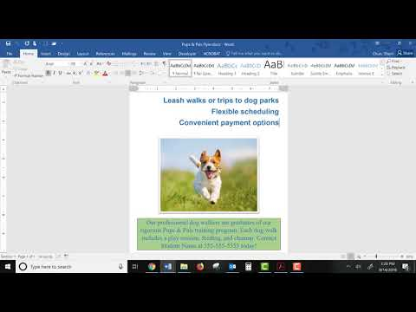
What is Accessibility?
The video below demonstrates how a screen reader is used to read a Microsoft Word document. Click on the video to play.
Accessibility is the concept of whether a product or service can be used by everyone—however they encounter it.
People with disabilities should be able to access the same course materials and participate in the same course activities using standard assistive technology or with appropriate accommodations.
Types of assistive technology
  Screen Reader (Visual)
  Captions/Transcript (Auditory)
Notes:
Simplified definition of accessibility

Slide 6
What are The Web Accessibility Guidelines?
People with disabilities must be provided the opportunity to (1) acquire the same information, (2) engage in the same interactions, (3) enjoy the same services as people without disabilities, with (4) "substantially equivalent ease of use.“ Texas law defines EIR

Slide 7
Accessibility for Documents (Basic)
Headings for document structure
Text is high contrast, reasonable font and size
Descriptive text for links
Alternative Text for images
OCR for scanned documents
Notes:
Keep these things in mind when creating documents or content in the LMS

Slide 8
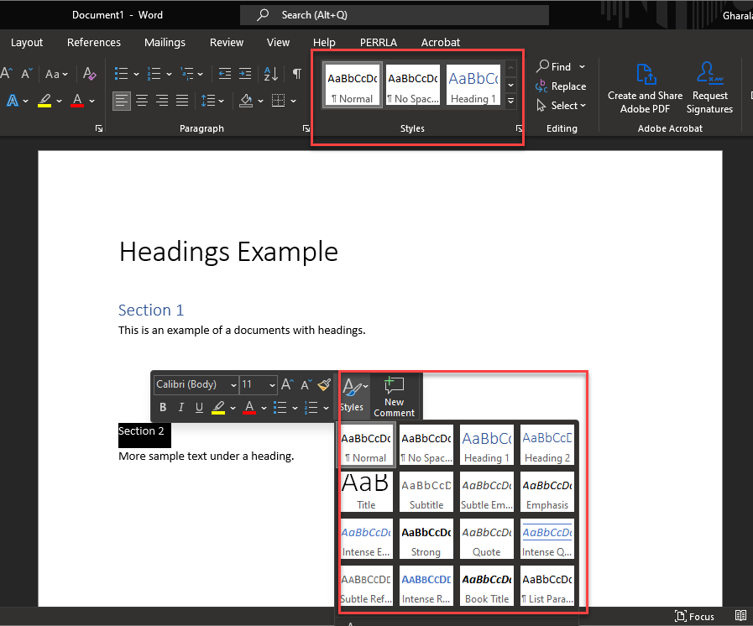
Headings
Use the Styles in the Microsoft Word toolbar
Use Heading 1 to break the document into sections
Use Heading 2 for sub sections
Headings are used by Screen Ready Users to quickly scan the page or jump to a specific section.
Notes:
Demo in word

Slide 9
Text readability
Text is high contrast, reasonable font and size
Descriptive text for links
  Do not use “Click Here”
  Avoid using the full web address
  Screen reader users can navigate between links on the page. It will read the text out loud. Click here is not descriptive enough. A full web address spelled out will take a long time to read.

Slide 10
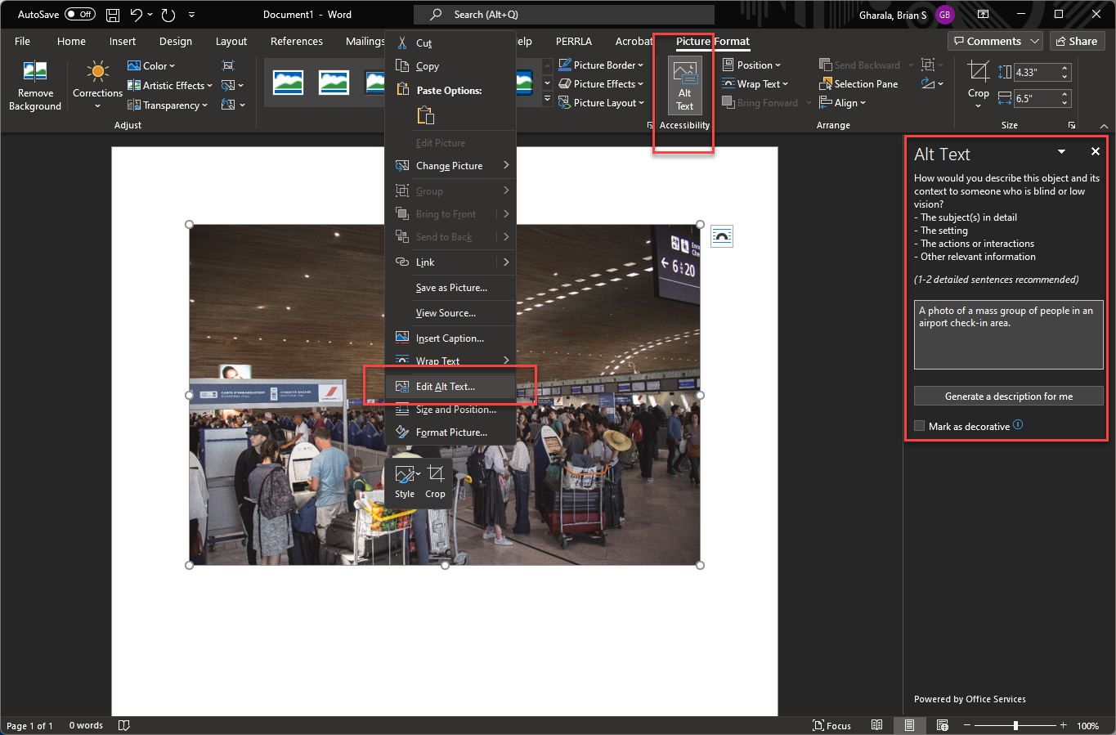
Image Alternative Text
Short description of the essential information conveyed by the image
If the image is purely decorative it a can be denoted as so.
In Word/PowerPoint right click on the image and select Edit Alt Text…
Alt text can also be adding using Adobe Acrobat
Web Accessibility Tutorial - Images

Slide 11
PDF is a scanned image of text
Since this is just an image of text it cannot be read using a screen reader (an assistive technology used by people with vision-based disabilities)
Avoid scanning book pages and instead make a request to the library to get a pdf copy to put in e-reserves.
If you must use a scanned document, make sure it is clearly readable and use OCR (Optical Character Recognition) in Acrobat or Word.
  Adobe Acrobat’s EDIT PDF tool uses OCR to recognize and convert text images to text.
  Opening the PDF in Microsoft Word will also use OCR to convert to text.
  The conversion will most likely have some mistakes.

Slide 12
Accessibility for Documents (In-Depth)
Figures
Tables
Equations (formulas) in classwork
Creating Accessible Quizzes/Exams
Video Captioning and Audio Description

Slide 13
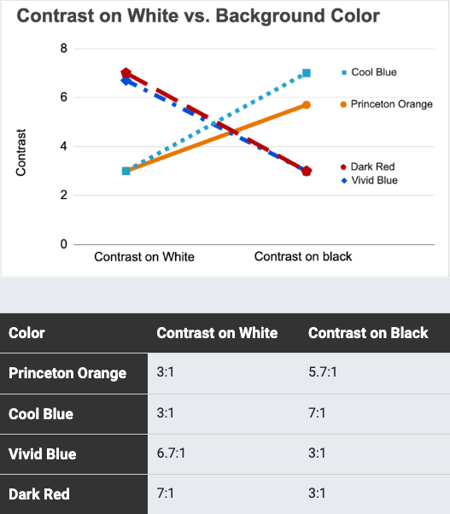
Figures (Charts, Diagrams, or Graphs)
  Create Descriptive Alt text for the information or relationships communicated.
    Communicating Complex Information
  Do not rely solely on the Font / Color to convey information.
    Best Practices for Communicating Color
  Color Contrast / Emphasis
    Ensure there is adequate color contrast between text and background (tip: use the Color Contrast Checker or the Individual impairments checker).

Slide 14
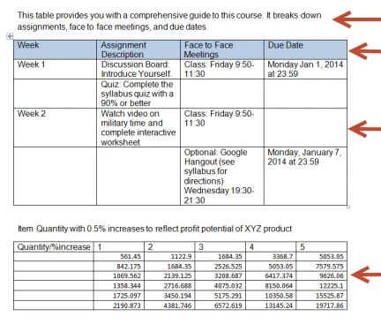
Tables
Best Practices
  Do not use tables for design layout.
  Add brief descriptive text directly before the table when possible.
  Tag row and column headers so that screen readers can identify content.
  Do not merge or leave blank spaces in tables, as it can confuse screen readers.
  When possible, break up complex tables (nested tables and merged or split cells inside of tables) into a series of simple tables.
Table Creation Resources
  Accessible Tables in Word
    Create an Accessible Table in Word - Perkins School for the Blind
    Create an Accessible Table in Word – Microsoft Tutorial
  Accessible Freestanding Tables (For Figures, Exams, and other uses)
    Tables Tutorial – W3c Web Accessibility Initiative
    Accessify Accessible Table Builder

Slide 15
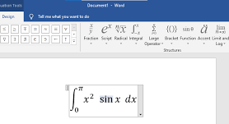
Equations
Equations in Classwork
  Use the equation editor to write all equations in Microsoft Word
Equations in Quizzes/Exams​
  In Blackboard: Inbuilt MathType tool, MathJax and Latex depending on what you have available.​
  ​
Hard-copy Exams​
  For students who need accommodations, provide the DART center with an electronic Word version of the exam.​
  No need to start from scratch if a Word file is unavailable, use Respondus 4 to download a word copy (Windows computer only).

Slide 16
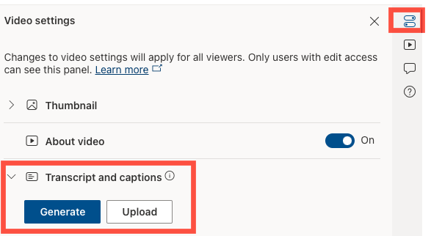
Video Captioning and Audio Description
Upload videos to OneDrive and enable transcription in the settings
  Closed captioning (so that users can turn them off/on)
  How to Generate Transcripts for Videos Uploaded to OneDrive
Videos recorded in Microsoft Teams have transcripts, Zoom files recorded locally come with VTT files.​
​Audio Descriptions ​
  Important to consider when using simulations in coursework.​
  Mac recording or Team's private channel recording.​
  Audio description can be substituted with descriptive text underneath each simulation.​
  More information on Audio Descriptions.

Slide 17
Accessibility Checkers/ Where to Find Assistance
Test Your Materials
Accessibility Checkers and Ally
Resources

Slide 18
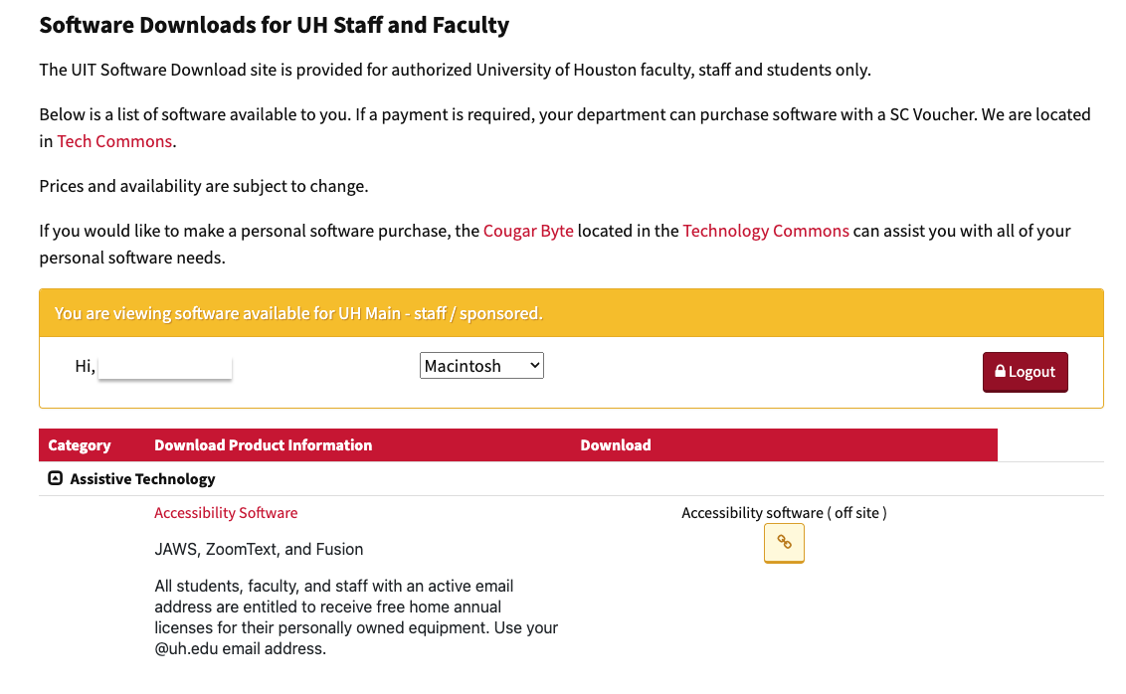
Test Your Materials
Windows Users: Download JAWS at the UH Software Downloads Page
  How to download and use JAWS
Mac has a built-in screen reader in settings called Voice Over
Use MS Immersive Reader or the "Read Aloud" Function in Microsoft Word

Slide 19
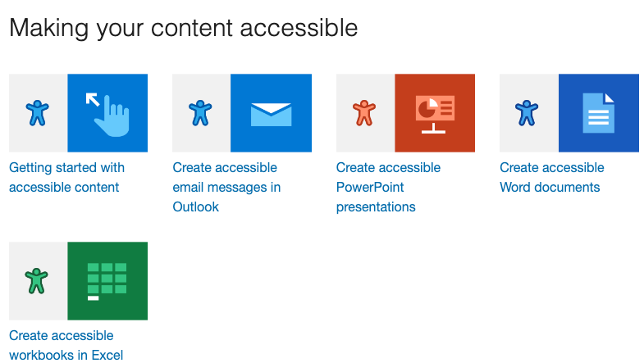
Accessibility Checkers
For Documents:
  Microsoft Office and Adobe Acrobat have accessibility checkers that you can use to check for issues before uploading to Blackboard.
  Make use of the Microsoft O365 suite of tools that have accessibility tools.
For Websites
  Web Content Accessibility Guidelines (WCAG) 2.1
  Web Aim's WAVE Web Accessibility Evaluation Tool.
  Silktide's Disability Simulator for the web.

Slide 20

Ally
Ally automatically rates the accessibility of your Blackboard content and shows you how to fix accessibility issues.
The accessibility scores are low (red), medium (yellow), high (light green), and perfect (dark green).
You want to fix content that is low or medium scoring.
Items with a high score can usually be easily fixed.
You can view the score directly in your content areas, content collection, or Course Tools > Accessibility Report.
Ally will also be available in Canvas.

Slide 21
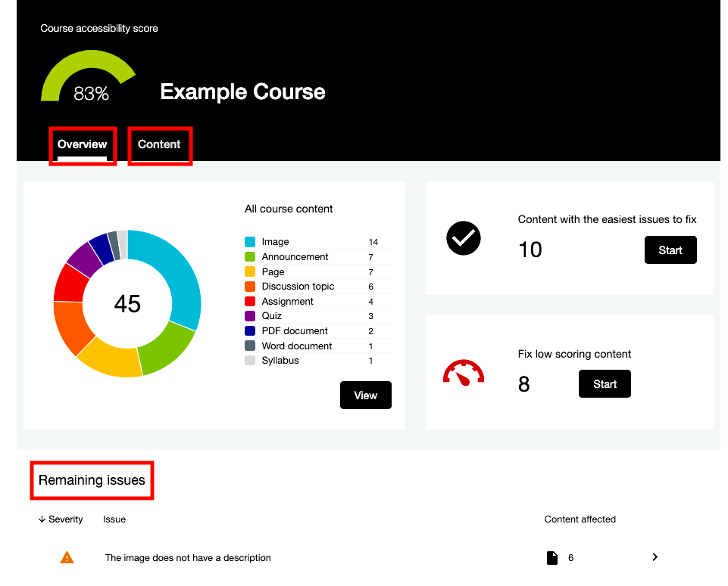
Accessibility Report Dashboard
Located under the Blackboard Course Management menu Course Tools > Accessibility Report
Easily find content with accessibility issues
Content Collection – remove old files that are not being used
Notes:
Live Demo in BB. Show easily fixed and low scoring

Slide 22
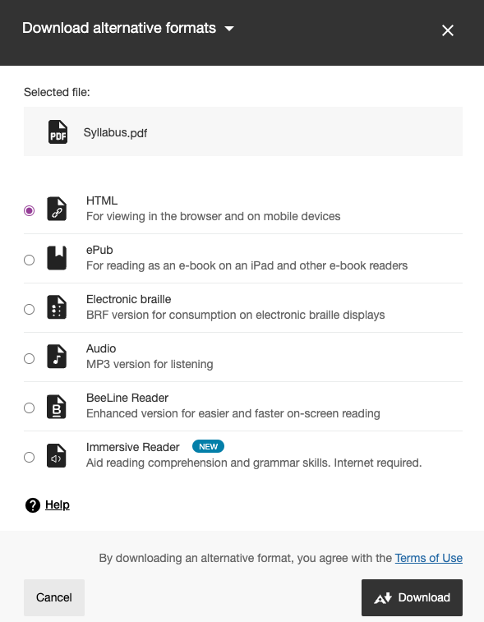
Ally Alternative Formats
Instructors and students can download content in other formats that can be more accessible for certain needs.
Ally does the conversion.
The formats include HTML, ePub, Electronic braille, Audio (MP3), BeeLine Reader, and Immersive Reader.
Notes:
Live Demo and explain each format

Slide 23
Conclusion
Learning Objectives
  Identify ways you can improve the accessibility of your course documents using inbuilt tools in Word, Adobe Acrobat, and LMS Systems.
  Apply Accessibility Checkers to Course Documents.
  Identify and Apply Accessibility Best Practices to your Course Design.
Practice the fundamental accessibility solutions to create accessible documents.
Numerous resources and tools are available to help ensure everyone can access digital offerings.
Keep this presentation for reference.

Slide 24
Resources
EIR Ally Training Video for Instructors
EIR Accessibility Self-Guide
20 Tips for Teaching an Accessible Online Course
Making Science Labs Accessible to Students with Disabilities
More Information about Ally
  Blackboard Ally Tutorials on Instruction@UH
  Blackboard Ally - UH Equal Opportunity Services (EOS)
Outside Resources
  Chekemeta Center for Academic Innovation Accessibility Checklist

Slide 25
Demo Creating a Document
Headings
Alt Text
Tables
High Contrast Color

Slide 26
Questions

