Slide 1
Assessment of Student Learning
Faculty Development Workshop
October 31, 2013
Donna L. Pattison, PhD
Instructional Professor
Department of Biology & Biochemistry

Slide 2
What types of things are helpful to assess :
a. At the classroom level?
b. At the program level (department)?
c. At the university level?

Slide 3
What types of things are helpful to assess?
a. At the classroom level?
Attitudes and motivation
Learning objectives
Activities (specific assignments, homework,
field trips, case studies, clicker useage, etc.)
b. At the program level (department)?
Program learning objectives
Retention
c. At the university level?
Retention
Student success across demographic variables

Slide 4
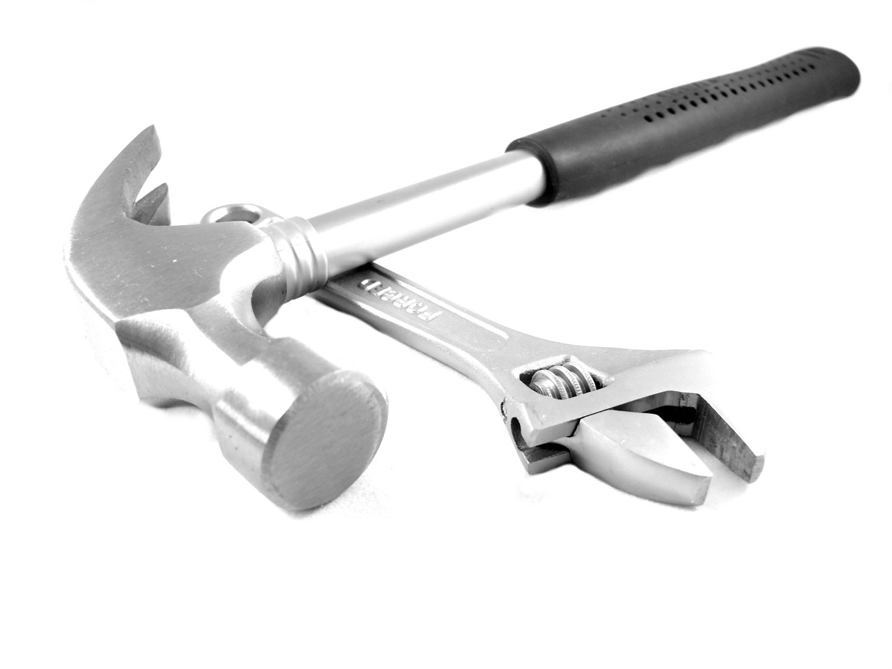
What tools can we use for assessment?
Share your ideas and tricks of the trade with your discussion group.

Slide 5
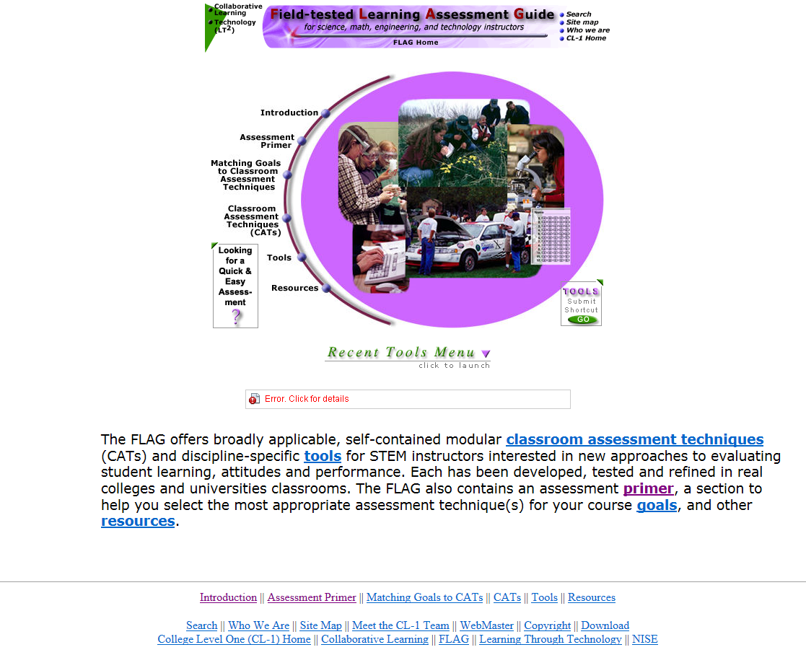
http://www.flaguide.org/

Slide 6
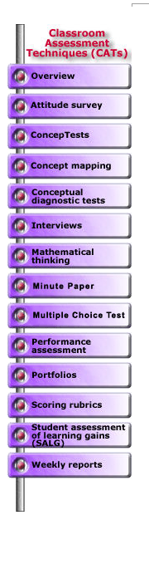
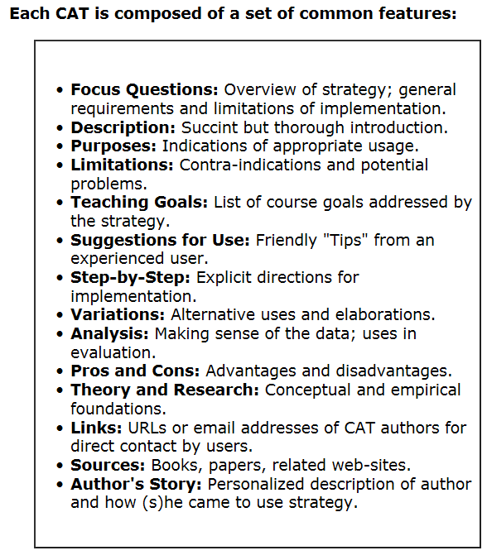
http://www.flaguide.org/cat/cat.php

Slide 7

Two types of pre-/post-course surveys:
Attitudes and Beliefs
Knowledge

Slide 8
Surveys to assess a particular activity
or ask a specific question :
What were student perceptions on the field trip?
What courses have students taken prior to this one?
Did you find this learning activity helpful in mastering the concept?
Quantitative: Use a Likert Scale (1 to 5)
Qualitative: Open ended questions

Slide 9
Examples of Student Responses to an Open Ended Question
Why the comment was informative to the instructor in red
List at least one thing you learned on the field trip:
We should measure our successes in square feet and not in acres. (Prairie planting field trip). Student understands how difficult conservation is.
I learned how there are so many diverse factors that can affect a species all with different consequences. The frog near the Rio Grande behaves differently than the ones in the greater Houston area. It was interesting to see how scientists pose questions and think about all the different ways in which a hypothesis can be answered (mapping the campus frog population trip). The nature of science was successfully conveyed!
Undergrads can do research. The word is getting out!
The number of mass extinctions was more than I had thought (Paleontology Hall). The student has modified their understanding of the world.
Possums don’t carry rabies (Texas Wildlife Rehabilitation Coalition field trip). Another common misconception has been debunked!
CO₂ in the air is where plants get their carbon (Community Garden Field Trip). Not the soil! Common misconception corrected!
You have to know what questions to ask with a multiple choice question. With an open ended question, you often learn surprising things and can see through the student’s eyes.

Slide 10
How can surveys be administered?
Paper
Scan Trons
3. Blackboard
Survey Monkey

Slide 11
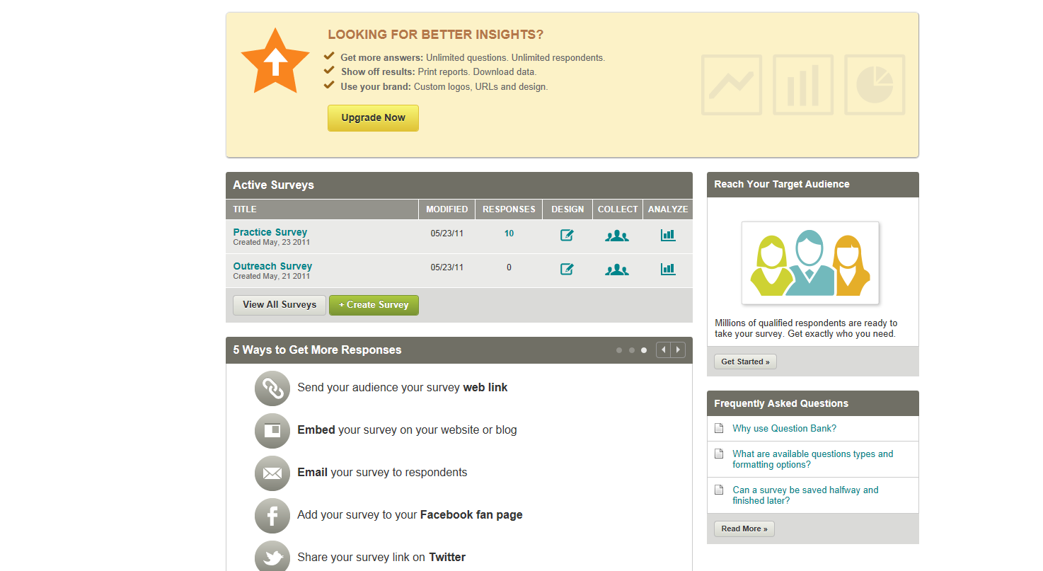
SurveyMonkey
Free
Easy to use
If you need to match responses to an individual, you must use the full version. The free version only gives you aggregated data.
A lot of ways to share:

Slide 12
How do you get reasonable participation rates?
A modest number of points
Class credit
Extra credit
Complete at the beginning of class
Exit surveys
Incentives (drawing for prize)

Slide 13
How do we know if an assignment was effective?
Quiz or exam
Track attempts on electronic homework
Pre- and post- assessments
Ask students to explain or illustrate

Slide 14
Assessment is Iterative
Ask questions about teaching or learning
Collect
data
Evaluate data
Modify teaching, assignment, etc.
Tanner, K. and Allen, D. (2004) Approaches to Biology Teaching and Learning: From Assays to Assessments—On Collecting Evidence in Science Teaching. Cell Biology Education. (3), 69-74.

