Slide 1

Undergraduate Research

Slide 2
Benefits ! Unique and valuable experience
Students experience research first-hand
Experience motivates students to go to graduate school or research career
The research findings make a contribution to the field
Faculty interaction and access
Real-world application
Expand knowledge of subject matter
Develop important skills

Slide 3
Skills needed and /or will be developed
Drawing conclusions and critically analyzing information
Defining and solving problems
Communication skills
Working independently
Understanding and applying research methods, ethics, and conduct rules
Understanding the link between academics and future careers
Utilizing technology and computer programs
Innovative thinking
Getting along with people who have different attitudes, opinions, and backgrounds

Slide 4
CS Undergraduate research (REU)
The University of Houston Department of Computer Science will conduct a Summer 2017 research program for undergraduate students during the period of June 5th through August 11th, 2017. The Department has funds available for 10 students.
http://www2.cs.uh.edu/~reu/

Slide 5
Provost’s Undergraduate Research Scholarship (PURS) - Fall 2017
PURS is a part-time, faculty mentored semester research opportunity. It awards $1K scholarships for the fall 2017 semester.
Full-time juniors and seniors from all majors with at least a 3.0 GPA are eligible to apply.
The deadline is Friday, April 28. For more information and to access the online application.
http://www.uh.edu/honors/undergraduate-research/uh-research/purs/

Slide 6


Faculty name: Jaspal Subhlok
Email: jaspal@uh.edu
Project: Enhancing lecture videos for education by applying techniques from video analysis, machine learning and natural language processing.
Topics:
  How students employ video for learning?
  Combining text and speech to automatically segment lecture videos by topic
  Automatically summarize content of a section of a lecture video
Background: Good programming and analytical skills. Knowledge of statistical data analysis and SQL is a plus, but not a requirement.
For more information: icsvideos.cs.uh.edu

Slide 7
Faculty name: Zhigang Deng
Email: zdeng4@uh.edu
Type of undergraduate research project: Working together with PhD students in the research group, the undergrad students are expected to work on a research project to design and development of immersive 3D augment/virtual reality environment for telepresence and teleconferencing. (more information at http://graphics.cs.uh.edu/ )
Topic: computer animation, graphics, and human computer interaction
Time frame: Students can start as early as 3/1/2016. It can be a semester-long, or year-long efforts, depending on the students’ specific situations.
Student level: junior or senior undergraduate students are preferred. Sophomore students can be considered as well. For US citizen or green card holders, a certain amount of monthly stipend could be provided for this research involvement.
Courses accomplished: Having taken c/c++, data structure, and algorithms courses is required. Taking computer graphics course previously would be a plus.
Additional skills needed: Any experience or skills with OpenGL, OpenCV, or general graphics/vision/mobile computing would be a major plus.
GPA : >= 3.3

Slide 8
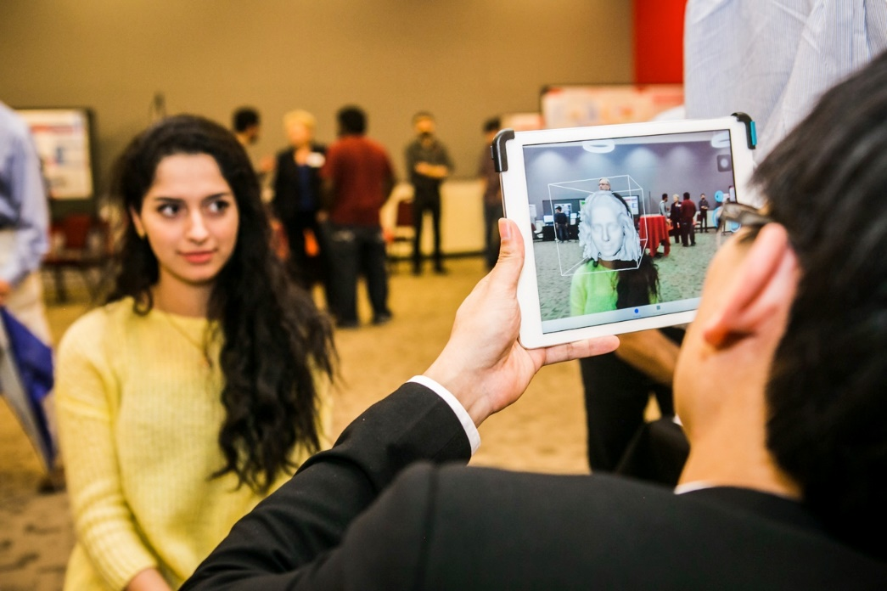
Faculty name: Ioannis A. Kakadiaris
Email: ioannisk@uh.edu
Type of undergraduate research project: Working together with PhD students in the research group, the undergrad students are expected to work on a research a project related to face recognition (biometric identify in general) and its applications on making our life earlier (more information at http://cbl.uh.edu/ ).
Student level: junior or senior undergraduate students are preferred. Sophomore students can be considered as well. For US citizen or green card holders, a certain amount of monthly stipend could be provided for this research involvement.
Courses accomplished: Having taken C/C++, data structures, and algorithms courses is required. Image Processing/Computer Vision experience would be a plus.

Slide 9
Faculty name: Shishir K. Shah
Email: sshah@central.uh.edu
Research Area: Undergraduate students will have an opportunity to work on a research project related to design and development of computer vision algorithms for intelligent video surveillance and monitoring and human motion and behavior understanding from videos (more information at http://qil.uh.edu/ )
Topics you would learn about: computer vision, image processing, machine learning, software systems
Suggested skills: Proficiency in programming (C/C++/Java/…), Data Structure, and Algorithms would be a benefit. Some exposure to Image Processing or Data Mining would be a plus. Any experience or skills in software design and development and experience with graphics and vision libraries would be a major plus.

Slide 10
Area: medical and mobile robotics
Faculty Name: Nikolaos V. Tsekos email: nvtsekos@central.uh.edu
Type of undergraduate research projects: Undergraduate students, working individually or in teams, will pursue research projects in the field of intelligent robotics. Two areas of focus are available: robot-assisted surgeries and mobile robots. The students will design and implement control software and/or physical prorotypes of robots and test them in eprforming specific tasks.
Topic: Robotics, path planning & control, sensors.
Time Frame: projects can start at any point and, the subject and duration customized to the particular interests of the students and their long term objective from this work. Projects can be customized for a semester, summer or year-long work.
Student Level: Junior or senior
Courses accomplished: C/C++ is needed. Highly desirable (but not required) are courses in: robotics, electroncis/devices, digital image processing or imaging, mobile computing.
Additional skills needed: Experience or any skills with robots, remote-conterolled models, microcontrollers or mobile computing, hands-on building of devices- electronics-models are a plus. Most important is motivation and desire to explore the fascinating area of robotics.

Slide 11
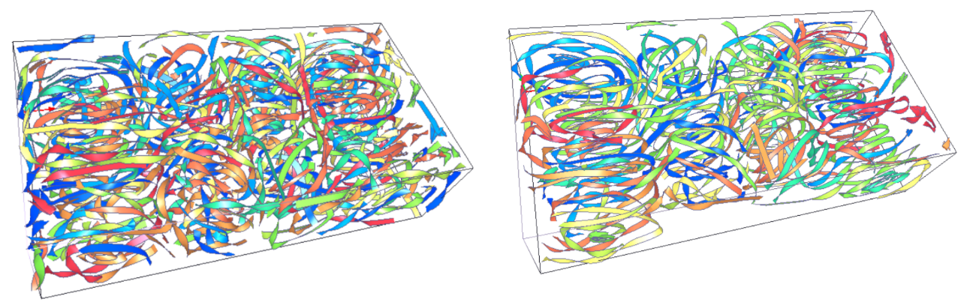

Guoning Chen chengu@cs.uh.edu
Undergraduate research project:
  (Project 1) the pathline placement/selection for unsteady flow visualization or
  (Project 2) the set up of an online visualization and scoring system to help collect data for the understanding of how human perceive and rank different visualizations.
Topic:
  Data visualization and analysis, computer graphics, algorithm design
Time frame
  The project(s) can start as early as the student is selected. Project 1 can be a semester-long, or a year-long project, depending on the students’ interest and situations. Project 2 will be about three month long.
Student level
  Students should have strong programming skills for both projects. For Project 1, C/C++ programming language will be used. For Project 2, javascript and other web-based language will be used.
  Junior and Senior students are preferred.
Courses accomplished
  Having taken C/C++ and data structure & algorithm courses is required. Experiences on numerical analysis (solving ODE/PDE) and computer graphics are preferred for Project 1. Knowledge on statistics is preferred for Project 2.
Additional skills needed
  Experiences with OpenGL/WebGL, VTK, CUDA/GPU, or QT would be a plus for Project 1.
which one looks better?

Slide 12



Achievement (1) Ricardo Vilalta
Improving Characterization of Supernovae
Using Deep Neural Networks
Improving Characterization of Supernovae
Using Deep Neural Networks
Automatic Recognition of
Features on Mount Olympus,
Planet Mars.
Automatic Recognition of
Features on Mount Olympus,
Planet Mars.

Slide 13
Achievement (2) Ricardo Vilalta
Learning to select the best predictive model in machine learning, a meta-learning approach.
Learning to select the best predictive model in machine learning, a meta-learning approach.
Neural Networks
Support Vector Machines
Neural Networks
Decision trees
Support Vector Machines
Decision trees
Any Guidelines?
Any Guidelines?

Slide 14
Faculty name: Nouhad J Rizk
Email: njrizk@uh.edu
Type of undergraduate research project: Educational Data Mining is an emerging trend that deals with the development of methods to explore data in educational context
Topic: Cyberlearning, data Analytics, data analysis, data analysis techniques and knowledge discovery process
Time frame: It can be a semester-long, or year-long efforts, depending on the students’ specific situations.
Student level: junior or senior undergraduate students are preferred
Courses accomplished: Student should have successfully completed the data structures course.
Additional skills: Knowledge in data analysis, R, and data mining is a plus, but not a requirement.

Slide 15
Faculty name: Christoph F. Eick
Email: ceick@uh.edu
Type of undergraduate research project: Working together graduate students in the research group, the undergrad students are expected to work on a research project; topics include: design and implementation of clustering algorithms, anomaly detection frameworks, and patch-based prediction techniques; application of data analysis and data mining techniques to make sense of real world datasets.
Topic: algorithms design, data analysis, data analysis techniques
Time frame: Students should contact me in April and the project could start in May or late August 2016. It can be a semester-long, or year-long efforts, depending on the students’ specific situations.
Student level: junior or senior undergraduate students are preferred; students should have a gpa of 2.8 or higher.
Courses accomplished: Student should have successfully completed the data structures course.
Additional skills: Knowledge in data analysis, R, and data mining is a plus, but not a requirement.

Slide 16
REU in Natural Language Processing
Faculty Member: Thamar Solorio Research Group: ritual.uh.edu
Contact email: solorio@cs.uh.edu
Current Projects: Mixed-Language Processing, stylistic analysis of text, cyberbullying detection, information extraction from support groups, language assessment.
Skills Needed: familiar with programming in python, strong analytical skills , resourcefulness, scientific curiosity
Course work: Data structures and algorithms
GPA: >3.0

Slide 17
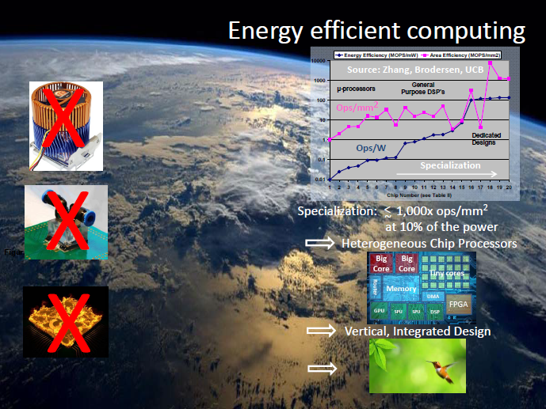
Faculty name: Lennart Johnsson
Email: johnsson@cs.uh.edu
Type of undergraduate research project:
Working together with graduate students
undergrad students are expected to develop
software for novel low power computer
architectures and systems on chips (SOCs)
and assess the efficiency and energy efficiency
of their software. The SOCs and low power
processors that are the objects of study are
typically targeted for mobile and embedded
applications.
Topic: computer architecture, algorithms, energy efficiency
Time frame: Students can start any time. Projects can be a semester-long, or year-long, depending on the students’ specific situations.
Courses accomplished: Having taken computer architecture, c/c++, data structure, and algorithms courses is required.

Slide 18
Omprakash Gnawali gnawali@cs.uh.edu
Type of undergraduate research project:
  The undergraduate student will design new platforms and technology as well as applications for Internet of Things systems. Examples include sensing, control, automation, wearable systems.
Topic:
  Networking and application for Internet of Things to build smart and connected cities, places, and environments.
Time frame
  Minimum of one semester commitment.
Student level
  Decent programming skills in any language.
Courses accomplished
  At least four computer science related courses completed with a minimum of B.
Additional skills needed
  Web and mobile programing is plus but not required.

Slide 19
Undergraduate Research Day
http://www.uh.edu/honors/undergraduate-research/events/urday2017/

