Slide 1
Breaking New Ground in Authorship Analysis: Leveraging Data in Cross-domain Settings
Thamar Solorio
Assistant Professor
Computational Representation and Analysis of Language (CoRAL) Lab
Department of Computer and Information Sciences
University of Alabama at Birmingham
Notes:
Cambiar lo negro con rojo y agegar el paper en revision

Slide 2
Forensic Linguistics: Real world example

Slide 3
Authorship Analysis
Notes:
Authorship Analysis is the task of extracting discriminant characteristics from written documents with the
goal of determining authorship of a document

Slide 4
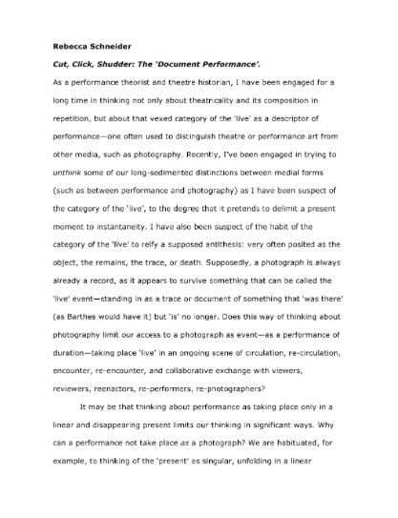
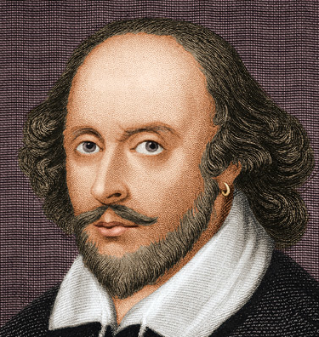
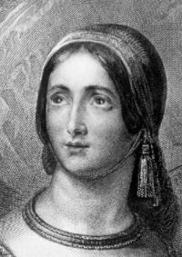
Authorship Analysis: Attribution
0, 1, 0, 0, 1, 0, 0, 0
Attribution
Model
Feature Extraction

Slide 5
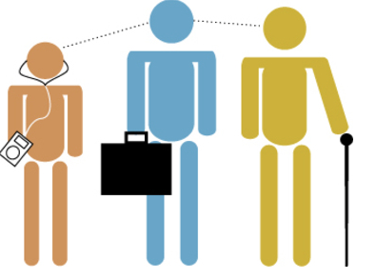
Authorship Analysis: Profiling
0, 1, 0, 0, 1, 0, 0, 0
Attribution
Model
Feature Extraction
Notes:
Authorship Analysis is the task of extracting discriminant characteristics from written documents with the
goal of determining authorship of a document, profiling the author of a document, to yield evidence in
a plagiarism dispute, or as a resource in computer forensics investigations.

Slide 6
Outline
Authorship Attribution (AA)
Applications & common frameworks
Cross-Domain AA
Problem set up
Research in Cross-Topic AA (CTAA)
New ideas to improve CTAA
Research Program
Authorship analysis
Code-switched data
Language assessment
Information extraction from clinical documents
Education & Outreach

Slide 7
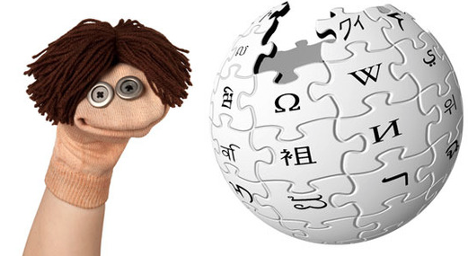
AA Applications
Resolve disputed authorship
Plays of Shakespeare (http://shakespeareauthorship.com)
National Security
Identify sources of terrorist plots
Criminal Law
Fight different forms of cybercrimes
Defend against pedophiles
Identify authors of malicious code
Verify the authenticity of suicide notes
Plagiarism
Data Provenance

Slide 8
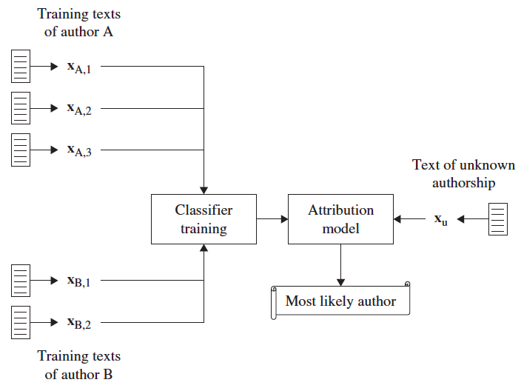
AA Approaches
Profile-based method
Machine learning method
(Figures due to Stamatatos 2009)

Slide 9
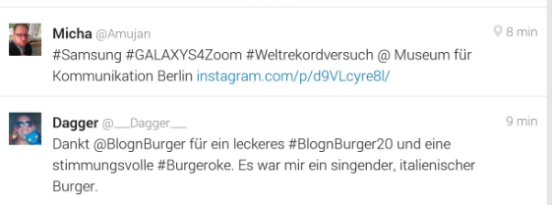
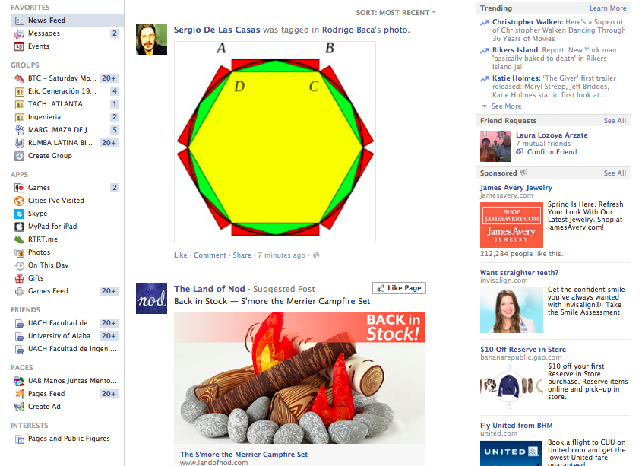
Gap in State-of-the-Art
Attribution
Model

Slide 10
Cross-Domain AA

Slide 11
AA in Cross-Domain Settings
Goal: To design new methods that can leverage out of domain data to improve cross-domain AA
Funding: NSF CAREER Award

Slide 12
Cross-Topic AA (CTAA)
Goal: Improve prediction performance in CTAA
Ideas:
Leverage information from other topics
Use distributional trajectories to map features into a common space

Slide 13
Datasets for CTAA
Dataset 1: language samples from 21 authors in six genres on six topics [Goldstein-Stewart et al. (2009)]
Dataset 2: texts published in “The Guardian” daily newspaper written by 13 authors on four topics [Stamatatos et al. (2013)]

Slide 14
AA Features
Char n-grams
Stop words
Stylistic
Lexical features
I think u were abit hard on me earlier, 1. I wasnt l8 purposely, 2, i nd a car 4assesments. Iv had a luk at myself in mirror n undastand 1, y u dnt fancy me n 2, y u dnt like me. Sory 4all the pain iv caused u, I love u amanda..... Chris. Xxx

Slide 15
Experimental Settings
Features:
Stylistic (13)
Char n-grams (n=3)
Lexical features (BoW)
Stop words (~630)
We fragment docs in dataset1
Machine learning algorithm: SVMs
Three AA models:
Train & test on same topic (IT)
Single cross-topic (SCT)
Multiple cross-topic (MCT)

Slide 16
How difficult is CTAA?
Columns IT and SCT show accuracy, column IT-SCT shows relative gain of IT over SCT

Slide 17
Cross-Topic AA (CTAA)
Goal: Improve prediction performance in CTAA
Ideas:
Leverage information from other topics
Use distributional trajectories to map features into a common space

Slide 18
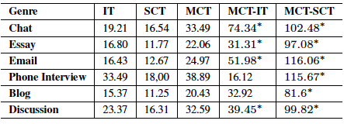
Leveraging Other Topics
Lexical Features
Stop words

Slide 19
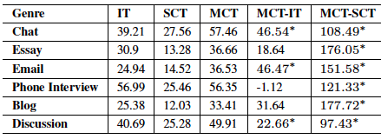
Leveraging Other Topics
Stylistic Features
Char n-grams

Slide 20
Results on Dataset 2

Slide 21
Cross-Topic AA (CTAA)
Question: Is it just the ‘more data’ effect or is there something else?

Slide 22
Analysis of Results

Slide 23
Summary of Contributions
Authors writing style is consistent across different topics
Comprehensive study of topic sensitivity of different feature types
More data helps, but diversity in topics will give the extra boost!
Simple approach

Slide 24
Cross-Topic AA (CTAA)
Goal: Improve prediction performance in CTAA
Ideas:
Leverage information from other topics
Use distributional trajectories to map features into a common space
Sapkota et al. (under review)

Slide 25
Distributional Trajectories
Pseudo-code:
Learn general linguistic distributions in large amounts of text
Do a “pseudo-translation” of features
Notes:
Our claim is that we can characterize language changes that occur when going from one domain to another,
in a very general way, by observing distributional correspondences in large amounts of text, written by a
large set of authors. More important, we can learn changes along specific linguistic dimensions. For instance,
we can observe changes in vocabulary by contrasting differences in the top K content words in each domain
and genre. We can also observe general stylistic changes across domains, such as changes in: top K sentence
lengths, the most frequent punctuation marks, frequent paragraph lengths, and so on.
The intuition behind this idea is that we can extract knowledge about
how text is written in different genre and domains, and then use this knowledge to predict how a particular
author will change his/her writeprint in the new domain. This is a reasonable assumption, since human
introspection dictates that authors will first learn the “practices” or format of a new domain, and then they
will adapt their writing accordingly.

Slide 26
Pseudo-Translation Model
t denotes tokens in the training domain
t’ denotes tokens in test domain
pos(x) is a function that returns PoS tags
θ is estimated using an EM-like algorithm
P(t) is estimated using a language model

Slide 27
A Motivating Example
From Dataset 1 we took two topics:
War in Iraq (I)
Catholic Church (C)
We removed data from 3 authors and used the rest to estimate lexical trajectories

Slide 28
Increasing Degrees of Domain Shift
Same-domain AA
Cross-topic
AA
Increasing need to transfer linguistic knowledge
lexical trajectories
Cross-genre AA
lexical, syntactic, and stylistic trajectories
Cross-modality AA
lexical, syntactic, speech fluency and production, and stylistic trajectories
Notes:
Our expectation is that as we move along each of these different
scenarios the AA models will demand richer linguistic knowledge mapping the changes from one domain
to the other. The diagram in Figure 1 shows how with increasing degrees of domain shift, the different
linguistic dimensions will change in relevance. At the top of the triangle we have same domain AA, where
there is no need for using domain adaptation techniques. As we move one level down to consider crosstopic
AA, we will need to rely on extracting lexical-level distributional trajectories. As we move towards
the base of the triangle, we will need to extract distributional trajectories along other linguistic dimensions.
The challenge this research will address is how these trajectories should be computed and integrated into the
model. Our findings will help advance all other tasks closely related to AA, including author profiling and
plagiarism detection, as most of them have to face the problem of domain shifts.

Slide 29
Putting it all Together
New approaches based on principles that are:
Linguistically grounded
Common-sense grounded
Can use Viterbi to translate text
Or word n-grams and syntactic knowledge
Interpolated language models
Notes:
The probabilistic framework described above requires us to create new approaches that can take advantage of
this knowledge. We will do so by using linguistic and common-sense grounded principles and observations
about the domains in question, in combination with corpus derived statistics. The simplest way to do this is
to replace the features for each author in the corresponding linguistic dimension by the most likely “pseudo
translation” feature, as determined by the Viterbi algorithm, which will result in something similar to the
example above. This will be a good starting point for cross-topic adaptation. More sophisticated approaches
will use word ngrams and additional grounding information. For instance, by mapping content words that
are in the vicinity of the same function words. In cases where we generate multiple mappings, we can rank
options using interpolated language models from the authors and the unlabeled target topic.

Slide 30
Research Program

Slide 31
Research Program
Authorship Analysis
Analysis of
Code-Switched
Data
Language Assessment
Information Extraction
from
Clinical Documents
Funding from NSF (00812134, 1018124)
Prediction of Language Dominance
Solorio et al. 2011
Language Status Prediction
Solorio and Liu 2008; Gabani et al. 2009; Solorio 2010; Ramírez de la Rosa et al. 2011; Gabani et al. 2011; Hassanali et al. 2012a; Hassanali et al. 2012b; Solorio 2013; Hassanali et al. 2013
Funding from UAB CAS Entrepreneurship Award
Grading Medical Evidence
Gyawali et al. 2012
Mining User Generated Data
Information Extraction from Patient Records
Osborne et al. 2013
Authorship Analysis
Analysis of
Code-Switched
Data
Funding from NSF CAREER, NSF (1254108), ONR (N00014-12-1-0217), UAB FDG
Authorship Attribution
Profiling
Plagiarism
Funding from NSF (0958088, 1205475)
PoS-Tagging
Solorio and Liu 2008a
Language Identification
Franco and Solorio 2007; Solorio and Liu 2008b
Shared task on language Identification in CS data
1st Workshop and Shared task (EMNLP 2014)
Language Assessment
Information Extraction
from
Clinical Documents
Pillay and Solorio 2010; Solorio et al. 2011a, 2011b; Escalante et al. 2011a, 2011b; Sapkota et al. 2013; Solorio et al. 2013; Solorio et al. 2014 (to appear)
Bogdanova et al. 2012a, 2012b; Sapkota et al. 2013; Gyawali et al. 2013; Bogdanova et al. 2014
Shrestha and Solorio 2013
Notes:
Change to white text

Slide 32
Research Program
Computational models of language to solve relevant problems
Gain better understanding of human language processing
New theories of language acquisition and evolution
Notes:
My research focus is on the development of innovative computational approaches to process spontaneous language
samples for solving relevant problems. My approach to tackle these research challenges is driven by my scientic
curiosity to better understand human language processing. All of my current projects have in common a desire to build
computational models of language that represent individuals (authorship attribution, and proling), and populations
(language and neurological assessment), or specic linguistic treats (negation detection in clinical documents), that
little by little contribute to the development of new theories of language acquisition and evolution.
In the coming years I will continue to develop a strong research program along the research lines described above. I
will continue to pursue cross-disciplinary collaborations that have allowed me to build more sophisticated models of
language. In addition, I will also continue to seek collaborations with other researchers in NLP, and across dierent
sub-elds in computer science, as relevant for my projects.

Slide 33
Education & Outreach

Slide 34
Education & Outreach
Mentoring research projects from high-school students to PhD
K-12 Outreach
Directed the last three editions of the Digital Film Festival
Since 2010, run local site for the North American Computational Linguistics Olympiad (~1800 high school students)
Industry
Daxko (SW development company)
Alabama Power

Slide 35
Acknowledgments
Lisa Bedore, U Texas
Steven Bethard, UAB
Elizabeth Blair, UAB
Hugo J. Escalante, INAOE
Binod Gyawali, ETS
Ragib Hasan, UAB
Julia Hirschberg, Columbia
Aquiles Iglesias, Temple
Yang Liu, UTD
Suraj Maharjan, UAB
Mainul Mizan, Amazon
Manuel Montes y Gómez, INAOE
Elizabeth Peña, U Texas
Paolo Rosso, UPV
Upendra Sapkota, UAB
Prasha Shrestha, UAB

Slide 36
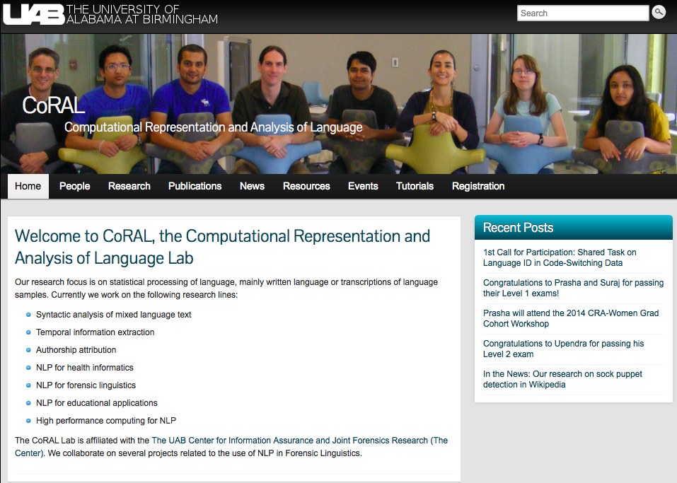
Thank you!
To U Houston for inviting me!
To learn more visit:
coral.cis.uab.edu
solorio.cis.uab.edu

Slide 37
References
T. Solorio, R. Hasan, and M. Mizan. Sockpuppet detection in wikipedia: A corpus of real-world deceptive writing for linking identities. In The 9th edition of the Language Resources and Evaluation Conference (LREC 2014), (to appear).
G. Ramírez de-la Rosa, T. Solorio, M. Montes-y-Gómez, Y. Liu, A. Iglesias, L. Bedore, and E. Peña. Exploring word class n-grams to measure language development in children. In Proceedings of the 2013 Workshop on Biomedical Natural Language Processing, pages 89–97, Sofia, Bulgaria, August 2013. ACL.
K. Hassanali, Y. Liu, and T. Solorio. Using latent Dirichlet allocation for child narrative analysis. In Proceedings of the 2013 Workshop on Biomedical Natural Language Processing, pages 111–115, Sofia, Bulgaria, August 2013. ACL.
T. Solorio, R. Hasan, and M. Mizan. A case study of sockpuppet detection in wikipedia. In Workshop on Language Analysis in Social Media (LASM) at NAACL-HLT 2013, pages 59–68, Atlanta, Georgia, June 2013. ACL.
U. Sapkota, T. Solorio, M. Montes-y-Gómez, and P. Rosso. The use of orthogonal similarity relations in the prediction of authorship. In Proceedings of the 14th International Conference on Intelligent Text Processing and Computational Linguistics, CICLing-2013, pages 463–475, Samos, Greece, March 2013.
K. Hassanali, Y. Liu, and T. Solorio. Coherence in child language narratives: A case study of
annotation and automatic prediction of coherence. In Proceedings of 3rd Workshop on Child, Computer and Interaction (WOCCI 2012), 2012.

Slide 38
References
K. Hassanali, Y. Liu, and T. Solorio. Evaluating NLP features for automatic prediction of language impairment using child speech transcripts. In Proceedings of INTERSPEECH 2012, 2012.
D. Bogdanova, P. Rosso, and T. Solorio. On the impact of sentiment and emotion based features in detecting online sexual predators. In Proceedings of the ACL 2012 3rd Workshop on Computational Approaches to Subjectivity and Sentiment Analysis (WASSA), pages 110–118, Jeju, Republic of Korea, July 2012. ACL.
B. Gyawali, T. Solorio, and Y. Benajiba. Grading the quality of medical evidence. In 2012 Workshop on Biomedical Natural Language Processing (BIONLP 2012), pages 176–184, Montral, Canada, June 2012. ACL.
D. Bogdanova, P. Rosso, and T. Solorio. Modelling fixated discourse in chats with cyberpedophiles. In EACL 2012 Workshop on Computational Approaches to Deception Detection, pages 86–90, Avignon, France, April 2012. ACL.
G. Ramírez de-la Rosa, T. Solorio, M. Montes-y-Gómez, Y. Liu, L. Bedore, E. Peña, and A. Iglesias. Language dominance prediction in Spanish-English bilingual children using syntactic information: a first approximation. In ICL Workshop on Iberian Cross-Language NLP tasks, Huelva, Spain, September 2011.
H. Escalante, M. Montes-y-Gómez, and T. Solorio. Weighted profile intersection measure for profile-based authorship attribution. In 10th Mexican International Conference on Artificial Intelligence, pages 232–243, Puebla, Mexico, November 2011.

Slide 39
References
K. Hassanali, Y. Liu, and T. Solorio. Evaluating NLP features for automatic prediction of language impairment using child speech transcripts. In Proceedings of INTERSPEECH 2012, 2012.
D. Bogdanova, P. Rosso, and T. Solorio. On the impact of sentiment and emotion based features in detecting online sexual predators. In Proceedings of the ACL 2012 3rd Workshop on Computational Approaches to Subjectivity and Sentiment Analysis (WASSA), pages 110–118, Jeju, Republic of Korea, July 2012. ACL.
B. Gyawali, T. Solorio, and Y. Benajiba. Grading the quality of medical evidence. In 2012 Workshop on Biomedical Natural Language Processing (BIONLP 2012), pages 176–184, Montral, Canada, June 2012. ACL.
D. Bogdanova, P. Rosso, and T. Solorio. Modelling fixated discourse in chats with cyberpedophiles. In EACL 2012 Workshop on Computational Approaches to Deception Detection, pages 86–90, Avignon, France, April 2012. ACL.
G. Ramírez de-la Rosa, T. Solorio, M. Montes-y-Gómez, Y. Liu, L. Bedore, E. Peña, and A. Iglesias. Language dominance prediction in Spanish-English bilingual children using syntactic information: a first approximation. In ICL Workshop on Iberian Cross-Language NLP tasks, Huelva, Spain, September 2011.
H. Escalante, M. Montes-y-Gómez, and T. Solorio. Weighted profile intersection measure for profile-based authorship attribution. In 10th Mexican International Conference on Artificial Intelligence, pages 232–243, Puebla, Mexico, November 2011.

Slide 40
References
S. Pillay and T. Solorio. Authorship attribution on web forum posts. In eCrime Researchers Summit , Dallas, TX, October 2010. APWG.

Slide 41
Sockpuppets in Wikipedia
Anyone can edit articles in Wikipedia
Fake (additional) accounts are called sockpuppets
The primary (oldest) account is the sockpuppeteer
In 2012 there were ~2,700 cases filed
Task: evaluate an automated approach to detection of sockpuppet cases
Notes:
Anyone can edit articles in Wikipedia
Collaborative projects are frequent targets of malicious users
When malicious users are caught they can be banned from editing

Slide 42
Our Framework
Comment 1
Feature 1
Feature 2
Comment 2
Feature 1
Comment 3
Feature 1
Feature 2
Feature 2
Time features
Time features
Time features
Case 1
Feature 1 (normalized distance)
Feature 2 (normalized distance)
Time features (normalized distance)
Comment 1
Feature 1
Feature 2
Comment 2
Feature 1
Feature 2
Time features
Time features

Slide 43
Our Contributions
A corpus of deceptive writing in the wild (~600 cases)
http://docsig.cis.uab.edu/tools-and-datasets/
74% F-measure
Some media hype:
The New Scientist
Wikipedia Signpost

Slide 44
Analysis of mixed-language in social media
Current project: Language identification (Elizabeth Blair)
@Pale_31 idk, ni savia que avia game. I might go alas movie con miri and chicken, not sure. Tu bas a ir?
@Pale_31 idk, ni savia que avia game. I might go alas movie con miri and chicken, not sure. Tu bas a ir?
English
Spanish
Ambiguous

Slide 45
Structural Corresponding Learning
SCL in pseudo-code:
Select a set of pivot features from unlabeled data
Use pivot features to learn a mapping into a shared lower-dimensional space
The learner is trained on a combination of the original and the transformed features

Slide 46
Structural Corresponding Learning
Figure due to Blitzer et al. (2006)
Notes:
2. Involves training linear predictors on the original feature space. L(x,y) is the Huber loss function for binary classification. The correlation between non-pivot features and pivot features will allow to find the common space representation.
3. Theta is a projection from the original feature space onto R^{h}. That is, x is the desired mapping to the (low dimensional) shared feature representation.
4. The final predictor is trained on a combination of the original plus the lower dimensional features

Slide 47
SCL Adaptation to Multiple Domains
Combine D_{i} with its k most similar/dissimilar domains to create multiple domain groups
Use SCL to train a classifier on each domain group and create an ensemble

Slide 48
Other Extensions to SCL
Different weights to instances
Potential pivot features: determiners, conjunctions and prepositions

Slide 49
5 Year Research Plan
Computer Security/Information Assurance
Cross-domain research in AA
Author profiling (native language, training/education)
Document signatures
Plagiarism detection
NLP in health informatics
Mining user generated data to improve patient care
Grading patient history reports
NLP for assessment of neurological conditions
Processing code-switching in Social Media
Develop gold standard data
New NLP technology
New theories
Infrastructure for large scale NLP

