Slide 1

Security: Protocols, Wireless Sensor Networks & Phishing
Rakesh Verma
Computer Science Department
University of Houston
Houston, TX

Slide 2
Motivation
Explosion of Devices and Interconnectivity
  How big is the Internet?
    An estimated 2.2 billion people access the net regularly from a computer, smart phone, tablet, TV, or other device. [health-information-technology.net/internet-size/
    The Indexed Web contains over 3.76 Billion Pages [Worldwidewebsize.com]
  Mobile devices, tablets and computers are proliferating
  Internet of things is coming next …

Slide 3
“To achieve a secure system,
security must be integrated into every component,
since components designed without security can become a point of attack.”
[Perrig, Stankovic, Johnson – 2004]
From Day One!
“… and he is skillful in defense whose opponent does not know what to attack.”
[Sun Tzu, The Art of War]

Slide 4
How did Mary Queen of Scots die?
“Mary was misled into thinking her letters were secure, while in reality they were deciphered and read by Walsingham.”
[wikipedia.org/wiki/Mary_Queen_of_Scots]
In general, when message M is transmitted from Alice to Bob, we have the following possibilities:
M may be read by someone else.
M may be modified in many different ways
  Sender information changed
  Insertion, deletion, reordering of content, etc.
M may be replaced by M’ (extreme form of modification)
M may be mis-delivered, delayed, lost, etc.

Slide 5
Security Goals
Security (CIA⁴N)
  Confidentiality – who can access the information
  Integrity – message/data tampering
  Authenticity (includes source and timeliness)
  Availability – denial of service can be costly
  Accountability – who was at fault
  Access Control/Authorization – who is authorized
  Nonrepudiation – Nondeniability
Other goals (not addressed here)
  Privacy – who controls the information
  Reliability – can we depend on it

Slide 6
Security Mechanisms
C: Symmetric or asymmetric key cryptography
I : Message Authentication Code (MAC) or secure hash functions
Authent. : Challenge-response protocol, digital signatures
Avail. : Captchas, games, statistical analysis
Account. : Audit trails, logs, etc.
Access : Role-based access control
Nonrep. : specialized protocols with or without trusted third party (expensive)

Slide 7
Outline
Cryptography Basics
Cryptographic Protocols
  Typical Challenge Response Protocol
  Freshness
  Verification
Wireless Sensor Networks
  Special characteristics and attacks
  Key Distribution: R-LEAP+
Phishing
  Email Detection: Phishnet-NLP
Conclusions and Future Directions

Slide 8
Cryptography Basics
Encryption, E, and Decryption, D, Algorithms are published
The secrecy of the encrypted message is based on a key
Example: In the Caesar Cipher the key is the shift value
  Mary → Nbsz is a shift of one
Secret Key or Symmetric Key Cryptography: just “one” key for both encryption and decryption
Example: Encryption: M ex-or K = M’ and Decryption: M’ ex-or K = M since K ex-or K = 0
Public (or Asymmetric Key) Cryptography: two keys K and K’: K is public and K’ private such that
  E and D are inverses of each other
  E(K: M) = M’ and D(K’: M’) = M also E(K’: M) = N and D(K: N) = M

Slide 9
Cryptographic Protocols
Are everywhere in networks: HTTPS, SSL/TLS, etc.
Can have subtle flaws even if the cryptographic algorithms are secure

Slide 10
Protocol Example
Challenge-response Protocol for Mutual Authentication
Goal: Over an open communication channel, Alice and Bob want to ensure that they are talking to each other only
Assumption: Attacker Mallory is listening in.
  Knows public key of all honest principals
  Learn from messages
  Construct new messages and then inject them
Assumption: Alice and Bob have generated and obtained each other’s public keys Ka and Kb. Only Alice has the decryption key for Ka and only Bob has the decryption key for Kb.
Assumption: Cryptographic algorithms are secure. Without the secret key, message cannot be deciphered

Slide 11
Challenge-response Protocol
Message
Alice → Bob | E(Kb: Na, A) Alice’s challenge
Bob → Alice | E(Ka: Na, Nb) Bob’s response and challenge
Alice → Bob | E(Kb: Nb) Alice’s response
Notation: E(K: M) – Message M encrypted with Key K | Na – random number generated by Alice Nb – random number generated by Bob
[Needham-Schroeder, Communications of the ACM, 1977]
Notes:
The text is not very good mathematical systems

Slide 12
Man In The Middle Attack
Alice → Mallory | E(Km: Na, A) | Session 1
Mallory(Alice) → Bob | E(Kb: Na, A) | Session 2
Bob → Mallory(Alice) | E(Ka: Na, Nb) | Session 2
Mallory → Alice | E(Ka: Na, Nb) | Session 1
Alice → Mallory | E(Km: Nb) | Session 1
Mallory(Alice) → Bob | E(Kb: Nb) | Session 2
If Mallory can convince Alice to communicate with him, then Mallory can convince Bob that he is communicating with Alice
[Gavin Lowe, Information Processing Letters, 1995]

Slide 13
How to Fix it?
Alice → Bob | E(Kb: Na, A)
Bob → Alice | E(Ka: Na, Nb, B)
Alice → Bob | E(Kb: Nb)

Slide 14
Freshness
Bob and Alice meet at a conference in Dehradun
Bob leaves a note at the conference desk for Alice on the last day of the conference for a meeting at a cafe
20 Years Later …
Bob and Alice meet at another conference in Dehradun
Alice finds a note at the conference desk for a meeting at the same café
Alice arrives but Bob does not
What happened?
Bob’s note: “Hi Alice, Meet me at the Green House Café today!” - Bob

Slide 15
Freshness
In [Liang-Verma 2008]:
Precise definition of freshness and attacks
A series of algorithms and complexity results for checking freshness goals in different scenarios
  Different attackers with different capabilities and knowledge
  Different bounds on the number of role instances

Slide 16
Protocol Verification
Exciting and important subfield of security
Most security goals are undecidable in general
Still, many results and protocol verifiers such as AVISPA, ProVerif, etc.
More work is needed for protocols involving timing information and richer set of security goals

Slide 17
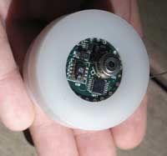
Wireless Sensor Networks (WSNs)
Small, inexpensive sensors are now available for many tasks
Networks containing sensors in the thousands are feasible
Use the radio channel
[coe.berkeley.edu]
Sensors are computationally limited. Memory size is small, typically 4K Bytes
Numerous applications: monitoring pollution, buildings, healthcare, warfare, etc.
Remember: Wireless does not necessarily imply mobile!

Slide 18
Special Characteristics and Attacks
Sensors are deployed in unsafe or hazardous environments
Limited in energy, computation and communication abilities
  Many security mechanisms such as public key cryptography are not feasible for WSNs
  Limited also in communication range due to battery
Besides the usual security goals of confidentiality, authentication, etc., some special attacks for WSNs are:
  Denial of Service attacks are much easier (Availability)
  Sensor nodes can be captured or compromised (Physical security)
  Resource depletion attacks (Availability)

Slide 19
Key Management for WSNs
Once a WSN is deployed, how are cryptographic keys set up between neighboring sensors
Neighboring sensors: sensors within communication range of each other
Also known as: Key Establishment or Key Distribution Problem

Slide 20
Key Management Protocols
Localized Encryption & Authentication Protocol/LEAP+ [Zhu et al. 2003, 2006]
  Use cryptographic hash functions
  Time limit on key establishment phase (prone to jamming attack)
Key predistribution [Eschenauer, Gligor 2002]
LEAP++ – Include preauthentication [Lim 2008]
R-Leap+ [Blackshear, Verma 2010]
  No time limit
  Combines positives of LEAP+ and Key Predistribution

Slide 21
Phishing

Slide 22

Phishing?

Slide 23
Phishing?
The fraudulent practice of sending e-mails masquerading as a trustworthy entity in order to induce individuals to reveal personal information

Slide 24
Phishing?
The fraudulent practice of sending e-mails masquerading as a trustworthy entity in order to induce individuals to reveal personal information
Information that phishers are generally looking for:
  username, password, credit card details from
    Online payment service account, e.g. eBay, amazon, paypal
    bank accounts

Slide 25

Phishing?
The fraudulent practice of sending e-mails masquerading as a trustworthy entity in order to induce individuals to reveal personal information
Information that phishers are generally looking for:
  username, password, credit card details from
    Online payment service account, e.g. eBay, amazon, paypal
    bank accounts
Notes:
Spam is unsolicited communication (usually advertising) mass-circulated internet . Originally used primarily for unsolicited promotional e-mails

Slide 26
Motivation
July 2011 – Aug 2012: 115 Phishing msgs passed through my spam filter. ~ 9/month.
Date: Tue, 13 Sep 2011 09:09:52 -0600
From: XYZ <abc@sw1.k12.wy.us>
To: undisclosed-recipients: ;
Subject: Mail Box Quota Exceeded
Your web mail quota has exceeded the set quota which is 3GB. you are
currently running on 3.9 GB.
To re-activate and increase your web mail quota please click the link
below.
<CLICK HERE>
Failure to do so may result in the cancellation of your web mail
account.
Thanks, and sorry for the inconvenience
Local-host.
Internet users are frequently targeted for theft of sensitive information
Email is a popular medium for such attacks
Problems include: lost time, lost productivity & monetary loss

Slide 27
Motivation
“It is non-trivial to distinguish phishing messages from legitimate messages, since phishing messages are constructed to resemble legitimate messages as much as possible.”
[Irani, Webb, Giffin, Pu – 2008]

Slide 28
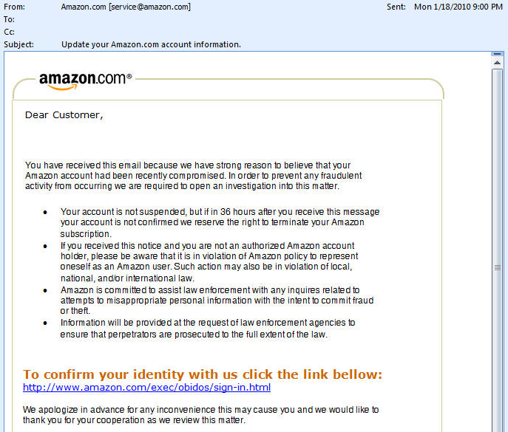
Example
Phishing Activity Trends
PhishNet-NLP
Text Analysis
Header Analysis
Link Analysis
Results
Related Work
Conclusion & Future Work
Example
Phishing Email
Notes:
Looks so real. Amazon logo is there, professionalism, credibility
Clues? Spelling mistake “bellow”… Unobservable

Slide 29
Example
Phishing Activity Trends
PhishNet-NLP
Text Analysis
Header Analysis
Link Analysis
Results
Related Work
Conclusion & Future Work
Example
Phishing Email
Fraudulent Link

Slide 30
Example
Phishing Activity Trends
PhishNet-NLP
Text Analysis
Header Analysis
Link Analysis
Results
Related Work
Conclusion & Future Work
Example
Phishing Email
Fraudulent Link

Slide 31
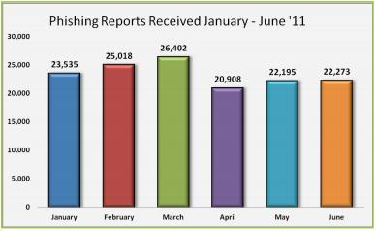
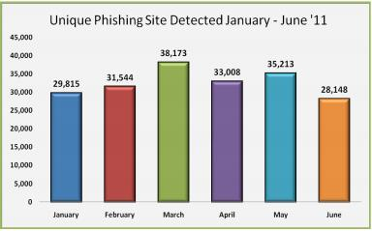
Example
Phishing Activity Trends
PhishNet-NLP
Text Analysis
Header Analysis
Link Analysis
Results
Related Work
Conclusion & Future Work
H1 2011 data obtained from Anti Phishing Working Group (APWG)
Notes:
Why is phishing detection important?
Notice proportionality between phishing sites and phishing reports… suggesting phishing sites are strong sources of phishing emails

Slide 32
Example
Phishing Activity Trends
PhishNet-NLP
Text Analysis
Header Analysis
Link Analysis
Results
Related Work
Conclusion & Future Work
H1 2011 data obtained from Anti Phishing Working Group (APWG)
Estimated losses = $520 M
  Assessed by EMC Corporation
Notes:
Why is phishing detection important?
Notice proportionality between phishing sites and phishing reports… suggesting phishing sites are strong sources of phishing emails

Slide 33
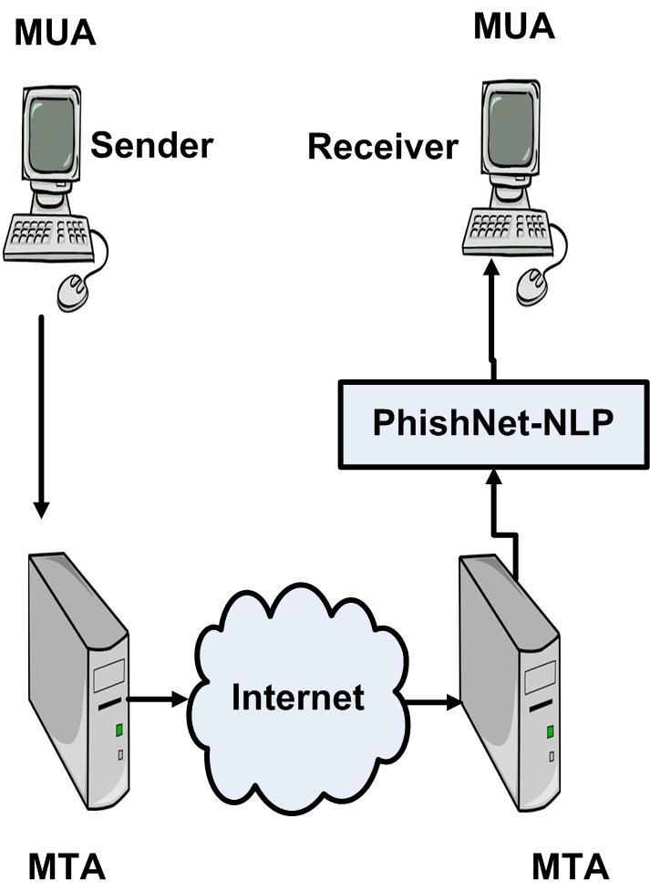
Example
Phishing Activity Trends
PhishNet-NLP
Text Analysis
Header Analysis
Link Analysis
Results
Related Work
Conclusion & Future Work
PhishNet-NLP – Our Implementation
  Three boolean classifiers:
    Text Analysis
    Header Analysis
    Link Analysis
  Combines results from each classifier to decide if email is phishing
  Analyzes emails before reaching mailbox to prevent attack by spywares and trojans
  Use contextual information of links for efficiency
  No training on or annotation of emails
Dataset
  4550 phishing emails (available online)
  1000 legitimate emails (from authors’ mailbox)

Slide 34
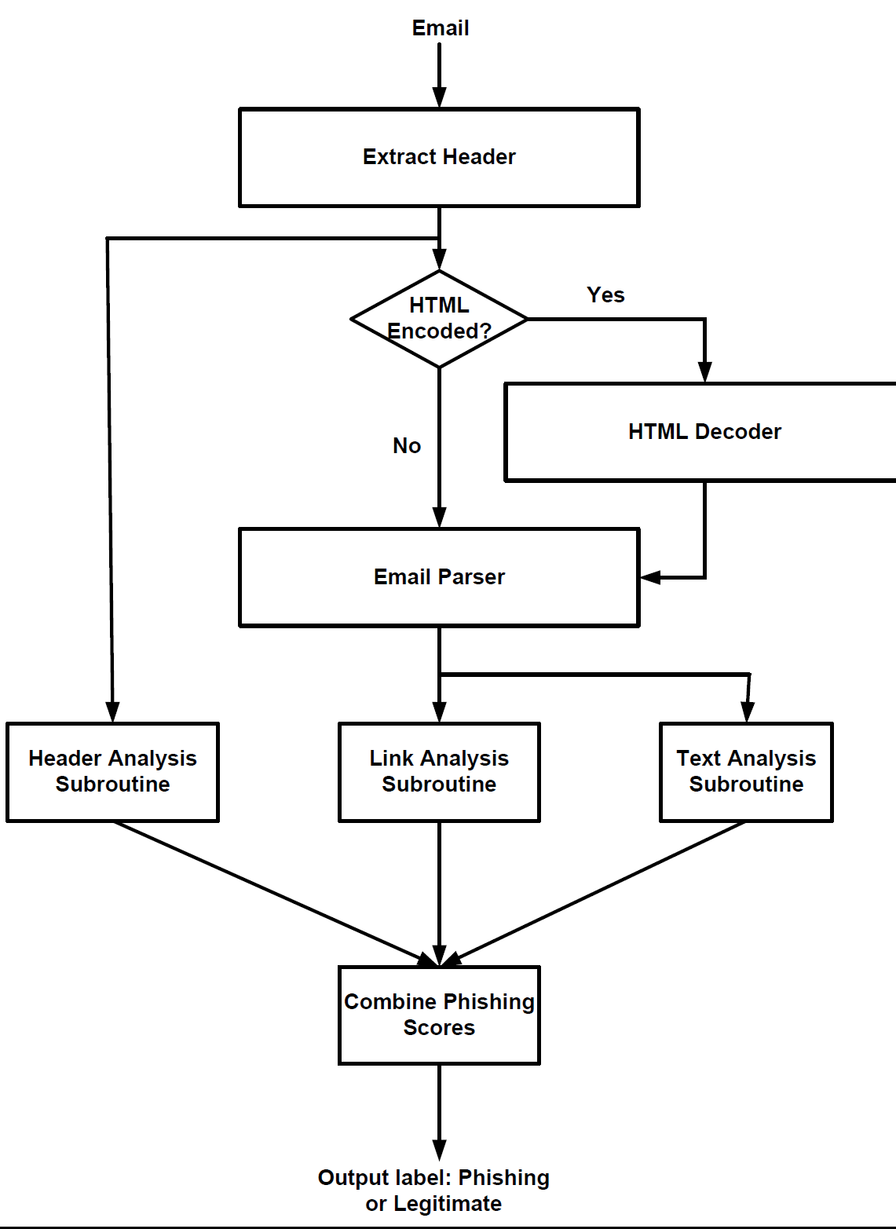
Example
Phishing Activity Trends
PhishNet-NLP
Text Analysis
Header Analysis
Link Analysis
Results
Related Work
Conclusion & Future Work
PhishNet-NLP
Flowchart

Slide 35
Example
Phishing Activity Trends
PhishNet-NLP
Text Analysis
Header Analysis
Link Analysis
Results
Related Work
Conclusion & Future Work
  Extracts text from email
  Uses NLP Techniques
    Named-entity extraction
      (person, place, organization, date, money)
    Part-of-speech tagging
    Word-sense disambiguation for polysemous verbs
      (Example: John gets it, The child got scared, Bob got a speeding ticket)
    Stemming
    WordNet (needs part-of-speech, stem and sense)
  Scores certain verbs, takes maximum score and compares with threshold (set to 1)
    Score increased with link, urgency, or incentive in same sentence
Text Analysis

Slide 36
Example
Phishing Activity Trends
PhishNet-NLP
Text Analysis
Header Analysis
Link Analysis
Results
Related Work
Conclusion & Future Work
  Semantics
    Uses hyponymy relation on verbs
    (Example: verb click is a hyponym of verb move)
  Uses context (user’s sent/recd. mail) when available
    Increases robustness provided phisher does not have access to context
    Increases detection
  Email scored for similarity and assigned a context-score
  Text score and Context-score combined logically
Text Analysis

Slide 37
Example
Phishing Activity Trends
PhishNet-NLP
Text Analysis
Header Analysis
Link Analysis
Results
Related Work
Conclusion & Future Work
  Context Score Details:
Email converted to vector using Information Retrieval techniques
  TF-IDF: Term Frequency-Inverse Document Frequency
  TF – No. of occurrences of a word within a document
  IDF – measure of how infrequently the word appears in other documents in the database
    Similarity score: Cosine of the angle between vectors
    Thresholding
Text Analysis

Slide 38
Example
Phishing Activity Trends
PhishNet-NLP
Text Analysis
Header Analysis
Link Analysis
Results
Related Work
Conclusion & Future Work
Text Analysis
Scored Verbs

Slide 39
Example
Phishing Activity Trends
PhishNet-NLP
Header Analysis
Link Analysis
Results
Results
Related Work
Conclusion & Future Work
Header Analysis Classifier
- DKIM
- SPF

Slide 40
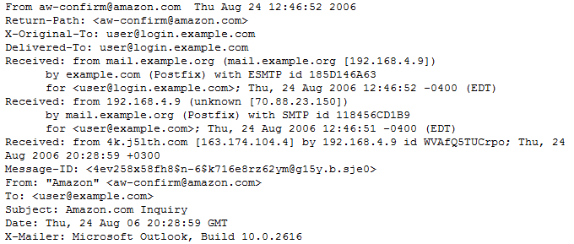
Example
Phishing Activity Trends
PhishNet-NLP
Text Analysis
Header Analysis
Link Analysis
Results
Results
Related Work
Conclusion & Future Work
Extract Email Header
  Extract Signing Domain Identifier (SDID) if header contains a DKIM signature
  Otherwise extract first Received from field
Notes:
PhishCatch didn’t track DKIM. DKIM is getting popular, e.g. Gmail -> from field = mr.google.com and

Slide 41
Example
Phishing Activity Trends
PhishNet-NLP
Text Analysis
Header Analysis
Link Analysis
Results
Related Work
Conclusion & Future Work
Extract Email Header
  Extract Signing Domain Identifier (SDID) if header contains a DKIM signature
  Otherwise extract first Received from field
Check if the field extracted above is same as the From Field
  If same, then legitimate
  Otherwise, also legitimate if any forwarding email address is same as From Field
Notes:
PhishCatch didn’t track DKIM. DKIM is getting popular, e.g. Gmail -> from field = mr.google.com and

Slide 42

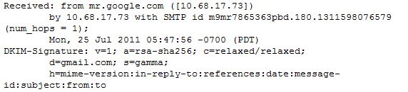
Example
Phishing Activity Trends
PhishNet-NLP
Text Analysis
Header Analysis
Link Analysis
Results
Related Work
Conclusion & Future Work
Significance of DKIM (Domain Keys Identified Mail – www.dkim.org)
  Method for validating a domain name identity through cryptographic authentication
  E.g. Gmail
The following email is legitimate:
Notes:
PhishCatch didn’t track DKIM. DKIM is getting popular, e.g. Gmail -> from field = mr.google.com and

Slide 43
Example
Phishing Activity Trends
PhishNet-NLP
Text Analysis
Header Analysis
Link Analysis
Results
Related Work
Conclusion & Future Work
Significance of DKIM (Domain Keys Identified Mail – www.dkim.org)
  Method for validating a domain name identity through cryptographic authentication
  E.g. Gmail
The following email is legitimate:
Notes:
PhishCatch didn’t track DKIM. DKIM is getting popular, e.g. Gmail -> from field = mr.google.com and

Slide 44

Example
Phishing Activity Trends
PhishNet-NLP
Text Analysis
Header Analysis
Link Analysis
Results
Related Work
Conclusion & Future Work
SPF (Sender Policy Framework – www.openspf.org)
  Email validation system that verifies sender IP address
PhishNet-NLP’s use of SPF
  If header contains SPF query that returns “pass”,
    then if domain in From Field designates sender’s IP address as permitted sender
    then legitimate

Slide 45
Example
Phishing Activity Trends
PhishNet-NLP
Text Analysis
Header Analysis
Link Analysis
Results
Related Work
Conclusion & Future Work
SPF (Sender Policy Framework – www.openspf.org)
  Email validation system that verifies sender IP address
PhishNet-NLP’s use of SPF
  If header contains SPF query that returns “pass”,
    then if domain in From Field designates sender’s IP address as permitted sender
    then legitimate
Notes:
Perform NSLookUp

Slide 46
Example
Phishing Activity Trends
PhishNet-NLP
Text Analysis
Header Analysis
Link Analysis
Results
Related Work
Conclusion & Future Work
Email is phishing if all of the above fails
Notes:
Perform NSLookUp

Slide 47
Example
Phishing Activity Trends
PhishNet-NLP
Text Analysis
Header Analysis
Link Analysis
Results
Related Work
Conclusion & Future Work
Link Analysis Classifier
Extract all links
Email legitimate if no links present
Else if any link is found in a phishing database (phishTank), then phishing
Else Google Search each domain + top 4 TF-IDF terms in the email
  if all domains appear in the top 30 search results, then legitimate
  Otherwise, phishing
Bing as backup in case Google search yields a DoS
Keep context of legitimate and phishing links to speed up future searches
NOTE: not clicking on the links, which prevents entry of trojans, malwares
Notes:
<10 words implies google search domains only (no keywords)

Slide 48
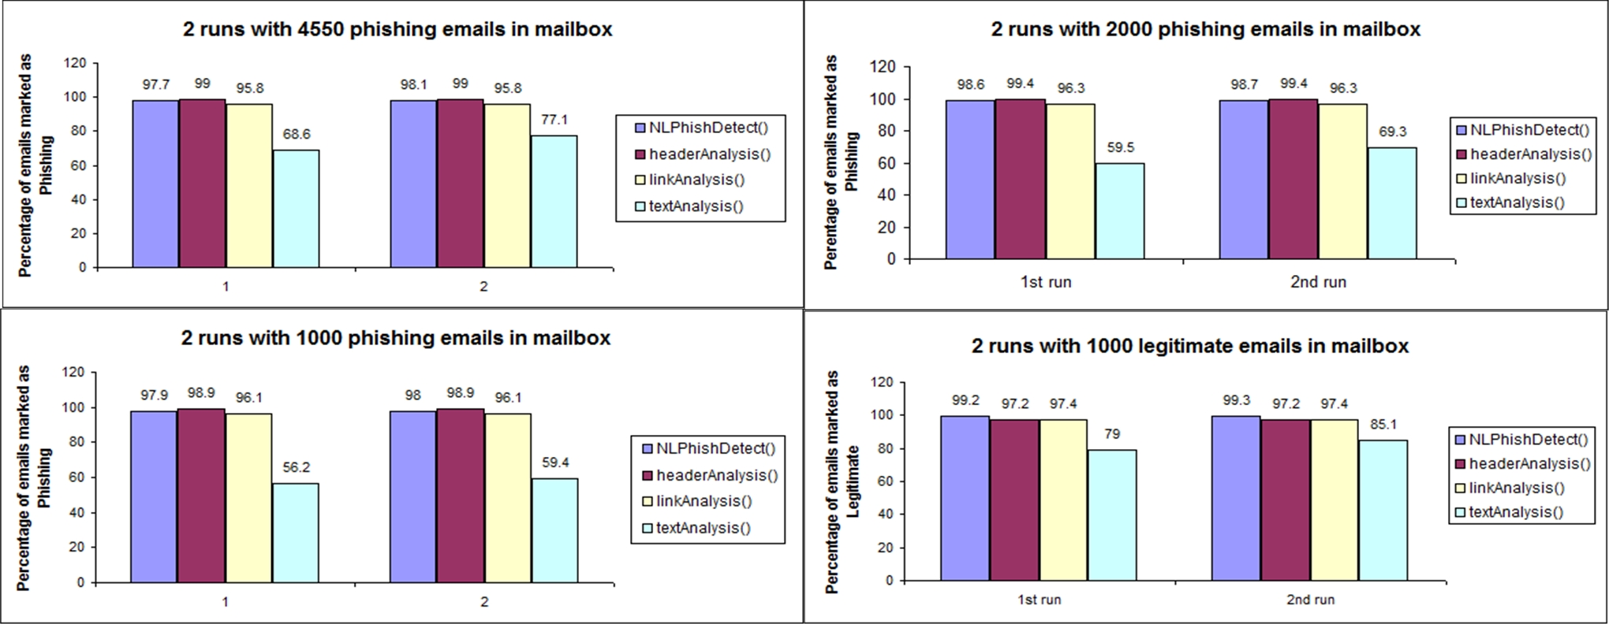
Example
Phishing Activity Trends
PhishNet-NLP
Text Analysis
Header Analysis
Link Analysis
Results
Related Work
Conclusion & Future Work
Results
Notes:
Note that one more classifier and a majority vote will bridge the gap between intersection and union

Slide 49
Example
Phishing Activity Trends
PhishNet-NLP
Text Analysis
Header Analysis
Link Analysis
Results
Related Work
Conclusion & Future Work
PhishCatch (Yu et al., 2009)
  heuristic algorithm
  performs mainly header and link of emails
  uses 3710 phishing emails from same corpus as us, and 1094 legitimate emails
  obtains a phishing detection rate of 80% and an accuracy of 99%
CANTINA (Xiang et al., 2011)
  detects phishing websites based on information retrieval and text mining algorithms
  web sites must be visited by CANTINA, may install malwares
  uses 100 phishing and 100 legitimate sites
  detects 89% phishing sites, with an accuracy of 99%
PILFER (Fette et al., 2007)
  machine Learning (Logistic Regression)
  uses 10 Features, mainly extracted from links and email content type
  uses 860 phishing emails and 6950 legitimate emails
  detection = 92%, accuracy = 99.9%
Notes:
Content type = contains javascript? Html encoded?
PhishCatch Legitimate emails = *** Also report exact phishing number

Slide 50
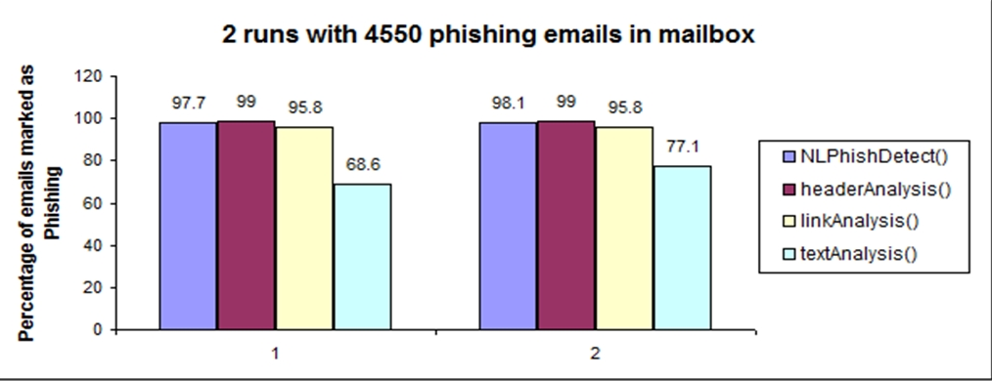
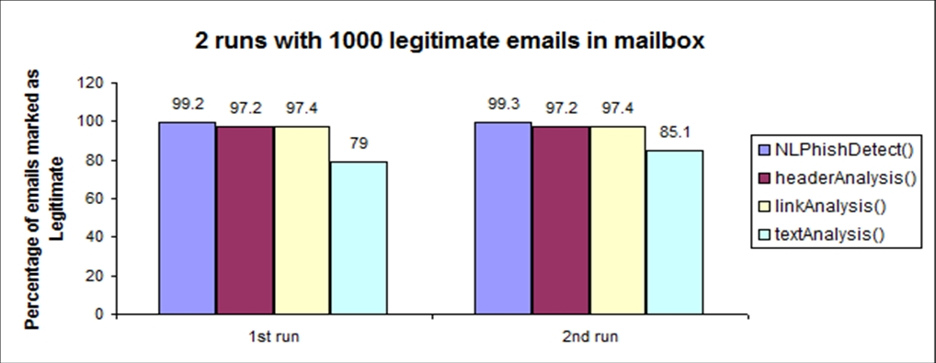
Example
Phishing Activity Trends
PhishNet-NLP
Text Analysis
Header Analysis
Link Analysis
Results
Related Work
Conclusion & Future Work
Algorithm | Phishing Detection | Accuracy
PhishCatch | 80% | 99%
CANTINA* | 89% | 99%
PILFER | 92% | 99.9%
*only detects phishing websites

Slide 51
Example
Phishing Activity Trends
PhishNet-NLP
Header Analysis
Link Analysis
Results
Related Work
Results
Conclusions
PhishNet-NLP is a strong phishing email filter
  High accuracy on detecting phishing emails
  High accuracy on marking good emails as ‘good’
Text Analysis
  Semantic
  Uses context when available
Header Analysis
  Check if header has been manipulated
  Use DKIM and SPF, if present
Link Analysis
  Use TF-IDF scores of words in email + links, to check if any link is fraudulent
  Make use of phishing databases available on the internet
  Store context of both legitimate and phishing links for efficiency purposes
  By analyzing links without visiting them, it prevents the user from being exposed to malwares, trojans, etc

Slide 52
Conclusions and Future Work
Security is an exciting area with lots of interesting unsolved problems
Build in security into all your components from day one
The overall goal in security is to make it costly for the attacker to gain something of value
  As long as the cost exceeds the value of the loss it will deter all rational attackers

Slide 53
Acknowledgments
Joint work with:
Zhiyao Liang [Protocols]
Sam Blackshear [R-Leap+]
Nabil Hossain, Tanmay Thakur [Phishing]
&
Supported by the National Science Foundation

Slide 54
Thank You
Questions/Comments

Slide 55
References
Adrian Perrig, John A. Stankovic, David Wagner: Security in wireless sensor networks. Commun. ACM 47(6): 53-57 (2004)
Zhiyao Liang, Rakesh M. Verma: Complexity of Checking Freshness of Cryptographic Protocols. ICISS 2008: 86-101
Laurent Eschenauer, Virgil D. Gligor: A key-management scheme for distributed sensor networks. ACM Conference on Computer and Communications Security 2002: 41-47
Sencun Zhu, Sanjeev Setia, Sushil Jajodia: LEAP&plus;: Efficient security mechanisms for large-scale distributed sensor networks. TOSN 2(4): 500-528 (2006)
Sam Blackshear, Rakesh M. Verma: R-LEAP+: randomizing LEAP+ key distribution to resist replay and jamming attacks. SAC 2010: 1985-1992
Rakesh Verma, Narasimha Shashidhar, Nabil Hossain: Two-Pronged Phish Snagging. ARES 2012: 174-179
Rakesh Verma, Narasimha Shashidhar, Nabil Hossain: Detecting Phishing Emails the Natural Language Way. ESORICS 2012: 824-841

