Slide 1
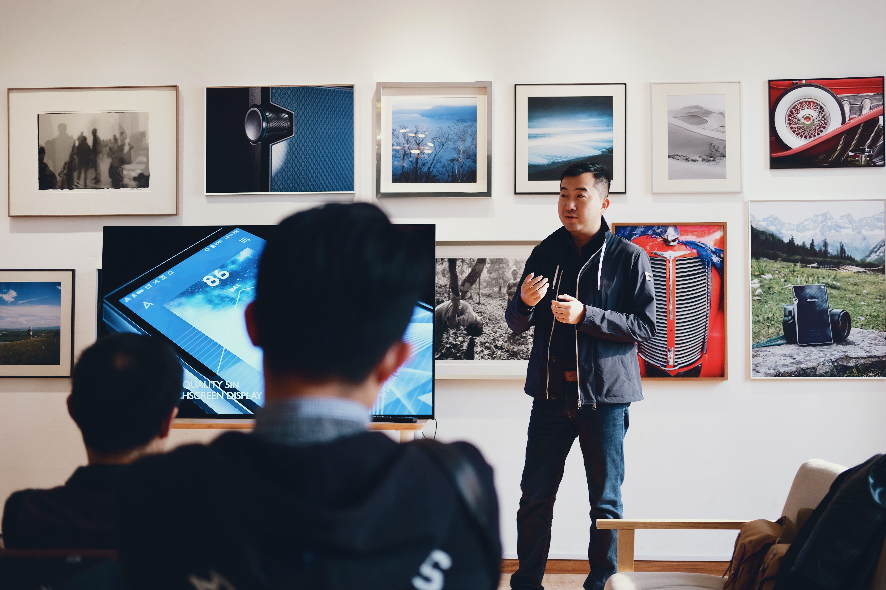
Navigating Your Role as a TA & Mentor
Dr. Nouhad Rizk
Director of
Undergraduate Studies
Computer Science Department
Wiley A. Graham, JD
Equal Opportunity Services
Marti Trummer-Cabrera, PhD​
Counseling & Psychological Services​

Slide 2
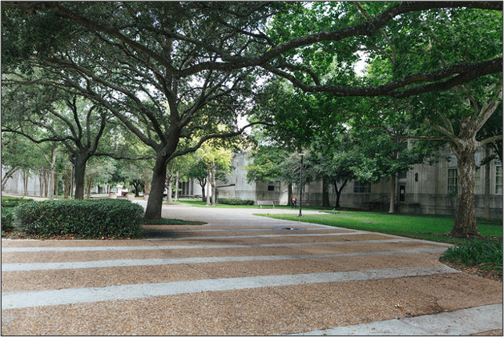
Navigating Your Role as a TA/Mentor
Understand UH policies and procedures
Review appropriate professional responses
Equip you with resources
CREATE A POSITIVE LEARNING ENVIRONMENT

Slide 3
Equal Opportunity Services
Anti-Discrimination Reporting
Affirmative Action Plan
Electronic Information Resource Accessibility
Employee Accommodation Requests
Sexual Misconduct/ Title IX Reporting

Slide 4
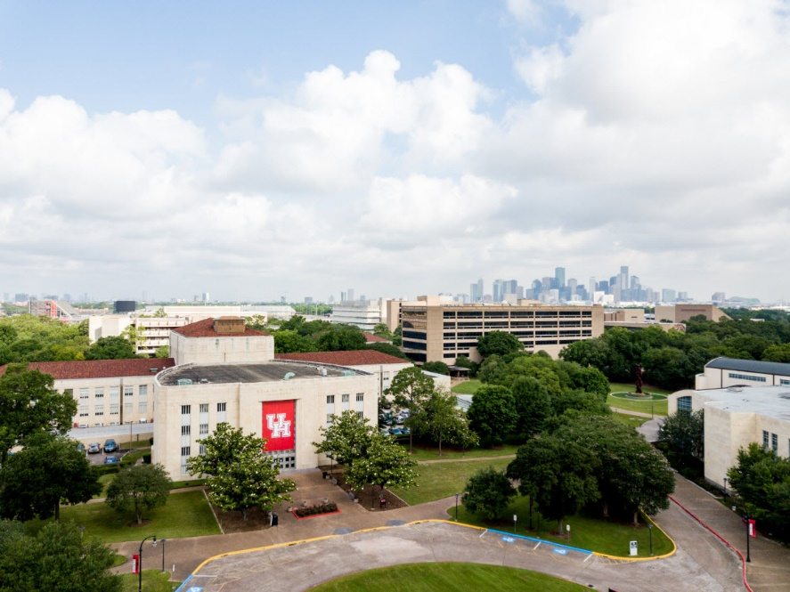
Anti-Discrimination Policy
Discrimination
Harassment
Treating an individual or members of a Protected Class less favorably because of their membership in that class or having a policy or practice that has disproportionally adverse impact on Protected Class members.
Subjecting an individual on the basis of membership in a protected class to unlawful severe or pervasive treatment that constitutes:
  Humiliating, abusive, or threatening conduct or behavior that denigrates or shows hostility or aversion toward an individual or group;
  An intimidating, hostile, or abusive living or working environment that alters the conditions of learning, living, or working; or
  An unreasonable interference with an individual’s academic or work performance

Slide 5
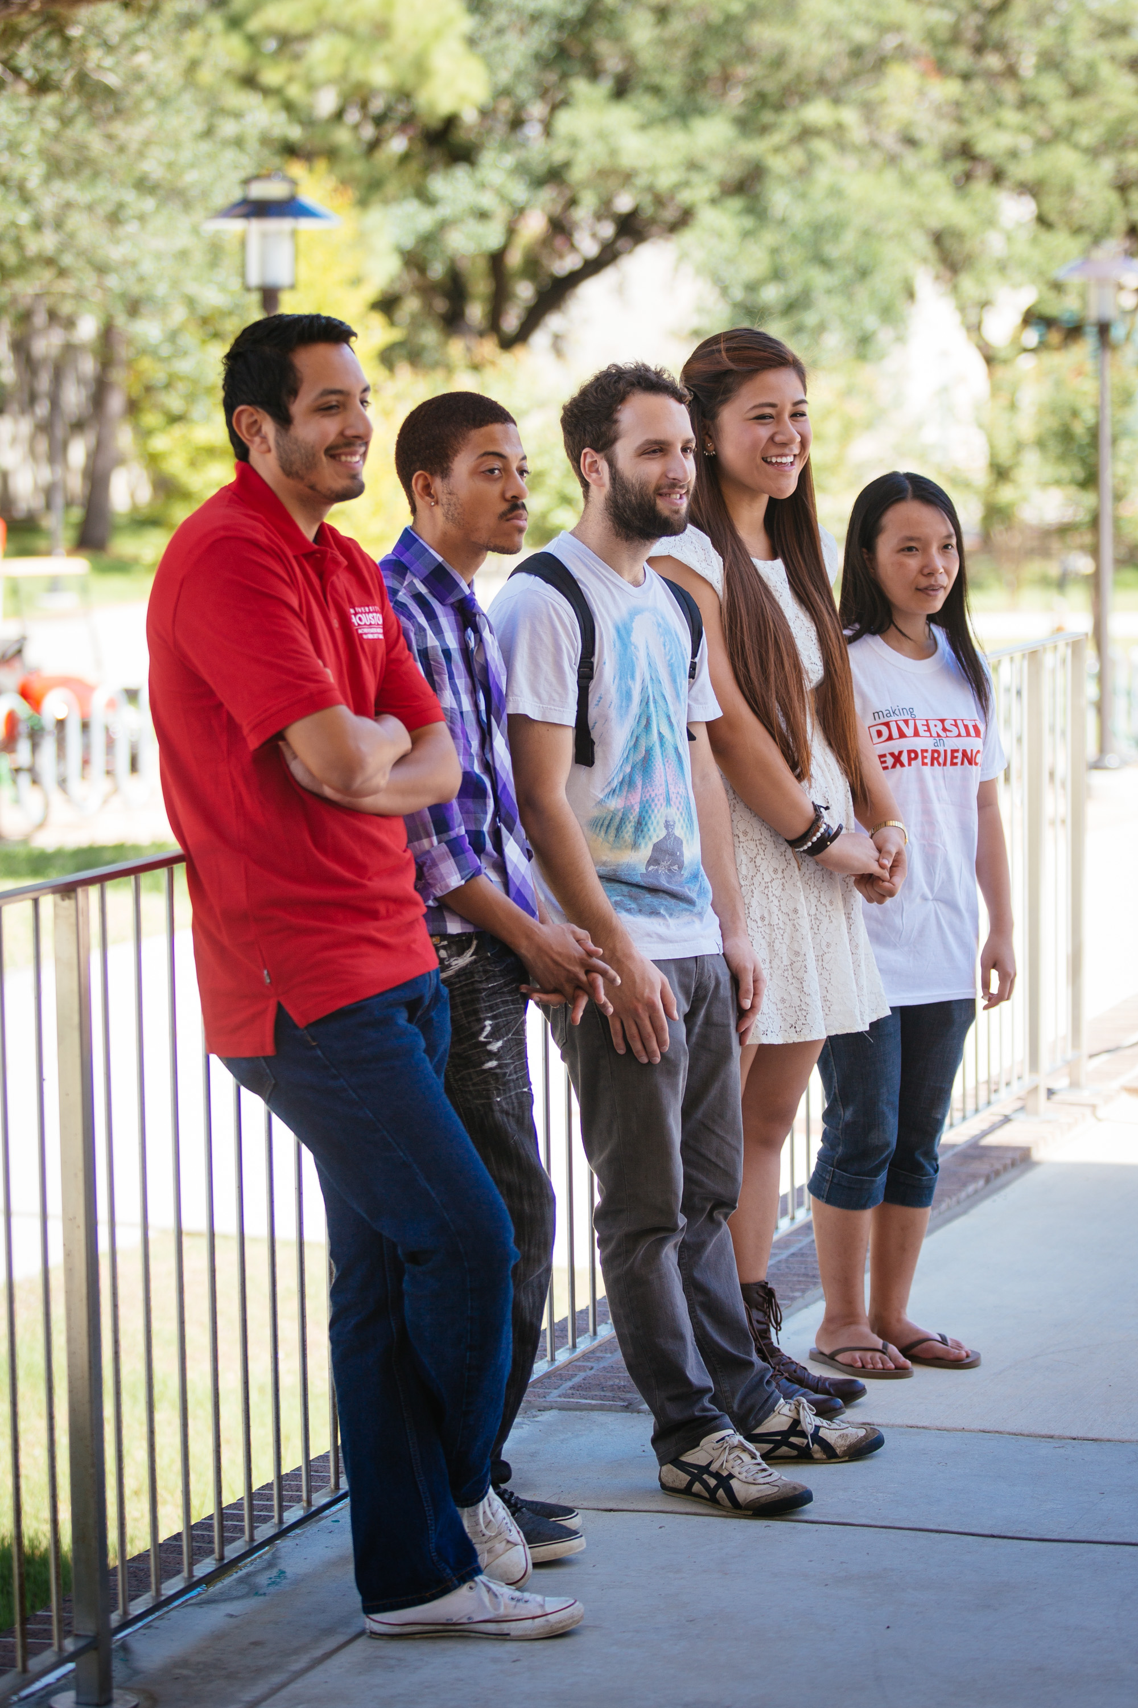
Anti-Discrimination Policy
System Administrative Memorandum (SAM) 01.D.07
Addresses Discrimination & Harassment on the basis of a protected class:
Veteran Status
Genetic Information
Sex (including Pregnancy)
Sexual Orientation, Gender Identity, and Gender Expression
Race
Color
Religion
Age
National Origin
Disability

Slide 6
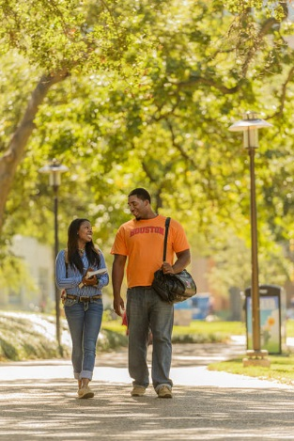
UHS Sexual Misconduct Policy
SAM 01.D.08
Referred to at times as
Title IX recently updated in August of 2020 by the Dept. of Ed.
“No person in the United States shall, on the basis of sex, be excluded from participation in, be denied the benefits of, or be subject to discrimination under any educational program or activity receiving Federal financial assistance.”

Slide 7
Sexual Misconduct Policy/Title IX
UH addresses all sexual misconduct under the Sexual Misconduct Policy regardless of whether the incident falls under the new federal laws.
We prioritize safety and are committed to taking all reports of sexual misconduct seriously.

Slide 8
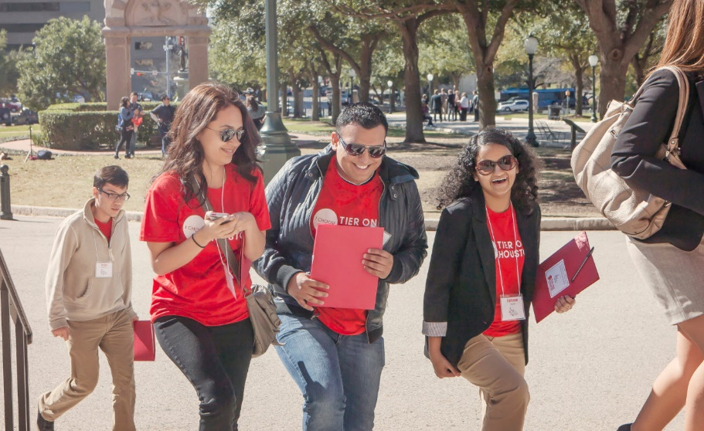
Sexual Misconduct Policy
  - Covers faculty, staff, students, and visitors
  - No time limit to report or file a formal complaint
  - Provides equal rights to people involved
  - Making a report does not automatically start the formal process
  - UH employees—including Graduate and Teaching Assistants—are required to report allegations of sexual misconduct to the Title IX Coordinator.
Do I report?
Yes…Even if:
  They heard it second-hand.
  They don’t know everyone involved.
  They were asked to keep it a secret.
  They’re not sure if it’s an EOS issue.
  It might be a rumor.
  They heard it from a third party.
What does the SMP cover?
Sexual Assault
Non-consensual Sexual Touching
Stalking
Sexual Intimidation
Sexual Exploitation
Dating and Domestic Violence
Sexual Harassment

Slide 9

Stalking
College students are more likely to experience stalking
Be aware of the information you share online
Safety in online dating
  You don’t really know who’s on the other side of a profile. Don’t immediately connect with someone on social media
  Let a friend know where you are going
  Majority of our stalking cases are social media related.
Observe boundaries!
Netflix series, You

Slide 10




Professionalism on Social Media
Remember the rules regarding TA and student conduct are the same for online and in-person interactions
Discrimination based on race, color, religion, sex, etc. (lack of respect for women)
Harassment such as “Sexual” harassment including unwelcome conduct such as sexual advances, requests for sexual favors or dates, remarks about appearance, discussions, remarks or jokes of a sexual nature, and/or other verbal or physical harassment of a sexual nature.
Harassing Conduct such as intimidation, ridicule, insult, comments
Retaliation action that might deter a reasonable person from participating in activity
Avoid inappropriate language (such as profane words)
Social media can connect classmates for group projects, support, community, and networking
Warn students that quiz, test, homework, lab, etc. information shared on social media will be a violation of university policy
Notes:
What can EOS help with beyond the disciplinary process?

Slide 11
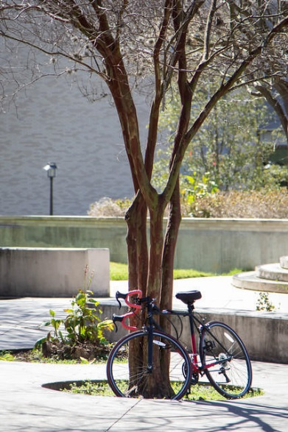
Reporting
Equal Opportunity Services​
File a University Complaint​
Online reporting link at the bottom of every UH webpage ​
University of Houston Police Department​
Criminal Complaint​
Fraud & Non-Compliance Hotline​
Option to report anonymously to the University​
By phone or online report​

Slide 12
Responding
Let them know you are not a confidential resource. Meaning that you’ll need to make a report to EOS
  Offer confidential resources
Listen.
  You don’t need to fill silence.
Ask:
  Are you physically hurting?
  Do you feel safe?
  What can I do for you?
Let them know that they are not alone.
  Be prepared to offer information about resources.
You are not expected to be an expert, counselor, or investigator.
Be professional.
Be consistent in your treatment of other students and your fellow staff.
Do not discuss incidents later with friends.
If you have concerns about ongoing issues, seek help from EOS or your supervisor.
Remember, when people see you, they see your position.

Slide 13
Signs of Distress
As Teaching Assistants and Mentors, you may or may not know this information. However, if you become aware of signs of distress it's important that you take action!
Examples:
Changes in academic performance
Excessive absences or tardiness
Avoiding participation
Dominating discussion
Disruptive behavior
Observable signs of injury
References to suicide or death

Slide 14
What I Should NOT Do?
What Can I Do?
Ignore concerning behavior
Keep suicidal ideation to yourself
Try to “fix” the situation
Adopt an overprotective or overinvolved attitude
Treat someone’s behavior as gossip
Be patient with yourself and your students
Reset reasonable expectations when necessary
Offer resources (e.g. Center for Students with Disabilities, LAUNCH)
Practice empathy

Slide 15
How to Respond and Refer
"I hear you are running into some barriers this semester. Do you know about the offices that offer support to students?"
"I believe that you are really struggling, and I want to make sure you get the help you need to be successful."
Disruptive students
Try to de-escalate the situation
Ask questions to understand
Avoid become defensive
Terminate the meeting/discussion if needed
Alert UHPD, CART, CAPS
Establish a code word for emergencies; ask a colleague to be on standby for support

Slide 16

On-Campus Resources
Confidential
  CAPS
  Sexual Misconduct Support Services (Devon Fan)
  Health Center
  A.D. Bruce Religion Center
Reporting
  EOS (University Policy)
  UHPD (Legal)
  Online
Other Resources
  UH Wellness (Prevention)
  Women and Gender Resource Center
Notes:
Our terminology is based on our UH Policies rather than the legal terminology.

Slide 17

Consensual Relationship Policy
Defined as: “Any consensual dating, intimate, romantic, and/or sexual relationship between:
  An employee (including staff, faculty or student employees) and
  An individual that the employee has responsibility as part of their job duties to teach, instruct, manage, supervise, advise, counsel, oversee, grade, coach, train, treat, or evaluate in any way.”
The University prohibits consensual dating, intimate, romantic, and/or sexual relationships between faculty and undergraduate students.
The University prohibits consensual dating, intimate, romantic, and/or sexual relationships between coaches and undergraduate students.

Slide 18
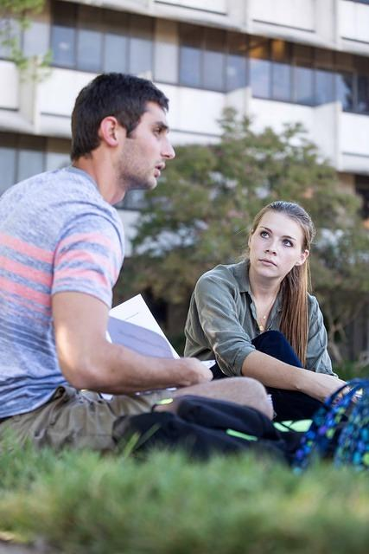
Creating a Good Environment
Everyone MUST take reports of sexual harassment seriously
  Encourage reporting
Never assume behavior is accepted
  Just because people are laughing doesn’t mean the comment or joke is appropriate
  Don’t assume everyone appreciates your sense of humor
Be a good bystander-bystander intervention
  Directly address; delegate or diffuse
Do not retaliate!
Notes:
What can EOS help with beyond the disciplinary process?

Slide 19
Set Expectations for
Acceptable Conduct
Protect and promote the pursuit of the following goals :
The opportunity for other students to attain their educational objectives,
The creation and maintenance of an intellectual and educational atmosphere throughout the University platforms, and
The protection of the health, safety, welfare, property, and human rights of all members of the University.
Refer to Student Conduct and Community Standards for processes
https://uh.edu/dos/_files/student-code-of-conduct-2019-2020.pdf
Notes:
What can EOS help with beyond the disciplinary process?

Slide 20
Avoid…
Making the class harder than it should be, even if you have the power to do so.
Ignoring preferred pronouns if you are aware of the existence of such. (she, they, or he may be displayed behind a students name to indicate preferred pronoun)
Treating individuals less favorably because of their membership in a protected class (i.e. gender or psychological/physical disability).
An outward impression that coding or tech is a “nerd industry” where only certain people can be successful.
Giving off the impression that only certain classes of individuals can be successful in the technological industry.

Slide 21
What NOT to do
What to do
Do not speak with arrogance to students especially to students who are struggling.
Do not discourage students by saying things like "this is easy, yeah you should be done with this by now"
Do not show surprise if the student does not know an essential skill (it is easy for students to pick up on condescendence and feel badly)
Express empathy, say that subject matter can be difficult at times
Encourage students to do their best and to study the information they find difficult
Express to students the importance of learning essential skills, offer support, and suggest repetition

Slide 22
What NOT to do
What to do
Do not follow a teaching method that promotes only getting the right answers
Do not offer help when you are truly busy, thus unable to provide a student with undivided attention.
Teach in a way that fosters understanding concepts, testing (not teaching) is used to check knowledge
Stick with the office hours you set and update students if office hours need to change. If a student reaches out for help inform them that you will assist them when you finish your current task

Slide 23
CREATE A POSITIVE LEARNING ENVIRONMENT
Just an FYI we aren't going to be answering any more questions about Lab quiz, so don't text us on Teams
I’m getting a lot of questions that I cannot answer at the moment. Continue to submit your questions and I will address them at my earliest convenience.
don't test me on the disorganization bs guys we have been giving u guys extensions, if u want a fully structured course we can stop extending things and keep it as is
Thanks for the feedback. I’ll ask everyone for patience and flexibility in order to promote learning of the material for everyone
Id be okay giving 1 or 2 grades but only here cause i actually enjoy watching u guys suffer

Slide 24
CREATE A POSITIVE LEARNING ENVIRONMENT
lmao honestly I dont get it when people say they're gonna drop a CS class. Like. Are you not a CS major or do you plan to be a semester behind for like ever? not to be rude or anything but
I’m sorry to hear that people are considering dropping the class, be sure to ask questions and make sure you have the time needed to understanding the material. Meet with your academic adviser before dropping any courses to discuss your options.
plz don't txt him guys I'm working with him rn
wait until after the meeting when I have all the info I swear some of u succ I'm trying my hardest
We’re currently working and will respond when finished with the current task. Thanks for your patience.
ur on thin ice

Slide 25
CREATE A POSITIVE LEARNING ENVIRONMENT
the hardest questions r probs gonna be the lab questions I am creating, cause these are testing if u actually understand the labs or if ur just winging them
Be sure to study the labs we’ve completed there will be questions to check understanding of how the concepts are applied
I just wanted to reach out to u guys directly cause u r the ones that r gonna fail it anyways
I’m reaching out directly because I’m concern about your progress up to this point in the class. I want to encourage you to devote more time to studying and ask questions if things are unclear
so if ur okay with a public humiliation lmk
the problem took me 20 minutes to code with no problems, but for u guys I expect it to be 2 hours of questioning why u choose a major in CS

Slide 26
Contact EOS
What support services does EOS offer?
Academic accommodations
Safety Planning
Changing parking locations
Changing residence halls
No Contact Orders
…and more!
Interim Title IX Coordinator: Toni Benoit
Email: eos@uh.edu
Phone: 713-743-8835
In-person:
  Student Service Center 2
  Next to CSD
Make a report by clicking “Sexual Misconduct Reporting & Awareness” at the bottom of any UH webpage

Slide 27
CAPS & Other Referral Resources
CAPS:
Remote services via telehealth
  Let's Talk Consultation
  Triage (M-F; 8:30 a.m. - 4:00 p.m.)
  Workshops
  Single Session
  Individual Counseling
  Couples Counseling
  After-hours crisis support
QPR Virtual Training
COVID-19 web resources
Additional Resources:
Employee Assistance Program (EAP)
CART
UHPD (713-743-3333)
Center for Students with Disabilities
LAUNCH- tutoring services, academic counseling, ADHD workshops

Slide 28







Counseling and Psychological Services
(CAPS)
Health 2 Building 2nd Floor
Phone number:
(713) 743 – 5454
Location:
Main Campus: Student Service Center 1, Suite 226
UH at Sugar Land: George Building, Suite 119 *limited hours
Website:
www.uh.edu/caps
Social media:
Facebook @UHCAPS
Twitter @UH_caps
Instagram @uhcaps
uh.edu/caps/calendar
Notes:
Welcome to Connect with CAPS part of the Coogs Conquer Workshop series happening Tuesdays at 10am next month. Check website for full schedule.
This is a quick presentation, and the intention is to give info about CAPS services while also providing an opportunity fort participants to ask questions about the counseling process at UH. Many may be wondering about how we will operate under COVID-19 precautions this semester. I can share what I know at this point, but acknowledge that circumstances can change.

Slide 29
Navigating Your Role as a TA & Mentor
Dr. Nouhad Rizk
Director of
Undergraduate Studies
Computer Science Department
Wiley A. Graham, JD
Equal Opportunity Services
Marti Trummer-Cabrera, PhD​
Counseling & Psychological Services​

