Slide 1
Social Media 101
Nick Pomes
Senior Manager of University Social Media

Slide 2
Social Media 101
Policy
Content
Analytics
Resources

Slide 3
Social Media Policy
Notes:
Full Social Media Policy is available on the website — here are a few key points.

Slide 4
Social Media Policy
DON’T:
Delete comments, filter comments or block accounts
As a public university, these are all considered violations of the First Amendment.
Notes:
Leave all comments, even if they are hateful or spam. We don’t have any wiggle room on this.

Slide 5
Social Media Policy
The email address associated with UH social media profiles should be a department email.
At least two permanent University employees must have access to login information.
Example: social@uh.edu

Slide 6
Profile Guidelines
40%
Up to 40% of Gen Z searches for things on social media before using Google, so it’s important to make a good first impression.

Slide 7
Profile Guidelines
Use a logo that is current, easy to see and specific to your profile.
z
z
z
z
z
z

Slide 8
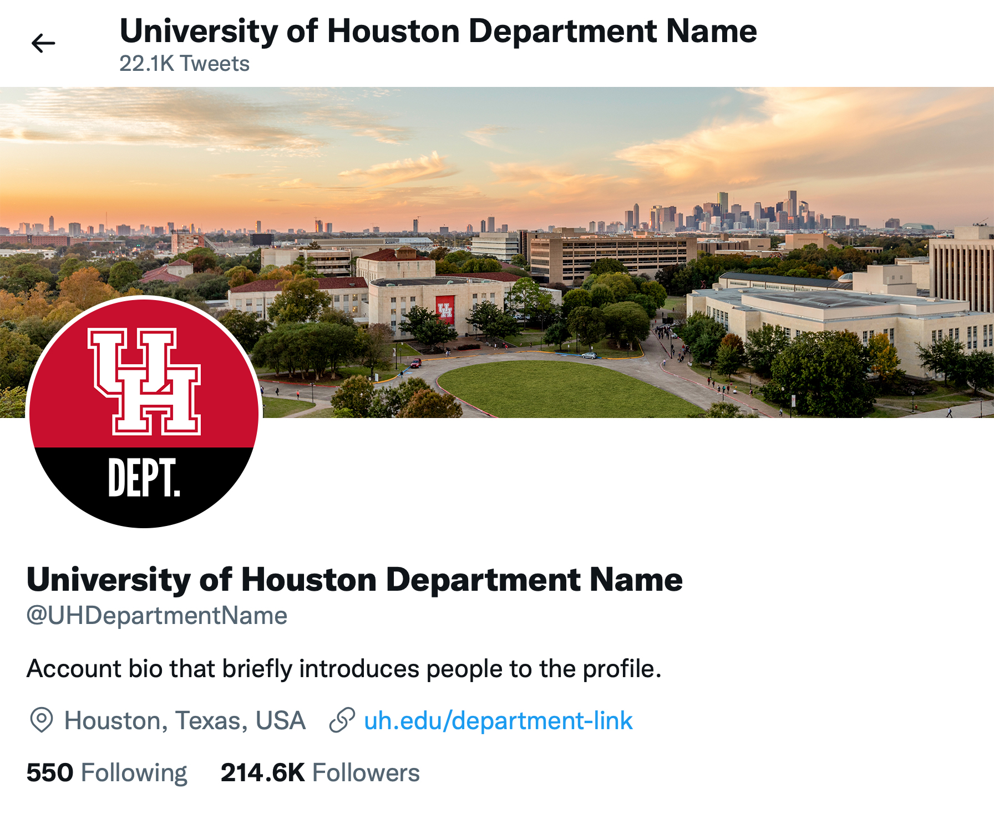
Profile Guidelines
Cover photo
Profile picture/avatar
Display name
Bio
Website/link
Username/handle

Slide 9
Profile Guidelines
Avoid adding a birthday to your bio.
If your birthday is set to a date that would make the profile less than 13 years old, social networks may ban your profile.

Slide 10
Photo Release Guidelines
In most cases, there are two forms you’ll need signed for permission to use a photo/video of a student:
Individual Photo Release Form
+
FERPA Authorization Form
These forms are available at uh.edu/marcom/guidelines-policies/photo-release/

Slide 11
Photo Release Guidelines
Photo releases are typically required if the individual:
Is recognizable; the primary focus of the photograph/video shot
Is identifiable in a small group setting, such as a small group of students studying in the library or congregating by the fountains. In these cases, a release should be obtained from each subject
Has been recruited to serve as a model
Is a minor (under 18 years of age); a parental release is required

Slide 12
Photo Release Guidelines
Photo releases are typically NOT required if:
Photographed in large group shots in a public space or at public events with little expectation of privacy, such as sporting events and concerts
It is a large group setting, such as wide shots of classrooms or campus scenic shots with no single subject
The subject is not recognizable, such as silhouettes, posterior view or out of focus
The photos/video are not being taken or distributed by UH. When news media is covering a story on campus or a production company is shooting content it plans to distribute, a UH photo release is not required. In many cases they will have their own releases. The “Filming at UH” guidelines outline protocols for filming on campus.

Slide 13
Accessibility
UH social media profiles must be accessible and usable by people with the widest range of capabilities possible.
Add alt text
Add video captioning
Capitalize the first letter of each word in hashtags

Slide 14
Content

Slide 15
Content
There are four stages in social media content production:
Planning
Producing
Posting
Engaging

Slide 16
Planning Content
Consider the interests of your audience:
Why are they following you?
Which social networks are they most active on?
How can you provide value to them with your content?

Slide 17
Producing Content
The format of your content needs to fit the platform.
For example, posts to an Instagram feed should be very visual. High-quality photography that shows the faces, places or things associated with your profile are very effective.

Slide 18
Producing Content
When you need to share a graphic on Instagram, do it as a Story rather than a post.
This will keep your feed clean and uncluttered.

Slide 19
Producing Content
Additionally, don’t use QR codes in social media posts.
QR codes are great for signage, but since most social media posts are viewed on a person’s mobile device, there is not an easy way to scan the code. Include the link in the post instead.

Slide 20
Producing Content
Avoid using stock imagery and graphics that are text-heavy.
Both of these provide very little value to your audience and may cause them to scroll past your posts.

Slide 21
Posting content
Focus on quality over quantity.
Your profile will perform better if you choose to be selective about what is worth being posted. Continue to consider what brings your audience the most value.
Ask yourself if the content you’re creating is content that you would interact with yourself or if it’s something you might mindlessly scroll past.

Slide 22
Posting content
Use the platform the way your audience does.
Matching the usage and tone of your audience will help you fit in, get engagement and grow your following.

Slide 23
Engaging with content
Interact with your audience!
Make your audience feel seen by interacting with them in the comments. A back-and-forth conversation can spark great engagement and make your profile seem more human.
Additionally, commenting on other people’s posts is good for the algorithm and the look of your brand.

Slide 24
Analytics

Slide 25
Analytics
Engagement rate is the most important metric when measuring social media success.

Slide 26
Analytics
Any interaction with your content is considered engagement.
Likes/reactions
Shares/reposts
Comments/replies

Slide 27
Analytics
One popular method for measuring engagement rate is taking the total number of engagements and comparing that to the total number of followers. This method is good for drawing comparisons to your competitors, as all of the data for this formula is publicly accessible.
(Total Engagements / Number of Followers) x 100
=
Public Engagement Rate

Slide 28
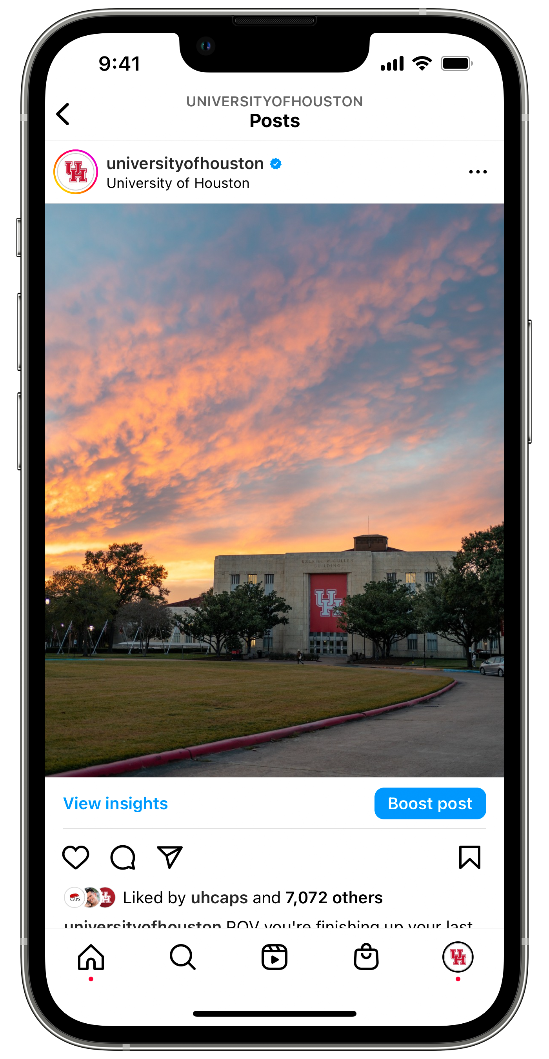
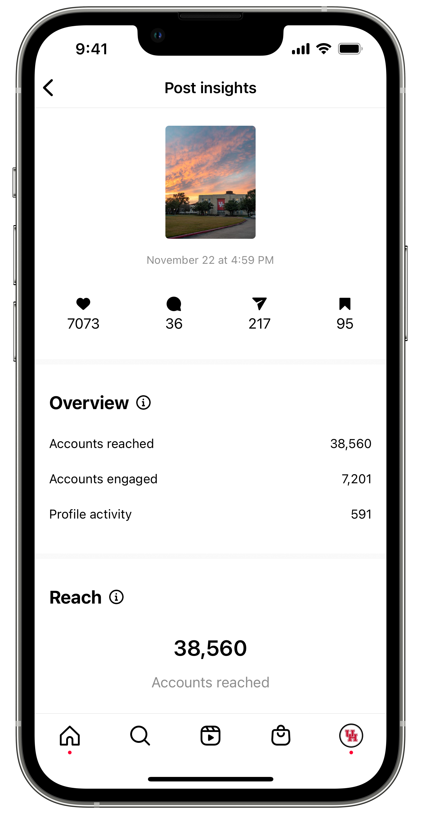
Analytics
Public engagement rate example:
(((7073 x 1) + (36 x 5)) / 129,000) x 100
=
5.62% public engagement rate
FOLLOWERS
Because comments indicate more interest in the content than a simple like/reaction, they are often weighted heavier in engagement rate formulas. In this example, each comment is worth 5x as much as each like.

Slide 29
Analytics
You will never have 100% of your followers see your post. For that reason, swapping out Number of Followers with Total Reach in the formula may give you more useful data for your post performance, as it will measure the engagement rate of those who actually saw your post.
(Total Engagements / Total Reach) x 100
=
Engagement Rate

Slide 30
Analytics
Engagement rate example:
(((7073 x 1) + (36 x 5)) / 38,560) x 100
=
18.81% engagement rate
POST’S REACH

Slide 31
Resources

Slide 32
Resources
Visit the University Marketing and Communications website for more social media resources:
Social Media Guidelines
UH Social Media Staff
Social Media Directory
Social Media Campuswide Teams Group
Photo Release Guidelines

