Slide 1

Notes:
Hello everyone, thank you for joining us today for our Medicare Preparation presentation.

Slide 2

Topics
Understanding Medicare
Enrolling in Medicare
Working past age 65
Medicare and your state
health insurance
Split households
Non ERS Part C and Part D plans
Resources
Notes:
There’s a lot to learn about Medicare. The topics we’ll cover today are:
Understanding Medicare
Enrolling in Medicare
Working Past Age 65
Medicare Premiums
Medicare and Your State Health Insurance
Split Households
Non ERS Part C and Part D plans
Resources available to you

Slide 3

Understanding Medicare
Notes:
Let’s start with understanding Medicare.

Slide 4



What is Medicare?
Medicare is a federal health insurance program for people:
age 65+;
medically disabled and
under age 65 or
any age with end-stage renal disease.
Notes:
Medicare is a federally-funded health insurance program administered by the Social Security Administration (SSA) and the Centers for Medicare and Medicaid Services (CMS) for people:
- age 65 or older,
- medically disabled, under the age of 65, or
- any age with end-stage renal disease.
Medicare is often confused with Medicaid which was created to provide medical care for those with limited income and resources, but they are not the same thing.

Slide 5




Four Parts of Medicare
Medicare Part A
- Hospital
Medicare Part B
- Medical Services
Medicare Part C
- Combines Part A & B
Medicare Part D
- Prescription drugs
Notes:
Medicare is made up of four parts.
Part A helps cover hospitalization, skilled nursing facilities, hospice and home health care.
Part B helps cover medical services like doctor visits and outpatient care. Part B also covers some preventive services including screenings, vaccines, diagnostic testing and some durable medical equipment like wheelchairs and walkers.
Part C, also known as Medicare Advantage plan, combines Part A, Part B and sometimes Part D coverage, and is managed by private insurance companies approved by Medicare. These plans must cover medically necessary services. ERS offers a Medicare Advantage Plan, which we’ll discuss a bit later on in the presentation.
Part D helps cover outpatient prescription drugs. Part D also may help lower your prescription drug costs and protect against higher costs in the future. ERS offers a Part D plan.

Slide 6

How Much Does It Cost?
Part A | Part B | Part C | Part D
No monthly premium for most participants | Standard monthly premium is $174.70* | Varies by plan | Varies by plan*
*Premium will increase if you are subject to the Income-Related Monthly Adjustment Amount (IRMAA).
Contact the SSA for details about Medicare premiums and how they’re calculated.
Notes:
Let’s discuss how much Medicare will cost.
Part A: For most employees there is no monthly premium for Medicare Part A. Based on federal policy, some higher education employees might have to pay a premium for Part A. If you have to pay a Part A premium, you will pay it to the federal government
Part B: Currently, the standard monthly premium is $174.70 (Premium for 2023 was $164.90.) However, if you don’t sign up for Medicare Part B when you are retired and first eligible, your premium may go up 10% for each 12-month period you’re not enrolled. Your Part B premiums are set by and paid to the federal government, and so is the penalty for late enrollment.
Part C: If you choose to enroll in a Part C plan, you have to pay an additional premium. There is a premium for the Medicare Advantage plan offered through ERS, but the state will pay at least 50% of that premium for retirees. How much the state pays depends primarily on your years of service. We’ll look at the cost later in the presentation.
Part D: If you choose a private Part D plan, which covers prescription drugs, there may be a premium. ERS provides Part D coverage at no costs to you with your selected health insurance benefits.
When determining your Medicare premiums for Medicare Parts A and B, the SSA uses the most recent federal tax return provided by the IRS.
Your premiums for Medicare Part B and, if applicable, Part D are based on your modified adjusted gross income reported on your most recent tax return, which is based on income from 2 years ago. If the annual income was more than $103,000 (up from $97,000) if you file an individual tax return or $206,00 (up from $194,000) if you’re married and file a jointly, you may be subject to the Income-Related Monthly Adjustment Amount (IRMAA). You will pay a higher monthly premium for Medicare Part B and, if applicable, an additional cost for Medicare Part D.
This amount can be changed (for example, if your income changes) by contacting Social Security.
Higher Medicare premiums affect fewer than 5 percent of people with Medicare. If you are subject to IRMAA, the Social Security Administration will notify you by mail.
For inquiries about how your Medicare Premiums will be calculated, contact the SSA.

Slide 7

Paying Your Medicare Premiums
Medicare premiums will be:
deducted from your Social
Security check (if you’re drawing it);
deducted from your bank
account after you set up
Medicare Easy Pay
mailed in with the payment coupon from your bill
Notes:
You will be required to pay your Medicare premiums for Part B to the federal government. The state does not cover this cost for you.
If you’re already drawing your SSA benefit, your Medicare premium will be deducted from your SSA payment automatically.
If you are not drawing your SSA benefits, you will have four other ways to pay your Medicare premiums.
The fastest way to pay, according to Medicare, is paying online through your secure Medicare account.
You can also sign up for Medicare Easy Pay, this service is free and Medicare will automatically deduct the premium payment from your saving or checking account each month.
You can pay directly from your savings or checking account through your bank’s online bill payment service.
Finally, you can mail your payments to Medicare. You would fill out the payment coupon on the bottom of your bill and send it in with your payment.
If you need assistance paying your Medicare premium or have additional questions, contact Medicare for more information.

Slide 8

Enrolling in Medicare
Notes:
If you’re retired and approaching age 65 or you’re under age 65 but eligible due to a disability, you’ll want to enroll in Medicare.

Slide 9
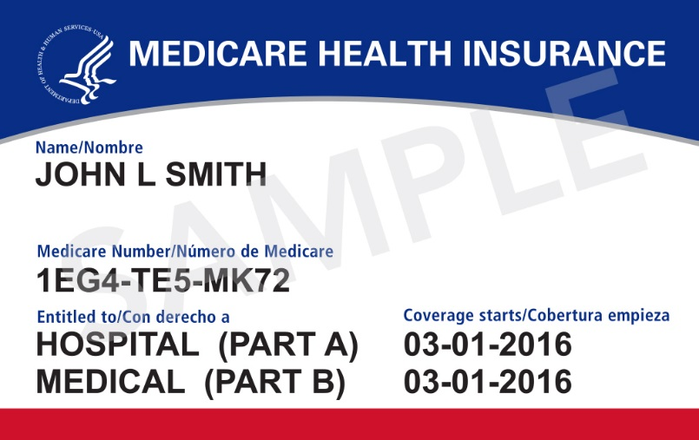

Automatic Enrollment
For individuals:
drawing SSA benefits, or
disabled under 65
(after you’ve received
24 months of payment).
The Social Security Administration will send you information in the mail.
Notes:
In most cases, if you’re already drawing SSA benefits, you’ll be automatically enrolled in Medicare Part A and Part B. The coverage will be effective the first day of the month you turn 65.
If you’re under 65 and certified disabled by the SSA you may be automatically enrolled in Medicare Part A and Part B after you’ve received Social Security Disability payments for 24 months.
If you are automatically enrolled in Medicare Part A and Part B, the Social Security Administration (SSA) will mail you your Medicare ID card. When you receive your card, call ERS and provide your Medicare information so that we can update your record and enroll you in our part d prescription drug coverage and, if you choose, our Medicare Advantage plan.
We’ll talk about what you need to do if you plan to work past the age of 65 in the next few slides.

Slide 10


Initial Enrollment Period
If you’re retired and not receiving SSA benefits enroll during the:
three months prior to your
65th birthday,
month of your 65th birthday or
three months after your
65th birthday.
If you miss your initial enrollment period
you will have a penalty for signing up late.
Notes:
If you’re retired and not receiving SSA benefits, you won’t be enrolled automatically. You’ll need to contact the SSA during your initial enrollment period and enroll in Medicare Part A and Part B.
Your initial enrollment period is the:
- three months prior to your 65th birthday,
- month of your 65th birthday, and
- three months after your 65th birthday.
We recommend contacting the SSA during the three months prior to turning age 65 to avoid any delay in coverage for your Part B services. There may be a delayed start for your Part B services, if you enroll the month of your 65th birthday or during the three months after.
If you’re eligible for Medicare due to a disability before the age of 65, be sure to enroll when you’re first eligible.
After you enroll in Medicare Part A and Part B, the SSA will mail you your Medicare ID card. Be sure to contact ERS and provide us with your Medicare information.
If you’re retired and don’t enroll during your initial enrollment period you will be subject to a penalty for signing up late.

Slide 11



Working Past Age 65
Active employees working for a state agency or higher education institution and their Medicare- eligible dependents can delay Medicare Part B.
Contact SSA before your retirement date to enroll yourself or dependent in Medicare Part B.
SSA will send you a form your employer must fill out to verify your employment.
You can enroll in Medicare Part A even if you’re delaying Medicare Part B.
Notes:
If you continue to work for a state agency or higher education institution past age 65, your state health insurance will remain primary to Medicare, meaning that your state health insurance pays for your care and services before Medicare. Because there is a monthly premium for Medicare Part B, we suggest you delay your enrollment in Part B until you retire.
However, typically there is no monthly premium for Medicare Part A, so most active employees age 65 and older tend to enroll in Part A. Your Part A will provide secondary coverage to your Texas Employees Group Benefits Program (GBP) health insurance plan for hospitalization services.
Once you’re ready to retire, contact the SSA a couple of months before your retirement date to enroll in Medicare Part B. Let the SSA know you want your Medicare Part B coverage to be effective the first of the month following your retirement date.
The SSA should send you a form to verify that you were employed past the age of 65. Take this form to your benefits coordinator/HR department (or Health and Human Services (HHS) Enterprise for employees of an HHS agency). Once your benefits coordinator has filled it out, send it back to the SSA to avoid any penalty for enrolling in Medicare Part B after your initial enrollment period ended.
Your spouse can also delay enrollment in Medicare Part B if he or she is a dependent on your health coverage and you are still actively employed with the state. Be sure to have your spouse call the SSA a couple of months before your retirement date to enroll in Medicare Part B with the effective date being the first of the month following your retirement date.

Slide 12

Medicare and Your State
Health Insurance
Notes:
Let’s learn about how Medicare works with your state health insurance. It’s important to remember your state health insurance will no longer cover primary on your medical services once you’re retired and eligible for Medicare.

Slide 13
How Much Does It Cost?
Medicare Part A costs | Medicare Part B costs
No monthly premium for most | Standard monthly premium is $174.10*
*This is paid to the federal government; the state does not cover this cost
State Premium Contributions for Retirees from Full-time Employment
100% | 5 or more years of GBP participation on Sept. 1, 2014 or 20 years of eligible service credit
75% | 15 years to 19 years 11 months of eligible service credit
50% | 10 years to 14 years 11 months of eligible service credit
Notes:
We’ve discussed the Medicare premiums. Now lets look at what you would pay to ERS if you have Medicare and the state health insurance.
You will pay your Medicare Part B premium to the federal government, while your state health insurance premium is paid to ERS. If you are retired and are receiving an annuity through ERS, your ERS health insurance premiums will be automatically deducted from your ERS annuity. If you retired through TRS or ORP, you would be responsible for sending your state health insurance premium payment to ERS directly.
You would have to pay the Medicare part B premium of $174.70 in addition to any health insurance premiums owed to ERS for yourself or your covered dependents. As a reminder, if you did not retire with more than 20 years of eligible service credit or have 5 years of eligible service credit on September 1, 2014, you will have to pay a percentage of your health premiums. If you have between 10 years and 14 years 11 months of eligible service credit, the state will pay 50% of your health insurance premiums. If you have between 15 years and 19 years 11 months of eligible service credit, the state will pay 75% of your health insurance premiums.
For example, if you have your Medicare-eligible spouse covered under your benefits with the HealthSelect Medicare Advantage plan, you would pay the Medicare premium plus the state’s health insurance premium. You would pay the $174.70 (Part B premium) plus the $113.62 (HealthSelect Medicare Advantage premium).

Slide 14

How Much Does Medicare Cover?
Traditional Medicare only covers 80% after you’ve met the deductible.
Not Covered by Medicare
20%
If you don’t enroll in Medicare Part A & B you’ll be responsible for paying the 80% Medicare would have covered.
80%
Covered by Medicare
Notes:
How much does Medicare cover?
Traditional Medicare only covers 80% of your medical services, after you have met the $240 deductible. Over the next few slides we’ll discuss how much of the remaining 20% the Texas Group Benefit Program (GBP) health plans cover.
Even though you are not required to enroll in Medicare Part B, once you are retired and eligible for Medicare, your state health insurance will no longer pay primary on your medical services. This means if you don’t enroll in Medicare Part B, you’ll be responsible for paying the 80% Medicare would have covered, before your state health insurance pays toward your medical services. For the majority of retirees it is more cost effective to enroll in Part B.

Slide 15



Works together with your Medicare Part A &B to cover up to 100% of most of your services.
no deductible
no coinsurance
a lower monthly premium for
Medicare-eligible dependents
and survivors
100%
United Healthcare bills Medicare their portion
100%
Make sure your doctor accepts Medicare and is willing to bill United Healthcare.
Notes:
HealthSelect Medicare Advantage preferred provider organization (MA PPO) is a Medicare Part C plan offered by ERS and administered by United Healthcare. A Medicare Part C plan works together with your Medicare Parts A & B to cover up to 100% of most of your medical services including doctor visits, hospital stays, emergency care and urgent care visits and wellness programs. The HealthSelect Medicare Advantage MA PPO offers extra services and lower out-of-pocket expenses – which helps save you money! It’s a well-liked plan that consistently gets high satisfaction ratings from members.
Plan features include:
no annual deductible, which is the amount you have to pay out of pocket before a plan starts to cover the cost of your services. You won’t have to pay the Medicare deductible if you’re enrolled in this plan,
no coinsurance – this means you won’t have to pay anything out of pocket for most of your services, and
a lower monthly premium for Medicare-eligible dependents and survivors,
You can enroll in HealthSelect Medicare Advantage once you have provided ERS with your Medicare information.
HealthSelect Medicare Advantage participants can see any provider as long as the provider accepts Medicare. However, it’s important to find out if your provider is willing to bill United Healthcare. If your doctor isn’t willing to bill United Healthcare, you may have to pay for your services up front and then submit claims to United Healthcare for reimbursement. You can contact United Healthcare and request they reach out to your provider to explain how the HealthSelect Medicare Advantage Plan works.
Retirees who return to work for a state agency or higher education institution aren’t eligible for the HealthSelect Medicare Advantage Plan while employed. You and your Medicare-eligible dependents will be re-enrolled in your previous health plan.

Slide 16

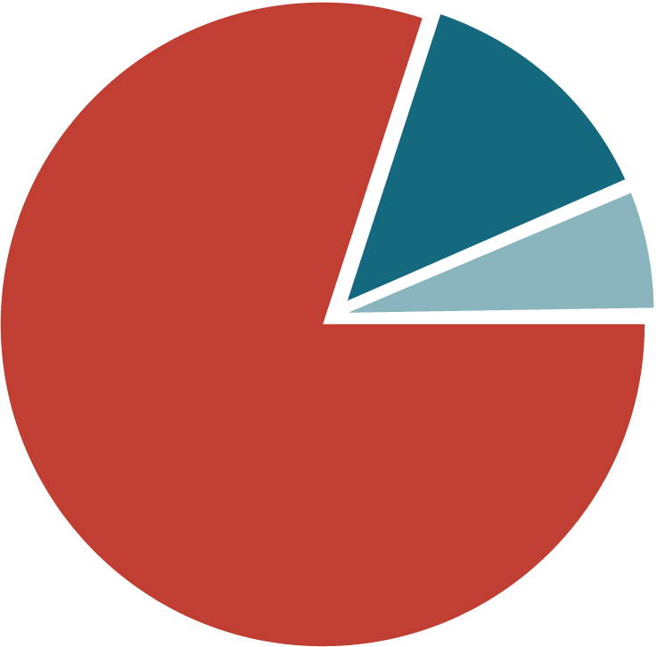
Secondary
Pays secondary
to Medicare.
you pay a $200 calendar-year deductible
30% co-insurance – you pay 30% of the 20% not covered by Medicare.
HealthSelect℠ pays
70%
30%
80%
You
pay
Covered by Medicare
Notes:
HealthSelect of Texas Secondary pays secondary to Medicare. The plan features include:
A $200 per individual ($600 per family) deductible. This deductible runs concurrently with the $240 (up from $226 in 2023)Medicare deductible which means once you meet the $200 HealthSelect of Texas deductible, you will only have $40 left to pay on the Medicare deductible before Medicare and HealthSelect Secondary pay a portion of your medical services.
HealthSelect Secondary pays 70% of the remaining 20% that is not covered by Medicare. You’ll be responsible for paying 30% of the cost not covered by Medicare – this is called your co-insurance amount.
Your out-of-pocket share depends on the coordination of benefits (COB) between HealthSelect Secondary and Medicare. Sometimes this means your share of the cost is $0. Please refer to your Summary of Benefits for more information.

Slide 17


Call ERS and provide your Medicare information to enroll!
Declining coverage means, you’ll lose all GBP prescription drug coverage.
If you decline, sign up for a private Part D plan within 63 days or you may be penalized.
Notes:
If you’re enrolled in HealthSelect of Texas Secondary or HealthSelect Medicare Advantage MA PPO, you will be enrolled in HealthSelect Medicare Rx, a Part D prescription plan, after you’ve provided ERS with your Medicare information.
You’ll have to meet a $50 calendar year deductible that starts every January 1 before your coverage begins. After you meet your deductible, you’ll pay copays for your prescription drugs. The copay amount depends on the tier your medication falls into – generic, name brand, or preferred.
You have the option to decline coverage with HealthSelect Medicare Rx, but ERS doesn’t offer an alternative plan. This means, if you decline HealthSelect Medicare Rx coverage, you (and your dependents enrolled in Medicare) won’t have any prescription drug coverage through the state.
If you decline HealthSelect Medicare Rx, you and your dependents enrolled in Medicare should sign up for a private Part D plan within 63 days of losing your GBP prescription drug coverage. Otherwise, you may be subject to a penalty from the SSA, if you decide to enroll in Part D at a later date.
Please note: You must be enrolled in either Medicare Part A or Part B to be eligible for Medicare Part D.

Slide 18

Freedom of Movement
If you switch from the HealthSelect Medicare Advantage plan to the HealthSelect Secondary plan, it will be effective the first of the month following your request.
If you switch from the HealthSelect Secondary plan to the HealthSelect Medicare Advantage plan there’s a 29-day Medicare enrollment period before the plan will be effective.
Switch between the HealthSelect Medicare Advantage plan and the HealthSelect Secondary plan anytime.
Notes:
It’s important to note that you have freedom of movement throughout the year. This means you can switch between the HealthSelect Medicare Advantage plan and your previous non-Medicare advantage plan anytime, if you determine one plan may work better for you than the other. You don’t have to wait for Fall Enrollment, just call ERS to make the change.
If you switch from the HealthSelect Medicare Advantage plan to your previous non-Medicare Advantage health plan, the change will be effective the first of the month following your request.
If you want to switch from your non-Medicare Advantage health plan to the HealthSelect Medicare Advantage plan, there’s a 29-day enrollment period that Medicare requires before the plan will be effective. For most, this pushes out the effective date an additional month.
For example, if you call to request to enroll in HealthSelect Medicare Advantage on April 15, the request is processed and ERS sends the information electronically to United Healthcare. If you count 29 days from United Healthcare receiving and processing the request, the enrollment period would end mid-May. Because ERS doesn’t begin coverage mid-month, the effective date for HealthSelect Medicare Advantage would be June 1.
Please Note: You must be enrolled in Medicare Part A and Part B to be eligible for the HealthSelect Medicare Advantage Plan.

Slide 19

Return to Work Retirees
Not eligible for HealthSelect Medicare Advantage and HealthSelct Medicare Rx .
Re-enrolled in previous non-Medicare Advantage health plan.
Option to choose active employee benefits.
Notes:
If you return to work for a state agency or higher education institution, your state health insurance will become primary to Medicare. While working, regardless if you keep your retiree benefits or elect to enroll in active employee benefits, you are not eligible for HealthSelect Medicare Advantage or HealthSelect Medicare Rx. You’ll be re-enrolled in your previous non-Medicare Advantage health and prescription plan.
Return-to-work retirees have the option to choose active employee benefits and can choose to increase your Optional Term Life Insurance to Elections 3x or 4x your salary, add short-term and long-term disability, Voluntary Accidental Death and Dismemberment and/or TexFlex.
Once you leave state employment, you can contact ERS to re-enroll in HealthSelect Medicare Advantage and HealthSelect Medicare Rx.
Please note: If you choose active employee benefits once you leave state employment again, your Optional Term Life Insurance will be based on the new salary and will not return to the salary you had when you initially retired.
For example, if you retired with an annual salary of $48,000 and returned to work with a new employee annual salary of $32,000, your Optional Term Life Insurance coverage amount will be based on the new employee annual salary amount. When you end your state employment you’ll be switched back to retiree benefits, and your Optional Term Life coverage amount will be based on the most current salary of $32,000 not the $48,000.
Talk to your benefits coordinator about your options if you return to work for the state.

Slide 20

Split Households
Notes:
Split Households – this is a term that you might not be familiar with.
A split household refers to a household of at least two people enrolled in a GBP health plan, with one member enrolled in Medicare while the other isn’t eligible for Medicare.
What happens to your health coverage and your dependent’s coverage in a split household situation?
Let’s go over the three main scenarios.

Slide 21


Retiree is Medicare-Eligible
The retiree is eligible for Medicare, the dependent is not
Retiree – Should provide ERS with Medicare info and can enroll in HealthSelect Medicare Advantage.
Dependent – remains on his or her non-Medicare Advantage health plan.
Retiree
Dependent
Notes:
In this first scenario, the retiree is eligible for, and enrolled in, Medicare Part A and Part B and the dependent isn’t.
This means the retiree can enroll in HealthSelect Medicare Advantage and HealthSelect Medicare Rx and the dependent will remain on his or her non-Medicare Advantage health and prescription plan.
If your dependent becomes eligible for, and enrolls in Medicare Part A and Part B, call ERS to provide his or her Medicare information and we will enroll him or her in the same health and prescription plan you’re enrolled in.

Slide 22


Retiree Is Not Medicare-Eligible
The retiree is not eligible for Medicare Parts A and B?
Retiree – remains on his or her current health plan.
Dependent – can enroll in HealthSelect Medicare Advantage.
Retiree
Dependent
Notes:
In this next scenario, the retiree isn’t eligible for, and not enrolled in Medicare Part A and Part B, but the dependent is.
This means the retiree will remain on his or her health and prescription plan and can call ERS to enroll the dependent in HealthSelect Medicare Advantage and HealthSelect Medicare Prescription Rx.
Once you become eligible for and enroll in Medicare, don’t forget to call ERS and provide your Medicare information. Once received, ERS can enroll you in HealthSelect Medicare Advantage and HealthSelect Medicare Rx.

Slide 23


Active Employee with
Medicare-Eligible Dependent
Active employee with a dependent who is eligible for Medicare
Active employee – remains on his or her current health plan.
Dependent can delay Medicare Part B – remains on same health plan as active employee.
Active
Employee
Dependent
Notes:
The last scenario we’ll discuss today is where an active employee (whether eligible for Medicare or not) has a dependent who is eligible for Medicare but enrolled in the state health coverage.
Active employees and their dependents are not eligible to enroll in the HealthSelect Medicare Advantage and the HealthSelect Medicare Rx plan because the state health insurance remains primary to Medicare. If your Medicare-eligible dependent stays under your health plan, he or she can still enroll in Part A (there’s no monthly premium) but delay enrollment in Medicare B until you retire.
Once you’re ready to retire, your dependent should contact the SSA before your retirement date and request to enroll in Medicare Part B with the effective date as the first of the month following your retirement date.
The SSA should send your dependent a form to verify that you were employed, and your dependent was under your active employee health insurance. Take this form to your benefits coordinator (or HHS Enterprise for employees of an HHS agency). Once your benefits coordinator has filled it out, your dependent should send it back to the SSA to avoid any penalty for enrolling in Medicare Part B outside of their initial enrollment period.

Slide 24


Non ERS Part C and Part D Plans
You want to pay attention to any mail that has the ERS logo on it.
Notes:
If you’re approaching age 65, you may have already started receiving information in the mail about private Part C and Part D plans. Or you might be eligible for an employer group plan offered by a previous employer or spouse’s employer. When you start receiving all this information in the mail about group or private plans, you may wonder, “Should I sign up for one of these plans?”
Your coverage with the state is as good as or better than a group or private Part C and Part D plans so you don’t have to sign up for one of those plans. However, let’s talk about what happens to your state coverage if you enroll in another Part C or Part D plan after you’ve enrolled in your GBP Medicare Advantage Plan and HealthSelect Medicare Rx Plan.
You want to pay attention to any mail that has the ERS logo on it. This information is coming from your GBP health plan provider or from ERS directly to provide you information on your benefits since you are Medicare eligible.

Slide 25

Enrolling in Private Part C and D Plans
Enrolling in a private or group Part C plan cancels your GBP HealthSelect Medicare Advantage plan.
Enrolling in a private or group Part D plan cancels your HealthSelect Medicare Rx coverage.
You can cancel your private or group Part C and Part D plan to re-enroll in your GBP coverage.
Notes:
You have the option to enroll in a group or private Medicare Part C, or a supplemental plan, instead of the HealthSelect Medicare Advantage plan but you can’t be enrolled in both at the same time.
If you enroll in a group or private Part C plan that isn’t offered through ERS after you have enrolled in the HealthSelect Medicare Advantage plan, your enrollment in the HealthSelect Medicare Advantage plan will be canceled and you’ll be enrolled in your previous, non-Medicare health plan.
You also have the choice to enroll in a group or private Part D or supplemental plan instead of the HealthSelect Medicare Rx plan, but you can’t be enrolled in both at the same time. If you enroll in a Part D plan that isn’t offered through ERS after you’ve enrolled in HealthSelect Medicare Rx, your prescription drug coverage will be canceled with ERS. You will only have prescription drug coverage through your non-GBP Part D plan.
If you enroll in a non-GBP Part C or Part D plan by mistake, or you enrolled in a group or private plan that isn’t working out for you, contact the group or private plan and request to cancel the coverage. Then, contact ERS to re-enroll in your GBP Medicare Advantage plan and HealthSelect Medicare Rx.
Please note: When re-enrolling in the HealthSelect Medicare Advantage plan or HealthSelect Medicare Rx plan, the coverage can’t be reinstated retroactively. Your re-enrollment effective date is dependent upon ERS’ rules and guidelines.

Slide 26


Resources
Social Security Administration
Toll-free (800) 772-1213 or online at www.ssa.gov
Medicare
Toll-free (800) 633-4227 or online at www.medicare.gov
ERS
Toll-free (877) 275-4377
Monday – Friday, 8:00 a.m. – 5:00 p.m. CT
or online at www.ers.texas.gov
Notes:
We covered a lot of information about Medicare today and you have resources available to help you.
You can contact the Social Security Administration toll-free at 800-772-1213 or visit www.ssa.gov to find answers to questions about enrollment or premiums.
You can call Medicare toll-free at (800) 633-4227 or go to www.medicare.gov if you have questions about coordination of benefits or coverage.
You can contact ERS toll-free at (877) 275-4377, Monday – Friday, 8:00 a.m. – 5:00 p.m. CT or online at www.ers.texas.gov. Be sure to check out our Facebook page and YouTube channel.

Slide 27

THANK YOU!

