Slide 1
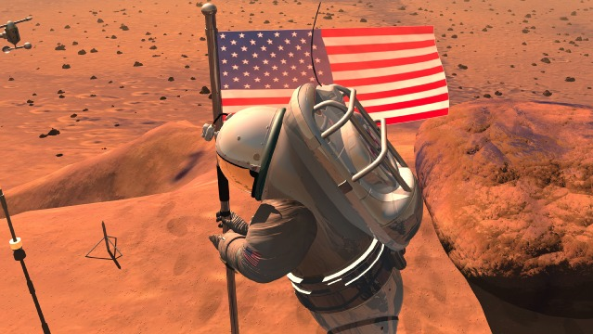
What Will It Take To Live on Mars?
Understanding Martian Resources
and Environmental Constraints

Slide 2
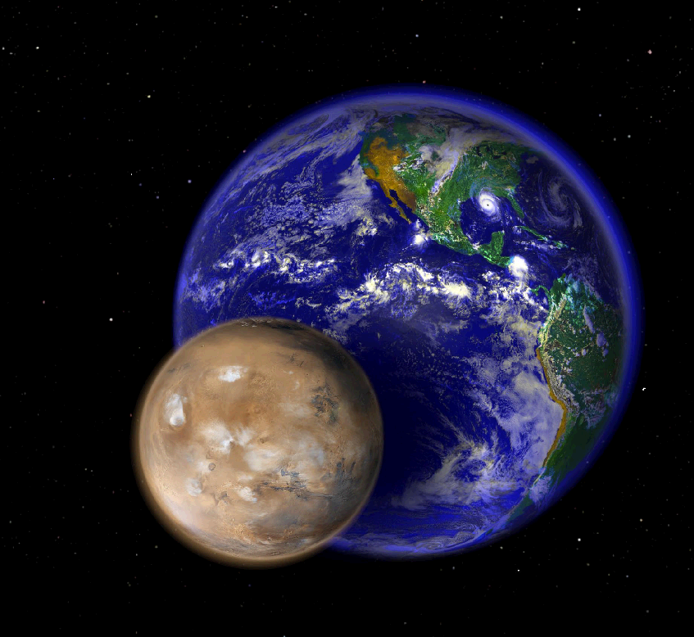
Beyond Earth, Mars is one of the only places in the
solar system where humans could one day live.
In size, Mars is about half the diameter of Earth.

Slide 3
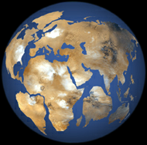
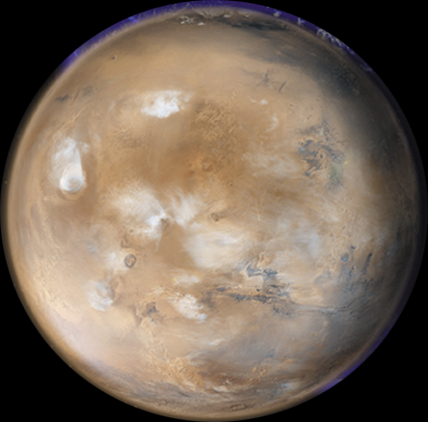
Mars’ surface area is equal to about 1/3 the surface of Earth
(about the total area of Earth's continents). That’s a lot of territory!
Where will you want to build your community?
Natural and human-made resources that are available,
along with environmental constraints, will help
you decide where and how to live.

Slide 4
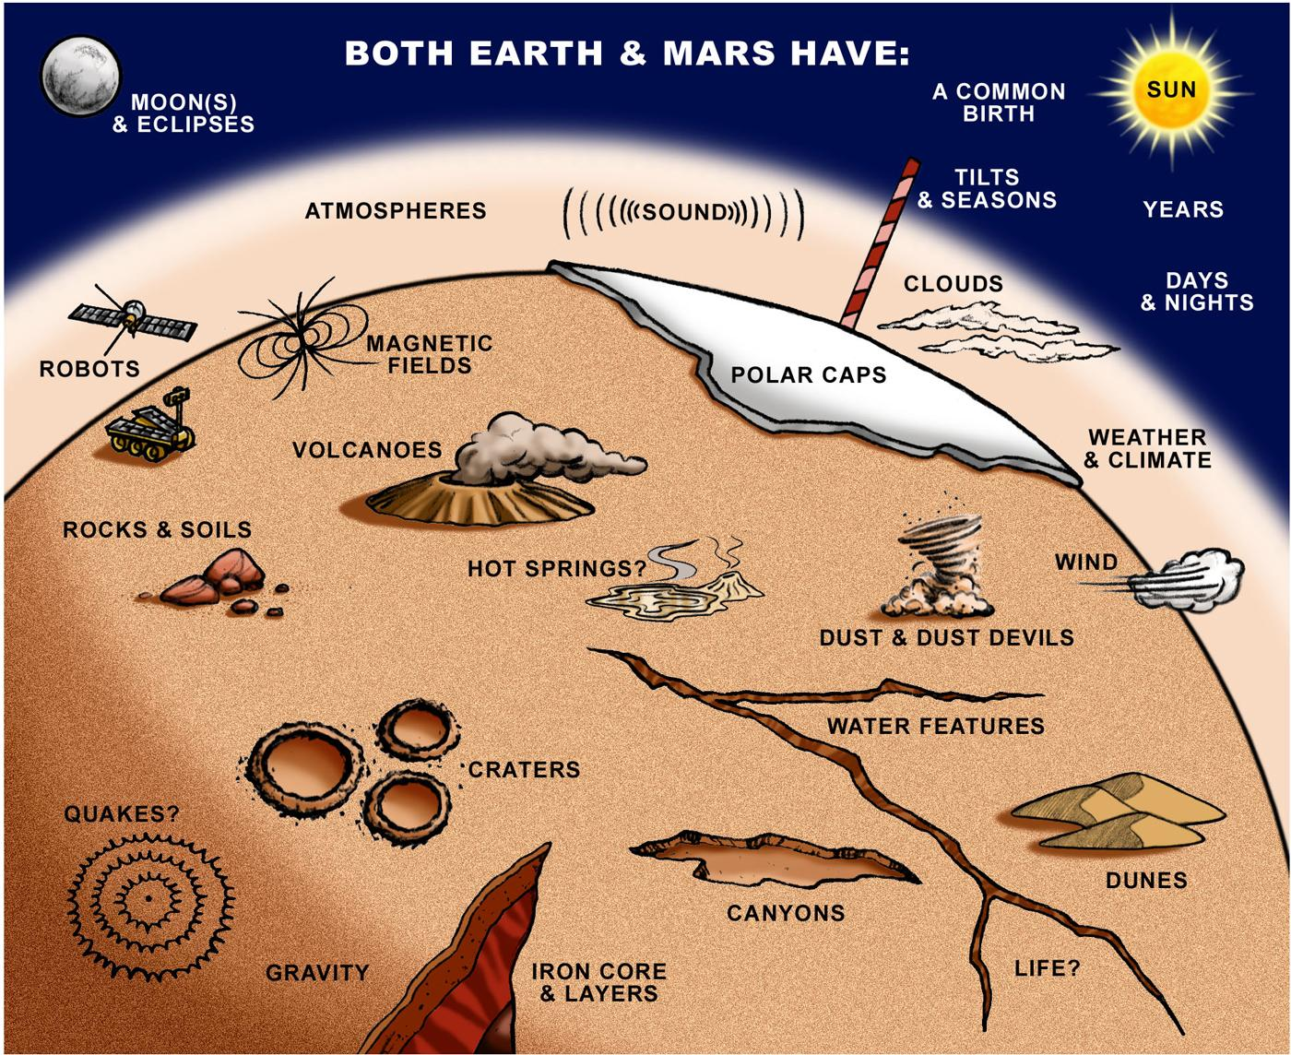
Scientists and engineers from all over the world have discovered many environmental and other similarities between Earth and Mars.
RADIATION

Slide 5
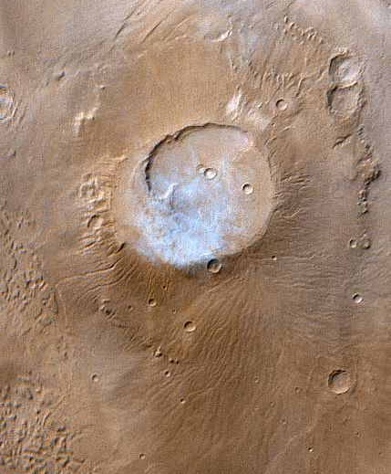
Mars has many landforms that are familiar to people
on Earth. Where is the best place to survive?
Olympus Mons
Apollinaris Patera
Volcanoes?
Notes:
Olympus Mons
Olympus Mons, 1998
Olympus Mons is a mountain of mystery. Taller than three Mount Everests and about as wide as the entire Hawaiian Island chain, this giant volcano is nearly as flat as a pancake. That is, its flanks typically only slope 2° to 5°.
The Mars Orbiter Camera (MOC) obtained this spectacular wide-angle view of Olympus Mons on Mars Global Surveyor's 263rd orbit, around 10:40 p.m. PDT on April 25, 1998. In the view presented here, north is to the left and east is up. The spacecraft was traveling from north to south (left to right). Although the camera looks straight down (towards the nadir) and cannot be pointed to the side, the wide angle camera has such a large field of view (it sees from horizon to horizon) that, in effect, it provides side looking views. Unlike some other MOC images, that have had to be warped to provide a view as if seen from a certain direction and altitude, this image shows what the camera saw without additional processing. It is easy to imagine that you are looking out a window at the surface of Mars from about 900 km (560 miles) up.
Apollinaris Patera
This month (April 1999), the Mars Global Surveyor Mars Orbiter Camera (MOC) passed over the Apollinaris Patera volcano and captured a patch of bright clouds hanging over its summit in the early martian afternoon. This ancient volcano is located near the equator and--based on observations from the 1970s Viking Orbiters--is thought to be as much as 5 kilometers (3 miles) high. The caldera--the semi-circular crater at the volcano summit--is about 80 kilometers (50 miles) across.
The color in this picture was derived from the MOC red and blue wide angle camera systems and does not represent true color as it would appear to the human eye (that is, if a human were in a position to be orbiting around the red planet). Illumination is from the upper left.

Slide 6
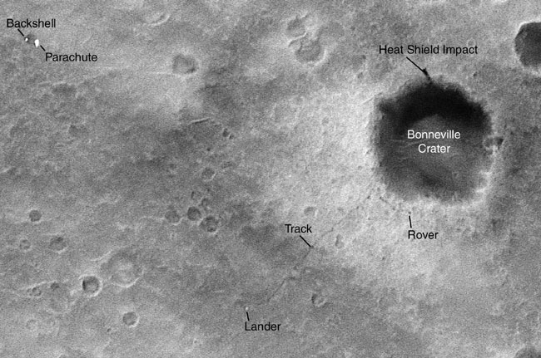
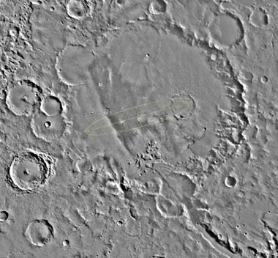
Gusev Crater
Bonneville Crater
Impact Craters?
Notes:
Rover Tracks Seen from Orbit
Wheel tracks left by NASA's Mars Exploration Rover Spirit, and even the rover itself, are visible in this image from the Mars Orbiter Camera on NASA's Mars Global Surveyor orbiter. North is up in this image. The tracks and rover are in the area south of a crater informally named "Bonneville," which is just southeast of the center of the image. The orbiter captured this image with use of an enhanced-resolution technique called compensated pitch and roll targeted observation. It took the picture on March 30, 2004, 85 martian days, or sols, after Spirit landed on Mars. The rover had driven from its landing site to the rim of Bonneville and was examining materials around the crater's rim.
Gusev-plain
The designated landing site for the first Mars Exploration Rover mission is Gusev Crater, seen here in its geological context from NASA Viking images.

Slide 7
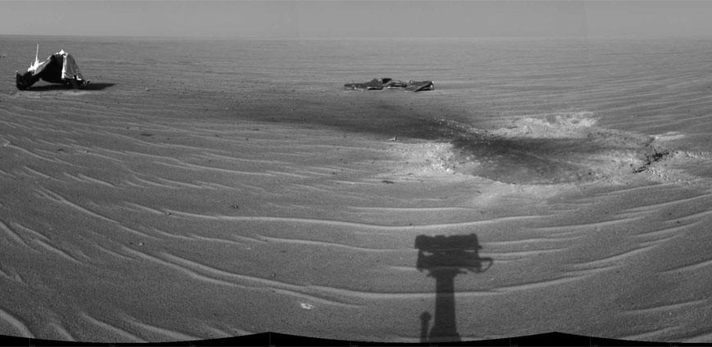
Low, Flat Plains?
The rover Opportunity’s heat shield and shadow at Meridiani Planum.
Notes:
Heat Shield Impact Site
NASA's Mars Exploration Rover Opportunity gained this view of its own heat shield during the rover's 325th martian day (Dec. 22, 2004). The main structure from the successfully used shield is to the far left. Additional fragments of the heat shield lie in the upper center of the image. The heat shield's impact mark is visible just above and to the right of the foreground shadow of Opportunity's camera mast. This view is a mosaic of three images taken with the rover's navigation camera.

Slide 8
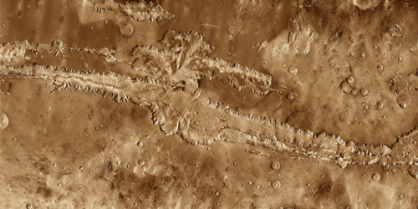
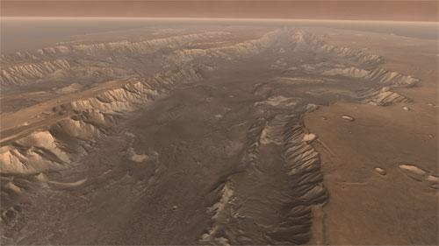
Deep Canyons?
Artist’s concept of High View of Melas
Valles Marineris
To decide on a place where your community will
survive and thrive, you’ll want to find the safest place.
with the most resources, plus design a few technologies.
Notes:
The Grand Canyon of Mars - Valles Marineris
This mosaic image of Valles Marineris - colored to resemble the martian surface - comes from the Thermal Emission Imaging System (THEMIS), a visible-light and infrared-sensing camera on NASA's Mars Odyssey orbiter.
Built from more than 500 daytime infrared photos, the mosaic shows the whole valley in more detail than any previous composite photo. Despite the valley's huge extent - including its western extension through Noctis Labyrinthus, it reaches some 3,000 kilometers (2,000 miles) long - the smallest details visible in the image are about the size of a football field: 100 meters (328 feet).
Geologists think Valles Marineris began to open along geological faults about 3.5 billion years ago. The faulting was caused by the tectonic activity that accompanied the growth of the giant volcanoes in Tharsis, lying just to the west. As molten rock (magma) pushed into Tharsis from below, the entire region rose, and the surrounding crustal rocks stretched and broke into faults and fractures.
As cracks opened, the ground sank, much as the keystone in an arch drops when the ends of the arch move apart. The faulting also opened paths for subsurface water to escape, undermining the ground and enlarging the fracture zone. In countless places, the valley's steep, newly exposed walls became unstable, causing landslides that widened the canyon further. It's not clear when the valley's growth stopped - and in places even today small landslides undoubtedly occur. But it appears the main activity came to a halt roughly 2 billion years ago.
High View of Melas
Soaring high above Valles Marineris, the "Grand Canyon of Mars," viewers look down and catch a sight resembling parts of the desert West of the United States, but on a vastly greater scale. Here the canyon averages over a hundred miles wide, and its floor is heaped with rocks, sediments, and landslide debris. Within the canyon walls lie possibly hundreds of layers filling many pages of Mars' geologic record.
This scene comes from "Flight Through Mariner Valley," an exciting video produced for NASA by the Jet Propulsion Laboratory. The video takes viewers on a simulated flight into Valles Marineris, where they explore its scenic wonders as their imaginary scout ship dives low over landslides and races through winding canyons.

Slide 9
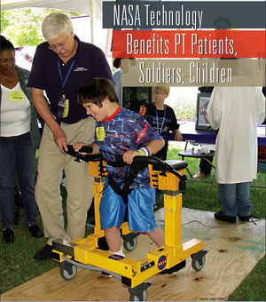
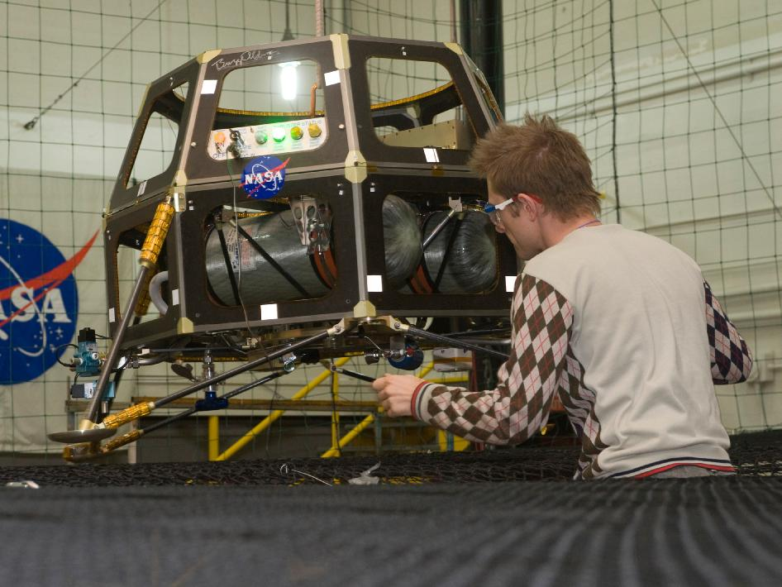
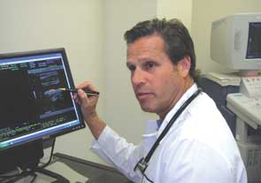
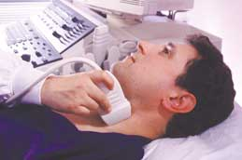
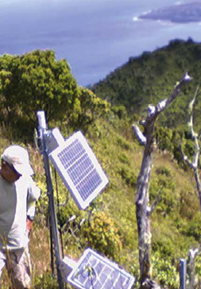
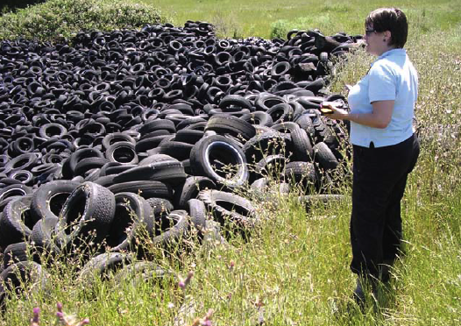
For a better life, every Earth community relies on people
of all different backgrounds to design solutions to problems.
Mars communities will too!
Communications
Clean Car/Clean Energy
Medical Devices
Crop Forecasting
Advanced Materials for
Disaster Relief
Environmental Monitoring
Notes:
http://beacon.jpl.nasa.gov/Histphotos/hpom/p-14116ac.html
http://ipp.nasa.gov/innovation/innovation131/A-feature-nasatech.html
http://www.sti.nasa.gov/tto/Spinoff2006/ch_9.html
http://ntrs.nasa.gov/archive/nasa/casi.ntrs.nasa.gov/20090002497_2009001820.pdf
http://www.nasa.gov/images/content/351558main_crop_forecast_sensor_HI.jpg
http://www.nasa.gov/topics/earth/features/crop_forecast.html

Slide 10
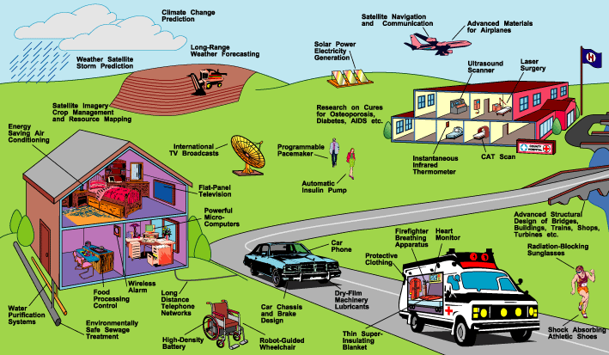
Many men and women have chosen science and technology
careers to design solutions for a better life on Earth.
Sample of NASA Technologies Used in Society
Notes:
http://www.nasa.gov/externalflash/nasacity/index2.htm
http://ntrs.nasa.gov/archive/nasa/casi.ntrs.nasa.gov/20080003903_2008001475.pdf

Slide 11
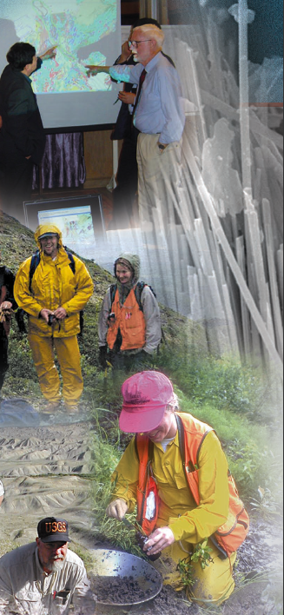
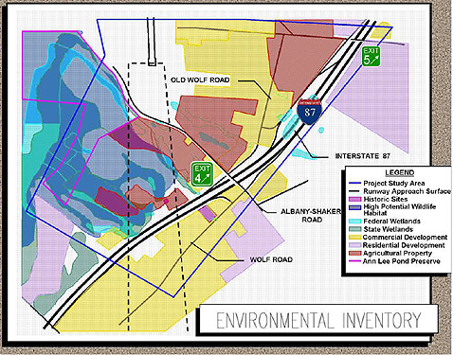
In designing community solutions on Earth, we have to
balance natural and human-made resources with
environmental and other constraints.
Notes:
https://www.nysdot.gov/regional-offices/region1/projects/i87exit3/repository/Exit3_environment.jpg
http://pubs.usgs.gov/fs/2007/3035/pdf/FS07-3035_508.pdf

Slide 12
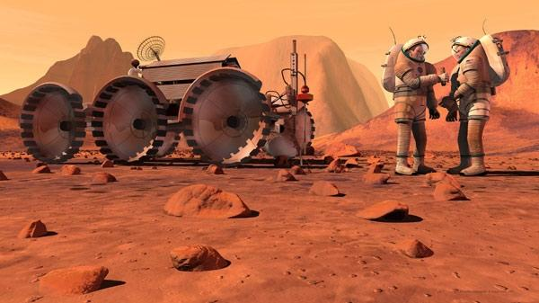
To design a community on Mars, you need to
understand how it is different from Earth
so that you can balance resources and constraints
for your community’s survival there.

Slide 13
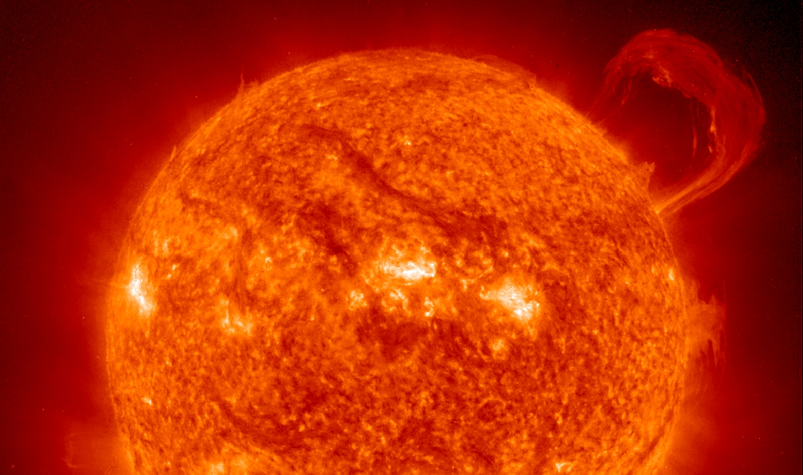
The sun is an example of a natural resource
that provides power and energy for life systems.

Slide 14
Because of the work of scientists and engineers from all
over the world, we know Mars is Earth’s neighbor and
the 4th planet from the sun.
Not to scale
Since Mars is farther away from the sun,
it receives less light than the Earth.
Notes:
5-8 Science and Technology: Develop understandings about science and technology: Many different people in different cultures have made and continue to make contributions to science and technology.

Slide 15
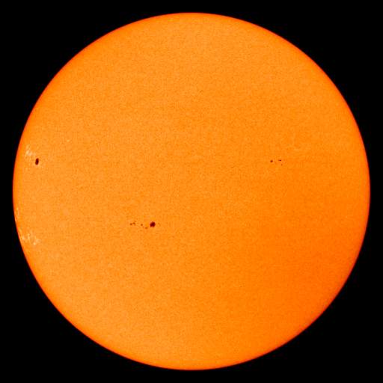
Compared to Earth, Mars is about 1.5 times
farther away from the sun.
THE
SUN
Not to scale
Earth: Sunlight
Mars: Reduced Sunlight
If you are about twice as far away from the sun,
you only have about ¼ the solar energy.

Slide 16
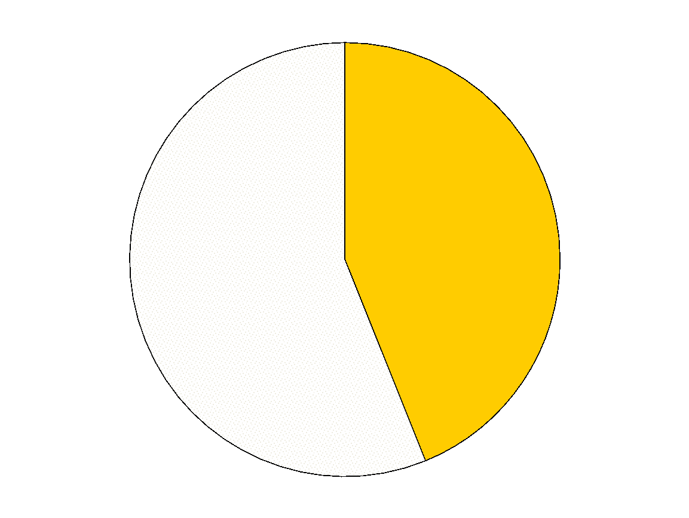
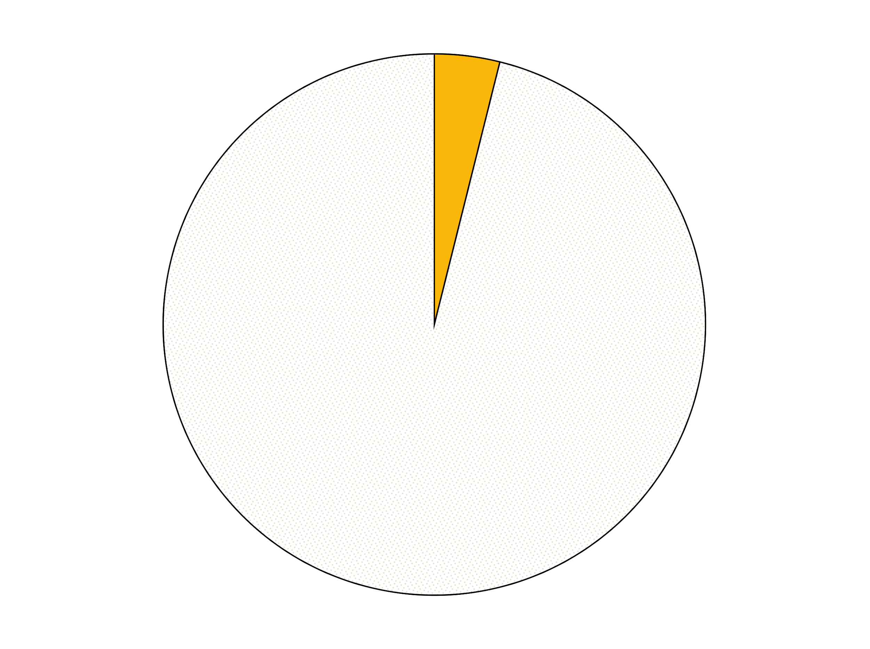
While solar energy is lower for Mars, the sun can still
be used as a natural resource for power.
Earth:
Compared to Earth, the sun’s intensity at other planets is:
100%
Mars:
44%
Jupiter:
4%
Not enough solar power:
Saturn:
~1%
Uranus:
~ 0.2%
Neptune:
~ 0.1%
Pluto:
~ 0.06%
You may wish to consider other sources to ensure
you have enough energy for your community.

Slide 17
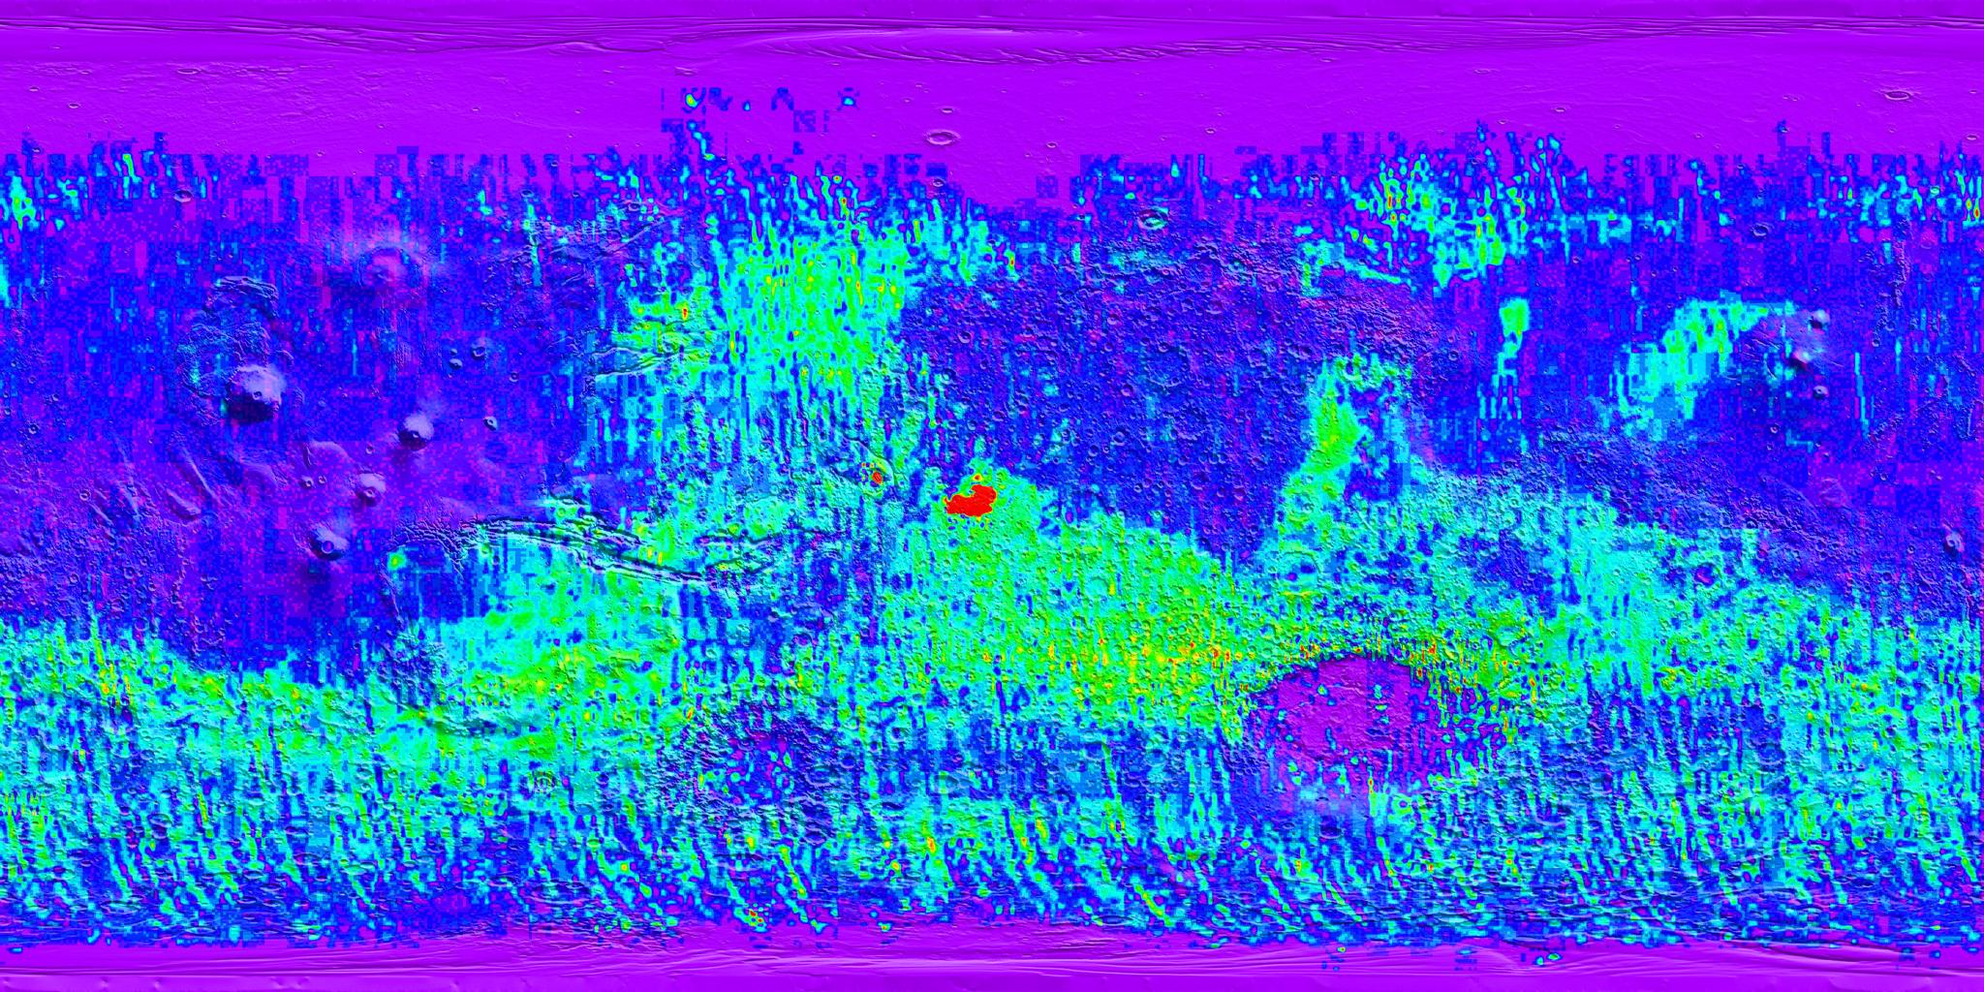
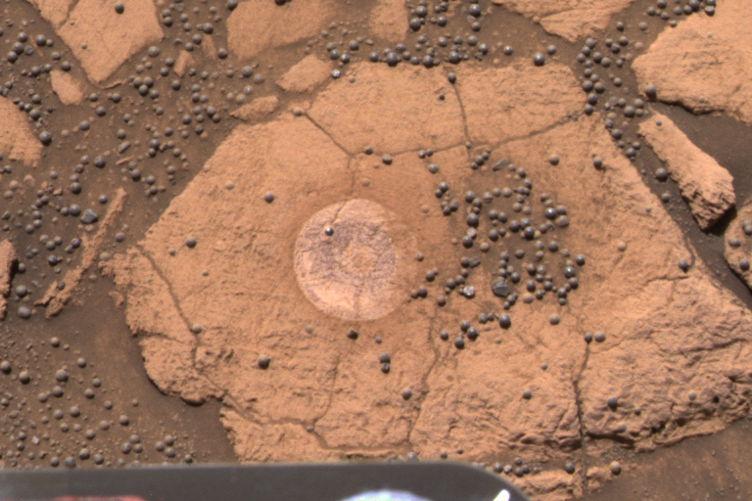
Hematite (aqueous mineral) on Mars
For your community to survive and thrive,
you will also need to identify places with natural
resources such as minerals that might be useful to you.
Technologies that identify where different minerals are on Mars
(in false color above) will be key to include.

Slide 18
Humans depend on Earth’s natural resources for life.
Water is one of the most precious of these resources.
Water probably flowed
on Mars long ago,
but no liquid water is
on the surface now.
Humans will have to
find a way to get water
to their community on Mars.
Nanedi Vallis
Notes:
Nanedi Vallis
This picture of a canyon on the Martian surface was obtained a few minutes after 10 PM PST, January 8, 1998 by the Mars Orbiter Camera (MOC), during the 87th orbit around Mars of the Mars Global Surveyor spacecraft. It shows the canyon of Nanedi Vallis, one of the Martian valley systems cutting through cratered plains in the Xanthe Terra region of Mars. The picture covers an area 9.8 km by 18.5 km (6.1 mi by 11.5 mi), and features as small as 12 m (39 ft) can be seen. The canyon is about 2.5 km (1.6 mi) wide. Rocky outcrops are found along the upper canyon walls; weathered debris is found on the lower canyon slopes and along the canyon floor. The origin of this canyon is enigmatic: some features, such as terraces within the canyon (as seen near the top of the frame) and the small 200 m (660 ft) wide channel (also seen near the top of the frame) suggest continual fluid flow and downcutting. Other features, such as the lack of a contributing pattern of smaller channels on the surface surrounding the canyon, box-headed tributaries, and the size and tightness of the apparent meanders (as seen, for example, in the Viking image 89A32), suggest formation by collapse. It is likely that both continual flow and collapse have been responsible for the canyon as it now appears. Further observations, especially in areas west of the present image, will be used to help separate the relative effects of these and other potential formation and modification processes.
Malin Space Science Systems (MSSS) and the California Institute of Technology built the MOC using spare hardware from the Mars Observer mission. MSSS operates the camera from its facilities in San Diego, CA. The Jet Propulsion Laboratory's Mars Surveyor Operations Project operates the Mars Global Surveyor spacecraft with its industrial partner, Lockheed Martin Astronautics, from facilities in Pasadena, CA and Denver, CO.
Photo Credit: NASA/JPL/Malin Space Science Systems

Slide 19
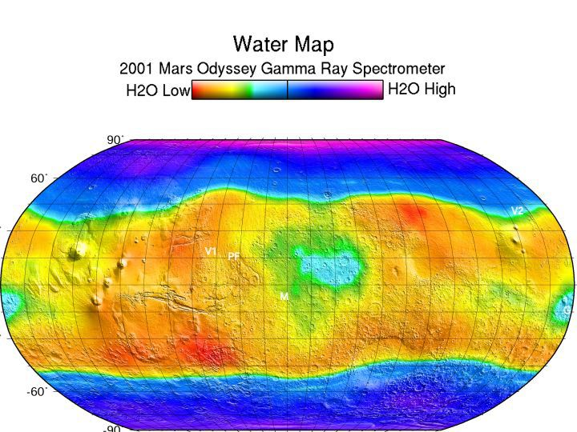
Scientists used a technology on the Odyssey spacecraft to
discover that Mars has water ice in the ice caps
and below the surface in other areas.
Your community will need to be near the natural resource water,
but since water ice is below the surface, you will have
to design technologies to access it.
Notes:
This map shows regions high in hydrogen at the north and south poles. The areas shown in blue and violet are believed to consist of 50% water ice by volume.
Image credit: NASA/JPL/University of Arizona

Slide 20
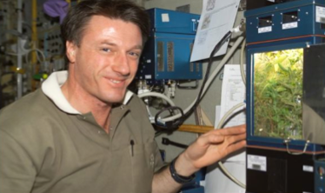
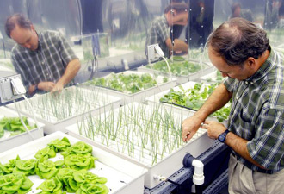
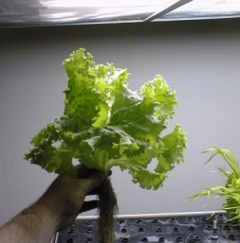
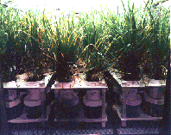
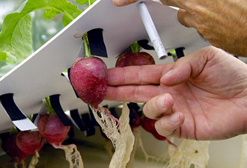
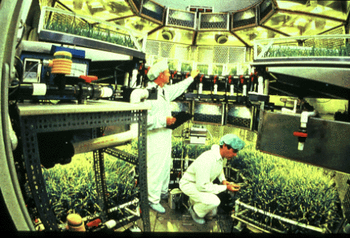
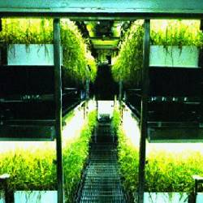
Food is another resource on which humans depend.
The Martian soil is toxic, which is a good example
of an environmental constraint.
Scientists and engineers around the world have to design a technology
for growing food without soil. This technology is called hydroponics.
Notes:
http://www.nasa.gov/images/content/462887main_iss022e097231.jpg
http://www.nasa.gov/vision/earth/livingthings/biofarming.html
http://settlement.arc.nasa.gov/designer/regen.html
http://quest.arc.nasa.gov/test/speakersnotes/ITP/912/examples_spsci.html

Slide 21
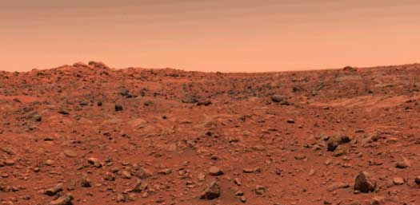
Compared to Earth, Mars is cold.
Temperature is another environmental constraint to be
considered in your community planning.
Notes:
http://marsprogram.jpl.nasa.gov/gallery/martianterrain/PIA00563.html
First color image from Viking 1

Slide 22
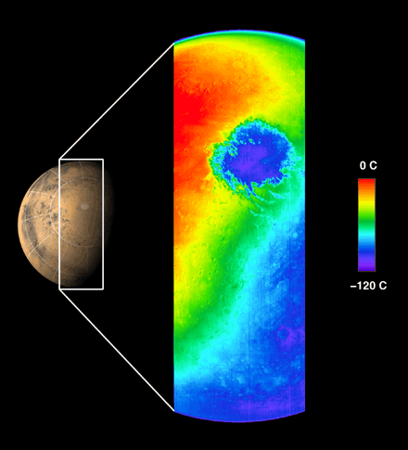
Mars is cold because it is farther from the Sun than Earth, and receives less of the Sun’s warming rays. Also, Mars’ thin atmosphere does not hold much of the heat from the Sun.
The extreme temperatures
on Mars vary between
-190° F and 75° F.
How will you stay
warm and provide
power to your
community?
32° F
- 184° F
Notes:
http://marsprogram.jpl.nasa.gov/gallery/polaricecaps/PIA03459.html First THEMIS Image of Mars
This thermal infrared image was acquired by Mars Odyssey's thermal emission imaging system on October 30, 2001, as the spacecraft orbited Mars on its ninth revolution around the planet. The image was taken as part of the calibration and testing process of the camera system.
This image shows the temperature of Mars in one of the 10 thermal infrared filters. The spacecraft was approximately 22,000 kilometers (about 13,600 miles) above the planet looking down toward the south pole of Mars when this image was acquired.
It is late spring in the martian southern hemisphere. The extremely cold, circular feature shown in blue is the martian south polar carbon dioxide ice cap at a temperature of about -120 °C (-184 ° F). The cap is more than 900 kilometers (540 miles) in diameter at this time and will continue to shrink as summer progresses. Clouds of cooler air blowing off the cap can be seen in orange extending across the image to the left of the cap. The cold region in the lower right portion of the image shows the nighttime temperatures of Mars, demonstrating the "night-vision" capability of the camera system to observe Mars even when the surface is in darkness. The warmest regions occur near local noontime. The ring of mountains surrounding the 900-kilometer (540-mile) diameter impact basin Argyre can be seen in the early afternoon in the upper portion of the image. The thin blue crescent along the upper limb of the planet is the martian atmosphere.
This image covers a length of over 6,500 kilometers (3,900 miles) spanning the planet from limb to limb, with a resolution of approximately 5.5 kilometers per pixel (3.4 miles per pixel), or picture elements, at the point directly beneath the spacecraft. The Odyssey's infrared camera is planned to have a resolution of 100 meters per pixel (about 300 feet per pixel) from its mapping orbit.
JPL manages the 2001 Mars Odyssey mission for NASA's Office of Space Science, Washington, D.C. The thermal emission imaging system was developed at Arizona State University, Tempe with Raytheon Santa Barbara Remote Sensing, Santa Barbara, Calif. Lockheed Martin Astronautics, Denver, Colo., is the prime contractor for the project, and developed and built the orbiter. Mission operations are conducted jointly from Lockheed Martin and from JPL, a division of the California Institute of Technology in Pasadena.
Image credit: NASA/Jet Propulsion Laboratory/Arizona State University.

Slide 23
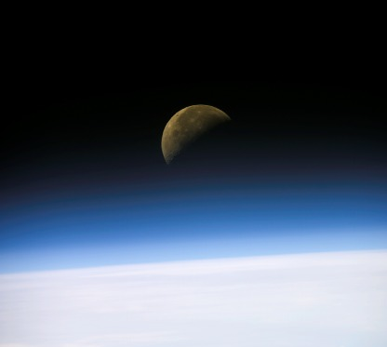
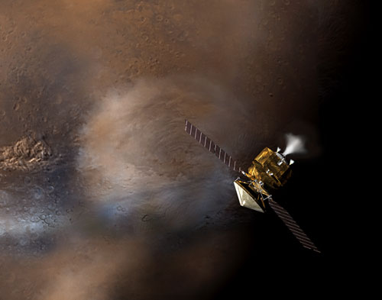
Unlike Earth, Mars’ very thin atmosphere has another big
environmental constraint—it does not have enough
oxygen for a human to breathe.
Digital camera image of Earth’s atmosphere and moon
taken by the Columbia Space Shuttle Crew Jan 26, 2003.
Artist’s concept of the Mars Reconnaissance Orbiter
flying through the martian atmosphere during aerobraking.
Oxygen is a basic and necessary natural resource on Earth.
Will we have to produce oxygen on Mars?
What technologies enable that?
Notes:
‹#›
K-4: Science in Personal and Social Perspectives: Understanding of types of resources: Resources are things that we get from the living and nonliving environment to meet the needs and wants of a population. And, Some resources are basic materials, such as air, water, and soil; some are produced from basic resources, such as food fuel, and building materials. . . . .
9-12: Science in Personal and Social Perspectives: Understanding of Natural resources, Understanding of Environmental quality.
The air of Mars is mainly carbon dioxide (95%). Only 0.1% is oxygen. Earth’s air is 21% oxygen, 0.035% carbon dioxide, and 78% nitrogen.
http://spaceflight.nasa.gov/gallery/images/shuttle/sts-107/html/s107e05697.html
STS107-E-05697 (26 January 2003) --- A quarter moon is visible in this oblique view of Earth's horizon and airglow, recorded with a digital still camera aboard the Space Shuttle Columbia.

Slide 24
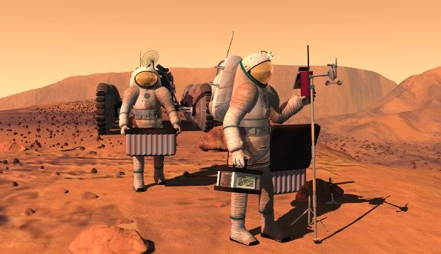
The thin atmosphere means
the surface pressure on Mars is 1/100 of Earth.
Without a special pressure suit, your organs would push out against your skin.

Slide 25
So, now engineers are researching how to make the
best spacesuits to protect human skin and organs.
Each new discovery leads to new technologies that must be developed.
A protective spacesuit is an example of a human-made resource.
Notes:
K-4 Science in Personal and Social Perspectives: Understanding of science and technology in local challenges: People continue inventing new ways of doing things, solving problems, and getting work done
5-8 Science & Technology: Science & Technology in Society: Societal challenges often inspire questions for scientific research, and social priorities often influence research priorities through the availability of funding for research.

Slide 26
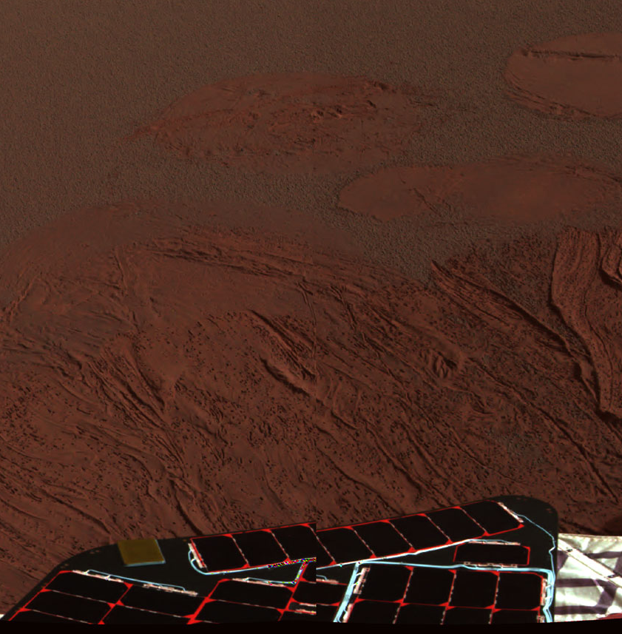
Mars is a dusty place, with a fine reddish-brown or butterscotch-colored soil on the surface.
This dust can gunk up spacesuits, jamming the shoulder, elbow,
knee and other joints,
making movement
difficult for people.
What can you invent to solve
this environmental problem
your community must address?
Notes:
‹#›
Meridiani Planum in Color
This color image shows the martian landscape at Meridiani Planum, where the Mars Exploration Rover Opportunity successfully landed at 9:05 p.m. PST on Saturday. This is one of the first images beamed back to Earth from the rover shortly after it touched down. The image was captured by the rover's panoramic camera.

Slide 27
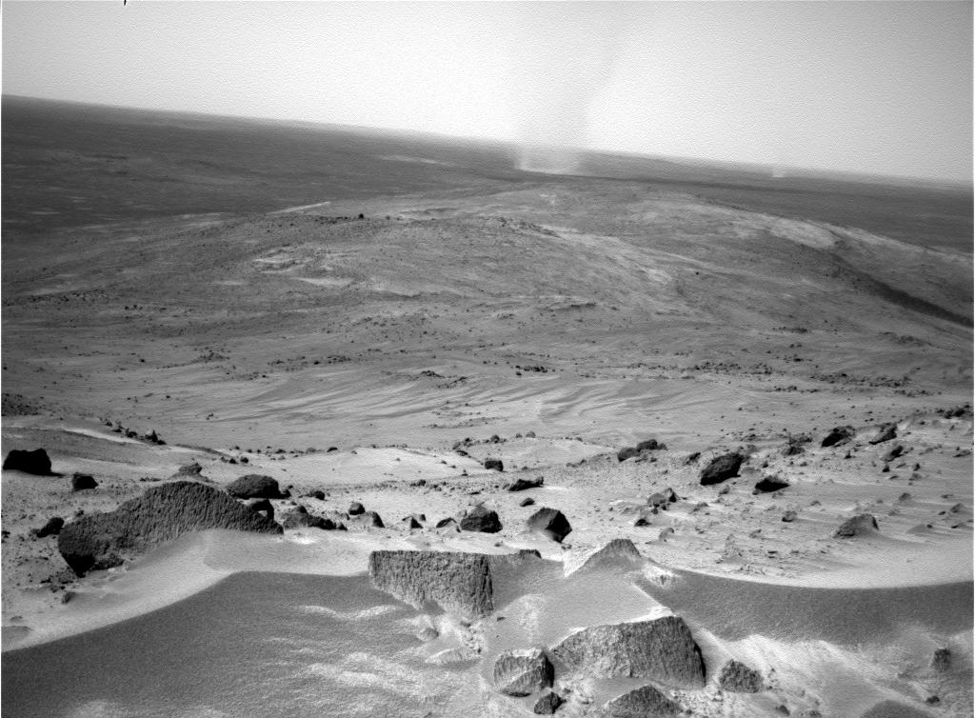
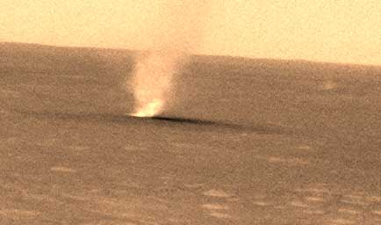
Winds on Mars also blow dust around the surface.
Is the wind a potential natural resource you could use
or is it an environmental hazard?
Notes:
‹#›
5-8 Science and Technology: Develop understandings about science and technology: Many different people in different cultures have made and continue to make contributions to science and technology.

Slide 28
The wind can be helpful in cleaning off important equipment
such as solar panels and other technologies…
but you can’t depend on it being there when you need it.
Spirit panoramic camera: March 5, 2005 (left) 416th martian day, or sol; March 15, 2005 (right), sol 426.
These two images show that wind removed dust
from the sundial and color calibration target
on NASA's Mars Exploration Rover Spirit.
Notes:
‹#›
Meridiani Planum in Color
This color image shows the martian landscape at Meridiani Planum, where the Mars Exploration Rover Opportunity successfully landed at 9:05 p.m. PST on Saturday. This is one of the first images beamed back to Earth from the rover shortly after it touched down. The image was captured by the rover's panoramic camera.
Before and After a Cleaning Event on Spirit
These two images from 10 days apart show that dust was removed from the panoramic camera's calibration target on NASA's Mars Exploration Rover Spirit. Spirit's panoramic camera took the picture on the left on the rover's 416th martian day, or sol, (March 5, 2005) and took the picture on the right on sol 426 (March 15, 2005). During the time in-between, other evidence of dust-lifting winds were a jump in power output by Spirit's solar arrays on sol 420 from removal of some accumulated dust, and sighting of two dust devils in sol 421 images from Spirit. The size of the base plate on the calibration target shown in both of these images is 8 centimeters (3.15 inches) on each side.
These are the panoramic camera team's best current attempt at generating "true color" views of what these scenes would look like if viewed by a human on Mars. They were generated from mathematical combinations of six calibrated, left-eye Pancam images for each sequence, using filters ranging from 430-nanometer to 750-nanometer wavelengths.

Slide 29
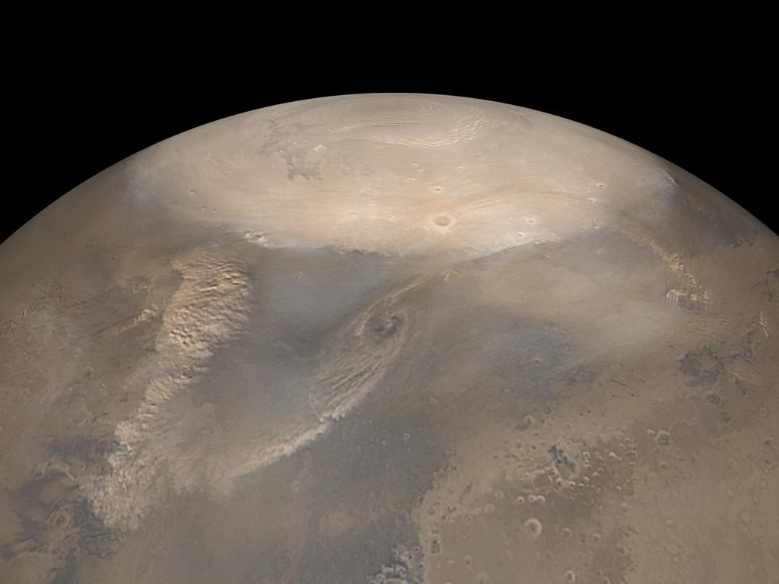
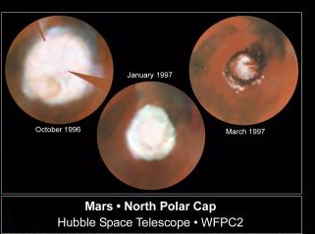
Dust storms often occur in the spring. . . and are sometimes helpful.
However, global dust storms can blanket the whole planet,
cutting of sunlight and affecting communications with Earth.
Springtime North Polar Dust Storm 2002
In winter, frozen carbon dioxide (dry ice) forms on the poles,
making the water ice there harder to access.

Slide 30
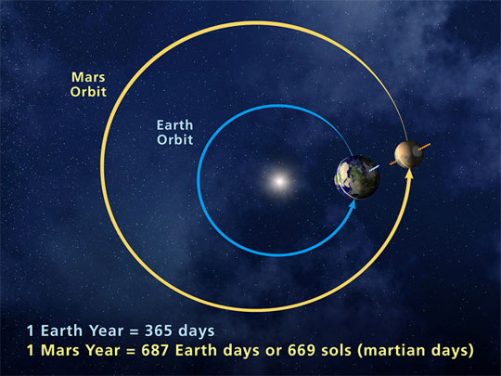
Therefore, you’ll have to deal with seasonal changes, but watch out!
Mars has seasons just like
Earth, but they last
about twice as long.
Notes:
‹#›
9-12 Science in Personal and Social Perspectives: Understanding of natural resources: Human populations use resources in the environment in order to maintain and improve their existence. Natural resources have been and will continue to be used to maintain human populations.

Slide 31
Mars’ thin atmosphere and missing magnetic field also allow
more of the sun’s harmful radiation to reach the surface
than we experience on Earth.
Earth’s magnetic field
Remnants of Mars’ magnetic field
Radiation can be considered an environmental constraint to
living healthily. How will you protect people from radiation?
Notes:
‹#›
Earth’s magnetic field shoots out from the poles up to 50,000 miles from the surface of Earth. Mars does not have a magnetic field. The magnetic field protects us from solar rays from our Sun and from Galactic Cosmic Rays coming from other stars and supernova.

Slide 32
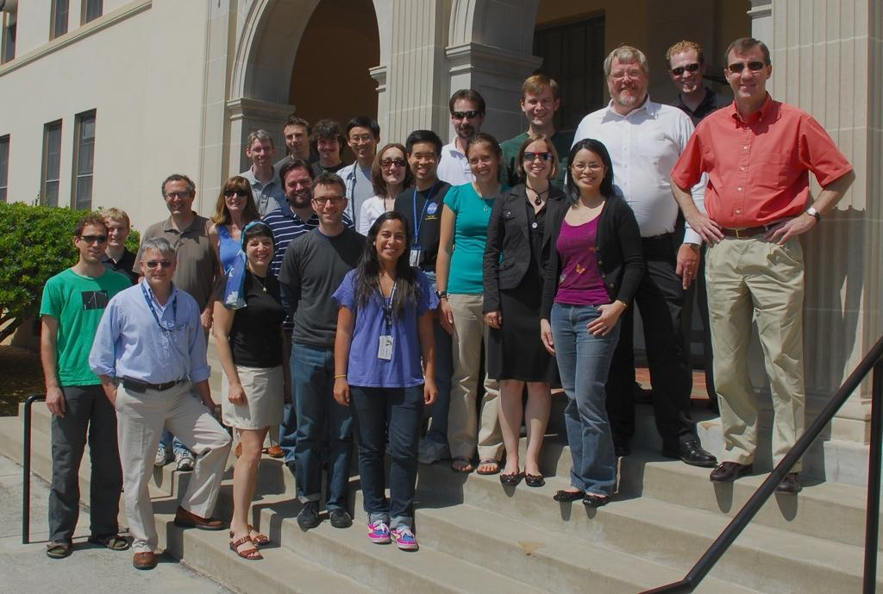
World scientists want to know more about radiation
on Mars to prepare for human exploration.
Earth’s magnetic field
Remnants of Mars’ magnetic field
So, they worked together with engineers to build the 2001
Mars Odyssey Orbiter to study radiation and other
aspects of Mars’ environment.
Notes:
9-12 History &Nature of Science: Understanding of Science as a human endeavor: Individuals and teams have contributed and will continue to contribute to the scientific enterprise. Doing science or engineering can be as simple as an individual conducting field studies or as complex as hundreds of people working on a major scientific question or technological problem.

Slide 33
The Odyssey science team discovered that radiation levels at Mars
are twice as high as those in orbit around Earth.
How will you solve this big potential health problem
for human explorers on Mars?
Notes:
K-4: Science and Technology: Develop abilities of technological design: Identify a Simple Problem

Slide 34
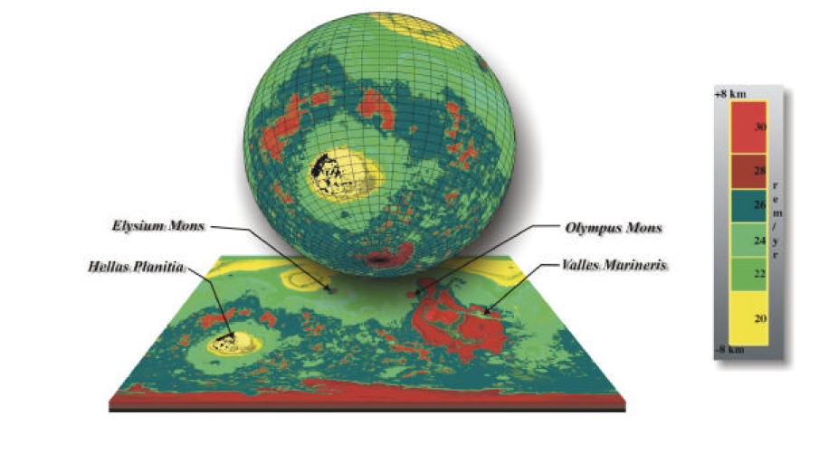
The good news is that scientists also discovered
that lower elevations on Mars have higher levels
of natural shielding from radiation.
Red = high elevation,
low level of shielding
Yellow = low elevation,
high level of shielding
Where will you build your community to encourage its survival?
Notes:
K-4 Science in Personal and Social Perspectives: Understanding of changes in environments: Environments are the space, conditions, and factors that affect an individual’s and a population’s ability to survive and their quality of life.
5-8 Science & Technology: Develop abilities of technological design: Students should make and compare different proposals in the light of the criteria they have selected. . . .
9-12 Science and Technology: Develop abilities of technological design: Itentify a problem or design and opportunity.
9-12 Science in Personal and Social Perspectives: Understanding of environmental quality
Mars Odyssey Marie data. Higher elevations (Olympus Mons) offer less sheilding.
http://marie.jsc.nasa.gov/Documents/Index.html

Slide 35
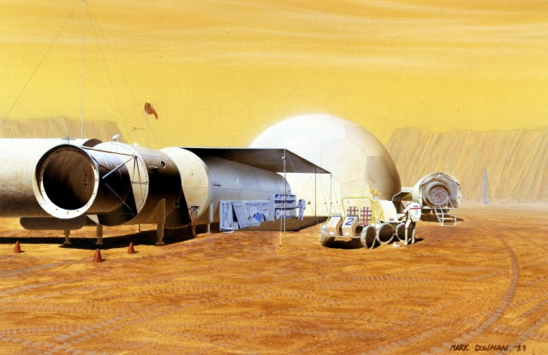
Scientists are currently researching materials
to shield astronauts from radiation.
So far, research shows that metals increase radiation levels,
while hydrogen seems to shield against it.
How will you keep your community members safe?
Notes:
‹#›
K-4: Science in Personal and Social Perspectives: Understanding of personal health: Safety and security are basic needs of humans. Safety involves freedom from danger, risk or injury. . . . .
5-8 Science and Technology: Develop abilities of technological design and Develop understandings about science and technology – technological designs have constraints.. .. .
http://spaceflight.nasa.gov/gallery/images/mars/marsbases/html/s89_51054.html

Slide 36
The pull of gravity on an object on Mars is
1/3 of the pull on the same object on Earth.
People will be able to jump higher and lift more on Mars.
Even if tasks are easier, will reduced gravity affect
human health, and what would help?

Slide 37
Scientific research shows that during long journeys in zero gravity,
astronauts lose muscle and bone mass.
They must exercise 2 hours a day to stay healthy.
How will you keep the first Martian settlers strong
during their six-month journey . . .
and in a 1/3 gravity environment on Mars?
Notes:
‹#›
K-4 Science and Technology: Develop abilities of technological design: Identify a Simple Problem and Propose a Solution
5-8 Science and Technology: Develop understandings about science and technology: Technological designs have constraints. And technological solutions have intended benefits and unintended consequences.
9-12 Science and Technology: Develop abilities of technological design: Identify a Problem and Propose designs and choose between alternative solutions.

Slide 38
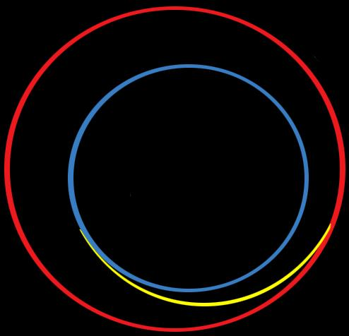
It’s important, because with the propulsion technologies
we now have, it takes a minimum of six months to get to Mars.
Yellow Line =
Successful route to Mars
of the 2001 Mars Odyssey Orbiter
Earth at
arrival
Launch
07-Apr-2001
Mars Arrival
23-Oct-2001
Mars at
Launch
With radio communications technology, it takes a minimum
of 4 minutes, and as much as 20 minutes each way
depending on where the planets are in their orbits.
Notes:
Explain Hohman transfer and that TCM = trajectory correction maneuver.

Slide 39
Even though Mars is 65 million miles away,
we now have the technology to land on its surface.
That accomplishment required the talents of men and women from
different backgrounds with different skills to contribute.
Notes:
‹#›
5-8 Science & Technology: Science & Technology in Society: Societal challenges often inspire questions for scientific research, and social priorities often influence research priorities through the availability of funding for research.

Slide 40
Thousands of years ago, humans could only see Mars
as a red dot in the sky, but now we are exploring with robots.
Maybe one day humans will go!
The possibility of human communities on Mars will depend
on men and women from around the world choosing
science and technology careers that will benefit
life in communities on Earth first.
Notes:
5-8 Science and Technology: Develop understandings about science and technology: Many different people in different cultures have made and continue to make contributions to science and technology.

Slide 41
What are all of the careers that make a community thrive?
How do people in those careers use science
and technology to improve their lives?
What kind of careers will be needed to make
sure your community on Mars survives and thrives?
Notes:
‹#›

Slide 42
Because of the work of scientists and engineers,
we know more about Mars every day.
Someday we may use this knowledge to build
safe and thriving communities. . . . What will your
community be like? What do you want to contribute?

