Slide 1
Welcome,
Building Coordinators!
January 31, 2025

Slide 2
AGENDA
Building Coordinator Meeting
January 31, 2025
9:00 a.m. –11:00 a.m.
Welcome – Yesenia Ramirez
Opening remarks- David Oliver
FIXIT overview and Outages – Yesenia Ramirez
Office of Emergency Management - Maia Solomon
Sustainability and Recycling- Beatrix Madersbacher
Building Coordinator Welcome Gifts (New BC’s) – Yesenia Ramirez

Slide 3
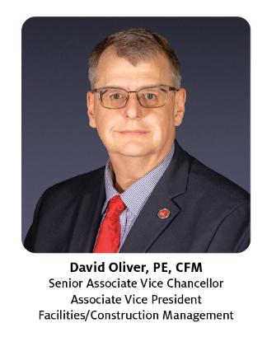
Opening Remarks - David Oliver AVC/AVP F/CM

Slide 4
FIXIT Process

Slide 5
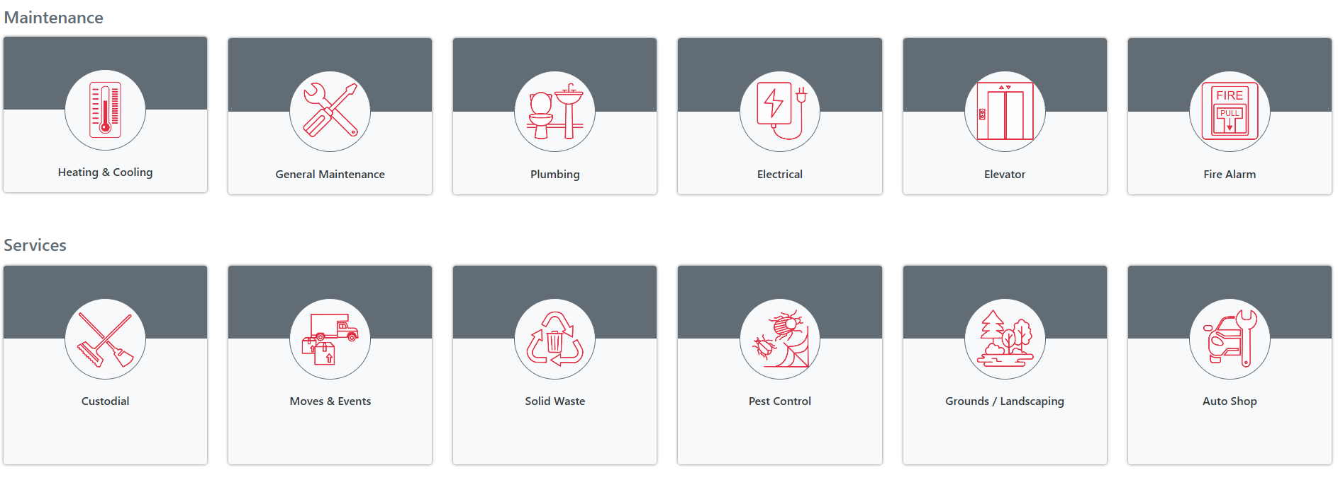
Submit a Service Request (SR) Online
Log into Access
UH
2. Click on the FIXIT
Icon
3. Select your SR category

Slide 6
Continued…
4. Provide Additional Details
Please include as much detail as possible in your request to ensure we have a clear understanding of the issue or request. Providing specific information will help us address the problem efficiently and accurately.

Slide 7
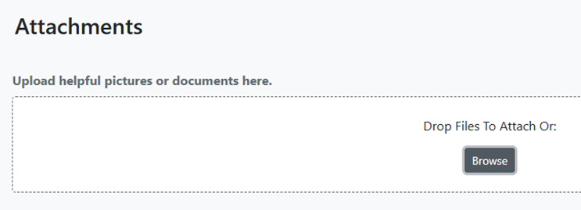
Continued…
6. Review and
Submit the Service Request

Slide 8
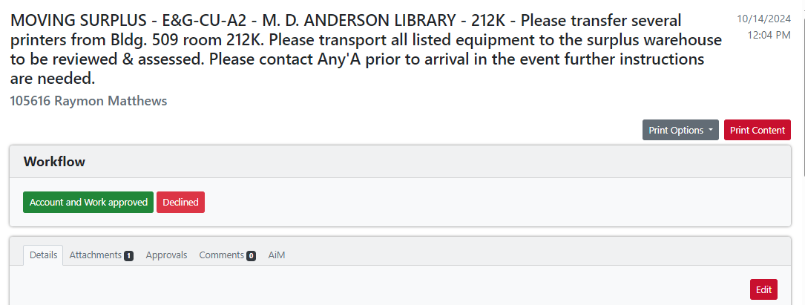
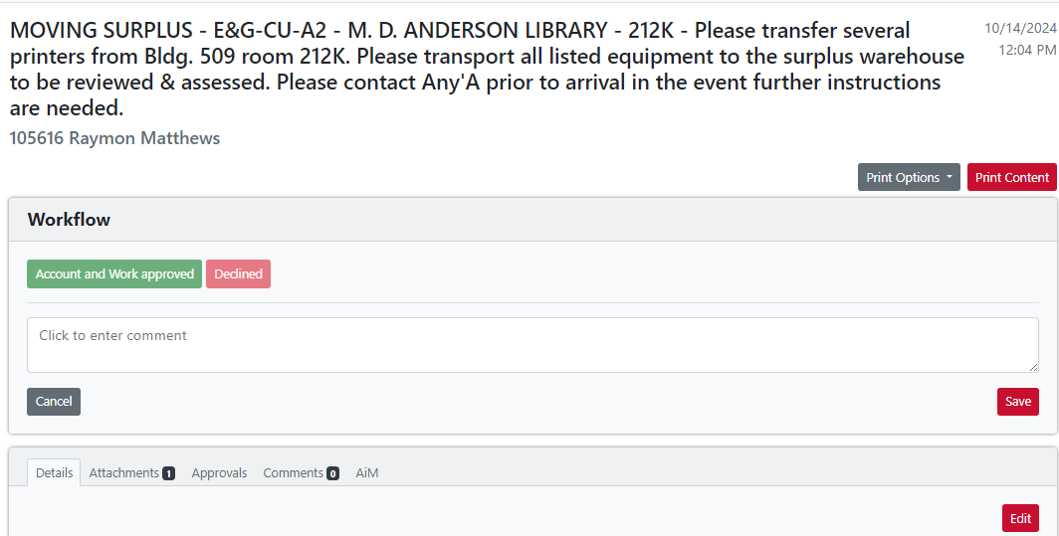
DBA APPROVALS
When FIXIT receives a billable request, it will be reviewed and triaged.
If no cost center is provided, FIXIT will reach out to the customer or forward the request to the DBA to add the cost center. If you're having trouble adding the cost center, please contact FIXIT for assistance.
The DBA will review the request and either approve or decline it (with comments).
Please ensure requests are approved promptly to avoid delays.

Slide 9
Overview of the Outage Process

Slide 10
Building Coordinator role in Outage Notification Process
• Receive Notification
• Verify
Have a point of contact for each department that occupies space in the building
- Be aware of events/activities that are taking place in the building
- Contact faccomm@central.uh.edu needed for questions or if additional support is
• Distribute Notification to Building Occupants

Slide 11
OUTAGE NOTIFICATION PROCESS
Facilities communications receives outage requests from UH FCM Employee and seeks approval from the BC (Building Coordinator) to ensure awareness of the notification and its impact on building users.
If there are concerns regarding the outage, please email faccomm@Central.UH.EDU , and we will communicate your concern to the UH FCM employee .
Facilities communications will receive requests for planned outages and will seek timely approvals to proceed as scheduled.
In the event that approvals are delayed, the outage may need to proceed as an immediate outage.
We kindly ask all Building Coordinators to respond promptly to our emails to ensure that the planned outage occurs as requested and without disruption.
*Facilities Communications’ goal is to distribute outage notifications within a ‘planned’ timeframe*

Slide 12
Friendly Reminder- Building Coordinator Changes
It is important to please let FACCOMM know if there is a Building Coordinator change, please contact FACCOMM with any Building Coordinator updates.
If there is a new Building Coordinator, please send an email to FACCOMM.
If you are out of office, please provide an email with a proxy to FACCOMM to approve outages in your absence.

Slide 13
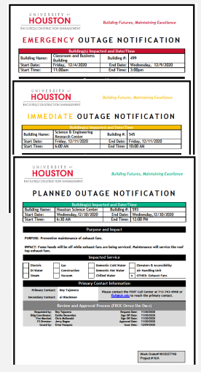
TYPES OF NOTIFICATIONS
• Be familiar with the Notification Guidelines
Planned: Distributed two weeks or more in advance.
Immediate: Distributed less than two weeks in advance.
Emergency: Distributed on the same day
• Notify all building users
• Contact FIXIT if any systems are not working properly after an outage

Slide 14
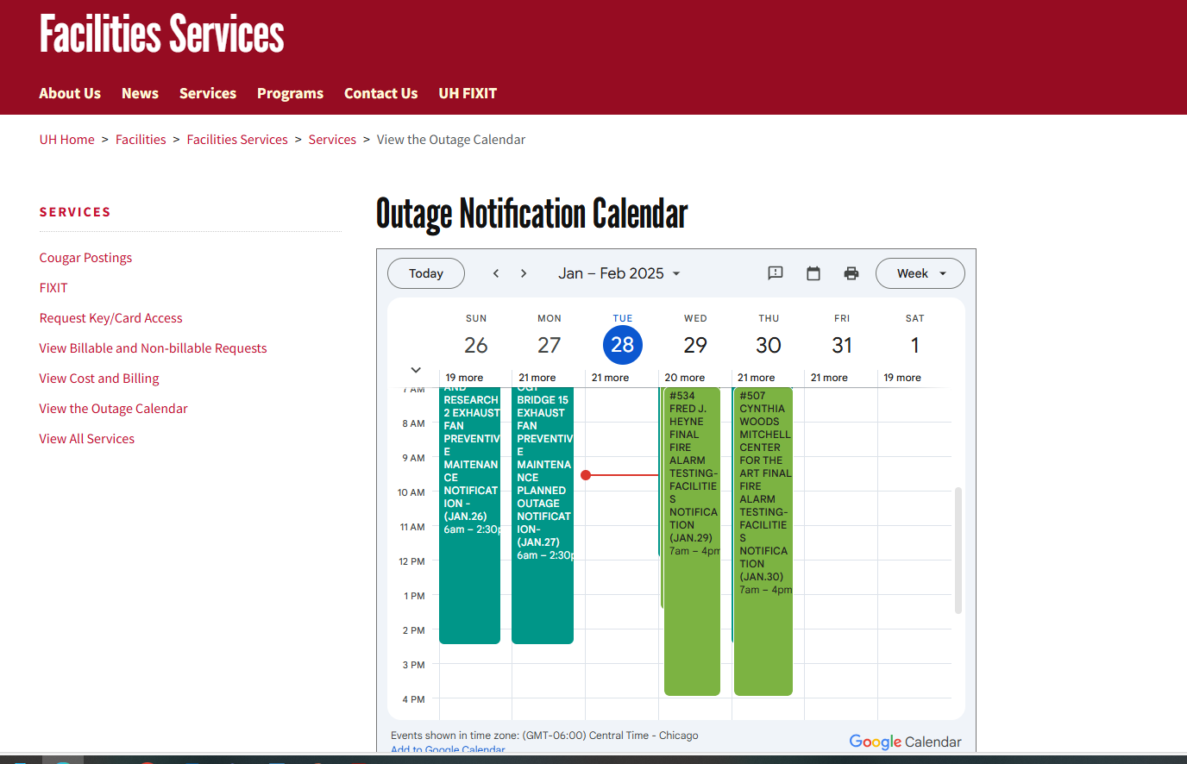
Outage Calendar
If you need to check for any ongoing outages or notifications, please visit the Outage Notification Calendar.
https://www.uh.edu/facilities-services/services/outage/index
All outages and notifications are posted there. If you have any questions, feel free to email FACCOMM.

Slide 17
Building Emergency Response Plan Template
Plans Include:
Emergency Response Procedures
Hazard/Incident Specific Procedures
Department Specific Operations/Procedures
Post Incident Procedures
Contact Lists
Roles and Responsibilities
Fire Safety Procedures

Slide 18
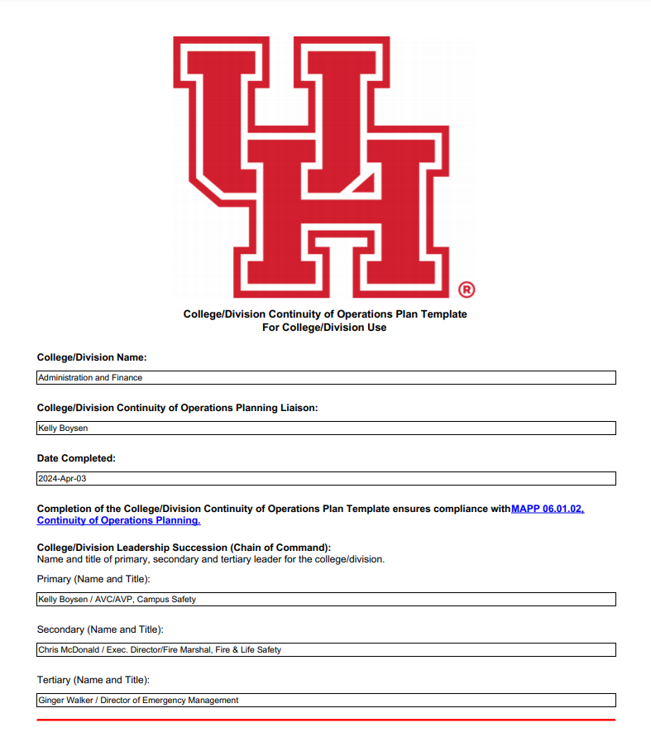
Continuity of Operations Planning
www.uh.edu/oem
Continuity of Operations Plans
UH COOP
College/Division
Department
Essential Personnel
Contact Information
Resources
Academic Continuity
Canvas – Instructions, Tutorials and Videos

Slide 19
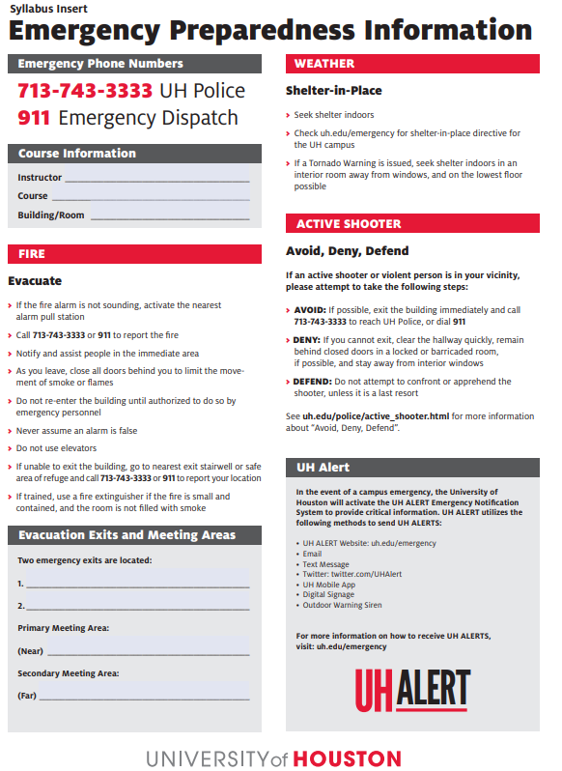
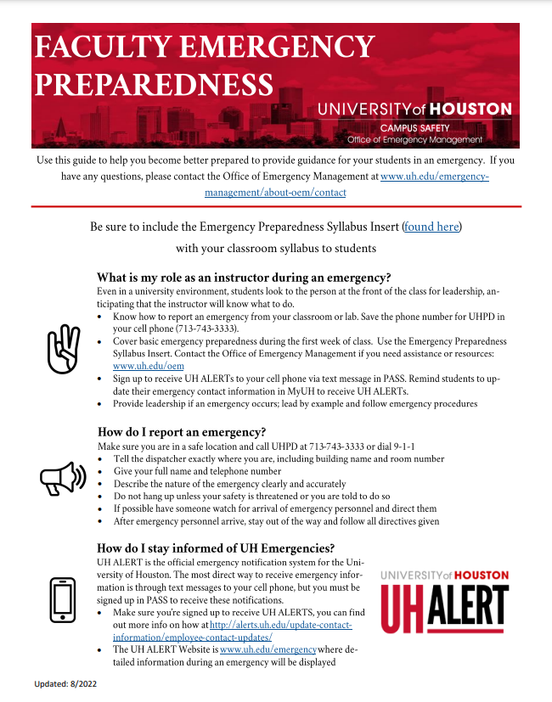
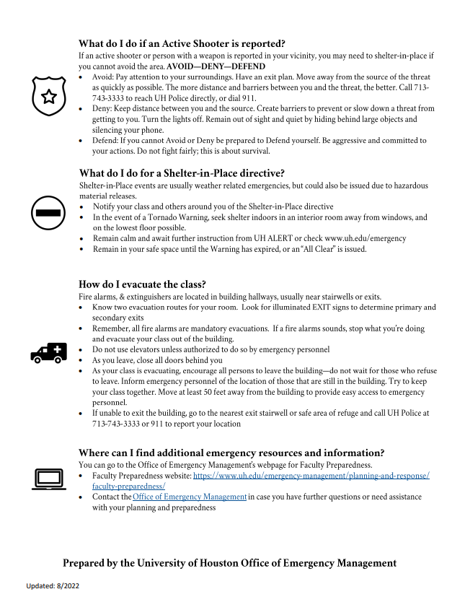
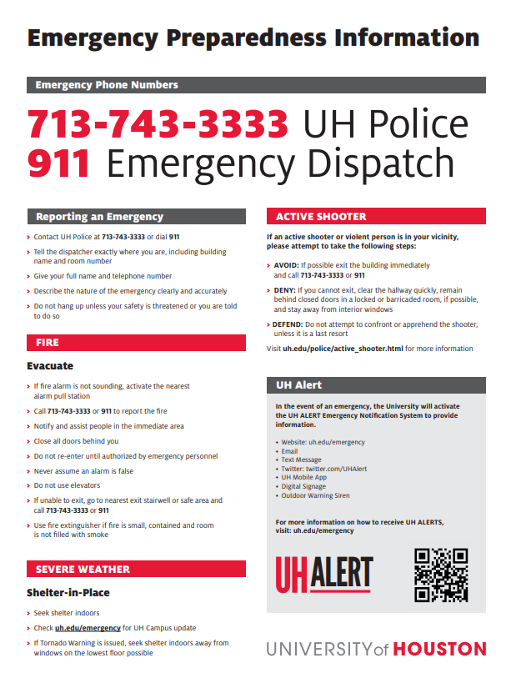
Faculty/Classroom Emergency Preparedness

Slide 20
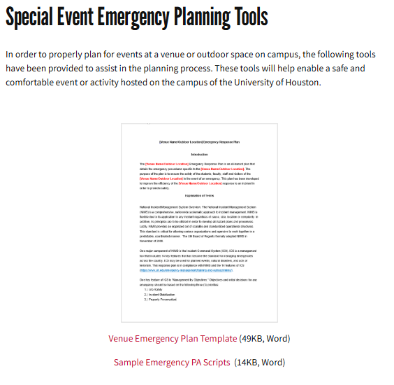
Special Event Emergency Planning
Safe and Security of Events on Campus
Venue Emergency Plan Template
Outdoor Emergency Response Plan Template
Sample Emergency PA Scripts
Special Event Safety Checklist

Slide 21
OEM Preparedness Resources
Hazards Include:
Active Shooter
Severe Weather
Fire
Hurricane Extreme Heat
Flood
Winter Weather
Hazard Material Release

Slide 22
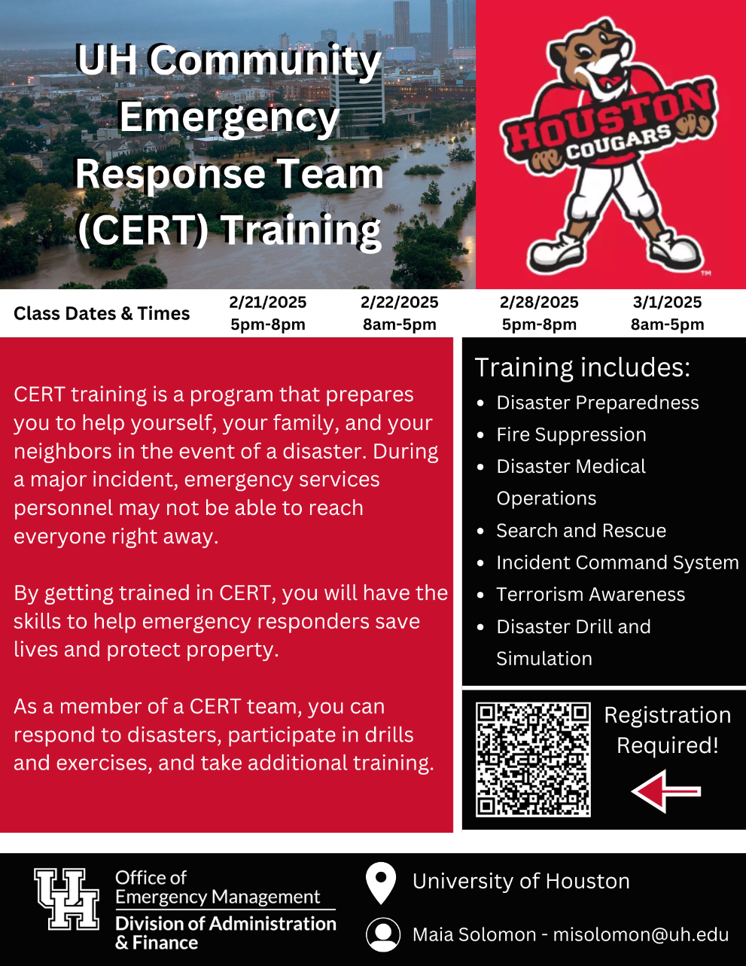
Community Emergency Response Team Training
Training Includes:
Disaster Preparedness Skills
Fire Suppression
Disaster Medical Operations
Search and Rescue
Incident Command System
Terrorism Awareness
Disaster Drill

Slide 23
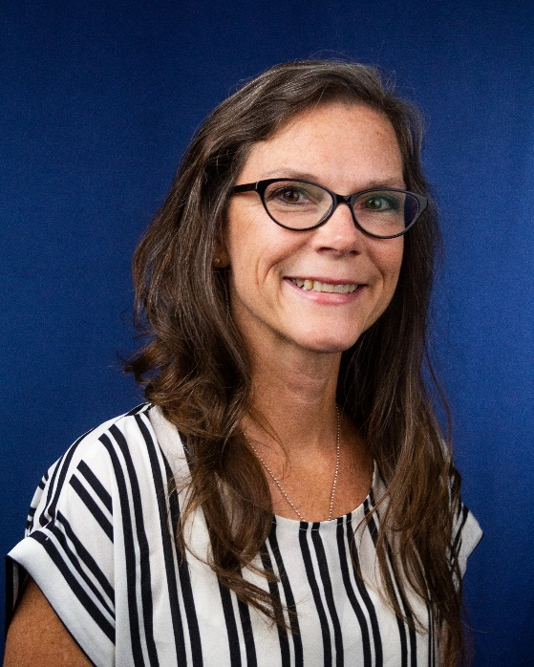
Office of Emergency Management
Ginger Walker​
Director, Emergency Management​
E-mail: gkwalker@uh.edu ​
Office: 832-842-0583
Maia Solomon​
Emergency Management Specialist​
E-mail: misolomo@central.uh.edu​
Office: 713-743-0256

Slide 24
Office of Sustainability
January 31, 2025

Slide 25
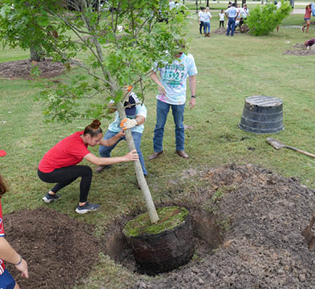
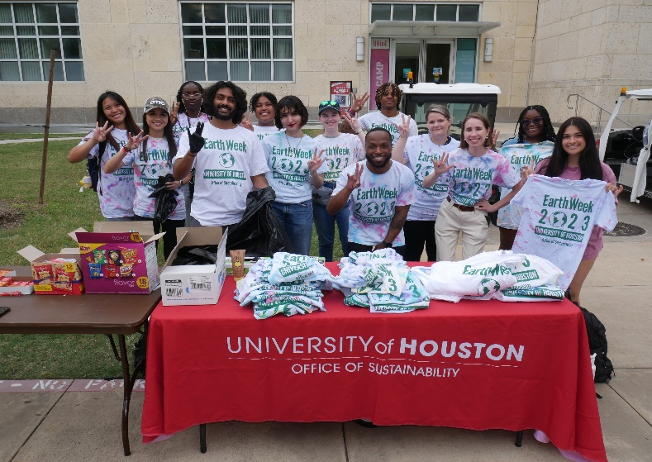
Introduction: Sustainability Coordinator
Beatrix Madersbacher Eide
Sustainability Coordinator
blmaders@cougarnet.uh.edu
sustain@central.uh.edu
Projects:
STARS report
Recycling Initiatives on Campus
Earth Month
Battery Recycling Program
Sustainability Lunch and Learns
Green Programs across UH

Slide 26
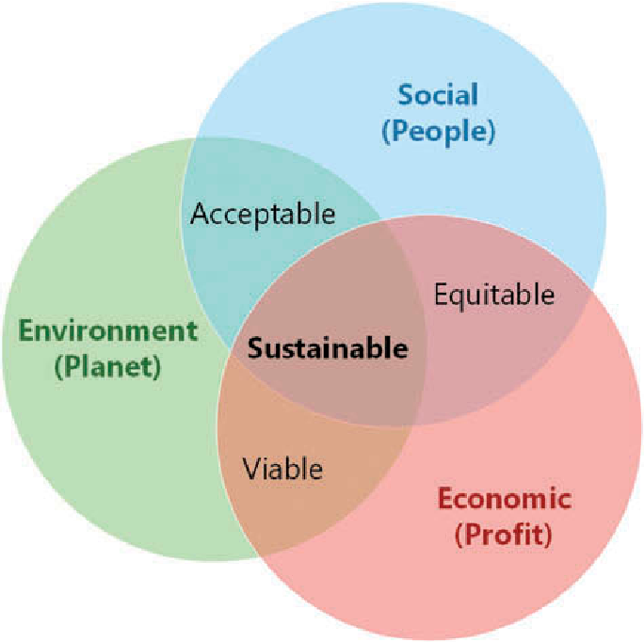
The 3 Pillars of Sustainability
Sustainability encompasses 3 pillars and these combined create a sustainable world. Sustainability “as the efficient, deliberate and responsible preservation of environmental, social and economic resources to protect our earth for future generations.”
Environmental (Planet) - managing our natural resources
Reducing fossil fuel consumption
Increased waste management and recycling
Renewable energy promotion and development
Economic (Profit) - using resources responsibly and efficiently
Responsible purchasing by businesses and individuals
Financial support for research and development
Creating new jobs and maintaining current jobs
Social (People) - promoting positive social well being for all
Providing equal opportunities for all
Access to adequate healthcare, education, and nutrition
Develop sustainable communities

Slide 27
Why is this important to know?
To determine the date of Earth Overshoot Day for each year, Global Footprint Network calculates the number of days of that year that Earth’s biocapacity suffices to provide for humanity’s Ecological Footprint.
The remainder of the year corresponds to global overshoot.

Slide 28
Why should we be greener?
No Planet B
We only have one planet that can currently sustain life.
If we frivolously waste resources, what will be left for us as we get older or for future generations?
Saving Money
By incorporating habits like utilizing natural light in your room, reducing the waste you produce, and purchasing foods that are in season you’re not only helping the planet, but you’re saving yourself money.
Quality of Life
Not only is living green better for the environment, it’s better for you too! For example, incorporating plants into your space improves air quality and has been shown to boost your mood and relieve stress.

Slide 29
What are the 3 R’s?

Slide 30
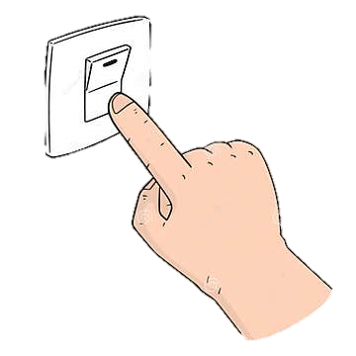
3 R’s
REDUCE:
REUSE:
Electricity
Furniture
Plastic Bottles
Water
Books
Metal cans
Waste
Containers
Paper and Cardboard
Fuel
Dishes
Batteries
Single-use items
Bags
Glass

Slide 31
What is one item you have recycled in the last month?

Slide 32
Importance of Recycling
Recycling: the action or process of converting waste into reusable material
Plastic bottle facts
6 benefits of Recycling
60 million
Plastic bottles are thrown away in the United States every day
Conserve natural resources:
Protect ecosystems:
Reduce demand for raw materials:
The worlds natural resources are finite, & some in short supply
Lessens the disruption and damage to the natural world
Avoid damage to land in the search for new raw materials
450 years
for one plastic bottle to decompose in landfills
Saves energy:
Better for human health:
More sustainable mindset:
1/3
of plastic litter found in the ocean is made up of plastic bottles
Products from recycled materials requires less energy.
Keeps methane -releasing waste out of landfill sites.
Increases thoughts regarding reducing, reusing, recycling

Slide 33
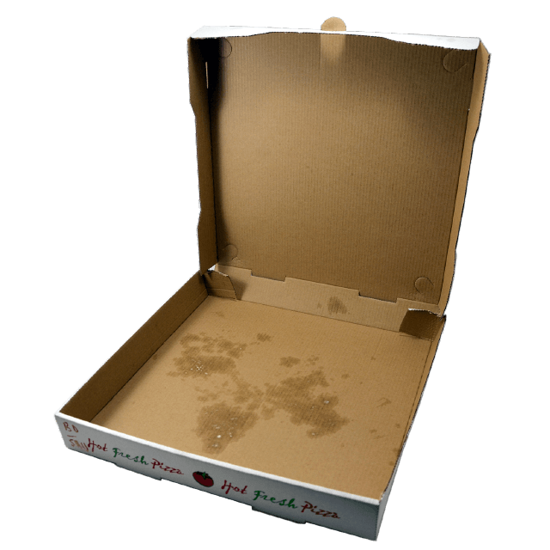
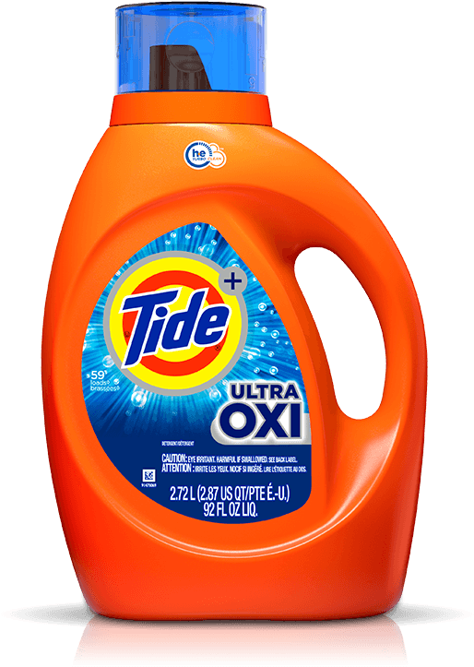
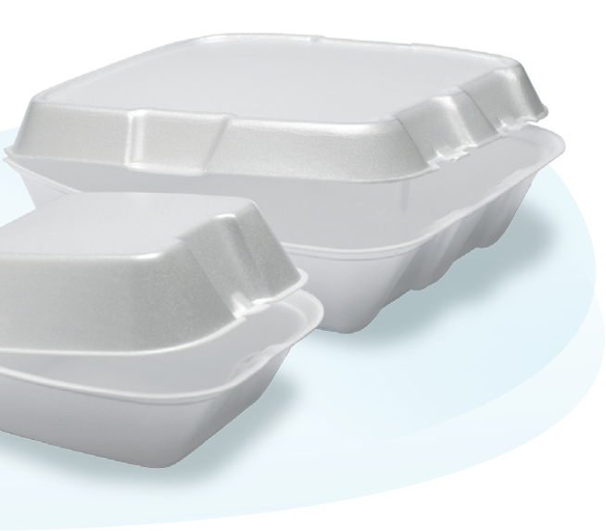
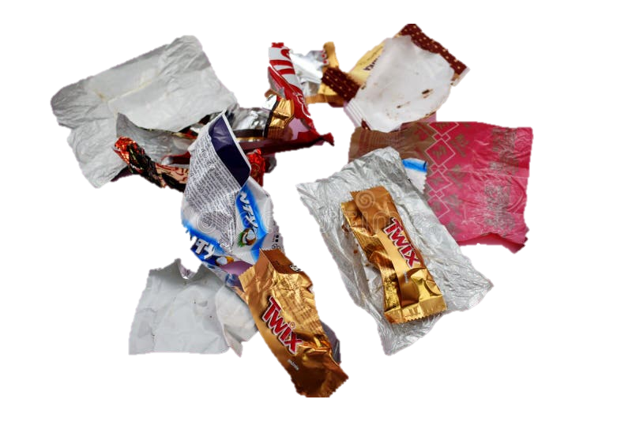
What's recyclable at UH and in Harris County?
What items CAN be recycled at UH*
What items CAN’T be recycled at UH
* All items must be clean from dirt and grease

Slide 34
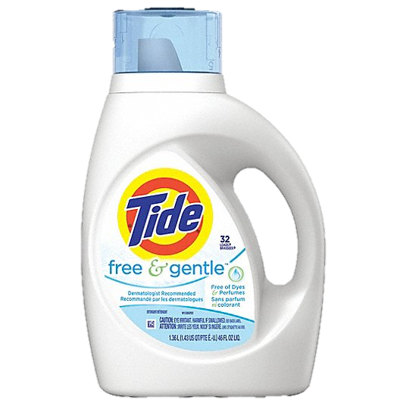
Common Recycling mistakes
1
Placing food or liquid stained items in recycling bins
3
Plastic items that aren’t recyclable
Dirty food containers
Dirty pizza boxes
Plastic Bags
Any Styrofoam Cups
Plastic
Utensils
Plastic
Straws
2
Not rinsing, emptying or cleaning, folding items
Styrofoam packaging
Candy Wrappers
Cardboard
Yogurt Cups
Laundry Jugs
Water bottle
Hot Drink Cup
Chips bags

Slide 35
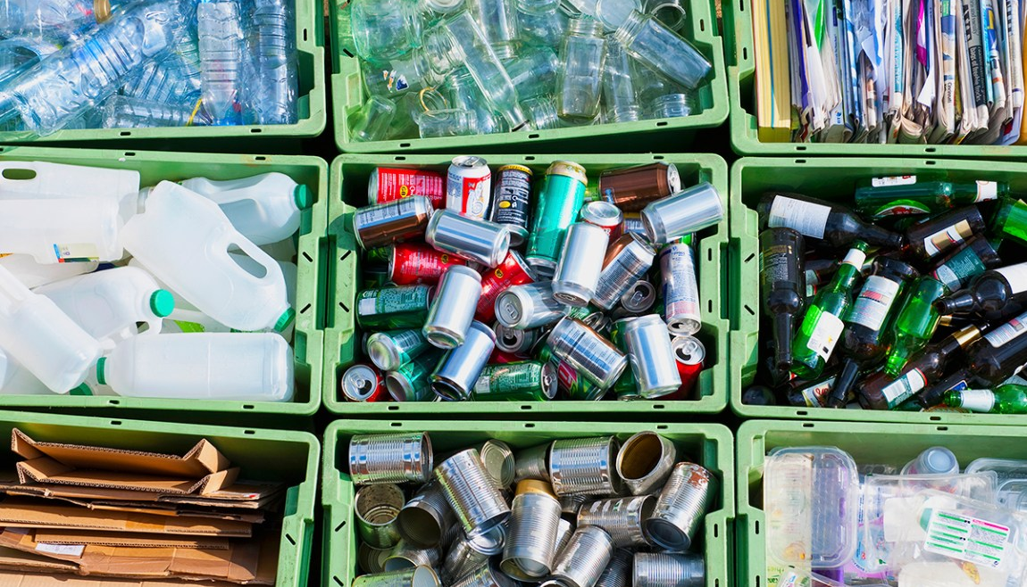
Demonstration on how to recycle

Slide 36
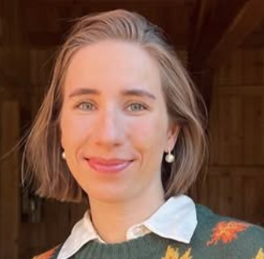
How can I check if something is recyclable?
1
Check the labelling
2
Check City of Houston website
3
Check with Google or Beatrix
All plastic items are labelled with a number within a recycling icon
- At UH and Harris County we recycle all except plastic #6
Examples:
UH uses the same company as the City of Houston
They list all recycling items as well as specialized recycling programs for tires, tree, bulk and electronic waste
Use Google or Reverse google image search to find out if an item is recyclable
I’m available for questions – and if I don’t have the answer, I’ll help you find it

Slide 37
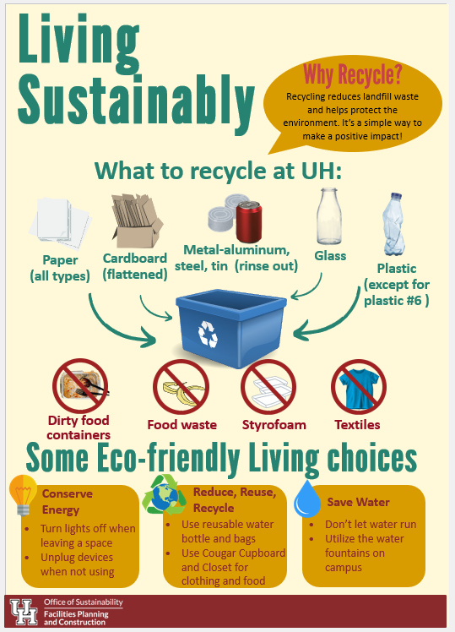
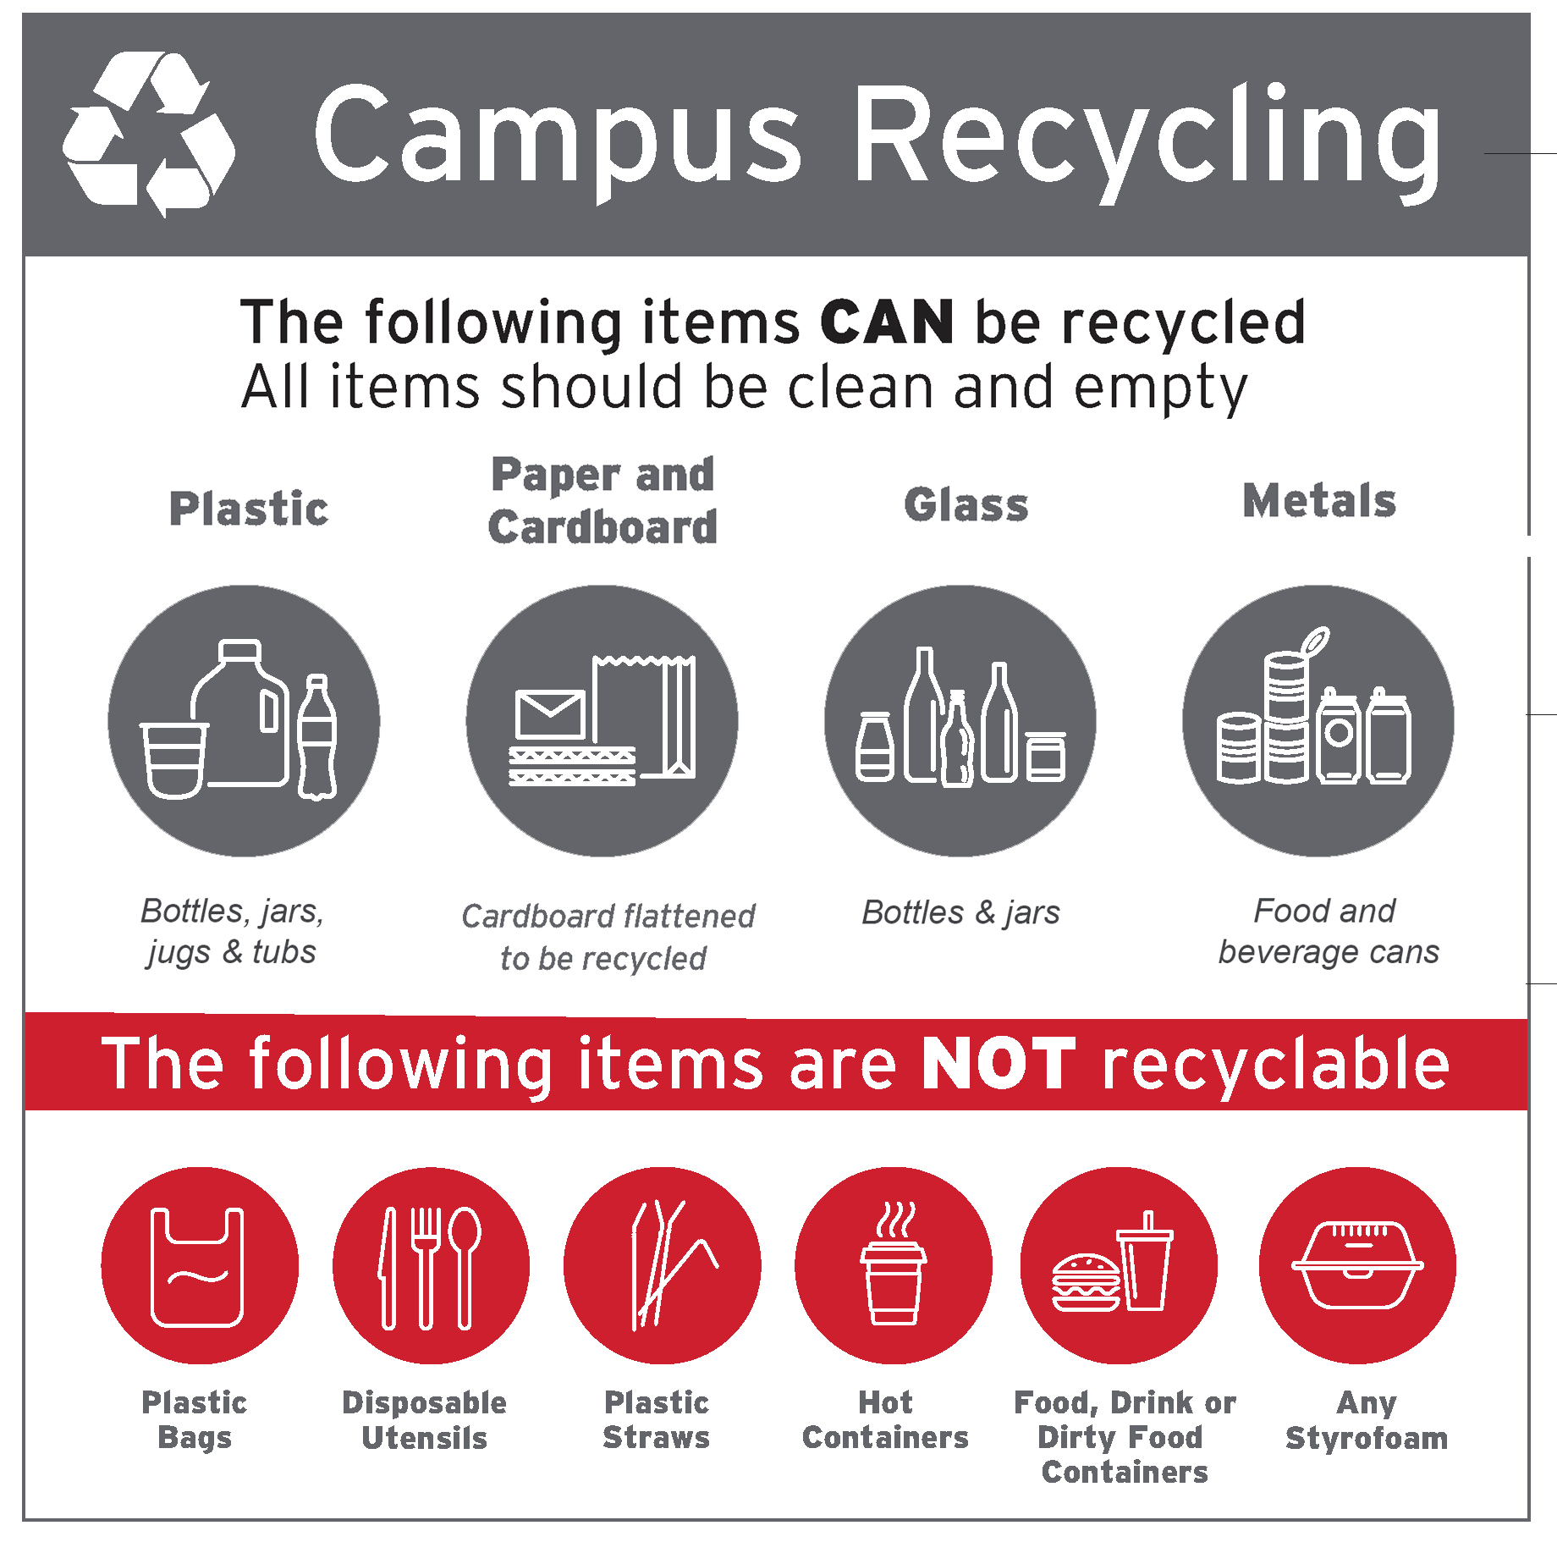
Available Recycling Materials

Slide 38
Thank you so much! Any questions?

Slide 39
Thank you everyone
for joining!

