Slide 1
Huisache Control
Trey Barron
Texas Parks and Wildlife
Wildlife Diversity Biologist

Slide 2
Establish Goals and Expectations
What is the target species?
Why?
How large is the area?
Budget?
What method will be best?
Is it the best option given the above?
Will it need follow up?

Slide 3
Huisache Methods
Broadcast
Large areas with moderate to heavy brush
High-volume Foliar
Light to moderate brush
Low Volume Basal
IPT
Basal Cut-Stump
IPT
Mechanical
Grubbing
Cut-spray

Slide 4
Huisache Methods
Broadcast –Aerial
3 year application
Year 1- Spray solid block
Year 2 – Spray 1 and skip 1
Year 2 –Spray 1 and skip 1
Opposite of year 2 application
GrazonNext, Tordon22K and MSM60 (sub Sendero and MezaVue)
Avg cost is ~$21-31per acre at 3 gallons/acre

Slide 5
Huisache Methods – Year 1

Slide 6
Huisache Methods – Year 1 Treatment

Slide 7
Huisache Methods –Results from Year 1

Slide 8
Huisache Methods – Year 2 Treatment

Slide 9
Huisache Methods – Results from Year 2

Slide 10
Huisache Methods – Year 3 Treatment

Slide 11
Huisache Methods – Final Results

Slide 12
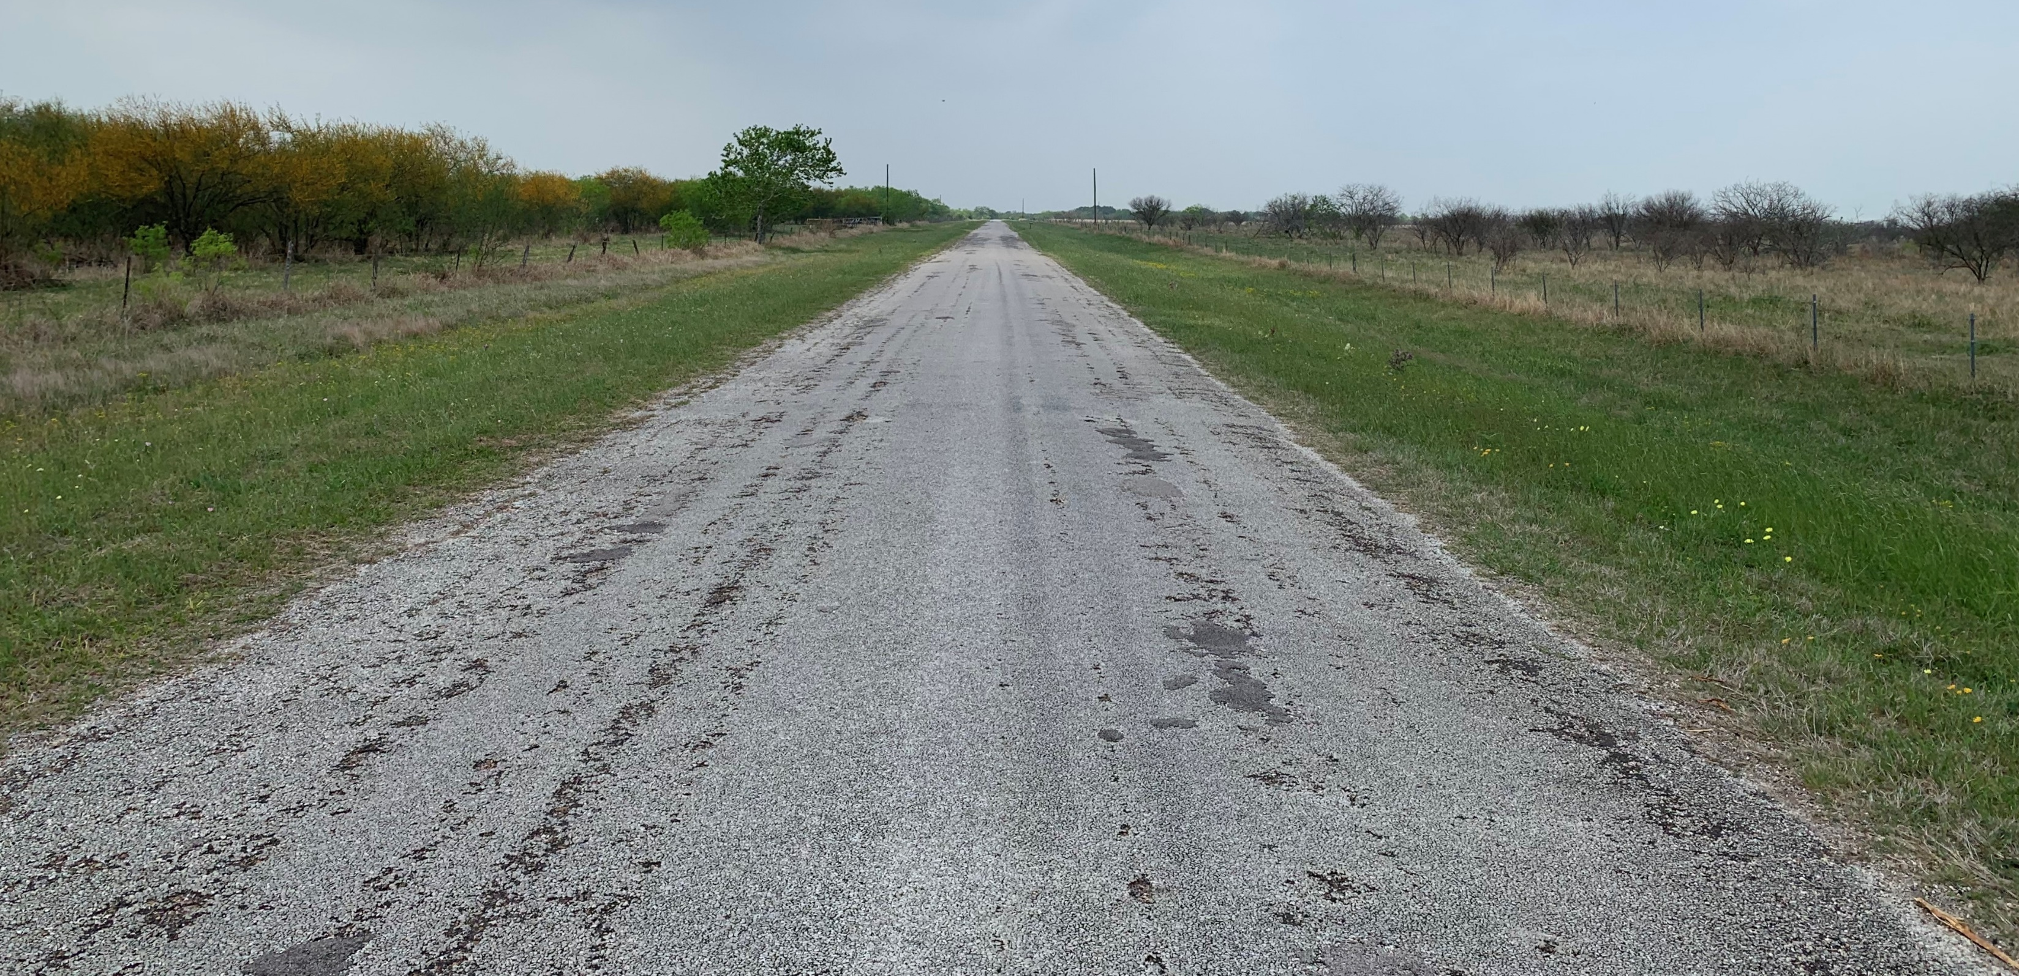
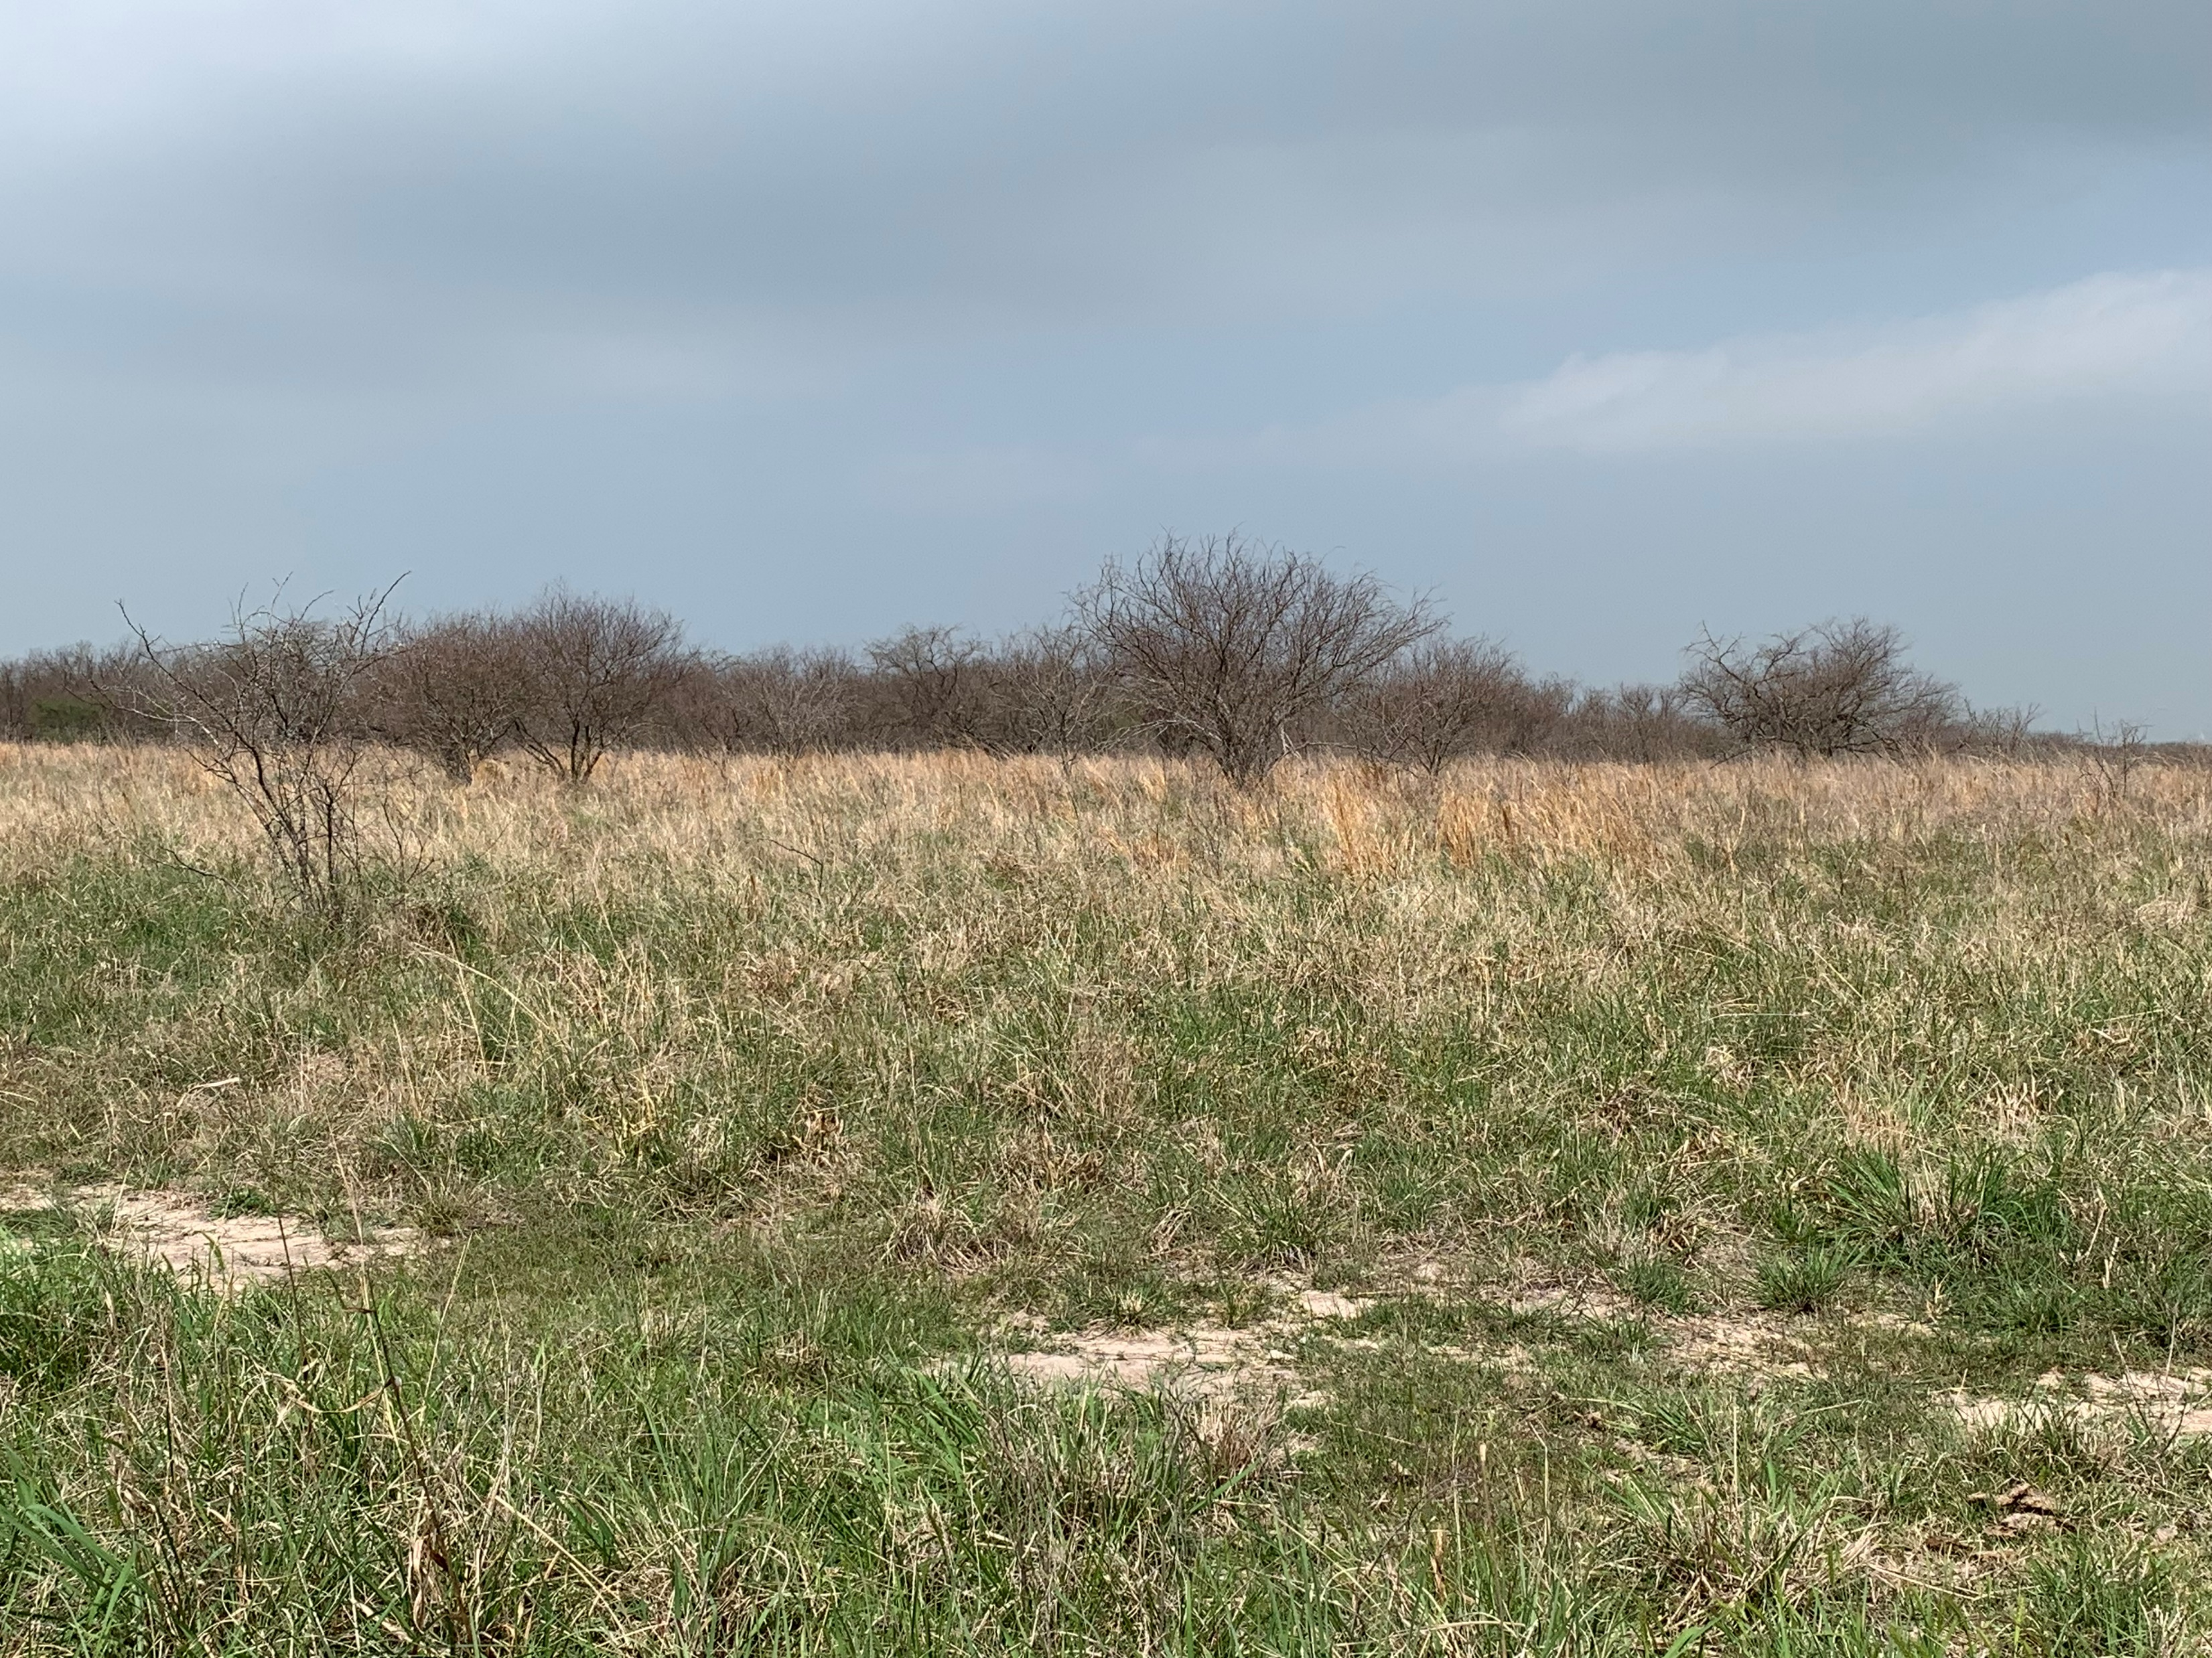
Huisache Methods

Slide 13
Huisache Methods
Low Volume Basal – IPT
Individual Plant Treatment
Spray bottom 12 inches of plant
Up to around 4 inches
Remedy/diesel mix
25%/75%
Excellent results
Must be done for follow up of any treatment

Slide 14
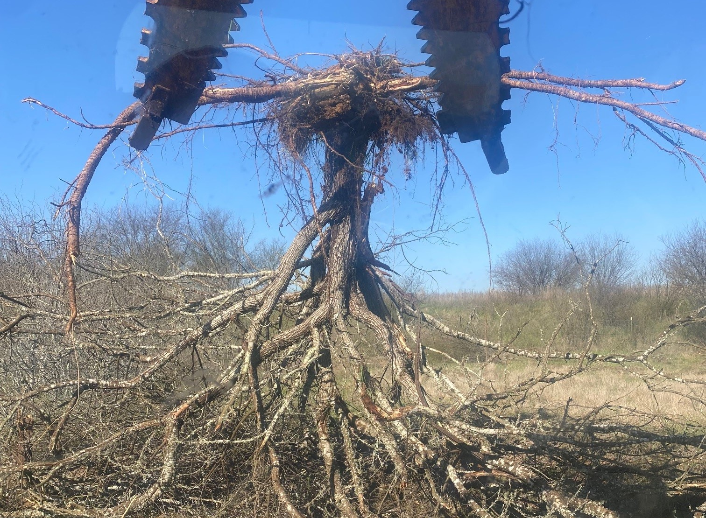
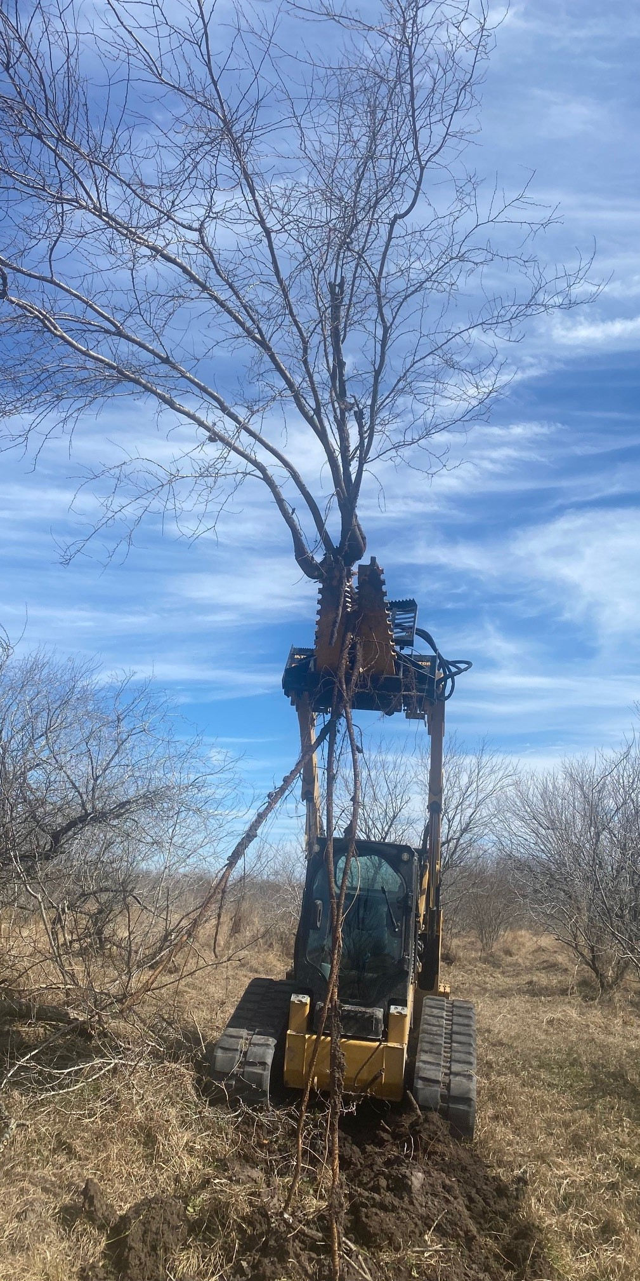
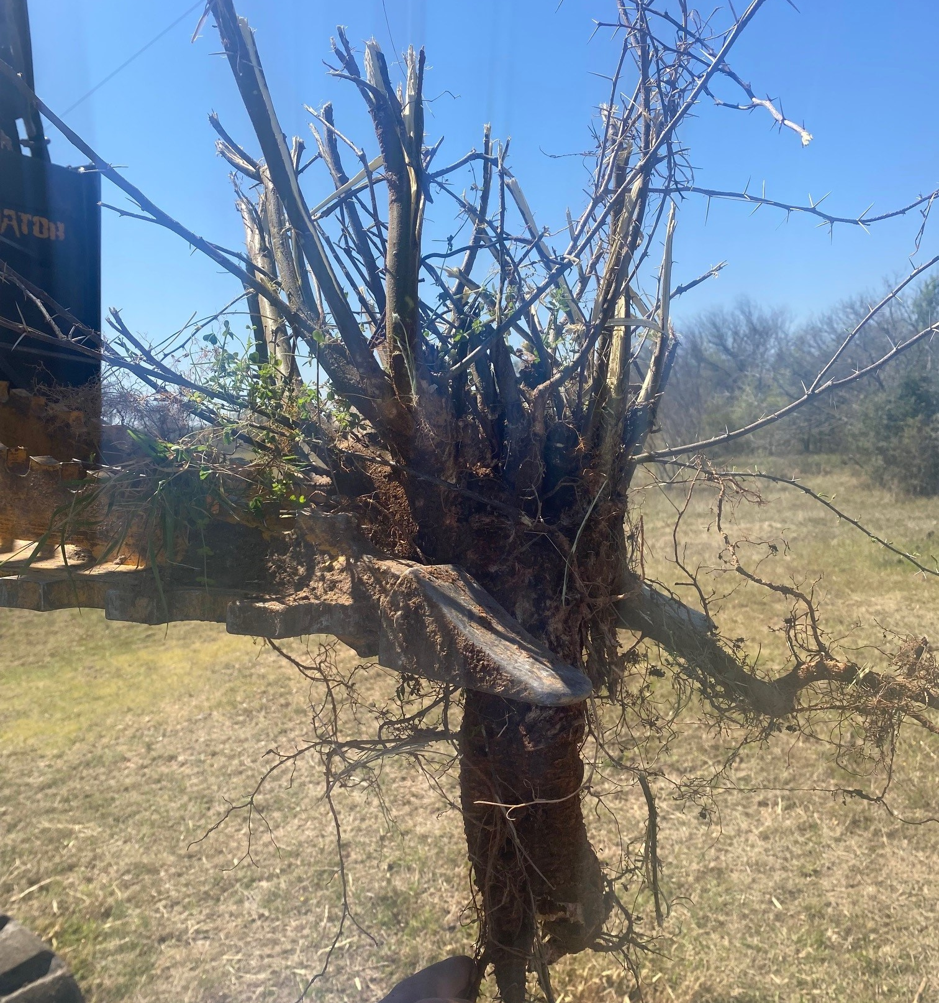
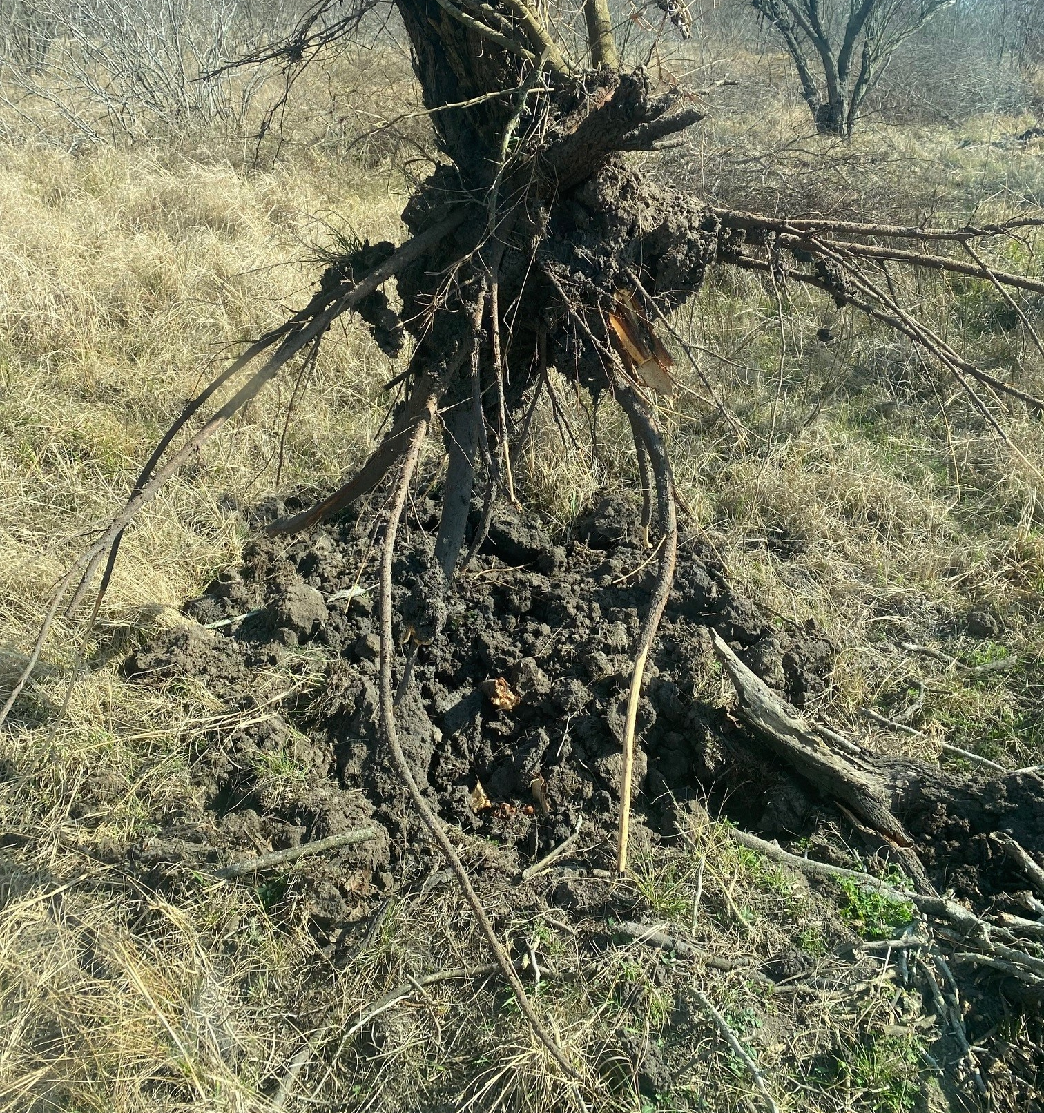
Huisache Methods
Mechanical
Grubbing
Removes individual plant
Highly effective
Dependent on operator
Avg ~$100/acre with densities of 288 plants/acre or $0.35/plant

Slide 15
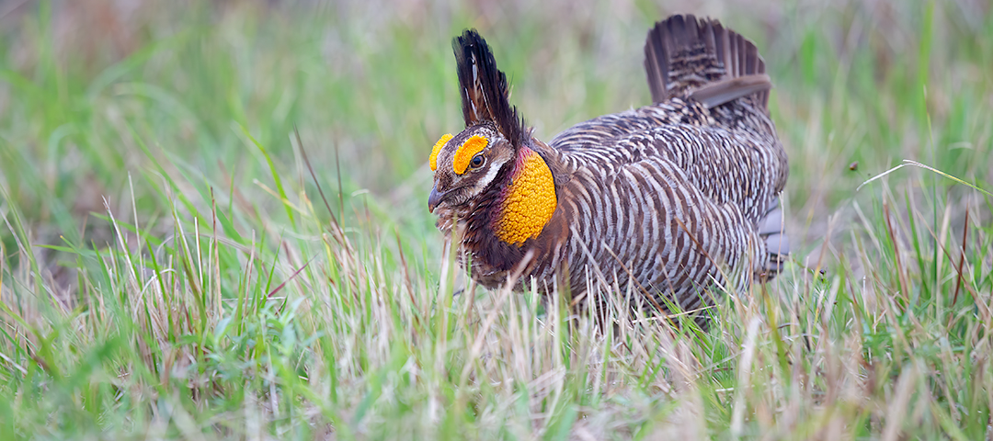
Don’t forget to follow up!!!!!

