Slide 1


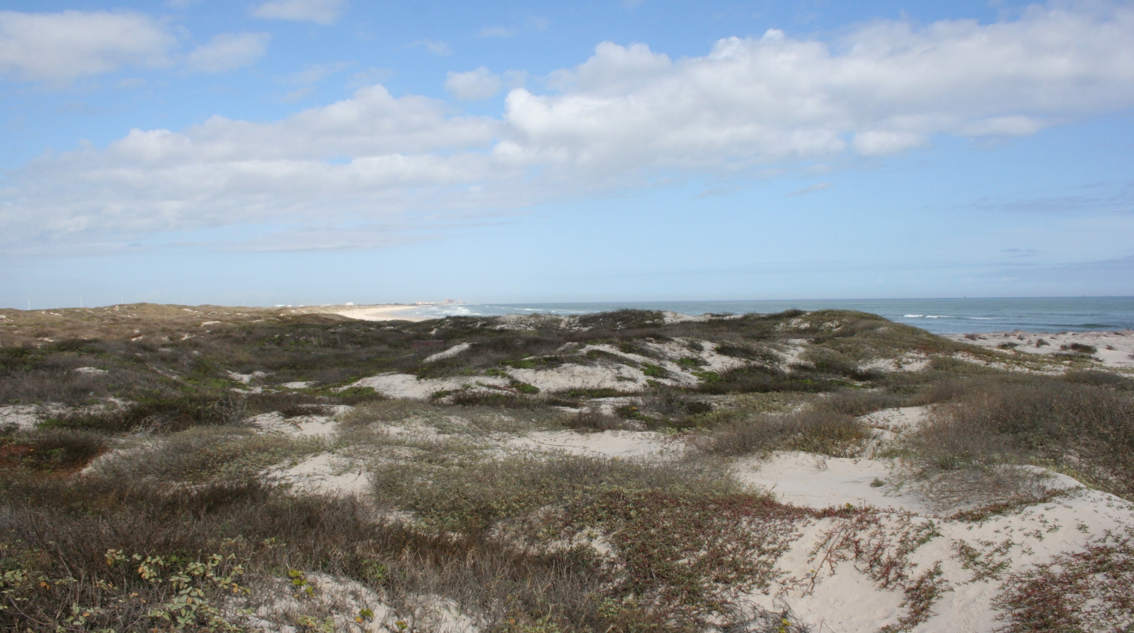
Barrier Island Grassland Restoration at Mustang Island State Park
2025 Coastal Prairies Restoration Practitioners Forum
Kristen Eggers
Natural Resources Specialist
TPWD State Parks
kristen.eggers@tpwd.texas.gov

Slide 2
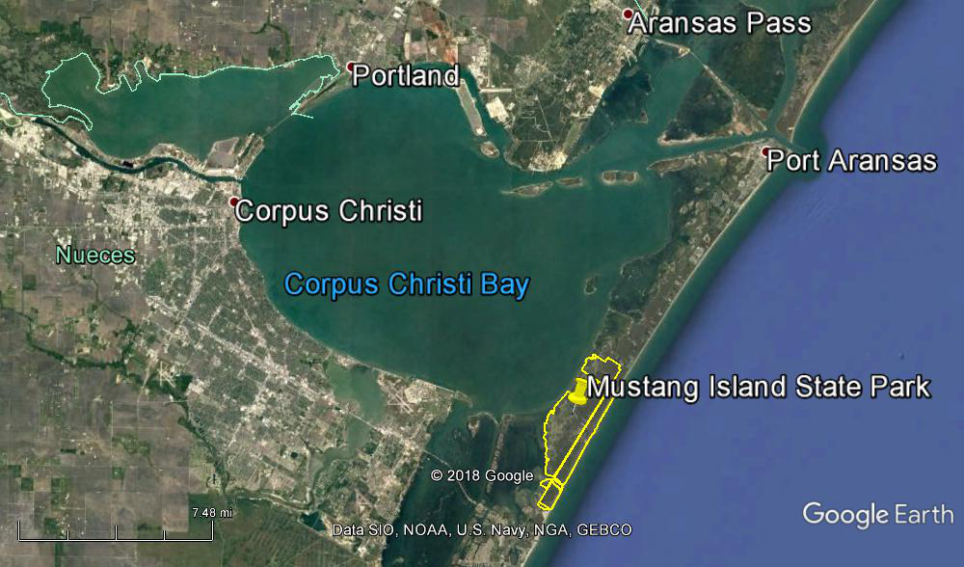
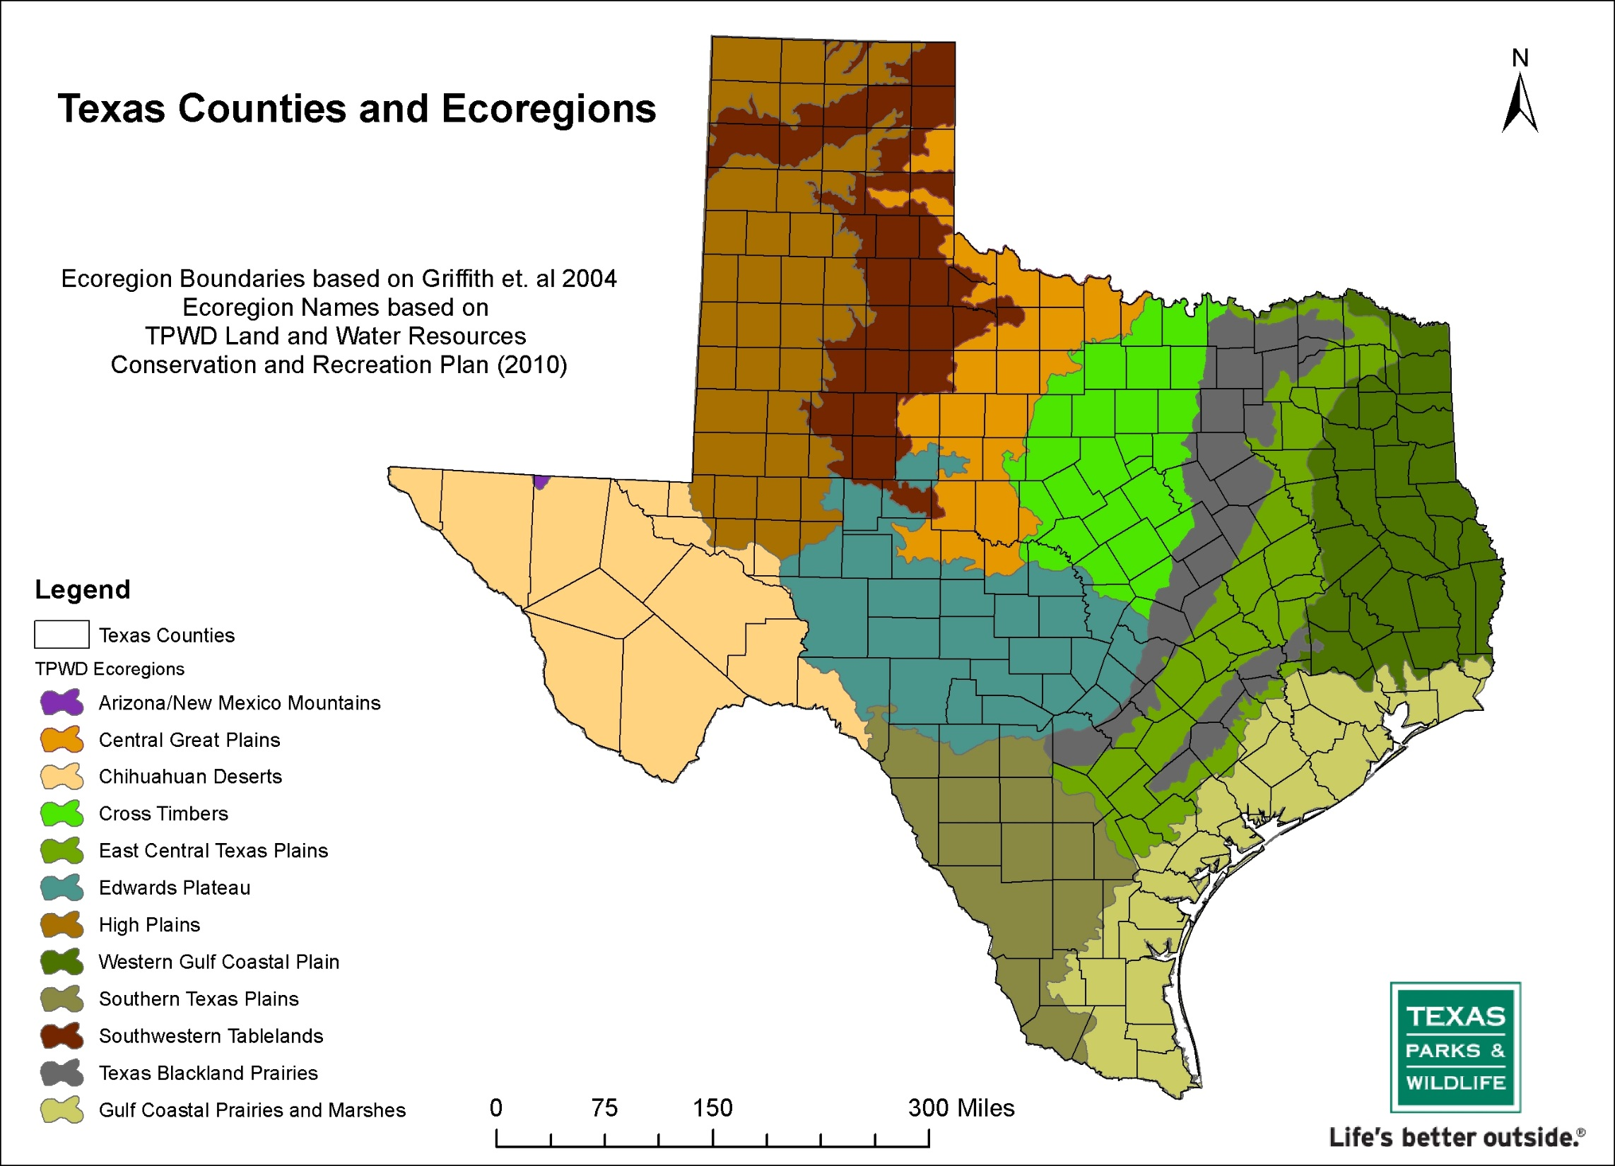
Mustang Island
Gulf of Mexico
Notes:
Mustang Island is located centrally along the Texas coast, in the Coastal Bend region and the Gulf Coast Prairies and Marshes Ecoregion. It is a relatively young barrier island, running 18 miles long, between the Gulf and Corpus Christi Bay with San Jose Island to the north and Padre Island to the south.
You can see in this map that the park makes up a sizeable part of the island. In total the park is over 4,700 acres. In 1972, 3,703 acres were purchased from private owners to establish the park. In 2002, a land exchange with the City of Corpus Christi expanded the park to over 4,000 acres and in 2015, an additional 700 acres was added. The Texas General Land Office owns another 500 acres within the park for which we hold a Coastal Lease.
Park opened in 1979

Slide 3
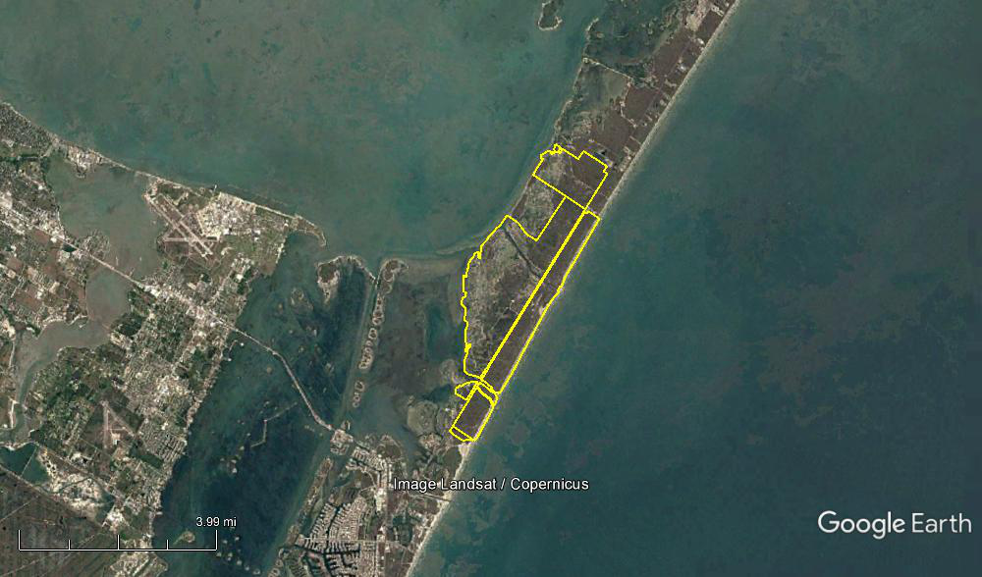
What Makes This Place Special?
Corpus Christi Bay
Fish Pass
Gulf of Mexico
Park HQ
Laguna Madre
Corpus Christi Pass
Packery Channel
Notes:
So, What Makes This Place Special enough to become a State Park? Our barrier island location, with over 5 miles of open ocean beach on our Gulf beach side, and another 6 miles of bay shoreline on our west side, make this place special. We are surrounded here by water, both ocean water and estuarine waters, so we have diverse aquatic environments surrounding us.
The open ocean with its wind, waves and moderate salinities are to the east. The ocean salinity remains constant providing a stable environment for many recreationally important species. The waves and wind limit what plants can survive on the beach side.
On our bay side, Corpus Christi Bay is an estuary, fed by the fresh waters of the Nueces River which flows into it. This creates a gradient of differing conditions to the west, offering different habitat niches for hundreds of species. There is also much less wind and wave energy.
Also on our bay shoreline, on the southwest shoreline, is the Laguna Madre, one of the world’s few hypersaline lagoons. There is little freshwater inflow here and water exchange between the Laguna and the Gulf is restricted. At times salinity can reach very high levels. These conditions mean that a special suite of flora and fauna has developed to survive in these wide ranging and at times very harsh conditions.
In addition, between the bay and Gulf shorelines, we find a diversity of habitats that are especially dynamic in nature, ranging from the beach and dunes, to the grasslands, tidal flats and marshes.
The wild landscape that we care for at the park is truly unique in the world.

Slide 4
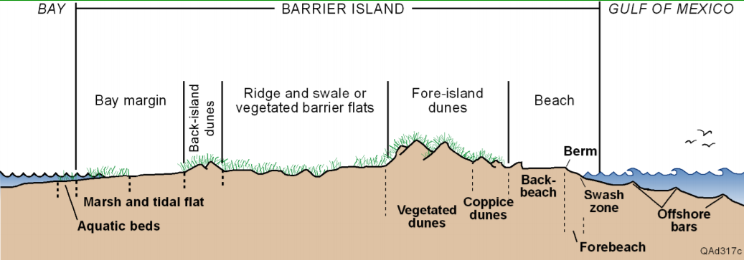
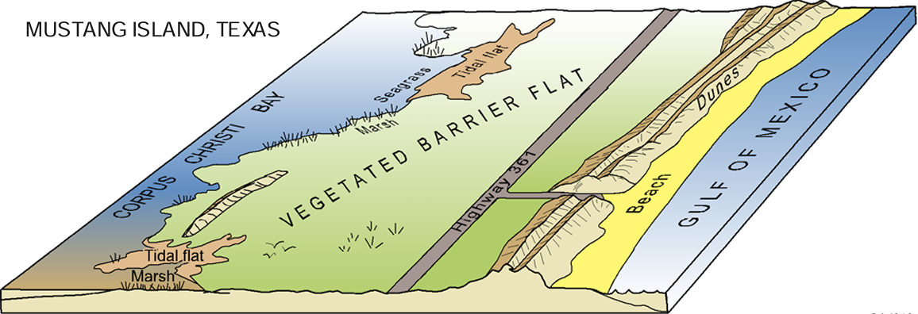
Barrier Island Structure
Barrier Island
Secondary dunes
Primary dunes
Notes:
This top diagram shows a cross section of a typical barrier island and Mustang Island is depicted in the bottom image. The island originally formed as a submerged sand bar about 5,000 years ago, and the tip rose above water about 1,000 to 1,500 years later.
Barrier islands protect the mainland from storms, and storms shape the island in the process. Hurricanes and wind carry the sand to the west side, where it slowly encroaches on Corpus Christi Bay and the Laguna Madre. At the same time, new sand washes in on the Gulf side causing the island to, in a sense, roll over. In our area, the influx of sediment offsets erosion and the area is relatively stable.
The dunes next to the Gulf beach are called primary dunes or fore-island dunes and at our location they may reach heights of up to 35 feet. Dunes can move and migrate and can be completely destroyed by large storms, but the dunes at the park maintain some stability where they are anchored by vegetation. The vegetation here consists mostly of grasses, shrubs and forbs. It is sparse on the seaward face of primary dunes, but becomes dense in the troughs, grassy flats and secondary dunes, or back-island dunes, that make up most of the rest of the barrier island.
On the bayside of the secondary dunes are tidal flats and fresh and saltwater marshes characterized by an extremely diverse array of plants and animals.

Slide 5
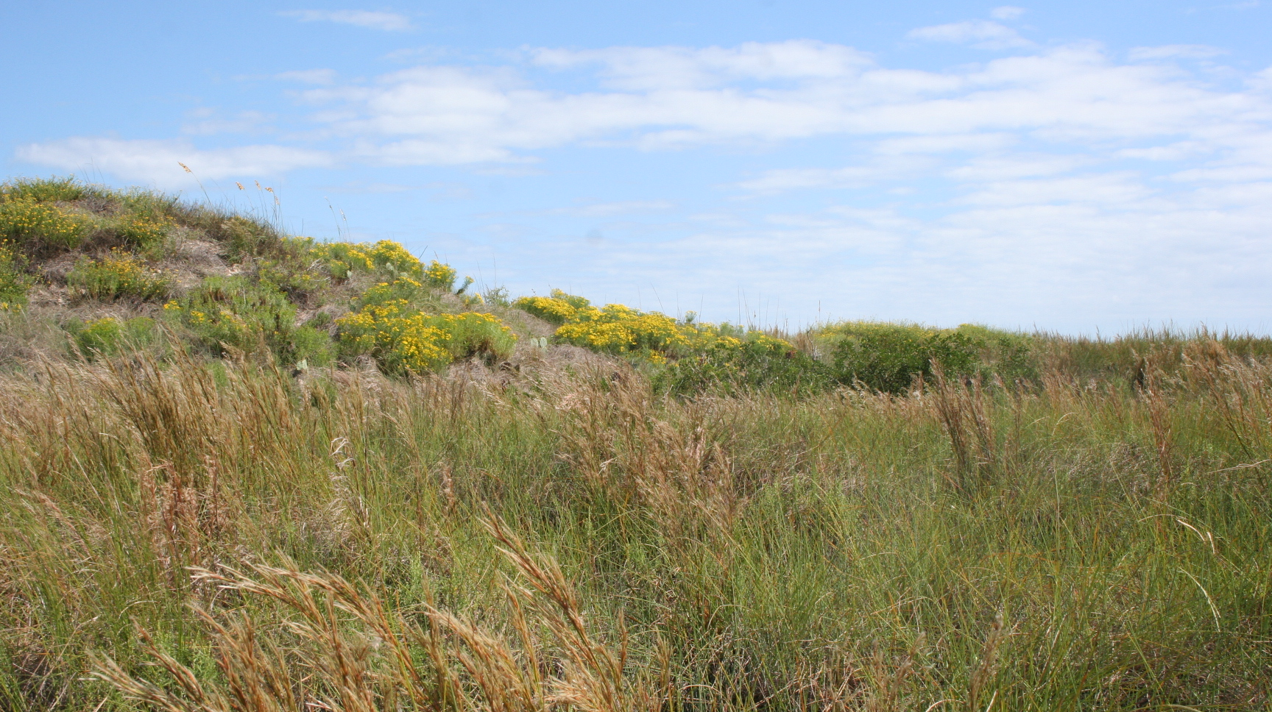
Coastal Prairie and Bayside Dunes
Notes:
Between the bayside marshes and the Gulf dunes is the vegetated flats where we find the Coastal Prairie and Bayside Dunes. These areas are dominated by grasses such as Gulf Dune Paspalum and Seacoast bluestem and numerous species of forbs and wildflowers. These areas are very diverse and abound with insects, birds and small mammals.
Many prairie species depend on fire for seed production because it removes accumulated plant litter and breaks dormancy in some seeds.

Slide 6
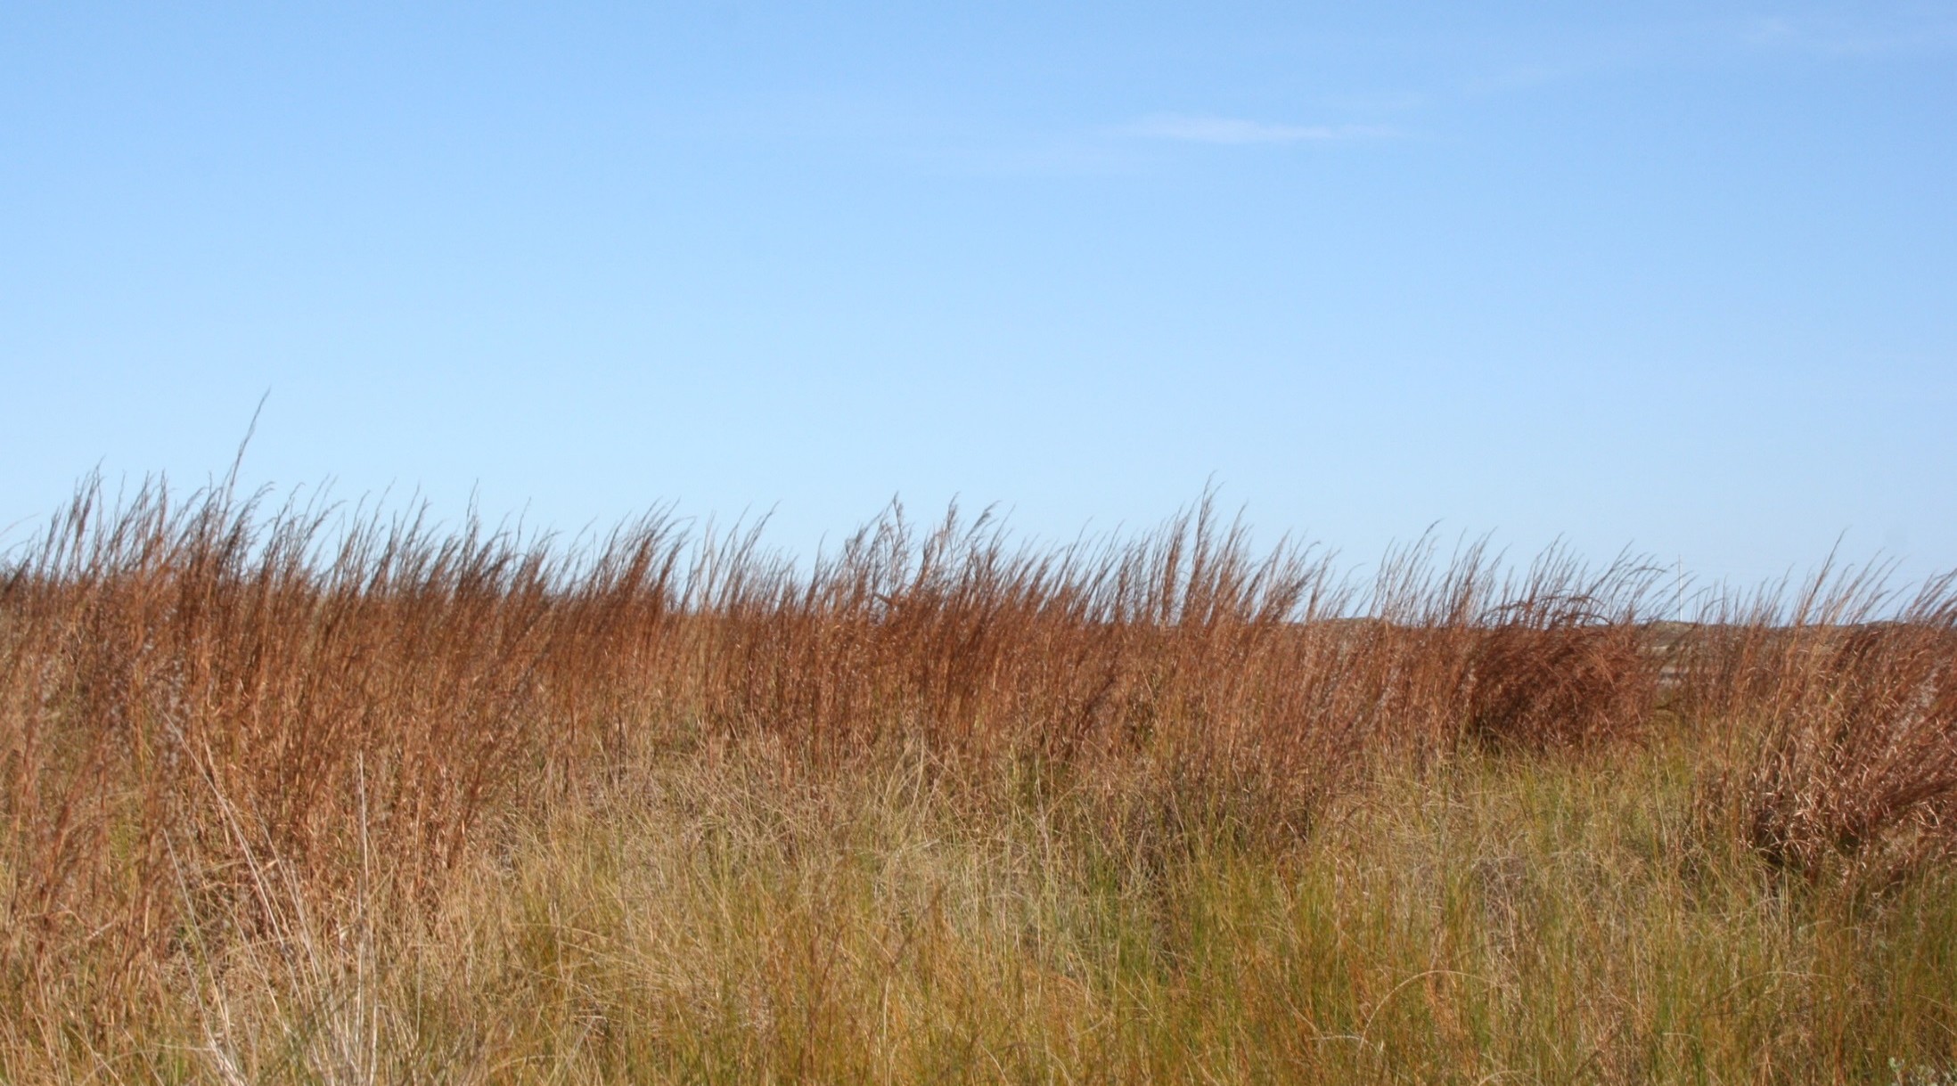
Seacoast Bluestem /Shore Little Bluestem
Notes:
Seacoast bluestem makes up a majority of the native prairie habitat. This species is not as tolerant of excessive salt spray and can therefore be found in the grasslands of the island or on the side of the dunes facing away from the gulf. As a dense bunchgrass, it provides good cover for ground nesting birds.

Slide 7
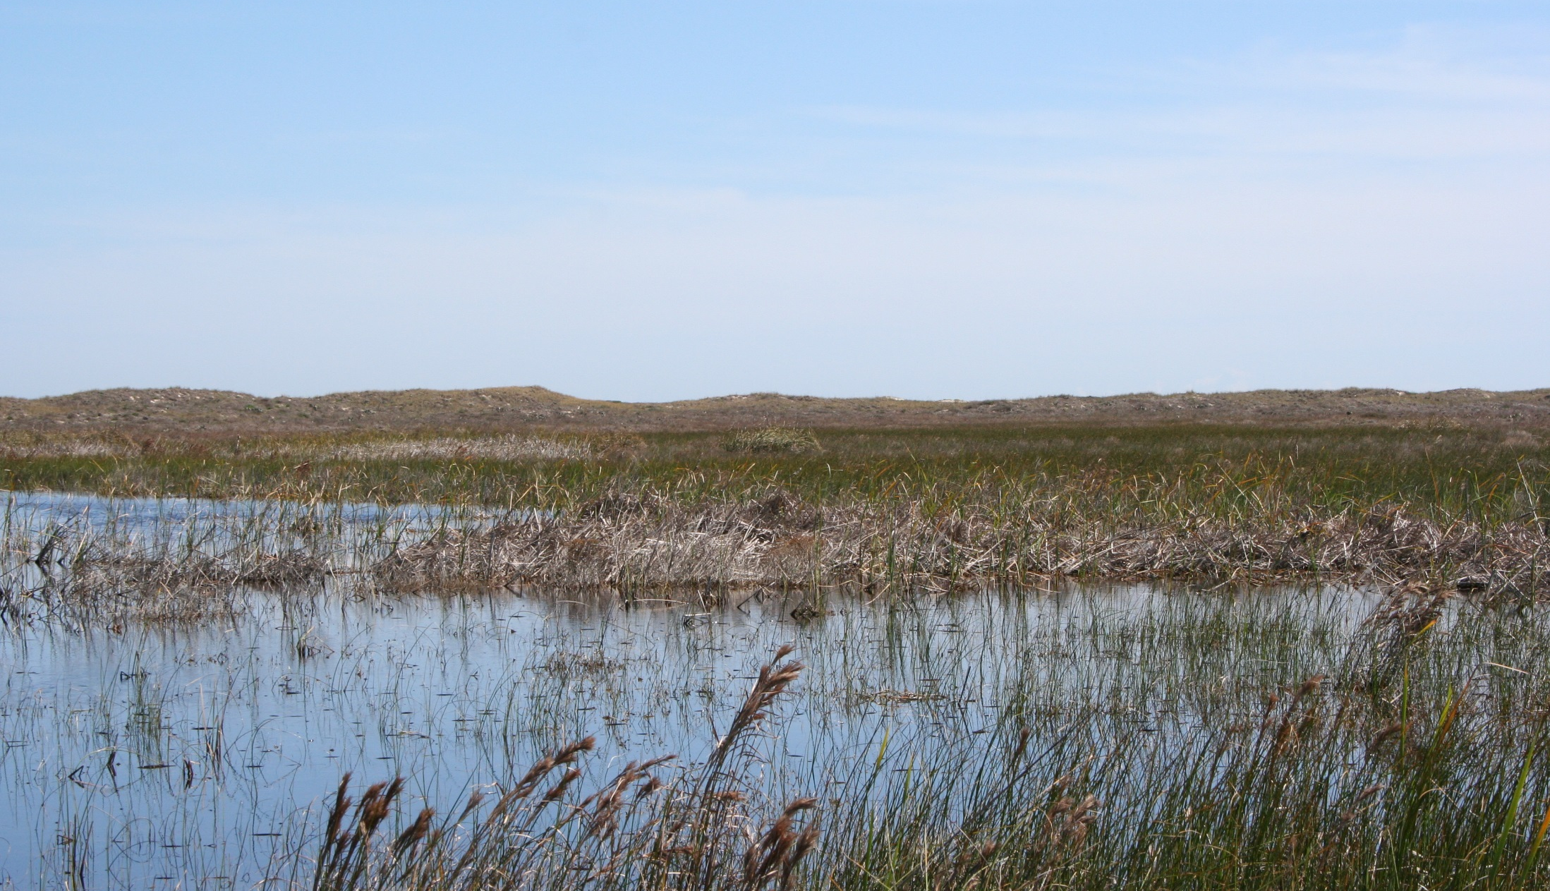
Freshwater Ponds
Notes:
Freshwater ponds are critically important to most of the wildlife on the island and play a critical role.
During wet times maybe half of the island is covered and when dry, even semi-permanent ponds may nearly dry up. Life here is harsh and species struggle to complete their life cycles.
Ponds are often attractive to many different species from white-tailed deer to coyotes, and many species of birds including the mottled duck which nests here. The edges of ponds are home to a huge variety of plants and animals including cattails, green tree frogs, snakes, and many species of insects including dragonflies.

Slide 8
Gulf Beach and Primary Dunes
Notes:
Upon reaching the Gulf beach and the primary dunes, the vegetation is patchier, the wind is stronger and the dunes are higher.

Slide 9
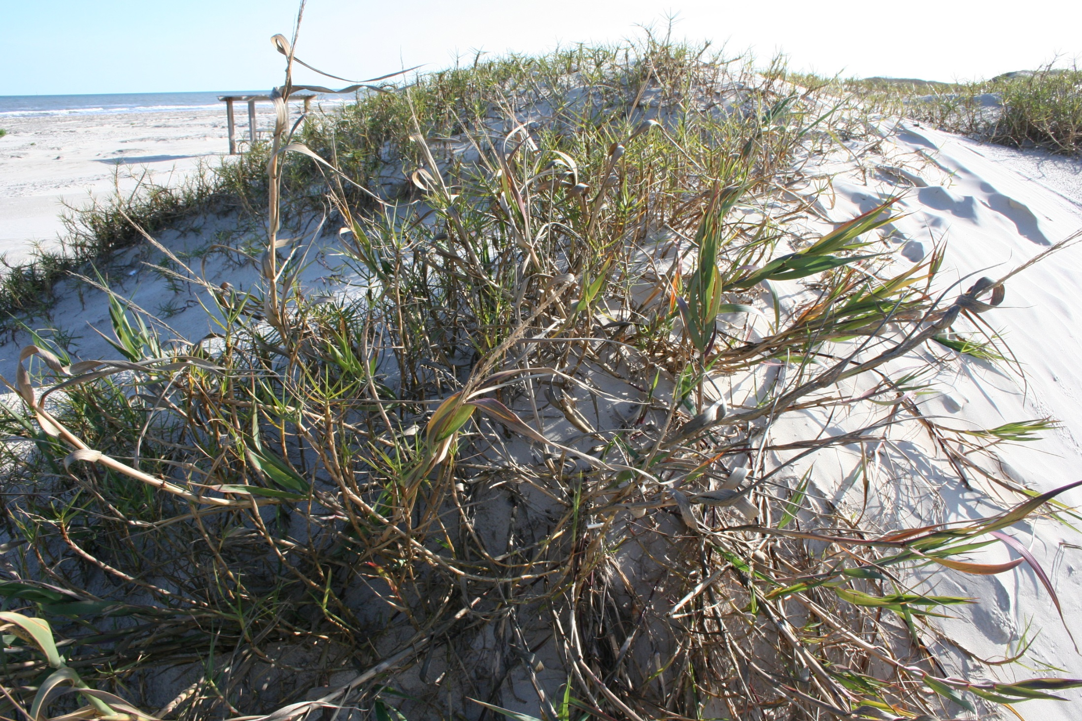
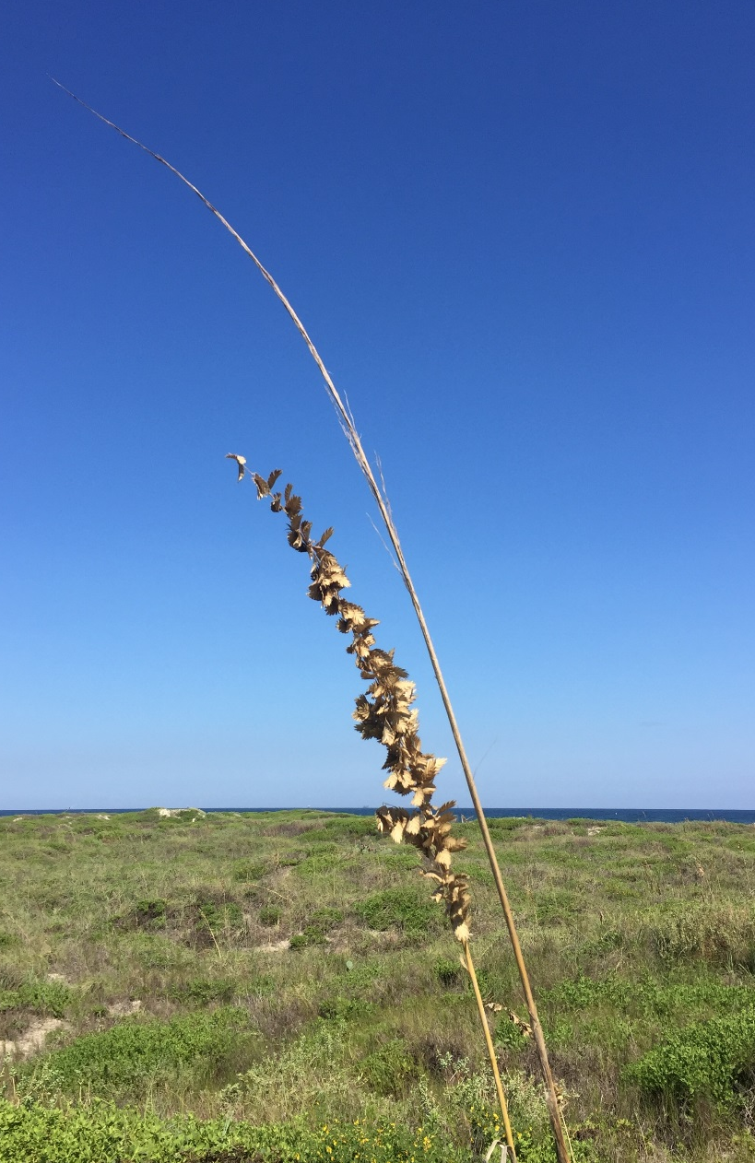
Bitter Panicum and Sea Oats
Notes:
Bitter Panicum and Sea Oats are important species holding the dunes in place against the wind and storms.

Slide 10
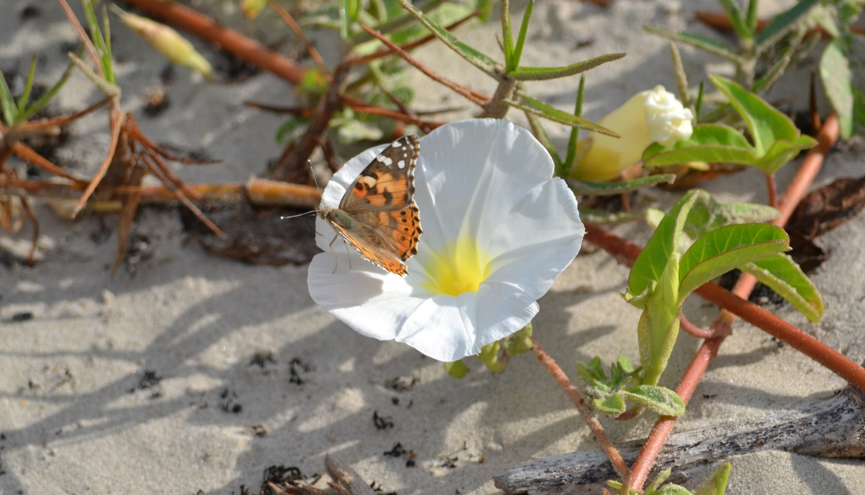
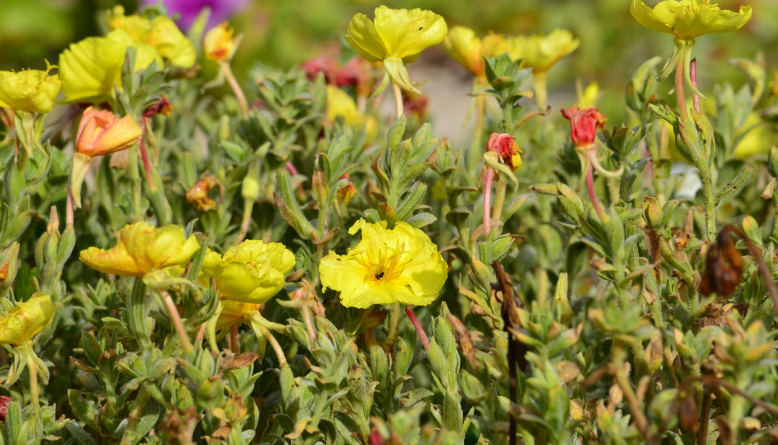
Beach Morning Glory & Beach Evening Primrose
Notes:
Beach Morning Glory & Beach Evening Primrose also colonize the strip of beach facing slopes of the fore dunes.

Slide 11
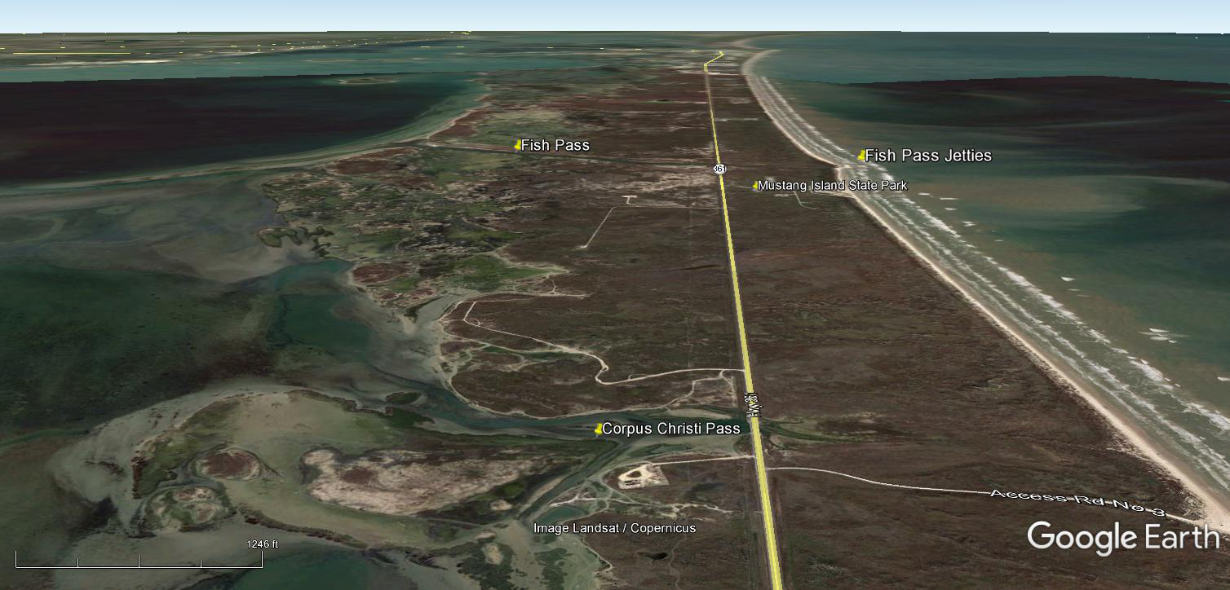
Site Purpose
The primary mission of Mustang Island State Park is to manage and conserve this barrier island ecosystem while providing quality recreational opportunities and site-based interpretation of natural and cultural resources.
Notes:
The primary mission of Mustang Island State Park is to manage and conserve this barrier island eco-system while providing quality, recreational opportunities and site-based interpretation of natural and cultural resources.
This two-pronged mission focused on both conservation and recreation comes as a challenge, often with the two objectives in opposition of each other. It takes a great deal of careful planning, review and implementation of operations to find a sustainable balance.

Slide 12
Maintaining Our Coastal Prairies and Dunes
Managing Habitat for Diversity
Prescribed Burns
Mimic processes which used to occur naturally.
Prevent conversion of native prairie to brush.
Management of Invasive Species
Prevent or reduce infestation with invasive native and exotic species.
Protection of Sensitive Habitats
Manage operations and direct public access to reduce impacts and promote recovery.
Notes:
We conserve habitat in our parks by several means including: conducting prescribed burns, monitoring and removing invasive species, and protection of sensitive habitats through park operations and directing public access.

Slide 13
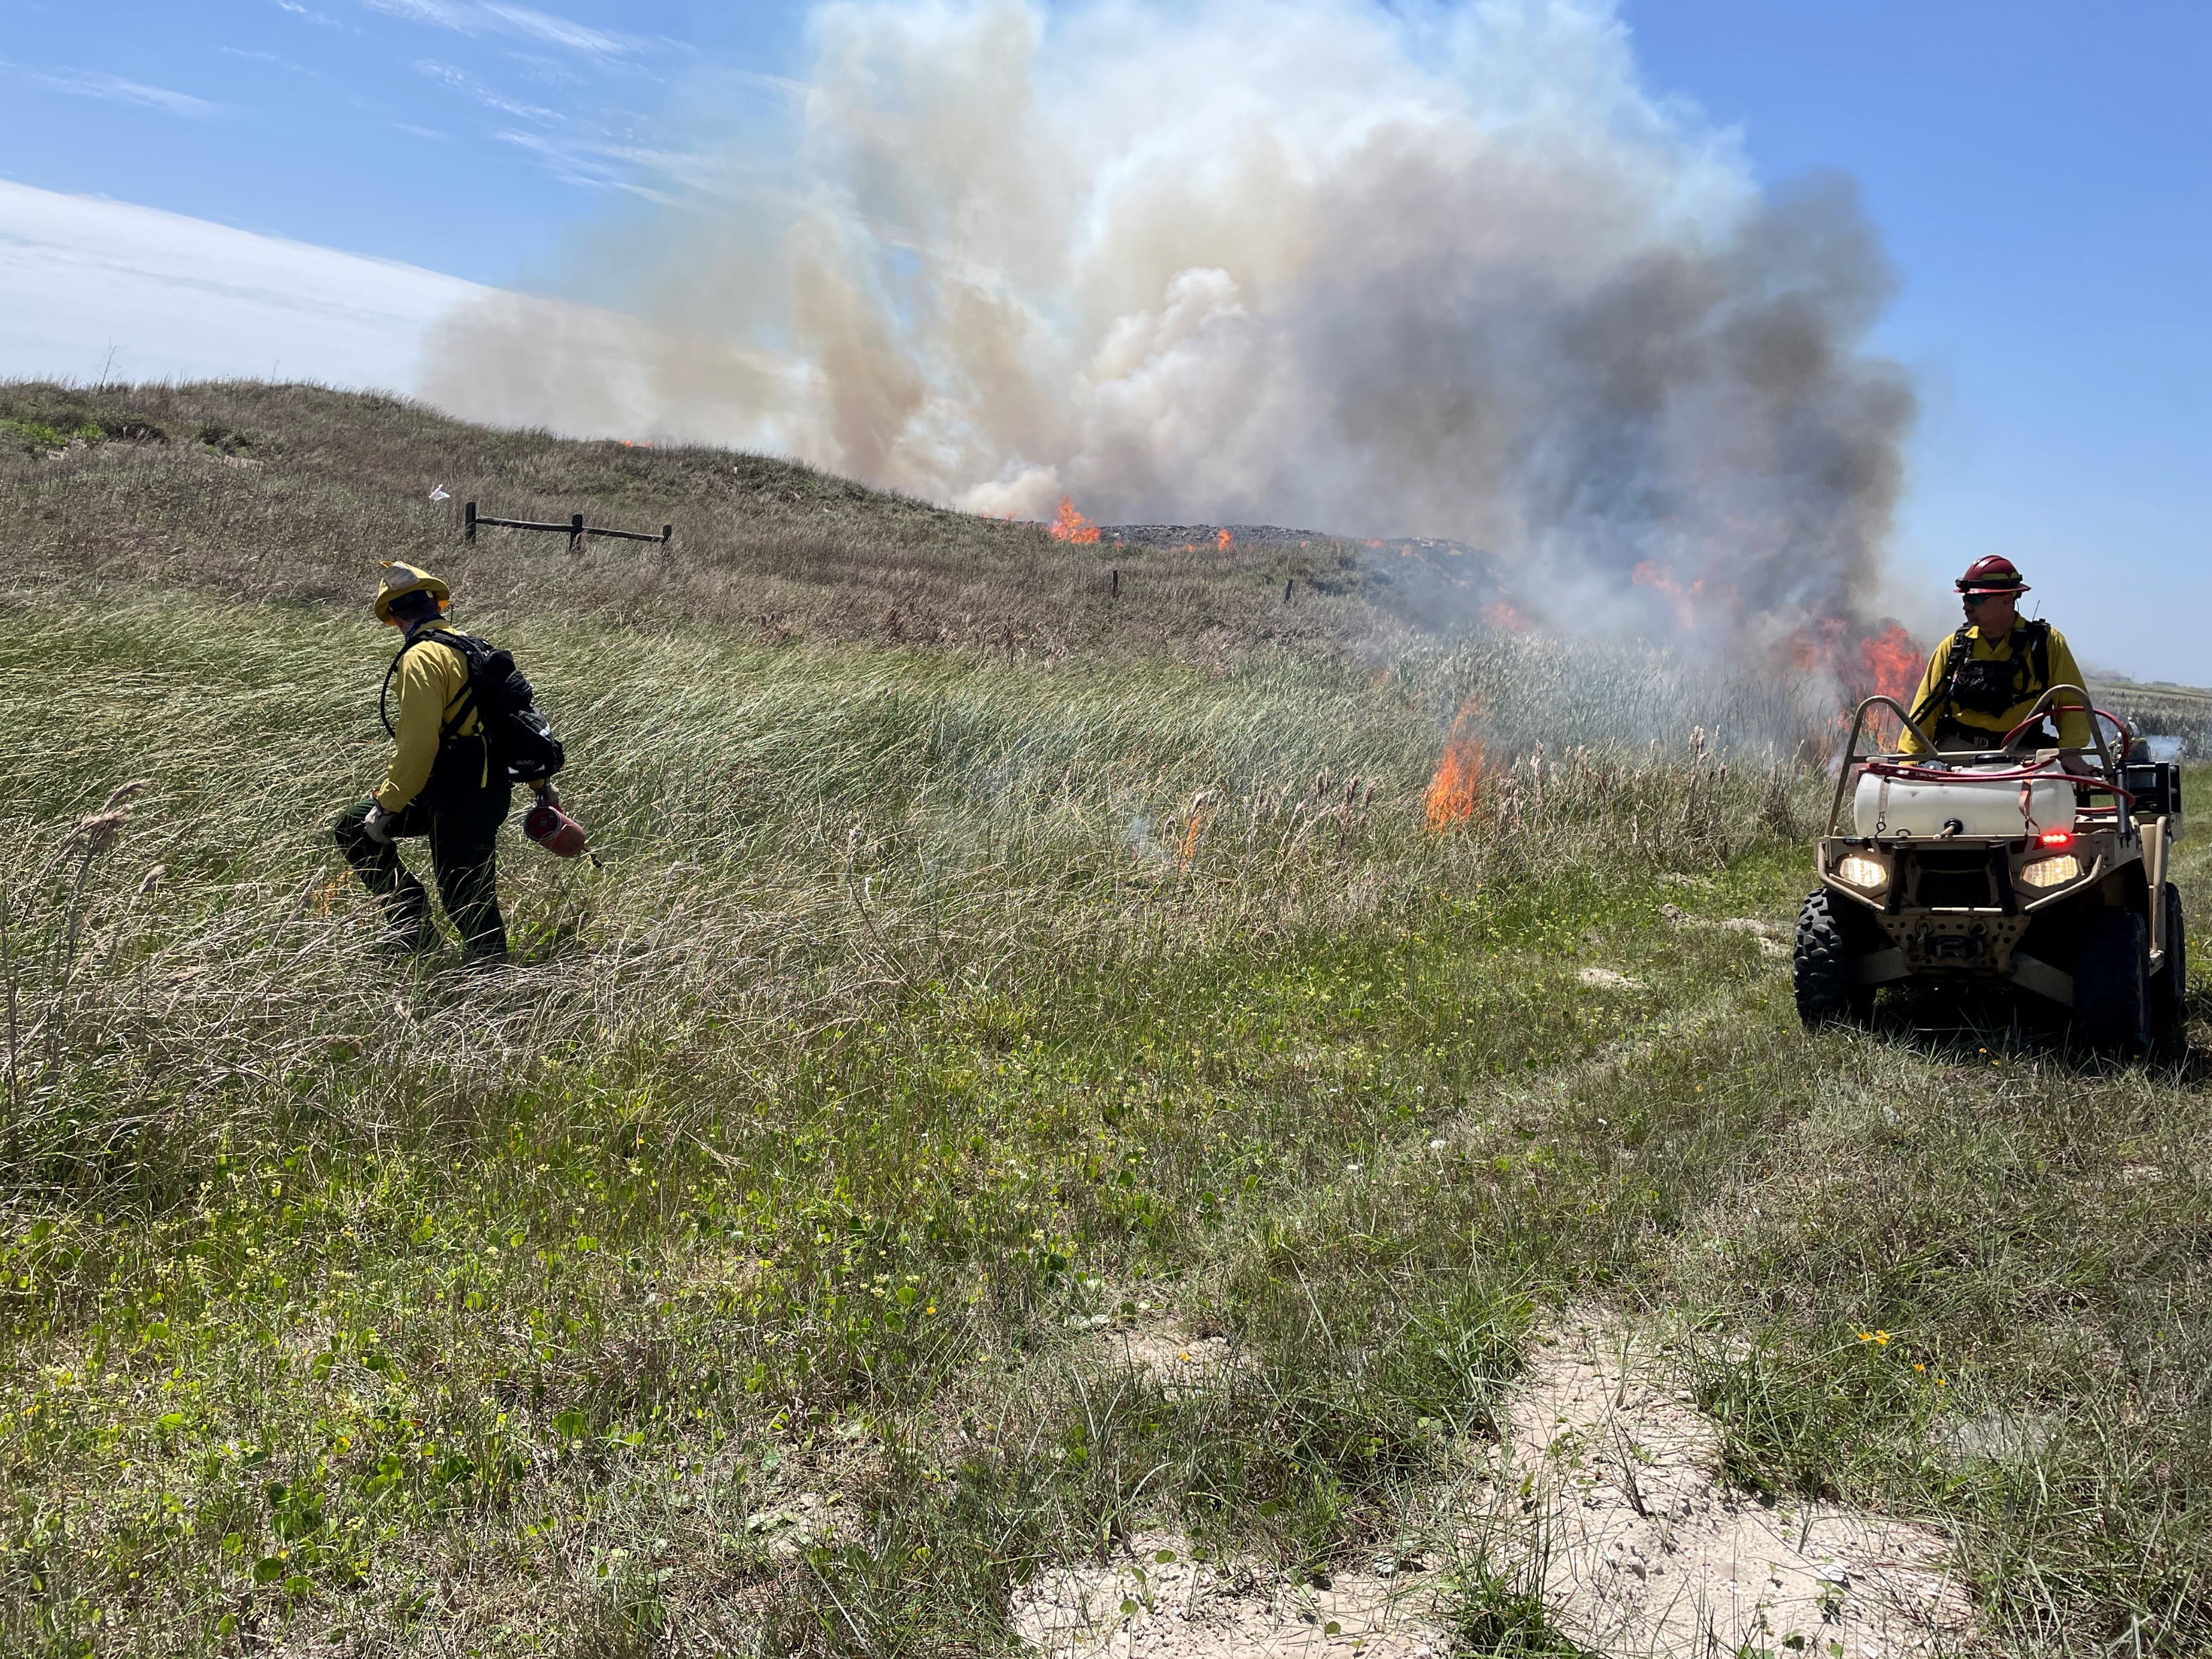
Prescribed Fire
TPWD Fire-fighters managing prescribed burn at Mustang Island SP
Notes:
One of the main tools we use to manage coastal prairie habitat is prescribed fire.
In the Gulf Coast Prairies and Marshes Ecoregion, conversion of native prairies to brush displaces many wildlife species which are dependent upon grasses and forbs. Fire used to occur naturally every three to five years, on average in this area. Fire would burn up the low brush that had developed over a short time, and would maintain the balance between brushland and prairie, but when settlers moved in and began suppressing wildfires, the balance was lost. Very little naturally occurring prairie now survives in Texas.

Slide 14
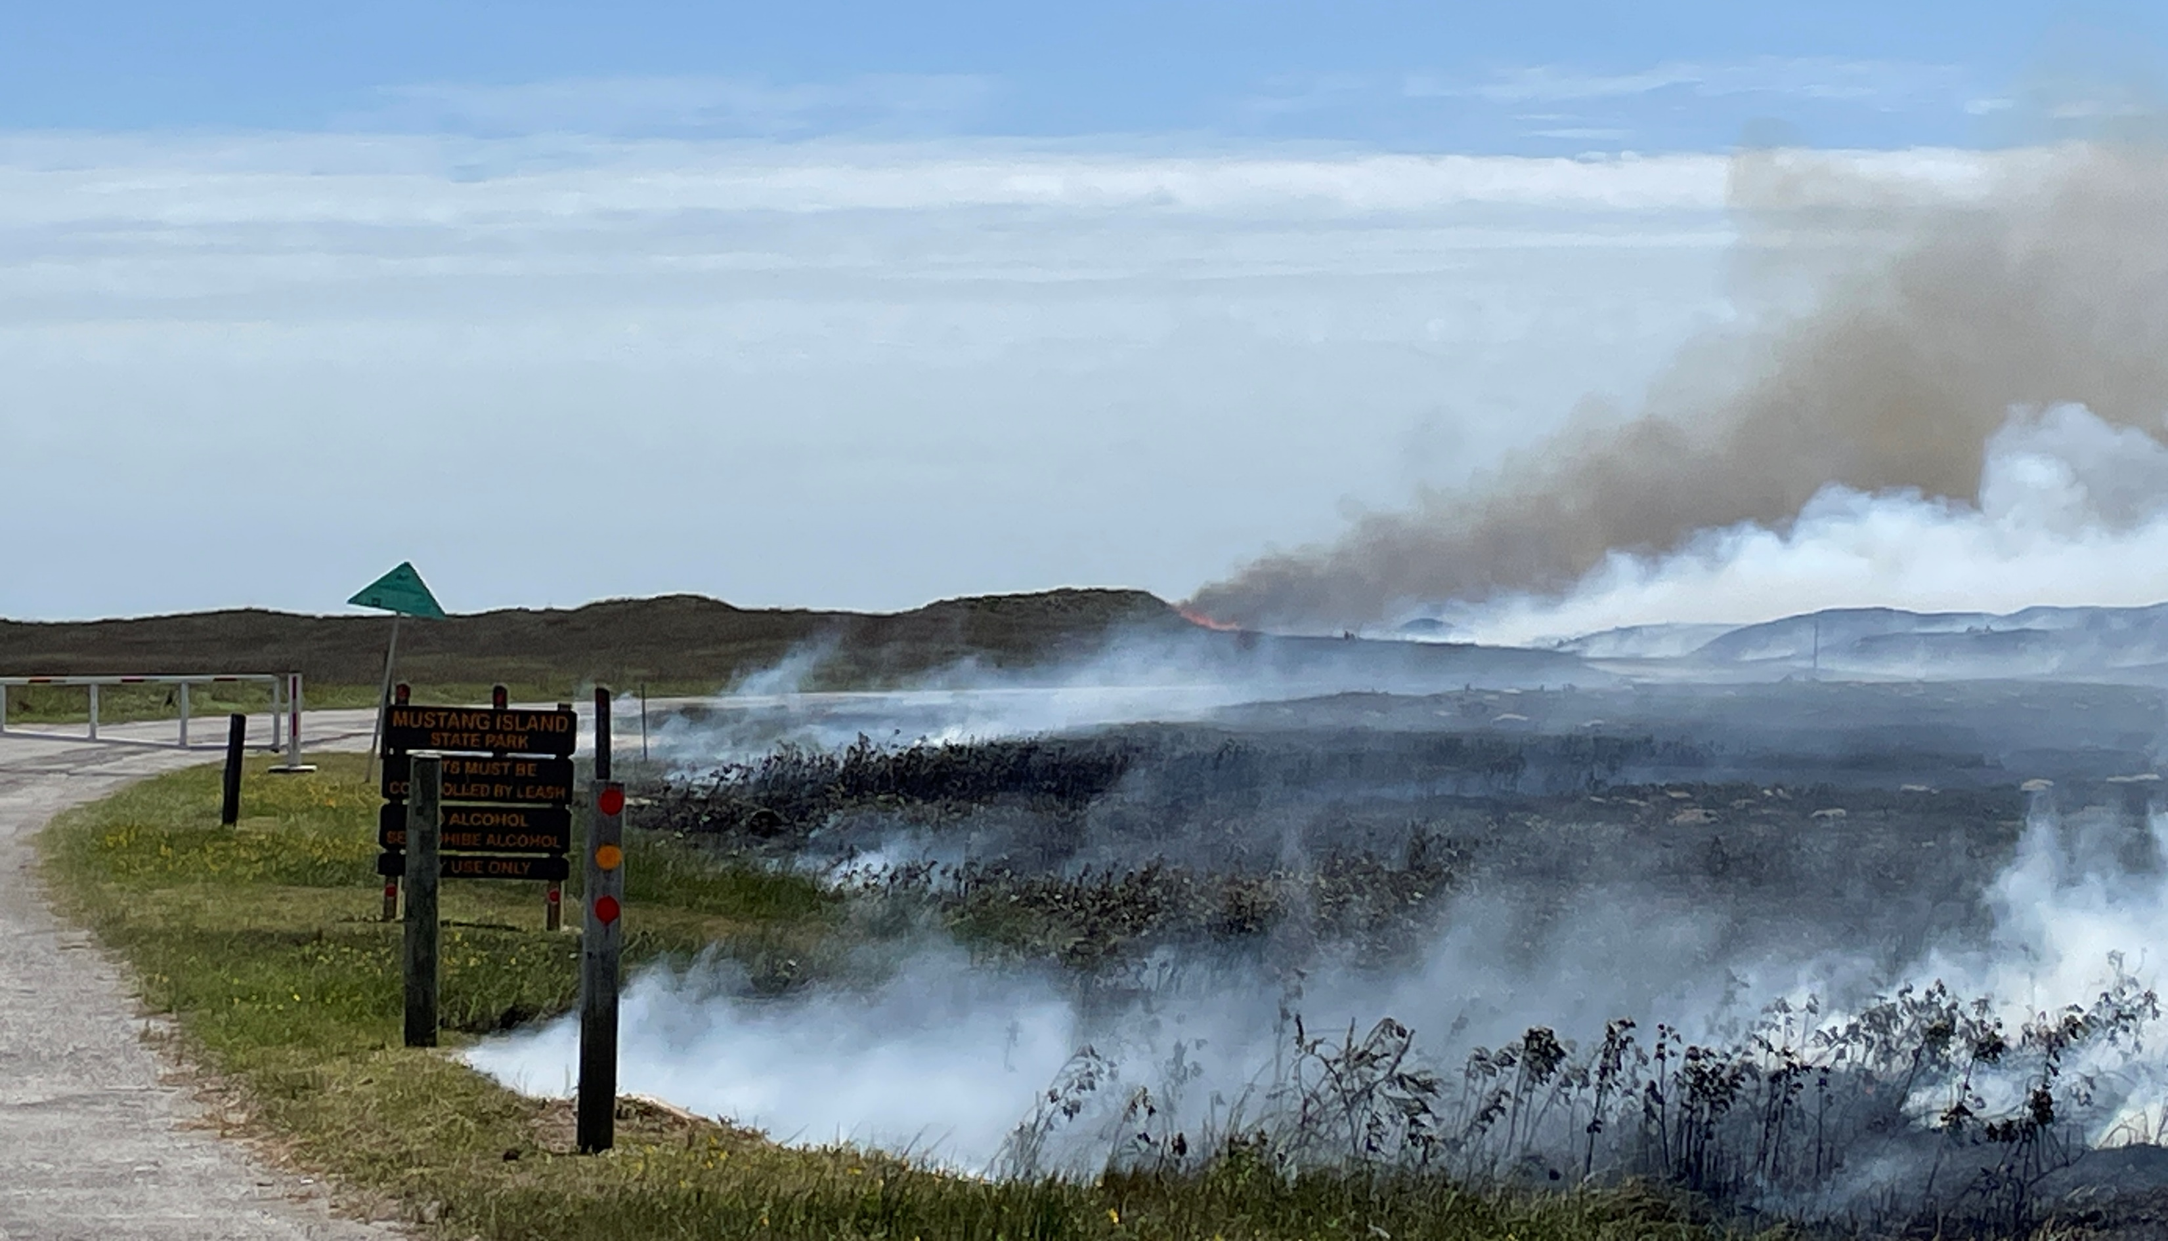
Fire Effects
Prescribed burn at Mustang Island SP
Notes:
After a fire burns through an area, nutrients are returned to the soil and vegetation resprouts providing nutritious forage for many species from insects to raptors and coyotes.

Slide 15
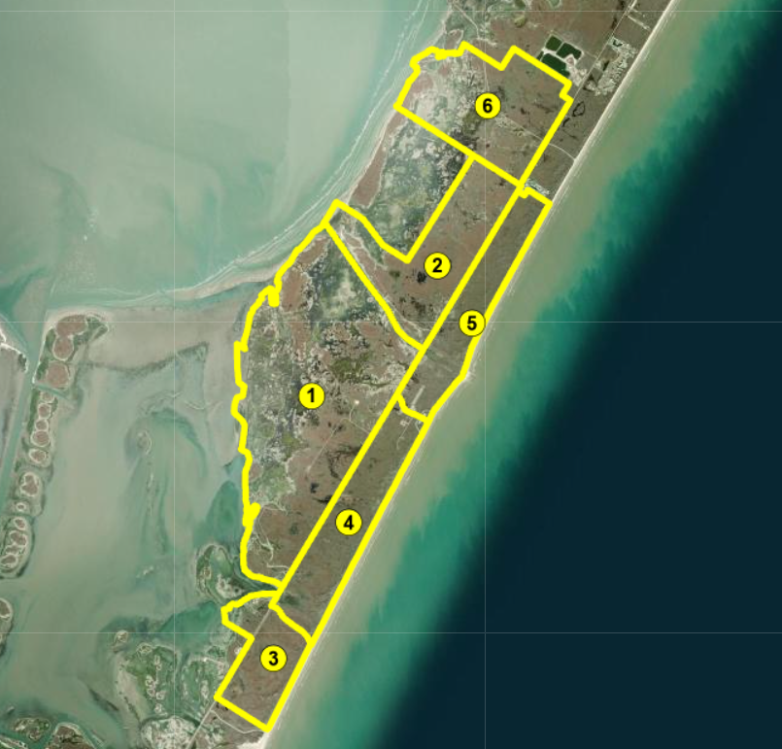
Prescribed Fire History
2019
Year | Units | Acres
2013 Apr | 4 | 544
2016 Jan/Feb | 1 & 2 | 2,976
2018 Jan | 4 & 5 | 1,036
2019 Mar | 1, 2, 6, GLO | 3,441
2019 Dec | 3 | 318
2024 Apr | 3 & 4 | 862
2025 Apr ?? | 1 & 2
2019
2016
2019
2018
2016
2019
2013
2018
2024
2019
2024

Slide 16
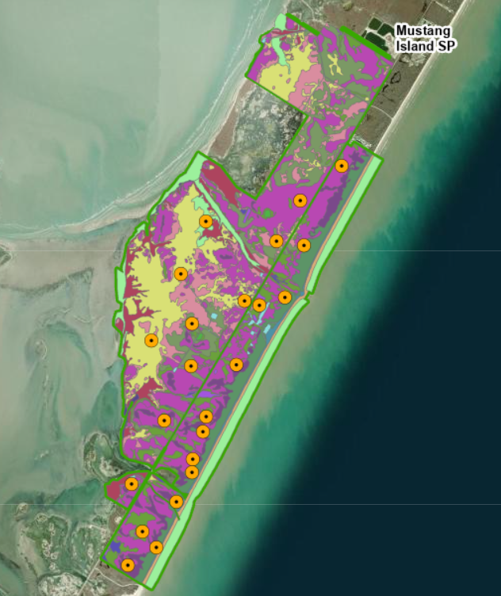
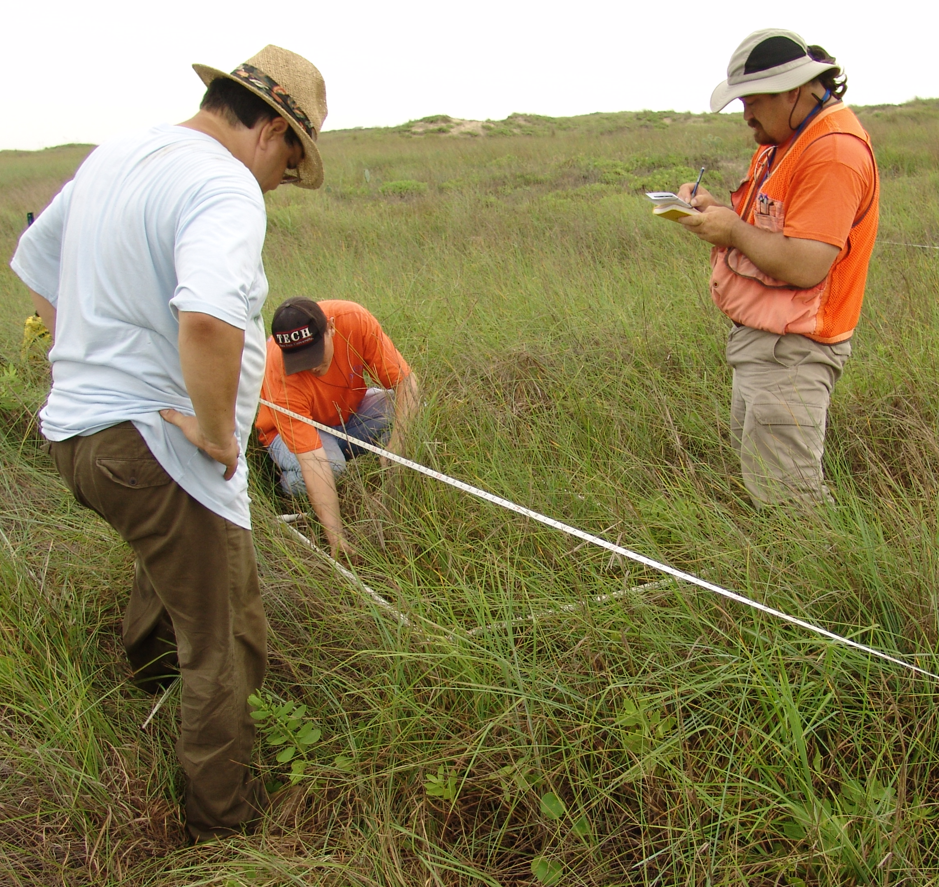
Vegetation Monitoring
Notes:
Comprehensive vegetation community mapping as a baseline inventory. Can see the mosaic of plant communities mapped here.
Over 20 Permanent Vegetation Plots – established to help us characterize the natural vegetation communities throughout the park. Plots are regularly re-sampled to help staff monitor succession, effects of management activities such as prescribed fire, and effectiveness of restoration efforts.

Slide 17
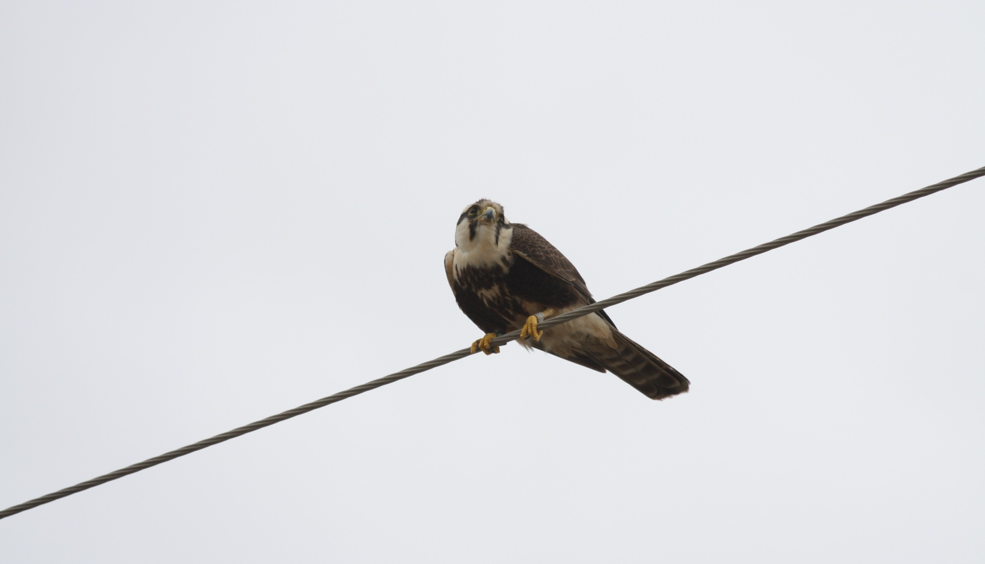
Aplomado Falcon Reintroduction
Young adult Aplomado
Notes:
One of the species that depends greatly upon our conservation efforts, and especially on prescribed fire, is the Northern Aplomado Falcon, a species listed as endangered since 1986.
They require open grasslands and savannahs where tall cacti, yuccas and taller pines and oaks grow in open stands. They nest in old stick nests of hawks and other birds constructed in tall yuccas. Sometimes they even evict other birds from their nests. They usually lay two or three eggs.

Slide 18
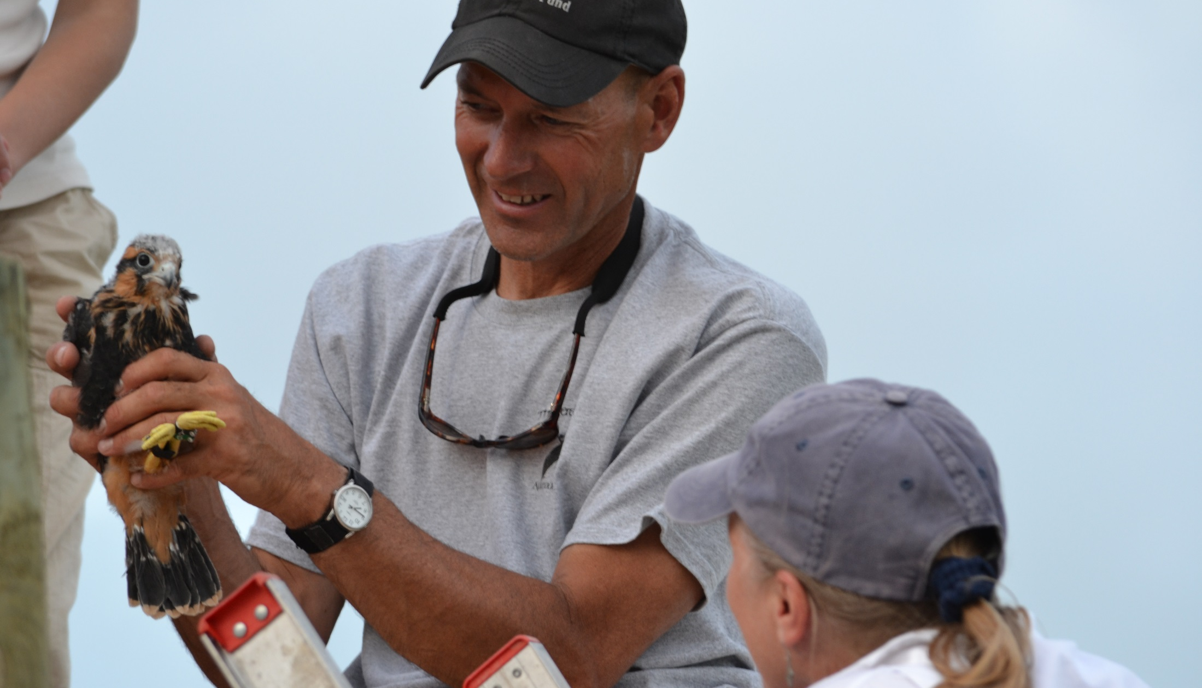
Aplomado Falcon Reintroduction
Peregrine Fund biologist holding one of the first introduced juveniles
Notes:
Aplomado falcons used to be found here, but had been absent from the area since the 1950s.
They were placed on the federal endangered species list primarily because of loss of the grassland prairie habitat where they hunt.
Aplomados were re-introduced to the park in 2012, through a partnership with The Peregrine Fund and USFWS -- and since then, falcons have continued to nest here.

Slide 19
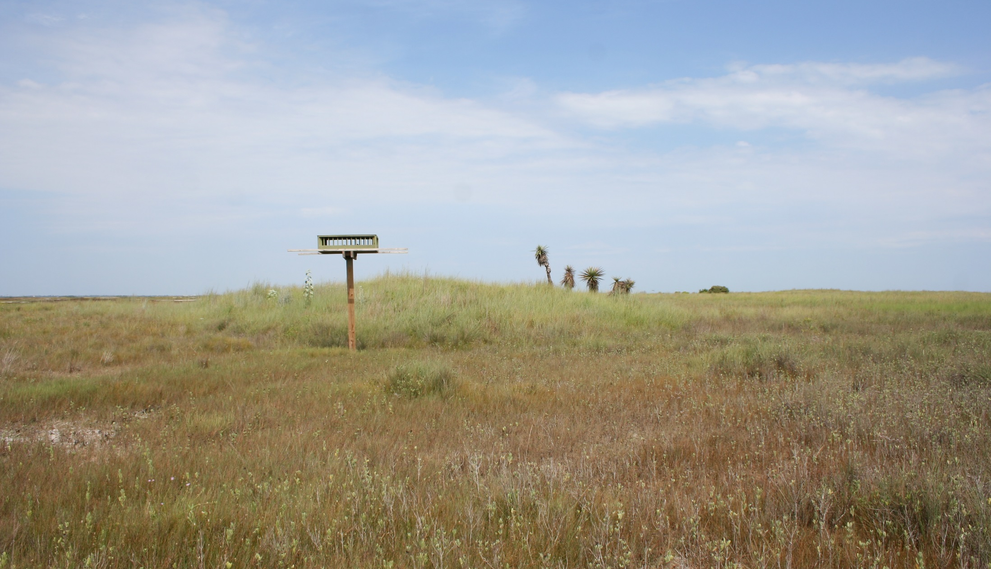
Aplomado Falcon Nest Box
Nest box and planted yuccas
Notes:
In this area, Aplomados would naturally use stick nests constructed by White tailed hawks. We have provided both natural and planted yuccas and protected naturally occurring yaupon bushes when they were found to have nests. We also have two nest boxes constructed in the park for their use.

Slide 20
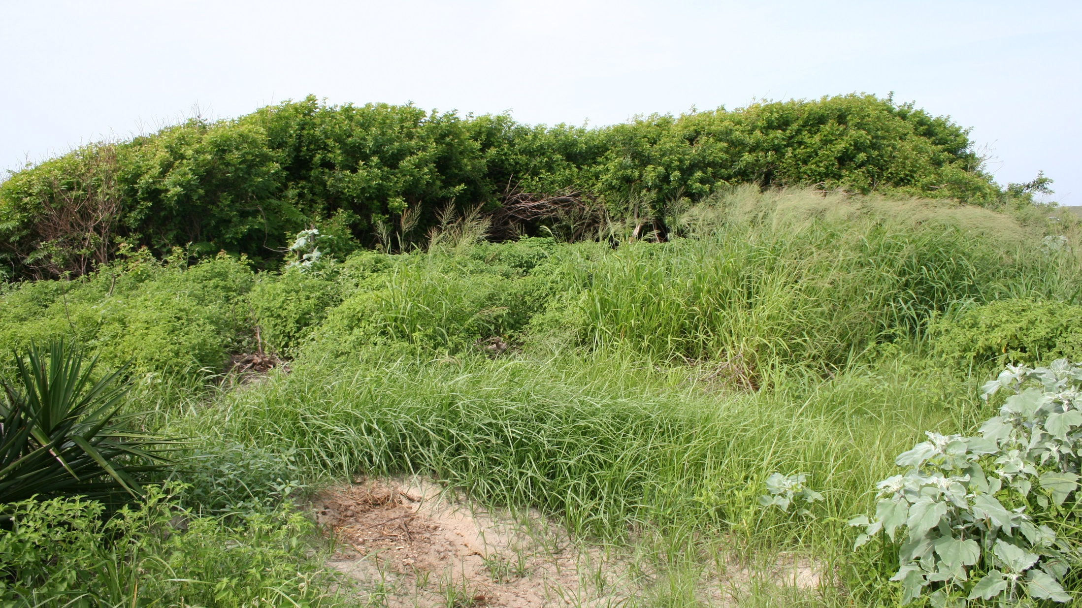
Invasive Species - Brazilian Peppertree
…and Guinea grass
Notes:
In addition to brush encroachment, many prairie areas on the barrier island are being invaded by non-native species. This photo shows Brazilian Peppertree and Guinea grass in the foreground.
These non-native plants, and many others, are imported for various reasons, and they overgrow in the natural environment, often as monocultures, and displace the native species. Wildlife that did not evolve to live with these species can no longer find the food, cover, nesting material and sites needed to survive and reproduce. It is critically important that we control invasive non-native species in order to maintain our native habitats and biodiversity.

Slide 21
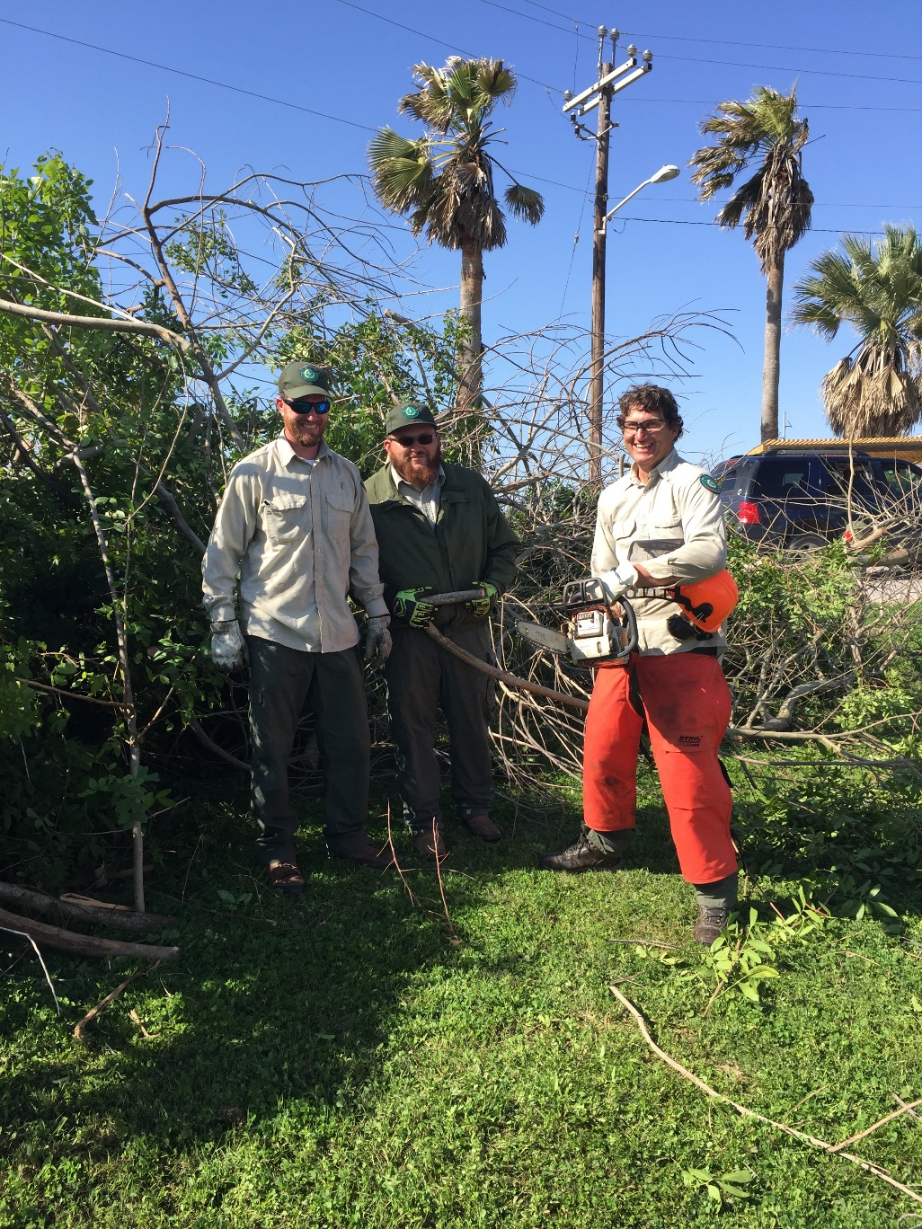
Cooperative Weed Management Area
Notes:
In 2014 we joined efforts with several other conservation partners and formed a Cooperative Weed Management Area. We work together several times each year to bring together all our resources to control Brazilian Peppertree and other invasives on Mustang Island.

Slide 22
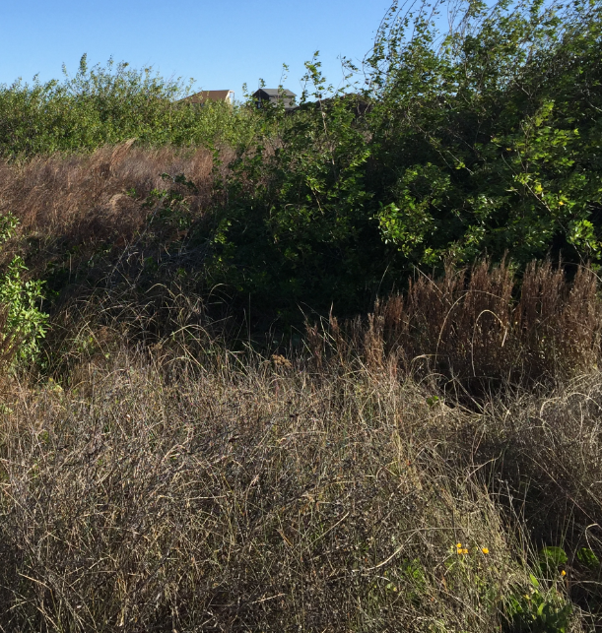
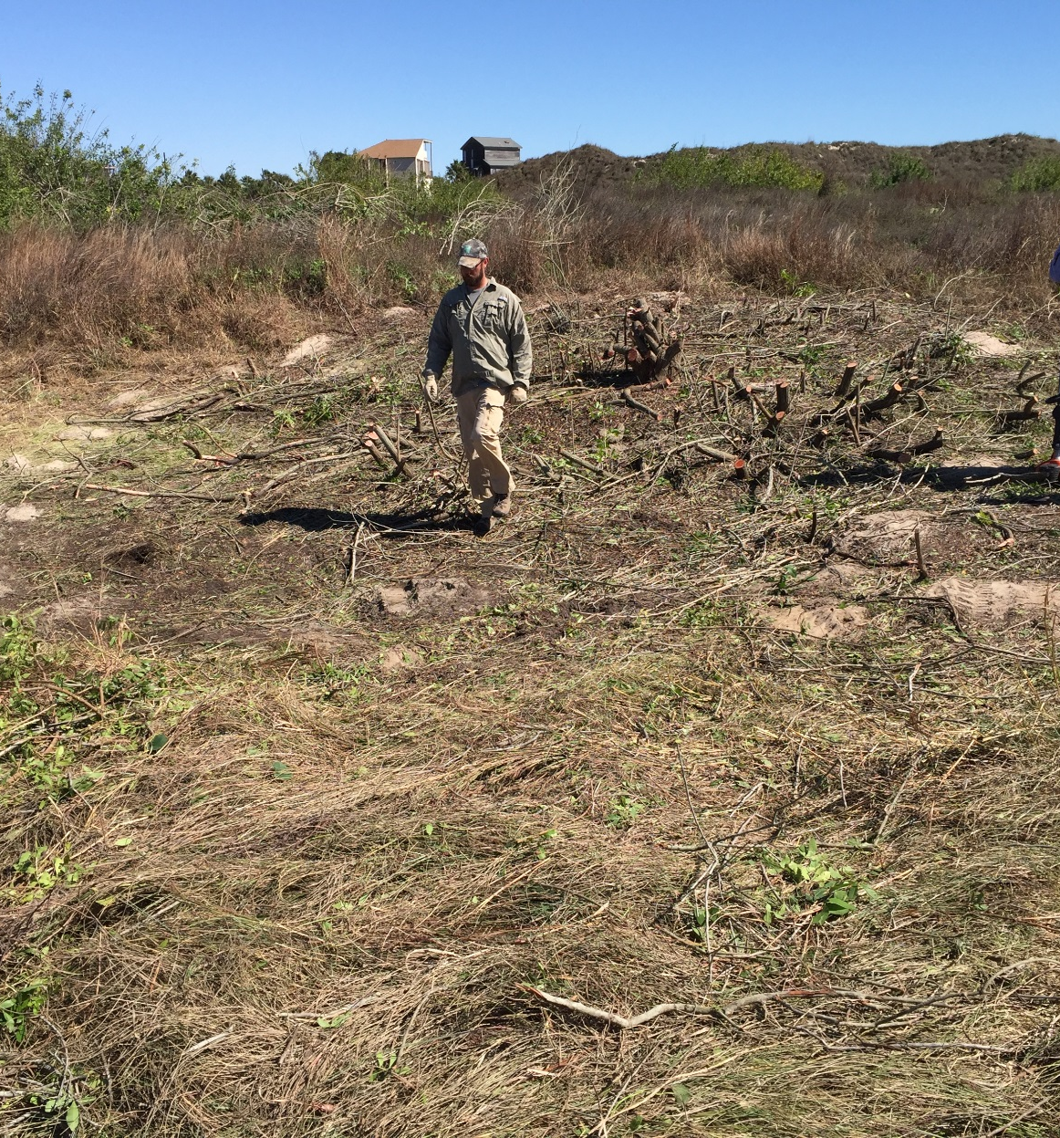
Cooperative Weed Management Area
Before and After clearing BP
Notes:
This photo shows before and after a site was cleared of Brazilian peppertrees. Grasses will grow back restoring the area to a more natural state with greater biodiversity.

Slide 23
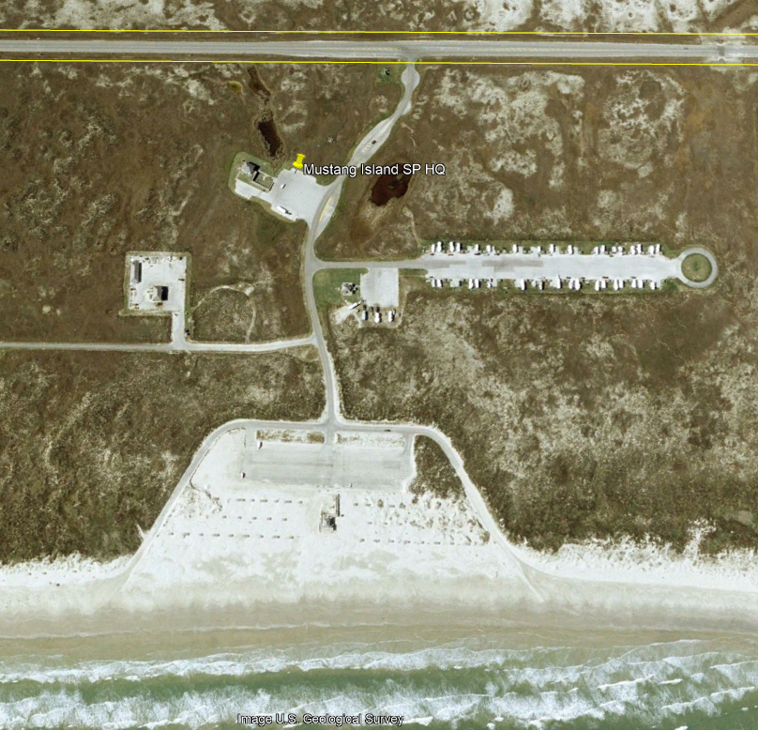
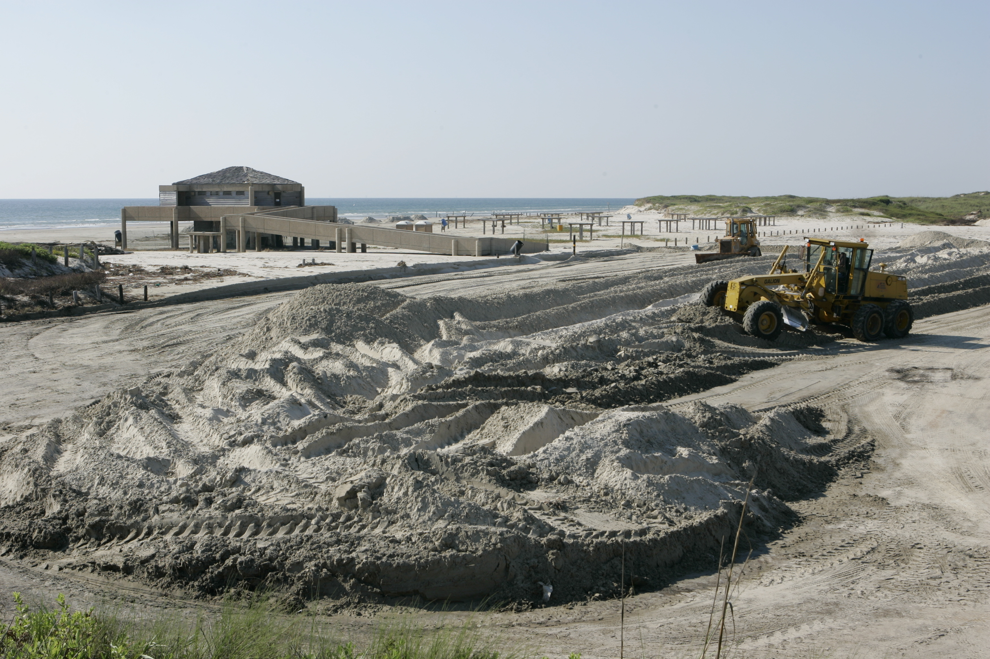
Protecting Sensitive Habitats
Adaptive Management Practices Over Time
Day-Use Beach Area –
In the past kept dune cleared from shore to parking lot for “beach” aesthetic

Slide 24
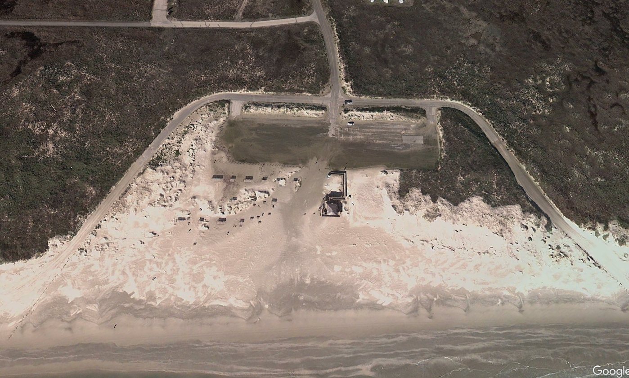
Protecting Sensitive Habitats
Adaptive Management Practices Over Time
Day-Use Beach Area –
2008 Hurricane Ike example without protection from dunes, overwash, flooding, and sand filled parking area

Slide 25
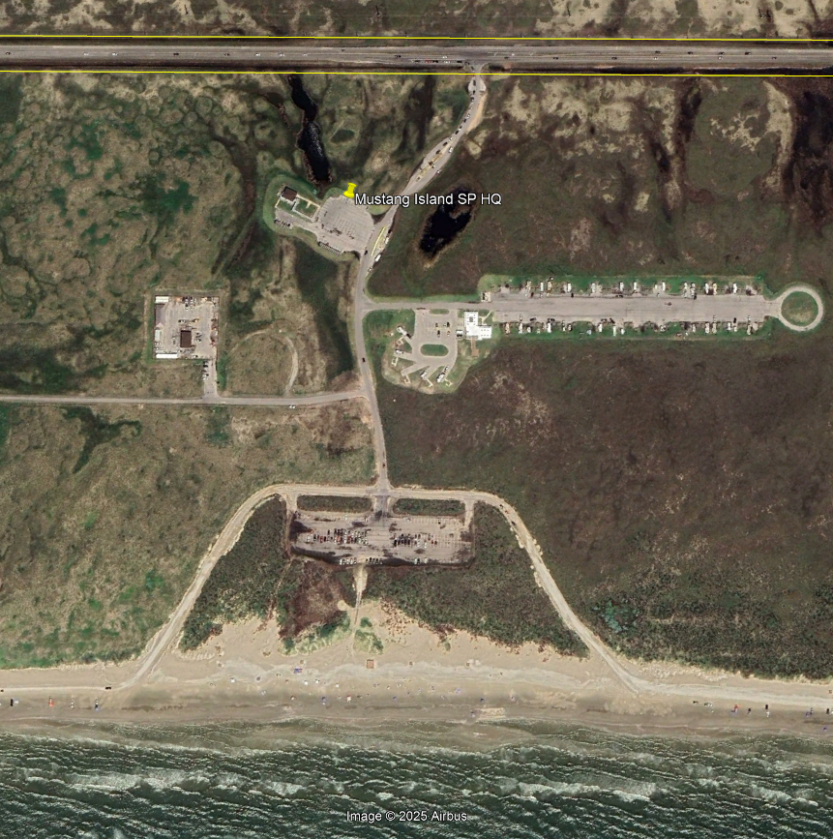
Protecting Sensitive Habitats
Adaptive Management Practices Over Time
Day-Use Beach Area –
Facilitated dune restoration back to natural ecology, filled in with sand, passive revegetation

Slide 26
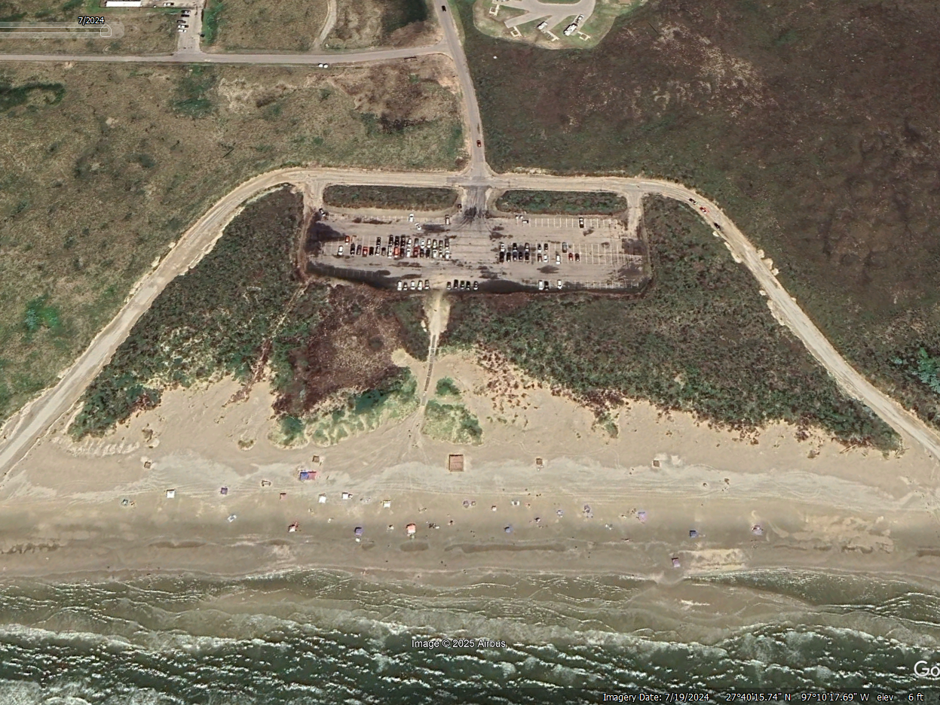
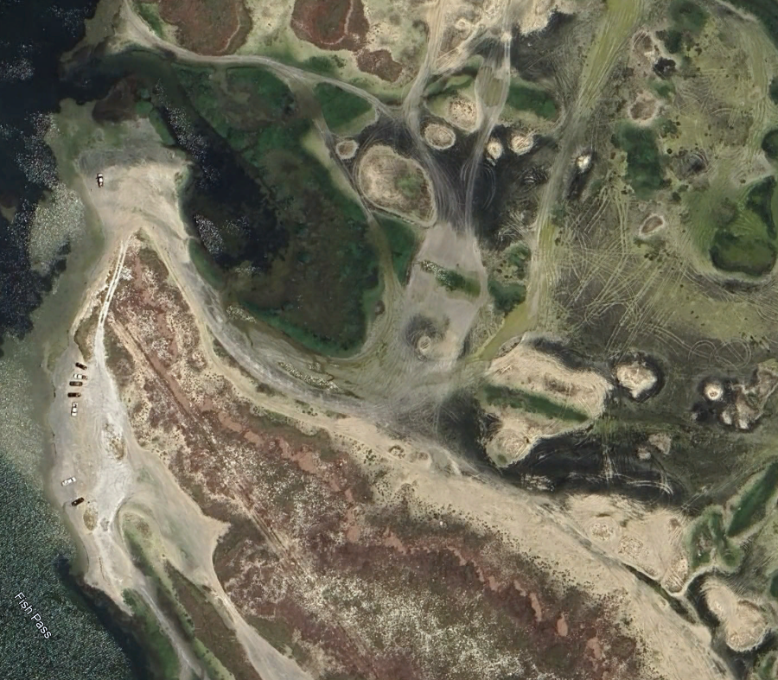
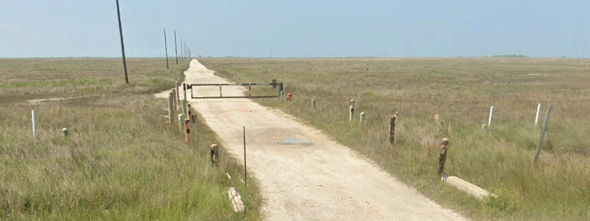
Protecting Sensitive Habitats
Fencing, Roads, and Walkways
Directing targeted public access to reduce impacts and promote habitat recovery.

Slide 27
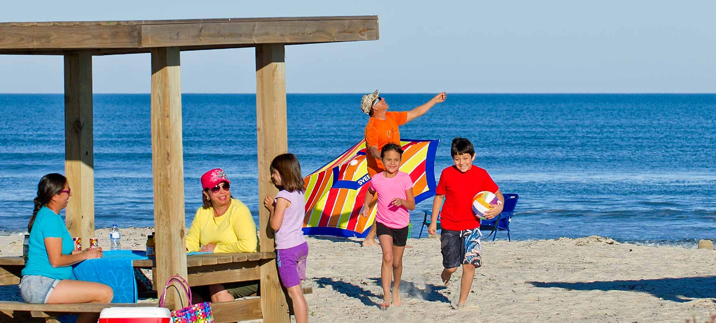
Site Purpose
The primary mission of Mustang Island State Park is to manage and conserve this barrier island ecosystem while providing quality recreational opportunities and site-based interpretation of natural and cultural resources.
Notes:
Back to the Mission – balancing conservation with quality recreational opportunities, all while educating the public to develop stewardship

Slide 28
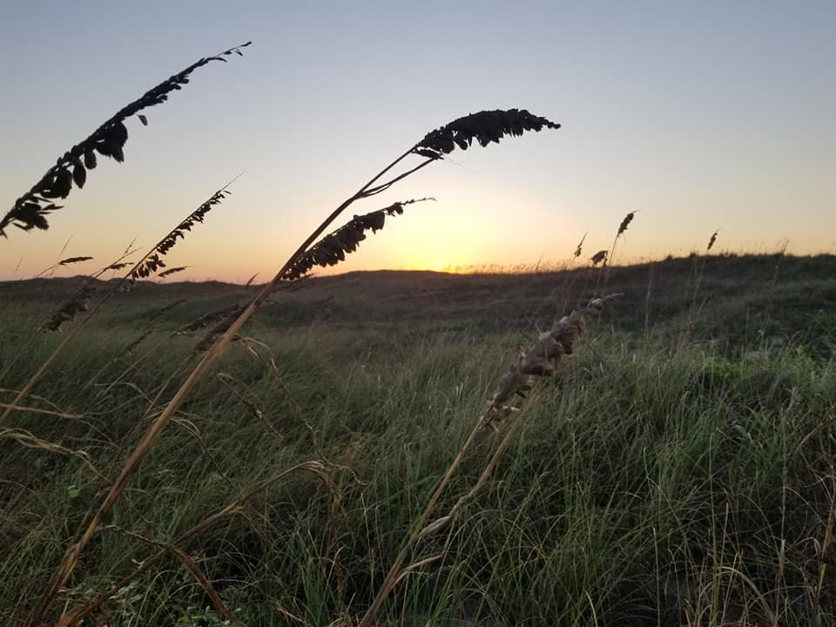
Questions?
Kristen Eggers
Natural Resources Specialist
TPWD State Parks
kristen.eggers@tpwd.texas.gov

