Slide 2
Kickoff: February 21, 2020
DNA Assays for Determining Honey Origins
Dr. Richard C. Willson, University of Houston (PI)
Dr. Aniko Sabo, Baylor College of Medicine (Expert in Bioinformatics)
Dr. Katerina Kourentzi, University of Houston (Expert in Assay development)
Other personnel:
Dimple Chavan, University of Houston (Graduate student)
Suman Nandy, University of Houston (Graduate student)

Slide 3
Project Overview
Goal:
The main goal of this project is to develop practical means to identify honey country of origin using pollen DNA, and the DNA dissolved in filtered honey
Three Objectives:
Objective 1: A DNA sequencing and sample-clustering analysis pipeline which identifies the origin of the great majority of honey samples based on known standard samples and ITS2 barcode databases

Slide 4
Project Overview
Objectives (continued):
Objective 2: DNA amplification-based RPA analysis methods derived from the sequencing work, capable of accurately identifying a large fraction of honeys originating from the People’s Republic of China, with a time-to-result below eight hours
Objective 3: Demonstration of purification, PCR amplification and sequencing of soluble DNA from filtered, pollen-free honey

Slide 5
Samples and Data
Goal 1: Pollen DNA barcode sequencing-based identification of plant and geographical origins of honey
Acquisition and pollen-sequencing of at least 300 honey samples, with emphasis on countries of CBP interest
Analysis by clustering
Analysis using public database information
Resistance to evasion attempts (e.g., pollen spiking) will be validated
Establishment and documentation of standard operating procedures for sequencing-based identification of the species of pollen grains

Slide 6
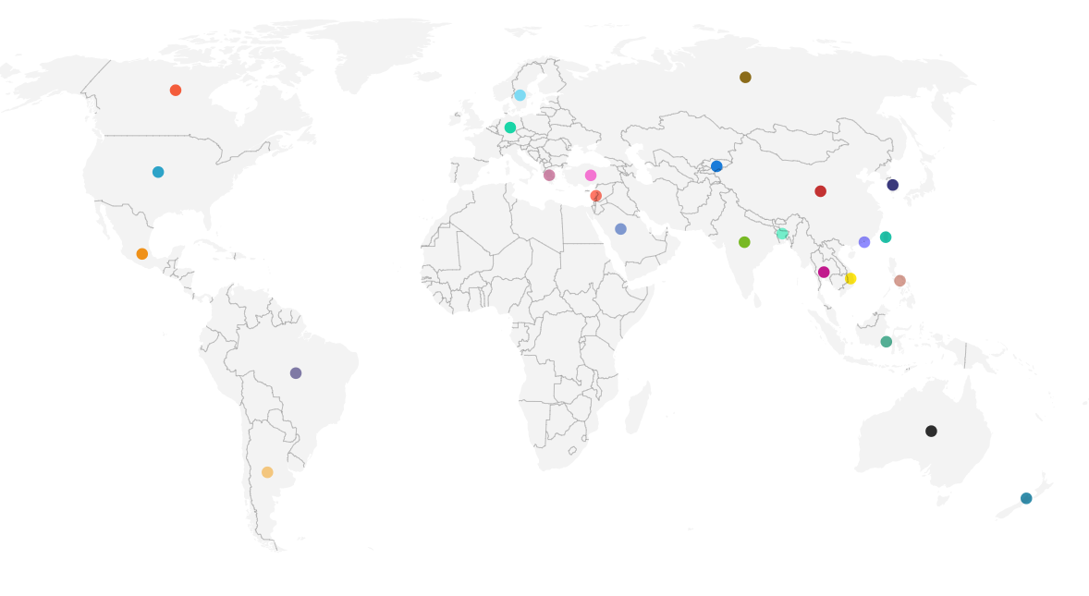
Honey Sample Library
1
1
3
3
13
2
5
40
2
4
3
1
18
4
3
1
7
5
2
2
1
2
3
1
1
129 samples from 25 countries (including 40 from PRC, 18 from India)

Slide 7
Honey Sample Library
Honey samples acquired from 15 provinces of China

Slide 8
RPA
Goal 2: Demonstrate RPA-based rapid analysis of pollen DNA
To be derived from the sequencing results (Goal 1)
Primer/probe design
Testing of primer sets with purified nucleic acids, known mixtures, and deep-sequenced DNA from honey
Documenting SOPs for RPA identification of the species of pollen grains
Identifies most samples from the PRC, within 8 hours
(scheduled to start March 1, 2020)

Slide 9
Pollen-Free DNA
Goal 3: Demonstration of purification, PCR amplification and sequencing of soluble DNA from filtered, pollen-free honey
Testing and optimization of pollen-free DNA capture and purification protocols, and if needed whole-genome amplification. Testing by spike/recovery of DNA fragments of varied size
Application of pollen-free plant DNA in sourcing of filtered DNA, using the sequencing and PCR methods of Goals 1 and 2
Efforts have been invested to develop different protocols for DNA capture
promising demonstration results, though only n = 1 (using anion-exchange Q Sepharose and anti-DNA antibodies coupled to amine-modified magnetic nanoparticles)

Slide 10
Student Involvement
Undergraduate students
Four paid undergraduate B.S. students will participate, two at a time
Supported by work-study funds or other in-house sources of support, with more intensive work during the summers and vacation periods
Some additional unpaid students may use this work in support of their B.S. degrees, but those paid in connection with the project will not be receiving academic credit
Will be involved in curation of our collection of honeys from international sources, literature research on the ranges of particular plants of interest, and assisting in the laboratory on purification of pollen and free DNA from honey samples, and later in development of RPA DNA amplification assays

Slide 11
Student Involvement
Graduate students
Dimple Chavan
Fourth-year Ph.D. student in Biology & Biochemistry working on DNA-based detection technologies, especially honey pollen DNA sequencing
Will assist Dr. Kourentzi with DNA extraction, isolation and purification, and library preparation for Next Generation sequencing and the development of isothermal RPA-based DNA amplification assays
Suman Nandy
Second-year Ph.D. student in Chemical & Biomolecular Engineering specializing in bioseparations including pollen-free DNA from honey, who will focus on purification methods to isolate pollen, pollen DNA, and soluble DNA from honey, in maximal yield and free of inhibitors or cross-contamination
Will also assist in the development of isothermal RPA-based DNA amplification assays

Slide 12
Timeline
Project Plan
Months> |  |  |  |  | Feb 2020 | Mar 2020 | April 2020 | May 2020 | June 2020 | July 2020 | August 2020 | Sep 2020 | Oct 2020 | Nov 2020 | Dec 2020 | Jan 2021
ID | Task Title | Start | End | Duration | 1 | 2 | 3 | 4 | 5 | 6 | 7 | 8 | 9 | 10 | 11 | 12
T.1 | Meetings with Project champion; kick-off, 30-days and quarterly reviews | 1 | 12 | 1, Q1-Q5
T.2 | Obtain honey samples | 1 | 6 | 6
T.3 | Development of pollen purification and DNA sample preparation | 1 | 1 | 1
T.4 | Honey pollen DNA sequencing | 1 | 9 | 9
T.5 | Honey plant DNA sequence clustering informatics analysis | 1 | 9 | 9
T.6 | Purification and analysis of soluble DNA from filtered honey | 1 | 11 | 11
T.7 | Curation and detection of country-specific plant barcodes | 1 | 9 | 9
T.8 | RPA amplification assays | 2 | 11 | 9
T.9 | Testing and validation | 10 | 12 | 2
T.10 | Produce report | 11 | 12 | 1
T.11 | Phase I closing meeting | 12 | 12 | 1

Slide 13
Deliverables
ID | Description | Type* | MAS
D.1 | Kickoff meeting minutes | Report | 1
D.2 | Accumulation of honey samples | Report | 3,6
D.3 | Pollen DNA purification and prep protocols | Report | 1
D.4 | Pollen DNA sequencing | Data, Report | 6, 9
D.5 | Pollen DNA clustering methods and data | Report, Data | 6, 9, 12
D.6 | Purification and analysis of soluble DNA from filtered honey | Report, Report, Publication | 3, 6, 12
D.7 | Country-specific plant DNA barcode archive and informatics | Report | 3, 6, 9
D.8 | RPA amplification assays | Report, Report, Publication | 6, 9, 12
D.9 | Testing and validation to determine origins of CBP-provided or blinded honey samples | Report | 12
D.10 | Overall Report | Report | 12
D.11 | Project Debriefing | Brief | 12

Slide 14
Milestones
ID | Description | Date | Means of verification
M.1 | Accumulation of 300 honey samples | 6 | Report at 6 MAS
M.2 | Sequencing of 300 honey samples | 9 | Report at 9 MAS
M.3 | RPA assay development | 9,12 | Report at 9, 12 MAS

Slide 15
Performance Metrics
Research and Innovation KPIs |  | Date | Means of verification
KPI-RI-1 | Honey sample acquisition | 6 MAS | Count of samples (Target: 300)
KPI-RI-2 | Honey sequencing reads per sample | 3 MAS | Run output statistics (Target: 30,000 reads per sample)
KPI-RI-3 | Filtered honey PCR success rate | 6 MAS | Fraction amplifiable (Target: 75%)
Dissemination KPIs (HSE, scientific community, public) |  | Date | Means of verification
KPI-D-1 | Presentation at technical conference accepted | 12 MAS | Acceptance letter
KPI-D-2 | Paper submissions to peer-reviewed journals | 9, 12 MAS | Journal acknowledges receipt
KPI-D-3 | Sequencing & analysis SOPs | 12 MAS | Delivery to LSS

Slide 16
Transition Plan
Stakeholder Engagement
Monthly teleconferences, supplemented by both summary and topic-focused written reporting, with associated feedback and answers
A detailed report at 30 days after start
Provide extensive SOPs for the sample-preparation, sequencing, and informatics analysis methods to CBP technical specialists, as well as a database of all sequence and clustering results obtained over the course of this work
Multiple in-person engagements between the Project PI and Project Champion/ CBP-LSS team including at the Annual BTI meeting and at CBP HQ as requested
Notional Transition Plan
Upon completion of this project, we will have established a new world-class resource for identification of the sources of honey
If the work is successful and CBP chooses to use DNA as a means of establishing country of origin of honey, CBP has expressed that it likely will prefer to establish this workflow in its own facilities
Toward this end, UH and Baylor will document and provide SOPs, primer sequences, databases and informatics workflows, as well as any assistance required

Slide 17
Programmatic Risks and Mitigation Plans
ID | Description of Risk | Tasks | Severity* | Proposed mitigation measures
R.1 | Failure to acquire sufficient samples from PRC |  | Medium | Send/partner with people going to PRC or go to PRC to acquire samples. We already have acquired 40 samples from the PRC.
R.2 | Lack of specificity because plants occur across broad regions |  | Medium | Accumulation of multi-plant signatures; Curation of plants known to occur only in PRC; deep sequencing (>30k reads per sample)
R.3 | Seasonal variability of pollen content |  | Medium | Acquisition of additional samples at different times of year, use of existing botanical knowledge, deep sequencing (>30k reads per sample)
R.4 | Inability to amplify DNA from filtered honey |  | Low | First 2 methods tested (anion-exchange and anti-DNA antibodies, applied to honey after 0.2 um filtration) both worked on first samples tried, yielding plant ITS2 sequences matching those obtained from pollen from same sample.
R.5 | Loss of confidentiality by use of commercial AWS compute resources |  | Low | Keep data on local UH/BCM clusters
R.6 | Data/sample overload (millions of reads; hundreds of sequences; hundreds of samples) |  | Low | Formal sample inventory and world-class bioinformatics. Automated cleanup and quality filtering of reads, read-grouping, clustering and distance calculations, auto-lookup of species, focus on clearly-present species
*Severity to completion of the project: high; medium; low

Slide 18
Schedule for report submission
Deliverables (MAS = Month after start)
ID | Description | Type | MAS | Scheduled dates
D.1 | Kickoff meeting minutes | Report | 1 | Feb 21 2020
D.2 | Accumulation of honey samples | Report | 3,6 | April 2020, July 2020
D.3 | Pollen DNA purification and prep protocols | Report | 1 | March 07 2020
D.4 | Pollen DNA sequencing | Data, Report | 6, 9 | July 2020, Oct 2020
D.5 | Pollen DNA clustering methods and data | Report, Data | 6, 9, 12 | July 2020, Oct 2020, Jan 2021
D.6 | Purification and analysis of soluble DNA from filtered honey | Report, Report, Publication | 3, 6, 12 | April 2020, July 2020, Jan 2021
D.7 | Country-specific plant DNA barcode archive and informatics | Report | 3, 6, 9 | April 2020, July 2020, Nov 2020
D.8 | RPA amplification assays | Report, Report, Publication | 6, 9, 12 | July 2020, Oct 2020, Jan 2021
D.9 | Testing and validation to determine origins of CBP-provided or blinded honey samples | Report | 12 | Jan 2021
D.10 | Overall Report | Report | 12 | Jan 2021
D.11 | Project Debriefing | Brief | 12 | Jan 2021
*Please note reports will be submitted in the last week of the scheduled month

Slide 19
Next Steps
Project Start Date- Feb 01, 2020
Pollen DNA purification and prep protocols (D3; report)- March 07, 2020
Monthly reports as stated in the project plan
1st Quarterly Meeting and Report- April 2020 as per the Project PI and the Project Champion’s schedule

Slide 20
Questions?

