Slide 1


Slide 2
Annual Report: April 28, 2020
Border Management/Cross Border Trade
Curriculum Development
Maria Burns, Principal Investigator
University of Houston
Other personnel:
Maura Pereira De Leon, Ph.D., Education Manager
Keashundria Porterfield, Instructional Designer
Phillip Boedeker, BTI Commun/Operations Manager
Yada Holton, Program Manager
Gautham Varadarajan, student assistant
BTI Institute
University of Houston

Slide 3
Project Overview
Project Theme: (Education)
Border Management/Cross Border Trade
Curriculum Development
Last Work Plan (Revision): 28 June 2019 (v.3)
Project Period: 01 July 2019 / 30 June 2020

Slide 4
Project Overview
Goals:
Providing DHS personnel with educational seminars and workshops critical to Homeland Security Enterprise
Establishing a pathway for post-secondary students to pursue a career path with HSE
Knowledge Gap Addressed:
Workforce educational and skills development needs of current HSE employees

Slide 5
Project Overview
Objective(s):
To develop the curriculum plan for a Bachelor of Science degree, a minor and a master's degree program.
To design two certificate programs in “Borders, Trade, and Transport Security” and “Border Operations Management and Security” that will be offered to homeland security professionals and industry personnel.
Notes:
The two objectives involve the development of academic programs.

Slide 6
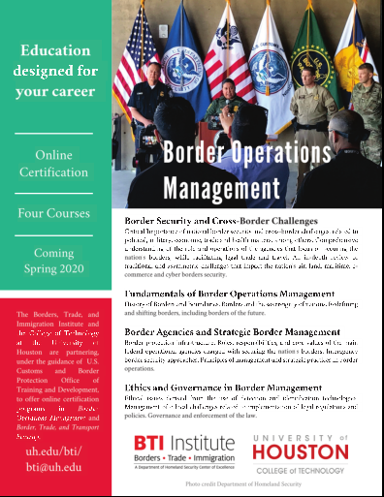
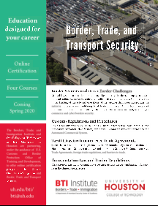
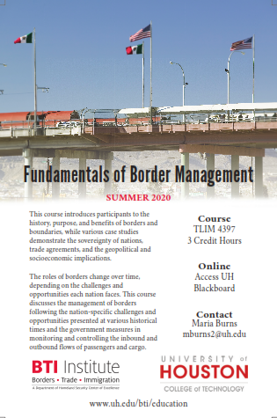
Project overview
New Academic & Continuing Education Programs
2 Certificate Programs
New Courses
Notes:
Address each objective: a) develop course curriculum. b) Design 2 certificate programs

Slide 7
Key Activities
ID | Task title | Q1 |  |  | Q2 |  |  | Q3 |  |  | Q4
 |  | 1 | 2 | 3 | 4 | 5 | 6 | 7 | 8 | 9 | 10 | 11 | 12
T.1 | Needs Analysis
T.2 | Curriculum Plan Development
T.3 | Courses Content Development of eight modules, 20 undergraduate and 10 graduate courses.
T.4 | Instructional Strategies Development for eight modules, 20 undergraduate and 10 graduate courses.
T.5 | Technology-based instructional resources development for eight modules, 40 undergraduate courses and 10 graduate courses
T.6 | Interactive online course building (40 undergraduate courses and 10 graduate courses).
T.7 | Pilot test online modules and courses.
Notes:
* Gantt Chart from Work Plan, page 6.

Slide 8
Approach and Methodology
Gap Analysis
Talent Acquisition
Higher Education Border Security-Related Programs
Program Emphasis | # Programs | %
Socio-cultural, community and linguistic | 7 | 27%
Terrorism studies, international relations and cybersecurity | 7 | 27%
Border ecosystem, activism, and human rights | 5 | 19%
Economic development and politics | 3 | 12%
Intergovernmental relations, public safety, emergency management | 3 | 12%
Maritime transportation and port operations | 1 | 4%
 | 26 | 100%

Slide 9
Instructional Approach and Methodology
        Instructional Strategies for Adult online Learning
          Case-study, problem-based and project-based learning, hands-on interactive student-led activities.
    Technology-Based Instructional Resources:
      Two Learning Management Systems (Blackboard and Canvas), video-lectures, online resources, online communication tools.
  Transversal Competencies
      Communication skills, presentation skills, data- visualization.

Slide 10
Data
Bachelor of Science in Border Operations Management, Trade and Transport Security
Courses Developed for: | University core requirements | College and department requirements | Major core requirements | Prescribed Electives | Total courses
Online delivery | 14 | 4 | 3 | 1 | 22
Face-to-face delivery and need to be converted into online format | 2 | 0 | 3 | 1 | 6
New courses to be developed for online delivery | 0 | 0 | 14 | 0 | 14
Total Courses |  |  |  |  | 42
Notes:
Curriculum Development Process. Please refer to section 4.1 of the Work Plan

Slide 11
Data
Curriculum Development Process
BSc in Border Management, Trade, and Transport Security
Note: Is this table in line with the previous table of slide 10?
Program | Program Level | # Courses | SCH | Comments
BS Degree in Border Operations Management, Trade, and Transport Security | Undergraduate Major | 12 | 36/120 | Includes 8 major core courses and 4 concentration courses
Minors in: Border Operations Management Cross-Border Trade and Transport Security | Minor | 5 | 15 | 15 SCH min with 9 hours of advanced courses
MS Degree in Border Management, Trade and Transport Security | Graduate | 10 | 30 | Online
Certificates in: Border Operations Management and Security Border, Trade and Transport Security | Certificate Programs | 4 | Self-paced | Online Certificate credits count towards degree-granting programs for UH registered students
Notes:
Curriculum plan

Slide 12
Data
Curriculum Development Process
BSc in Border Management, Trade, and Transport Security
Major Core Courses
Introduction to Homeland Security | Border Agencies and Strategic Border Management
Fundamentals of Border Operations Management | Customs Regulations and Procedures
Border Security and Cross-Border Management | National Security Law
Ethics and Governance in Border Management | Capstone Project
Notes:
3.1

Slide 13
Data
Curriculum Development Process
BSc Concentrations
Trade and Transport | Migration | Technology
Transportation Economics and Policy | U.S. Immigration Law & Policies | Cross-Border Security Technologies
Transport Law and Border Regulations | History of Human Migration and U.S. Migration Patterns | Cybersecurity Strategy and Policy
Tariffs Classifications and Free Trade Agreements | Immigration in U.S. Society | Information Security
International Trade Treaties and Conventions | International Landscape of Forced Migration | Intrusion Detection and Incident Response

Slide 14
Data
Course Organization :
Course Content (Textbook) 12 Units (3-5 Thematic Groups ➔ Readings: Online & Printable format
Powerpoint Presentations Video Tutorials Additional Readings
Learning Assessments & Assignments
Online mentoring & guidance. Highly interactive environment
Notes:
6.3 of the work plan Current status

Slide 15
Data
  Course Organization :
  Each unit includes an overview, learning objectives, competences, tools/tutorials, assignments, additional readings, and references.
  Participants will have 14 weeks (1 academic semester) to complete the course: 12 weeks to cover the material, and 2 weeks for the Assessment and the Capstone project.
  Assessments enhance students’ writing skills and comprise segments of the Capstone Project.
Notes:
Methods used for each objective. Please refer to section 4 of the Work Plan

Slide 16
Results
New Academic & Continuing Education Programs
2 Certificate Programs
New Courses
Notes:
Action taken. Results. Address each objective: a) develop course curriculum. b) Design 2 certificate programs

Slide 17
Results
ID | Task title | Q1 |  |  | Q2 |  |  | Q3 |  |  | Q4
 |  | 1 | 2 | 3 | 4 | 5 | 6 | 7 | 8 | 9 | 10 | 11 | 12
T.1 | Needs Analysis
T.2 | Curriculum Plan Development
T.3 | Courses Content Development of eight modules, and 20 undergraduate courses. *The graduate courses are part of another work plan submitted to the DHS. (please advise how to present/phrase this info)
T.4 | Instructional Strategies Development for eight modules, and 20 undergraduate courses and 10 graduate courses .
T.5 | Technology-based instructional resources development for eight modules, 40 undergraduate courses and 10 graduate courses
T.6 | Interactive online course building (40 undergraduate courses and 10 graduate courses).
T.7 | Pilot test online modules and courses.
Notes:
* Gantt Chart from Work Plan, page 6.

Slide 18
Results
  Development of a curriculum plan for a BSc with three concentrations and 42 courses, of which:
23 courses already developed for online delivery by the UH;
4 courses already developed for face-to-face; to be converted into an online environment
2 courses already developed and converted.
2 new courses developed, approved by DHS & offered in Spring/Summer 2020
2 new courses developed in April 2020 & in internal approval process in May 2020.
9 new courses in the development process
Notes:
Actions taken; Accomplishments; Address each objective: a) develop course curriculum. b) Design 2 certificate programs

Slide 19
Results
    The following BSc courses were added in the UH Curriculog (Students Academic Catalog):
      Introduction to Homeland Security
      Fundamentals of Borders Operations Management
      Tariff Classification and Free Trade Agreements
      Cybersecurity Strategy and Policy
      Customs Regulations and Procedures
      Transportation Law and Border Regulations
      Border Security and Cross-Border Challenges
      Border Agencies and Strategic Border Management
      Ethics and Governance in Border Management
(1-4)
Already
added
(5-9)
To be added
by the end
of the project
Notes:
Actions, Accomplishments, Objectives

Slide 20
Results
  T1. Needs Analysis: Reviewed and analyzed 26 higher education institution offerings in the field of Borders and Homeland Security
  T2. Curriculum Plan: Designed a curriculum plan for a Bachelor of Science, two minors and two certificate programs
  T3. Course Content Development: Prof. Maria Burns, Principal Investigator and Subject Matter Expert is developing the Core Courses of the Bachelor of Science.
  T4. Evaluation: Courses will be pilot-tested and evaluated by UH and BTI to gather feedback for quality assurance. (See Appendix B’)
Notes:
Action taken, accomplishments, objectives

Slide 21
Results
  T5. Technology-based instructional resources development:
  33 undergraduate courses and their modules are ready by early May – 7 more to go!
  The work plan for 10 graduate courses has been submitted to the DHS;
  T6. Interactive online course building:
  30 undergraduate courses are ready. The work plan for 10 graduate courses has been submitted to the DHS;
  T7. Pilot test online modules and courses.
  Spring & Summer 2020: 5 courses and one certification program
Notes:
Action taken, accomplishments, objectives

Slide 22

Results: Course Content Development
Major Core Requirements – New Courses
☑ Course 1: Introduction to Homeland Security
☑ Course 2: Fundamentals of Border Operations Management
  Course 3: Border Security and Cross-Border Challenges
  Course 4: Border Agencies and Strategic Border Management
☑ Course 5: Customs Regulations and Procedures
  Course 6: Capstone Project
  Existing Elective Courses:
  ☑ Geography
  ☑ Logistics Technology
  ☑ Security Law
  ☑ Microeconomics
Image: source https://www.thakerlaw.com/wp-content/uploads/2017/01/Border.jpg

Slide 23
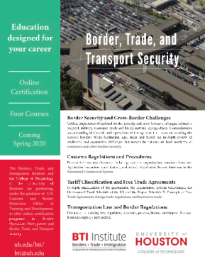
Results: Course Content Development
Offered: Spring & Summer 2020
Major Core Requirements – New Courses
Course 1: Introduction to Homeland Security
  Comprehensive study of the homeland security system
  Structure, operations, programs
  Safeguarding nation from security challenges
  Intensive technical writing course

Slide 24
Results: Course Content Development
Offered: Summer 2020
Major Core Requirements – New Courses
Course 2: Fundamentals of Border Operations Management
  The Genesis and significance of National Borders
  The benefits of having borders in relation to trade, immigration and security
  Sovereignty of nations, geopolitical and socioeconomic implications
  Managing borders in accordance to the nation-specific challenges and opportunities

Slide 25

Results: Course Content Development
Offered: late Summer 2020
Major Core Requirements – New Courses
Course 5: Customs Regulations and Procedures
  The significance of national customs at sea, air, and land ports of entry
  Customs management and the entry process for travelers and cargoes
  The WCO, global harmonization, and customs reform
  Customs laws and regulations: code of ethics & conduct; anti-corruption code; rules of origin, reasonable care, advance notice, etc.
  Operations: a) the entry process: inspections, warehousing, processing times, etc. b) the exporting process: export control, etc. c) documentation.
  Systems and technologies: ACE (single window), cargo scanning technologies, etc.

Slide 26
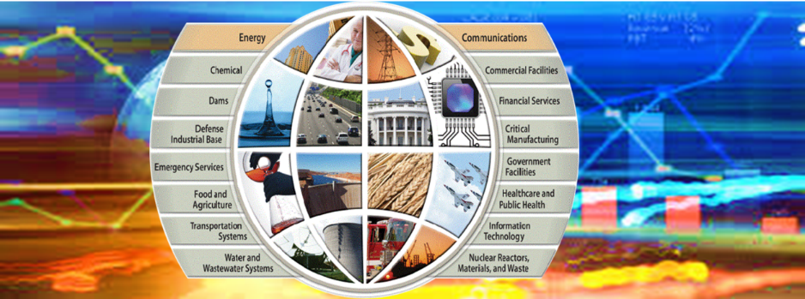
Results: Course Content Development
Concentration on Trade & Transport
Course 7: Transportation Law and Border Regulations
  Course 8: International Trade Treaties and Conventions
  ☑ Course 9: Tariff Classification and Free Trade Agreements
  Existing Course:
  ☑ Transportation Economics & Policy

Slide 27


Results: Course Content Development
Concentration on Trade & Transport
Course 7: Transportation Law and Border Regulations
  Legal systems. Global laws, and organizations for intermodal transportation. International conventions and general average.
  U.S. legal system: Common law and types of transportation law: Administrative departments and agencies (DHS, DOT, FAA, NTSB, FRA, etc.). Federal and State laws. Penalties and non-compliance.
    How the U.S. legal framework regulates borders, diplomatic, and socioeconomic conditions.
    U.S. borders, import/export rules; Carriage of Goods; Hazardous Materials; Insurance.
    Proof of compliance: Contracts, licenses, certification, notifications, and documentation.
  Regulatory framework and industry standards for occupational health, safety, security, quality, and the environment. (HSSQE).
  Conflict resolution: law, mediation and arbitration.
Image source: department of state https://www.state.gov/bureaus-offices/bureaus-and-offices-reporting-directly-to-the-secretary/office-of-the-legal-adviser/office-of-the-assistant-legal-adviser-for-private-international-law/
Image source: https://www.bestlawyers.com/article/transportation-law/1710

Slide 28

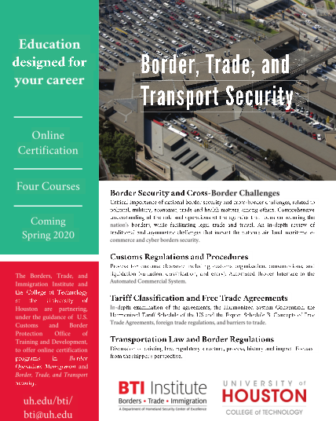
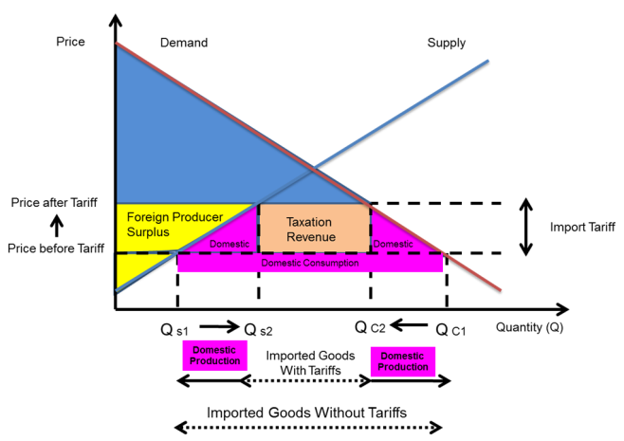
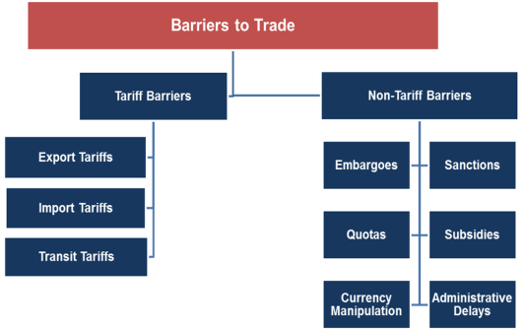
Results: Course Content Development
Concentration on Trade & Transport
Offered: late Summer 2020
Course 9: Tariff Classification and Free Trade Agreements
  Global trade facilitation and development: from GATT to WTO. Trade agreements in the U.S. and the rest of the world.
  Free Trade vs. Protectionism. Tariff Barriers vs. Non-tariff barriers to trade.
  Unfair trade practices. Sanctions, Embargoes, Boycott.
  HS universal classification codes; HTSUS and Schedule B’.
  Export control; export license; Regulations. Red flags, violations and penalties. The Single Control List: USML and CCL. The deemed export rule. Dual use.

Slide 29

Results: Course Content Development
Concentration on Migration
Course 10: History of Migration and U.S. Migration Patterns
Course 11: U.S. Immigration Law & Policies
  Course 12: Global Landscape of Forced Migration
  Existing Course:
  ☑ Immigration in U.S. Society

Slide 30
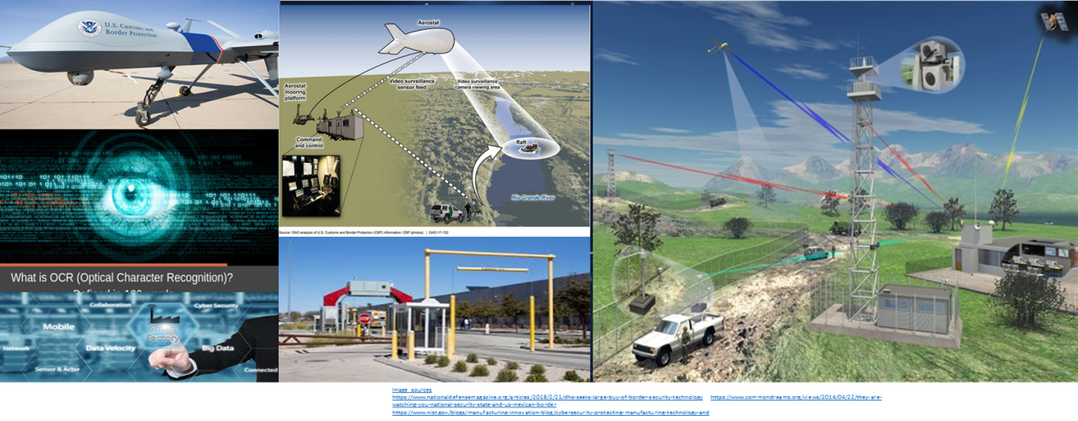
Results: Course Content Development
Concentration on Technology
Course 13: Cross-Border security Technologies
Course 14: Cybersecurity Strategy & Policy
  Existing Courses:
  ☑ Fundamentals of Info Security
  ☑ Intrusion Detection and Incident Response

Slide 31
Results: Course Content Development
Offered: Summer 2020
Continuing Education / Certification Program
  ☑ Introduction to Homeland Security
  ☑ Fundamentals of Border Operations Management
  ☑ Tariff Classification and Free Trade Agreements
  Transportation Law and Border Regulations

Slide 32
Results: Course Content Development
Offered: Fall 2020
Continuing Education / Certification Program
  ☑ Fundamentals of Border Operations Management
  Border Security and Cross-Border Challenges
  Border Agencies and Strategic Border Management
  Ethics and Governance in Border Management

Slide 33
Milestones Achieved
  Developed Instructional approach for course design.
  Developed Curriculum Plan for:
    Bachelor Degree in Border Operations Management, Trade, and Transport Security
    Minor in Border Operations Management
    Minor in Trade and Transport Security
  Submitted curriculum plan for two minors to the College of Technology committee for approval.
Notes:
Accomplishments so far. Within anticipated time frame?

Slide 34
Milestones Achieved
ID | Description | Effort Period | Due Date | Status
M.1 | Needs analysis complete | Q1 | 07/31/2019 | A
M.2 | Curriculum Plan Development: bachelor of science and master’s degree | Q1 | 08/31/2019 | A
M.3 | Course Content Development: eight modules | Q1 | 11/30/2019 | A
M.4 | Course Content Development 20 undergraduate courses and 10 graduate courses | Q2 | 11/30/2019 | IP
M.5 | Instructional Strategies Development: eight modules | Q1 | 03/31/2020 | A
M.6 | Instructional Strategies Development: 20 undergraduate and 10 graduate courses. | Q3 | 03/31/2020 | IP
M.7 | Technology-based instructional resources development: eight modules. | Q1 | 06/30/2020 | A
M.8 | Technology-based instructional resources development: 40 undergraduate courses and 10 graduate courses | Q4 | 06/30/2020 | IP
M.9 | Interactive online course building into LMS (eight modules). | Q1 | 06/30/2020 | A
M.10 | Interactive online course building (40 undergraduate courses and 10 graduate courses). | Q4 | 06/30/2020 | IP
M.11 | Pilot test online modules: *The first course was tested in Spring 2020. Four courses are offered in Summer 2020. The remaining academic and training courses will be offered from Fall 2020 onwards. | Q2 | 06/30/2020 | IP
Notes:
Please refer to section 6.4 of the Work Plan. Accomplishments so far. Within anticipated time frame?

Slide 35
Milestones Achieved
  Two courses are approved and offered:
    Introduction to Homeland Security (Spring & Summer 2020)
    Fundamentals of Borders Operation Management (Summer 2020)
  One course has been developed and is under review/editing:
  3) Tariff Classification and Free Trade Agreements
  Two courses are under development:
  4) Customs Regulations and Procedures (late April 2020)
  5) Cybersecurity Strategy and Policy (late May 2020)
Notes:
Accomplishments so far. Within anticipated time frame?

Slide 36
Deliverables
ID | Description | Effort Period | Status
D.1 | Needs Analysis report | Q1 | ☑
D.2 | Report of Expert Reviewers on course content adequacy | Q1 | ☑
D.2 | BS and MS courses content analysis report | Q2 | ☑
D.3 | Eight online modules developed | Q2 | ☑
D.4 | BS and MS 50 courses completely developed | Q4 | In process
D4:
33 undergraduate courses and their modules are ready by early May – 7 more to go!
The work plan for 10 graduate courses has been submitted to the DHS;
Notes:
6.3 of the work plan (Description table) : status and possible problems

Slide 37
Performance Metrics
ID | Description | Effort Period | Status
P.1 | Needs analysis of the three academic components: certificate programs, bachelor of sciences, and master’s degree. | Q2 | ☑
P.2 | Report of Expert Reviewers on course content adequacy | Q2 | ☑
P.3 | Complete development of eight online modules available through a LMS. | Q2 | ☑
P.4 | Complete development of 40 undergraduate online courses available through a LMS. | Q4 | In process
P.5 | Complete development of 10 graduate online courses available through a LMS. A separate work plan has been submitted to DHS. | Q4 | In process
Notes:
6.2 of the work plan (Description table) : performance metrics (Key Activities and Metrics, within time & budget )

Slide 38
The stakeholders’ section describes certain “decision points”
Decision Points
Courses added to the course catalog as they become available.
Engaging with Dr. Paul Baker as Project Champion, to refine the CBP’s curriculum needs and provide project updates.
Once there was a consensus in content (BTI, CBP and other DHS entities) the courses will be recorded and offered for online distance learning opportunities.
Notes:
Please refer to section 7 of the Work Plan (Stakeholder engagement)

Slide 39
Transition
Wherever applicable, content copyright will be pursued with the assistance of the University of Houston, Division of Research Office of Tech Transfer and Innovation. Concurrent with our efforts, we will initiate the appropriate processes to ensure State of Texas approves to offer these courses in the future. Curricula will be offered by the University of Houston. As we develop this course curriculum we will socialize our efforts publically so that other accredited universities across the United States can position themselves to utilize our product upon completion. We will also work closely with the Project Champion to ensure DHS is positioned to take advantage of this course work.
Moreover, we will promulgate these courses to interested non-US universities across the global commons.
This is the Transition paragraph of the work plan. It does not specify end users, knowledge gap, pains, gains and outcomes – as requested by the template description
Notes:
Please refer to Section 5 of the Work Plan

Slide 40
Transition
End-users of this research:
  DHS (CBP, Border Patrol, USCG, ICE, TSA);
  State Department, DoD, DoT, U.S. Census, etc.
  Professionals related to Customs Border Protection, Border Patrol, Transport, Import & Exports, Diplomacy, Sanctions, Export Control, etc.
Educational/knowledge gap
  Rapid developments require timely educational content;
  New challenges and new laws ➔ the coronavirus pandemic; the trade & travelling crisis; the immigration crisis; the border crisis, etc.;
Main issues the capability/knowledge gap is causing (end-user “pains”)?
  Need for concise educational foundations to address new challenges;
Main outcomes and benefits end-user desires (the “gains”)?
    Concise educational foundations to address challenges;
    Sharing best practices and global case studies ➔ to obtain a broader perspective;
    Enhance Situational Awareness; problem solving; polish soft & hard skills.
This is a new, enhanced version of the Transition paragraph of the work plan. It describes in detail the end users, knowledge gap, pains, gains and outcomes – as requested by the template description
Notes:
Please refer to Section 5 of the Work Plan

Slide 41
Programmatic Risks and Mitigation Plans
  Issue #1: Change of personnel included in the work plan
  The original work plan included 3 personnel members who later resigned (Lopez, Borders, DeLaIsla), and one person on a long-term sick leave (B.Bakash):
  Corrective action & Revision of budget allocation:
  These professionals were replaced as follows:
    Instructional Designer: B. Bakash ➔ M.Pereira-Leon
    Instructional Designer: T.Lopez ➔ K. Porterfield
    Web Project Manager: S.Borders ➔ Y. Holton
    Graphic Designer: A. De La Isla ➔ P. Boedeker
Notes:
Please refer to Section 9 of the Work Plan: Problems, Corrective actions, revisions.

Slide 42
Programmatic Risks and Mitigation Plans
  Issue #2: The Coronavirus Pandemic
  The coronavirus pandemic has impacted the smooth development of this project. Working remotely has led to restrictions involving the University facilities, personnel, and other resources. Coronavirus quarantining has also slowed internet speeds, further impacting our working pace.
  As a result, delays are being experienced in the course development phase of this project, and impacts the Milestones #6, #8, #10, and #11.
  Corrective action & Revision of time line:
  We are kindly requesting your approval for a NCE of 3 months, i.e. September 30, 2020.
  The additional time and the use of unused funds will enable the development of a high-quality content with the existing resources.
Notes:
Please refer to Section 9 of the Work Plan: Problems, Corrective actions, revisions.

Slide 43


Thank You !

Slide 44
Appendix A’: Students’ Accomplishments
Prepared Posters to be presented in the following events:
University’s Provost Office: Annual Research Events
  (Spring, Summer, Fall Research days)
Port of the Future Research Day

Slide 45
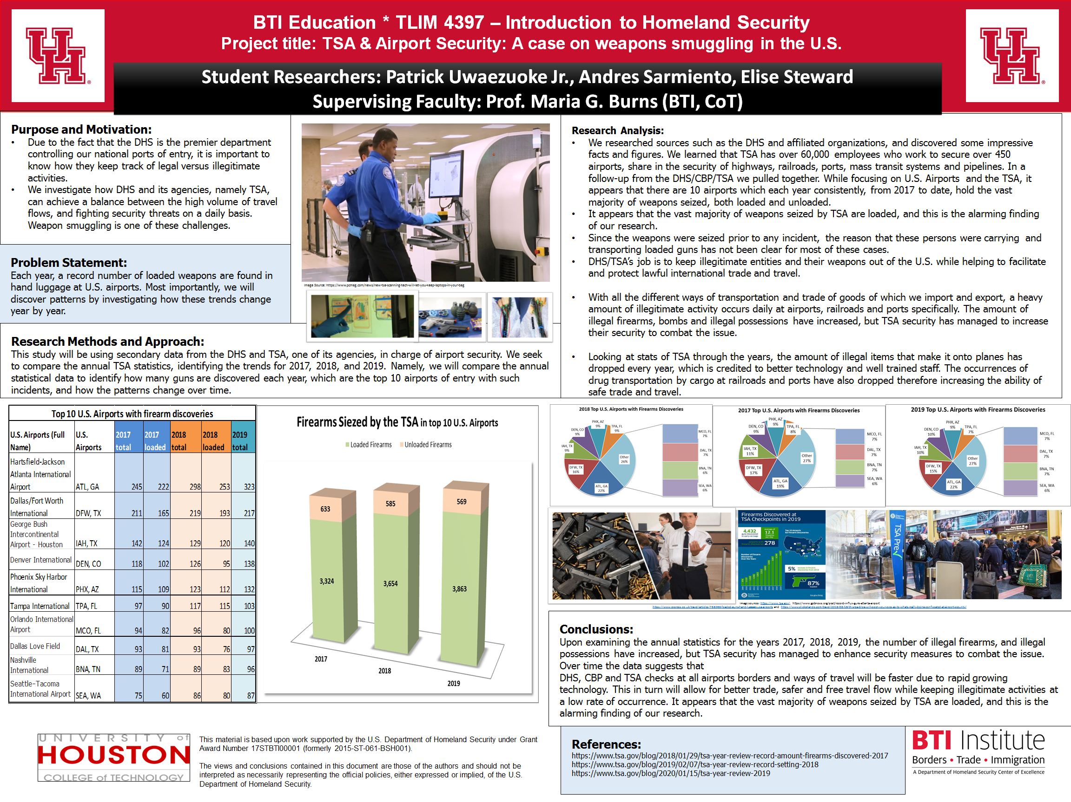

Slide 46
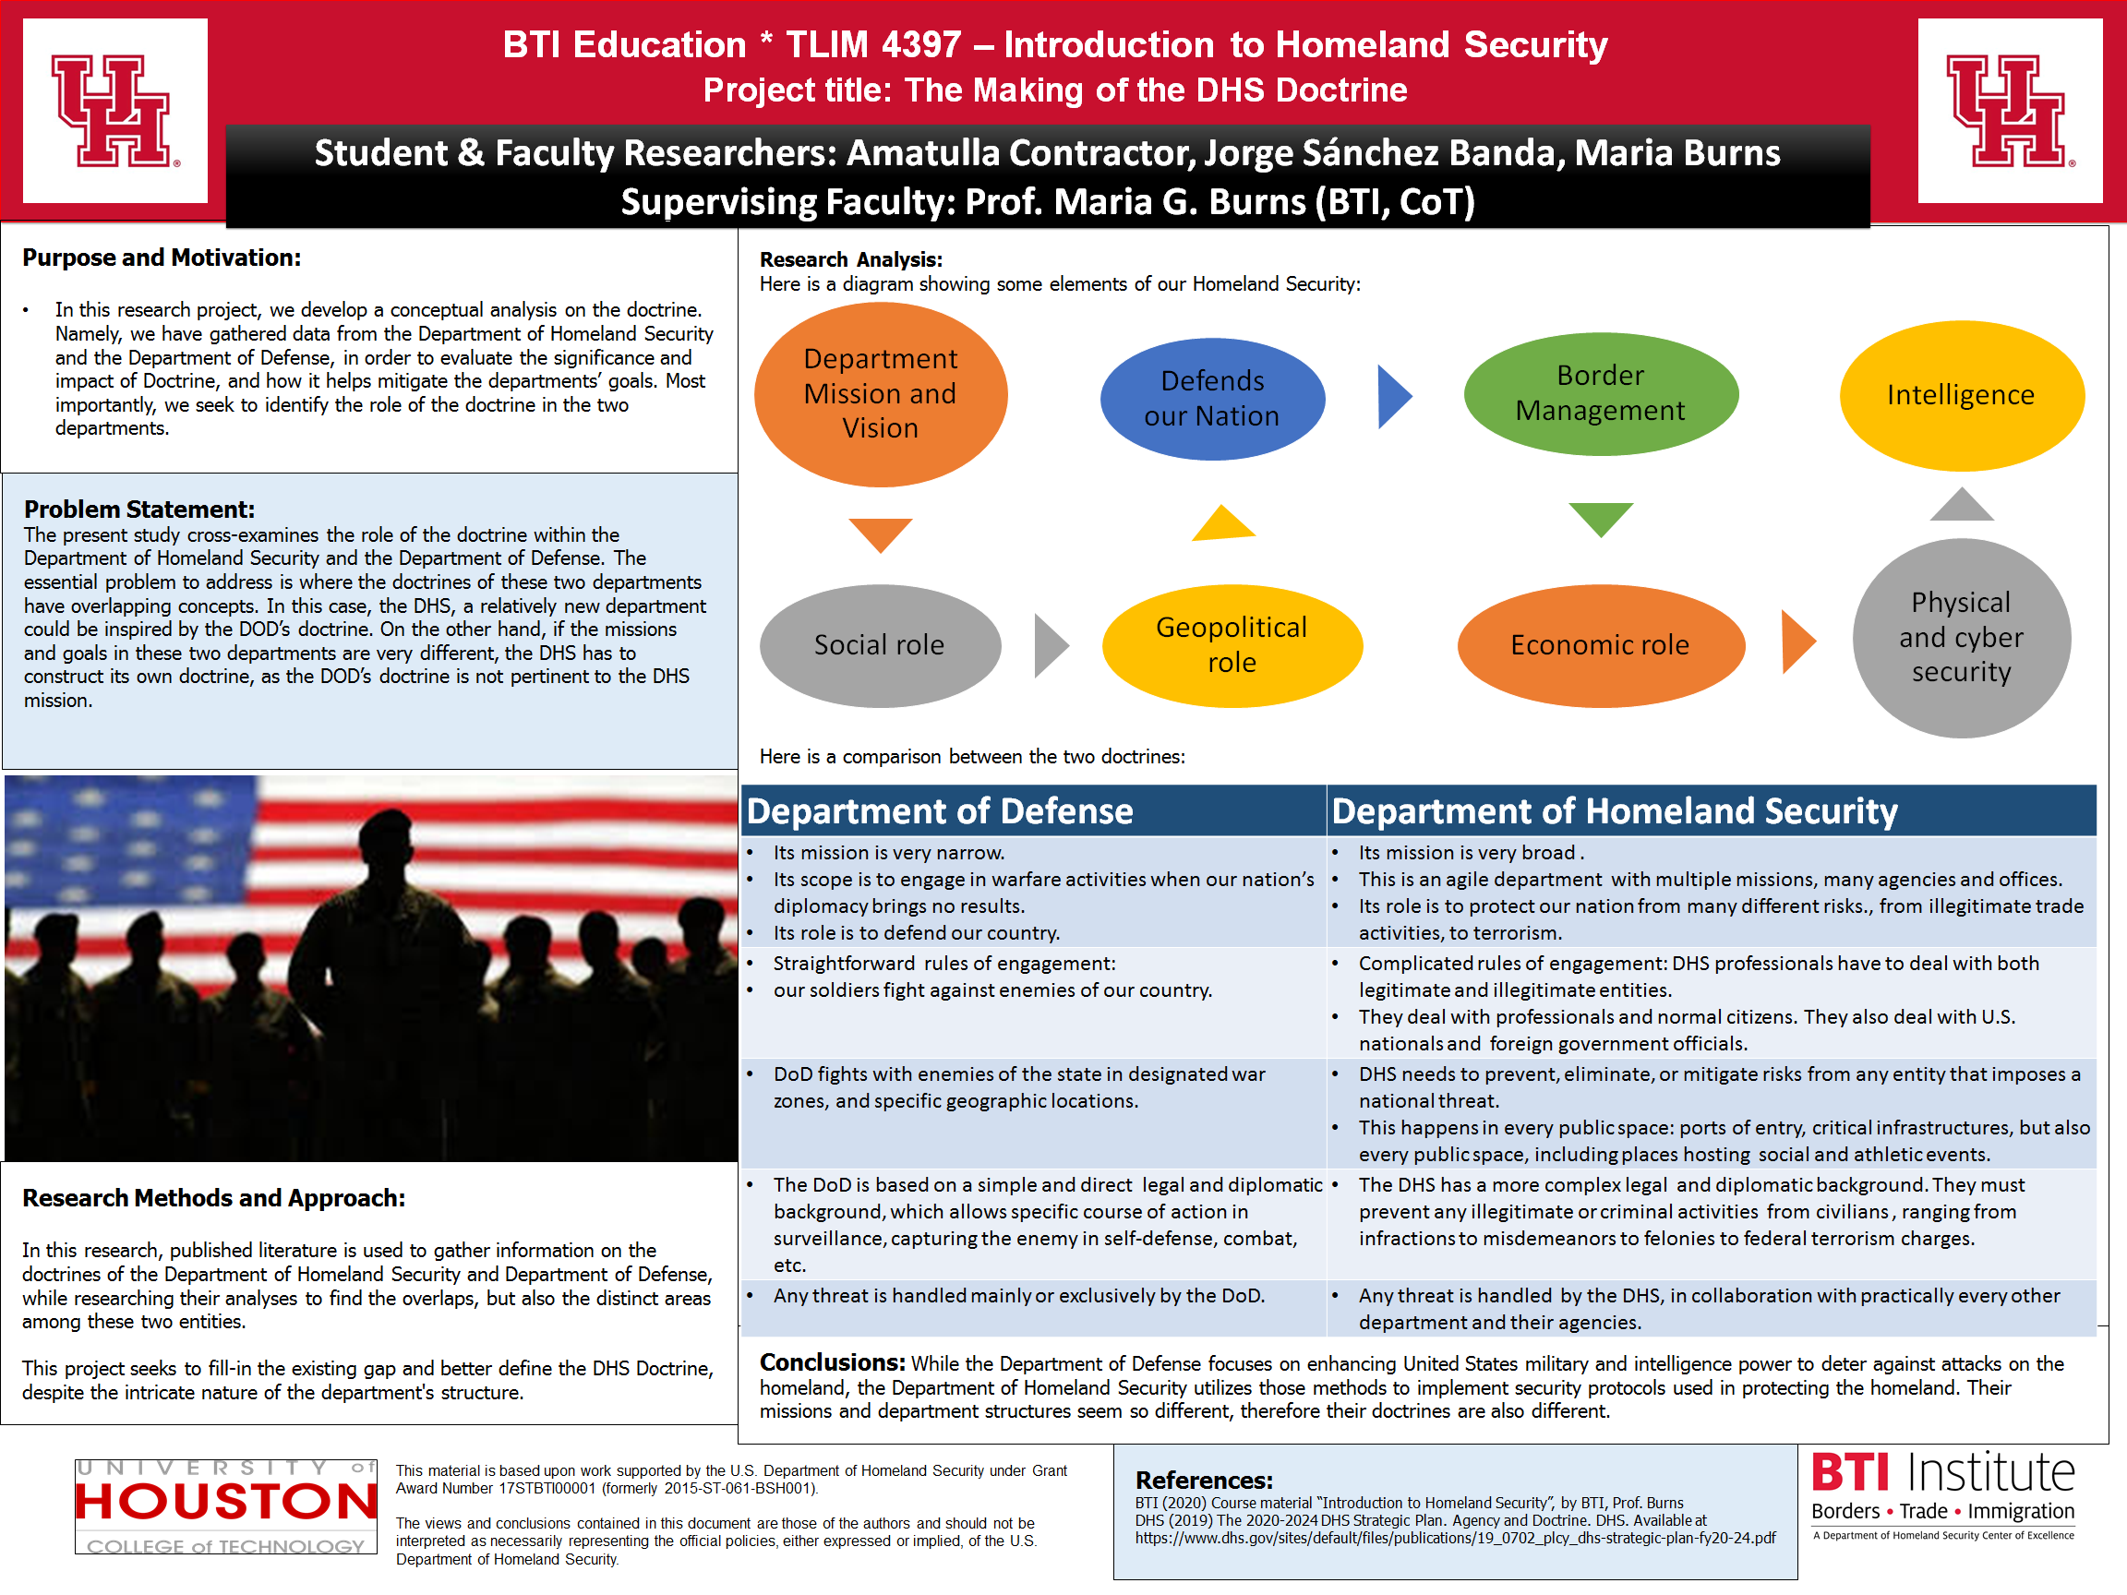

Slide 47
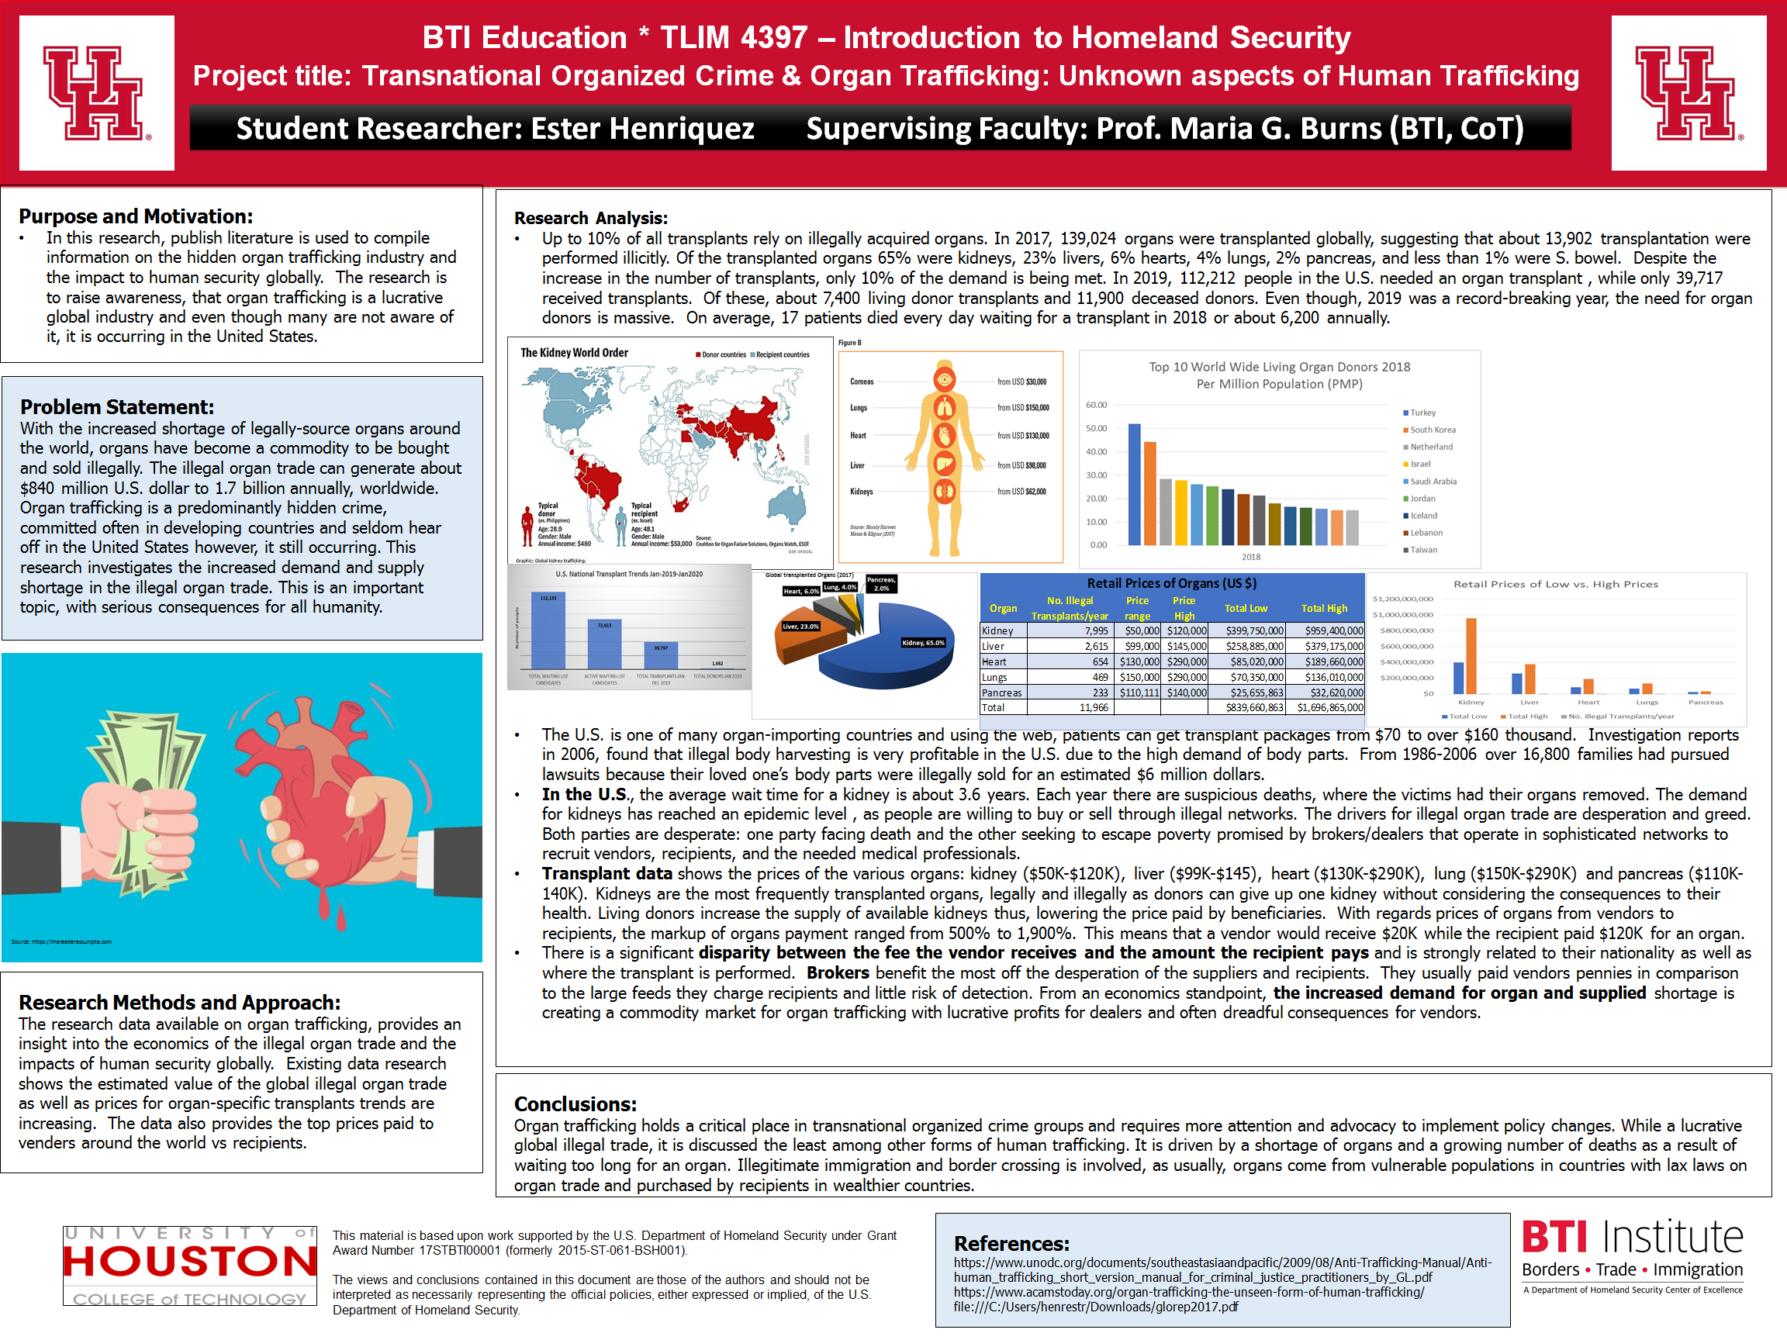

Slide 48
Appendix B’: Students’ Evaluations
Pilot course “TLIM 4397 - Introduction To Homeland Security”
This is a deep dive into what makes the Department of Homeland Security thrive and take on new challenges this world presents. The material provided in this course is great. There are videos, links and other study materials given to where you can get a full grasp of Homeland Security. Professor Burns is very communicative and is there to help when needed.
You can tell the professor takes pride in how she teaches and conducts her online environment. The expectations are clear, and the schedule is known through the Syllabus provided. I enjoy this class because it gives me a greater understanding on how broad of a spectrum Homeland Security covers.
The class had been very well put together and encouraging to learn about DHS and the branches of it. I like that we receive well informed feedback on our assignments a day or 2 after submission. The feedback is done positively, which is what I like best even if it highlights a mistake of mine. Overall the class has been productive and informative thus far, with a professor who strives to help students in all ways possible!

Slide 49
Appendix B’: Students’ Evaluations
Pilot course “TLIM 4397 - Introduction To Homeland Security”
The Introduction to Homeland Security course has to this point in the semester been a revealing experience into the framework of the Homeland security enterprise. The material provided by the Professor Maria Burns in such a concise manner using videos has allowed for greater grasping of the course materials. The ability to absorb large amounts of information in such a short period of time has made this course enjoyable and informative.
The presentation of the course in such manner resembles a series of documentaries that allow students to explore the Homeland security enterprise by giving us the background and the causes that led to the formation of the DHS.
The assignments and assessment for this course have proven to be challenging but have provided me with access to understanding the different agencies and their functions towards the greater purpose of safeguarding the U.S. Recognizing the makeup of the DHS has been greatly emphasized due to the broad spectrum of responsibilities agencies undertake for the well-being of the American public.

Slide 50
Appendix B’: Students’ Evaluations
Pilot course “TLIM 4397 - Introduction To Homeland Security”
The course has so far provided me a simple outlook into the realm of homeland security: what it entails, and their purpose thought the various agencies that compose the DHS. The course has inspired interest for a future career within U.S. Citizenship and Immigration Services which administer the legal immigration system and processes immigration applications from people around the globe.
This course has been pretty interesting and informative for me in learning the background aspect of what makes up each department within the DHS. So far, this course is preparing me to know basic information, such as mission statements, purposes and goals. This course will still allow me to pursue my ultimate goal, working with DHS or other parts of the government. I believe I will have an advantage over a lot of my peers who are competing for the same opportunities.

Slide 51
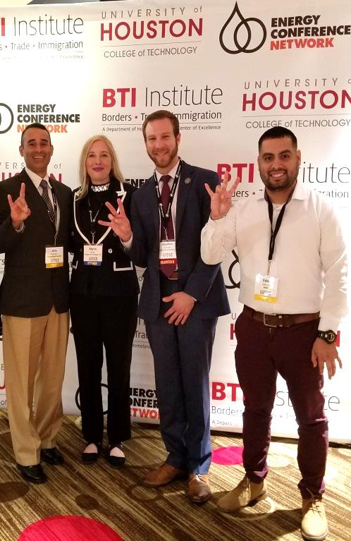
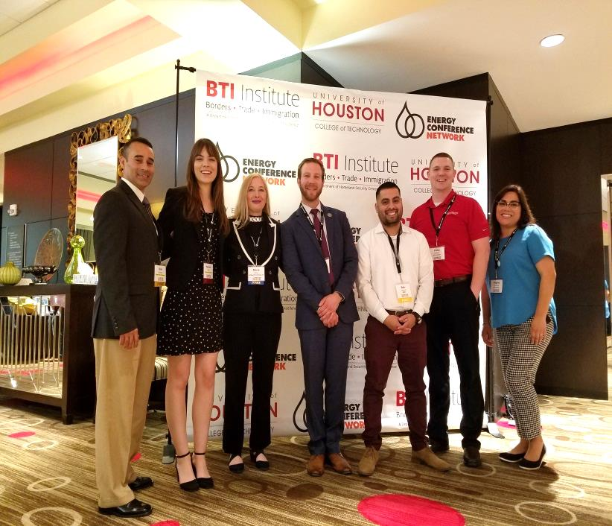
Appendix C’: Video
Presenting the Program to the Ports of the Future Conference (March 2020)
Ports of the Future Conference (March 2020)
Workforce Development Panel titled “Intermodal Connectivity”.
The status of the Curriculum Development project is presented by:
Dr. Maura Pereira De Leon, BTI Education Manager; and
Prof. Maria Burns, Principal Investigator of the Curriculum Development project.
Link: https://www.youtube.com/watch?time_continue=112&v=1-3iQqXLLgI&feature=emb_logo

