Slide 1

myUH
Announcing
A New Feature to Upload Documents to Your To Do List
________________
Your access to admissions status, academic records, financial aid and financial services online.

Slide 2
Uploading General To Do List Items
Applicants and students can now take advantage of a convenient new process to upload certain To Do List item documents via their myUH self-service account.
This new process eliminates the need for applicants/students to wait in lines to submit paper documents to resolve items on their To Do List.
Applicants and students can upload documents from the comfort of their home or any other place that is convenient for them.
This presentation outlines the process for
uploading the Bacterial Meningitis (BACMEN) form.

Slide 3
Uploading a BACMEN To Do List Item
A few notes to remember:
Beginning January 2014, Texas State Law SB 62 mandates that all entering students under the age of 22 submit:
  a certificate signed by a health care provider or,
  an official immunization record verifying vaccination against bacterial meningitis, or has received a booster during the five years prior to registration,
  proof of approved conscience exemption from the Texas Department of State Health Services.
Students must complete the PROOF OF BACTERIAL MENINGITIS IMMUNIZATION COMPLIANCE form which may be conveniently uploaded to their To Do List through their Student Self Services.

Slide 4
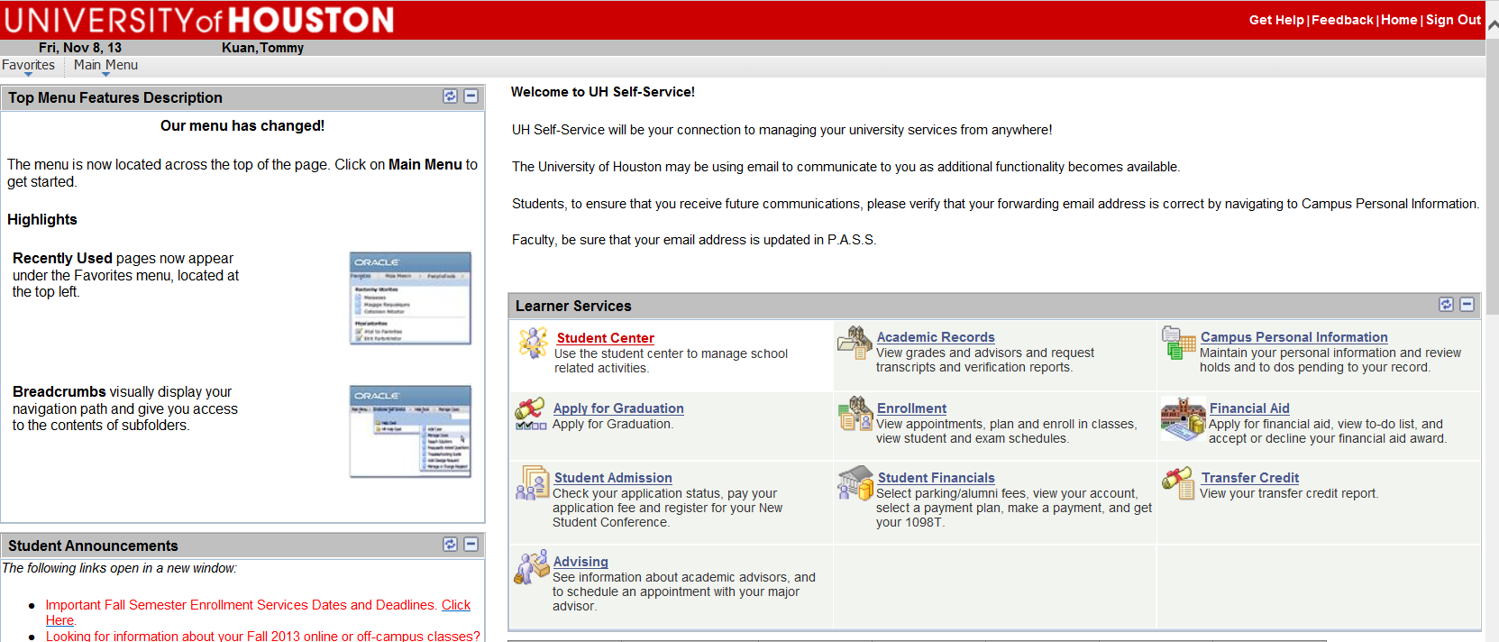
Uploading a BACMEN Form
Step 1:
  Navigate to the Student Center (See Figure 1).
Figure 1

Slide 5
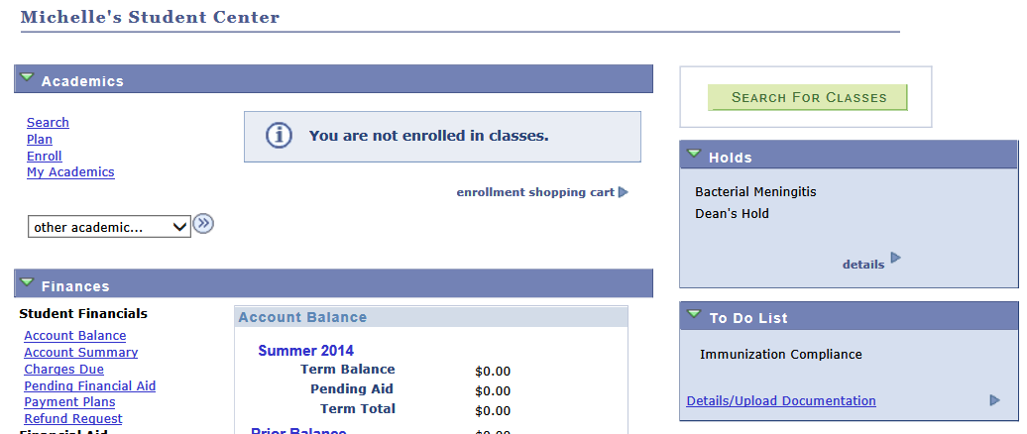

Uploading a BACMEN Form
Step 2:
Notice in the Holds area the “Bacterial Meningitis” item and in the To Do List the “Immunization Compliance” item. (See Figures 2a and 2b).
Figure 2a
Figure 2b

Slide 6
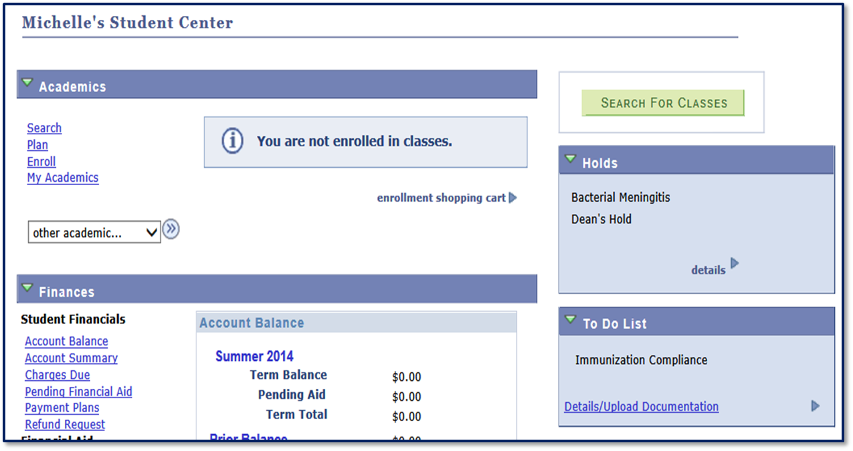
Uploading a BACMEN Form
Uploading a BACMEN Form
Step 3:
To start the document upload process, click on the “Details/Upload Documentation” link (See Figure 3).
Figure 3

Slide 7
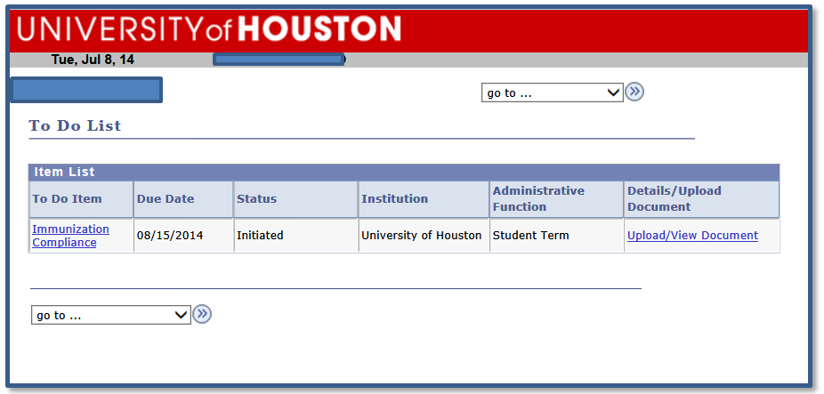


Uploading a BACMEN Form
Step 4:
Click the “Upload/View Document” link (See Figures 4).
Figure 4

Slide 8
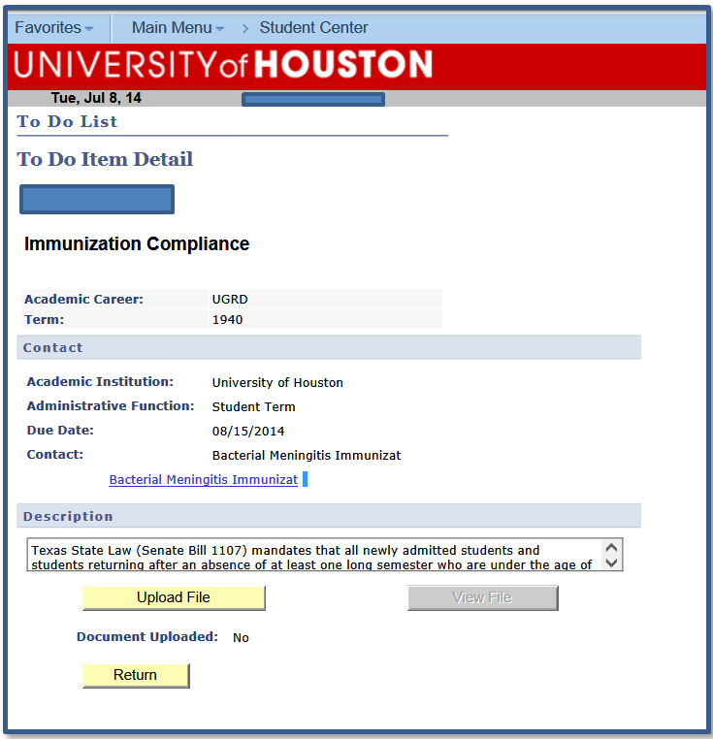
Uploading a BACMEN Form
Step 5:
Click the “Bacterial Meningitis Immunization” link (See Figure 5).
You will be directed to the Bacterial Meningitis Immunization page where you will find information about BACMEN regulations, your compliance responsibilities, and the BACMEN Compliance Form for you to complete and submit.
Figure 5

Slide 9
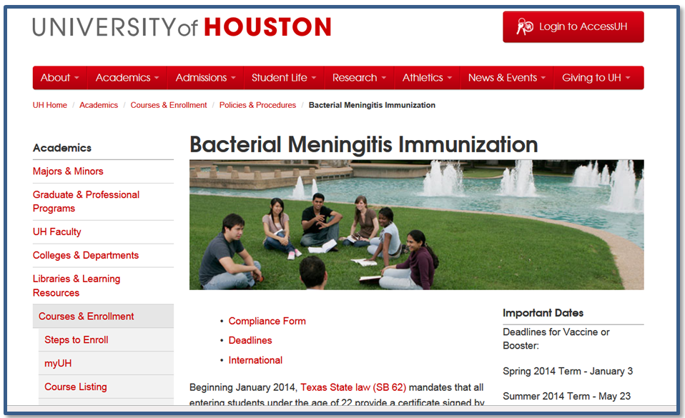
Uploading a BACMEN Form
Step 6:
Read the “Bacterial Meningitis Immunization ” information.
You will see a link to download the BACMEN Compliance Form; Click on the “Compliance Form“ link to download the BACMEN Compliance Form (See Figure 6)
Figure 6

Slide 10
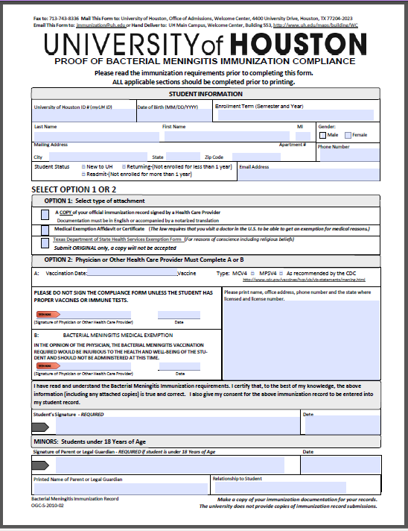
Uploading a BACMEN Form
Step 7:
Complete the form (with signature) and save it to your computer or other storage device.
Note: See Step 9, Figure 8, for information about the PDF file naming rules which must be followed for a successful upload.

Slide 11
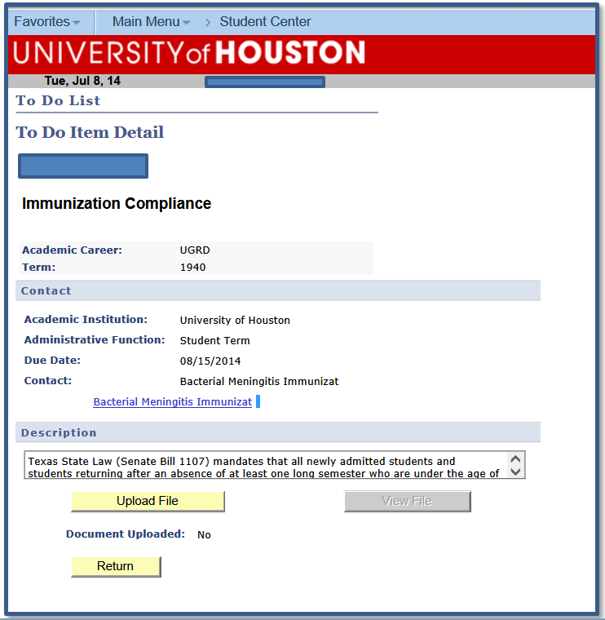

Uploading a BACMEN Form
Step 8:
After saving the Bacterial Meningitis Immunization Compliance form, close the form and you will be returned to the “To Do List Item Detail” page.
Click “Upload File” when you are ready to upload your document and follow the instructions (see Figure 7).
Figure 7

Slide 12
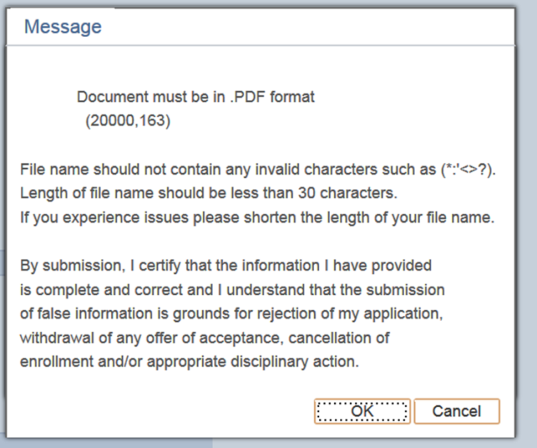
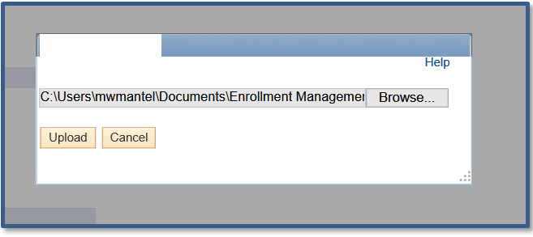


Uploading a BACMEN Form
Step 9:
View instructions for file type format and then click “OK” (See Figure 8).
Click “Browse” to locate the BACMEN Compliance form that was just completed and saved. (See Figure 9).
Figure 8
Figure 9

Slide 13
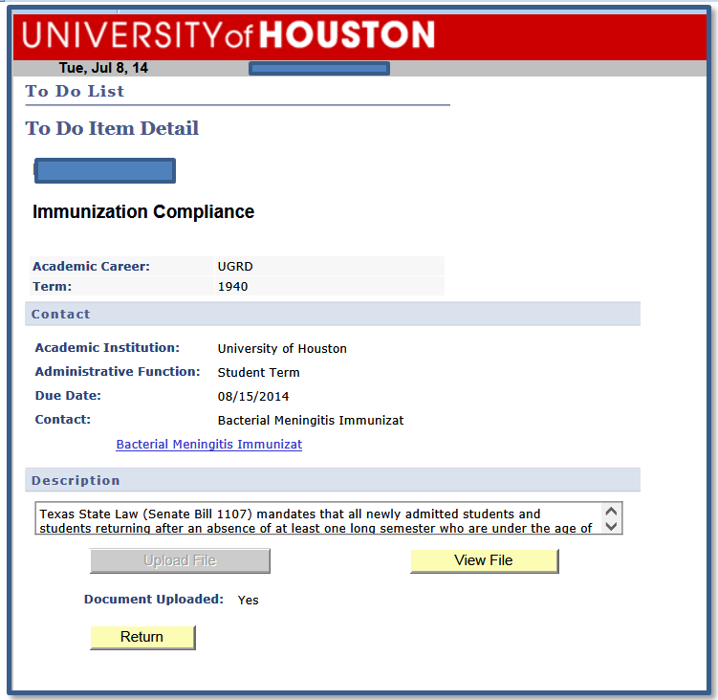


Uploading a BACMEN Form
Step 10:
When the upload is complete, a message indicating that the document upload was successful will appear.
Click “View File” to confirm that the correct BACMEN Compliance was uploaded.
Click “Return” to go back to your To Do List.
Successful upload!

Slide 14
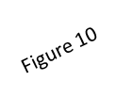

Uploading a BACMEN Form
Step 11:
NOTE: When you return to the Student Center page, you will notice that the “Holds” area still displays the “Bacterial Meningitis” notification (see Figure 10) and the “Immunization Compliance” item remains on the To Do List (see Figure 11). This is normal; an administrator has been notified by the system that your Compliance Form has been uploaded and is ready for review.
After confirming the upload is correct and compliant with state law, the administrator will clear the “Bacterial Meningitis” item form your “Holds” area and the “Immunization Compliance” item from your To Do List.(See next slide).
Figure 11

Slide 15
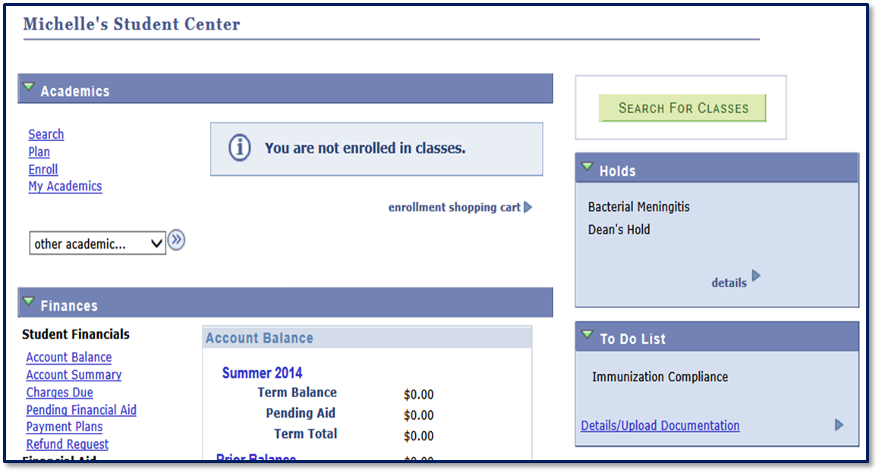
Uploading a BACMEN Form
Step 12:
Student Center Page – BACMEN “Hold” & Immunization Compliance “To Do List” items cleared.

Slide 16
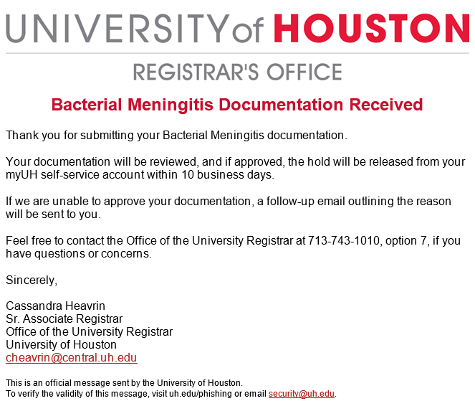
Uploading a BACMEN Form
You will receive a confirmation email that your Bacterial Meningitis Immunization Form has been received and is being reviewed.
Scott Sawyer
University Registrar

Slide 17
Uploading Other To Do List Items
Don’t Forget!!
Applicants and Students can now take advantage of a convenient new process to upload certain To Do List item documents via their myUH self-service account.
This new process eliminates the need for Applicants and Students to wait in lines to submit certain paper documents to resolve items on their To Do List.
Applicants and Students can upload documents from the comfort of their home or any other place that is convenient for them.

