Slide 1
Are You Smarter than a Texas 11th Grader?
Debbie Kiesel
East Texas College Readiness Special Advisor
Stephen F. Austin State University

Slide 2
Current Assessment Program
Texas Assessment of Knowledge and Skills (TAKS)
TAKS Grades 3-11
3 million+ tested in 2009
Special TAKS Forms (Special Education, English Language Learners)
TAKS in Spanish 3-5
Reading: 57,000 Math: 46,000
TAKS College Readiness 2009 (230,000+ seniors)
63% met ELA standard
62% met Math standard

Slide 3
New Assessment Program
State of Texas Assessments of Academic Readiness (STAAR)
More rigorous than TAKS
Aligned to readiness standards
Grades 3-8
Math, Science, ELA, Social Studies
In same grades/subjects as TAKS
High School
Twelve end-of-course tests
Graduation requirement

Slide 4
STAAR Assessment Program
EOCs
English I, II and III, Algebra I and II, Geometry, Biology, Chemistry, Physics, World Geography, World History, U. S. History
9th grade
Students starting 9th grade in 2011 take all twelve EOC tests
Graduation requirement: pass all twelve tests, achieve cumulative score for all courses in each of four foundation areas
TSI
English III and Algebra II will replace 11th grade TAKS measures
Will begin for Seniors 2015

Slide 5
STAAR vs. TAKS Tests
“Fewer, clearer, deeper” focus in all assessment areas
Emphasis on preparedness for next grade or subject
Linked to standards for college and career readiness (CCRS)

Slide 6
Implementation Timeline
 | 2011-2012 | 2012-2013 | 2013-2014 | 2014-2015
Grade 9 | STAAR EOC | STAAR EOC | STAAR EOC | STAAR EOC
Grade 10 | TAKS | STAAR EOC | STAAR EOC | STAAR EOC
Grade 11 | TAKS | TAKS | STAAR EOC | STAAR EOC
Grade 12 | TAKS* | TAKS* | TAKS* | STAAR or TAKS*
*Out-of-school and 12th-grade re-testers may take TAKS
Great source for more information: http://www.tea.state.tx.us/student.assessment/hb3plan/

Slide 7
How Will Changes Affect TSI?
House Bill 3 changed TSI as follows:
“A student who has completed a Recommended or Advanced high school program. . . and demonstrated the performance standard for college readiness on Algebra II and English III end-of-course assessments is exempt from the requirements of this section with respect to those content areas.” [TEC §51.3062 (q-1)]

Slide 8
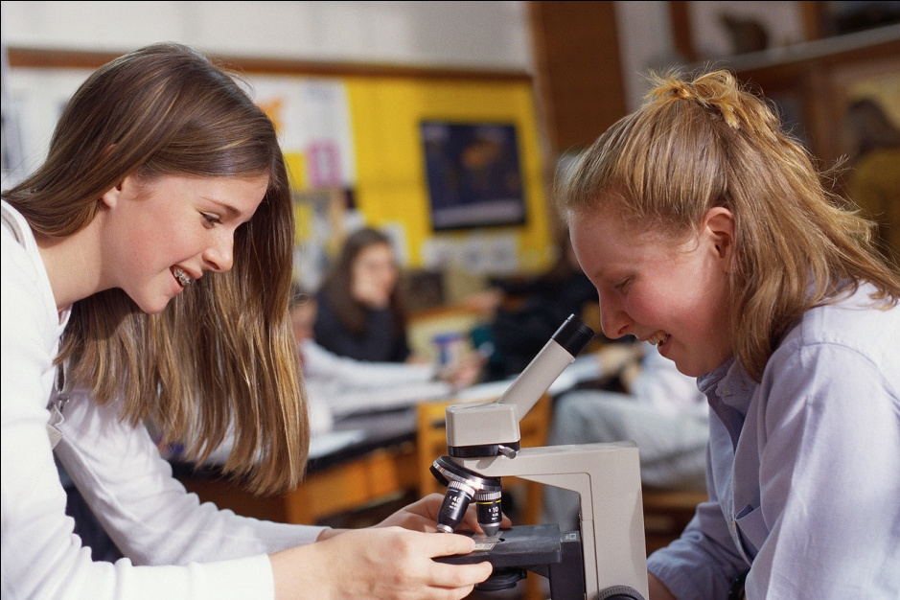
Check Our Progress
What is TAKS?
What is STAAR?
What’s an EOC?
What are CCRS?
Remember: students who began 9th grade in 2011 or later will take
all twelve end-of-course exams in order to graduate.

Slide 9
College/Career Readiness Standards (CCRS)
Developed by four vertical teams of public and higher ed faculty
Standards set for Math, Science, Social Studies, English/Language Arts
Cross-disciplinary standards also set

Slide 10
Why Develop the CCRS?
Proportion of population with a college credential is declining in Texas
CCRS will raise the bar for academic rigor throughout state
Better preparation means more success in college and the workforce

Slide 11
Purpose of CCRS?
Help families, educators and students understand college/career readiness expectations
Prepare students for the assignments and expectations they will encounter when starting college or technical training

Slide 12
Purpose of CCRS?
Help students prepare for successful transition to postsecondary education
Improve alignment and connection between secondary and postsecondary educational systems

Slide 13
What Comes Next?
TEA and THECB set performance measures on new STAAR exams (March 2012)
Seniors of 2015 will have multiple ways to show college readiness, including STAAR results in 11th grade
Meeting standard means no remediation required at a public college/university before taking intro-level course

Slide 14
What Comes Next?
State-funded initiatives to strengthen and diversify developmental education
Ongoing training and professional development for educators
Outreach to inform students/parents
Upcoming alignment of approved TSI assessment(s) with CCRS in 2013

Slide 15
CRAs: College Readiness Assignments
More than 60 assignments, field-tested for use by educators
Will help students and families better understand readiness concepts
Aligned with standards and new assessments (STAAR, TSI testing)

Slide 16
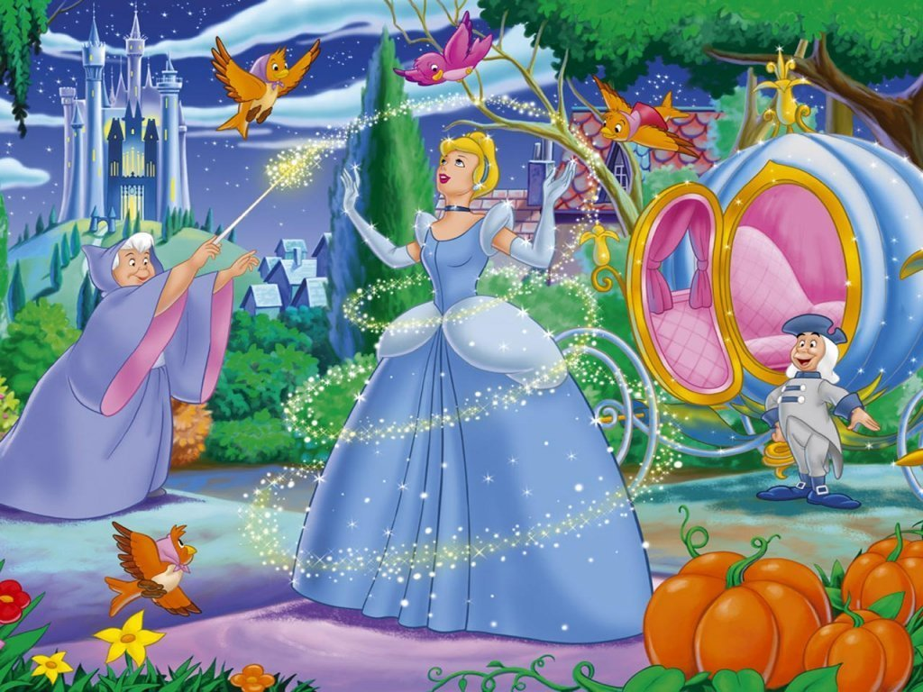
Our CRA Task: Literary Analysis of the Cinderella Story

Slide 17
Levels of Questions for Literary Analysis Assignments
4: Evaluating & Synthesizing
3: Analyzing
2: Applying
1: Understanding

Slide 18
Cinderella: Level 1
Search for the literal answer. There is one right answer, and it can be proven.
How many stepsisters did Cinderella have?
How did she get to the ball?
What kind of shoes did she wear to the ball?

Slide 19
Cinderella: Level 2
Apply text to make interpretations, draw conclusions, make predictions, etc.
What conclusions can be drawn about the prince from his actions after Cinderella leaves the ball?
Are Cinderella and the prince likely to live happily ever after? Why or why not?

Slide 20
Cinderella: Level 3
Which components of the text create overall tone and theme?
How do ashes symbolize Cinderella’s life after her father died?
Analyze the diction used by her stepmother and by the prince to address Cinderella.

Slide 21
Cinderella: Level 4
Display significant conceptual understanding, make connections.
What implications do tales like “Cinderella” have for gender roles in societies that teach these tales to children?
How is the conflict in “Cinderella” like or unlike the conflict in “Romeo and Juliet”?

Slide 22
Four Levels of Readiness
4: Exceeding College Ready
3: College Ready
2: Approaching College Ready
1: Initiating College Ready

Slide 23
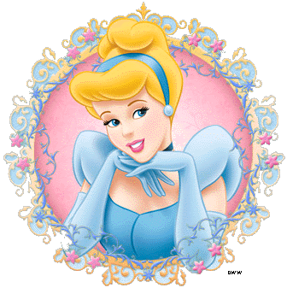
Are We College Ready?

Slide 24
College Readiness Skills
Develops multiple questions at varying levels to advance his/her and others’ understanding
Listens and engages others in discussion
Cites valid examples from the text to support interpretation of pivotal events
Puts forth a persuasive argument, backed by analysis, about the story’s meaning
Communicates and interprets information accurately throughout discussion and writing

Slide 25
College Readiness Skills
Identifies literary elements like irony and symbolism correctly and notes their importance in understanding the work’s theme
Creates clear thesis statement and lists examples in logical groupings
Determines best order for presenting major/minor points in text analysis
Submits a final work product that reflects a thorough understanding of the topic and meets all requirements of the assignment

Slide 26
Resources Provided
Copy of CCRS as adopted
Presentation slides
THECB Overviews: Texas CCRS and Transforming Developmental Education
THECB Publication: “Texas College and Career Ready”

Slide 27
Upcoming Event
Second Annual College Success Summit
July 12-13, 2012 in Austin
Co-hosted by Texas Woman’s University
Coordinated by Regional College Readiness Special Advisor Barbara Lerner
Explore promising practices related to first year seminar, peer instruction, faculty engagement, and student-centered instruction
See www.thecb.state.tx.us/appnewsletters

Slide 28
Thank You!
Debra R. Kiesel
Director, Academic Advising Center
Stephen F. Austin State University
kieseldk@sfasu.edu
936-468-5803

