Slide 1
Workshop 6: Teaching with Technology
Introduction: Kay Porter
The Pros and Cons of Using Facebook in the Classroom: Aaron Milstead
The Flipped Classroom: Kristin Thomas
Using Online Tools and Audio Commentary: Dr. Elizabeth Tasker

Slide 2
Empowering Education Through Technology

Slide 4
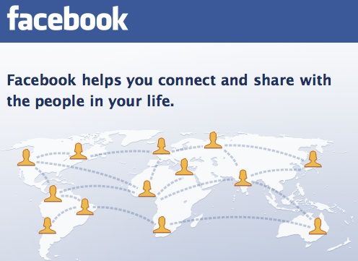

Slide 5
The Pros and Cons of Using Facebook in the Classroom

Slide 6
The Flipped Classroom

Slide 7
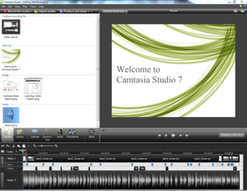
Using Online Grading Tools and Audio Comments

