Slide 1
Teaching Writing 2012
Multi-modal Mixed-media Methods for Teaching Composition
Elizabeth Tasker
Assistant Professor
SFA Lower Division Writing Program Administrator

Slide 2
Background
Funded by a grant from the Texas Higher Education Board Success Initiative.
Summer 2010 – Tasker and Thomas conducted a literature review on college writing readiness.
Summer 2011 – First annual Teaching Writing summer symposium at SFA.
Summer 2012 – Second annual Teaching Writing summer symposium will be held at SFA.
Fall 2012 – roll out of Composition in the Pineywoods website.
Future?

Slide 3
Special thanks to
Deb Kiesel, SFA Director of Academic Advising
Mark Sanders, SFA English Department Chair

Slide 4
What we did at our first symposium: Teaching Writing 2011
DAY 1
Morning – Teaching College Readiness
Afternoon – Teaching the Personal Narrative
DAY 2
Morning – Teaching Summary and Exposition
Afternoon – Teaching Analysis
DAY 3
Morning – Teaching Synthesis
Afternoon – Teaching Argument
DAY 4
Morning – Teaching Research
Afternoon –Teaching the Short Story

Slide 5
Focus for Teaching Writing 2012: Multi-modal Mixed-media Methods
DAY 1
Morning – Visual Composition Strategies
Afternoon – Prezis in the Composition Classroom
DAY 2
Morning – Collaborative Learning to Maximize Critical Thinking
Afternoon – Harnessing Students’ Own Technology as a Teaching Tool
DAY 3
Morning – Composing a Profession: Case Study of Writing and Nursing
Afternoon – Technology in the Classroom Roundtable
DAY 4
Morning – Teaching Developmental Writing
Afternoon –Teaching Poetry

Slide 6
National Findings
One-third of high school students planning to attend college do not meet the readiness standards for college composition courses (ACT 2005)
70% of secondary school students “low-achieving” writers (National Assessment of Educational Progress 2007)
Of 1,500 surveyed high school graduates from the class of 2010, 33% say their high school should have done a better job preparing them for college-level work (College Board 2011)

Slide 7
Survey of College Teachers
65% think high school standards do not prepare students for college:
High school curriculum is not aligned to college requirements.
High school is focused on too wide of a coverage of topics.
More focus is needed on rigorous critical thinking, big ideas in key content areas, and academic behavior and work habits.

Slide 8
Critiques of College Classes
Longitudinal study of student performance across six U.S. colleges:
Only 45% of students showed improvement on test scores by the end of sophomore year.
36% of seniors did not improve significantly.
Half of the students were not required to write a total of 20 pages for any class throughout college.
One third were not required to read more than 40 pages per week for any class.

Slide 9
Ground Truth: your own experiences with students

Slide 10
The stuff of our jobs today:

Slide 11
What is multimodality?
Modes - “ways of representing information” e.g., words, sounds, images, animation
Media -“the ‘tools and material resources’ used to produce and disseminate texts” e.g., books, tv, computers, pencils, human voice
Genres – kinds of texts or artistic productions, e.g., novels, songs, reality shows, essays, cartoons, films, paintings, sculptures

Slide 12
Modes of Learning
What we Read
What we Hear
What we See
What we both See and Hear
What we Discuss with others
What we Experience
What we Teach someone else

Slide 13
“The modes” of discourse (now viewed as methods of paragraph development)
Narration
Description
Exposition
Argument
Definition
Process
Example
Classification and Division
Compare/Contrast
Cause and Effect

Slide 14
21st century literacy

Slide 15
Multimodality and Composition Pedagogy
Modes of Learning
+
Modes of Discourse
+
Literacy

Slide 16
Historic Trends in Composition Pedagogy
Early 20th century - Current Traditional Model “the modes”; product focused
Later 20th century - Process Pedagogy skills-based (invention, drafting, revision) and expressivist, cognitive, or rhetorical focus
The past two decades – Post Process “the social turn”; writing as service (pre-service, in-service, service learning, mentoring, peer review)
Now?

Slide 17
Current State of Composition
NCTE 2008 guidelines: effective composition pedagogy is holistic, authentic, varied, and collaborative
Multimedia, multimodal
Recent trends:
Primary research (enabled by digital tools)
Explication of cultural material; objects
A reconsideration of aesthetics?

Slide 18
Think, Write, Share
Your greatest strength as a teacher
Your classroom compared to an object or entity (using either metaphor or simile)
A multi-modal or mixed-media activity or technique to try in your classroom
Introduce yourself and share some piece of the information from above (in one minute or less).

Slide 19
Our Approach to College Readiness
A regional model with the university as a hub
Multiple, collaborative, grass roots projects
Sharing of ideas across departments and institutions
Involvement of instructors, students, tutors, and other direct stakeholders
Longevity: a multi-year regional effort

Slide 20
Let’s collaborate!
pwcomp.sfasu.edu

Slide 21
Let’s take a break!
Resume in 30 minutes.

Slide 22
Workshop 1: Visual Composition Strategies
Visual Invention
Poster design
Story boarding
Mixed-media notebooks
The Lesson of Objects (Hesse, Sommers, and Yancey)
Exercise: Critical reading and information design

Slide 23
Poster Design

Slide 24
Storyboarding

Slide 25
From two students’ satire notebooks

Slide 26
From a student’s satire notebook on Education

Slide 27
From a student’s satire notebook on Education

Slide 28
From a student’s satire notebook on Institutions

Slide 29
From an student’s satire notebook on Institutions

Slide 30
Satire notebook on “states of nature”

Slide 31
Entry on reason and mankind

Slide 32
Satire notebooks on Gender

Slide 33
Entry on the female stereotype

Slide 34
Entry on lesbianism

Slide 35
Entry on masculinity

Slide 36
Entry on the “soft side of bravery”

Slide 37
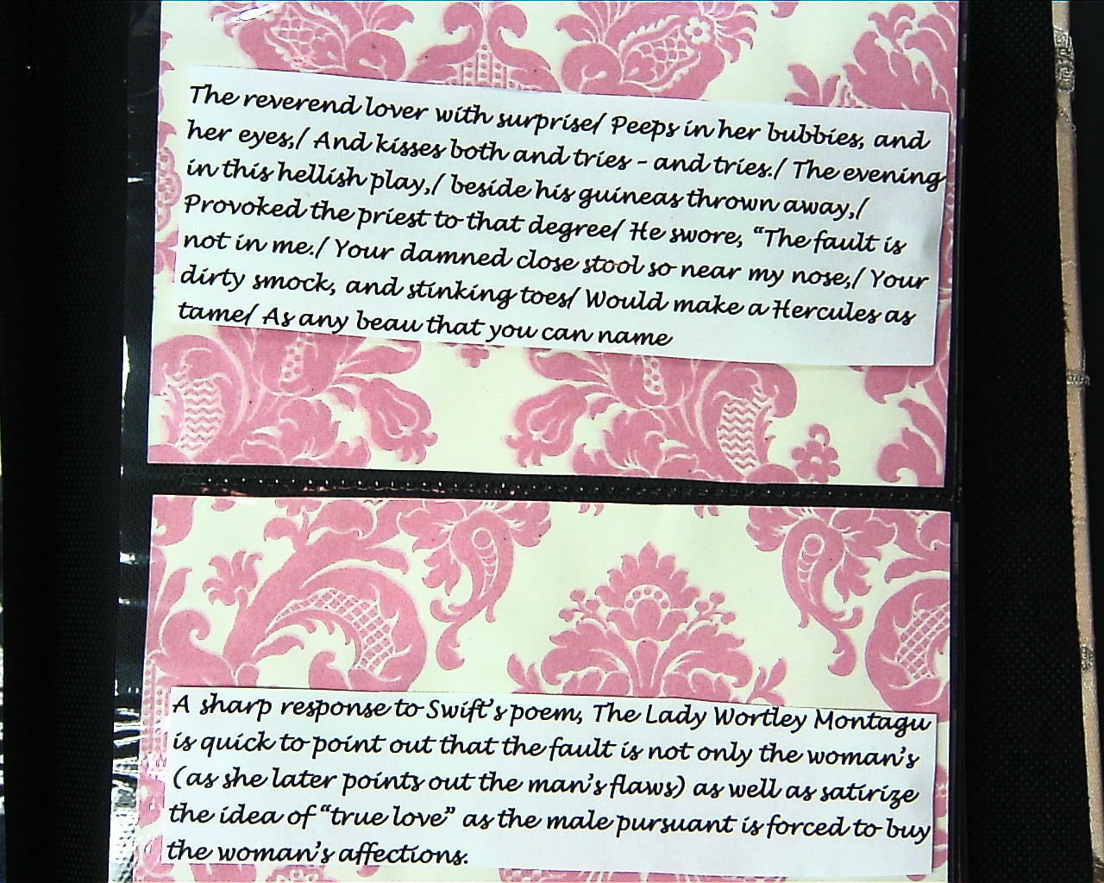
Entries on gender: Swift vs. Montagu

Slide 38
Materials and Objects
Hesse, Doug. Nancy Sommers, and Kathleen Blake Yancey.“Evocative Objects: Reflections on Teaching, Learning, and Living in Between.” College English 74.4 (2012): 325-350.
“The Lesson of Objects” – a 2012 CCCCs presentation by Hesse, Sommers, and Yancey
Adaptable for many explication assignments and units

Slide 39
Exercise: Critical Reading and Information Design
Read and annotate “Guidelines for Teacher Evaluation” in Appendix for Workshop 1.
Design a poster to advocate your group’s analysis and position: - Use only information from the essay. - Arrange in logical groupings. - Use headings. - Use 2-4 visual images.

