Slide 1
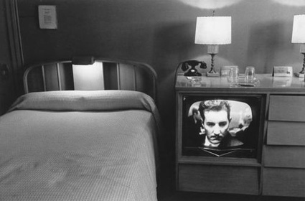
The Shrine Down the Hall
Poetry Writing &The New York Times

Slide 2
I. Generating Raw Material: Self

Slide 3
Ice breaker
Bring in 5 images (I use Powerpoint) that reveal your obsessions, desires, objects you love
This allows student to be known in the room
Articulation of self as “I” as opposed to “you”
Student stakes a claim, takes a stance, reveals a point of view
Leads to discussion about the importance of detail

Slide 4
diorama

Slide 5
photography/symmetry/ferry ride/friedlander

Slide 6
letters, handwriting, stamps

Slide 7
Americana, motels, Holga

Slide 8
road trip, Jolene, blt

Slide 9
reading, the interconnected world
Notes:
Knowing the world

Slide 10
The Interconnectedness of the World: Relevance
Inspiration is all around us
Our story is one part of other stories unfolding every minute
We make a mark on the world every day
Literature teaches us what it means to be human

Slide 11
Man on Wire
(see every day as a true challenge)

Slide 12
Finding Other Material: New York Times

Slide 13
The New York Times: Goat Man
Coty Creighton, 33, spotted the goat man Sunday during his hike. He said he came across the herd, but noticed something odd about one goat that was trailing behind the rest.
"I thought maybe it was injured," Creighton said Friday. "It just looked odd."
He said he pulled out binoculars to get a closer look at the herd about 200 yards away and was shocked. The man appeared to be acting like a goat while wearing the crudely made costume, which had fake horns and a cloth mask with cut-out eye holes, Creighton said.
"I thought, 'What is this guy doing?' " Creighton said. "He was actually on his hands and knees. He was climbing over rocks and bushes and pretty rough terrain on a steep hillside."
Creighton said the man occasionally pulled up his mask, apparently trying to navigate the rocky terrain. The man then appeared to spot Creighton.
"He just stopped in his tracks and froze," he said.

Slide 14
The New York Times: Facebook
Grafitti Art

Slide 15
The Learning Blog
Learning Network Home
Keats & Psychedelic Drugs

Slide 16
Go in Fear of Abstractions: How to Shape Your Material
Embrace Life
The Wind

Slide 17
It’s Always All in the Details: The Shrine Down the Hall
Bedrooms

Slide 18
It’s Halftime America (and time for a break)
http://www.youtube.com/watch?v=tFAiqxm1FDA

Slide 19
Few More Ideas for Craft Exercises
Video games (perspective)
High-school Seniors Predict Their Future
Taxi (making something large out of the small)
Camera in the woods (curiosity)

Slide 20
III: Craft New York Times + Poetry (my own experience)
River Legs

Slide 21
Traveling Typewriter

Slide 22
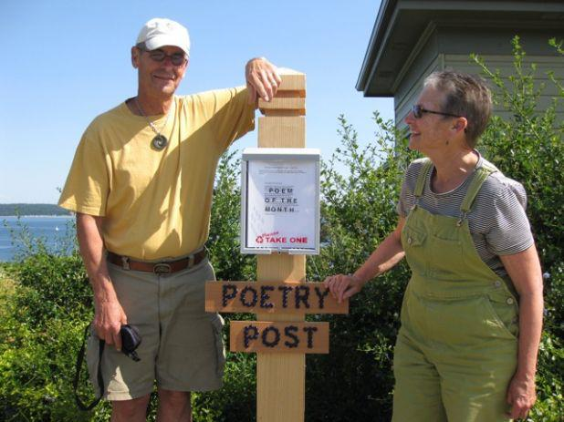
Poetry Post

Slide 23
“Literature can remind us that not all of life is already written down: there are still so many stories to be told.” LGWS

