Slide 1
Student Centers sustainability Lunch and learn: water conservation
January 26, 2017

Slide 2
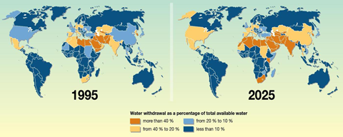
Why does water conservation matter?
• Ensures water for future growth and future generations
• Reduces costs to water customers since conservation is almost always less expensive than other water supply options
• Reduces the need for additional water since removing water from a river can impact fish and wildlife habitat
• Conserves energy since treating, moving, and cleaning water used in cities is energy intensive

Slide 3
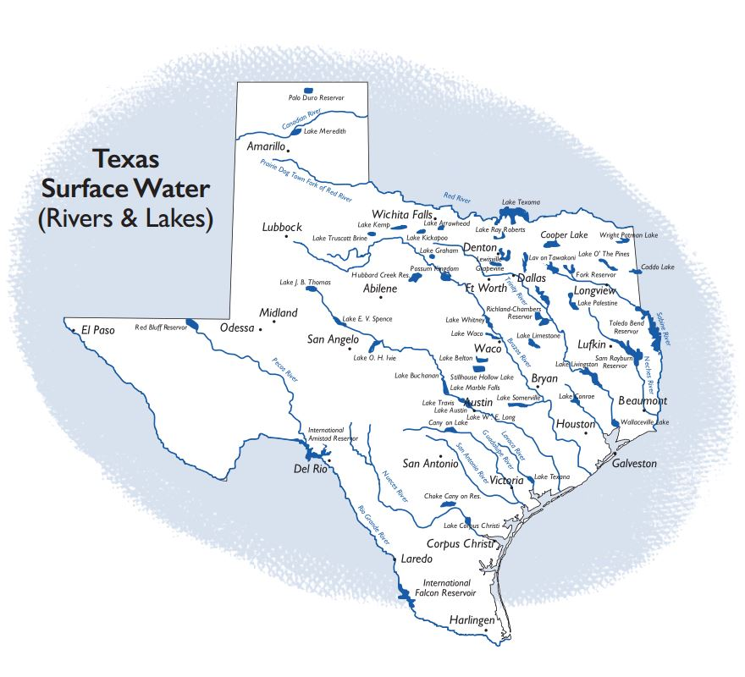
Water Sources in Texas

Slide 4
Water Usage Per Year
That’s over 316 BILLION gallons!
Notes:
Population
4.33 Mil
2.48 Mil

Slide 6
How can you help?

Slide 7
Notes:
https://www.youtube.com/watch?v=cV_Vr_xgrn0

Slide 8
Student centers

Slide 9
5 Easy Water Saving Tips
Wash laundry & dishes with full loads
Always turn off running water
Take shorter showers
Eliminate any and all leaks
Reduce the flow of toilets & showerheads
Notes:
There are 5 easy ways you can start conserving water today.
We all need to take responsibility for saving water whether or not there is a drought.
Remember, every drop counts.
Additional Tips:
As you are warming the shower water, put a bucket in to collect the clean water. This water can be used for several things in your home, such as watering plants, mopping the floor and a variety of household chores.
Plan ahead when cooking and thaw out food in the refrigerator to prevent running under water to thaw.
You should also reduce the flow of water from your showerhead. The average showerhead uses 2.5 gallons of water a minute. A low-flow showerhead can easily reduce the flow to 1.5 gallons per minute.
If you don’t know how much water your shower uses, you can measure the flow rate per minute with a bucket. You could hold the bucket under the showerhead for one minute, but it is easier to check the flow for 30 seconds and multiply by two to get the per minute flow.

Slide 10
Sustainability contest and upcoming events
4/17 – eco-artist grant manier
4/17 – 4/22 Earth week celebration
Notes:
https://www.youtube.com/watch?v=rTVjnBo96Ug&list=PL8OVuhLh9VCudHiFMdsYpAhWSKZz_yr5G

Slide 11
Thank you
Linda rodriguez
Christian ramos
Ashriel dunham
Sam ngyuen
Ida Thompson
Myra conley
Willie mae lewis
James pettijohn
Niya Blair
Melissa halstead
Rosario Ashley
John price
Jason Bergeron
Doug eck
Michael crook
Michael Mendoza
Eve esch
Angela allen
Brittany hart
Vicky Henderson
Cassandra joseph
Jaqueline burkes
Colin adams
Luke parnell
Matthew sebby
Celeste fuentes
Lauren ellzey
Frontier fiesta
Adria terry
Alicia Garcia-Valero
Keishla segarra
Pam moon
Kyle stehling
Le nguyen
William “bill” Schwehr
Andrea Trevino
Council of Ethnic Organizations

