Slide 1
Contact us!
Office: Heyne 105
Email: uh.psichi@yahoo.com
Blog: http://psichiuofh.blogspot.com/
: Psi Chi and Psychology Club at the University of Houston
: uhpsichi
: uhpsichi
Connect with Psi Chi on Get Involved – UH Access

Slide 2
First General Meeting
Thursday, September 8th

Slide 3
announcements
Make sure you sign in so you receive points for attending the meetings and events!
Please refer to the first edition of the Psychobabble for more information about the points system.

Slide 4
Psi Chi officers 2016-2017
President: Sahar Anjum
Vice President: Mohammad Abdel-Aziz
Treasurer: Stephen Netzley
Secretary: Hoang Tran
Historian: Nohal Hussain
Academic Affairs: Cana Quave

Slide 5
Faculty Advisor
Dr. Herb Agan
After receiving a business degree from the University of Texas in Austin and completing a Masters in theology during his six years in youth ministry, he moved to Houston to attain a Masters in Counseling and, eventually a Doctorate in Counseling Psychology from UH. He worked 7 years at a county mental health center.
For 35+ years, Dr. Agan has practiced as a psychologist and a marriage and family therapist, while serving as a consultant and lecturer to business, religious, medical, and educational groups throughout the country. He has been an adjunct faculty member in Clinical Psychology at UH, teaching a variety of classes since 1998 and has taught year-round at the Jung Center of Houston for the past 18 years.

Slide 6
purpose
Psi Chi is an international honor society whose purpose shall be to encourage, stimulate, and maintain excellence in scholarship of the individual members in all fields, particularly in psychology, and to advance the science of psychology.

Slide 7
Mission
The mission of Psi Chi is to produce a well-educated, ethical, and socially responsible member committed to contributing to the science and profession of psychology and to society in general.
Subends for accomplishing above mission:
Advance the science and profession of psychology
Promote an educational experience consistent with the mission
Promote ethical and socially responsible members and leaders
Define and establish an organizational structure that promotes our mission
Recognize and foster the contributions that diversity makes to the science and practice of psychology

Slide 8
Psi chi membership
Completion of at least 3 semesters of college courses.
If you are a transfer student, only one semester at the University of Houston is necessary.
Completion of at least 9 semester hours of psychology (3 courses)
Registration for major or minor standing in psychology.
Undergraduates must be earning a minimum GPA of at least 3.5 in psychology courses, and a minimum overall GPA of 3.00.
For graduate students, an average grade of “A” or “B" in all graduate courses, including psychology.
High standards of personal behavior.
Commitment to actively participate in chapter events/activities.

Slide 9
Psychology club membership
This club is open campus wide and to all majors.
Must be enrolled in at least 1 semester of college courses.
Must have genuine interest in psychology.
Demonstrate leadership and high standards of personal behavior.
Commitment to actively participate in chapter events/activities.

Slide 10
Psi chi vs. psychology club
Both organizations meet together
Member of only one organization
Psi Chi membership: honor society membership for life
If you do not currently qualify for Psi Chi, you can become a member of Psychology Club until you fulfill the requirements

Slide 11
applications
If you would like to be inducted this semester, Psi Chi and Psychology Club applications and dues are due by November 17th
You can turn in your Psychology Club applications after today’s meeting or to our office in Heyne Rm 105.
Psi Chi applications can be emailed to uh.psichi@yahoo.com

Slide 12
Applying for psi chi
http://www.psichi.org/?
Psi Chi applicants must apply online and send us an email of a screenshot of your confirmation as well as your Full Name and PeopleSoft ID #.
We have instructions for this online process at the table in front of our office.
Psi Chi Certificates - Please collect them from us if have already been inducted!

Slide 13
Applying for psi chi

Slide 14
Applying for psi chi

Slide 15
Applying for psi chi

Slide 16
dues
Psi Chi
One time national dues are $55
Chapter dues are $50
Psychology Club
Chapter dues are $50
Dues are due November 17th – Meeting Day

Slide 17
Points system
50 points for community service events
25 points for social events
25 points for academic events
15 points per hour for fundraising events
10 points for donating items for bake sales (i.e. sodas, cookies, brownies, etc.)
10 points per hour for running Psi Chi store (Up to limit of 150 points)
10 points for meetings
10 points for wearing Psi Chi/Psychology Club shirt to meetings/events
5 points for wearing Psi Chi/Psychology Club wristband to meetings/events
10 points for bringing a friend to Psi Chi meetings/events
10 points for committee activities (i.e. newsletter, scrapbook pages)

Slide 18
Points system
Earn 0 – 199 points = $50 Dues
Earn 200 - 399 points = $40 Dues
Earn 400+ points = $25 Dues

Slide 19
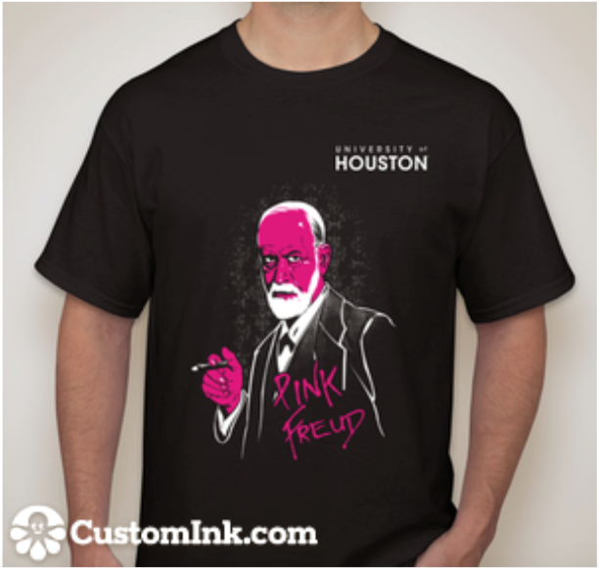
t-Shirts
1 for $7
2 for $12
SOLD OUT

Slide 20
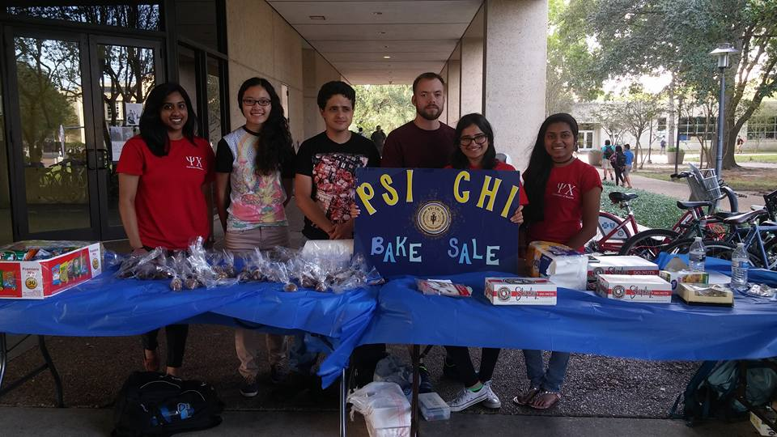
Bake sale
Tuesday, September 13th
9:00 AM-4:00 PM
Donations (food/drink)
Volunteers

Slide 21
Halloween party
Thursday, October 27th
Heyne 135 at 5:30 PM

Slide 22
inductions
Saturday, December 3rd
7:00 PM – 9:00 PM
TBD

Slide 23
Swpa
March 31 – April 2, 2017
Riverwalk San Antonio
Hyatt Regency
Deadline for Submission: November 1, 2016 at 11:59 PM

Slide 24
Tutoring
uh.psichi.tutor@gmail.com
Courses offered:
Intro to Psychology Personality Psychology
Research Methods I/O Psychology
Abnormal Psychology Social Psychology
Psyc Stats Physiological Psychology
Cognitive Psychology

Slide 25
Chair elections
September 22, 2017
Commitees:
Social: Sahar Anjum
Inductions: Mohammad Abdel-Aziz
Fundraising: Stephen Netzley
Volunteering: Hoang Tran
Scrapbook/Blog: Nohal Hussain
Academic Affairs/SWPA: Cana Quave

Slide 26
Chair elections
September 22, 2017
Psi Chi and Psychology Club members are allowed to run for chair positions
Email uh.psichi@yahoo.com by September 21st if you want to run for a position
Prepare a short speech

Slide 27
Ra opportunities
Developmental Cognitive Neuroscience Lab
PI: Dr. Don Foss
RAs would be involved in collecting data from experiments and engaging in discussions about lab research and other peer reviewed articles in laboratory meetings
Contact: Joe Pirozzolo at jwpirozzolo@uh.edu

Slide 28
Ra opportunities
School of Social Work; Adolescent mental health
PI: Dr. Gearing
Tech Connect Intervention
Tech Connect HD (Hospital Discharge)
Engaging Latinos in Youth Mental Health Services: Examining Stigma, Barriers, and Facilitators
Contact: Dr. Gearing at rgearing@uh.edu

Slide 29
Ra opportunities

Slide 30
Ra opportunities

Slide 31
Upcoming events
September 13: Bake Sale
September 22: Second General Meeting
October 6: Third General Meeting
October 13: CV Talk
October 20: Fourth General Meeting/Research Talk
October 25: Bake Sale
October 27: Halloween Party
November 3: Fifth General Meeting
November 15: Bake Sale
November 17: DUES DUE/Sixth General Meeting
December 3: Inductions

Slide 32
Contact us!
Office: Heyne 105
Email: uh.psichi@yahoo.com
Blog: http://psichiuofh.blogspot.com/
: Psi Chi and Psychology Club at the University of Houston
: uhpsichi
: uhpsichi
Connect with Psi Chi on Get Involved – UH Access

Slide 33
snapcode

