Slide 1
CORE PROJECTs
July 27, 2018

Slide 2
Core Project and Selected Building Facts
Buildings with high student impact
(Mission is to enhance student learning environments on campus)
Buildings with high deferred maintenance cost
(six identified bldgs. have $71M in standing deferred maintenance)
$100M total budget
HEAF Funding

Slide 3
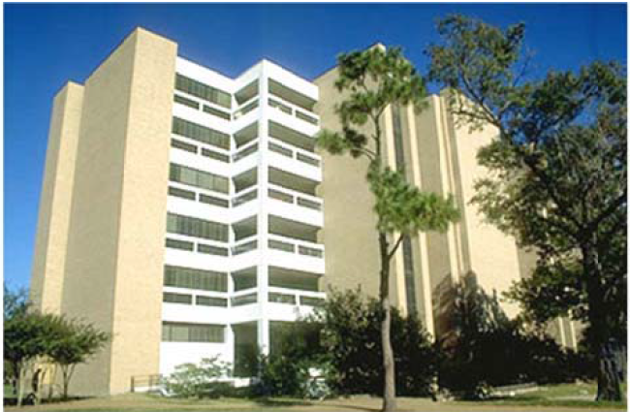
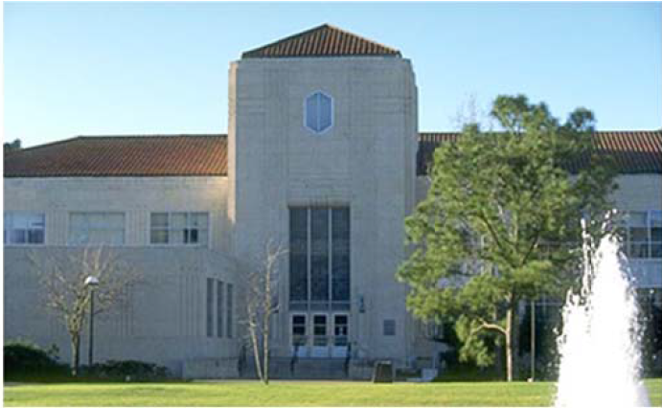
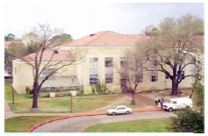
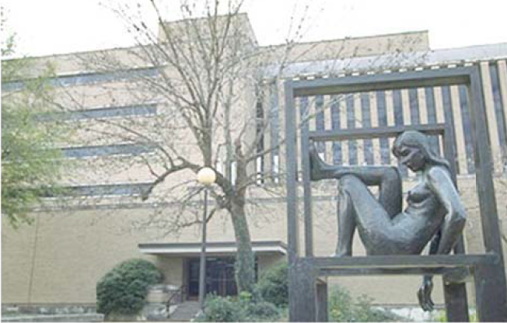
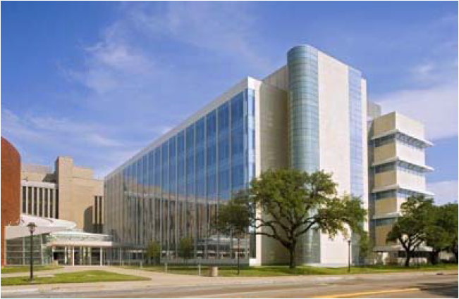
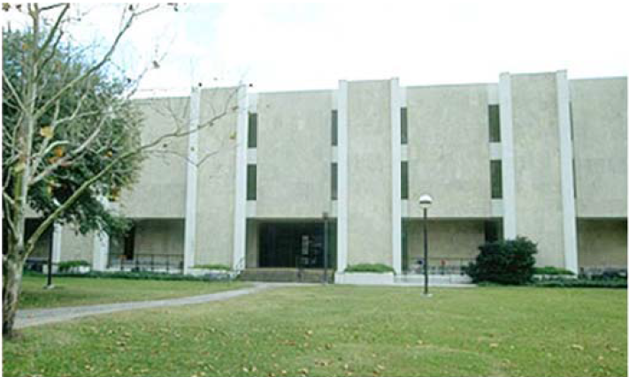
Core Project Buildings
Agnes Arnold
Roy Cullen
Old Science
Completion Scheduled for 2019
McElhinney
S&R I
SERC
Completion Scheduled for 2020

Slide 4
Core Project Inclusive Upgrades
Major building systems (HVAC, electrical, etc.)
Fire & Life Safety and ADA
Public areas and classrooms
Technology Infrastructure (WiFi, Building Connection)
Energy efficiency
Interior finishes
Repurpose/Reconfiguration of space as budget allows
*Any changes to the existing space allocations would need to be directed by the Provost. Any changes
will follow the UH Design Guidelines.

Slide 5
Colleges & Deans
College of Liberal Arts & Social Sciences
Dean Antonio Tillis
Roy G. Cullen
English Department
Charles F. McElhinney
Center for Public History
Communication Disorders
Comparative Cultural Studies
Economics
Hobby Center for Public Policy
Agnes Arnold Hall
African American Studies
Center Public History
Hispanic Studies
History
Mexican-American Studies
Modern & Classical Languages
Philosophy
Sociology
Women’s Studies
College of Natural Science & Mathematics
Dean Dan Wells
Science & Research I
Center for Advanced Materials
Chemistry
Earth & Atmospheric Sciences
Physics
Human Resources
Joan Nelson
Charles F. McElhinney
General Purpose Classrooms
Truman Glenn - Register

Slide 6
Project Updates & Schedule
Broaddus Planning and UH FP&C have developed a preliminary renovation schedule for Roy G. Cullen, Science & Research 1, Charles F. McElhinney and Agnes Arnold. The Executive Steering Committee has reviewed and approved the schedule.
RFQs have been issued for the architectural design services and the construction manager at risk.
The building renovations will occur over the next 6-years. They are expected to be complete by the end of 2024.

Slide 7
Master Schedule (preliminary)
Old Science Renovation
Construction Summer 2018 – Summer 2019
Roy G. Cullen (single phase)
Construction Fall 2019 – Fall 2020
Charles F. McElhinney (multi-phase)
Phase I Construction Fall 2020 – Fall 2021
Phase II Construction Fall 2021 – Fall 2022
Agnes Arnold Hall
Phase I Construction Fall 2022 – Summer 2023
Phase II Construction Summer 2023 - Summer 2024
Phase III Construction Summer 2024 – Winter 2024
Science & Research I (ongoing, multi-phase)
Phase I Construction Fall 2019 – Summer 2020
Phase II Construction Fall 2020 – Fall 2021
Phase III Construction Fall 2021 – Summer 2022
Phase IV Construction Summer 2022 – Summer 2023
Phase V Construction Fall 2023 – Summer 2024
Phase VI Construction Summer 2024 – Winter 2024

