Slide 1

Open Educational Resources
Presenters:
Ariana Santiago, Dr. Mary Henderson, Dr. Melissa Markofski

Slide 2
Overview
Open Educational Resources (OER)
Financial Evaluation for Supply Chain
Exercise Testing
Q & A

Slide 3
Why OER?
Open educational resources (OER) are any educational materials that are in the public domain or shared with an open license; this allows anyone to use, share, and sometimes modify the resources, free of cost.
Notes:
Libraries.uh.edu/oer

Slide 4
Why OER?
Open educational resources (OER) are any educational materials that are in the public domain or shared with an open license; this allows anyone to use, share, and sometimes modify the resources, free of cost.
OER allow all students to access course materials
OER provide instructors greater control over course content
Notes:
Libraries.uh.edu/oer

Slide 5
Access to course materials
$1,240
The average undergraduate budget for books and supplies
$418
Average amount college students spend on required course materials
37.37%
UH students report not purchasing a required textbook due to cost
Impact of textbook costs:
Earn a poor grade Take fewer courses Don’t register for a course Drop a course

Slide 6
Increasing OER use at UH
Student advocacy
Administrative support
Incentive program, library and campus support
Replace costly textbooks with OER and freely-available resources
Students have free and immediate access to course materials
Instructors have greater control over course content

Slide 7
Alternative Textbook Incentive Program
Replace a required traditional textbook with:
  Open educational resources (OER)
  Freely available or library sponsored resources
Any instructor of record is eligible
Awards ranged from $500-2,500
  Depends on cost-savings, type of project, and feasibility
  Can be used for any purpose
libraries.uh.edu/oer/incentive
Application info for 2020-21 coming soon!

Slide 8
OER and alternative textbook options
Adopt existing resources
Adopt OER, library resources, or a combination
Adapt/modify existing resources
Make changes to OER
Create a new resource
Pressbooks platform for authoring and publishing
Can draw from multiple resources
Open license that allows for derivatives
libraries.uh.edu/oer/find-an-open-textbook/
Notes:
libraries.uh.edu/oer/find-an-open-textbook
uhlibraries.pressbooks.pub

Slide 9
Impact so far

Slide 10
Control of course content
Appropriate resources
Customize to course content
Multiple/diverse perspectives
Continually tailor materials
“The resources I am using prevents students from reading material in a book that does not pertain to the course. It also prevents students from buying a book that they partially use.”
“Texts from diverse writers offered perspectives that would not be captured in a traditional textbook…students were able to examine points of views they otherwise would not have encountered.”
“It gave me more control over the course content rather than binding me to one textbook author who might have addressed some, but not all, concepts well.”

Slide 11
Access to materials
Money saved
Free availability
Student preparation
Student engagement
Learning outcomes
“The students were relieved to know that there was no required textbook to buy at the beginning of the semester. As an instructor, I appreciated that there were no excuses regarding the ability to begin using the textbook for the very first assignment.”
“Teaching with an alternative textbook seemed to enhance the dynamic of the class discussions and assignments – the students seemed more prepared and I wonder if the free access to the texts resulted in more people actually reading the texts.”

Slide 12
Process and implementation
Lack of existing OER
Distribution to students
Time and effort
“The most difficult part about teaching with alternative texts was finding texts that were open-sourced that met the parameters of the course.”
“Switching books was a lot of work, but now that I’ve made the switch I am glad.”
“The initial identification of the course materials was time-consuming and not exactly as straight- forward as I may have liked it to be.”

Slide 13
SCLT 4387:
Financial Evaluation for Supply Chain Management
Dr. Mary E Henderson, Assistant Instructional Professor
Supply Chain and Logistics Technology
College of Technology

Slide 14


Why Open Educational Resources (OER) – for me
SCLT program focuses on the efficient flow of goods and information through the supply chain from point of origin to point of consumption
Effective graduates need a grounding in business
SCLT is the only senior level course focusing solely on financials

Slide 15
Why OER – for me?
Vision of course content includes
  Management functions
  Financial statement creation and analysis
  Financial decision making (Break Even, Make-Buy, Total Cost)
  Inventory valuation
  Budgeting
  Earned Value
  Balanced Scorecard

Slide 16

Why OER – for me?
Vision for class draws from
  Financial Accounting
  Managerial Accounting
  General Business
  Operations
Searched for years for an all purpose textbook
Prior Textbook - Introduction to Accounting: An Integrated Approach
  Used pieces of chapters
  Augmented with other material
  Students were intimidated by an “Accounting” class

Slide 17
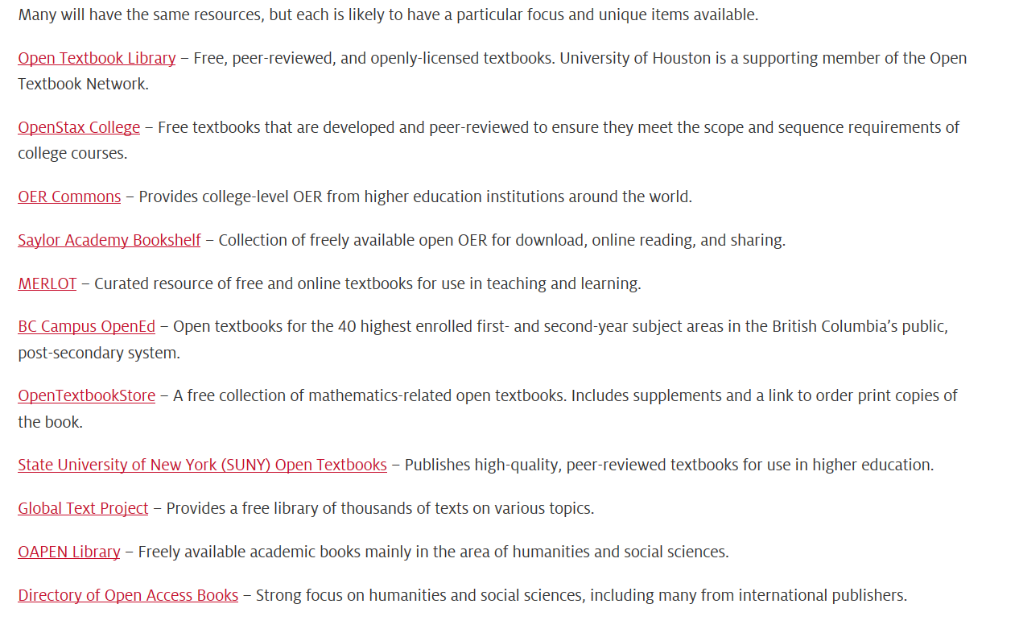
Sample OER Resources

Slide 18
Sample OER Resources

Slide 19
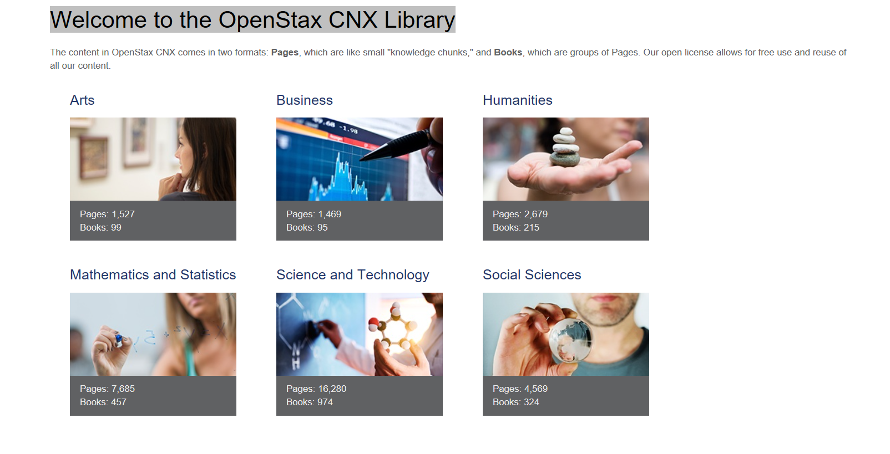

Slide 20
OER Adopted Material
From OpenStax
  Principles of Accounting: Volume 1 – Financial Accounting (3 chapters)
  Principles of Accounting: Volume 2 – Managerial Accounting (3 chapters)
  Introduction to Business (3 chapters)
From Open Textbook Library
  Accounting Principles: A Business Perspective (2 chapters)
From Lyryx
  Introduction to Financial Accounting (1 chapter)

Slide 21

OER Incorporation
Was able to keep
  Most of the lecture slide content
  All of the homework assignments
  All of the semester project content
  Most of the exam content

Slide 22
OER Incorporation
Was able to keep
  Most of the lecture slide content
  All of the homework assignments
  All of the semester project content
  Most of the exam content
Required Rework
  Syllabus
  Blackboard

Slide 23
Syllabus Incorporation
WEEK | DATE | Topics | Book Chapter
1 | Aug 20 | Introduction, Overview and Scope of Class Four functions of Management Int’l Content – Management functions applicable worldwide | Introduction to Business Chapter 6 – Management and Leadership in Today’s Organizations. See BB for specific reading instructions https://cnx.org/contents/Tgl3H6iq@8.5:G60oVkdH@7/Introduction
2 | Aug 27 | History Concepts Introduction of Financial Statements Int’l content: History - Accounting concepts developed in Middle East and Europe. GAAP (US standards) vs. IFRS (international standards) | Principles of Accounting: Volume 1 Financial Accounting Chapters 1, 2 & 3. See BB for specific reading instructions https://cnx.org/contents/mrS6bR5I@4.25:qv6kYQJ7@3/Why-It-Matters

Slide 24
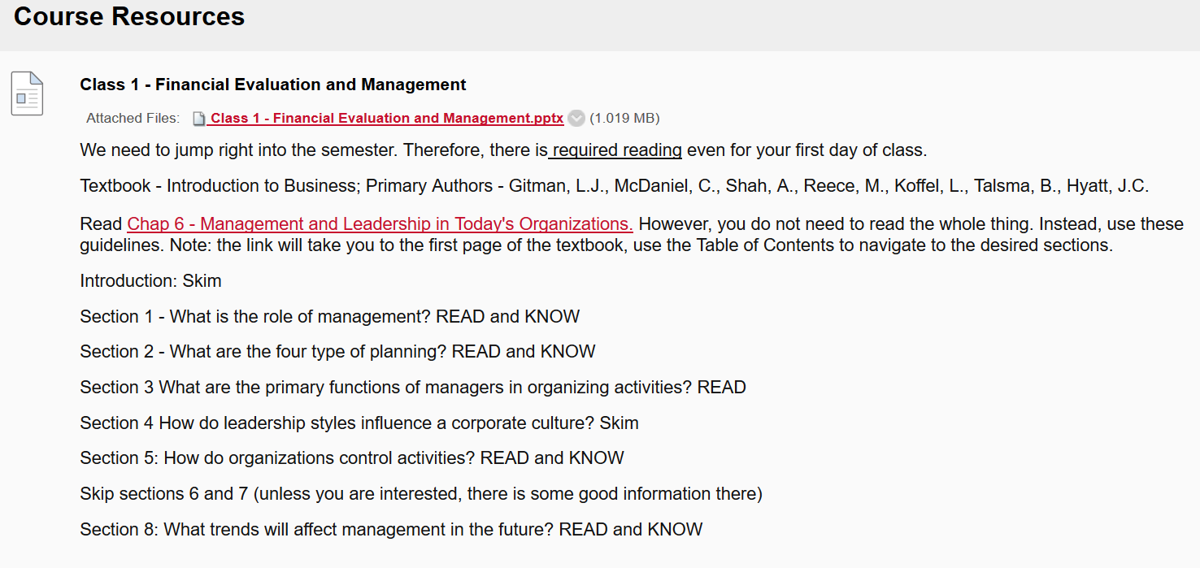
Black Board Incorporation

Slide 25
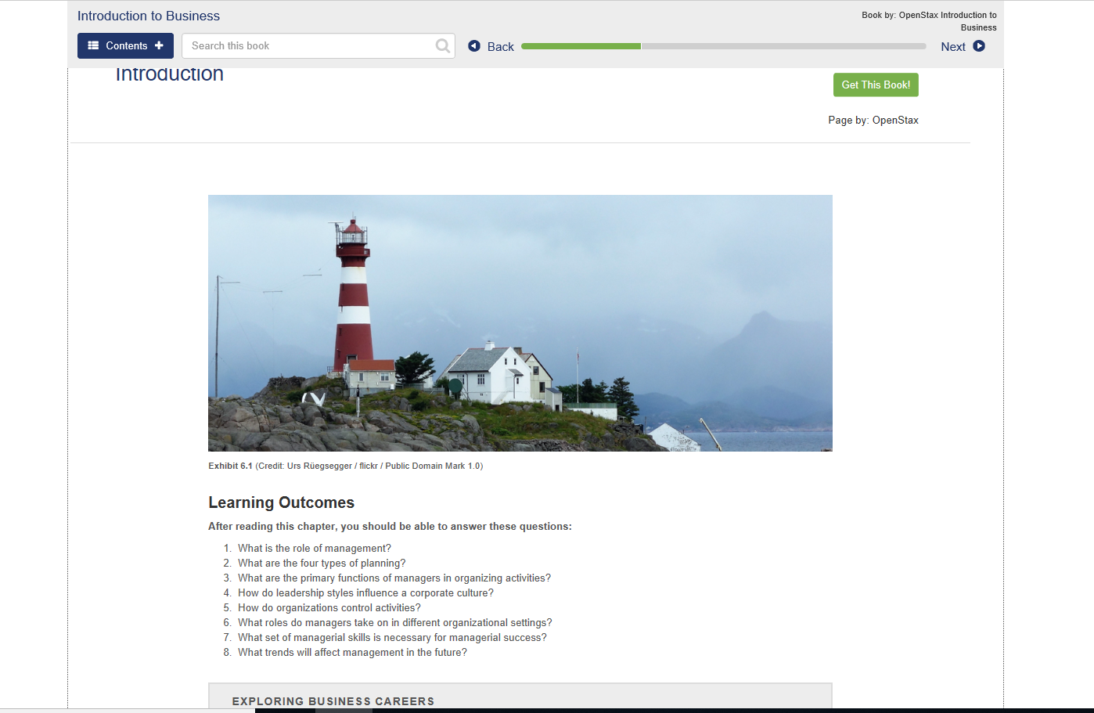

Slide 26
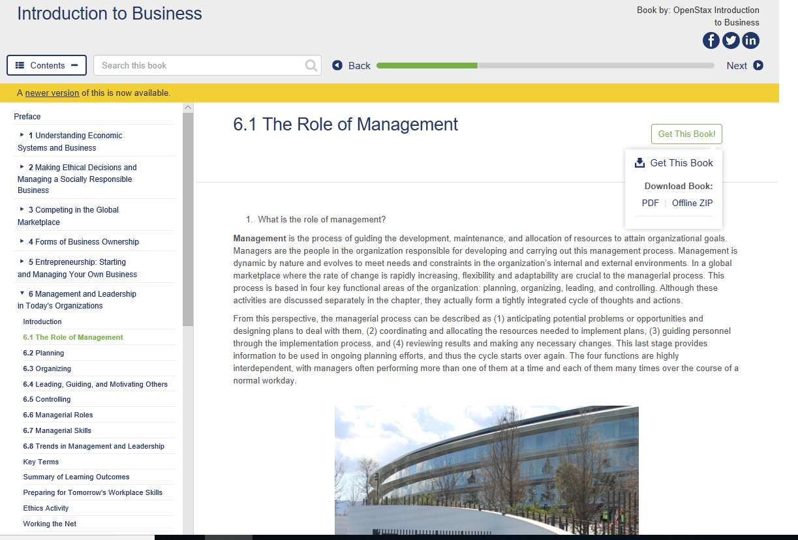

Slide 27
Preliminary Student Feedback

Slide 28
Preliminary Student Feedback
40-50 students per semester
~$140 for used textbook
Savings: $5,000 to $7,000 per semester

Slide 29
Student Feedback

Slide 30
Take Aways
Surprising amount of quality “plug and play” resources available
Content for traditional subjects relatively easy to find

Slide 31
Take Aways
Surprising amount of quality “plug and play” resources available
Content for traditional subjects relatively easy to find
  Next Steps
Pressbooks for organization and accessibility
Deeper dive in search of material for other courses

Slide 32
Pressbooks open access course laboratory manual
Melissa M. Markofski, PhD ACSM-EP CSCS
Dept. of Health and Human Performance

Slide 33
Course background
KIN 4370: Exercise testing and prescription
Moved hands-on activity lab from 1000 level course to this course
Assist in preparation for the Certified Exercise Physiologist exam

Slide 34
Needs: Exercise testing and prescription
Specific to the lecture material in the book
Specific to the equipment available in our teaching lab
~350-375 students per year take this course Laboratory manual manual
Low cost (suitable lab manual available for $151)

Slide 35
Option:
Word processing
Pros: Ubiquitous, know how to use
Pros: Easy to use, print, and post in BB
Cons: It’s word processing (not very “pretty”)
Cons: Limited interactive content, Office365 linking issues

Slide 36
Pressbooks: Initial impression
Pros: free to UH users, already set up for UH
Pros: UH library support, built-in accessibility support
Concern: Worth the effort of new system? (appreciated?)
Concern: Make visible only to my students?

Slide 37
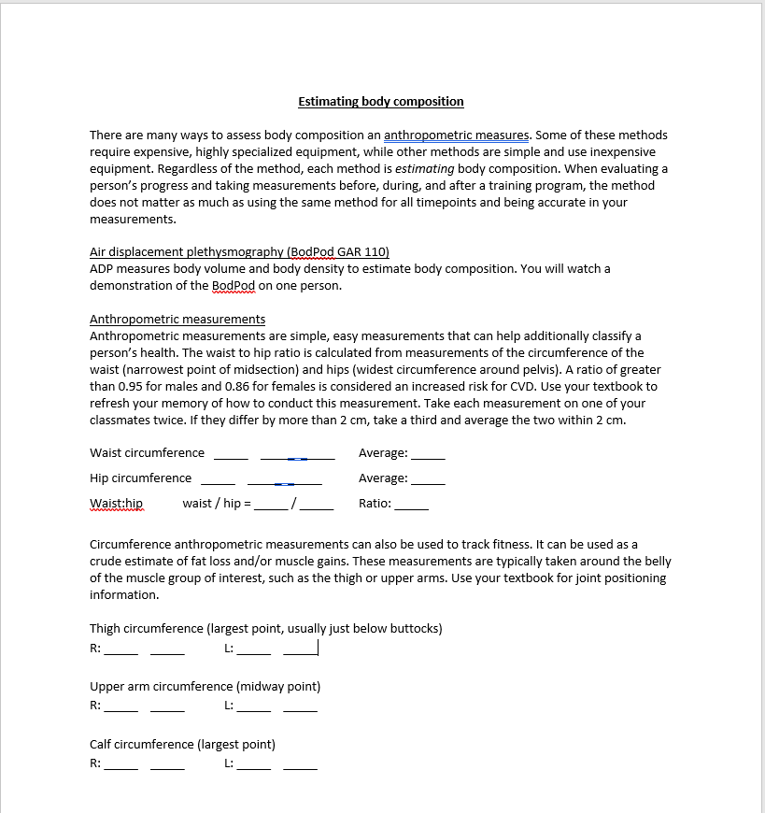
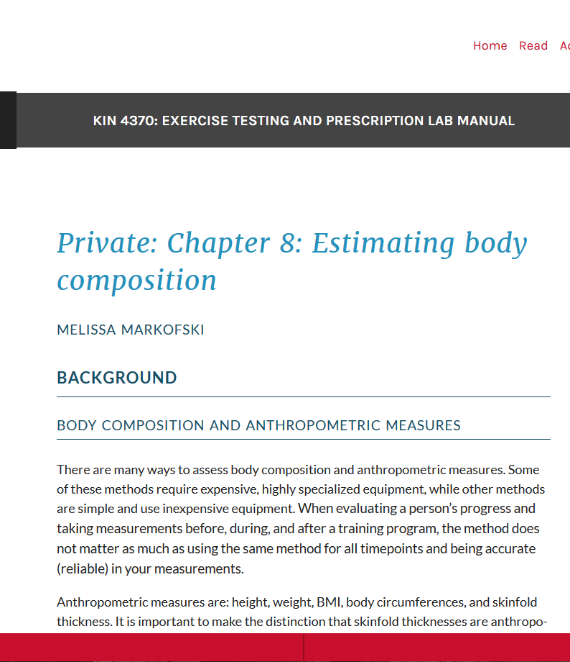
Pressbooks: starting out

Slide 38
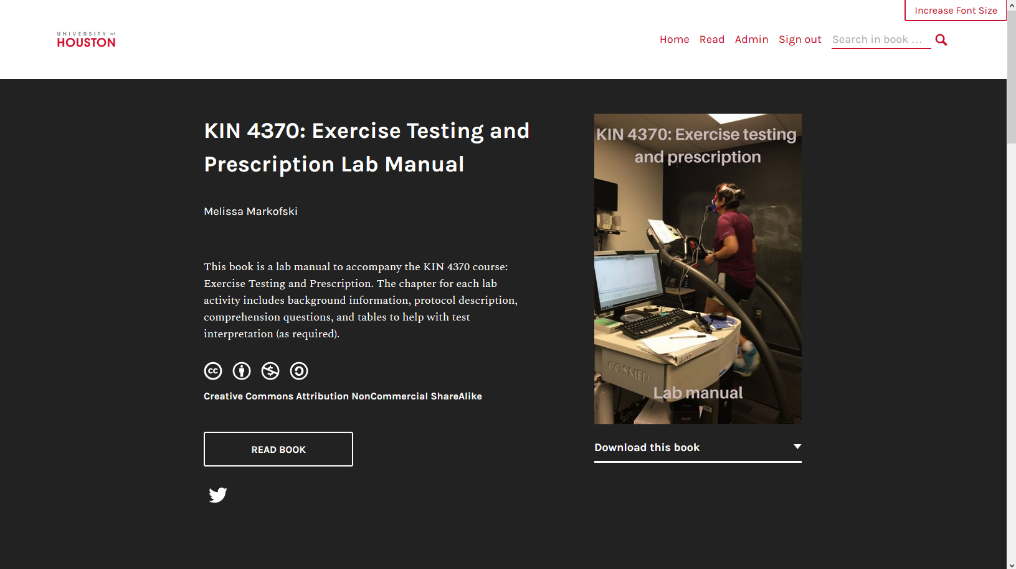

Slide 39
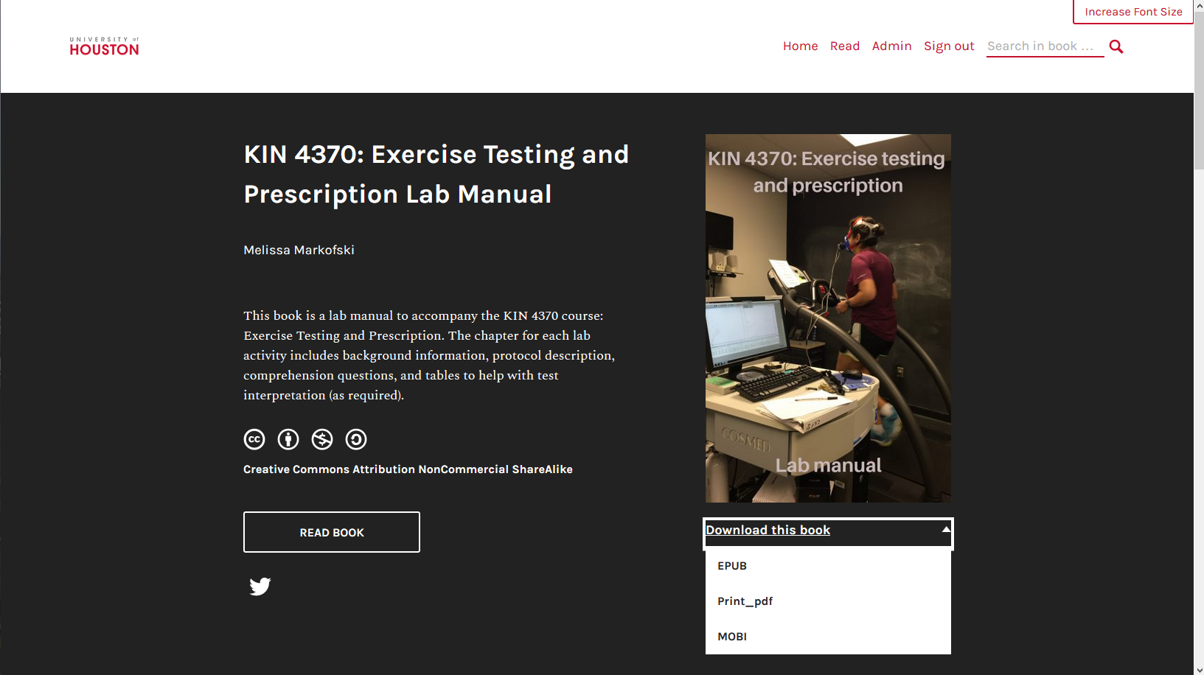

Slide 40
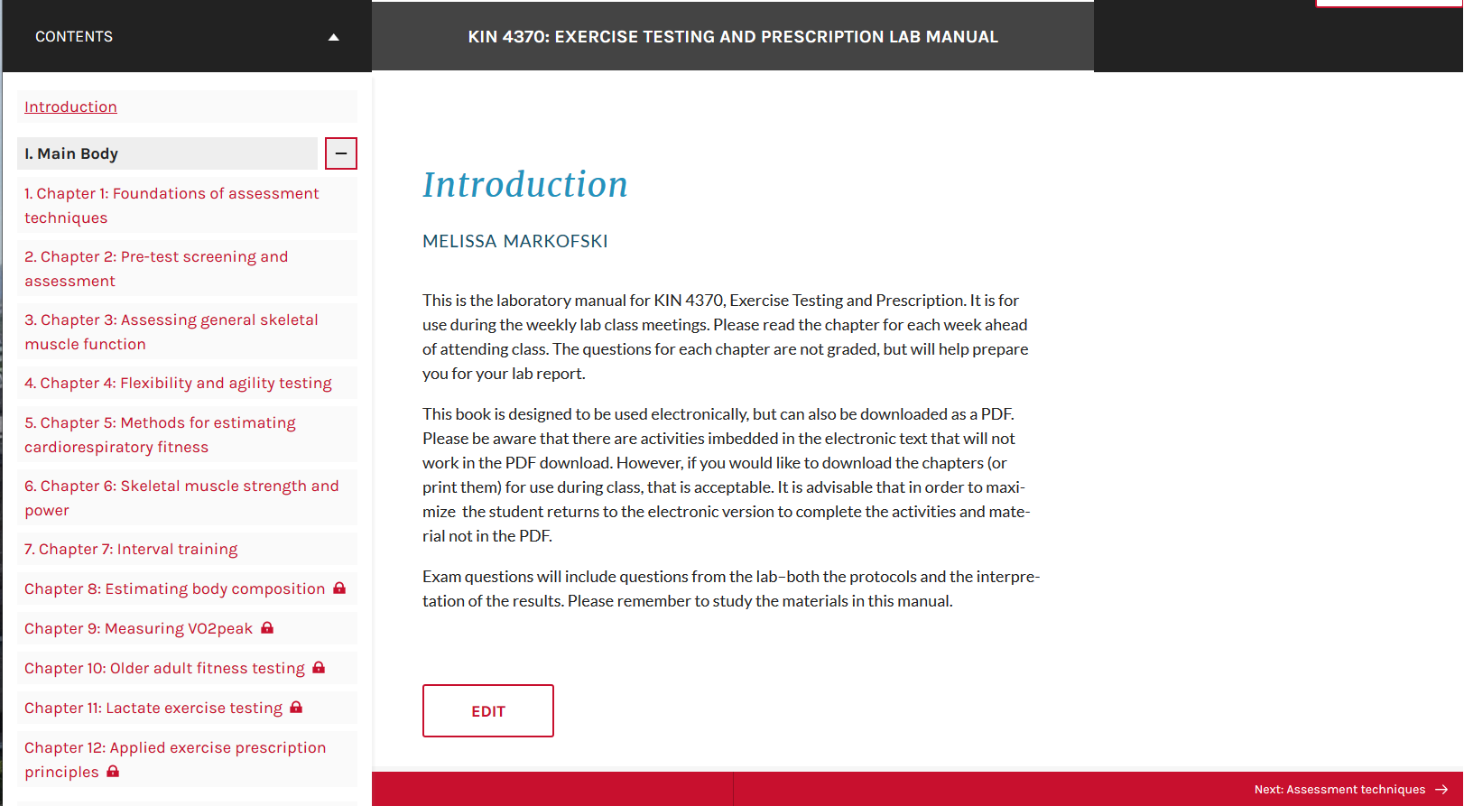

Slide 41
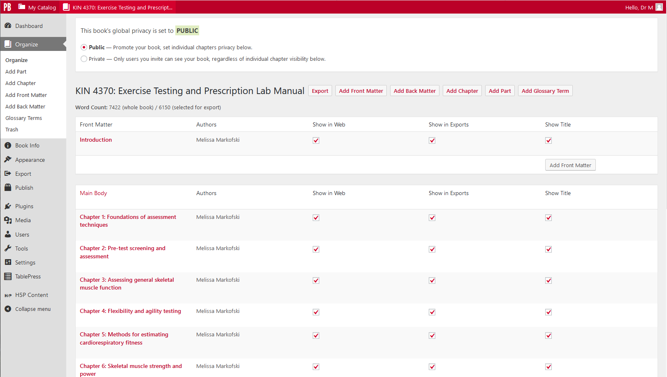

Slide 42
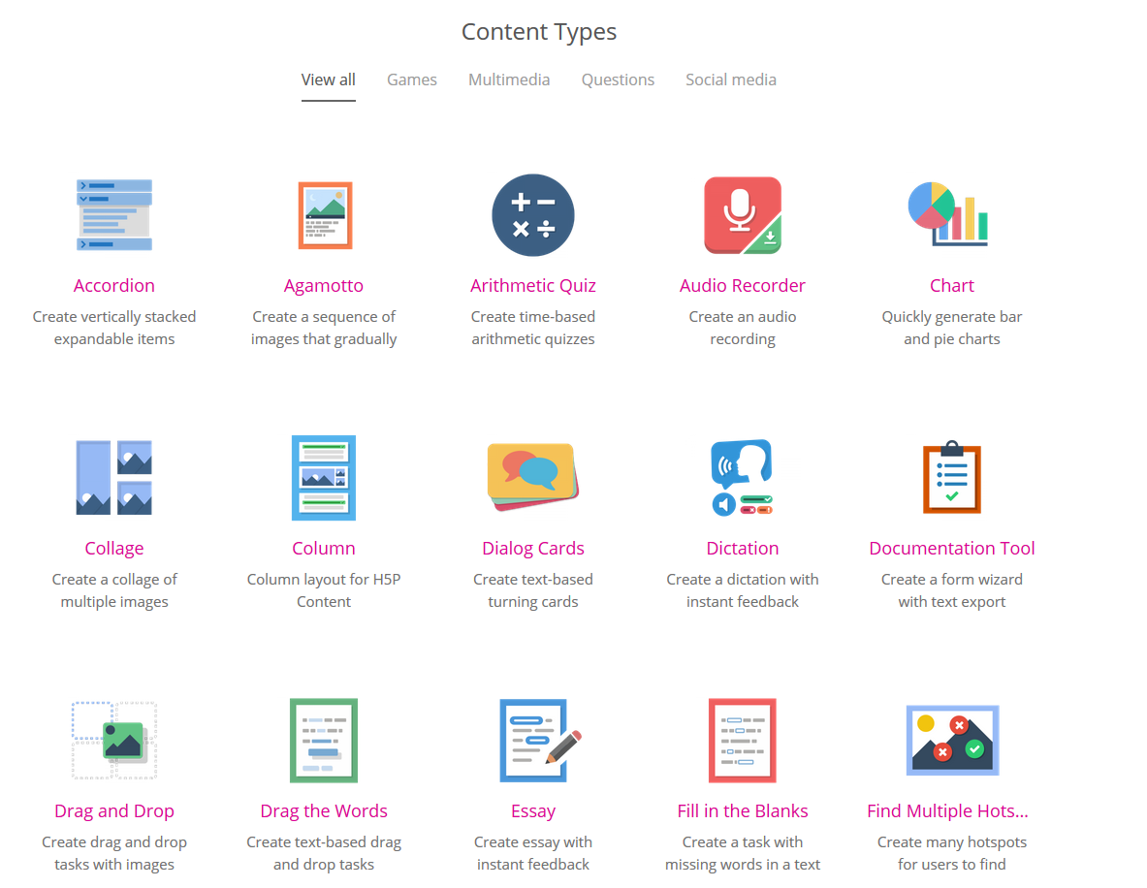
H5P examples

Slide 43
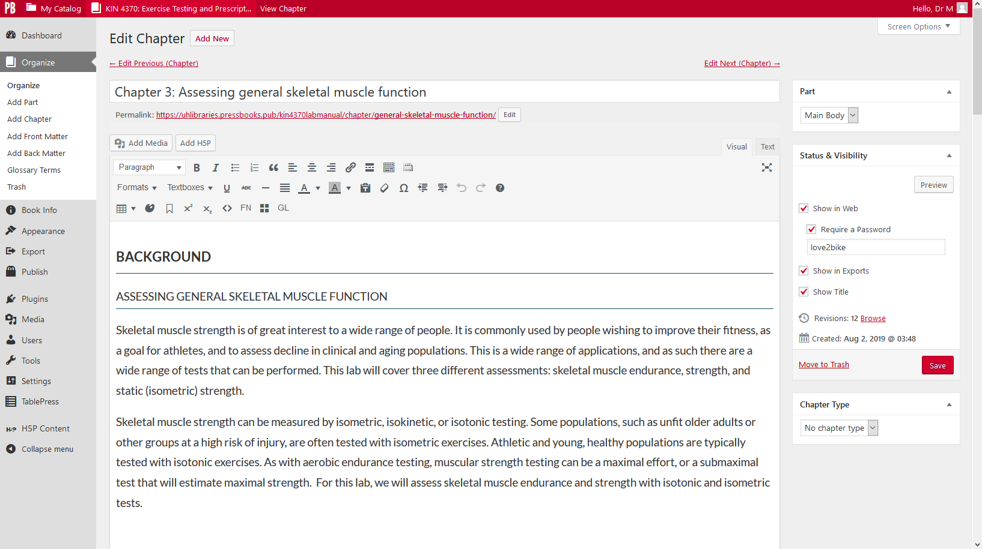

Slide 44
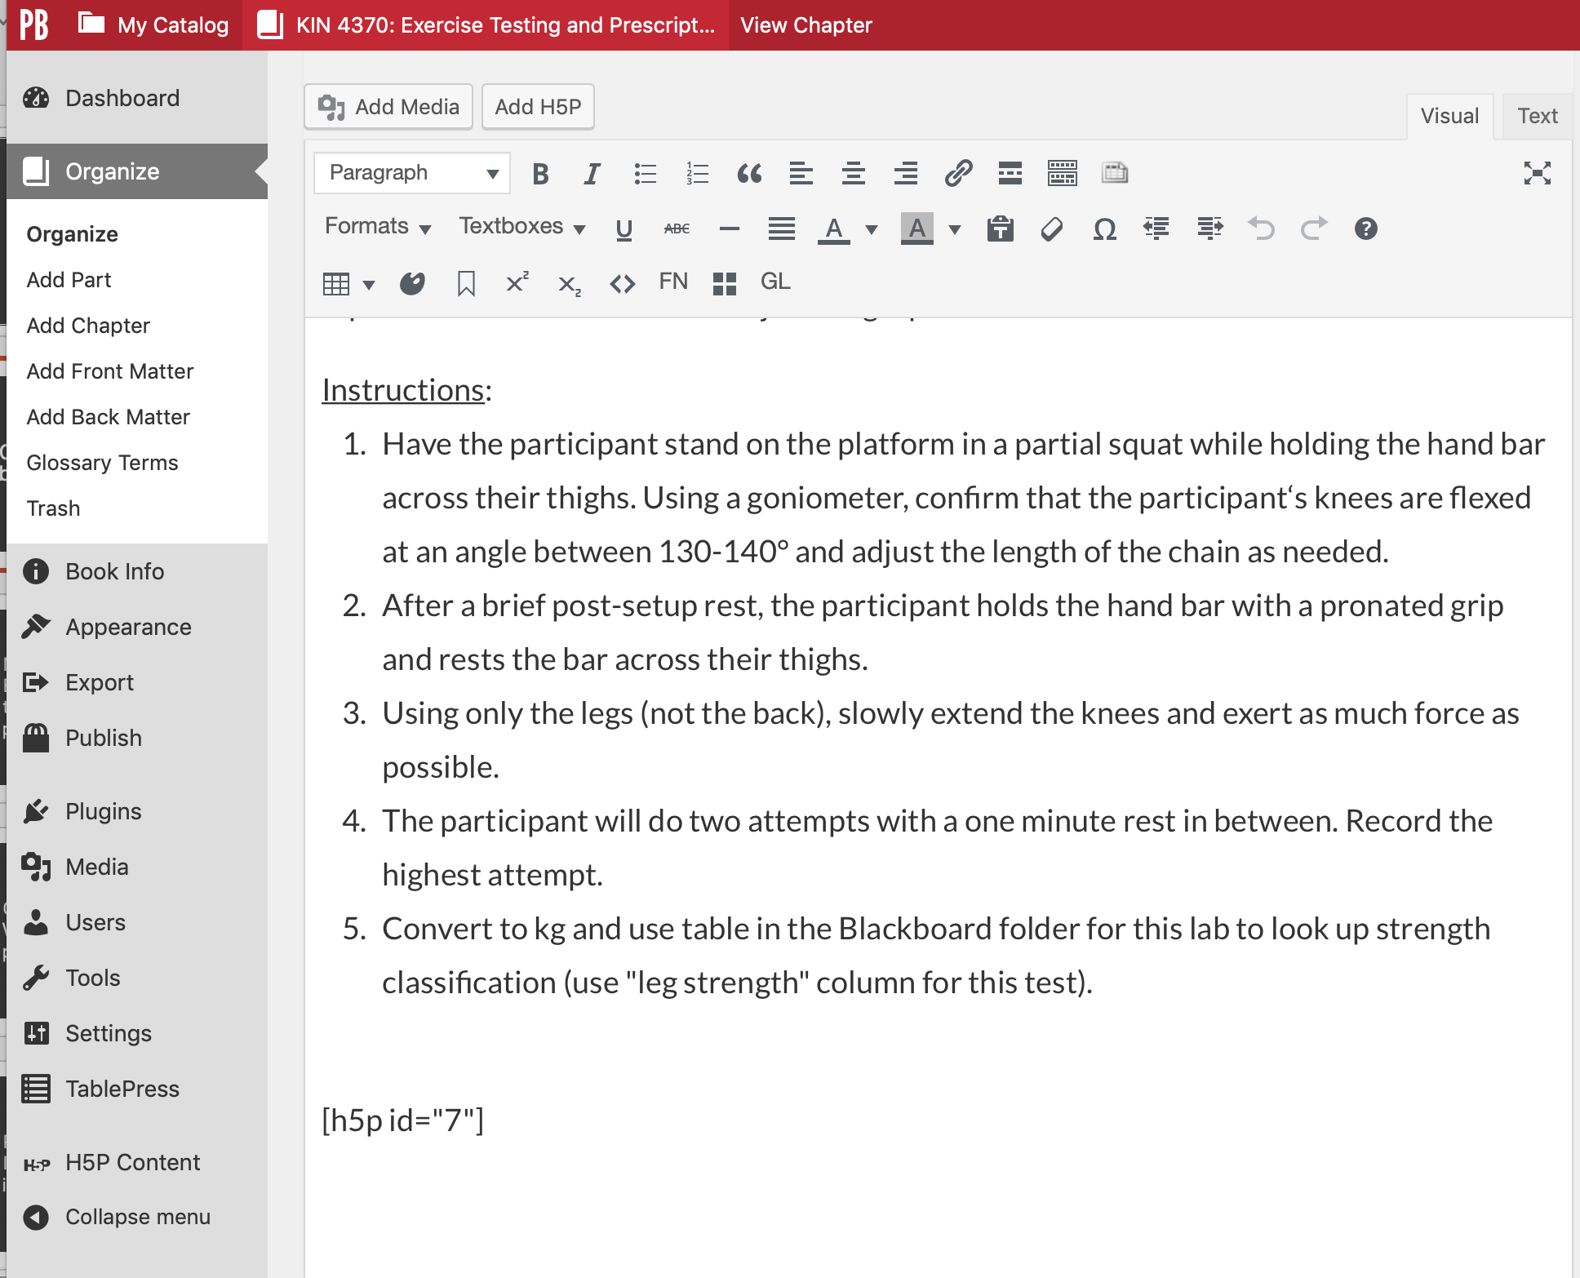

Slide 45
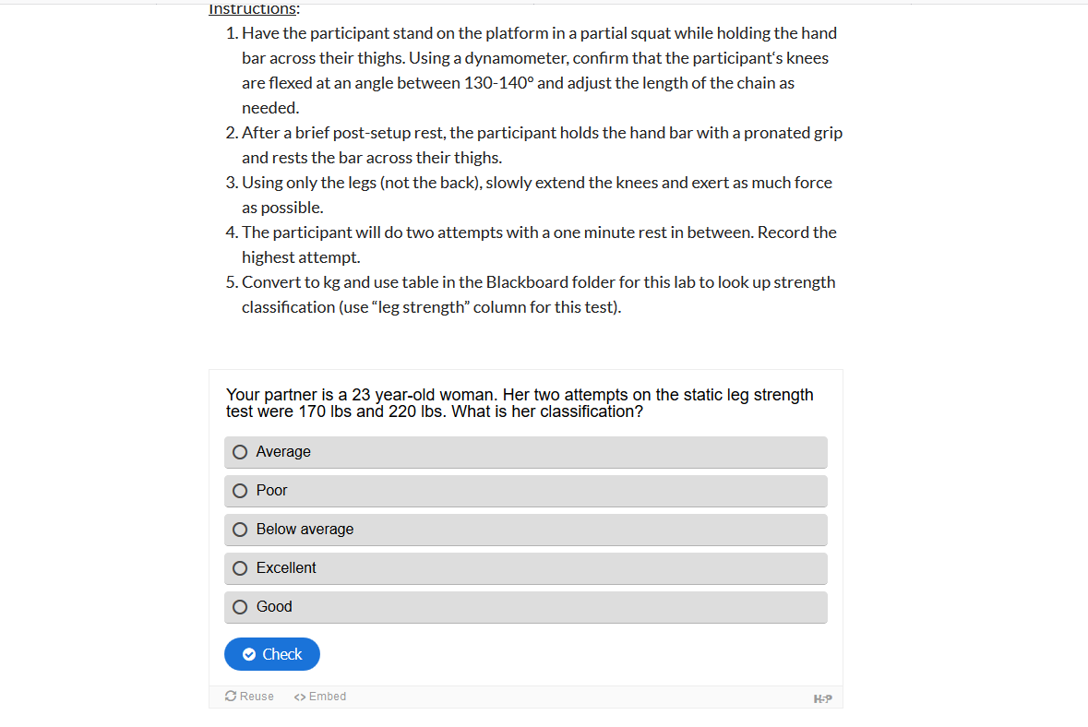

Slide 46
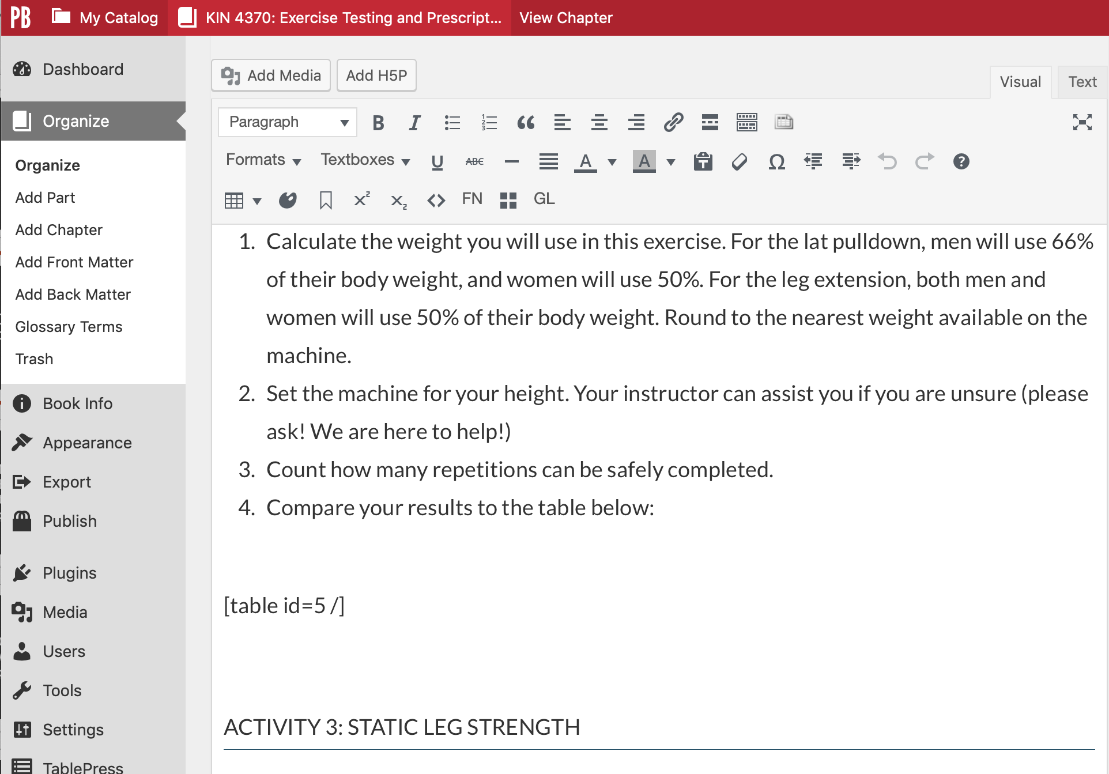

Slide 47
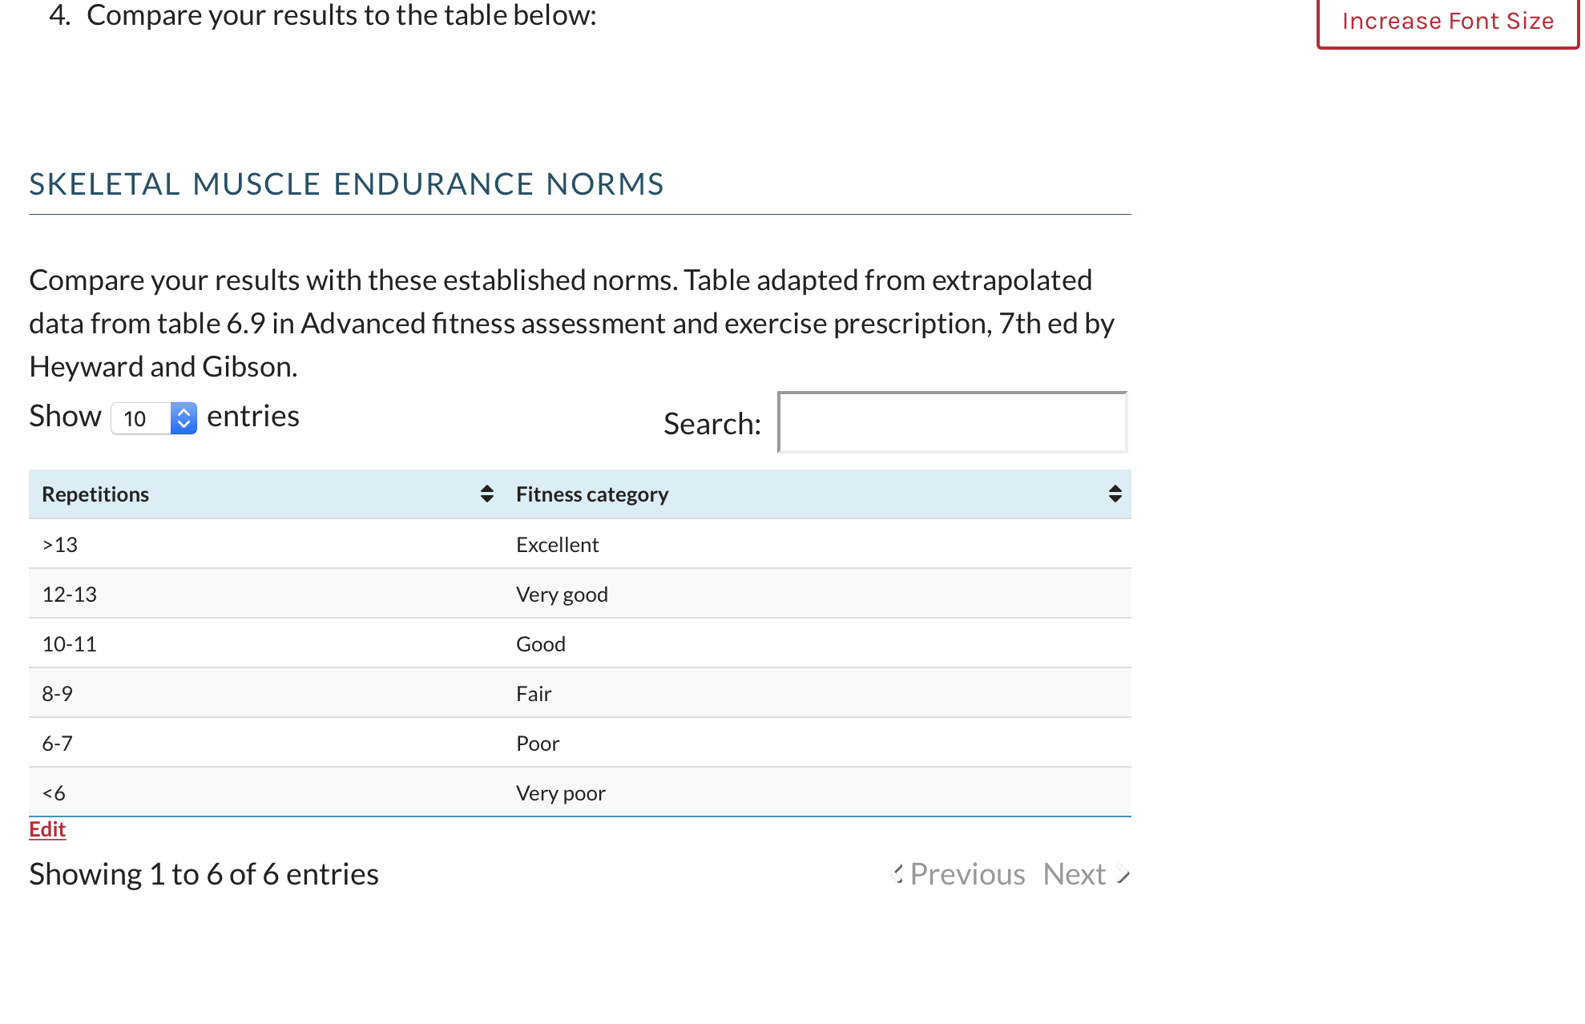

Slide 48
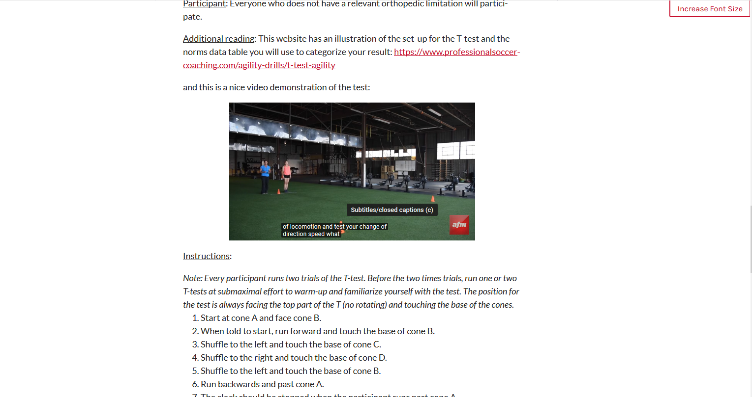

Slide 49

Student reception

Slide 50

Informal anonymous survey
In class
Office365
Midpoint of course
10 questions

Slide 51
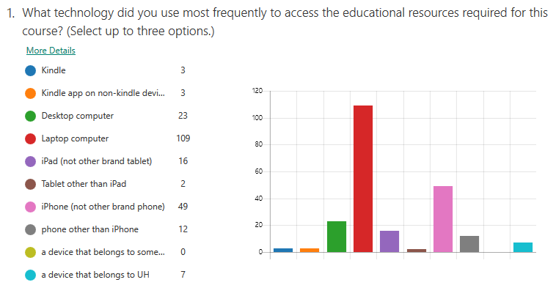

Slide 52
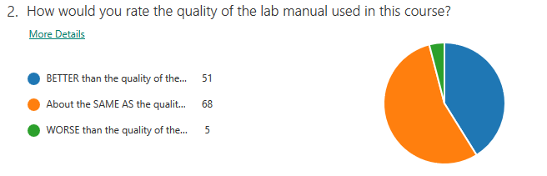

Slide 53
If you rated this as BETTER, why did you give it that rating? (60)
It is clear and very direct for the equipment we have. Very specific and it makes learning along side it easier
More interactive and makes sure I’m actually ready with the embedded questions
Easily accessible, can be used on mobile devices, relatively easy questions, and interactive responses with explanations to answers
I normally have Physical lab manuals. This was my first time using an electronic one. It was easy to access as well as maneuver around

Slide 54
If you rated this as WORSE, why did you give it that rating? (3/18)
Material does not line up with lab and or book/quiz
The lab manual is concise in it’s [sic] instruction
None of questions to get [sic] a good estimate on how well we did.

Slide 55
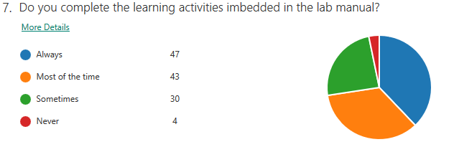

Slide 56
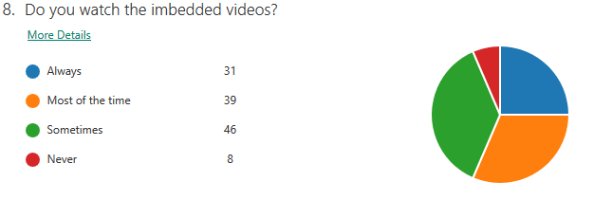

Slide 57
What changes would you like to suggest, if any, for the lab manual? (58)
I like to download my Manuel’s [sic] to my iPad. Maybe a way to copy a PDF version so that students can take notes, etc.
Have all the charts within the text section for labs would be ideal. Having to search up in the book can be tedious.
Having a tab on the side to choose each chapter, rather than going through the entire book from chapter one, to find the right chapter
No password

Slide 58
Do you have any other comments about the lab manual, or about the lab manual being made available at no cost to students in this course? (56)
The Pressbook link is really interactive and easy to access which I like. This is a great cost effective lab manual
The learning activities helped me understand the lab manual more in depth
It has helped so much, times are tough for us broke college kids. Made me extremely happy to hear it was free.
Thank you for letting it be free and online

Slide 59
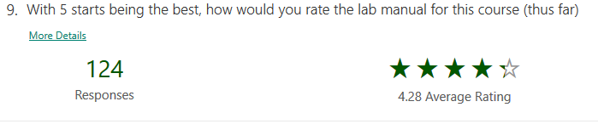

Slide 60
Pressbooks: Current impression
Pros: Free to UH users, UH library support
Pros: already set-up, built-in accessibility
Cons: designed with humanities subjects in mind
Cons: struggles with some science needs (tables, equations, symbols “≥”)
Cons: students struggle a little with the navigation

Slide 61
Summary
Overall, students have embraced it and like the free aspect
Ease of use is worth the trade-off of “loss” of some functions
Supplement on Blackboard, but students prefer all-in-one

Slide 62
Events and resources
Events
Fri. 10/18 at 12pm: OER Discussion Group
Wed. 10/23 at 10am: OER Presentation
Thurs. 10/24 at 10am: OER Presentation
Fri. 11/15 at 12pm: OER Discussion Group
UH OER Listserv
for updates and resources
Schedule a meeting with me for one-on-one help
libraries.uh.edu/oer
Ariana Santiago, OER Coordinator
asantiago2@uh.edu
Notes:
libraries.uh.edu/oer

